Slide 1
Concept
Use a real-life, road side assistance event (motorist in distress during a blizzard) to illustrate the connectedness of all CDOT employees to that positive outcome.
Presentation will be built with an intro video clip with a voice over narration track. Narration accompanies each slide.

Slide 2
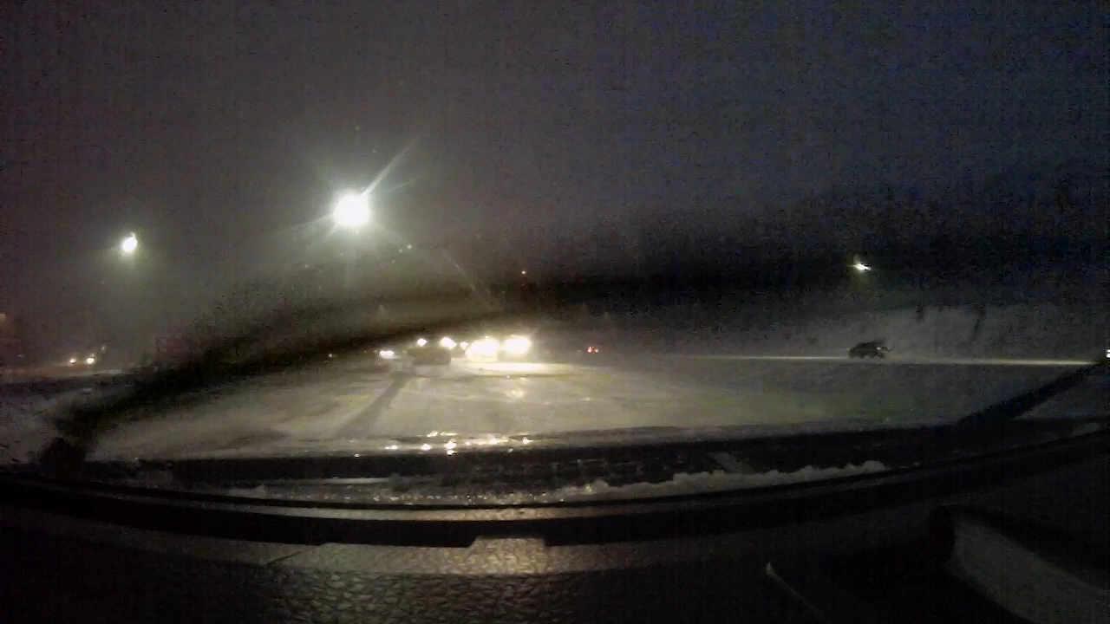
The Faces of CDOT
The Faces of CDOT
Notes:
Introduction Slide: CDOT Banner across a still image (first frame) of the Video Clip. At the start of the video clip, the banner disappears
The Faces of CDOT
10 second Clip starts: Plow Driver’s View from out of the Windshield with sound
At 6 seconds,
Narrator: The Faces of CDOT

Slide 3
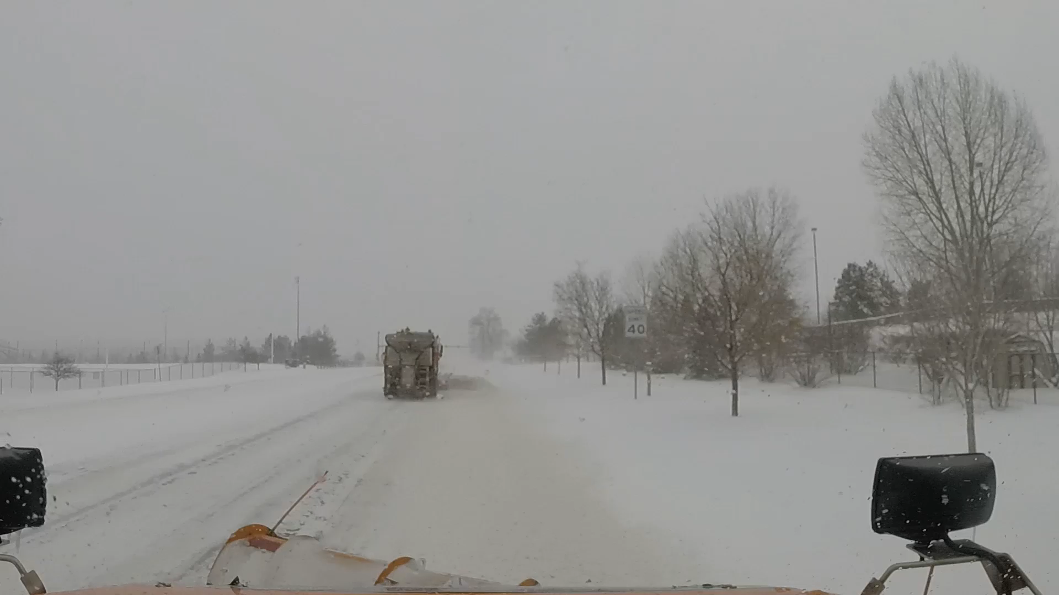

The Faces of CDOT
The Faces of CDOT
Notes:
Introduction Slide: CDOT Banner across a still image (first frame) of the Video Clip. At the start of the video clip, the banner disappears
The Faces of CDOT
10 second Clip starts: Plow Driver’s View from out of the Windshield with sound
At 6 seconds,
Narrator:
The Faces of CDOT We are 3000 strong, in over 55 career specialties,

Slide 4
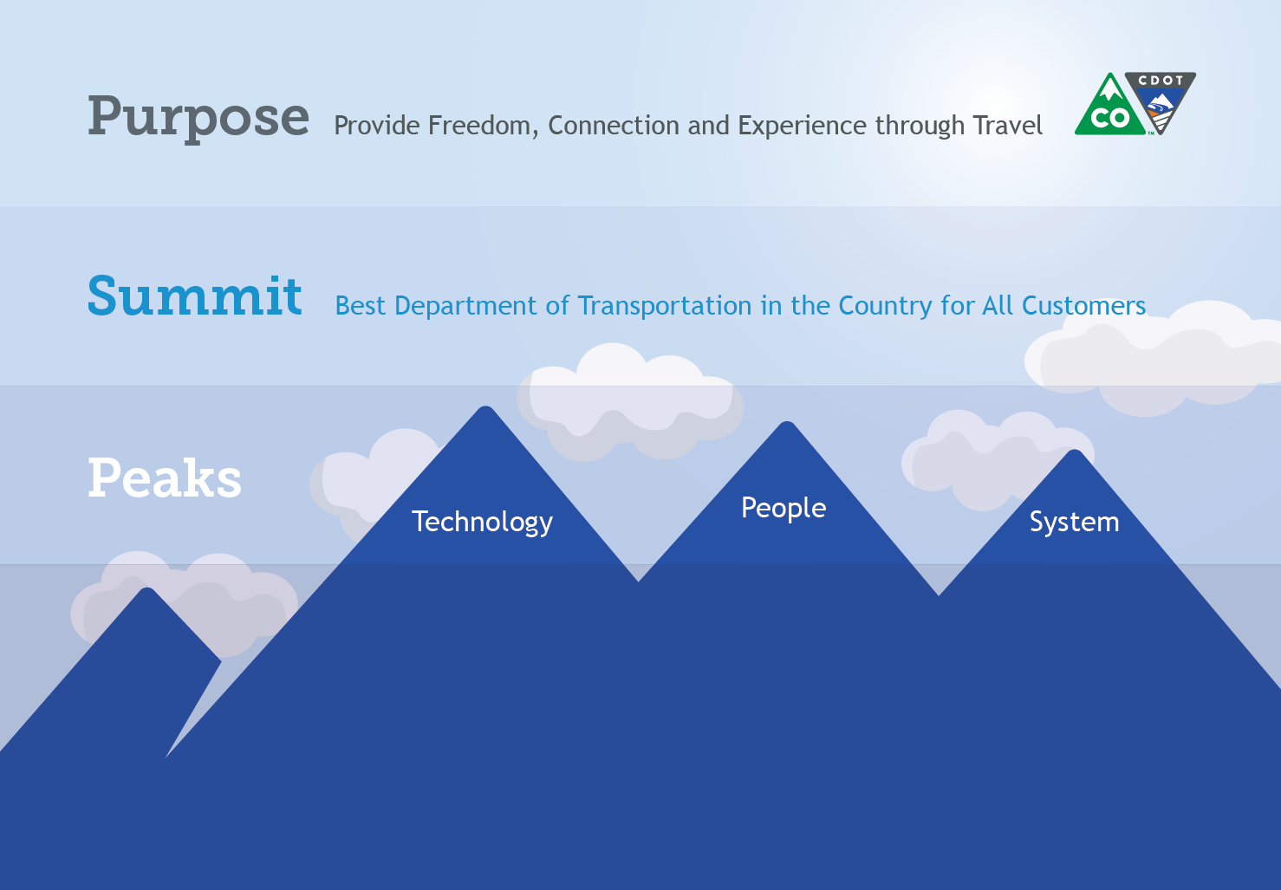


To Save Lives and to Make People's Lives Better
Notes:
Narrator:
And are dedicated to a common purpose: To Save Lives and to Make People's Lives Better by Providing Freedom, Connection and Experience Through Travel.

Slide 5


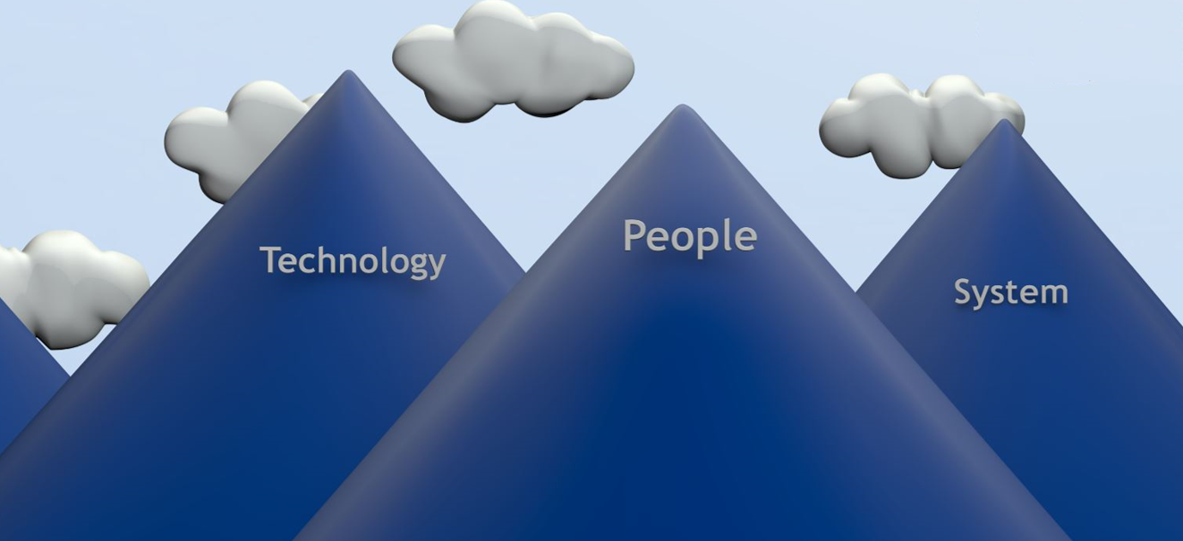
To Save Lives and to Make People's Lives Better
Best Department of Transportation in the Country for all Customers
Notes:
Narrator:
“In fulfilling that purpose, we are climbing the summit to be the Best Department of Transportation in the Country for all of our Customers.“

Slide 6
To Save Lives and to Make People's Lives Better
Best Department of Transportation in the Country for all Customers
Notes:
Narrator:
“In fulfilling that purpose, we are climbing the summit to be the Best Department of Transportation in the Country for all of our Customers.“

Slide 7
To Save Lives and to Make People's Lives Better
Best Department of Transportation in the Country for all Customers
Notes:
Narrator:
“In fulfilling that purpose, we are climbing the summit to be the Best Department of Transportation in the Country for all of our Customers.“

Slide 8
To Save Lives and to Make People's Lives Better
Notes:
Narrator
And together, we are scaling three peaks to get us there: Our People, Leading Edge Technology and a Healthy, Multi-modal System
From these peaks we design, build, and operate a transportations system upon which millions depend every minute of every day.

Slide 9

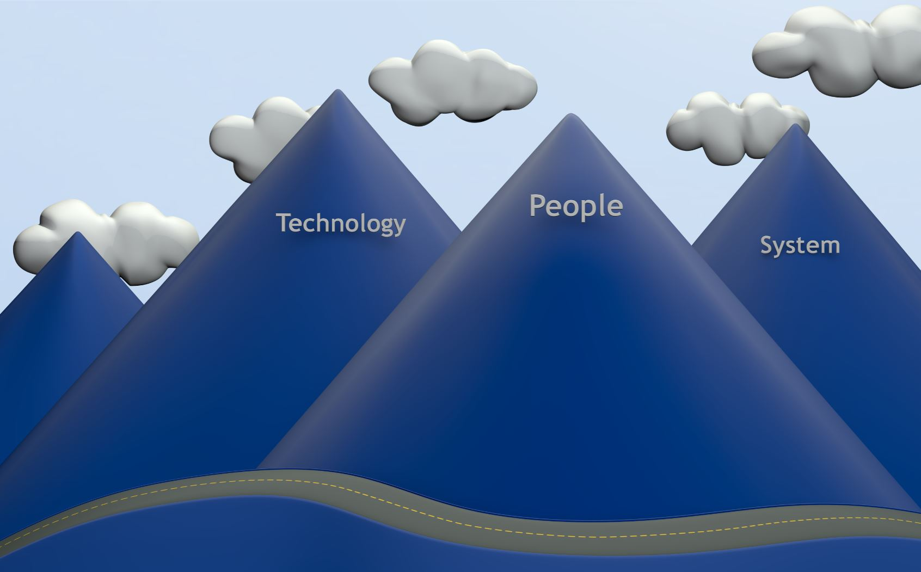
Notes:
Narrator:
And Every year, and in every season, one of the most visible things that CDOT does is plow roads and coming to the aid of drivers in distress.
Here is a typical scenario:
Mother’s voice:
Dear CDOT
I am writing to you because one of your drivers got my family out of a really bad situation and I wanted to make sure that you knew what that great employee did for us. I was heading down the highway with two very young children. We hit some black ice and completely slid off the road and down a hill into some trees. A CDOT driver came along and noticed the tracks left by my truck going off the road and investigated. Had he not stopped, I honestly don’t even want to think what would have happened. Our truck was not visible from the road and I could not climb that icy slope to flag down help in the freezing cold, much less with two infants. That CDOT driver actually pulled both all of us out of the wrecked car and up that slope and in our state of shock, he got us in his vehicle with heat. He contacted the state patrol and he stood out in the cold and waited for a tow truck and the trooper to arrive, which took quite a while! Without his help, I think we could have frozen to death on that hill side. He didn't leave until our family came to get us. He made sure we were safe and sound. We are so fortunate to have upstanding people like him keeping our roads safe!”
Narrator:
That was a happy ending to what could have been a tragic event, had that CDOT driver not been there.
But have you ever stopped to consider what it takes to get that CDOT driver to that motorist in trouble?

Slide 10


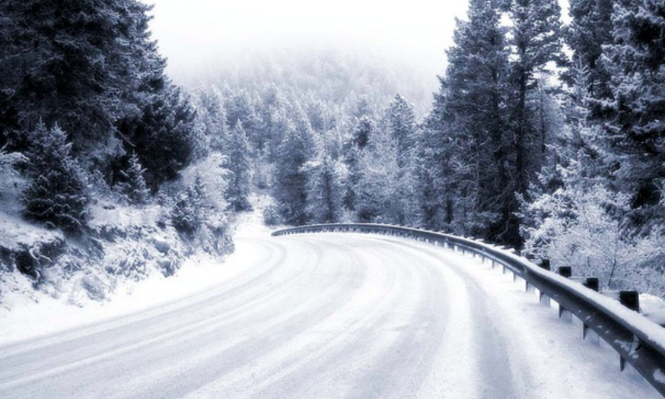
Notes:
Narrator:
Well, it starts with a road, but how does that road get there?
It takes a whole lot people, working in a wide range of specialties, like these
Budget (Barella)
Procurement (Roth)
Contracting (Dingle
Property Management (Chenery)
Survey (Manadarich)
Appraisal (Cichello)
Right of Way Access (Mary Heinlein)
Environmental (Erickson)
Utilities (Mckinney)
Roadway Design (Swacroft, Valentini)
Program Delivery (higaside)
Performance Planning (Pakbaz)
Project Development (Aloala)
Project Support (Sankar)
Roadway Construction (Carter)
Geotechnical and Hydraulics (Javier)
Staff Bridge (Armenderiz)
Local Agency Liaison (Karen S)
Civil Rights (Arcila)
Landscape Design (Ryer)
Plus many others

Slide 11




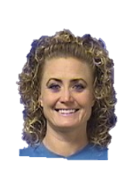
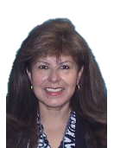


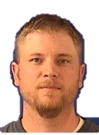





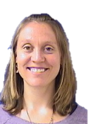


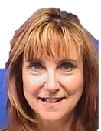

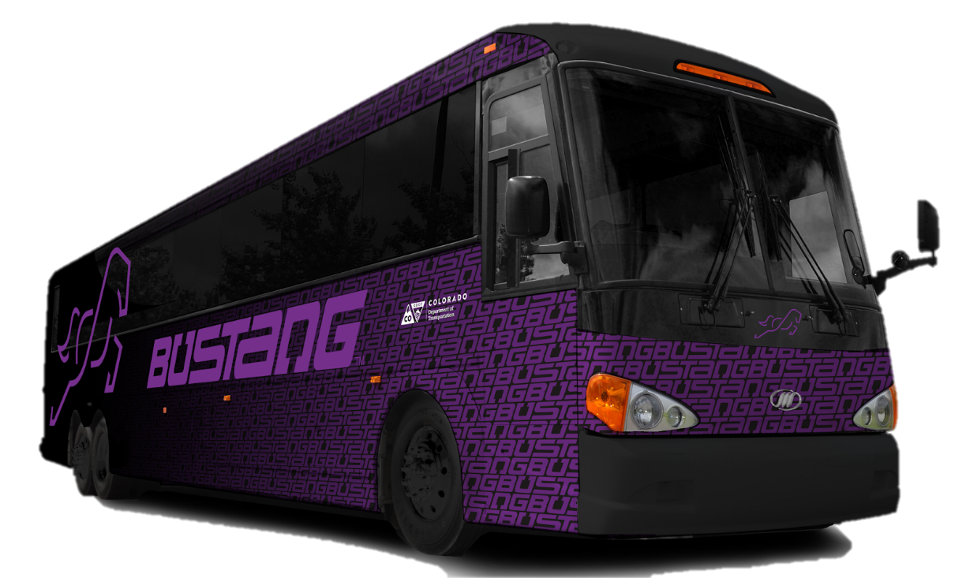

Slide 12
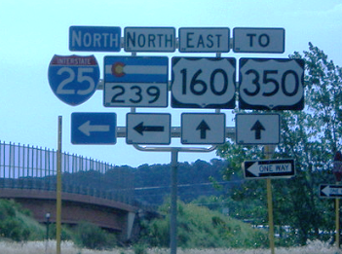
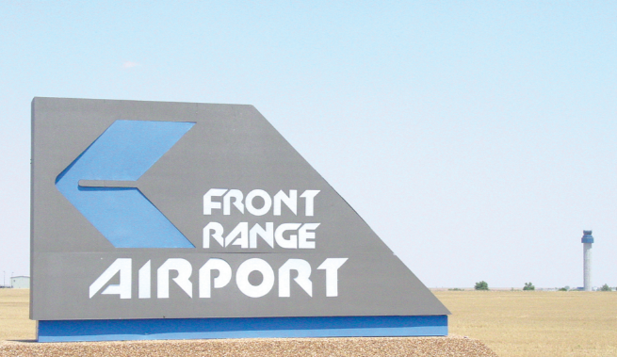
Notes:
Narrator:
Ok, so we have roads.
Add transportation modes, what does it take to operate them together as a system?
Well, it takes more people doing these things this,
Structural Trades F Martinez
Intermodal planning Hoffman
Corridor Management Neilson
Traffic Analysis Aguilar
Aeronautics Eldridge
HTPE Delgado
Government Relations Malbry
Corridor Operations Largent
Bus Operations Timlin
RoadX Kozinski
Business Operations Johnson
Audit Nnuro
Print Services Leigh
IT Services Chen
Business Office Martinez
Electrical Trades Castiglione
Purchasing Mathews
Facilities Espinoza
Project Development Mahoney
Grants Administration Erez
Materials Testing Shafer
Program Administration Creecy
Tunnel Operations Dennie
Sign Shop Eyl
plus a whole lot more

Slide 13


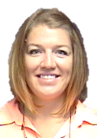


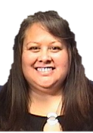











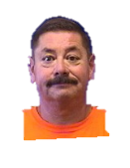
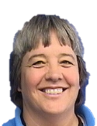






Slide 14
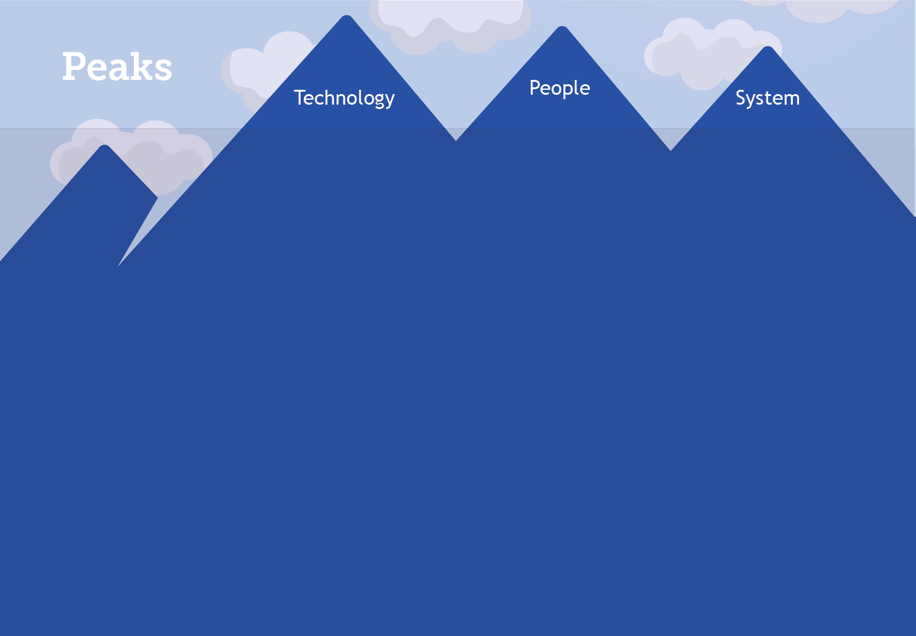
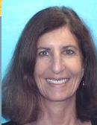
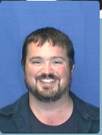
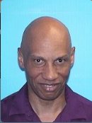
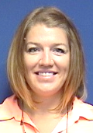
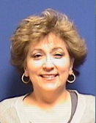
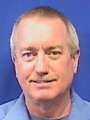
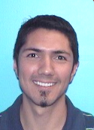
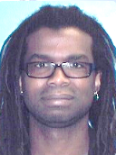
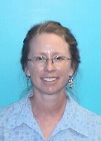
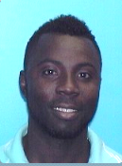
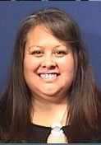
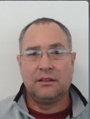
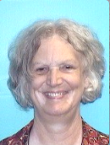
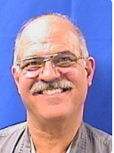
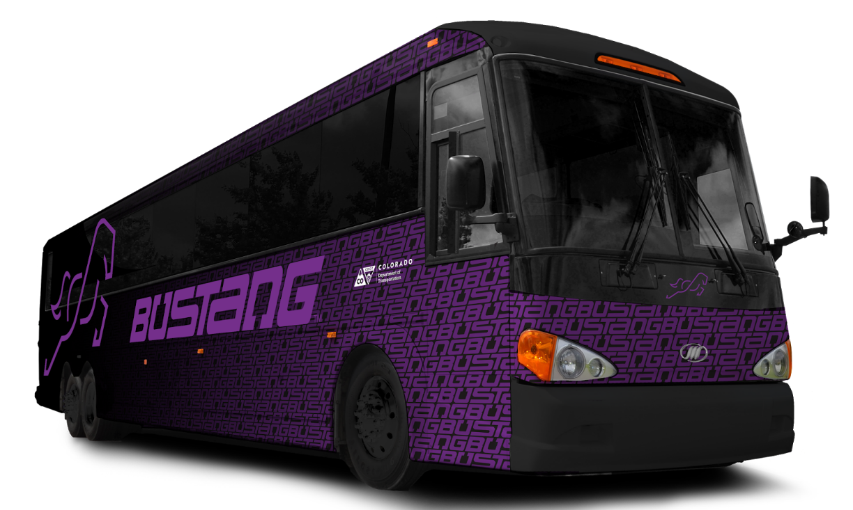
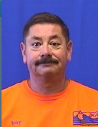

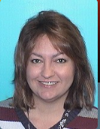
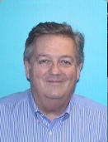
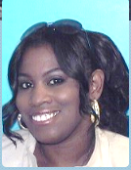
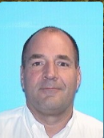
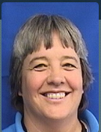

Slide 15
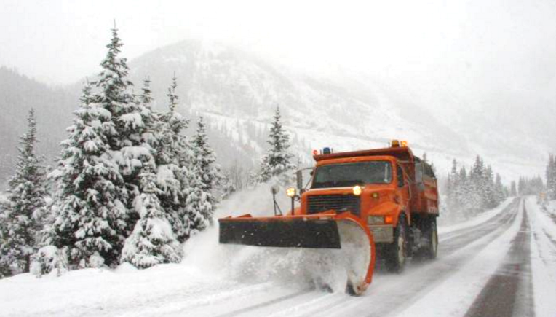
Notes:
Narrator:
And finally, what does it take to get a plow and driver on the scene to help that stranded motorist?
It couldn’t happen without these people, either
Risk Management Goodwin
Safety Simpson
Program Support Carlberg
Office Managers Carrillo
Communications Wilson
Accounting Daviss
Human Resources Schakel
Permits Williams
Sign Shop Eyl
Process Improvement Malloy
Engineering support Walker
Fleet management Neuschwanger
Machining Trades S Martinez
Signing and Stripping Miller
Bridge Crew Franklin
Heavy Equipment Operators Wiggins
Mechanics Wood
Materials Handlers Allen
Business Office Krajecki
Admin Support Montoya
Incident Command Igel
And of course, plow drivers

Slide 16

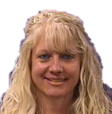



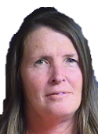
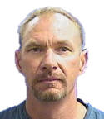





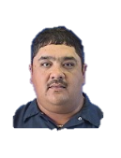




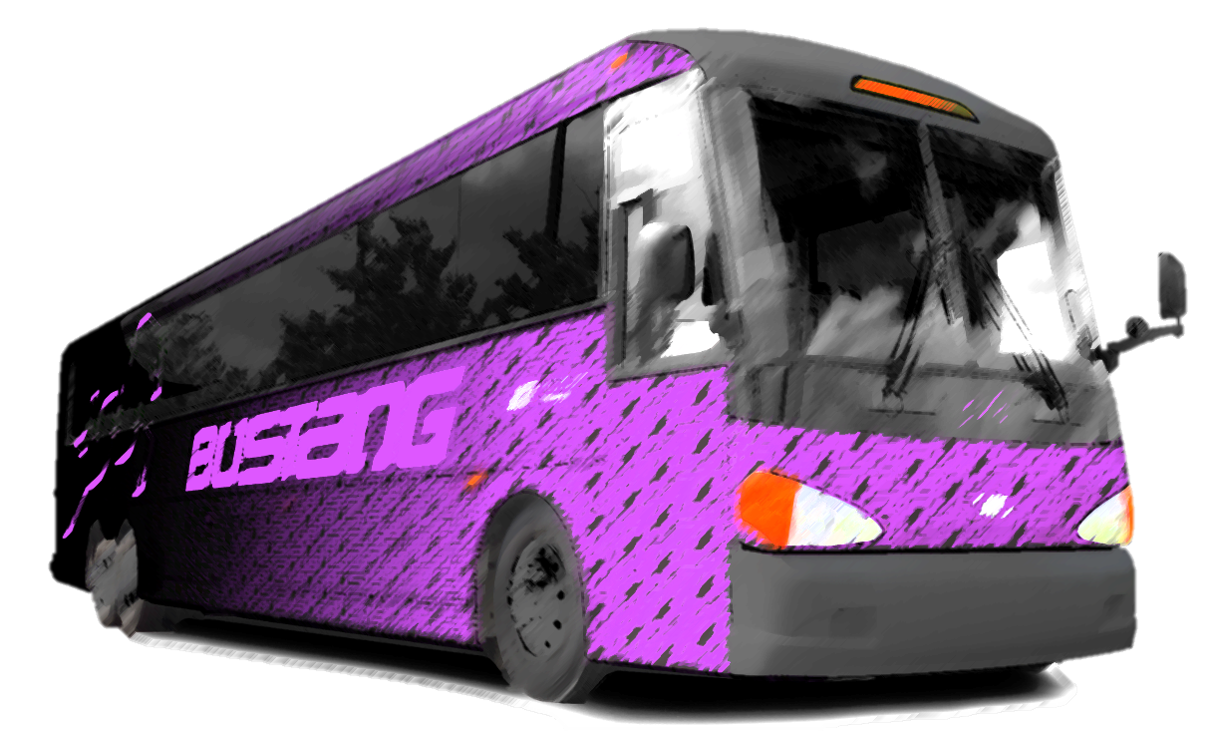









Slide 17
3.8 Licensed Colorado Drivers
5.4 Million Residents
77.7 Million Visitors
28 Billion Miles of Vehicle Travel Annually
$200+ Billion in Freight Crossing Our State
Notes:
Narrator:
And when we put it all together, its easy to see that we are all part of a much bigger picture.
Each year, we serve
3.8 Licensed Colorado Drivers
5.4 Million Residents
77.7 Million Visitors
28 Billion Miles of Vehicle Travel
$200+ Billion in freight crossing our state and going all across America

Slide 18
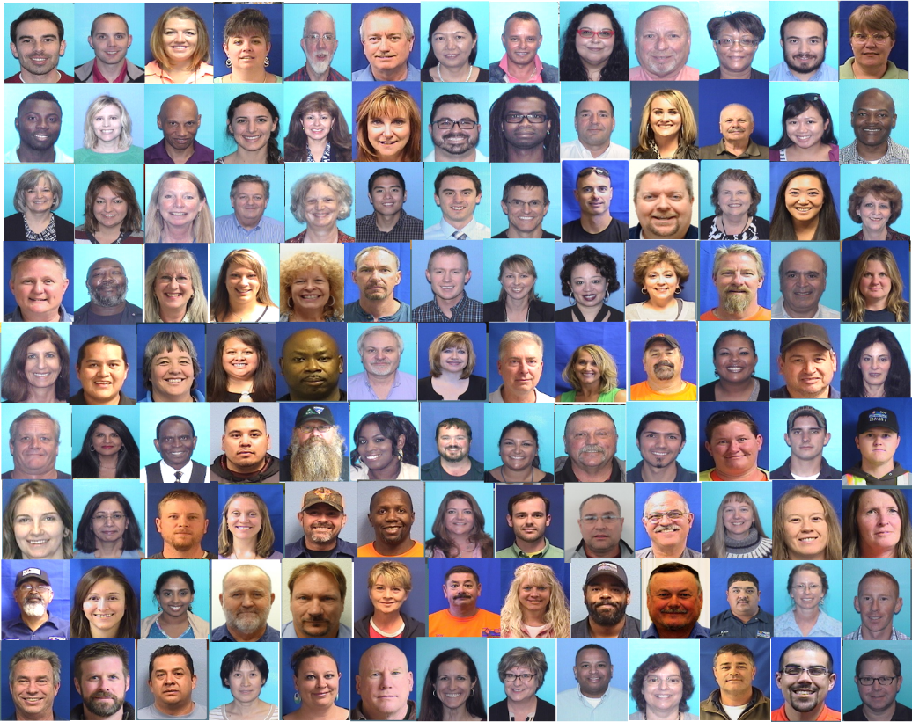
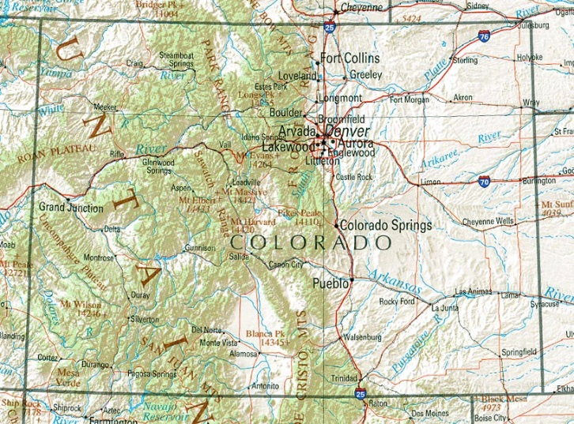
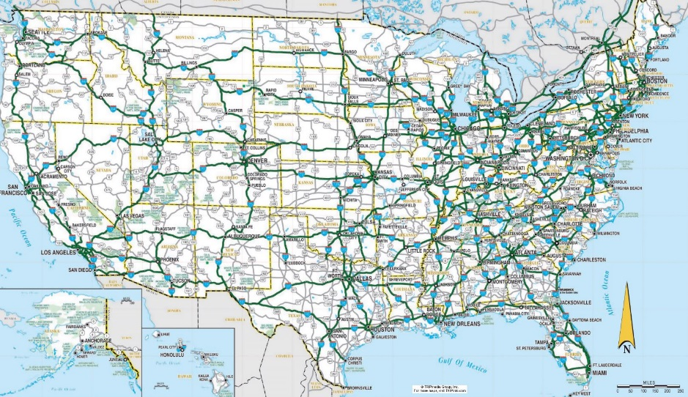
Notes:
Narrator:
To make all of that work, it takes you, it takes me, it takes us. 3000 strong. Serving Colorado. Serving America.

Slide 19
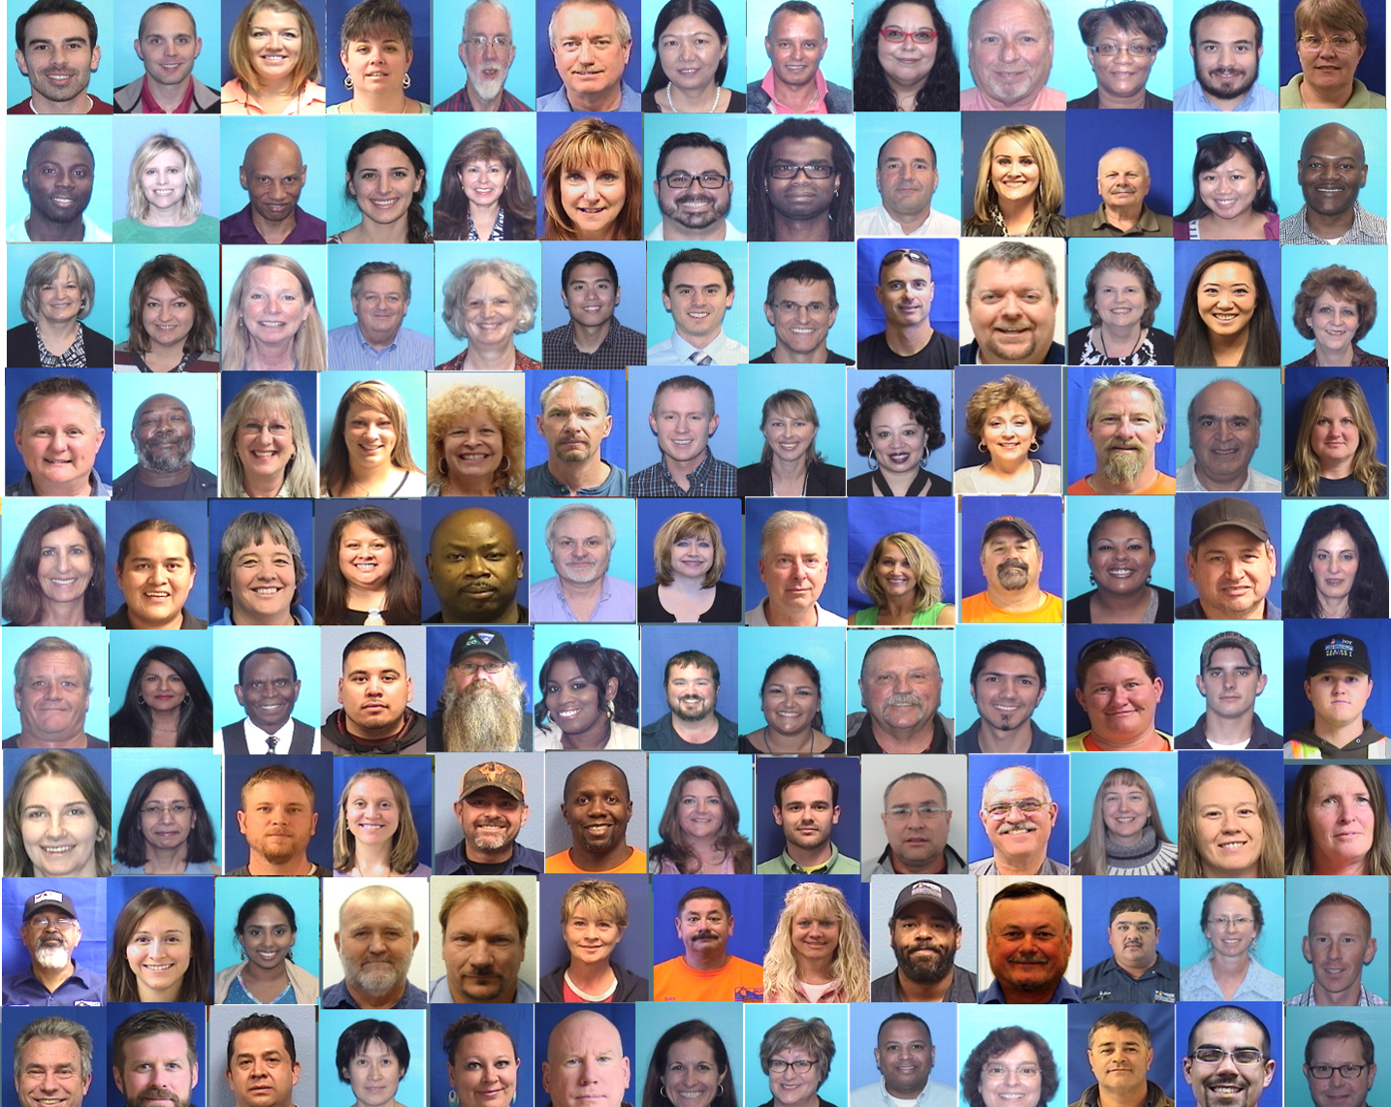
TEAM CDOT
Notes:
We are Team CDOT.

Slide 20

The Faces of CDOT
Notes:
-Video footage of the plow-
Narrator:
Thank you for what you for our team.
- Close -

Slide 21


Notes:
That’s who we are. 300 strong.

Slide 22









































































































TEAM CDOT
Notes:
TEAM CDOT. Thank you for being a part of the best DOT in the country.

Slide 23
TEAM CDOT
Notes:
TEAM CDOT. Thank you for being a part of the best DOT in the country.

Slide 24
I AM
TEAM CDOT
Notes:
Graphic spelling “I am Team CDOT” using the images of CDOTers as pieces of the mosaic
Narration: “I am Team CDOT. I support:
3,837,488 Licensed Colorado Drivers
$200+ Billion in freight transits SOURCE: U.S. Department of Transportation, Bureau of Transportation Statistics and Federal Highway Administration, Freight Analysis Framework, version 3.6, available at http://faf.ornl.gov/fafweb/FUT.aspx as of September 2015.
Maintains, repairs and plows over 23,000 total lane miles of highway
* Maintains 3,447 bridges
* Oversees 28 billion miles of vehicle travel annually
* Plows about 6 million lane miles each year
* Spends $69 million annually on snow removal
* Keeps over 35 mountains passes open year-round
* Monitors 278 of 522 avalanche paths
$11 million in federal grants for transit operators and
$41 million in federal aviation grants for airports
* Manages over $5 million in federal grants for safe driving programs
Maintains, repairs and plows over 23,000 total lane miles of highway
* Maintains 3,447 bridges
* Oversees 28 billion miles of vehicle travel annually
* Plows about 6 million lane miles each year
* Spends $69 million annually on snow removal
* Keeps over 35 mountains passes open year-round
* Monitors 278 of 522 avalanche paths
* Administers about $11 million in federal grants for transit operators and $41 million in federal aviation grants for airports
* Manages over $5 million in federal grants for safe driving programs
1,800/ 184/ 8/ 2,637/ 30/ 865/ 269/ 1,316/ 3 x 1K registered vehicles private
7,181 478,720 97,410 583,311 7,237 590,548 commercial

Slide 25
I AM
TEAM CDOT
We serve
3,837,488 Licensed Colorado Drivers
XX Residents
XX million travelers
28 billion miles of vehicle travel annually
$200+ Billion in freight transits
Notes:
Graphic spelling “I am Team CDOT” using the images of CDOTers as pieces of the mosaic
Narration: “I am Team CDOT. I support:
3,837,488 Licensed Colorado Drivers
$200+ Billion in freight transits SOURCE: U.S. Department of Transportation, Bureau of Transportation Statistics and Federal Highway Administration, Freight Analysis Framework, version 3.6, available at http://faf.ornl.gov/fafweb/FUT.aspx as of September 2015.
Maintains, repairs and plows over 23,000 total lane miles of highway
* Maintains 3,447 bridges
* Oversees 28 billion miles of vehicle travel annually
* Plows about 6 million lane miles each year
* Spends $69 million annually on snow removal
* Keeps over 35 mountains passes open year-round
* Monitors 278 of 522 avalanche paths
$11 million in federal grants for transit operators and
$41 million in federal aviation grants for airports
* Manages over $5 million in federal grants for safe driving programs
Maintains, repairs and plows over 23,000 total lane miles of highway
* Maintains 3,447 bridges
* Oversees 28 billion miles of vehicle travel annually
* Plows about 6 million lane miles each year
* Spends $69 million annually on snow removal
* Keeps over 35 mountains passes open year-round
* Monitors 278 of 522 avalanche paths
* Administers about $11 million in federal grants for transit operators and $41 million in federal aviation grants for airports
* Manages over $5 million in federal grants for safe driving programs
1,800/ 184/ 8/ 2,637/ 30/ 865/ 269/ 1,316/ 3 x 1K registered vehicles private
7,181 478,720 97,410 583,311 7,237 590,548 commercial

Slide 26

TEAM CDOT

Slide 27
TEAM CDOT

Slide 29
TEAM CDOT
TEAM CDOT

Slide 32


Slide 34

Notes:
Narrator:
“
Introduce the motorist in distress scenario
Set up the concept that the roadside rescue had the entire CDOT Team behind it to make it possible

Slide 35
Notes:
Narrator:
“
Introduce the motorist in distress scenario
Set up the concept that the roadside rescue had the entire CDOT Team behind it to make it possoble

Slide 36



Slide 37

Notes:
Brief Illustration of the unit’s role in supporting the roadside event.

Slide 38
Notes:
Brief Illustration of the unit’s role in supporting the roadside event.

Slide 39
Notes:
Brief Illustration of the unit’s role in supporting the roadside event.

Slide 40
Notes:
And what does it take to get a plow on the scene to help that stranded motorist?
These people, and a whole lot more.
Risk Management – Goodwin
Safety – Simpson
Program Support – Carlberg
Office Managers – Carrillo
Communications – Wilson
Accting – Daviss
HR – Schakel
Permits – Williams
Sign Shop – Eyl
Process Improvement – Malloy
Engineering support – Walker
Fleet management – Neuschwanger
Machining Trades - S Martinez
Signing and Stripping – Miller
Bridge Crew – Franklin
Heavy Equipment Operators – Wiggins
Mechanics – Wood
Materials Handlers – Allen
Business Office – Krajecki
Admin Support – Montoya
Incident Command – Igel
And of course the plow drivers

Slide 42
3,837,488 Licensed Colorado Drivers
XX Residents
XX million travelers
28 billion miles of vehicle travel annually
$200+ Billion in freight transits
Notes:
Here is the big picture

