Slide 1
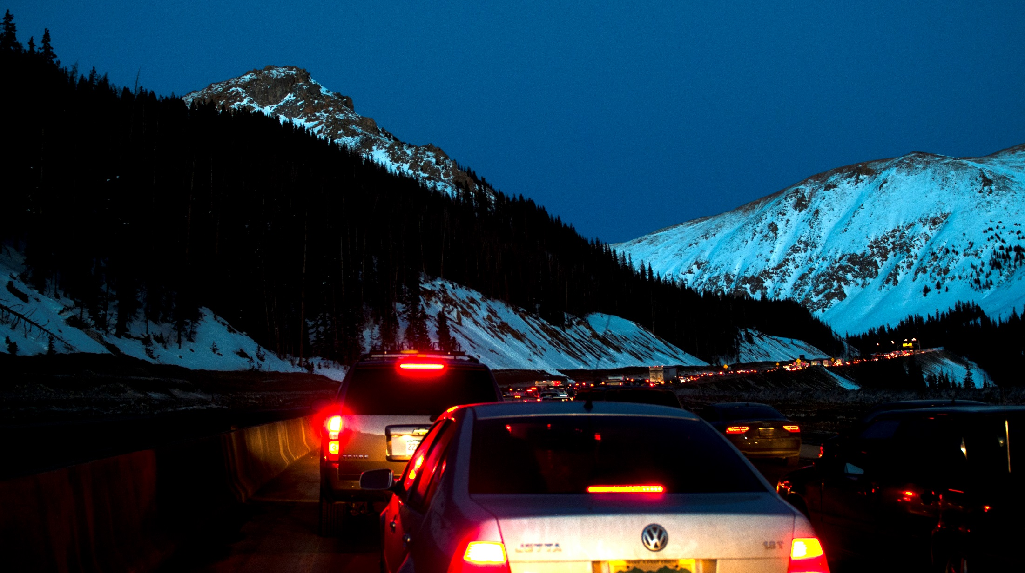
The Faces of CDOT
Notes:
Introduction or presentation title slide.

Slide 2
Concept
Use a real-life, road side assistance event (motorist in distress during a blizzard) to illustrate the connectedness of all CDOT employees to that positive outcome.
Presentation will be built in Prezi for a more dynamic affect, with a voice over narration track.

Slide 3
Insert an image (collage of faces)spelling CDOT
Notes:
Narrator: We are CDOT. An organization of 3000 people serving in some 50+ career fields and specialties.

Slide 4
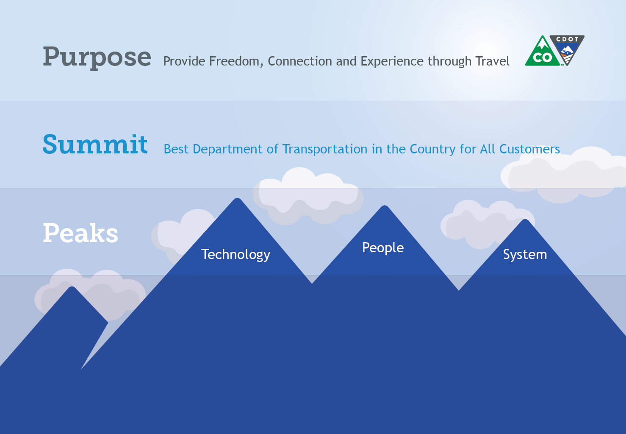
Notes:
Narrator: Our 3000 are dedicated to a common purpose: Provide Freedom, Connection and Experience through Travel

Slide 5
Notes:
Narrator: In fulfilling that purpose, we strive to be the best DOT in the county,

Slide 6
Notes:
And together we are climbing three peaks to get there.

Slide 7
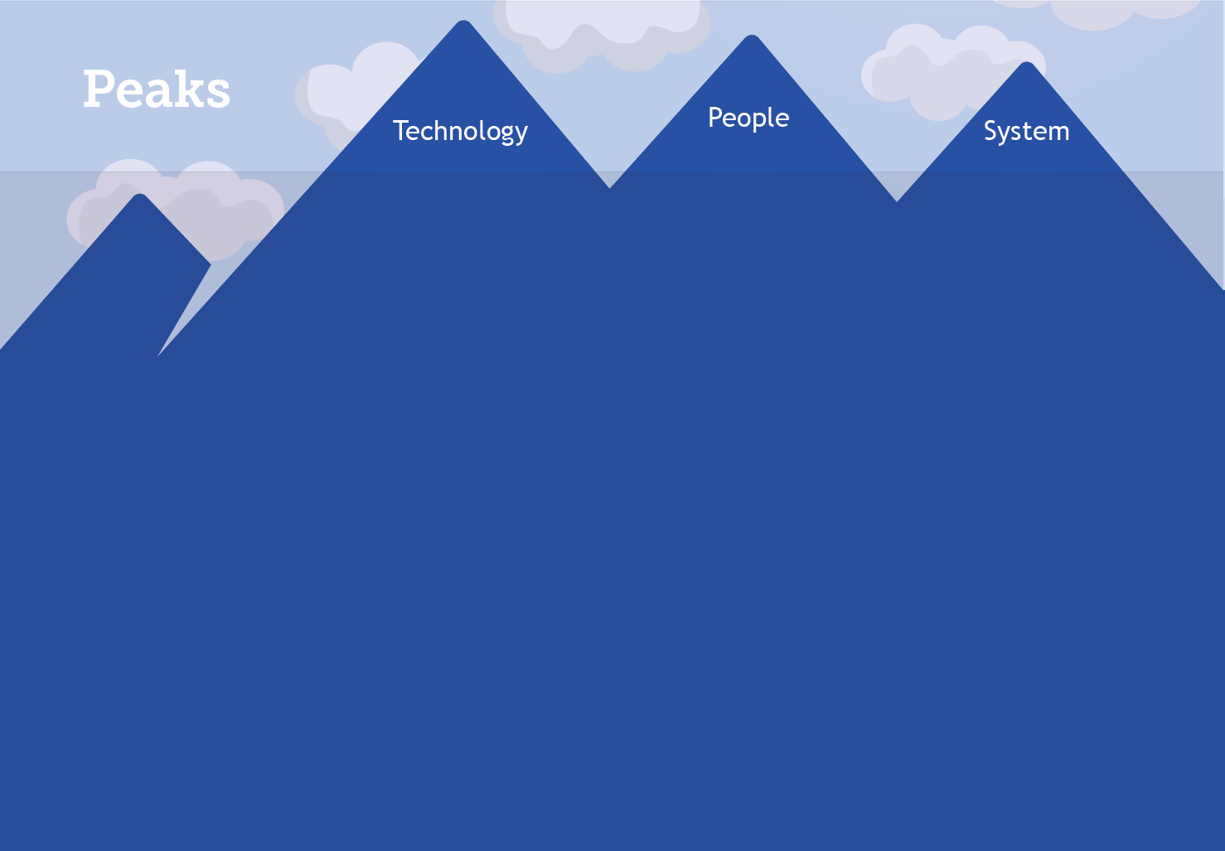
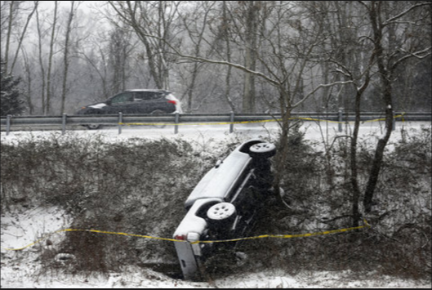
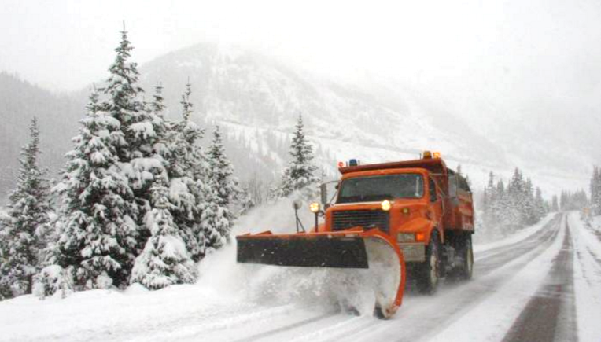
Notes:
Lets look at how 3000 come to the aid of one, at a typical day at CDOT.
“I am writing to you because one of your drivers has been a big hero to us and I wanted to make sure you knew what an amazing employee and wonderful person Jason Fernandez (region 1 traffic south holly) is. I was heading down 285 South bound w two infants and my friend. We hit some slush/black ice and totally slid off the road over a ledge and down a huge hill into some trees. Jason saw the tracks and didn't just shrug it off, he investigated. We are beyond fortunate he stopped because we were more than 100 feet down a hill under a massive tree and no one would have ever seen us. He actually pulled both of us mommies and babies out of the wrecked car up a huge snowy hill and in our state of shock he got us in his vehicle with heat. He spoke to the highway patrol and he stood out in the cold and waited for triple A and highway patrol to arrive, which took quite a while! We would have been frozen! We couldn't have gotten help with out his assistance even if we were able to climb that hill which I doubt I could have done alone with my baby as I kept sliding (he had to pull me up) but even if we had we would have waited over an hour in the cold on the dangerous road side!! He was truly a hero! He didn't leave until he spoke with highway patrol and our families came to get us. He made sure we were safe and sound. When I asked him for his address to send a thank you gift he declined and told me he was glad to help and to pay it forward! How amazing is that! We are so fortunate to have an upstanding young man like him keeping our roads safe! I asked for his bosses email because I just thought he deserved at least some recognition, if not a parade in his honor or a metal for heroism! Please keep employing people like Jason! He will always be our hero, I was so scared and so upset and he was really there for us when we were in a time of need. I wish I had more eloquent words to describe his bravery and altruism but hopefully my story will be enough for you to understand what a truly awesome human being Jason is!
Warm Regards,

Slide 8

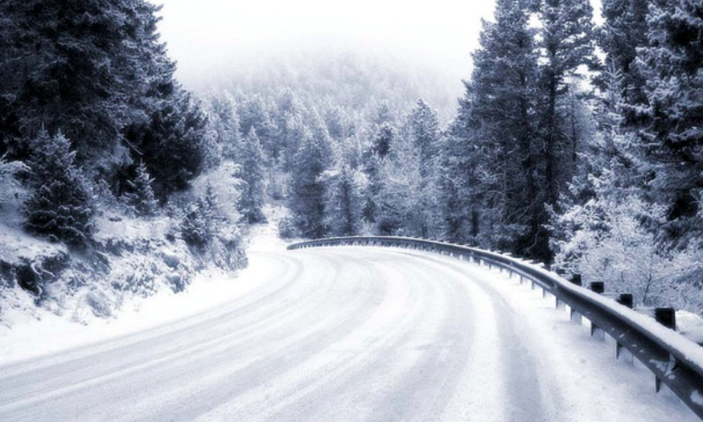
Notes:
That’s a great story! But what did it take to get both the motorist and the plow driver there?
Well, it starts with a road, but how does that get there?

Slide 9

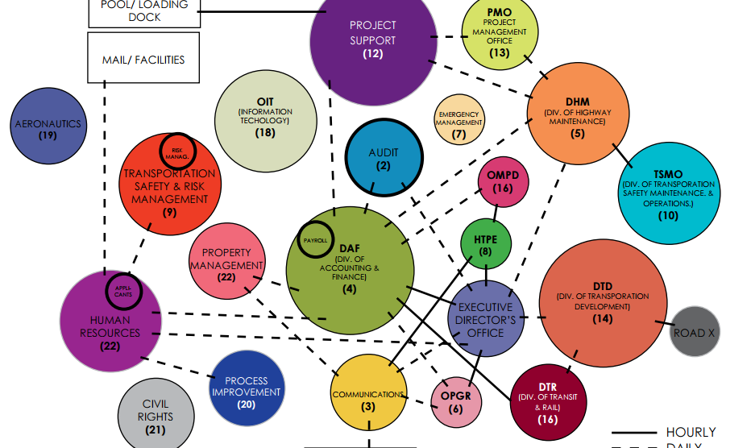
Notes:
Well, it starts with a road, but how does that get there?
Well, it takes all of these people,
Budget
Procurement
Contracting
Property Management
Survey
Right of Way
Environmental
Utilities
Roadway Design
GIS
Project Management Office
Traffic Safety
Roadway Construction
Geotechnical and Hydraulics
Staff Bridge
Local Agency Liaision
Civil Rights
Plus a bunch others

Slide 10

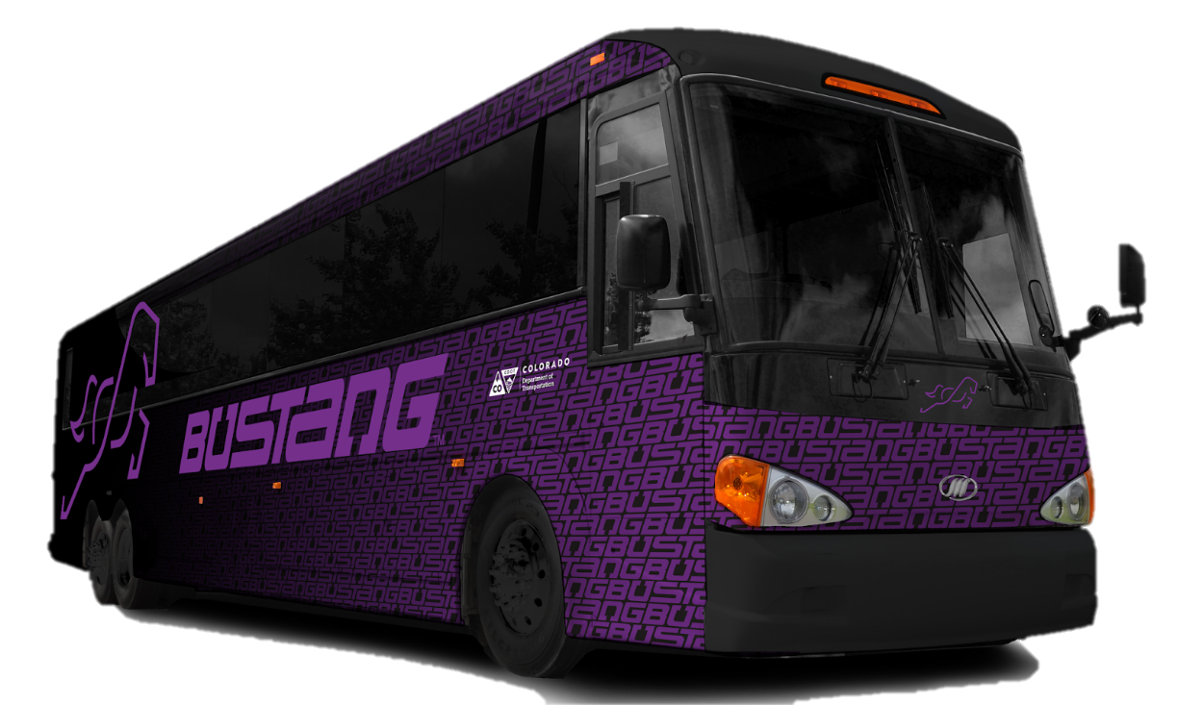

Slide 11
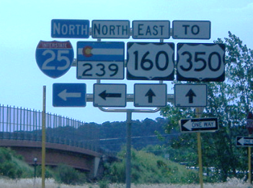
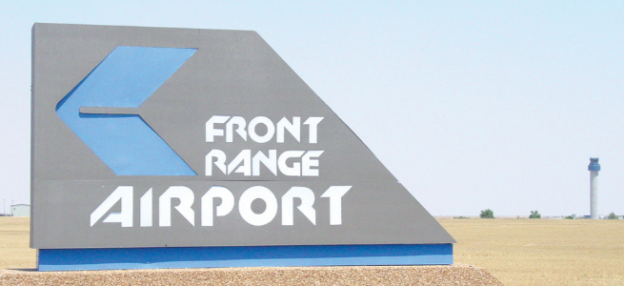
Notes:
Once you have roads and transportation modes, what does it take to operate them as a system?
Well, it takes of these people plus a whole lot more.

Slide 12
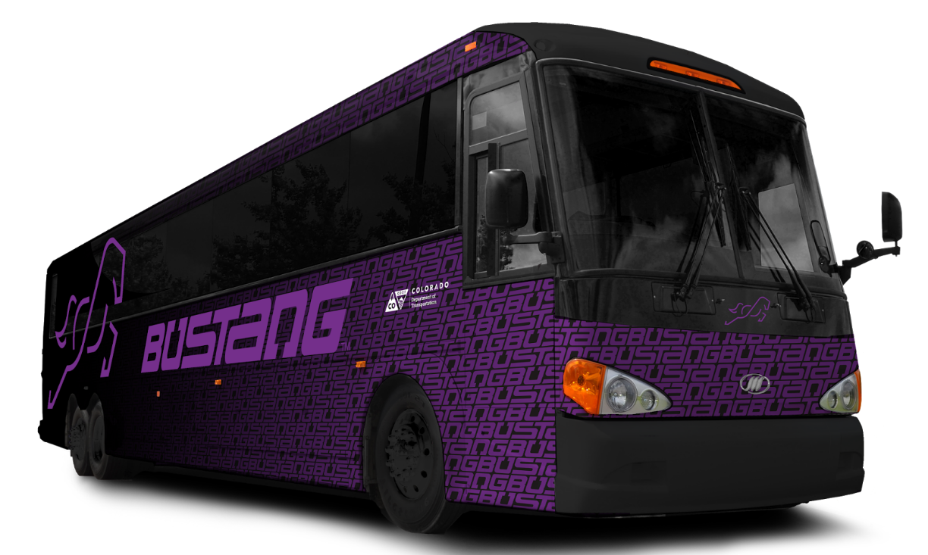
Notes:
Once you have roads and transportation modes, what does it take to operate them as a system?
Well, it takes of these people plus a whole lot more.

Slide 13
Notes:
And what does it take to get a plow on the scene to help that stranded motorist?
These people, and a whole lot more.

Slide 14
3,837,488 Licensed Colorado Drivers
XX Residents
XX million travelers
28 billion miles of vehicle travel annually
$200+ Billion in freight transits
Notes:
Here is the big picture

Slide 15
I AM
TEAM CDOT
Notes:
Graphic spelling “I am Team CDOT” using the images of CDOTers as pieces of the mosaic

Slide 16
I AM
TEAM CDOT
Notes:
Graphic spelling “I am Team CDOT” using the images of CDOTers as pieces of the mosaic
Narration: “I am Team CDOT. I support:
3,837,488 Licensed Colorado Drivers
$200+ Billion in freight transits SOURCE: U.S. Department of Transportation, Bureau of Transportation Statistics and Federal Highway Administration, Freight Analysis Framework, version 3.6, available at http://faf.ornl.gov/fafweb/FUT.aspx as of September 2015.
Maintains, repairs and plows over 23,000 total lane miles of highway
* Maintains 3,447 bridges
* Oversees 28 billion miles of vehicle travel annually
* Plows about 6 million lane miles each year
* Spends $69 million annually on snow removal
* Keeps over 35 mountains passes open year-round
* Monitors 278 of 522 avalanche paths
$11 million in federal grants for transit operators and
$41 million in federal aviation grants for airports
* Manages over $5 million in federal grants for safe driving programs
Maintains, repairs and plows over 23,000 total lane miles of highway
* Maintains 3,447 bridges
* Oversees 28 billion miles of vehicle travel annually
* Plows about 6 million lane miles each year
* Spends $69 million annually on snow removal
* Keeps over 35 mountains passes open year-round
* Monitors 278 of 522 avalanche paths
* Administers about $11 million in federal grants for transit operators and $41 million in federal aviation grants for airports
* Manages over $5 million in federal grants for safe driving programs
1,800/ 184/ 8/ 2,637/ 30/ 865/ 269/ 1,316/ 3 x 1K registered vehicles private
7,181 478,720 97,410 583,311 7,237 590,548 commercial

Slide 17
I AM
TEAM CDOT
We serve
3,837,488 Licensed Colorado Drivers
XX Residents
XX million travelers
28 billion miles of vehicle travel annually
$200+ Billion in freight transits
Notes:
Graphic spelling “I am Team CDOT” using the images of CDOTers as pieces of the mosaic
Narration: “I am Team CDOT. I support:
3,837,488 Licensed Colorado Drivers
$200+ Billion in freight transits SOURCE: U.S. Department of Transportation, Bureau of Transportation Statistics and Federal Highway Administration, Freight Analysis Framework, version 3.6, available at http://faf.ornl.gov/fafweb/FUT.aspx as of September 2015.
Maintains, repairs and plows over 23,000 total lane miles of highway
* Maintains 3,447 bridges
* Oversees 28 billion miles of vehicle travel annually
* Plows about 6 million lane miles each year
* Spends $69 million annually on snow removal
* Keeps over 35 mountains passes open year-round
* Monitors 278 of 522 avalanche paths
$11 million in federal grants for transit operators and
$41 million in federal aviation grants for airports
* Manages over $5 million in federal grants for safe driving programs
Maintains, repairs and plows over 23,000 total lane miles of highway
* Maintains 3,447 bridges
* Oversees 28 billion miles of vehicle travel annually
* Plows about 6 million lane miles each year
* Spends $69 million annually on snow removal
* Keeps over 35 mountains passes open year-round
* Monitors 278 of 522 avalanche paths
* Administers about $11 million in federal grants for transit operators and $41 million in federal aviation grants for airports
* Manages over $5 million in federal grants for safe driving programs
1,800/ 184/ 8/ 2,637/ 30/ 865/ 269/ 1,316/ 3 x 1K registered vehicles private
7,181 478,720 97,410 583,311 7,237 590,548 commercial

Slide 18


Slide 19
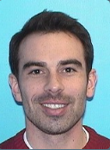
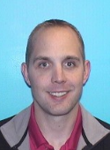
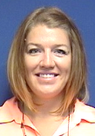
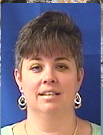

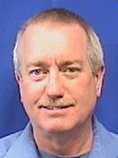
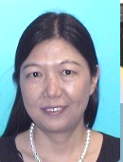
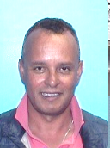
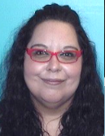
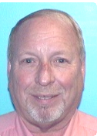
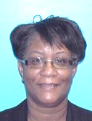
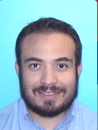
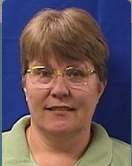
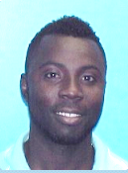
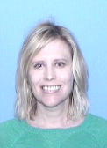
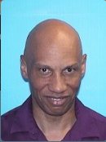
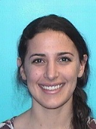
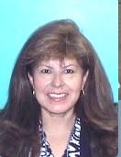
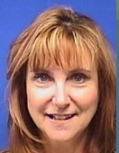
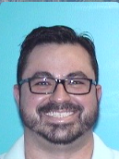
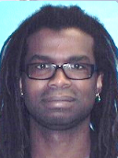
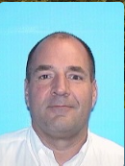
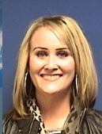
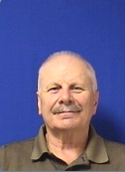

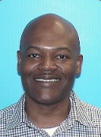
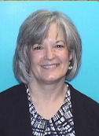
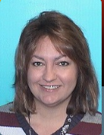
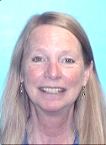
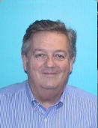
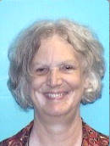
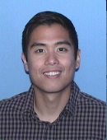
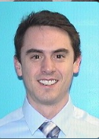
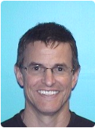
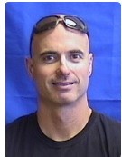
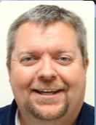
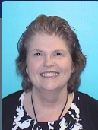
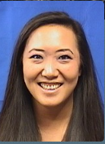
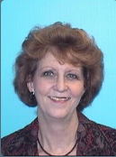
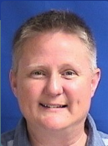
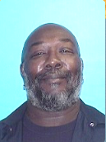













































































TEAM CDOT

Slide 20

TEAM CDOT

Slide 21

TEAM CDOT

Slide 23

TEAM CDOT
TEAM CDOT

Slide 24
TEAM CDOT

Slide 25


Slide 27

Notes:
Narrator:
“
Introduce the motorist in distress scenario
Set up the concept that the roadside rescue had the entire CDOT Team behind it to make it possible

Slide 28
Notes:
Narrator:
“
Introduce the motorist in distress scenario
Set up the concept that the roadside rescue had the entire CDOT Team behind it to make it possoble

Slide 29


Slide 30

Notes:
Brief Illustration of the unit’s role in supporting the roadside event.

Slide 31
Notes:
Brief Illustration of the unit’s role in supporting the roadside event.

Slide 32
Notes:
Brief Illustration of the unit’s role in supporting the roadside event.

