Slide 1


What Makes a Great CDOT Supervisor
Notes:
Notes:
Welcome to the What Makes a Great CDOT Supervisor course! This course is designed to help you understand the roles and responsibilities of being a supervisor at CDOT.

Slide 2

Introduction
Introduction
Role of the Supervisor
Click next to continue the course, the green question mark to display the section agenda or the blue section title to jump to that section.
Performance Management Behaviors
Communication
Moving from a Peer to a Supervisor
Conclusion
Notes:
This section of the course is the introduction. It covers how to navigate the course, the course objectives and what is required of you in terms of the assessment.
Click next to continue the course, the green question mark to display the section agenda or the blue section title to jump to that section.

Slide 3
Section Objectives
Upon completing this section, you should be able to:
Describe the course learning objectives
Explain how to navigate the course
Discuss the course assessment
Notes:
Take a moment to review the topics for this section of the course. When you are done reviewing them, click the Next button to go to return to the course outline.

Slide 4
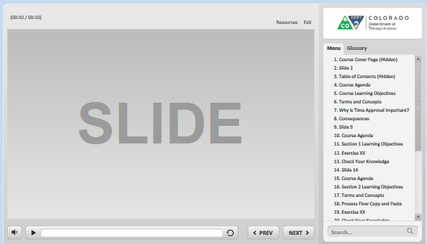
Navigation, Resources and Glossary
Before we begin, let’s look at the resources available to you
Notes:
As you go through the course there are a couple of items you can use to help you learn. The first is the Resources link as indicated by the red arrow. This link contains copies of all of the documents referenced in this course.
The Glossary tab displays an alphabetical list of terms that are used throughout the course. Anytime you are uncertain about a term, this is the best place to look. Unlike the resources link clicking on the glossary does not pause the course.
If you want to navigate, use the previous or next buttons or click on the slide you want to navigate to under the menu tab. There is also a search field located at the bottom of the Menu tab that brings up all of the slides related to your search. The progress bar displays your progress within a slide.
If for any reason, you need to close the course before you have completed it, you will be returned to the page you were on once you log back in. Now let’s move on to what you will learn in this course.

Slide 5
Course Learning Objectives
Upon completing this course you should be able to:
Explain how supervision is vital to CDOT being able to achieve its goals and objectives
Describe the roles and responsibilities of the Supervisor
Explain the role of the supervisor as an advocate of CDOT and their employees
Identify and explain the components of the supervision competency on CDOT’s performance appraisal form
Describe when to communicate information to employees and the channels available to do so
Identify the actions you can take to transition from the role of the peer to that of the supervisor
Notes:
In your role as a supervisor, it is important to be able to apply the each of the learning objectives of the this course. Take a moment to review the learning objectives of the course. Upon completing this course you will have a chance to review them and see if they were met. When you are done click the next button to continue.

Slide 6

Course Assessment
Throughout the course, you will have an opportunity to test your knowledge
At the end of the course, there will be an assessment to:
  Verify your knowledge
  Validate you have completed the course
Notes:
And one last thing, before we continue. Throughout the course you will be asked to verify your knowledge of the content in the course by answering questions. At the end of the course you will be asked to complete an assessment. The assessment will be used to verify you have knowledge of the content of the course and is also used by the LMS to validate that you have taken the course. Now let’s move on to the next section of the course.

Slide 7
Role of the Supervisor
Introduction
Role of the Supervisor
Click next to continue the course, the green question mark to display the section agenda or the blue section title to jump to that section.
Performance Management Behaviors
Communication
Moving from a Peer to a Supervisor
Conclusion
Notes:
In this section, you will learn about some key roles and responsibilities of a supervisor.
Click next to continue the course, the green question mark to display the section agenda or the blue section title to jump to that section.

Slide 8
Section Objectives
Upon completing this section, you should be able to:
Describe the role of the supervisor in supporting the mission vision and values of CDOT
Explain how time is spent as a supervisor
Describe the role of the supervisor
Identify the responsibilities that are common to all supervisor positions
Notes:
Take a moment to review the topics for this section of the course. When you are done reviewing them, click the Next button to go to return to the course outline.

Slide 9
The Supervisor as a Representative of CDOT
Mission
To provide the best multi-modal transportation system for Colorado that most effectively and safely moves people, goods, and information.
Vision
To enhance the quality of life and the environment of the citizens of Colorado by creating an integrated transportation system that focuses on safely moving people and goods by offering convenient linkages among modal choices.
As a representative of CDOT:
Connect the work of your team to the mission and vision of CDOT
Hold your team and yourself accountable for demonstrating the values
Notes:
The role of the Supervisor is to serve as a representative of CDOT. This means your job is more than making sure people are completing there assigned tasks. Your job involves helping CDOT achieve its mission and vision through its people. As part of this, you need to be familiar with the mission and vision of CDOT. As a supervisor it is your responsibility to communicate the mission vision and values to your team, explain how the team contributes to the mission and vision and holding the team accountable for demonstrating the values. Take a minute to review the mission and vision, we will talk more about the values on the next slide.

Slide 10
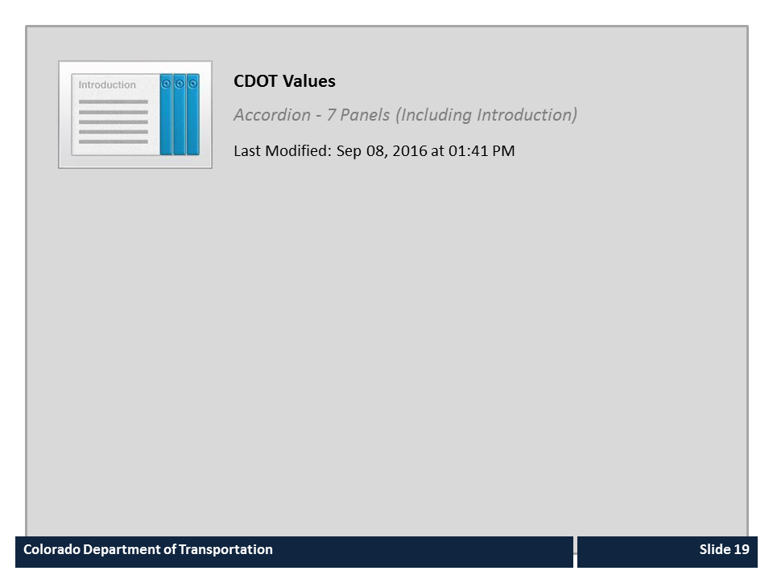
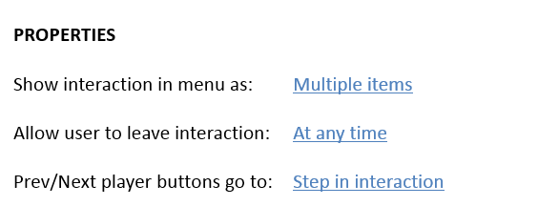


CDOT Values

Slide 11
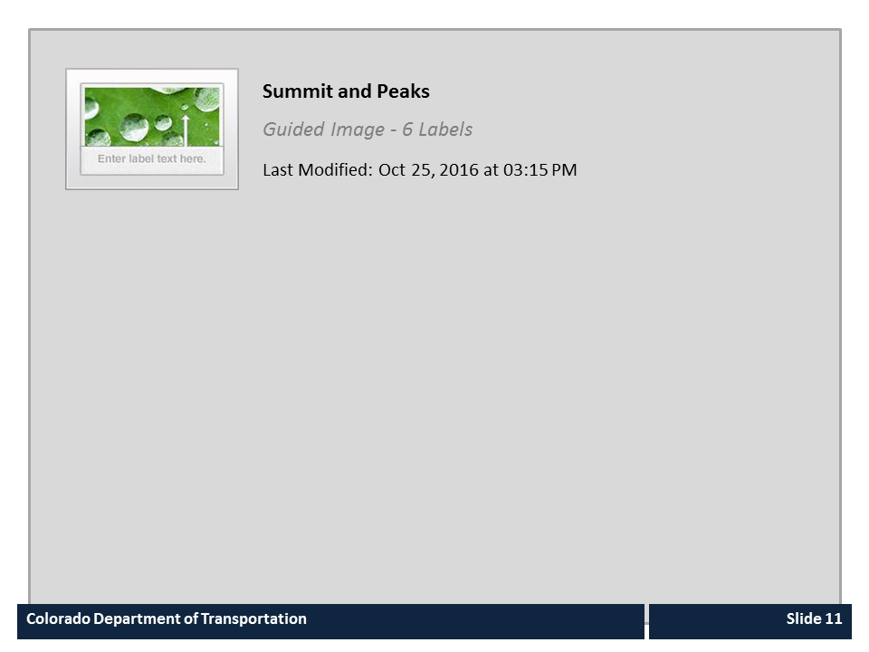
Summit and Peaks

Slide 12

Time Spent as a Supervisor
Time Spent
Managers
First-Level
Supervisors
Conceptual Skills
Interpersonal Skills
Lead Worker
Individual
Contributors
Technical Skills
Notes:
As you transition from an individual contributor to a supervisor your time is spent using different skills. On the top of the chart is the time the role spends working. Starting from the bottom of the diagram you can see individual contributors spend the majority of their time using their technical skills, the area in blue, to complete their job. In the next position, the lead worker, you can see that this starts to change and more time is spent on Conceptual skills, such as problem solving, and Interpersonal Skills, such as workings with other to accomplish key tasks. It is important to note that all three skill are used at all levels, however more time is spent on Technical as an Individual Contributor, and then more time is spent on Conceptual and Strategic Skills as a supervisor. On average, about 20% of a supervisor’s time is spent on managing/developing direct reports. And dealing with indirect reports adds to this. Now let’s answer a quick questions and then move on to the role of the supervisor.

Slide 13
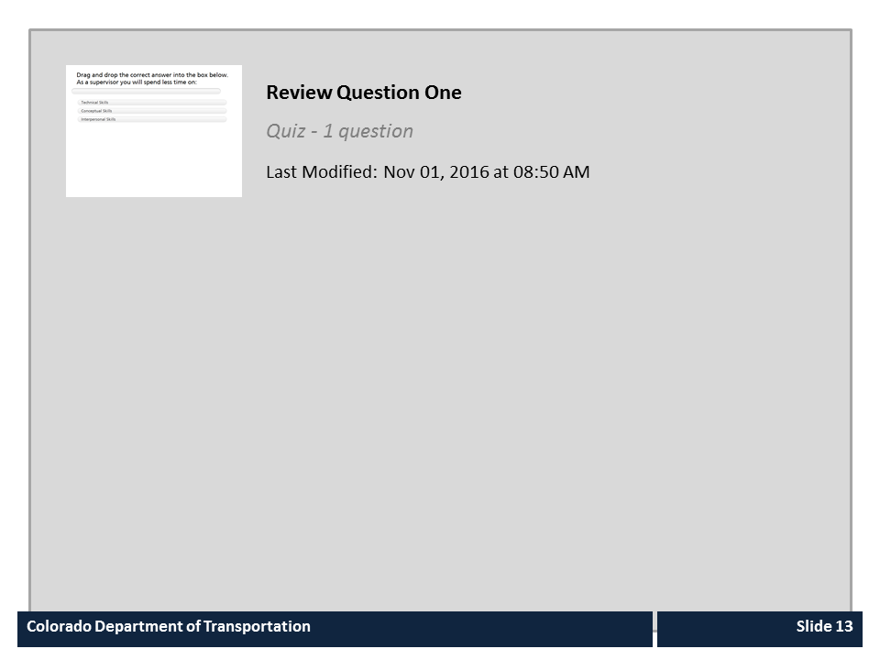
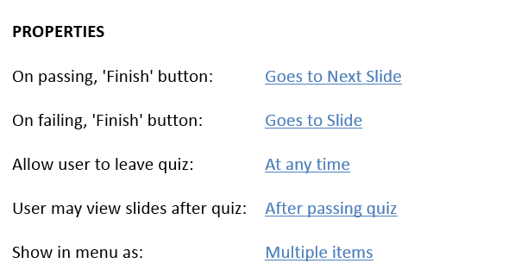

Review Question One

Slide 14
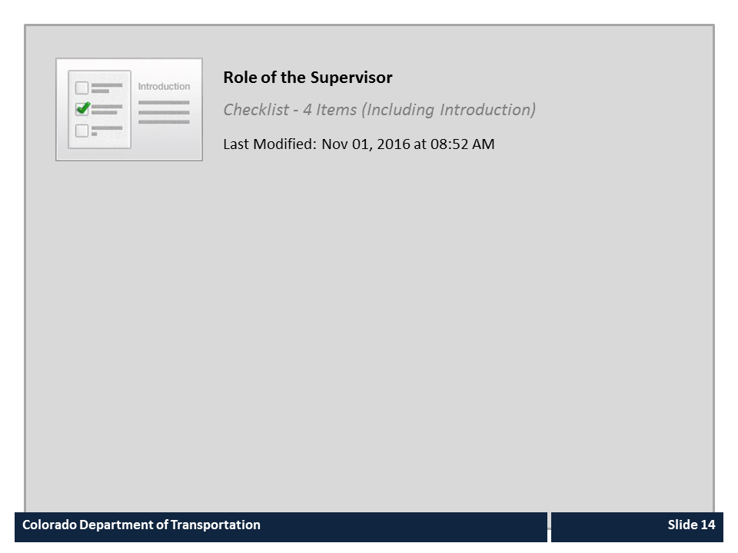
Role of the Supervisor

Slide 15

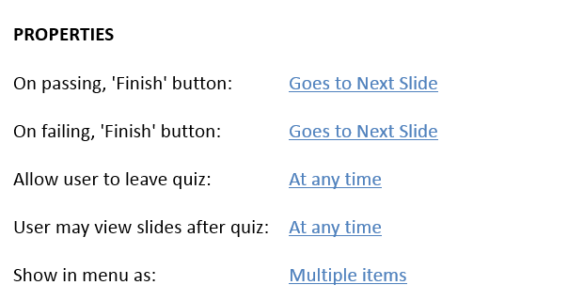
Review Question Two

Slide 16
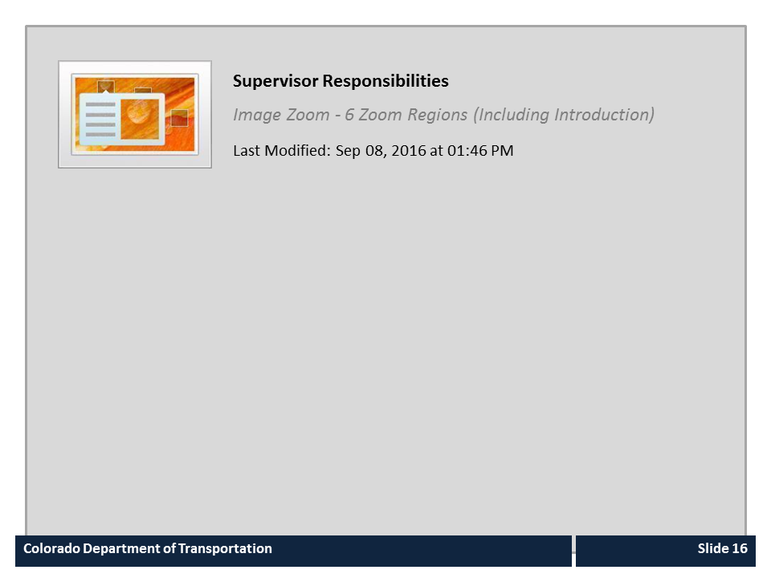
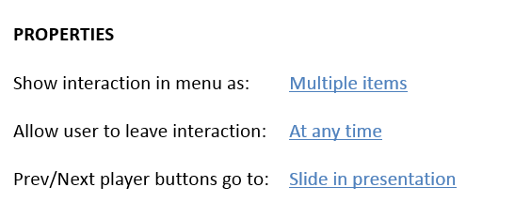
Supervisor Responsibilities

Slide 17
Performance Management Behaviors
Introduction
Role of the Supervisor
Click next to continue the course, the green question mark to display the section agenda or the blue section title to jump to that section.
Performance Management Behaviors
Communication
Moving from a Peer to a Supervisor
Conclusion
Notes:
This section of the course will identify and explain the components of the supervision competencies from CDOT’s performance appraisal form.
Click next to continue the course, the green question mark to display the section agenda or the blue section title to jump to that section.

Slide 18
Section Objectives
Upon completing this section, you should be able to:
Identify and explain the components of the supervision competencies on CDOT’s performance appraisal form
Notes:
Take a moment to review the topics for this section of the course. When you are done reviewing them, click the Next button to go to return to the course outline.

Slide 19
Work Leading and Supervision Competency
The supervisory competency:
Was added by CDOT in addition to the five main competencies required by the State of Colorado
Encompasses all manager or supervisor job classes
Must be evaluated on the PMP for all managers and supervisors
Accountability Credibility
Work Leading / Supervision
Job Performance Expectations
Safety
Customer Service
Communication Interpersonal Skills
Notes:
In this section of the course we will look at each of the bulleted items in the supervisory competency and explain what they mean to you as a supervisor. Although we don’t often think about it, Performance Management is the process where we align the employee with the goals and objectives of CDOT’s strategic plan and to a larger degree the State of Colorado. Part of a well-crafted Performance Management Plan is to inform the employee of what is expected of them in terms of there performance. Now let’s look at accountability.

Slide 20

Model Accountability
1: Model accountability for behaviors
Responsible for your work and actions
Demonstrating you plan ahead
Communicating what needs to be accomplished
When you model accountability as a leader, you are:
Notes:
The word “Accountability” means being held answerable for our actions and accomplishing goals and assignments. Supervisors model Accountability in most everything they do. When you complete your assigned tasks on time and with good quality, you are demonstrating accountability for your work. When you accept responsibility for a mistake you have made and resolve to make it right, you are demonstrating accountability for your actions.
Also, when you model accountability to employees you are showing that you plan ahead. Remember, accountability is not something that is assigned at the end of a project or task, it starts at the beginning when you agree to take on the work.
Accountability is also about communication. Outlining what you are accountable for requires communication about what you are going to do. When you ask a member of your team to be accountable for a task, be sure to communicate clearly what they need to do to be successful.
Now let’s look at developing employee’s through performance management.

Slide 21
Performance Management
2: Conduct timely and effective employee performance planning meetings with supporting records, forms and documents
The role of the supervisor in performance management is to:
Ensure the employee must have a performance plan within 30 days of hire
Meet with your employees regularly
Complete the final review by March 31st of each calendar year
Conduct a planning meeting that includes a discussion of:
  Department goals
  Work Unit plan
  Employee’s Position Description Questionnaire
  Employee’s goals and competency expectations
Click HERE to review performance management dates, requirement and guides
Notes:
As a supervisor, you play an important role working with employees to manage their performance. This is accomplished through Performance Management. Performance Management is the process of communicating throughout the year about the development and performance of an employee. It is important to CDOT because it is how we develop our employees and communicate the type of work they should be doing and how it supports the organization. Performance Management occurs when you set expectations and goals with the employee and how it relates to the goals of CDOT and your work group. A critical component is to document relevant information of both desirable and non-desirable behavior so that it is not forgotten during reviews. For information on performance management go the Performance Management page by clicking on the word here. Now let’s take let’s answer a quick question before going on to coaching and feedback.

Slide 22

Review Question Three

Slide 23
Feedback and Coaching
3: Develop and encourages employees’ ability to perform job tasks and interactions through feedback and coaching
When providing feedback or coaching an employee, make sure it is:
Based on observance of behavior and not assumptions
Work related
Based on the behavior and not the person
Effective feedback
Candid
Specific
Positive
Timely / Frequent
Action focused
Job-related
Notes:
Feedback from a supervisor is the main way employees knows how they are performing. Therefore, one of the most important roles of a supervisor is to give effective feedback. The graphic on the right side of the screen shows what makes up effective feedback.
Feedback should be candid, honest and direct. Every employee deserves to know where they stand in terms of how you view their performance, so supervisors should not avoid a difficult performance conversation or “sugarcoat” a difficult message. By being honest and direct about your feedback to the employee you do not leave room for misunderstandings about the actions of the employee.
When you are coaching an employee or providing feedback, tell the employee specifically what they have done. For example instead of saying “Great job this week!” you could say, “I noticed that this week you took an extra tool with you, this made a difference in completing the project on time. Great job on thinking ahead and being proactive!” In addition to letting your employees know what they are doing right, it is a great management tool because it also lets them know you are paying attention to the work they are doing.
It is also important to be positive when you provide feedback. This is easy to do when it is positive message. However, being positive is also important when there is change the employee needs to make. Being positive about the change shows that you believe the employee will make the change. It also shows that you are willing to work with them.
Also, make sure to try and provide the feedback or coaching as close to the event as possible. If an employee needs to make a change or improvement in their performance, the sooner they find out about it, the sooner they can take action. If an employee has done something very well, the sooner they receive positive feedback, the more rewarding it feels.
As a supervisor or manager, it is up to you to communicate to your employees frequently enough so they know how they are doing. But how much feedback you provide ultimately depends on the employee. For example, you may need to have more frequent communication with a new employee or an employee who is struggling than with an employee who is doing well and understands their position well.
It is also important that you focus on the actions the employee can take to improve. Provide examples of the actions the employee has done and actions that may be done differently. This reinforces the positive behavior and when improvement is required allows the employee to model the behavior and show they are taking action on feedback you are providing. In other words, provide them with the tools they need to make the change.
And lastly, feedback and coaching must be Job Related. Keeping feedback focused on the job helps to depersonalize the information and is more likely to produce a defensive reaction from the employee.
If you would like more information about providing feedback click on the resources link and select the Giving feedback document. Now let’s look at communicating with employees.

Slide 24

Communication
4: Communicate with employees in an open respectful way to provide frequent and ongoing communications
Ongoing communication is:
Given in a respectful manner, especially for difficult messages
Critical to the employee understanding what they need to do
Accomplished through weekly meetings, one-on-ones, coaching sessions, discussion of goals, emails and hallway chats
Notes:
Supervisors are expected to communicate with employees in an open, respectful way and provide frequent and ongoing communications. The next section of this course will go into more detail about the supervisor’s role as Communicator. But, for now, the key words to focus on here are “respectful” and “ongoing.” Recall that Respect is a CDOT value and involves being kind and civil with all employees. Supervisors sometimes need to deliver difficult messages and should do so with consideration for how the information may impact the employee.
Ongoing informal communication is critical to the success of your employees. It provides the employee the ability to make the small adjustments to their performance to be successful. This is also where much of the communications about the tasks the employee needs to do occur. Ongoing communication allows the employee to make changes before their actions need to be resolved through other means. As a supervisor you benefit because when it is time to evaluate employees there are no surprises.
Now let’s look at the process of resolving Personnel Issues and Conflict.

Slide 25

Resolving Personnel Issues and Conflict
5: Resolve personnel issues, conflicts or work related problems appropriately; keeps supervisor informed
When discussing personnel issues or a conflict provide employees with:
Why – Provide context on how the behavior impacts others at CDOT
Immediate – Keep the feedback as close to the event as possible
Think Small - Think about the chain of events that leads to success or failure
Specific – Do not make your employees guess about behavior; provide details
Notes:
Whether we like it or not, personnel issues and conflicts are bound to happen, and it is often up to the supervisor to manage the resolution of such issues.
When counseling an employee on their behavior or conflict remember use the acronym W.I.T.S, which stand for Why, Immediate, Think Small, and Specific. Employees need to understand why the issue or conflict at hand is a problem for the unit or for other employees. By explaining the impact of their behavior, you are creating motivation to change. Issues and conflicts need to be addressed as close to the event as possible. However, you do want to allow yourself time to document the behavior and prepare for the conversation. Although, we want resolution to begin right away, sometimes the best way to make a change is to think small and make the changes over time. And finally, be as Specific as possible. Tell them specifically what they have done right or what they can do differently.

Slide 26

Completing Paperwork Accurately and Timely
6: Completing administrative paperwork accurately and timely
When completing paper work:
Confirm all of the required fields are correct and completed
Save a copy for your records if the form is not part of an information system
Set a reminder for reoccurring tasks such as timesheets
To find forms go to the CDOT forms by clicking HERE
Notes:
Completing paperwork and getting it right the first time is one of the last things we think about when it comes to supervision. So why is it so important? Most of the paperwork we complete at CDOT is required so we have the data we need as an organization to accomplish tasks such as pay our employees or receive Federal funding. In most cases, the paperwork you complete as a supervisor is for the organization such as the PDT (Promotion, Demotion or Transfer) or they may be for ourselves, such the benefit paperwork for open enrollment. Regardless of the form it needs to completed correctly, or if you are the approver, it needs to be verified to ensure it is correct. Inaccurate paperwork can cause delays in payment both to CDOT, our employees and our vendors and can have serious consequences to the our organization.

Slide 27
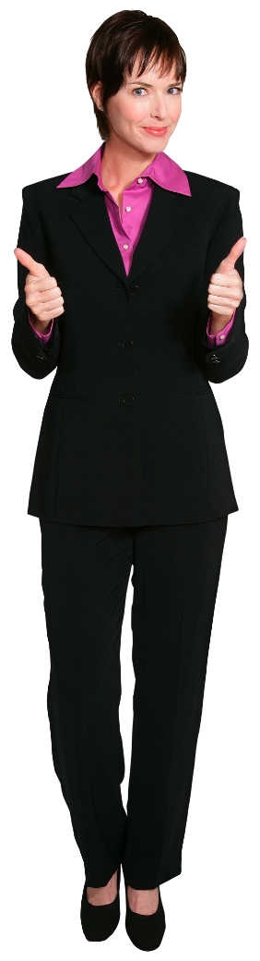
Acknowledge Accomplishments
7: Acknowledge and recognize the work efforts and accomplishments of the team
When an employee does something right:
Say something
Provide feedback, be specific
Tie it to CDOT Values
Document it!
Employee recognition programs include:
Monthly Division/Workshop recognition
Leadership coins
Statewide employee recognition
Lean Everyday Ideas
Notes:
When was the last time you took the time to talk to an employee or your team to let them know what they are doing right? One of the biggest complaints employees had about their supervisor is that they are not acknowledged for what they do right. This may be obvious, but when you see something going right it is usually because of the efforts of the team.
When you are acknowledging an accomplishment, let the employee know exactly what they have done right and don’t just say “good job”. What did the employee do right. For example, “Mark, I noticed how patient you were when explaining how to fill in a work order. That’s great teamwork and really helped me because I have to approve them. Thanks!”
It is also nice to tie it into the core CDOT values and document the behavior. When you document then you remember and can provide examples of the types of actions your employees are doing to make you a successful supervisor. CDOT is currently in the process of creating an employee recognition program. This program, once it goes live, will formalize current efforts in place. Now let’s review collaborating with your peers. Now let’s answer a quick questions before moving on.

Slide 28

Review Question Five

Slide 29

Collaborate to Resolve Issues
8: Collaborate with peers to discuss and resolve mutual supervisory issues
Having a good relationship where you are able to resolve issues can be accomplished by:
Establishing trust and respect
Seeking out the common issues
Seeking collaboration, not blame
Notes:
As a supervisor you are part of a team that works with other supervisors and employees. While this may not be listed as a job duty, it is critical to your success. There are several things you can do to make sure collaboration happens.
The first is to build trust and respect with your peers. This is done directly through your own actions, by making and keeping commitments and by treating others with respect. A foundation of trust and respect will go a long way when issues arise. Think of how difficult it is to resolve a conflict with someone you don’t trust.
The second thing you can do is to seek out common issues you can resolve by either sharing information you have that can be used to solve a problem or being open to asking for help and listening to the solutions that may be offered to you. Remember, most likely the issues you are having are shared by other supervisors.
A third thing you can do is to make yourself available to other supervisors to discuss and strategize together. Conflicts rarely go away on their own. If you have a conflict, be sure to resolve it as quickly as possible so it does not carry over into other projects and hamper your relationships with other members of your team.
Seek out collaboration with the other member of your team. This is done by working on shared projects. When you do this remember to communicate with others about the project and what needs to be accomplished. And don’t forget to celebrate when you are successful. This keeps the motivation high and creates an opportunity to bond.
Now let’s look at the last item, using CDOT Values to resolve conflict.

Slide 30

CDOT Values
9: Use CDOT values to make ethical decision when faced with conflicting choices
CDOT Values:
Safety
People
Integrity
Customer Service
Excellence
Respect
Notes:
And last but not least is using CDOT’s values to guide how we conduct our work. The values are more than just words, they are there to guide us when we are not sure of what to do and shape the behaviors of all of our employees. They are the common bond to keep us aligned on the work we do. If you have not already done so, please review the policy on the our values in the resources section of this course.

Slide 31
Communication
Introduction
Role of the Supervisor
Click next to continue the course, the green question mark to display the section agenda or the blue section title to jump to that section.
Performance Management Behaviors
Communication
Moving from a Peer to a Supervisor
Conclusion
Notes:
Communication is a critical skill for the supervisor. In this section you will be provided an overview of the types of meeting it is recommended you have, what is recommended you communicate upward and how to share information with employees to build trust.
Click next to continue the course, the green question mark to display the section agenda or the blue section title to jump to that section.

Slide 32
Section Objectives
Upon completing this section, you should be able to:
Explain the advantages of communicating
Identify the consequences of not communicating
Describe the importance of the one-on-one meeting
Explain the importance of team meetings
Describe how and when to share information with employees
Identify the common communication channels
Explain what you should communicate to your supervisor
Notes:
Take a moment to review the topics for this section of the course. When you are done reviewing them, click the Next button to go to return to the course outline.

Slide 33

Making Time to Meet with Employees
When you met with your employees:
Understand that feedback requirements are different for each employee
Make the most of the time you scheduled with employees
Be proactive in your communication and match the style of the employee
Notes:
It can be difficult to meet with employees as a supervisor because of the demands placed on your time. But it is critical to both your success and the success of you employees. When it comes to communication not all employees are the same. Some employees may require that you provide them immediate feedback while others may only need to have biweekly meetings.
For example, if you have an employee who comes back to you with questions, let them know the time you will be available later in the day for questions and outline how you want to receive the questions. This not only helps you to budget your own time, but the employee remains productive. When you have meetings make sure the employee leaves with everything they need prior to the end of the meeting. This is done by providing clear directions about what they need to accomplish. Set a time limit for the conversation and let the employee know what they need to communicate or prepare prior to the meeting.
Also you need to be proactive in your communication, by understanding what the preferred communication style of the employee. For example you may spend a lot of time drafting an email to an employee to let them know what you would like them to do, but then they come to you with questions about the project. Why not spend the time meeting with the employee instead, and drafting the email as a follow-up? Understanding what is effective communication means you will spend less time communicating in ways that do not meet the needs of the employee.

Slide 34

Consequences of Poor Communication
Poor communication can result in:
Disengagement
Rumors
Misinformation
Poor work performance
Surprises
Notes:
Before we get started, let’s talk about some of the consequences of poor communication. A big consequence of poor communication is disengagement or poor morale. Employees can feel isolated without communication. Lack of information can also lead to rumors and misinformation spreading throughout the unit. Another consequence is poor work performance when employees are not given clear direction about a task or goal. A final consequence, especially if you do not communicate to your supervisor, are surprises – supervisors need to be kept in the loop about important information to avoid being caught off guard.

Slide 35

Review Question Six

Slide 36
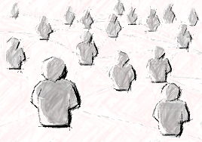
Types of Communication
Types of communication:
One-on-one
Team meetings
Upward communication
Notes:
Communication is critical to your success as a supervisor. While there are many ways you communicate information on a daily basis, in this course we are going to focus on three types of communication. The first is one-on-one communication with the members of you team where you can connect with the employee directly. Team meeting are great for bring your team together to share information. There is upward communication to your supervisor. Now let’s look at the One on one meeting.

Slide 37

The One-on-one Meeting

Slide 38
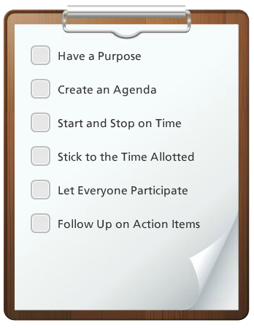
The Team Meeting
When you have a team meeting keep the items on the checklist to the left in mind.
Notes:
When you have a team meeting there are a couple of things you might want to keep in mind. The first is have a purpose so the meeting is relevant to all employees. Also is a good idea to have an agenda. If you do not have one click on the resources link to download one you can modify. In terms of time keep it focused and stick to the timeframe you allotted. Be sure everyone has an equal opportunity to participate and if there is something that requires follow up be sure to cover it via email or during the next team meeting. Now let’s look at communicating upward.

Slide 39
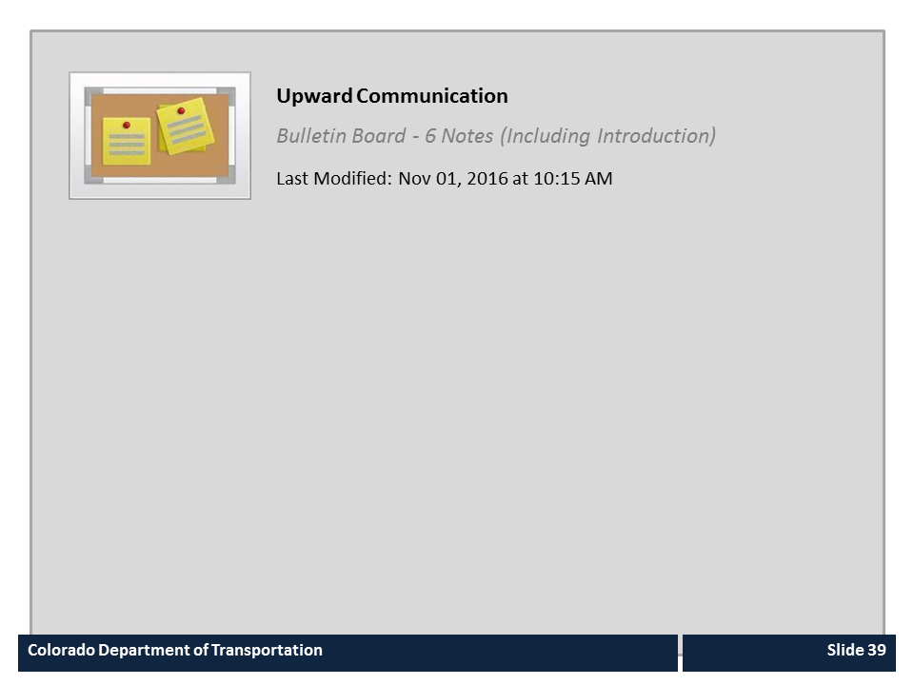
Upward Communication

Slide 40
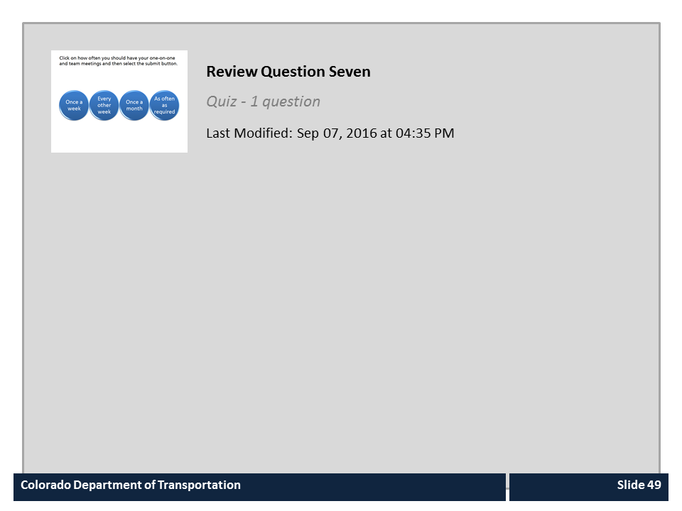
Review Question Seven

Slide 41
Sharing Information
When sharing information with employees be sure to:
Let employees know as soon as you can
Avoid rumors by providing what you can to your team
Share what you can, when you can
Provide/Receive feedback
Notes:
Sharing information, when you are able, is one of the most important aspects of the job of the supervisor. When sharing information there are four things to keep in mind.
The first is to let your employees know as soon as you can. As a supervisor you may be privy to information that your employees would like to know, but are not able to because of organizational needs. When you are able to share information you should do so with all employees.
Sharing information when you are able allows employees to be connected to what's happening in the organization. When employees learn about an event through the news or through other channels when you have the information, then they may feel the organization does not trust them, or that they are out of the loop.
Providing what information you can is a good way to avoid rumors. Remember, In the absence of a message one is usually created from what is known and it is rarely correct. Also, when you have information you may not be able to share everything, but you can share a little of what you know and the reason you are not able to provide the rest of the information. This can build trust and prevent rumors because everyone one is on the same page.
Another way you can share information is by providing feedback or answering questions. Providing feedback or answering questions is also information and can be useful to both you and the employee. When you are open to feedback or questions you are showing you are open to communication and what to share information. Now let’s look at where you can find information.

Slide 42
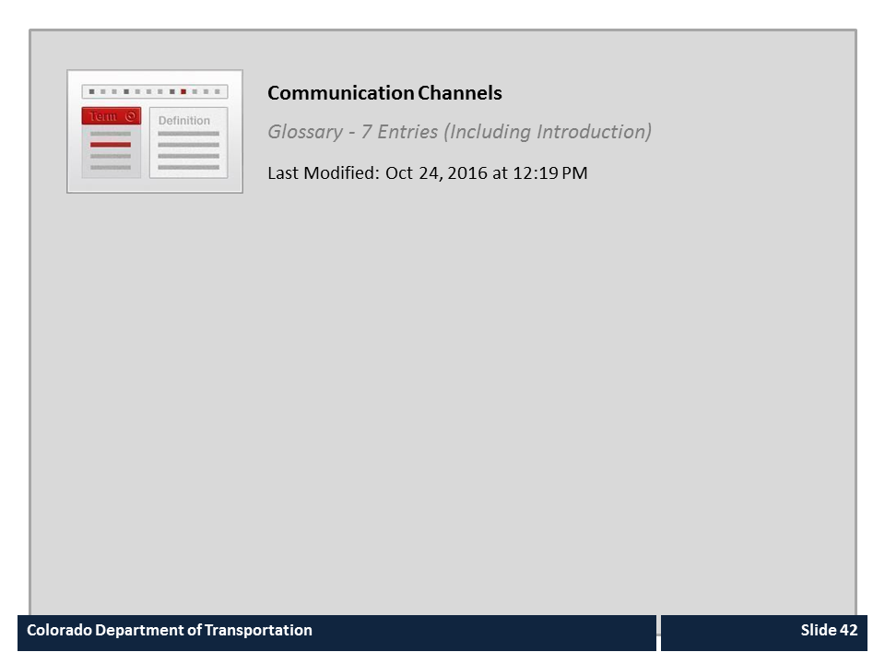
Communication Channels

Slide 43
Moving from a Peer to a Supervisor
Introduction
Role of the Supervisor
Click next to continue the course, the green question mark to display the section agenda or the blue section title to jump to that section.
Performance Management Behaviors
Communication
Moving from a Peer to a Supervisor
Conclusion
Notes:
This is an optional section where you will learn about the actions you can take to make your transition from an employee to a supervisor as smooth as possible. If you do not want to take this section, click on the Conclusion tab to skip this section and complete the course.

Slide 44
Section Objectives
Upon completing this section, you should be able to:
Describe how to talk to your employees about your transition to a supervisor or manager
Describe how to deal with disgruntled employees who did not get your promotion
Identify how some of your previous relationships may change as a result of you promotion
Identify which actions you should stop and/or adopt as a new supervisor
Understand the forming, storming, norming and performing stages of new leadership
Notes:
Take a moment to review the topics for this section of the course. When you are done reviewing them, click the Next button to go to return to the course outline.

Slide 45

Discussing the Transition to Supervisor
When talking to your former coworkers about your promotion:
Listen, but don’t defend
Transition the topic to something the employee can do
Ask the employee about their career direction and accomplishments
Discuss how you can help steer their career towards the next opportunity
Set performance expectations
Notes:
When are awarded a promotion, over your former coworkers, they may have bad feelings about what they interpret as a loss. As the supervisor, you need to help your employee get past these feeling so they can be productive. The first step is to listen to the employee, but don’t defend. The hiring decision was not yours to make and it is not yours to defend. In realty there is very little you can do about how the employee feels and the quicker you can help move them on to something they can do something about the better off you and the employee are going to be.
The next step is to re-direct the conversation to the goals of the employee and the contributions they can make to the team. This allows the employee to transition their thoughts to how they can help both themselves and team.
You should have discussions with employee about their career goals and aspirations. As the supervisor you have the ability to position them for their new opportunity through the type of work you assign and giving them constructive feedback. Over time, continue to set performance expectations and give feedback in a respectful way.
Now let’s answer a brief questions before we look at the actions to start and stop.

Slide 46

Review Question A (Optional)

Slide 47
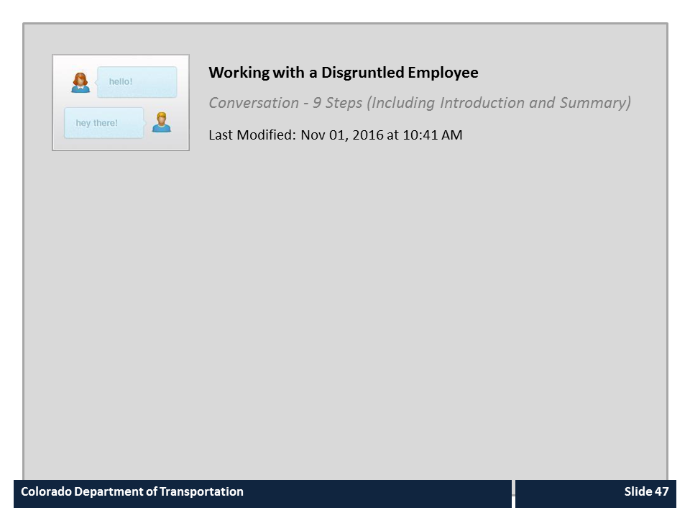
Working with a Disgruntled Employee

Slide 48
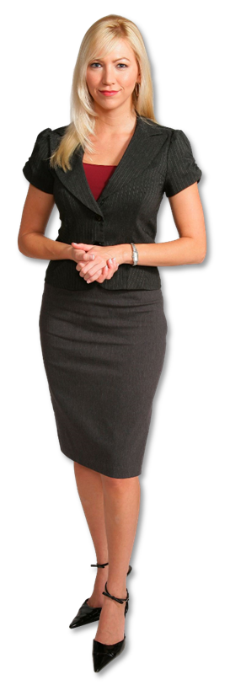
Relationship Changes
Friendships with former peers may change because:
You need to create boundaries between work and friendship
You must treat all employees fairly
There is information you cannot share with your employees
You may have to take actions that benefit CDOT and not your friend
Notes:
One of the challenges of making the transition from a peer to a supervisor is that you may now be supervising people you have formed close friendships with. There is no rule against being friends with people you supervise. However, if not handled appropriately, you could be accused of showing favoritism to your friends. The best way to avoid being accused of favoritism is to treat all employees fairly and keep work and friendships separate.
In some cases, there may be a change to some of the relationships with your former coworkers. This is not to say that you cannot be friends, but there may be some changes you need to make. First as a supervisor you will need to create boundaries while you are at work between you and your employees. This is because you need to treat all of your employees fairly, and if there is the perception that an employee is being treated differently there can be issues for you as a supervisor. Additionally, you are sometimes going to be trusted with information you cannot share. Not sharing this information could impact your friendship. And finally, there are times when you have to take actions as a supervisor that may not equally benefit CDOT and your friend. For example asking someone to work extra hours over a holiday. As a supervisor it is up to you to find the right balance. Now let’s look at the actions you need to start and stop once you become a supervisor.

Slide 49
When you become a Supervisor
Start
Reconnecting with your team as a supervisor not a peer
Assigning the team projects
Communicating through one-on-one meetings and team meetings
Connecting with your new peers and manager
Stop
Staying the same
Continuing in your old job
Trying to make too many changes at once
Notes:
When you step into your new role as a supervisor there are a couple of things you can do right away. Let’s start off with what you need to start doing. The first thing you can do is to reconnect with your former coworkers as a supervisor and not a peer. This involves setting up meetings to discuss your new role and your expectations of your employees. Communicate to your employees what you need to accomplish in your new role and how their work is connected to your mutual success. You should also begin to assign projects to the team. This allows you to determine how they work and also shows you are willing to share your authority. This involves delegating, setting deadlines and planning the workload of your employees so you can accomplish all of the new tasks you have been assigned.
Finally begin communicating with your employees through one-on-one meeting and team meetings. By doing so you are not only establishing communication channels you are also taking time to get to know you employees as a supervisor and also avoid the perception of favoritism by any one employee spending too much time in your office. Understand that this may change some of the relationships you had in the past and create distance. This is not say you can’t be friends, just that the relationship may change.
As a supervisor, you also need to change. If you continue with how you have always done things then you will not be successful. Connecting with your new peers, there other supervisors and your new manager can help. You must transition into your new role, but give it time, by not trying to make every change you want at one time. Now let’s answer a quick question about the content we have reviewed so far.

Slide 50
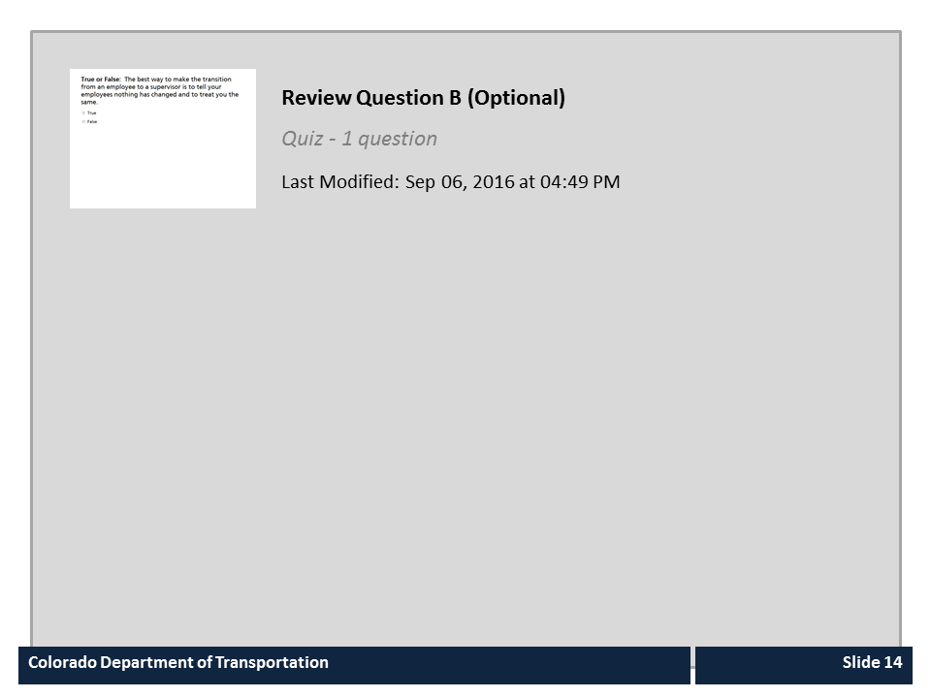
Review Question B (Optional)

Slide 51
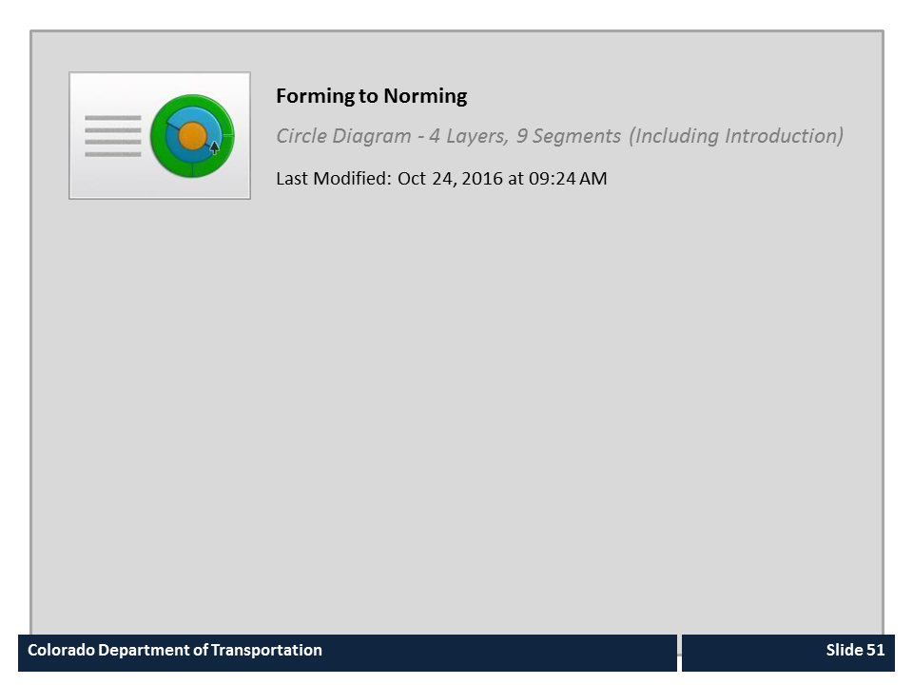
Forming to Norming

Slide 52
Conclusion
Introduction
Role of the Supervisor
Click next to continue the course, the green question mark to display the section agenda or the blue section title to jump to that section.
Performance Management Behaviors
Communication
Moving from a Peer to a Supervisor
Conclusion
Notes:
This section summarizes the course, outlines help resources, and also contains the assessment.
Click next to continue the course, the green question mark to display the section agenda or the blue section title to jump to that section.

Slide 53
Section Objectives
Upon completing this section, you should be able to:
Describe the help resources available to you
Review the course objectives
Identify how to complete the assessment
Notes:
Take a moment to review the topics for this section of the course. When you are done reviewing them, click the Next button to go to return to the course outline.

Slide 54
Conclusion
You should now be able to:
Explain how supervision is vital to CDOT being able to achieve its goals and objectives
Describe the roles and responsibilities of the Supervisor
Explain the role of the supervisor as an advocate of CDOT and their employees
Identify and explain the components of the supervision competency on CDOT’s performance appraisal form
Describe when to communicate information to employees and the channels available to do so
Identify the actions you can take to transition from the role of the peer to that of the supervisor
Notes:
Now that you have competed the course you should be able to describe each of the items on the bulleted list. Please take a moment to review the conclusion slide. When you are done click the next button to learn about the types of help resources available to you.

Slide 55
Where Can I Get Help (People)
For additional assistance contact:
Region | Name | Email | Phone
One | Kathy M. Williams | kathy.williams@state.co.us | 303-757-9386
Two | Mary Vigil | mary.vigil@state.co.us | 719-546-5432
Three | Chip Brazelton | chip.brazelton@state.co.us | 970-683-6210
Four | Juliet Sheets | juliet.sheets@state.co.us | 970-350-2156
Five | Jason Benally | jason.benally@state.co.us | 970-385-1403
Notes:
If you are uncertain about how to supervise an employee the best person to contact is your civil rights manager. If you need additional help contact the Civil Rights Manager for your region. Now let’s look at other training courses on leadership you can take.

Slide 56
Where can I get Help (Training)
The following is a list of the leadership courses available for you to take. They are:
Built around people focused supervisory skills
Comprised of a combination of online and instructor led training
Helpful to build new skills or refresh old ones
Click HERE to review the course

Slide 57

Course Complete
Congratulations, you have completed CDOT’s the What Makes a Great CDOT Supervisor Course!
To confirm you have completed the course, complete the following assessment.
For course credit, you must achieve a score of at least 70%. Please remember you can take the course as many times as you want until you achieve this score.
And remember, once you click the “Submit” button the question is locked and you can no longer change your selection.
Notes:
Congratulations, you have completed the What Makes a Great CDOT Supervisor course! In order to maintain a record of your successful completion of the course, you must complete the following assessment. You may take the assessment as many times as you want, until you are happy with the results. Click the next button to begin the assessment.

Slide 58

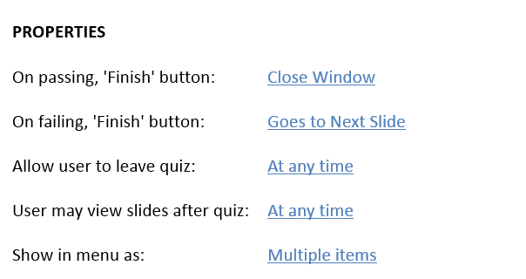
Course Assessment

