Slide 1
Requesting and Coordinating New Training
Notes:
Notes:
Welcome! This brief course guides you through the process of requesting a new training for either purchase or in-house development for CDOT employees or contractors.
This process will help you, the training purchaser, developer, or administrator to save time and possibly a lot of money. We’ll explain how in just a few minutes.
If you intend to purchase a training course from the National Highway Institute, there is a separate process. Please contact the NHI Coordinator at the Office of Employee Development at extension 7-9167 for additional details.
Now let’s look at what we will cover in this course.

Slide 2
Let’s Get Started
The topics covered in this course include:
Identifying how the process helps you
Locating the Coordination Form for New Training
Identifying the Roles (who does what)
Describing how to complete the form
Answering Frequently Asked Questions (FAQs)
Notes:
Take a moment to review the topics covered in this course. When you are done reviewing them, click the Next button to continue.

Slide 3
How this Process Helps You
Help avoid duplication of courses that CDOT or the state has already bought or developed
Identify training that requires a DPA approval (waiver) for purchase
Gather data to get the training supported in the Learning Management System
Notes:
As mentioned on the first slide, this process helps you in several important ways.
First, by avoiding the purchase or development of a course that either CDOT or another state agency may already have available to you for free or at a highly discounted price.
Second, it will help you obtain any required waivers to purchase training, as may be required by state and CDOT purchasing policies.
Third, it will help you get your training course supported in the Learning Management System, which assists you in advertising your course, registering your participants and recording credit for the course in the employee’s official learning history at CDOT.

Slide 4
Locating the Form
The Coordination Form for New Training can be found by going to the CDOTU Intranet page, and clicking on the link for “CDOTU Manual and Forms”.
A copy of the form can also downloaded from the resources link.
Notes:
The first step is finding the form. The Coordination Form for New Training can be found by going to the CDOTU Intranet page, and clicking on the link for “CDOTU Manual and Forms”.
A copy of the form can also be downloaded by clicking on the resources link at the top right of this window. Now let’s look at the roles of the people filling out the form.

Slide 5
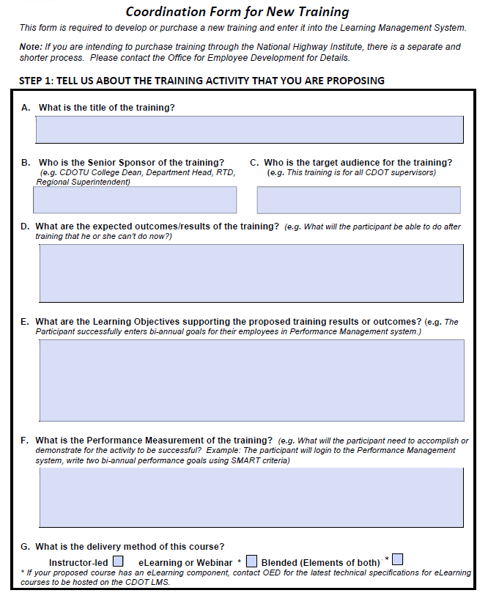
Step 1: Initiator
Initiator
Completes Step One of the form
Forwards form to Sponsor for approval
Notes:
There are three roles that are part of the request process.
The request begins the you, the initiator, who completes Step One of the form. The initiator is typically a training coordinator, subject matter expert or manager who has identified a training need for CDOT employees, consultants or contractors.
This Section collects all of the required data to both get the training into the Learning Management System, and help the Office of Employee Development to identify if there is already a comparable training option that has already been developed or purchased by CDOT. If so, OED will provide the initiator with the details of that training and help the initiator to decide if the existing training is a suitable substitute.
If no currently available training fits the need, OED will use the information in Section One to coordinate a DPA waiver to purchase that training, if required.

Slide 6
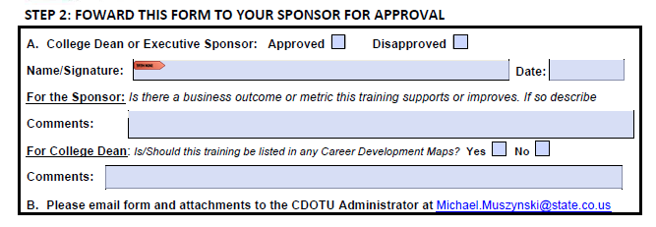
Step 2: Sponsor
Sponsor
Completes Step Two of the form
Forwards form to the CDOTU Administrator
Notes:
Every initiative to develop or purchase new training needs a Sponsor. This is typically a CDOTU Dean, senior manager or member of the Executive Management Team. The level of sponsorship depends on the scope of the intended audience.
For example, if the target audience is a single business unit, then the senior manager of that unit is an appropriate sponsor. (The request will be coordinated with the appropriate CDOTU Dean so that he/she will have awareness of it, as the training may be of interest to other groups or may be included on a career development map. ) If the target audience is across multiple business units, then Executive-level sponsorship is required. When in doubt contact either the Dean for the CDOTU College that represents your business unit or contact the CDOTU Administrator in OED. To find the CDOTU Dean that represents your business unit, consult the CDOTU intranet page or contact the CDOTU Administrator whose email address is linked on Step 2 of the form.

Slide 7
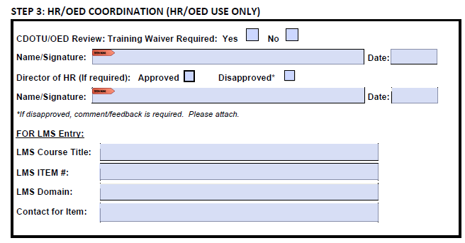
Step 3: OED
OED
Completes Section Three of form
Coordinates any needed waivers
Loads the Course into the LMS
Notes:
The Office of Employee Development and the Director of HR provide CDOT-wide visibility on both training that is currently available, what is in development, as well as what is available from DPA and other sources. This awareness of state-wide training is important in avoiding unnecessary duplication of effort or expenditure for training. Also, the Office of Employee Development is your liaison for DPA waivers required for purchase of training.
Lastly, you may need the approval of the HR Director if your proposed training is intended as mandatory for CDOT employees.

Slide 8
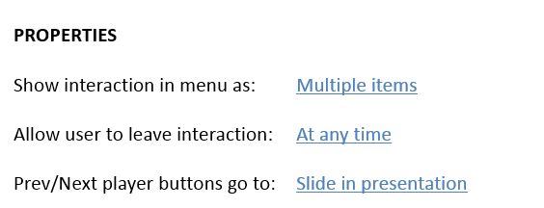
Page One (Coordination Form for New Training)

Slide 9
Page Two (Coordination Form for New Training)

Slide 10
Timeframes
Initiator
(30 minutes)
Sponsor
(5 Minutes)
OED
(3 to 5 Days)
Notes:
As the initiator the first step is up to up to you. The form should take no longer than an 30 minutes to complete and send to the sponsor for approval. The sponsor may need to set up a meeting with you to discuss the training need and resources required, but the form approval by the sponsor should only take 5 minutes. Once the form is received by OED they will need to review content and compare this against the database of available training and research is this training exists within the State. Please keep in mind if your course needs to purchased that this is not part of the timeline.

Slide 11
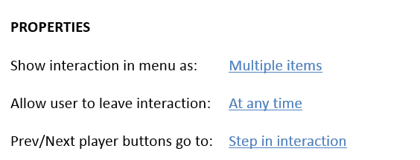
Sample FAQ

