Slide 1


Completing the Request for Development of New Training Form
Notes:
Notes:
Welcome to the XXXX course. This brief learning is designed to help you complete the XXXX form. Before we get into the content, let’s learn how to navigate the course.

Slide 2
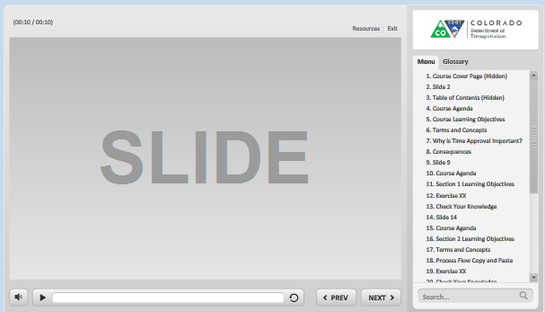
Navigation, Resources and Glossary
Before we begin, let’s look at the resources available to you
Notes:
As you go through the course there are a couple of items you can use to help you learn. The first is the Resources link as indicated by the red arrow. This link contains copies of all of the documents referenced in this course.
The Glossary tab displays an alphabetical list of terms that are used throughout the course. Anytime you are uncertain about a term, this is the best place to look. Unlike the resources link clicking on the glossary does not pause the course.
If you want to navigate, use the previous or next buttons or click on the slide you want to navigate to under the menu tab. There is also a search field located at the bottom of the Menu tab that brings up all of the slides related to your search. The progress bar displays your progress within a slide.
If for any reason, you need to close the course before you have completed it, you will be returned to the page you were on once you log back in. Now let’s move on to what you will learn in this course.

Slide 3

Outline
Click on the button of the topic you want to learn about or the green button to learn what is covered in the Section.
?
Getting Started
?
Completing the Form
?
Timeframes and Help
Notes:
This brief learning is divided into three sections. You can view the sections in any order, based on what you want to learn, or you can take go through the sections in order to complete the
This course is divided into six sections and help. You can view the sections in any order ,based on what you want to learn, or you can take the whole course by going through each section. If you want to see the topics within the section, click on the green button. And one more thing, you will be returned to this slide at the end of each section.

Slide 4
Getting Started
The topics covered in this section include:
Locating the form
Purpose of the form
Identifying the roles
Notes:
Take a moment to review the topics for this section of the course. When you are done reviewing them, click the Next button to view the section, or if you are only reviewing the objectives, select the Return to Course Outline button to select a different topic.

Slide 5

Locating the Form
The XXXX form can be found by going to XXX
A copy of the form can also downloaded from the resources link
Notes:
The XXXX form can be found by going to XXXX . A copy of the form can also be downloaded by clicking on the resources link

Slide 6

Purpose of Form
The purpose of the form is to:
Enter the training into the LMS
Help ensure duplicate courses do not exist
Identify training that requires DPA approval
Notes:
The purpose of the XXXX for is to enter the training into the LMS which allows participants to register and

Slide 7



Roles
Completes section one of form
Initiator
Sponsor
HR / OED

Slide 8
Roles
Completes section two of form
Initiator
Sponsor
HR / OED

Slide 9
Roles
Completes section three of form
Approves
Initiator
Sponsor
HR / OED

Slide 10
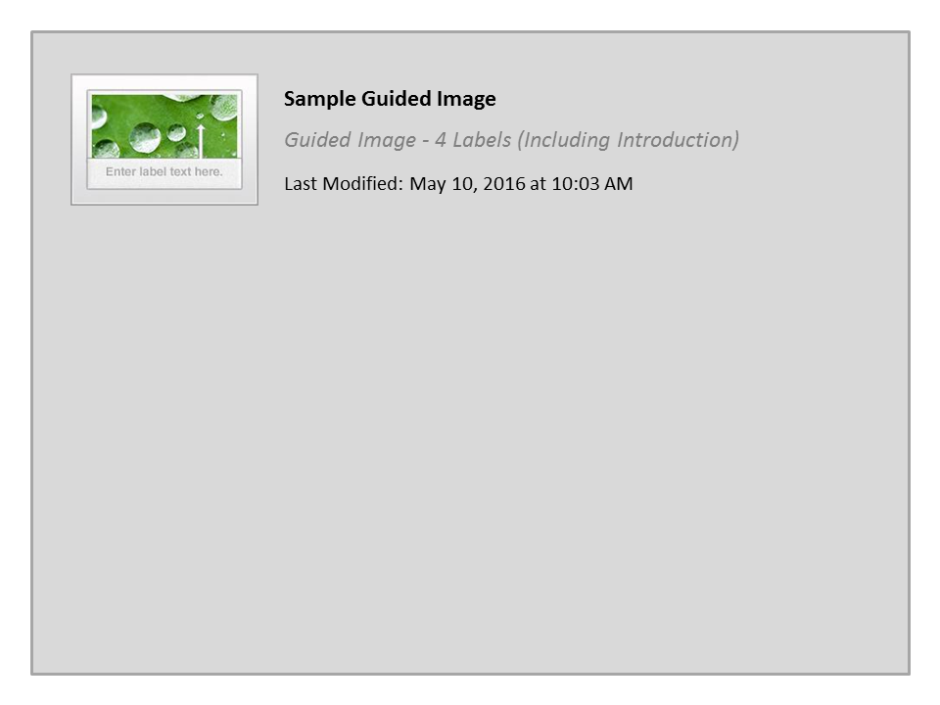
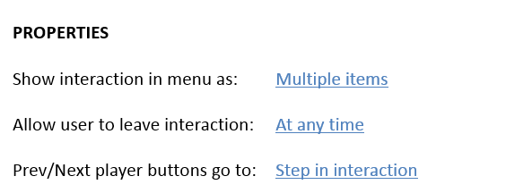


Sample Guided Image

Slide 11
Completing the Form
The topics covered in this section include:
Identifying the sections of the form
Complete the sections of the form
Send the form to the next role
Notes:
Take a moment to review the topics for this section of the course. When you are done reviewing them, click the Next button to view the section, or if you are only reviewing the objectives, select the Return to Course Outline button to select a different topic.

Slide 13
Timeframes and Help
The topics covered in this section include:
Identify the turn around time on the form
Answer frequently asked questions
Notes:
Take a moment to review the topics for this section of the course. When you are done reviewing them, click the Next button to view the section, or if you are only reviewing the objectives, select the Return to Course Outline button to select a different topic.

Slide 14
Timeframes

Slide 15
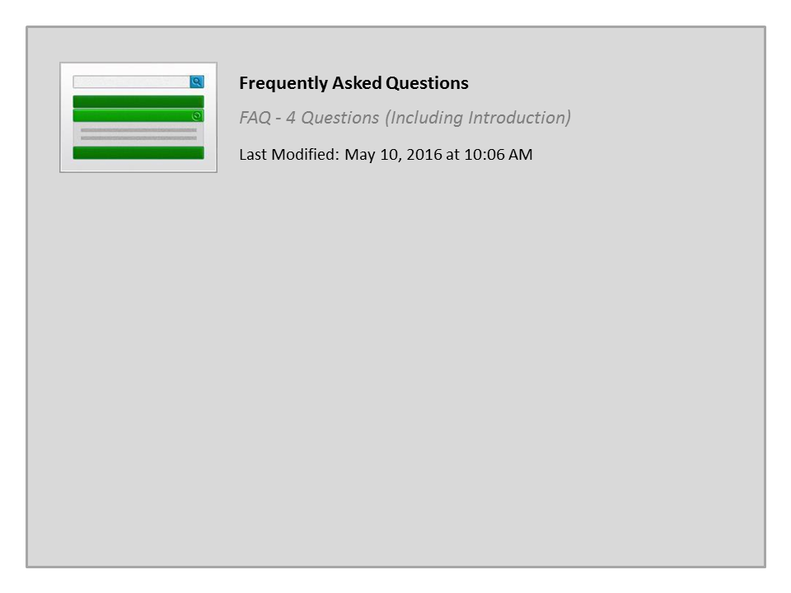
Frequently Asked Questions

