Slide 1


Supervisor Time and Leave Approval
Notes:
Notes:
Welcome to the Supervisor Time and Leave Approval Course! This course is designed to help you understand time and leave approval processes and procedures.
The course takes you about one and half hours to complete. If you do not have this much time, don’t worry about it, you are able to stop this course at anytime and return to where you left off. Now, let’s get started.

Slide 2
Learning Logistics
Learning Logistics
Section 1 – Course Overview
Section 2 – Introduction to Time and Leave
Section 3 – Approving Working Time
Section 4 – Approving Leave
Section 5 – Approval Deadlines and Issues
Conclusion
Notes:
This course is broken five sections and the conclusion. In the learning logistics section, you will learn how to navigate the course, use the glossary and the resources available to support your learning.
In the Course Overview, you will be introduced to the learning objectives of the course and why time and leave approval is important.
The Introduction to Time and Leave section provides you with an overview of time and leave processes, and explains your roles as a supervisor in time and leave approval.
The Approving Working Time section explains the process of approving attendances in detail and how to review the timesheets of your employees for accuracy.
Approving Leave covers the different types of leave an employee is able to take and what to check when approving leave.
The final section explains approval deadline and how to resolve issues.
The conclusion summarizes what you have learned and where you can find help. Now let’s look at the prerequisites for this course.

Slide 3
Prerequisites
Prior to taking this course you should have taken:
Employee Time Entry
If you have not yet taken the Employee Time Entry course, click the button below
Employee Time Entry
Notes:
Entering time as an employee is vital to your understanding of this course. If you have not already taken the Employee Time Entry, please click the Employee Time Entry button this will take you directly to the course. Once you are done you can return. Now let’s look at how to navigate.

Slide 4
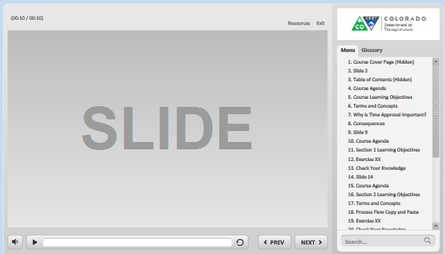
Navigation, Resources and Glossary
Before we begin, let’s look at the resources available to you
Notes:
As you go through the course there are a couple of items you can use to help you learn. The first is the Resources link as indicated by the red arrow. This link contains copies of all of the documents referenced in this course.
The Glossary tab displays an alphabetical list of terms that are used throughout the course. Anytime you are uncertain about a term, this is the best place to look. Unlike the resources link clicking on the glossary does not pause the course.
If you want to navigate, use the previous or next buttons or click on the slide you want to navigate to under the menu tab. There is also a search field located at the bottom of the Menu tab that brings up all of the slides related to your search. The progress bar displays your progress within a slide.
If for any reason, you need to close the course before you have completed it, you will be returned to the page you were on once you log back in. Now let’s move on to what you will learn in this course.

Slide 5
Learning Logistics
Learning Logistics
Section 1 – Course Overview
Section 2 – Introduction to Time and Leave
Section 3 – Approving Working Time
Section 4 – Approving Leave
Section 5 – Approval Deadlines and Issues
Conclusion
Notes:
In this section of the course, you will learn why approval of time and leave is important as well as the consequences if it is late or inaccurate.

Slide 6
Course Learning Objectives
At the end of this course, you should be able to:
Understand the Supervisor’s role within the time entry and approval process, why it is important, and any budgetary impacts
Understand work schedules and their relevance to time approval
Evaluate timesheet entries (attendance, leave, and special pay) to ensure compliance with CDOT time policies and FLSA regulations when approving time
Describe the types of reports available to assist with time approval
Approve and reject time in SAP within applicable deadlines
Resolve common employee time and leave entry errors and issues
Access resources to manage special leave situations and exceptions
Notes:
Upon completing this course you should have a understanding of the objectives on this slide. Please take a minute to review these before you continue. When you are done click the next button.

Slide 7
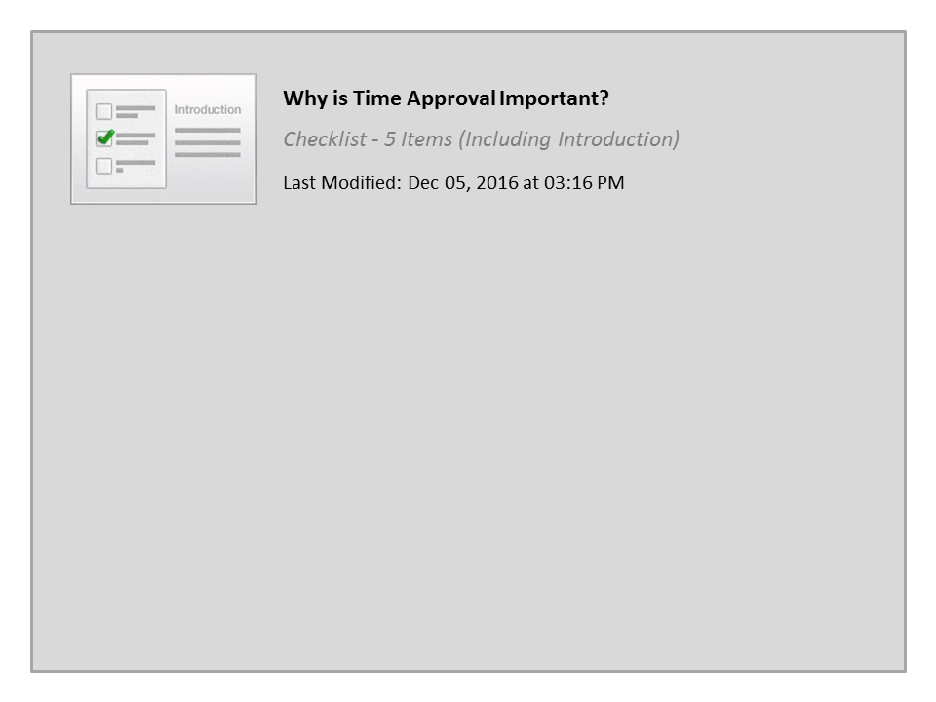
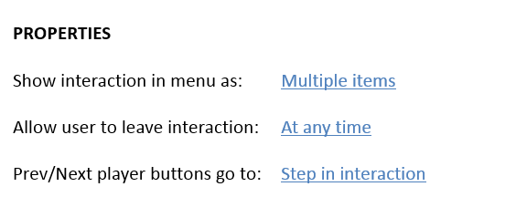


Why is Time Approval Important?

Slide 8

Consequences
Time approval is important to pay our employees:
If time is not approved:
  Permanent Part-time, Winter Permanent Part-time and Temporary Employees may not be paid until the next pay period
  Permanent Full Time are paid based on their work schedule and no overtime will be paid until the next pay period
Supervisors who fail to approve and monitor their employees time may be subject to corrective or disciplinary action
Notes:
In short, time approval is how we know what to pay our employees. For example, If you had a temporary employee start and you did not approve his timesheet on time, he would have to wait an extra two weeks to be paid. This is a hardship on the employee and his family that could have easily been avoided.
For permanent Full Time and Winter Employees not approving overtime would result in the employee not being paid for work they performed. Both of these examples go against CDOTs core values of people and customer service.
Because time approval is a legal requirement, supervisors who fail to approve and monitor their employees time may be subject to corrective or disciplinary action. That being said, this course is designed to provide you with the knowledge and tools you need to make approving time and leave easier.

Slide 9

Course Design
Throughout the course you will be asked to make decisions based on the type of employees you supervise. This has been done to:
Customize the course based on your needs
Shorten the duration of the course
Make additional content available to you should you want to review it based on future needs
Click the button below to continue the course.
Continue
Notes:
Now let’s cover one more thing before moving on to section two. Throughout the course you will see slides like this one that ask you to make a choice about the content you view. Based on the decisions you make the content of the course will be customized to reflect the time entry you would approve for the type of employees you supervise. All you have to do is click on the button based on the directions on the slide. Now let’s get started by clicking on the “Continue” button.

Slide 10
Learning Logistics
Learning Logistics
Section 1 – Course Overview
Section 2 – Introduction to Time and Leave
Section 3 – Approving Working Time
Section 4 – Approving Leave
Section 5 – Approval Deadlines and Issues
Conclusion
Notes:
This section provides you with an overview of time and leave as well as what you need to know as a Supervisor to begin approving time and leave submitted by your employee’s

Slide 11
Section 2 Learning Objectives
At the end of this section, you should be able to:
Describe the role of the Supervisor in the approval process
Describe the Time Entry to Pay process
Recognize different employee groups and subgroups including
  How they are paid
  How they impact time approval and pay
Describe the Work Schedule (why it is important)
Identify additional factors that impact time (Essential Position / Work and Flex Schedule) and which employees are impacted
Describe help resources and what kind of help they can offer (Employee, Timekeeper, Payroll, HR Employees)
Notes:
Upon completing this section you should have an understanding of the objectives on this slide. Please take a minute to review these before you continue. When you are done, click the next button.

Slide 12
Supervisor Responsibilities
The Supervisor has following responsibilities:
Understand and apply time and leave policy
Verify and approve time weekly
Timely respond to timekeepers to correct errors
Balance overtime hours and budget
Request work schedule changes
Notes:
As a supervisor, you are responsible for applying State and Federal laws to verify your employee’s time entry is accurate. You also must approve all time submitted by your employee’s weekly. If asked by a timekeeper to make a change, please do so in a timely manner. You also need to review the timesheet cost elements for impacts to CDOT’s project budgets. Now let’s look at the people who can help you if you have difficulties carrying out you responsibilities.

Slide 13
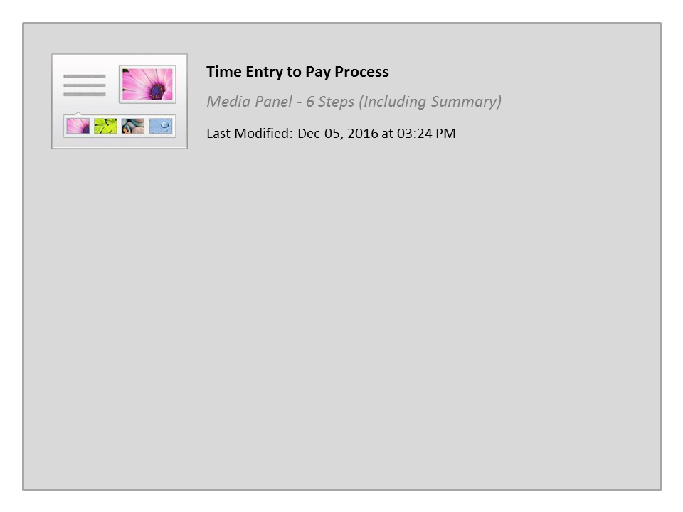
Time Entry to Pay Process

Slide 14

Exempt and Non-Exempt
All CDOT employees fall in one of two groups:
Exempt – Do not get paid overtime
Non-Exempt – Get overtime after 40 hours worked and may be eligible for Shift, On-call and Essential
Notes:
There are a variety of factors that impact the time entered by the employee. Let’s start with Exempt and Non-exempt and why this is important to understand when approving time. Exempt employees and Non-exempt employee are different based on their ability to receive overtime based on over 40 hours worked.
Because Exempt employees do not receive overtime they do not have the ability to enter overtime codes on their timesheet. They can, and should however, enter their actual hours worked.
Non-Exempt employees are also required to enter the times they worked. When they work over forty hours they receive overtime for the hours over forty hours worked. They may also be eligible for Shift, On-call and Essential pay. Because of the additional labor cost you must approve overtime prior to the employee performing the work. When you approve overtime you need to keep a record of it and compare it to the employee’s timesheet.
Additionally, some non-exempt employees are eligible for shift differential, and on-call pay and are considered essential. It is important for you to know which of your employees are eligible for these because overtime may result and impact your budget.

Slide 15
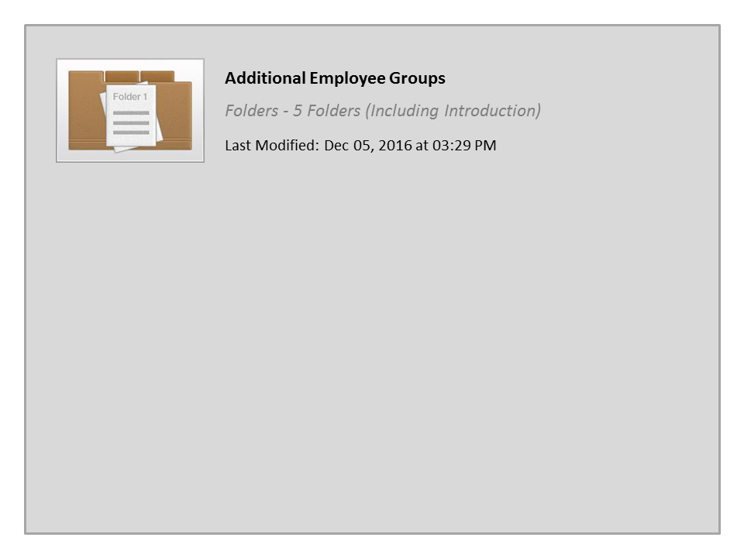
Additional Employee Groups

Slide 16
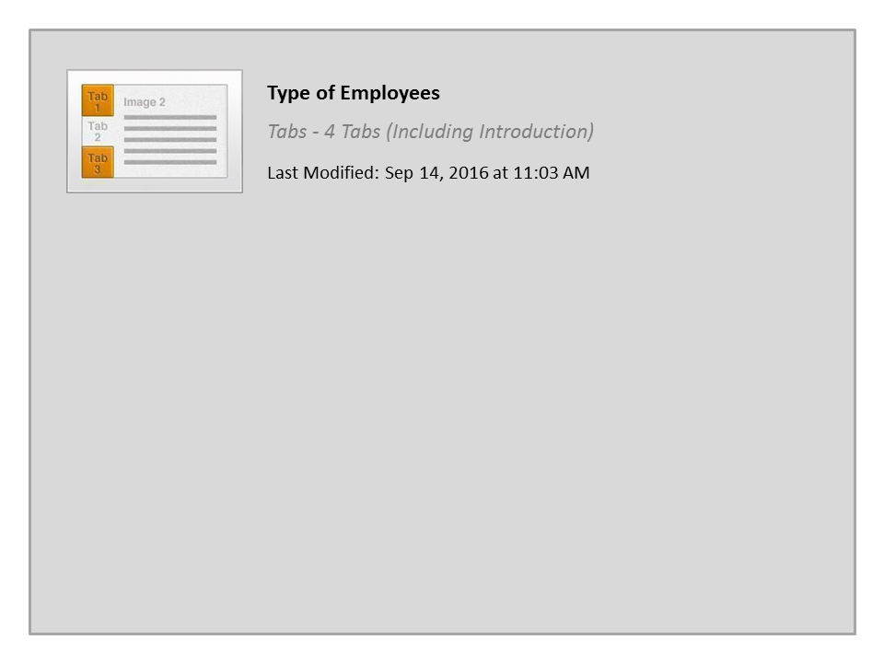
Type of Employees

Slide 17
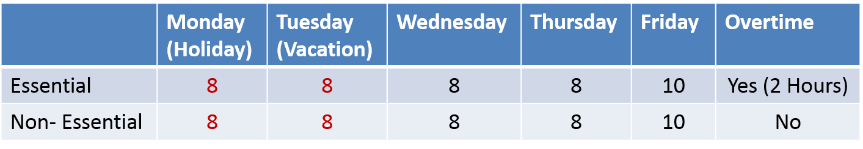
Essential Position / Overtime
Essential - Employee’s holiday and paid leave are included when calculating overtime hours. Essential employees are:
  All non-exempt Maintenance Employees
  Anyone designated by the appointing authority (see PD 1230.2)
Non-Essential – Must physically work 40 hours before overtime
 | Monday (Holiday) | Tuesday (Vacation) | Wednesday | Thursday | Friday | Overtime
Essential | 8 | 8 | 8 | 8 | 10 | Yes (2 Hours)
Non- Essential | 8 | 8 | 8 | 8 | 10 | No
Notes:
Knowing whether or not your employee is essential is critical in understanding how to review overtime for approval.
For a position to have been designated by the Appointing Authority as essential to achieving the mission of CDOT the position must have a job assignment that is critical to the health, safety and welfare of the citizens of Colorado. This designation must occur before the work is performed and cannot be done retroactively additionally it is only for non-exempt positions.
Now let’s take a look at Essential Positions and work. As a rule, CDOT employees are not able to use their holiday and paid leave towards overtime unless the employee is essential. Take a look at the hours worked on the slide for a full-time employee. The employee worked a five work week that included a holiday on Monday, and vacation on Tuesday and 2 extra hours on Friday. For essential positions, because holidays and leave are treated the same so they are included in the calculation towards overtime and are called essential work. For the non-essential employee, the above calculation would only result in 26 hours worked so the 2 extra hours on Friday are not counted as overtime.

Slide 18
Shift Differential
Shift Differential is additional pay for some employees who work the majority of hours in second or third shift:
  Second shift falls between 16:00 and 23:00
  Third shift falls between 23:00 and 06:00
  For unscheduled hours, the shift rate is paid hour for hour
  Does not apply to holiday or paid leave
Who is eligible for shift work?
  All non-exempt Maintenance employees
  Additional non-exempt positions identified in the Annual Compensation Plan
  Any other non-exempt position designated by the Division Director or RTD
Notes:
Now let’s look at the shift differential. Knowing whether or not you have employees who are eligible for a shift differential is important as it may impact your budget. Only non-exempt employees are potentially eligible for shift differentials. If your employee is eligible, be aware that any time worked outside of regularly scheduled hours may impact your budget because shift is paid hour for hour. For example, you have an employee who is eligible for shift differential who is scheduled to work from 8:00am to 5:00pm. The shift differential would not paid, since the majority of the was performed during the first shift. If the same employee worked past 5:00pm, the shift rate would be paid up to 11:00pm.

Slide 19
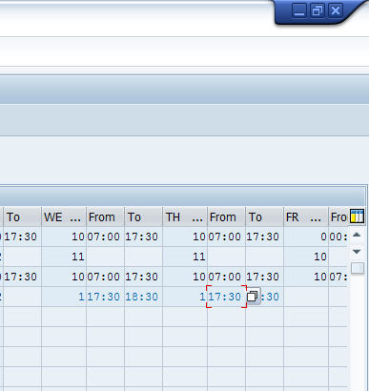
Work Schedule And Time Entry
All CDOT employees have a work schedule in SAP. The work schedule:
Starts Saturday 12:00AM
Represents the hours the employee should work
Unscheduled time are hours outside the employee’s schedule
For all employees can be reviewed using the Work Schedule Report.
Notes:
Now let’s talk about the Work Schedule. All employees at CDOT have an assigned work schedule that is loaded into SAP. The work schedule starts Saturday 12:00AM, except for employees who are on flex schedules. It represents the time the employee is expected to be at work or account for using leave. When an employee works outside of their work schedule, and they are not exempt, they may become eligible for overtime or shift differential. As a supervisor, it is your responsibility to ensure the work schedule is accurate. It is also your responsibility to understand how time worked outside of the work schedule may impact your budget. If you are uncertain of your employee’s work schedule, click on the Resources tab and select the Work Schedule Report to view their work schedule of your employee.

Slide 20

Help Resources
Employee
Change timesheet (bi-weekly within 2 weeks / Monthly within 5 weeks)
Timekeepers
Answer questions about time
Time entry for absent employees
Correcting errors (within 12 weeks)
Payroll
Answer questions regarding timesheet errors and approve deadlines
HR
FLSA rules and access to approve time in SAP
Notes:
Now let’s look at the resources available to help you with time entry and approval. The first resource is your timekeeper who can answer any questions you may have about time. They are also able to help you with time entry when an employee is absent and correcting errors on the timesheet. Click on the resources link for a list of timekeepers in the work schedule report.
Payroll is also available to help. Payroll works with your timekeeper to resolve timesheet issues and answer questions about pay. Click on the resources link to go to their webpage. If you have not already done so, you can bookmark this site by clicking “control D”. The site contains Frequently asked questions, details about the leave without pay process, monthly and biweekly pay schedules, and information about the how to make timesheet revisions.
In some cases, you may need to contact HR for help. HR is able to answer questions regarding time and leave rules, policies and procedures. They can also assist if you are unable or having difficulty approving time in SAP.

Slide 21
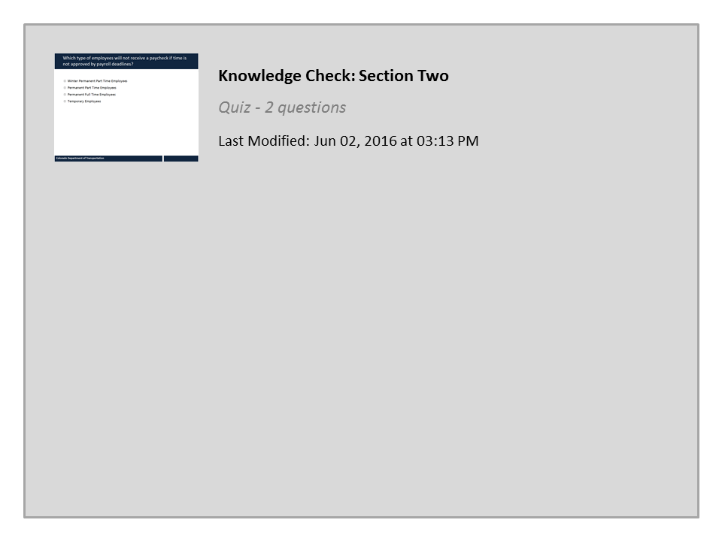
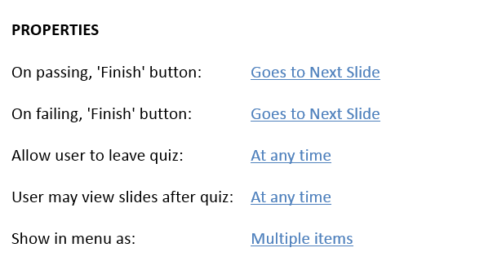

Knowledge Check: Section Two

Slide 22
Learning Logistics
Learning Logistics
Section 1 – Course Overview
Section 2 – Introduction to Time and Leave
Section 3 – Approving Working Time
Section 4 – Approving Leave
Section 5 – Approval Deadlines and Issues
Conclusion
Notes:
The Approving Working Time section explains the process of approving attendances in detail and how to review the timesheets of your employees for accuracy.

Slide 23
Section 3 Learning Objectives
At the end of this section, you should be able to:
Identify if time entries on the timesheet are entered correctly
Determine if an employee has accounted for all working time
Evaluate timesheet to identify when an employee is eligible to earn overtime, comp time and alternate holiday
Understand when wage types should be used and evaluate if they are correct on the timesheet
Understand budget impact as a result of approving working time (shift differential during unscheduled hours, overtime, etc.)
Understand rules and policy associated with working time entry (Regular time, overtime, comp time, alternate holiday)
Notes:
Upon completing this section you should have a understanding of the objectives on this slide. Please take a minute to review these before you continue. When you are done click the next button. Remember you can use the menu to the right to navigate back to a section or a specific slide within a section.

Slide 24
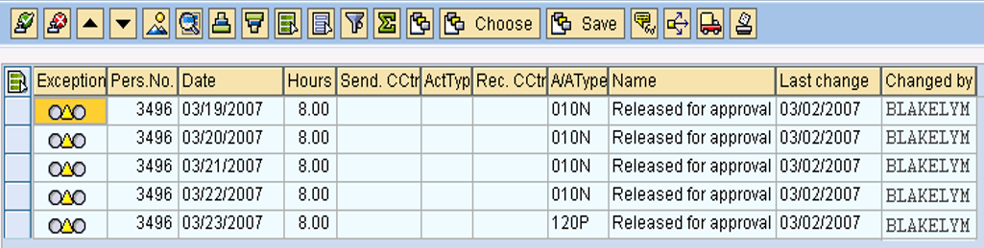
Regular Time
When entering time ALL Employees need to account for their regular time based upon their:
Work Schedule (hours assigned to the employee)
  Work week including leave (from Saturday 00:00 – to Friday 24:00)
Work Schedule Report
CAPP
Notes:
Now let’s look at regular time. All employees need to account for their regular working time based on their Work Schedule and their work week. The Work schedule represents the hours the employee is assigned to work. In the example, you can see the work schedule is from 08:00 to 16:30 Monday through Friday with half hour lunch from 12 to 12:30. Because the employee is a full-time employee they must account for 40 hours a week.
In most cases the work week starts at midnight Saturday and goes until Friday at 11:59 Friday. Full time employees are required to account for 40 hours every week. The work week and work schedule are important because they dictate when the employee should code working time, leave, and overtime and determine shift pay. Working time should always be recorded based on the hours actually work even if this is outside of the planned working schedule.

Slide 25

Regular Time
When approving regular time:
You must approve any variations to the planned work schedule
Exempt Employees can work more than 40 hours a week, but do not earn overtime
Working time should not be approved prior to being worked
Notes:
When working with regular time evaluate any deviations from the work schedule. This is done because it may impact on your budget if the employee is paid for overtime. When approving time be aware that exempt employees cannot earn overtime. Finally employees should only enter the hours they have worked on their timesheet and you should only approve hours the employee has actually worked.
Now let’s practice on how to approve regular time.

Slide 26
Notes:
See script in file.

Slide 27

Evaluate Time Approval
Choose the button that represents the type employees you approve time for:
Note: You may have to review multiple sections if you have more than one type of employee
When you have reviewed the sections for the types of employees you supervise click Continue.
Maintenance
Engineering
General
Continue
Notes:
Now let’s take a look at the time sheets for different employees. Click on the button for the type of employees you approve time for the most, if your employees are not maintenance or engineering, select general. Don’t worry if you have more than one type of employee, as you will be returned to the page and can select another type of Employee. When you are done viewing the timesheets for the employees you supervise, click the continue button for a chance to practice what you have learned so far.

Slide 28
Types of Time Entered by Maintenance
A Work Order
  Used to provide MLOS budget with real time data
  Includes the work order number, an activity number, and a work center number, A/A type and working time
Cost Center
  Can be used to record administrative work, such as training or admin work
  Includes the work order number, an activity number, and a work center number, and A/A type and working time
On Call
  Used only to record time the employee was on call
  Includes the cost center, receiving functional area, wage type 4099 and hour on call
Notes:
The majority of maintenance employees record time against a corresponding work order. The connection between the timesheet and the work order provides the MLOS budget with real time data. A work order time entry includes the work order number, an activity number, and a work center number. As with all employee types, the A/A type needs to be entered correctly. An exception to the required A/A type is on call entries. These require a Cost Center and Receiving Functional Area. All on call entries are charged to the Wage Type 4099. Now let’s look at the dates and time worked.

Slide 29
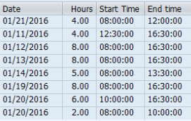
Date, Hours and Start/End Time
Regardless of the type of working time entry, all employees enter the following:
The Date, Hours and Start and End Time fields should match the work schedule of the Employee.
When reviewing these fields ask yourself:
  Does the Date, Hours and Start and End time fields match the actual time the employee worked?
  Does the time match the Employee's work schedule?
  If not, have I approved and documented the change?
Notes:
All timesheets require a date, number of hours worked and the time the employee started and ended work. As a Supervisor it is your responsibility to approve and document any changes to the work schedule of you Employees. If the Timesheet does not match with your understanding of the working time of the employee, you need to reject the time. Now let's look at A/A Types.

Slide 30
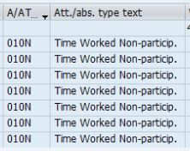
A/A Type
The A/A type is applicable when and employee is charging working time to Work Order or Cost Center:
The first three numbers (010N) indicate the type of working time or leave
Verify employee “P” (010P) participating and “N” (010N) Nonparticipating is correct
When reviewing the A/A Type check:
  Does the grant allow for the type of attendance?
  Did you approve regular working time?
Notes:
Attendance Absence Types are used to describe how the employee spent their time at work or what kind of absence they took. A/A Types are only applicable to time enter against a work order and a cost center.
When reviewing A/A Types pay close attention to how the Employee coded the Attendance or Absence. It must match up with any approvals you have given for Overtime. Comp Time, or additional working time. Now let’s review the types of time entered by Maintenance employees and what to look for when you are reviewing their timesheet.

Slide 31
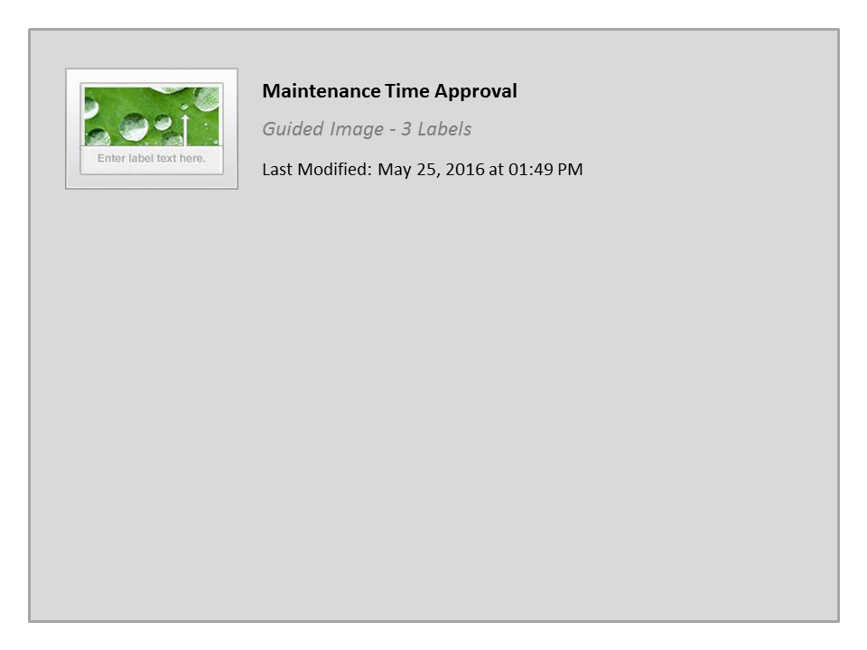
Maintenance Time Approval

Slide 32
Evaluate Time Approval
Choose the button that represents the type employees you approve time for:
Note: You may have to review multiple sections if you have more than one type of employee
When you have reviewed the sections for the types of employees you supervise click Continue.
Maintenance
Engineering
General
Continue
Notes:
If you have any other types of employees that you approved time for select the button for that type of employee. If not, click the continue button to practice what you have learned so far.

Slide 33
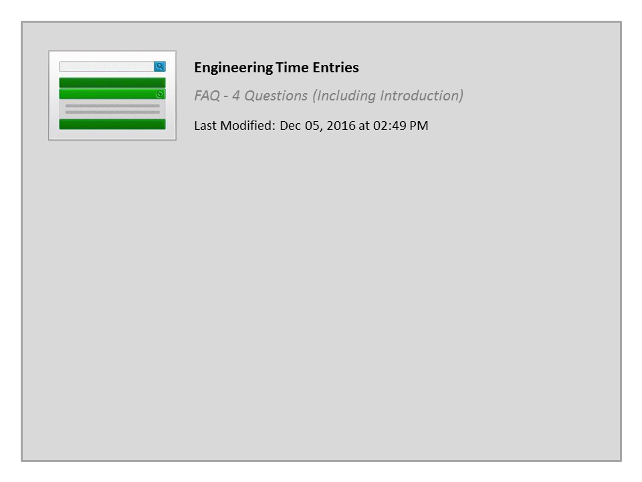
Engineering Time Entries

Slide 34
Date, Hours and Start/End Time
Regardless of the type of working time entry, all employees enter the following:
The Date, Hours and Start and End Time fields should match the work schedule of the Employee.
When reviewing these fields ask yourself:
  Does the Date, Hours and Start and End time fields match the actual time the employee worked?
  Does the time match the Employee's work schedule?
  If not, have I approved and documented the change?
Notes:
All timesheets require a date, number of hours worked and the time the employee started and ended work. As a Supervisor it is your responsibility to approve and document any changes to the work schedule of you Employees. If the Timesheet does not match with your understanding of the working time of the employee, you need to reject the time. Now let's look at A/A Types.

Slide 35
A/A Type
The A/A type is always required:
The first three numbers (011P) indicate the type of working time or leave
Verify employee “P” (011P) participating and “N” (011N) Nonparticipating is correct
When reviewing the A/A Type check:
  Did you approve regular working time?
  Is the employee eligible to use the A/A type?
Notes:
Attendance Absence Types are used to describe how the employee spent their time at work or what kind of absence they took.
When reviewing A/A Types pay close attention to how the Employee coded the Attendance. It must match up with any approvals you have given for Overtime. Comp Time, or additional working time. Now let’s review the types of time entered by Engineering employees and what to look for when you are reviewing their timesheet.

Slide 36
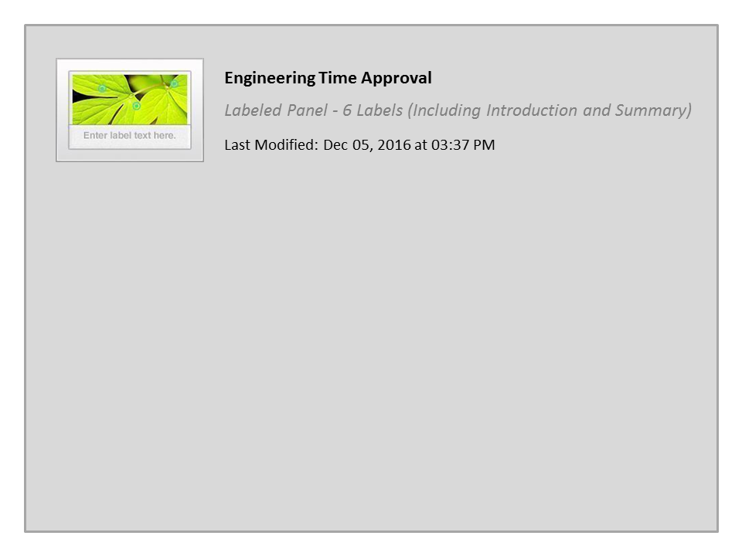
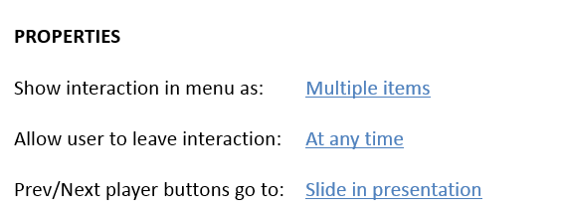
Engineering Time Approval

Slide 37
Evaluate Time Approval
Choose the button that represents the type employees you approve time for:
Note: You may have to review multiple sections if you have more than one type of employee
When you have reviewed the sections for the types of employees you supervise click Continue.
Maintenance
Engineering
General
Continue
Notes:
If you have any other types of employees that you approved time for select the button for that type of employee. If not, click the continue button to practice what you have learned so far.

Slide 38
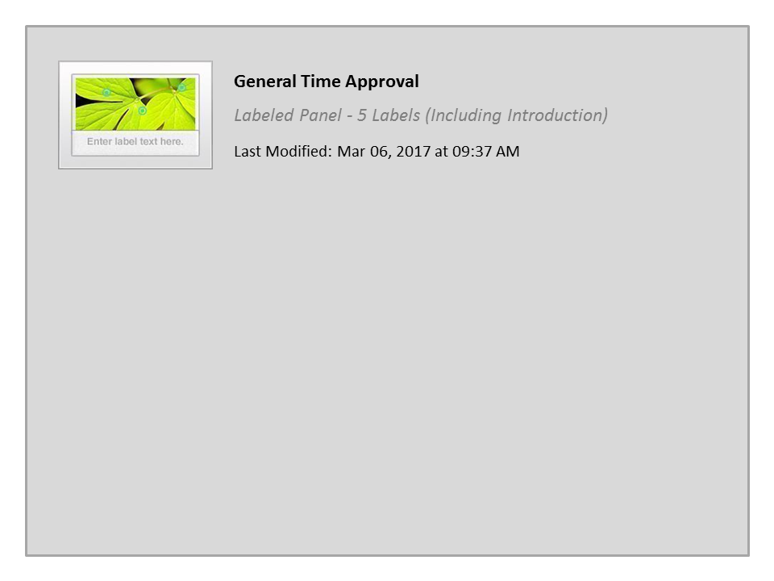
General Time Approval

Slide 39
Evaluate Time Approval
Choose the button that represents the type employees you approve time for:
Note: You may have to review multiple sections if you have more than one type of employee
When you have reviewed the sections for the types of employees you supervise click Continue.
Maintenance
Engineering
General
Continue
Notes:
If you have any other types of employees that you approved time for select the button for that type of employee. If not, click the continue button to practice what you have learned so far.

Slide 40
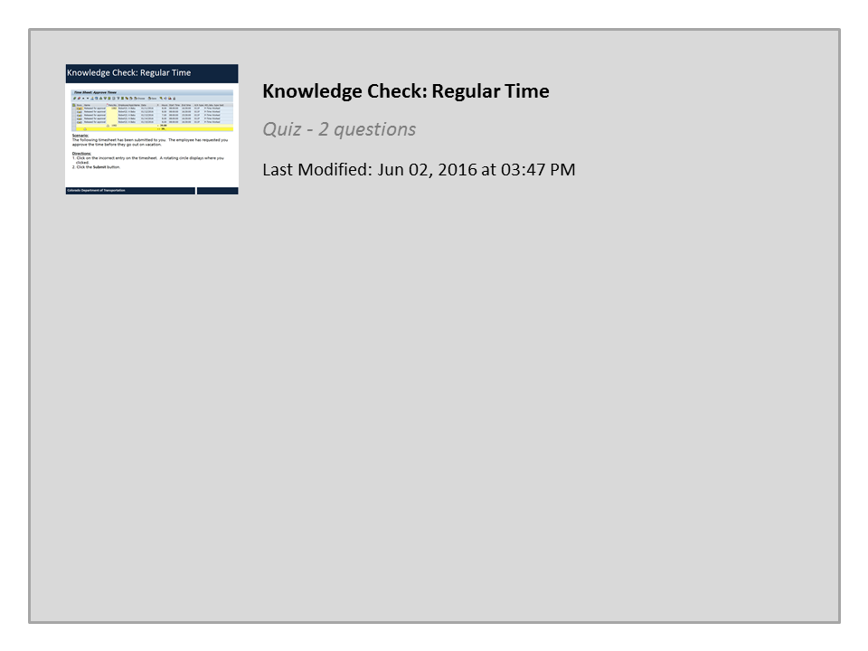
Knowledge Check: Regular Time

Slide 41

Premium Pay
To be eligible for shift premium pay an Employee must meet ALL of the following criteria:
Non-Exempt
Eligible for a shift pay differential
Assigned to 2nd or 3rd shift work schedule
Do you have one or more non-exempt employees
eligible for a shift pay?
Yes
No
Notes:
Now let’s look at premium pay employees. If you manage Employees who are Eligible for premium pay click the “Yes” button to continue. If you manage only first shift you can skip this section by clicking the “No”. You will be taken to the next section.

Slide 42
Premium Pay
Employee who regularly work 2nd or 3rd shift can be paid when they work 1st shift when:
The event is qualifying (Remembrance, Safety Events, Employee Appreciation, mandatory meetings and training)
The hours coded match the hours of the event
Approval is obtained prior to the event
The shift premium is not applied for:
Overtime for non-qualifying events
Snow Shift
Notes:
Employees who are scheduled to work 2nd or 3rd shift but work 1st shift due to a qualifying event taking place between the hours of 6AM and 4PM may be eligible to receive shift pay for the hours worked on 1st shift. Examples of qualifying events are Safety meetings, mandatory trainings, and Remembrance events. Mandatory overtime due to snow or other routine maintenance operations is not eligible for the shift premium. When approving shift premium, be sure to verify that the hours worked on 1st shift are for a qualifying event and the hours coded to the wage type match the number of the hours worked for the qualifying event. For more information on shift premium, including how it is entered by the employee, click on the resources link and select the document titled Shift Premium.

Slide 43
Overtime
An Employee’s eligibility for overtime is based on their position
Exempt Employees are not eligible for overtime compensation for over 40 hours worked
Non-Exempt Employees are eligible for overtime or comp time for over 40 hours worked
Do you have one or more Employees eligible for Overtime?
Yes
No
Notes:
Now let’s look at Overtime. If you manage Employees who are Eligible for overtime click the “Yes” button to continue and learn about overtime. If you manage only Exempt Employees you can skip this section by clicking the “No” button this will take you to the next topic, Exempt time off.

Slide 44
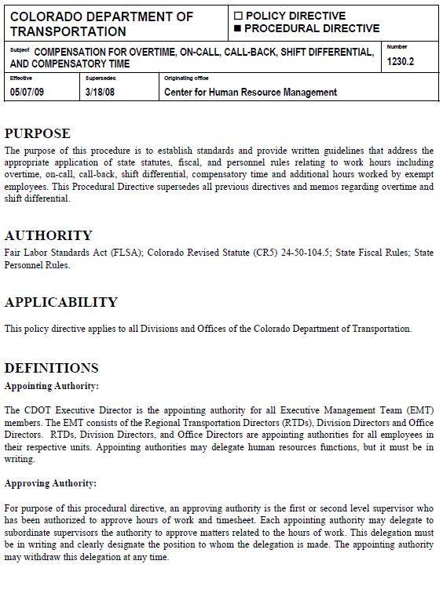
Overtime
Overtime is covered in the following PDs
1230.0 Work and Overtime Compensation
1230.2 Compensation for Overtime, On-call, Call Back Shift Differentials and Compensatory Time
Overtime occurs when:
An employee’s physical working time exceeds 40 hours in a week or
An essential employee enters more than 40 hours of combined working time and leave in one week
Notes:
Now let’s look at approving overtime. If you have not already done so, review PD 1230.0 and 1230.2 which can be found by clicking on the resources link above. Overtime occurs when a non-exempt employee physically works more than 40 hours or an essential employee works or codes more than 40 hours in a work week. The work week is defined as starting at midnight Saturday and ends at 11:59 Friday with the exception of employees on Flex Schedules. Now let’s look at overtime in more detail.

Slide 45
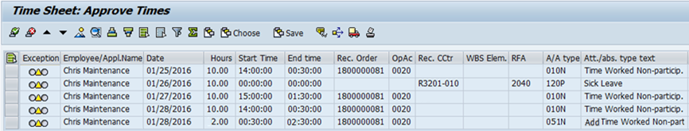
Approving Overtime (Non-essential)
When approving overtime for non-essential employees:
Review the entire work week of the employee
Confirm overtime is authorized
Ensure leave does not count for overtime
Confirm all overtime is entered as 014P or 014N A/A Type
Notes:
So what constitutes overtime for non-essential employees. Employees must physically work 40 hours before overtime is paid. Take a moment to review the screenshot of the CAPP transaction. Overtime must be authorized prior to the Employee working overtime, but this does not tell the whole story. When approving overtime you should always look at the entire week because overtime is based on the work week and not by the number of hours worked during a single day. While you are doing this you should also review any approvals for overtime you have made during the week.
Just because time is worked outside of an employee’s planned work schedule, does not mean overtime should be paid, as the example on line three of the CAPP transaction shows. When an employee is non-essential and codes the leave it is not counted towards the total for overtime. And finally, the A/A types you should be looking for when approving overtime are 014P and 014N . Now let’s look at approving overtime for Essential Employees.

Slide 46
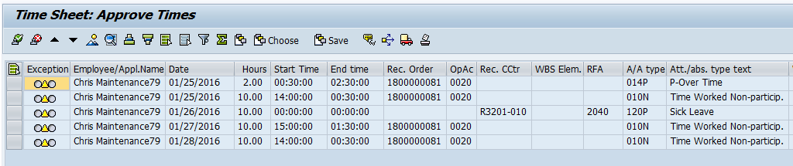
Approving Overtime (Essential)
When approving overtime for essential employees:
Review the entire work week of the employee
Confirm overtime is authorized
Confirm all overtime is entered as 014P or 014N A/A Type
Remember leave counts towards overtime
Ensure Comp time does not count towards overtime
Notes:
Take a look at the example of CAPP transaction screen for an essential employee. Just like for Non-essential employees you should check the time worked during the work week, any approval you made have made and the correct Attendance Absence type is entered. The main difference between Essential and Non-Essential employee is that leave counts towards overtime for Essential employees. For example, the sick leave the Employee took on line three counts towards overtime. If the leave were taken as comp time, instead of sick, then this would not have counted. Now let’s practice looking at overtime.

Slide 47
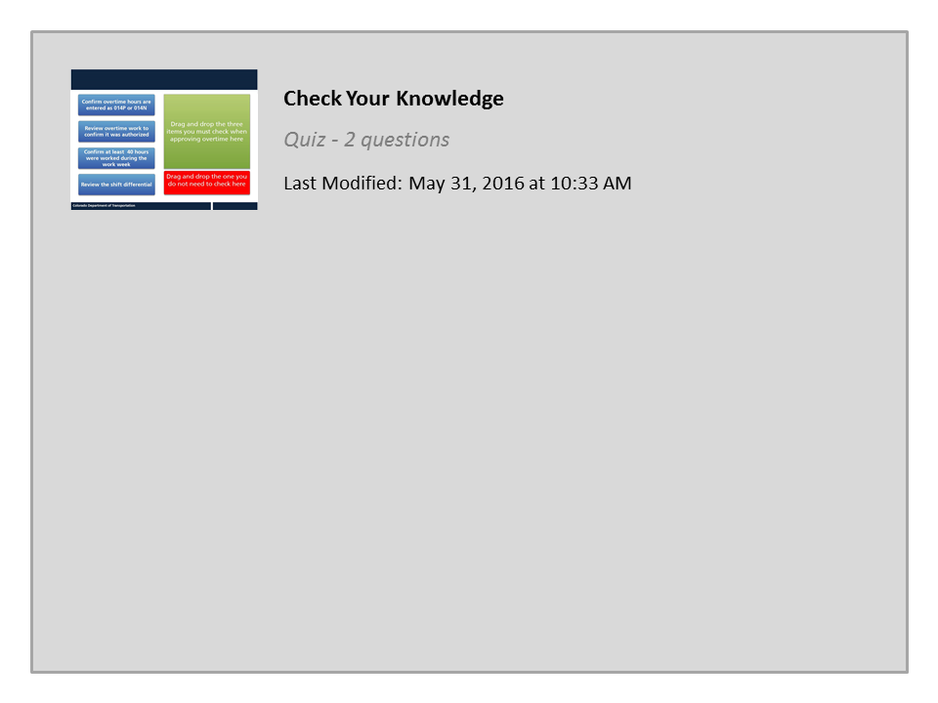
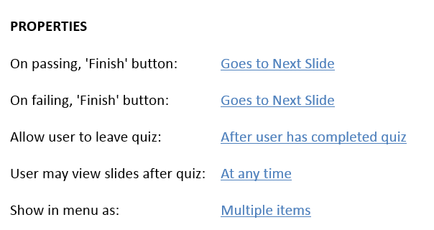
Check Your Knowledge
Notes:
Regardless

Slide 48
Compensatory Time
To be eligible for Comp Time an Employee must be:
Non-Exempt
Have a Compensatory Time Agreement in place
Do you have one or more Non-Exempt Employees
eligible Compensatory Time?
Yes
No
Notes:
Now let’s look at Comp time. If you manage Employees who are Eligible for comp time click the “Yes” button to continue and learn about compensatory time. If you manage only Exempt Employees you can skip this section by clicking the “No”. You will be taken to a description of Exempt Time Off

Slide 49
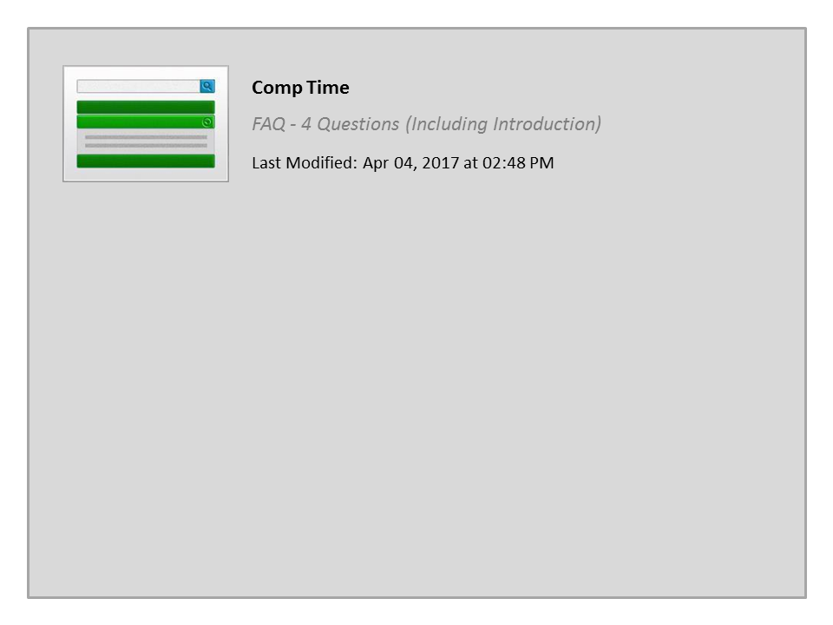
Comp Time

Slide 50
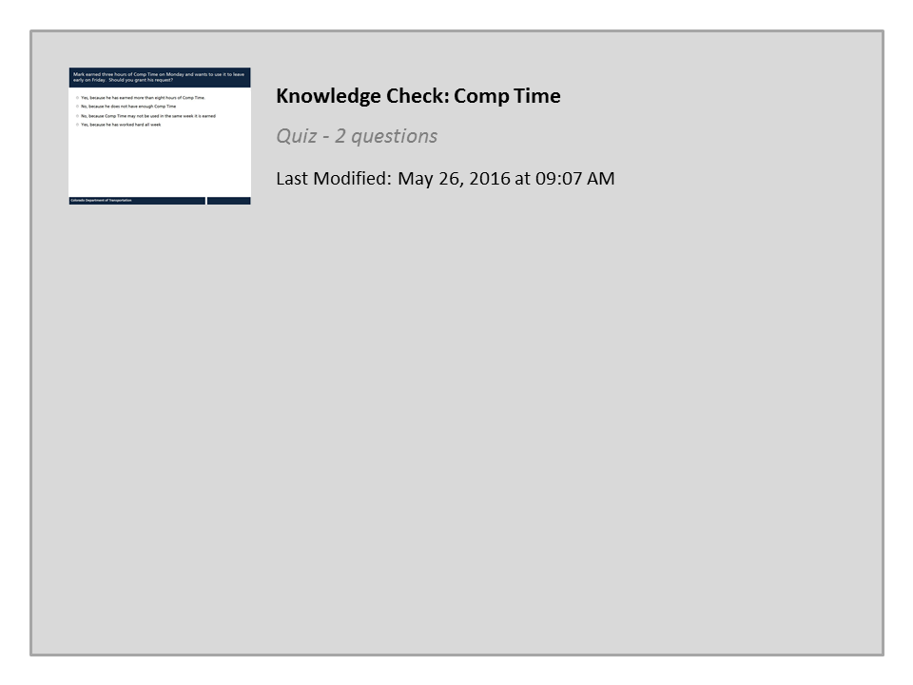
Knowledge Check: Comp Time

Slide 51
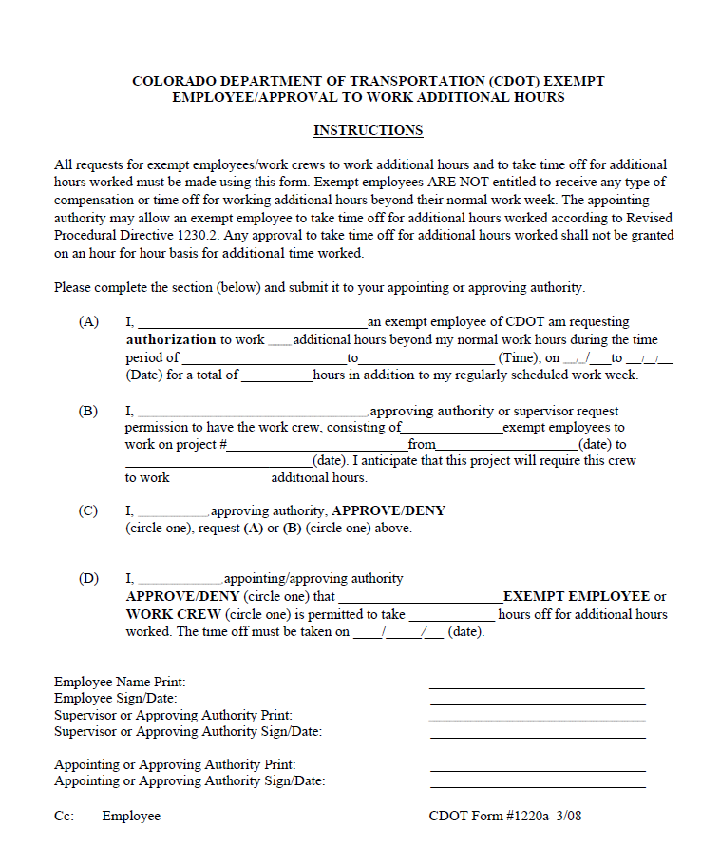
Exempt Time Off
Exempt Time Off:
Only earned by exempt employees
Can be earned when significant additional hours have been worked in a week
An agreement must be in place prior to the work performed (unless an Emergency)
Exempt Time Off is:
At the discretion of the Appointing Authority
Not awarded hour by hour
Is not tracked in SAP or paid out
Coded as regular working time when earned
Click HERE to view PD 1230.2 (page 8)
Notes:
The Fair Labor Standards Act prevents exempt employees from earning comp time or overtime pay for working more than 40 hours in a work week. However, CDOT, at the discretion of the Appointing Authority, can recognize exempt employees who work significant additional hours during a work week using Exempt Time Off. This is not awarded hour for hour and requires the submittal of CDOT form 1220(a) prior to the work being completed. If awarded the exempt time off is entered as regular time. Exempt time off earned is not tracked in SAP and no quota is created. Supervisors are responsible for how many hours are used based on the agreement and tracking their use. Now lets do a quick knowledge check before proceeding to section four.

Slide 52
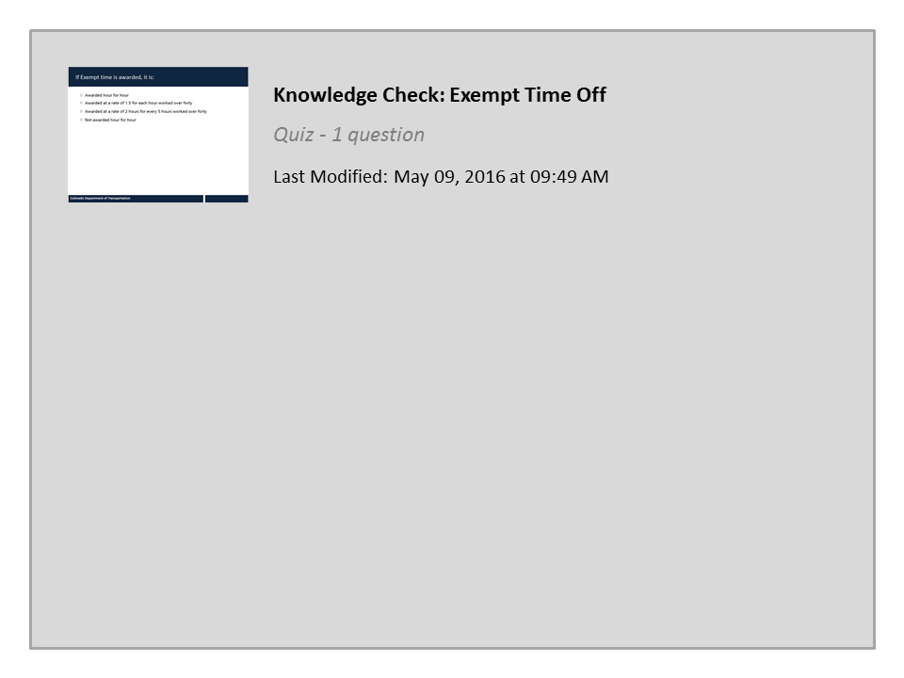
Knowledge Check: Exempt Time Off

Slide 53
Learning Logistics
Learning Logistics
Section 1 – Course Overview
Section 2 – Introduction to Time and Leave
Section 3 – Approving Working Time
Section 4 – Approving Leave
Section 5 – Approval Deadlines and Issues
Conclusion
Notes:
Approving Leave covers the different types of leave an employee is able to take and what to review when approving leave.

Slide 54
Section 4 Learning Objectives
At the end of this section, you should be able to:
Describe expectations about using leave to employees
Describe the leave request process
Evaluate timesheet and approve leave entries including number of hours, A/A Type is accurate and employee is eligible for leave
Identify the types of leave that require additional process steps before approval
Understand how leave approval impacts quota banks
Utilize the leave summary report and annual use or lose report
Understand the budget impact of approving leave
Describe resources available to Supervisors by leave type
Notes:
Notes:
Take a moment to review the learning objective for approving leave. When you are done, click the Continue button to go to the next page of the course.

Slide 55
Communication of Leave Expectations
You must communicate the following to your employees
Who to call when they are sick
When to request annual leave
Your expectations for covering holidays
How comp time is used
  Maintenance and Tunnel – Limited to 16 hours and is paid out end of fiscal year
  Non-maintenance – Limited to 40 hours and is carried over each fiscal year
Notes:
The first step in the leave process is for employees to understand the expectations about leave entry and when it is entered. For example, when an employee is sick, should they call you or should they call a central timekeeper? How far in advance should your employee’s notify you of their annual leave and how will you cover holidays? This is especially true of comp time because unused comp time, if not used, may impact your budget. Now let’s take a look at the leave request process.

Slide 56
Leave Request Process
SAP sends Employee email
Appointing Authority receives email and approves or rejects request
Employee discusses leave with Supervisor
Rejects
Yes
Approves
Is Admin or unpaid leave requested?
Employee enters and verifies leave request
SAP verifies leave Quota for requested leave
Employee enters corrections and releases and saves request
SAP adjusts leave bank as applicable
No
Approves
Supervisor receives email and approves or rejects request
Rejects
SAP sends Employee email
Notes:
The first step in the leave request process is for the employee to discuss their leave with their Supervisor. Once the time is agreed upon the Employee submits their leave request in SAP. SAP then verifies the request for adequate leave. The employee makes changes, if required, and submits and releases the request. The leave cannot be approved if it is not released. Depending on the request, the supervisor or appointing authority is sent an email for approval. It should be approved or denied within one week. When approved or rejected, SAP sends an email to the employee. If applicable, the leave balance of the employee is adjusted. Now let’s learn about the types of leave you can approve as a supervisor.

Slide 57
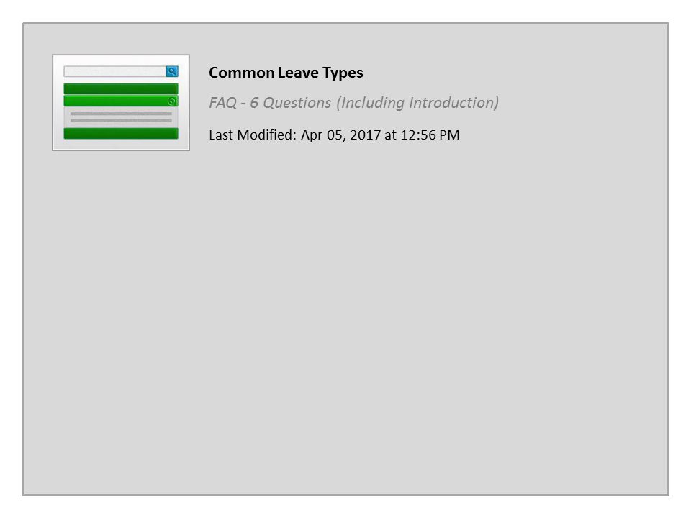
Common Leave Types

Slide 58
Approving Leave
When approving leave validate the:
Employee is eligible for the absence type entered
Leave entered is not used before it is accrued, earned and/or authorized
Number of hours entered is accurate
Notes:
When approving leave you must validate that the employee is eligible for the leave, it is not used before it is accrued and the number of hours match with the type of leave being taken.

Slide 59

Leave Approval and Quota Banks
The employee’s quota is only reduced once you approve the leave. This means an employee:
Can send a leave request against future leave
Cannot use leave unless it has been earned
An employee must zero out the leave if the request is canceled after it is approved
Supervisor must approve zeroed leave enter to restore the quota
Notes:
And one last thing before we go into leave and the fiscal year end. When an employee submits leave, it does not reduce the quota until you have approved the leave. For example, if an employee has 24 hours of annual leave and submits a request one month in advance. If you were to approve it right away then the employee’s balance would be reduced to zero and no leave could be taken for the month, once time evaluation occurred.
It is for this reason, that you need to balance your scheduling needs with the needs of your employees when approving requests. Now let’s look at the absence quota report.

Slide 60
Notes:
The Absence Quotas is useful to help review the leave balances available to the employee and for making a decision about what to do when two employees have request leave at the same time. The Absence Quotas report is accessed from the MSS tab of Manager Self-service so let’s start here and then clicking on the Absence Quotas link.
This takes you to the Launch Reports screen. From here you can choose your selection criteria. It is best to always go with today as the period, to prevent historical data from displaying. Under display it is showing direct reports, but if you are a level 2 or 3 you could display all of your employees or all organization units. Now let’s select the employee you want to display leave balances for. In this example, Les Pearson so select the box to the left of his name.
The record is now highlighted, so click the launch reports button in the upper left of the screen.
The Absence Quota Information report for Les Pearson displays. Let’s start by looking at annual leave. There are two rows for annual leave the current entitlement of 28 hours and he has not used or requested any leave. He also has a carryover of 336 hours which is the maximum for his entitlement. To use all of his annual leave which accrues at 14 hours a month he will have to take 168 hours of vacation by the end of July. In this example it is only September, but you might want to talk to Les about this so the time he takes off doesn’t impact your team and he does not lose the leave.
Now let’s look at the budget impact of leave approval.

Slide 61
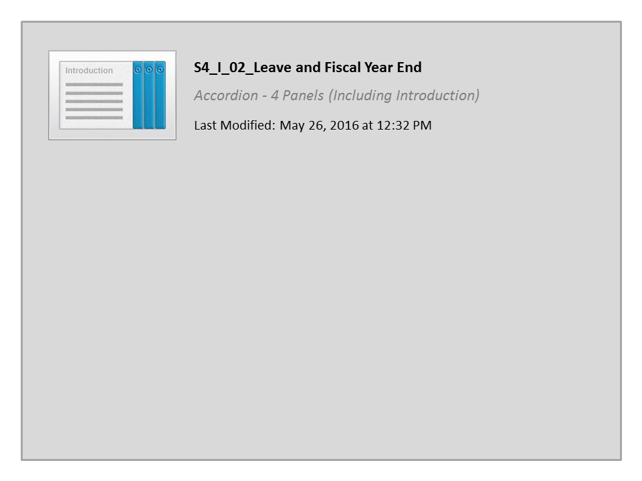
S4_I_02_Leave and Fiscal Year End

Slide 62
Notes:
Now let’s review how to use access and use the Annual Leave Use or Lose report. In this example you Employee NAME has traditionally not taken a lot of vacation and because he has worked for CDOT for 10 years you know he is close to, or over on his annual leave. You are already logged on to the SAP Portal. Start by clicking on the MSS tab and then select the Reports link. This takes you to all of the Reports you have available to you as a supervisor. Now click on the Use or Lose Report link. The report is always run with the as of today date. You also want to display all of the direct reports, just in case another employee is in the same situation as NAME so you use the table selection menu to select all of the employees that report to you and launch the report. The results are just as you expected, you will have to closely monitor NAME leave as he will be XXXX hours over by the end of the year. This is because he has already reached the maximum accrual of XXXX and his projected accrual of XXXX means that he will have to use XXXX hours of annual leave or be at risk of use or lose. Now let’s look at how the different types of leave impact your budget.
USE THE MSS VERSION

Slide 63

Budget Impacts of Leave Approval
  All costs associated with paid leave are charged to the employee’s home cost center
  Potential leave types that may be paid out include:
    Annual leave (130P)
    Sick (120P)
    Alternate holiday (141P)
    Comp time (110P)
Notes:
Employee absences are automatically charged to their home cost center. When approving leave, pay attention to the Attendance Absence types above 100 and which are leave. A/A types ending in “U” are unpaid and should only be approved by the Appointing Authority. And remember, if any leave is paid out to the employee this will be funded from the employee’s home cost center and impacts your budget.
Now let’s take a look at where you can go for help with leave approval.

Slide 64
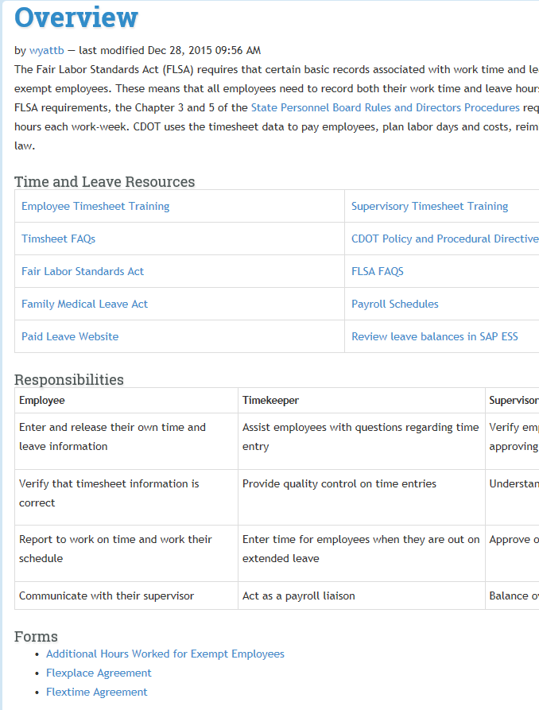
Leave Approval Help
Available links to help resources:
CDOT’s Time and Leave webpage
Timekeepers for general leave questions
FML Liaisons for FML
Risk Management for injury leave questions
Leave calculators
Notes:
The time approval process can be tricky because of the number of rules and policies involved. This is especially true for FML, injury, medical and administrative leave. The first resource you can go to to get help is the website. If you do not find the answer you need, contact the help resource based on the type of help you are requesting.

Slide 65
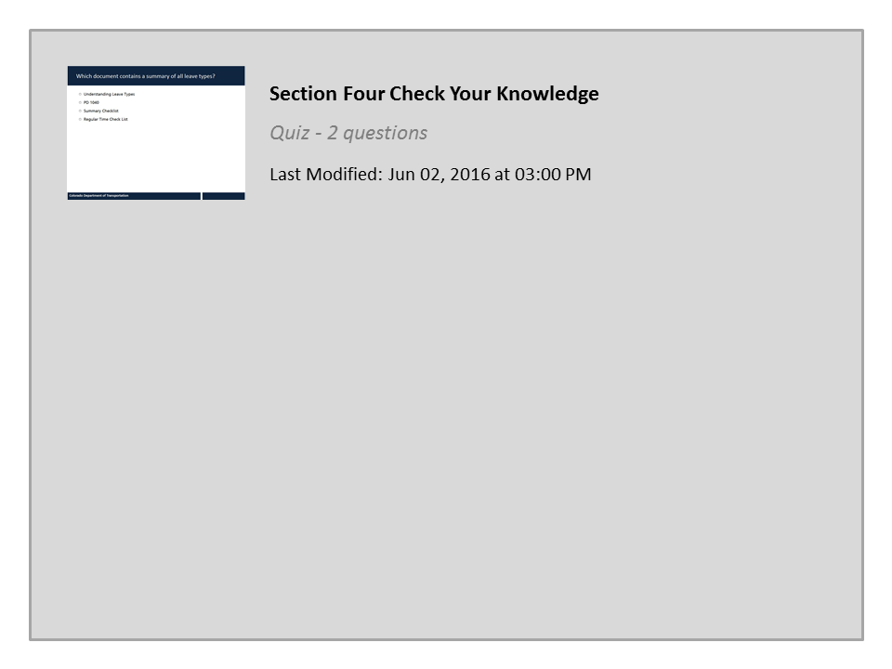
Section Four Check Your Knowledge

Slide 66
Learning Logistics
Learning Logistics
Section 1 – Course Overview
Section 2 – Introduction to Time and Leave
Section 3 – Approving Working Time
Section 4 – Approving Leave
Section 5 – Approval Deadlines and Issues
Conclusion
Notes:
This section covers approval deadlines and some of the issues you may encounter when approving time.

Slide 67
Section 5 Learning Objectives
At the end of this section, you should be able to:
Describe the timeline for time approval and changes to errors in the timesheet
Identify what collisions on the timesheet mean and how to trouble shoot them
Describe when an employee work schedule needs to be changed
Notes:
Upon completing this section you should have a understanding of the objectives on this slide. Please take a minute to review these before you continue. When you are done click the next button to review the time approval deadlines. And remember, you can use the menu to the right to navigate back to a section or a specific slide within a section.

Slide 68
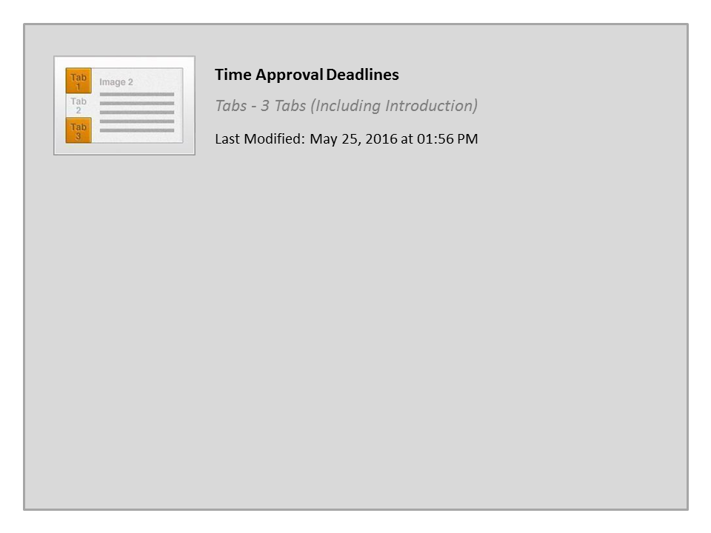
Time Approval Deadlines

Slide 69

Reminder
The best way to remember, is to set up a reoccurring appointment on your calendar to approve working time.
Notes:
Because Mondays are busy it would be a good idea to create an weekly reoccurring appointment to approve your employee’s timesheets. This is not only serves as a reminder, it sets the time aside for you. Now let’s look at time collisions.

Slide 70
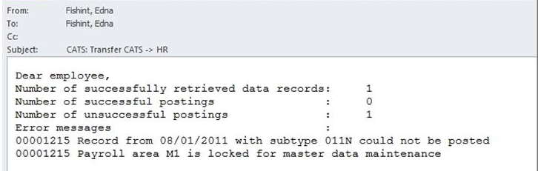
Time Collisions
Collision emails are sent to timekeepers and supervisors for approved conflicting entries :
Collisions are not processed through time evaluation and can affect an employee's paycheck
When a collision occur you will receive an email
Timesheet entries and errors corrected and approved after payroll deadlines are posted to the next monthly or biweekly paycheck
Notes:
SAP uses the term “collision” to indicate that time cannot be transferred through to Payroll. You will know that one of your employees has a timesheet collision when you receive an email from the CATS transfer program shortly after you approve the timesheet. The message for a collision identifies the employee’s personnel number, the date of the time entry, the attendance/absence type and a description of the issue.
If you receive this email contact your timekeeper to make sure the employee impacted the collision will be paid correctly. Now let’s look at the work schedule.

Slide 71

Wrong Work Schedule
When changing a work schedule:
Submit the PCR using Manager Self Service
Confirm the employee does not have future time on their timesheet
Complete the Flextime Agreement form with the employee if the employee is changing to a flex schedule. Click here to find a copy of the form
Click here to go to the CDOT work schedule page FAQ
Notes:
Sometimes it may be necessary to change an employee’s work schedule to meet business needs or the needs of the employee. Before making any changes, you must ensure that you have discussed these changes with the employee. Also, any future entries in an employee’s timesheet must be deleted before the work schedule is changed. To request the work schedule change, you must complete a Personnel Change Request, or PCR. There are two things you must remember about work schedules: an employee’s work schedule cannot be changed retroactively and the employee must be assigned to the new work schedule at the beginning of the work week. Click on the “here” link to go to the work schedule page. Now let’s review what we have learned in this section so far.

Slide 72
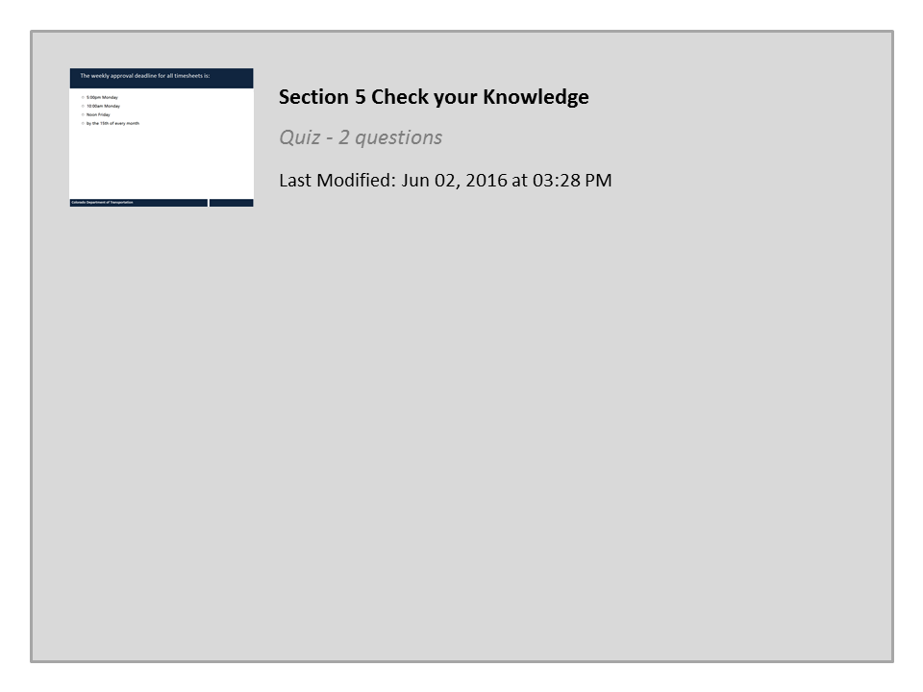
Section 5 Check your Knowledge

Slide 73
Learning Logistics
Learning Logistics
Section 1 – Course Overview
Section 2 – Introduction to Time and Leave
Section 3 – Approving Working Time
Section 4 – Approving Leave
Section 5 – Approval Deadlines and Issues
Conclusion
Notes:
Now that you have complete the course you should be able to describe the process for approving time and leave for your employees. Let’s take a minute to review what you have learned.

Slide 74
Course Summary
You should now be able to:
Understand the Supervisor’s role within the time entry and approval process, why it is important, and any budgetary impacts
Understand work schedules and their relevance to time approval
Evaluate timesheet entries (attendance, leave, and special pay) to ensure compliance with CDOT time policies and FLSA regulations when approving time
Describe the types of reports available to assist with time approval
Approve and reject time in SAP within applicable deadlines
Resolve common employee time and leave entry errors and issues
Access resources to manage special leave situations and exceptions
Notes:
Notes:
Take a minute to review what you have learned from the course. If there is anything that is unclear, you can use the menu to navigate to the section or use the search feature. When you are done, click the Next button to review the resources available to help you with time and leave approval.

Slide 75

Where Can I Get Help?
For additional assistance contact:
  Rachel Grafton:
    Email: Rachel.Grafton@state.co.us
    Phone: 7-9081
The following resources are also available:
Work Schedule Report to find the Timekeeper of a specific employee
Payroll Office
Notes:
Notes:
Remember, you are not alone. If you run into technical problems or have policy questions, contact Rachel Grafton at extension 7-9081. Other resources available to help you include, your HR Timekeepers and the Payroll Office. A list of timekeepers can be found in the Work Schedule Report under the Resources link. For Payroll related questions, use the Payroll Office Contact link, which is also located in the resources tab. If you have not already done, so it would be a good idea to bookmark these resources before you continue.
Now let’s look at what you need to do to get credit for the course.

Slide 76

Course Complete
Congratulations, you have completed Manager Time Approval Course Training!
To confirm you have completed the course, complete the following assessment.
For course credit, you must achieve a score of at least 70%. Please remember you can take the course as many times as you want until you achieve this score.
And remember, once you click the “Submit” button the question is locked and you can no longer change your selection.
Notes:
Congratulations on completing the Supervisor Time and Leave Approval Course! The final step is for you to take a short quiz to get credit for this course. You must get a score of at least 70% to pass and you can take it as many times as you like. Good Luck!

Slide 77
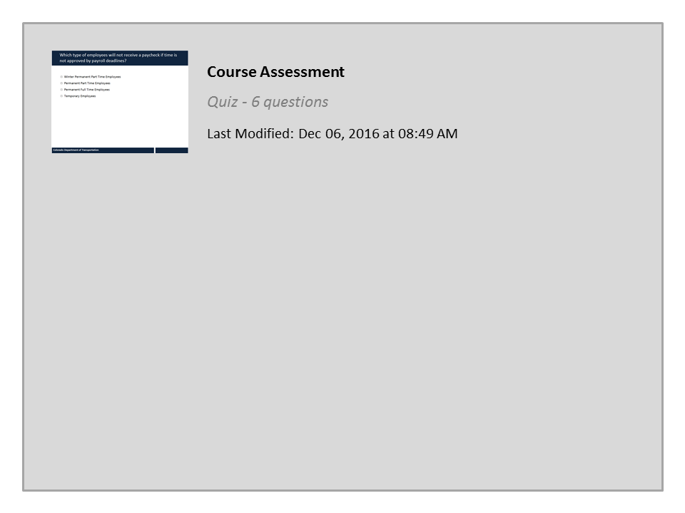
Course Assessment

