Slide 1
Smart Scanning and Digital Signatures Using Adobe Acrobat DC
Notes:
Welcome to the Smart Scanning and Using Digital Signatures with Adobe Acrobat DC course. In this course you will learn the steps you need to take to scan and archive your documents according to CDOT’s archiving standard. This standard is used by CDOT to archive our important documents, so they can be read in years to come regardless of the hardware or software used to read them. This advanced method of archiving an electronic document will save CDOT the step of microfilming all documents, and will create business efficiencies by having access to a searchable electronic document in your shared drive.

Slide 2
What you will Learn
At the end of this course, you should be able to:
Explain how to Smart Scan your document
Describe how to format your document so that it is searchable, deskewed and compressed
Describe how to save your document so it is a properly archived file
Notes:
Upon completing this course you should have an understanding of each of the objectives on this slide. Please take a minute to review these before you continue. When you are done, click the next button to continue the course.

Slide 3
Getting Ready: How Do I Download Adobe Acrobat DC to my Computer?
Click on the bottom left Microsoft symbol on your desktop
Type in “soft” in the search window and it will bring up “software center”
Look for “Adobe Acrobat DC” (if it is not listed, you already have it installed on your computer, this will show in the tab called “installation status”)
Check the box for Adobe Acrobat DC then click “install” in the bottom right corner
Do NOT install Adobe Systems Acrobat X Pro Install and/or Upgrade
You’re done!
Notes:
To be able to perform any of the tasks listed in this course, you must have Adobe Acrobat DC installed on your computer. If you already have it installed you may skip this slide other wise follow these instructions to install Adobe Acrobat DC to your computer.

Slide 4
What is “Smart Scanning”?
Smart Scanning is a way of making your CDOT document comply with a level of archiving that is internationally recognized.
By following a few simple steps outlined in this Training Guide, you will be able to retain your CDOT document in electronic format so that it can be read, regardless of the hardware or software used, in one hundred years.
This is an important step forward for CDOT, as we move away from paper to electronic-based business processes.
Notes:
So what is Smart Scanning? Smart Scanning is a way for CDOT to guarantee that we can rely on the electronic document as one that can be read for many years to come. We previously relied on microfilm to meet this requirement, but microfilm does not have the search capability and other tremendous advantages available to us now with Adobe Acrobat DC. These include searchability, ability to be compressed, a clean and legible document, and most importantly, being archived so that the document can be read for many years to come. As we said before, this is also a way for us to store the document so it can always be read, regardless of the software or hardware we use in the future. In other words, we will always be able to view them. It is also an important step as we move forward with archiving the documents in a electronic format instead of in print.

Slide 5
What Documents Do I Need to Smart Scan?
Not all documents need to be Smart Scanned. You should Smart Scan any documents that:
Have a legal retention period of 3.5 years or longer (check with the Records Management Team or your Records Coordinator if you don’t know)
Are vital to your division, unit or program (are important documents that you will need to retain for reference or business needs)
Would be valuable to have available in a searchable format
Notes:
Not all documents need to be scanned using the process outlined in this course. However you should scan documents the have a legal retention period of 3.5 years or longer, are vital to your division, unit or program or documents that would be valuable to have in a searchable format.

Slide 6
Summary of Smart Scanning
Step 1
Scanning your document by making sure the copy machine is set to 300 dpi (dots per inch), not more and not less! (Your copier should already be set at 300 dpi)
Formatting your PDF so that it is:
Searchable (optical character recognition – OCR)
Deskewed or aligned
Compressed
Step 2
Saving your PDF as an “archived” file (this archives it so it meets CDOT’s archiving standard of “PDF/A-1 b”)
Notes:
The Smart scanning process requires two steps. The first step is to scan your document using the copy machine and formatting the resulting document using Adobe so it is searchable, deskewed and compressed. The next step to save the PDF as an archived file so that it meets CDOT’s archiving standard.

Slide 7
Step 1: Scan you Document
Scan the document you wish to archive by using a copier that is set at 300 dpi. Most copiers have been set to scan/copy at 300 dpi.
If the copier has an option of automatically saving to a PDF/A 1-b standard, DO NOT say yes. The archiving method set out in this tutorial is required, not the automatic option on the copier.
Ask OIT if you need help setting the copier.
Notes:
The first step in the process is to scan your document using a CDOT copier that is set to 300 dpi. If you need help with the settings on the copier or are uncertain if it is are set to 300 dpi, contact CDOT Help Desk.

Slide 8
Step 1: OCR, Deskew, and Compress your PDF using “Action Wizard” in Adobe Acrobat DC
Open the PDF of your scanned document using Adobe Acrobat DC.
Click on the “Action Wizard” tool under the “Tools” selection in Adobe Acrobat DC
This should take you to your document in Action Wizard mode.
Notes:
Once you have scanned the document and have it in a PDF format the next step is to open the PDF of your scanned document using Adobe Acrobat DC. When you open the you will see a menu as shown by the image on the left. Click on the Tool section at the top of the page as indicated by the arrow. Next you will need to select Action Wizard as indicated by the second arrow. This takes you to the action wizard mode and allows you to make the necessary changes to the PDF so that it meets the document standards.

Slide 10
Step 1: OCR, Deskew, and Compress your PDF using Action Wizard (continued)
In the tool bar on the right side of the window, select “Optimize Scanned Document” (Click HERE for visual).
The default settings for “Optimize Scanned Document” will automatically apply the following to the PDF for archiving:
OCR (make searchable through Optical Character Recognition)
Deskew
Reduce file size (compress the file)
Notes:
The next step is to click on the Optimize Scanned Document in the right side of the window. If you are not sure what it looks like click on HERE to see a screenshot. By the way, throughout the course you will be presented the option of viewing the screenshot if you need to. The default settings for document will automatically apply are OCR or Optical Character Recognition, Deskew and Reduce file size.

Slide 11
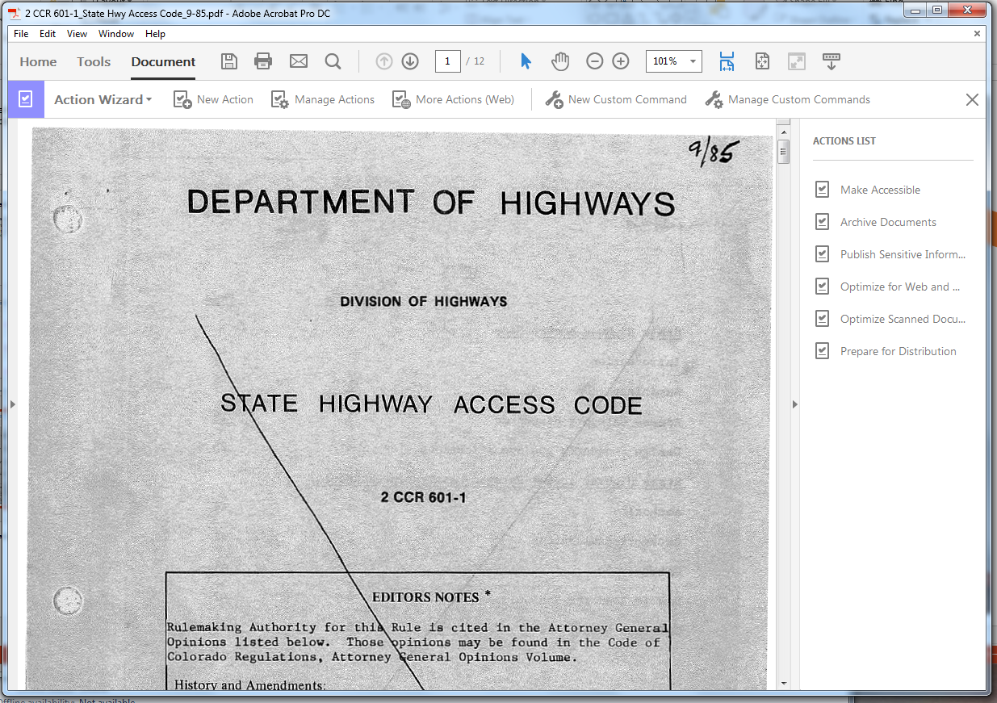
Notes:
The arrow is pointing to the “Optimize Scanned Document” as referenced in step four. When you are done reviewing this page click the next button to return to the previous screen.

Slide 12
Step 1: OCR, Deskew, and Compress your PDF using Action Wizard (continued)
Click “Start” to apply the deskew, OCR, and compression to the entire document (click HERE for a visual).
A “Description” box will pop up (click HERE for a visual). This “Description” box allows you to populate your file with metadata (title, subject, author and keywords). It is not necessary to add metadata, but it is available if it suits your business needs. More information on metadata is available on the Adobe Acrobat website.
Either fill out the metadata or leave the fields blank and hit “ok” to run the optimization function (click HERE for a visual).
Notes:
Once you click the Start button, the deskew, OCR and Compression will be applied to the document. A “Description” box displays which allows you to populate the metadata for the document if your business needs require it. When you click “ok” optimization will run. Now you need to save the optimized document. Let’s look at how to do that now.

Slide 13
Notes:
The arrow is pointing to the Start button as referenced in step six. When you are done reviewing this page click the next button to return to the previous screen.

Slide 14
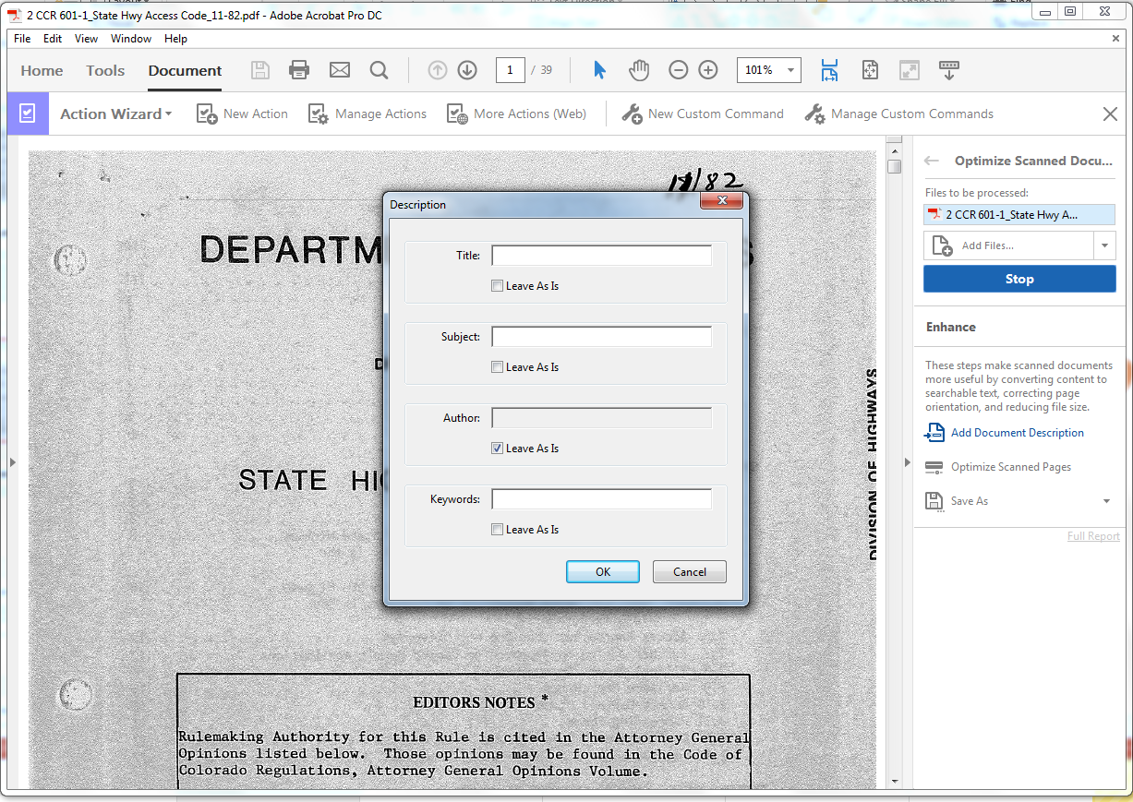
Notes:
The arrow is pointing to the “Description” box and the Ok button as referenced in step seven and eight. When you are done reviewing this page click the next button to return to the previous screen.

Slide 15
Step 1: Save Optimized PDF
After the optimization is complete, Adobe will prompt you to save your file.
In the save window, select the correct file folder (all files should be saved on a shared drive or a drive that is backed up).
Make sure you are using a logical naming convention. This will depend on each office. For construction projects, the file name should start with the subaccount or project number.
After typing out the proper naming convention, hit “Save.”
Notes:
Once you have completed the optimization of your document Adobe will prompt you to save the file. When you save the file always save it to a shared or drive that is backed up. When naming the document use a logical name based on your division, program or office. Once you are done click the save button to save your document.

Slide 16
Step 2: Properly Saving your PDF to Meet CDOT Archival Standard
After you have saved the PDF using a proper naming convention, click the back arrow next to “Optimize Scanned Document” on the right tool bar of your window (click HERE for a visual).
This takes you back to the menu in Action Wizard.
Select “Archive Documents” (click HERE for a visual) on the right tool bar Click “Start.” (click HERE for a visual)
The “Description” Pop-Up will appear again; click “ok” to proceed unless you want to fill in metadata for your file.
After the archive function is complete, it will prompt you to save the file again. This new file name will automatically have “A1b” added to your previously saved file name. This indicates that the PDF is now in A1b archiving format, and is now ready to be saved as a properly archived file. The file name should look like this:
PDF file name: [Naming Convention]_A1b.pdf
Notes:
The second step is to take the PDF document you have created and turn it into a document that meets CDOT’s Archival Standard. This should be done immediately after you have saved the document. Click on the back button to return to the Action Wizard. Select the “Archive Documents” on the toolbar and click “Start.” The Description box will appear again and you have the option of entering the metadata for your file. When you are done click “ok” to proceed. After the archive function is complete, you will be prompted to save your file again. This file will “A1b” added to name of the file. This is used to indicate it is in the correct archiving format.

Slide 17
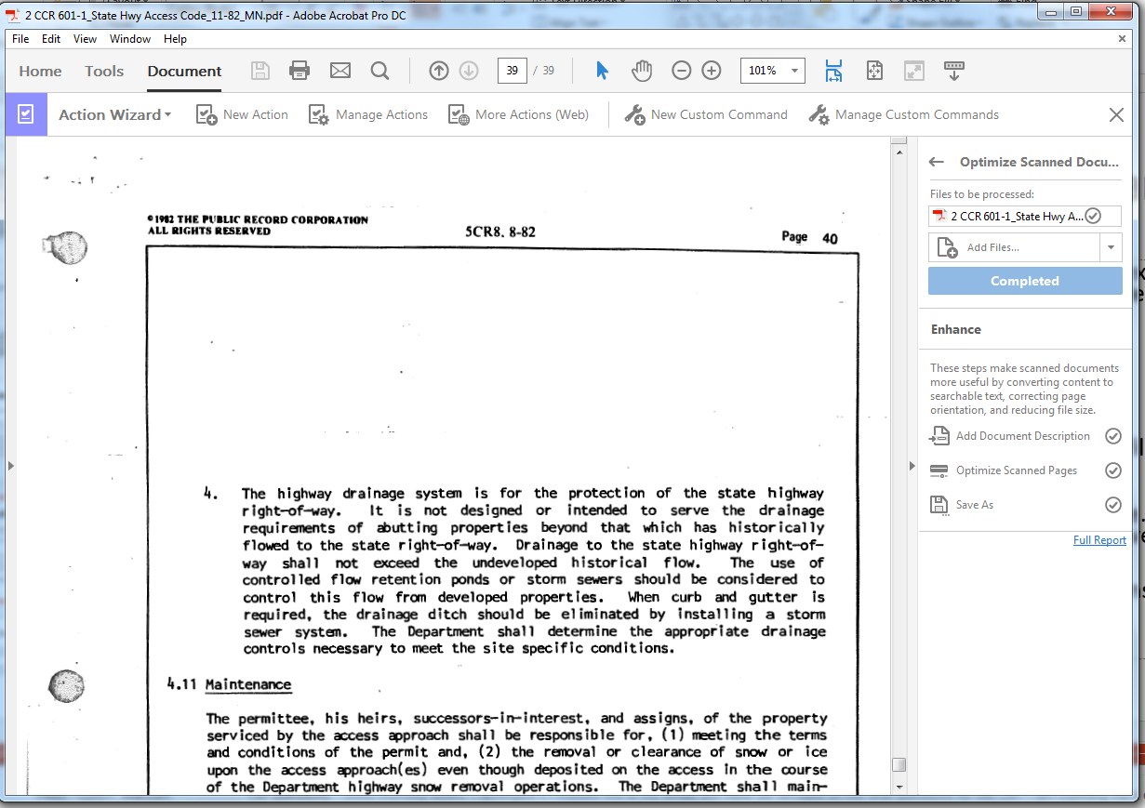
Notes:
The arrow is pointing to the “Optimize Scanned Document” as referenced in step one. When you are done reviewing this page click the next button to return to the previous screen.

Slide 18
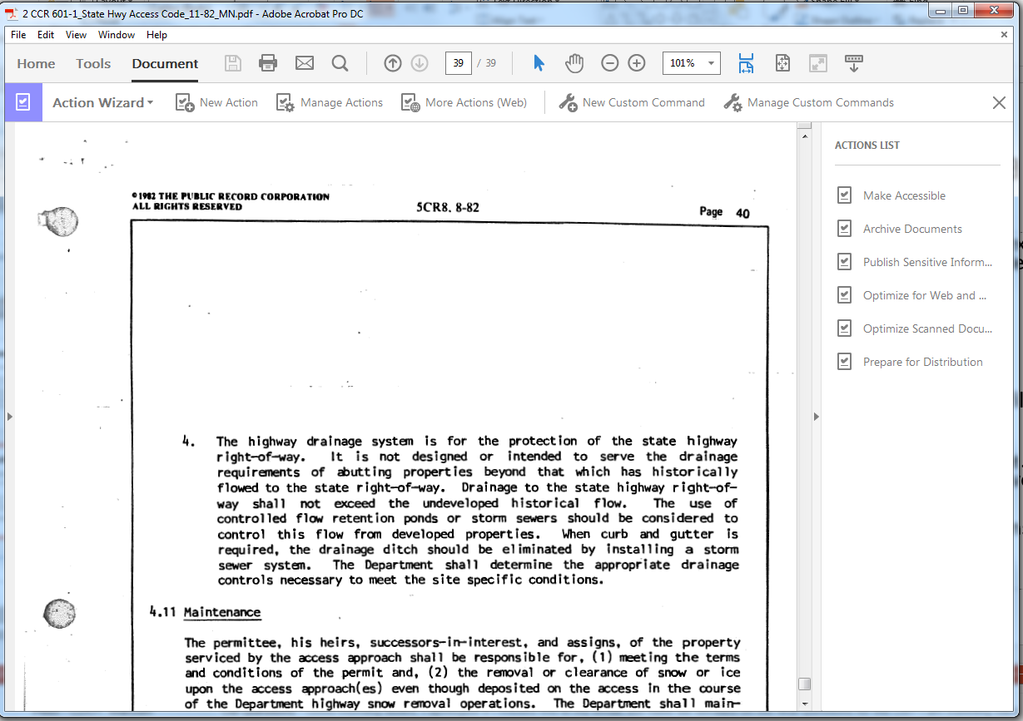
Notes:
The arrow is pointing to the “Archive Document” as referenced in step three. When you are done reviewing this page click the next button to return to the previous screen.

Slide 19
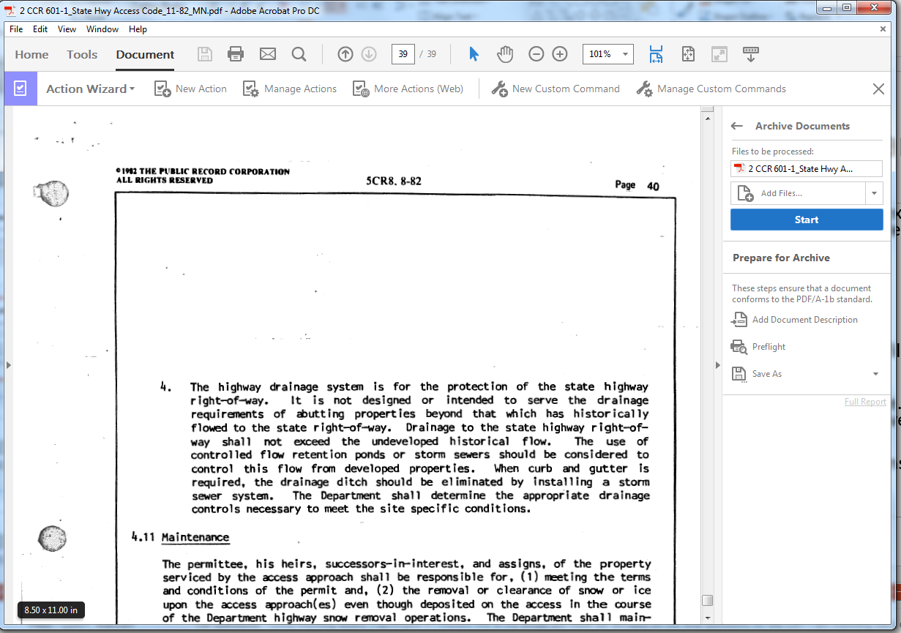
Notes:
The arrow is pointing to the “Start” button as referenced in step two. When you are done reviewing this page click the next button to return to the previous screen.

Slide 20
Warning!
After your PDF is properly saved to CDOT’s archival standard, at the top of the PDF window, you will see a blue banner with the message “this file claims compliance with the PDF/A standard and has been opened read-only to prevent modification.”
If you hit the “Enable Editing” box on the banner, you will convert the document from PDF/A 1-b archiving standard to a non-archive quality document.
If you wish to go back to edit the document after preparing it for PDF/A 1-b standard, you must repeat the Smart Scanning Step 2 (Archiving).
Notes:
Once you have saved the PDF a blue banner will display at the top of the window with the message “This file claims compliance with the PDF/A 1-b standard and has been opened read-only to prevent modification”. Next to this message is a button labeled “Enable Editing”. If you click this button the document is converted back to a non-archive quality document and you will need to repeat Smart Scanning step 2 (archiving) to bring the document back into compliance.

Slide 21
Archiving an Electronic Document
You don’t have to print out a document to Smart Scan it, you can print it to a printer that wholly produces electronic files, like PDF.
An available printer is called “CUTE PDF Writer”
If this printing option is not installed on your computer, call the CDOT HELP Desk to have it installed.
To use the CUTE PDF Writer option:
Open your document.
Select the Cute PDF Writer printer option.
Select “Print” then name the document and select a file location.
Save the file in a PDF format. Then follow Steps 1 and 2.
Notes:
When you are archiving your document you do not have to print a paper copy so you can scan it to create the PDF document. Instead you can print the document using the CUTE PDF Writer using the steps listed on this slide.

Slide 22
What are Digital Signatures?
Digital Signatures are certificate-based signatures (sometimes called a “Digital ID”) that verify both the integrity and authenticity of the document. Certificate-based signatures are nearly impossible to forge because they are encrypted with information unique to the signer.
Adobe Acrobat DC allows you to create a digital ID that you can use to digitally sign a PDF.
Notes:
Now that you have created the document, you may or may not want to sign it digitally by creating a digital signature. If you do, there are several advantages. The first is that you can verify the integrity of the signed document. It is also digitally encrypted with the information that is unique to the signer and may not be edited without the password. Just like the other processes outlined this is done with Adobe Acrobat DC.

Slide 23
Who May Use a Digital Signature?
All CDOT employees who are authorized to sign documents on behalf of CDOT may utilize Adobe Acrobat DC “Certificate-Based Signatures” to electronically sign documents. This applies to all divisions, Regions and programs of CDOT.
Electronic signatures may not be used on any document requiring a State Controller’s signature, a CDOT Controller signature, contractual documents, Speed Memos (Form 105), change orders (Form 90), or any documents that explicitly require a hand-written signature under state or federal law.
Notes:
All CDOT employees who are authorized to sign documents on behalf of CDOT may utilize Adobe Acrobat DC “Certificate-Based Signatures” to electronically sign documents. However, electronic signatures may not be used on any document requiring a State Controller’s signature, a CDOT Controller signature, contractual documents, Speed Memos (Form 105), change orders (Form 90), or any documents that explicitly require a hand-written signature under state or federal law.

Slide 24
How to Digitally Sign a PDF Using Adobe Acrobat DC
If you are digitally signing a PDF, the signature field will be marked with a red border and have a red arrow on the upper left corner of the field.
When you click on the signature field, Adobe will ask you whether you want to digitally sign. If you already have a digital ID set up in Adobe, the prompt window will automatically show your digital signature. You will need to enter your password to complete the digital signature in that field.
Notes:
Once created the digital signature field is marked by a red border and has a red arrow in the upper left corner of the field. When you click on the field you are asked if you want to sign the document. If you created your digital ID then the prompt window will automatically display your digital signature, but you will need to enter your password to complete the digital signature field.

Slide 25
Creating a Digital ID in Adobe Acrobat DC
If you have never created a Digital ID in Adobe Acrobat DC before, you can do so when you start to sign the document in the signature field.
Click on the signature field, and you will be asked whether you want to create a new digital ID. Follow the instructions to set up your digital ID.
Notes:
The process to create a digital signature is simple. Go to the signature field and you will be prompted to create a digital signature and all you need to do is follow the instructions provided to you to set up your digital ID.

Slide 26
Non-Certificate Based Signature not Recommended
The other signature function in Adobe Acrobat DC only requires a picture of a conventional handwritten signature and does not include certificate-based signature authentication.
This may be used on documents that have no binding legal, financial or administrative effect on CDOT. This Adobe signature feature is not the preferred method of electronically signing a document.
Note that the Adobe “certificate-based signature” or another certificate based method is required for CDOT documents signed by 3rd parties outside of CDOT.
Notes:
The other signature function in Adobe Acrobat DC only requires a picture of a conventional handwritten signature and does not include certificate-based signature authentication. This is not recommended and is not the preferred method for electronically signing a document

Slide 27
Official Documents Requiring Engineers, Architects, and Surveyors Stamps and Signatures
CDOT is currently procuring a contract with a vendor to be the official keeper of electronic stamps and signatures for engineers, architects, and surveyors.
Project Support will be notifying these groups once this has been acquired and has been beta-tested. The official documents requiring a stamp and signature by these three professions will use this software rather than Adobe for the stamping of official documents.
Notes:
This slide is only applicable to Engineers, Architects and Surveyors. CDOT is currently in the process of procuring a contact with a vendor that will create electronic stamps. They will be used for official documents requiring a stamp and signature by Engineers, Architects and Surveyors and will be used in instead of Adobe. Once this contact has been acquired you will be notified.

Slide 28
Questions?
For questions about this training contact:
dot_records_mgmt@state.co.us
Notes:
Congratulations! You have completed the course. If you have any questions about the training or how to archive your records, email Records at DOT_Records_Mgmt@state.co.us.

