Slide 1
Notes:
This is a hidden slide, and only available in Notes Page View.
It functions as the Cover Page of the Conclusion Section. This slide remains here and is not removable.
To customize the notes content in Notes Page View: Click on “VIEW” tab → Select “Notes Page” → Double click the page, an Microsoft Word document would pop up → Click on “Course Title” and type in the training course title → Click on the margins or close word. The changes you made will be automatically saved into PowerPoint.
Notes:
CDOT Records Management
Participant Guide
Mary Frances Nevans
March, 2017

Slide 2
CDOT Records Management
Notes:
Notes:
Welcome to the CDOT Records Management course! This course is designed to help you understand how to maintain records produced by your department or division. By the end of the course you should be able to describe the role of Records Management and your role as a Record Coordinator, identify the record retention schedules, and complete the Records Inventory and File plan spreadsheet.

Slide 3
Table of Contents (Hidden)
Notes:
This is a hidden slide, and only available in Notes Page View.
It functions as the Table of Contents of the training course. This slide remains here and is not removable.
To customize notes content in the Notes Page View: Click on “VIEW” tab → Select “Notes Page” → Manually type in the Section Number, Title Name, and according Notes Page Number → To add more lines: Click the “LAYOUT” tab, select “Insert Below” or “Insert Above” up to your choice.

Slide 4
Course Agenda
Learning Logistics
Section 1 – Introduction to Records Management
and Records
Section 2 – Record Coordinator Responsibilities
Section 3 – Implementing the File Plan
Conclusion
Notes:
Notes:
This course is designed to help you understand your role as a Record Coordinator. It is comprised of the following sections:
The Learning Logistics section of the course, discusses the learning objectives of the course.
Section One covers what Records Management does, what records are and the resources available to you.
Section Two discusses your role as a Record Coordinator.
Section Three, describes how to inventory your records and create a file plan for your division or department.
The Conclusion, summarizes what you have learned and discuss the help resources available to you.

Slide 5
Course Learning Objectives
At the end of this course, you should be able to:
Describe what Records Management is and your role in the process
Identify a record and its retention schedule
Describe the lifecycle of a record
List the responsibilities of the Record Coordinator
Implement a File Plan using the File Plan Spreadsheet
Complete the Inventory Spreadsheet
Notes:
Notes:
The list on the slide above are the high level leaning objectives for this course. Upon completing this course you should be familiar with the course and be able to perform all of the listed actions. This slide repeats at the end of the course and you will be shown the course objectives again and will be able to ask questions about anything you do not understand.

Slide 6
Participant Introductions
Please take a moment to share:
Your name
Your role within CDOT
Your expectations of this course
Notes:
Notes:
Please take a moment to introduce yourself to the other participants in the course and the instructor. When you introduce yourself, include you name, role within CDOT and any expectations you may have of the course.

Slide 7
Learning Logistics
Classroom participation is encouraged; ask, answer, and participate in the discussion
Please actively participate in course exercises as they provide you an opportunity to practice
The Parking lot is used to capture questions for in-class follow-up
Notes:
Notes:
When you are in the classroom, please feel free to ask questions to the instructor and refrain from side conversations.
The exercises in this course exist to provide you with a chance to practice the content of the course. Please participate. If there is a question the instructor is not able to answer they will add it to the parking lot. They will provide an answer to you within three working days.

Slide 8
Your Contributions to Learning
Please respect the other participants by silencing your cell phones
Focus on the course, please use the Internet and email over lunch and break times
Please delay your side conversations until break times
Notes:
Notes:
Take a moment to turn off, or silence your cell phones. This is your time to learn. Please refrain from browsing the Internet, sending/reading text messages, or sending/reading e-mails during class. Participate in the course and listen, and refrain from having side conversations. Be sure to attend the entire class to get credit for the course; if more than 15 minutes are missed you will not get credit for attending the class

Slide 9
Notes:
This is a hidden slide, and only available in Notes Page View.
It functions as the Cover Page of the Conclusion Section. This slide remains here and is not removable.
To customize the notes content in Notes Page View: Click on “VIEW” tab → Select “Notes Page” → Double click the page, an Microsoft Word document would pop up → Click on “Course Title” and type in the training course title → Click on the margins or close word. The changes you made will be automatically saved into PowerPoint.
Notes:
Introduction to Records Management and Records

Slide 10
Course Agenda
Learning Logistics
Section 1 – Introduction to Records Management
and Records
Section 2 – Record Coordinator Responsibilities
Section 3 – Implementing the File Plan
Conclusion
Notes:
Notes:
This course is designed to help you understand your role as a Record Coordinator. It is comprised of the following sections:
The Learning Logistics section of the course, discusses the learning objectives of the course.
Section One covers what Records Management does, what records are and the resources available to you.
Section Two discusses your role as a Record Coordinator.
Section Three, describes how to inventory your records and create a file plan for your division or department.
The Conclusion, summarizes what you have learned and discuss the help resources available to you.

Slide 11
Section 1 Learning Objectives
At the end of this section, you should be able to:
Identify the Records Management Team and their Website
Describe what Records Management does at CDOT
Identify what is and is not a record and why records are managed
Explain when to use the General and Unique Records Schedules
Explain why we manage records and the lifecycle
Notes:
Notes:
Each of the learning objectives corresponds to a slide, or a series of slides, in this section of the course.
By the end of this section you should be able to perform each of the listed objectives with the support of the training materials.
The section objectives are tied directly to the course objectives reviewed at the end of the course.

Slide 12
Record Management Team
Records Management Team Contacts:
Herman Stockinger, Director of OPGR
Mary Frances Nevans, Program Manager
James Mabry
Lizzy Savino
Tammi Haddad
Kelley Tatman
Tammy Tunis
Group email: Dot_Records_Mgmt@state.co.us
Notes:
In addition to our website, we are here to help you. We have created an email box to respond to questions. This is checked often by our team and is the best way to get help. If you have questions that are not answered by the Frequently Asked Questions section of our webpage, please reach out to us.

Slide 13
What Records Management Does
The Records Management Team is responsible for:
Ensuring compliance with State and Federal laws regarding records
Filing compliance documents with Colo. State Archives
Developing the polices and policies and procedures used by CDOT to maintain records
Training and assisting records coordinators
Assisting CDOT employees with records
Notes:
Notes:
The Records Management team is part of the Office of Policy and Government Relations. Records Management is responsible for the development and compliance of records requirements through the development of policy, procedures and training.

Slide 14
The Records Management Webpage
The Record Management webpage contains:
A FAQ
All the Records Management Forms Record Schedules
The Address is: http://intranet.dot.state.co.us/business/records-management/records-management
Notes:
Notes:
Tab 01 – Frequently Asked Questions (FAQs)
The Records Management Webpage contains most of what you will need to perform your role as a Record Coordinator. If you don’t find what you need on the FAQ page, please don’t hesitate to contact us. To add this as a favorite enter the link above and click ctrl + D and click save.

Slide 15
Records Management Authority
Records Management Team’s authority comes from:
C.R.S 24-80-102.7 (2) (a) that requires all state agencies to “establish and maintain a records management program . . . and document the policies and procedures of such a program”
PD 51.1 - Retention of CDOT records
The Records Management Team is responsible for ultimately deciding on the record retention period under state or federal law. The records coordinators are not legally responsible; they are point of contact to work with the subject matter experts, or sometimes the subject matter experts, who will determine if the record retention period must be longer than legally required (it may not be shorter)
Notes:
Notes:
Tab 02 – PD 51.1 Retention of CDOT Records
The authority of CDOT comes from § 24-80-102.7 (2)(a), Colorado Revised Statutes, that states that each state agency shall "establish and maintain a records management program for the state agency and document the policies and procedures of such a program.“ In addition there is PD 51.1 which describes the role of Records Management within CDOT.

Slide 16
What is and is not a Record
In general, records are NOT:
Books, manuals, or pamphlets, not written by CDOT
Personal papers
Documents of immediate or transitory value only (ex.: Post-it Notes, to-do lists)
Documents that do not have historical, legal or financial importance
Documents created by another entity that do not have historical, legal or financial importance
Notes:
Notes:
The slide above lists what are documents and not records. As we get ready for the move there have been questions about historical documents. The general records retention schedule addresses records that have historical value. Records that document CDOT's history (such as, but not limited to, scrapbooks, photographs, articles, program notes, documentation of CDOT sponsored/funded events, audio narratives, or audiovisual narratives) may be considered historical and may be eligible for transfer to the State Archives.
If you have records that you believe are of historical value, but are not CDOT records, CDOT cannot send them to the State Archives. Contact the CDOT official records officer if you believe you have historical CDOT records or have a question about historically important documents that may be non-CDOT material.

Slide 17
What is and is not a Record
A record is a document (physical or electronic) created or (in some cases) received by CDOT that is retained for legal, administrative or historical reasons as part of CDOT’s business.
All CDOT employees are responsible for retaining CDOT records for the time frames required by law.
Notes:
Notes:
Records are all books, papers, maps, photographs, or other documentary materials, regardless of physical form or characteristics, made or received by any governmental agency in pursuance of law or in connection with the transaction of public business and preserved or appropriate for preservation by the agency or its legitimate successor as evidence of the organization, functions, policies, decisions, procedures, operations, or other activities of the government or because of the value of the official governmental data contained therein. Records document the business and history of CDOT, regardless of their physical or electronic format. If there are any questions about a document being a record the CDOT official records officer should make the determination.

Slide 18
General and Unique Retention Scheduled
The CDOT Records Management Program must comply with:
State General Retention Schedules
State Unique Retention Schedules
FHWA, FTA, FAA Guidance
State Statute
CDOT Policies and Procedural Directives
Notes:
Notes:
Tab 3 – Retention Schedule from the Colorado State Archives (GENERAL)
Tab 4 – Retention Schedule Unique to CDOT
The retention schedule is a control document developed by the CDOT official records officer that sets the timeline for when records are to be reviewed, how long specific records must be held, and how they must then be destroyed or archived. It applies to records in all formats, including paper and electronic media. The records retention schedule must meet the requirements of state and federal law.
The general records retention schedules are created and defined by the State Archives Office within the Department of Personnel and Administration, in accordance with applicable state and federal laws and regulations. CDOT regional and unique CDOT records retention schedules are created and defined by the State Archives and the CDOT official records officer.
The CDOT official records officer works in consultation with the respective CDOT units to appraise the legal, fiscal, administrative and informational value of a record. The CDOT official records officer works with the State Archives to review the appraisal and determine a retention period.

Slide 19
Why we to Manage Records
Records are managed for:
Legal purposes – State and Federal regulations, litigation and audits
Financial purposes – Tracking expenditures, audits
Business Purposes:
Construction/engineering records
Continuity of process
Information Access
Notes:
Notes
Records are import to CDOT because it is how all fiscal and legal documents are identified and preserved. The Benefits of Records Management include being able to retrieve your records and (both paper and electronic); reduce your record-keeping redundancies. It also reduces the costs for records storage and increased usable space throughout CDOT. In addition, Records Management provides institutional accountability and timely access to information.

Slide 20
The Records Management Lifecycle
Create/ Receive
Use/Send
File and Store
Retain and/or Destroy
Preservation
Notes:
Notes:
The records management lifecycle is comprised of five distinct stages. They are:
Create/Receive – During this stage the record is either created by an employee of CDOT or is received as the result of conducting business.
Use/Send – In this stage the record is used for it business purpose.
File and Store – During this stage the document has been used or may need to be used so it is stored where is can be easily retrieved.
Retain and/or Destroy – In this stage the determination is made about what to do with the record based on the type of document it is. What is done with the document is based on the retention schedule.
Preservation – If the document is retained then is may be preserved in a variety of ways such as scanning or being stored.

Slide 21
Notes:
This is a hidden slide, and only available in Notes Page View.
It functions as the Cover Page of the Conclusion Section. This slide remains here and is not removable.
To customize the notes content in Notes Page View: Click on “VIEW” tab → Select “Notes Page” → Double click the page, an Microsoft Word document would pop up → Click on “Course Title” and type in the training course title → Click on the margins or close word. The changes you made will be automatically saved into PowerPoint.
Notes:
Record Coordinator Responsibilities

Slide 22
Course Agenda
Learning Logistics
Section 1 – Introduction to Records Management
and Records
Section 2 – Record Coordinator Responsibilities
Section 3 - Implementing the File Plan
Conclusion
Notes:
Notes:
This course is designed to help you understand your role as a Record Coordinator. It is comprised of the following sections:
The Learning Logistics section of the course, discusses the learning objectives of the course.
Section One covers what Records Management does, what records are and the resources available to you.
Section Two discusses your role as a Record Coordinator.
Section Three, describes how to inventory your records and create a file plan for your division or department.
The Conclusion, summarizes what you have learned and discuss the help resources available to you.

Slide 23
Section 2 Learning Objectives
At the end of this section, you should be able to:
Describe the roles and responsibilities of the Record Coordinator including:
Inventorying records
Developing a File Plan
Completing a Destruction From
Notes:
Notes:
Each of the learning objectives corresponds to a slide, or a series of slides, in this section of the course.
By the end of this section you should be able to perform each of the listed objectives with the support of the training materials.
The section objectives are tied directly to the course objectives reviewed at the end of the course.

Slide 24
Four Roles of Record Coordinators
Record Coordinators have four main roles:
Inventorying records
Developing and implementing file plans
Taking necessary steps to document and destroy public records
Working together to improve electronic storage of records
Notes:
Notes:
As a Record Coordinator you are responsible for helping your department or division to work with department or division to meet legal requirements, optimize use of space, minimize cost, and preserve the vital history of CDOT through the identification and retention of necessary documents and the destruction of outdated and obsolete records in a documented and secure process.
This is accomplished by working with the Records Management team and carrying out the files plans created for your department. Remember, throughout the process you are never alone and Records management has created a variety of forms and training to help you with the process.

Slide 25
Point of Contact
Record Coordinator Point of Contact responsibilities include:
Attending “Record Rant” zoom meetings to share ideas and knowledge about records
Assisting with “Records on the Move!”
Assisting in the organization of documents to be stored, scanned or shredded
Assisting with the decision to scan documents.
Notes:
Notes:
As a Record Coordinator, you are the first point of contact. Part of the responsibility to attend meetings so you can have the information your department or division needs. You will also be trained on how to work with the records found in your department so you can assist with the storing, scanning and shredding of records.

Slide 26
Working with File Plans
Record Coordinator File Plan responsibilities:
Completing a file plan for the division, office or program
Implementing records retention periods in the file plan
Answering questions or sharing them with the Records Management Team during “Record Rants” sessions
Helping with the determination to store, scan or shred records
Notes:
Notes:

Slide 27
Notes:
This is a hidden slide, and only available in Notes Page View.
It functions as the Cover Page of the Conclusion Section. This slide remains here and is not removable.
To customize the notes content in Notes Page View: Click on “VIEW” tab → Select “Notes Page” → Double click the page, an Microsoft Word document would pop up → Click on “Course Title” and type in the training course title → Click on the margins or close word. The changes you made will be automatically saved into PowerPoint.
Notes:
Implementing the File Plan

Slide 28
Course Agenda
Learning Logistics
Section 1 – Introduction to Records Management
and Records
Section 2 – Record Coordinator Responsibilities
Section 3 - Implementing the File Plan
Conclusion
Notes:
Notes:
This course is designed to help you understand your role as a Record Coordinator. It is comprised of the following sections:
The Learning Logistics section of the course, discusses the learning objectives of the course.
Section One covers what Records Management does, what records are and the resources available to you.
Section Two discusses your role as a Record Coordinator.
Section Three, describes how to inventory your records and create a file plan for your division or department.
The Conclusion, summarizes what you have learned and discuss the help resources available to you.

Slide 29
Section 3 Learning Objectives
At the end of this section, you should be able to:
Complete the Record Inventory Spreadsheet
Describe what a file plan is, how it is used, and how it is completed
Notes:
Notes:
Each of the learning objectives corresponds to a slide, or a series of slides, in this section of the course.
By the end of this section you should be able to perform each of the listed objectives with the support of the training materials.
The section objectives are tied directly to the course objectives reviewed at the end of the course.

Slide 30
Inventory Spreadsheet
The Inventory Spreadsheet is:
Downloaded from the Records Management webpage
Filled out when a record needs to be retained in paper or electronic form
Approved by a Supervisor with authority over the record
Approved by the Records Management Program team
Retained by the records coordinator for the division, office or program as guidance and
Used as a tool by the records coordinator to train employees on retention
Notes:
Notes:
Tab 05 – Records Inventory Spreadsheet
When you and your supervisor have determined that your records must be stored in paper form, the first step is to use the Inventory Form to document which records you are storing. This will help the Records Coordinator and Records Management team assign a retention period to the records. Don’t worry about filling out the proper retention period – the Records Management team will fill out that part of the form.

Slide 31
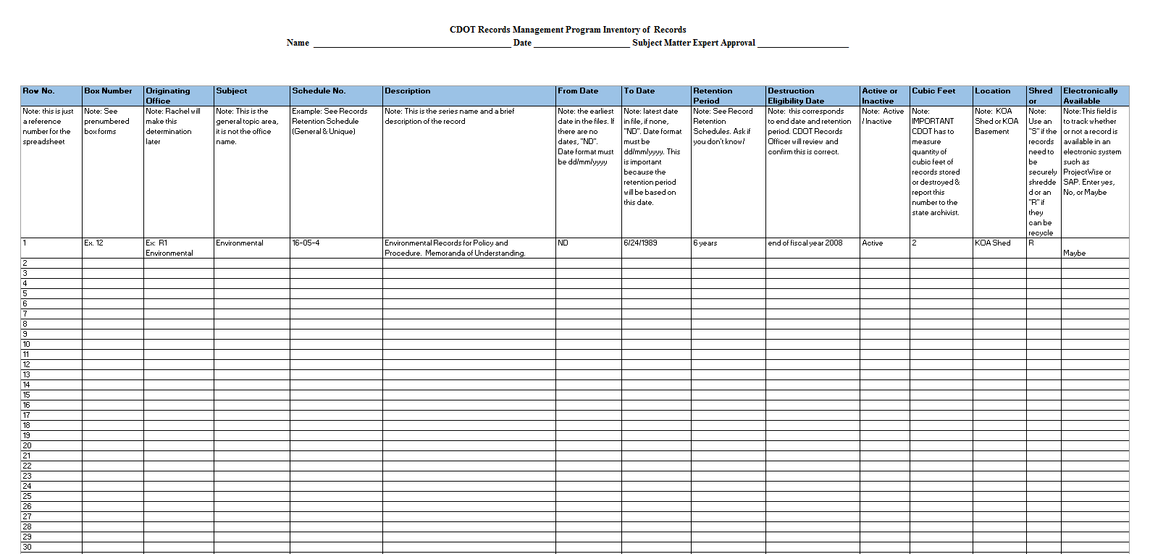
Records Inventory Spreadsheet
The Inventory Spreadsheet is completed when you have records that need to be stored
Notes:
Notes:

Slide 32
Now its Your Turn…
Now take ten minutes to complete the exercise:
Using the sample Records Inventory Spreadsheet, develop an inventory of something in your home. This could include tools, shoes, purses, animal toys, books, children, CD’s, neighbors you don’t like, flowers, bicycles, your wine collection.
The first column is just an example of how to fill out the sheet.
Notes:
Notes:
Now its your turn to practice what you have learned. To complete the exercise:
Read the instructions on the slide
Use the sample Records Inventory Spreadsheet provided by you instructor to complete the exercise
Feel free to ask questions during the exercise
Be prepared to share the results of the exercise when you are done

Slide 33
The File Plan
A file plan is a reference that describes:
What records your division or office creates
What records you are responsible for
Provides of retention periods for retention periods, record copies and desk copies
The File plan is a joint effort between the Records Coordinator and Records Management
Notes:
Notes:
Tab 5 – File Plan Spreadsheet
The File Plan is a document that you work with your division or department to create. The goal of the File Plan is to describe the type of files that are created by your division or department and describe what should typically be done with them and who is responsible for them. A good file plan saves you time as everything you need to know about records is in one place.

Slide 34
Developing the File Plan
Identify what you don’t need to include (non-records) such as:
Brochures and pamphlets
To-do lists and memos
Handouts and reference materials
Non-CDOT Manuals
Anything that is no longer needed for business purposes and is not a record
Notes:
Notes:
When you are creating the File Plan you only need to create one for records. The slide above is a reminder on the types of documents you should not include.

Slide 35
What Needs to be Included?
Completing the File Plan answers questions, such as:
What kind of records are developed by the division, office or program?
Whose responsibility is it to retain them?
What is the legal retention period?
What is to be done with the official record and the duplicates?
Notes:
Notes:
A good File Plan needs to include the title of the record, a description of the records, what is done with the record and duplicates. It also provides examples of the documents. In some cases, such as the Basis for Legal Retention field, you may need help. Please do not hesitate to contact us if you need help.

Slide 36
Now its Your Turn…
Now take ten minutes to complete the exercise:
Using the sample file plan, complete the file plan using the cards provided
Leave blank what you don’t know and remember to talk to the Records Management Team about questions
The more you can fill in the better!
Notes:
Notes:
Now its your turn to practice what you have learned. To complete the exercise:
Read the instructions on the slide
Use the sample File Plan Spreadsheet provided by you instructor to complete the exercise
Feel free to ask questions during the exercise
Be prepared to share the results of the exercise when you are done

Slide 37
Sample File Plan Spreadsheet
Notes:
Notes:

Slide 38
Destroying Public Records
When destroying records you are responsible for:
Completing the Destruction Approval form and obtaining supervisor approval
Sending the form to Records Management for approval
Overseeing the proper destruction method: shred bin, recycle bin, or boxing documents and arranging for a shredding company to remove them.
Notes:
Notes:
When documents are shredded by a shredding company, the company requests a name for a person to whom they should send the certificate of destruction. This ensures CDOT that the documents were shredded so that no information can be retrieved, and confirms the quantity destroyed.

Slide 39
Notes:
This is a hidden slide, and only available in Notes Page View.
It functions as the Cover Page of the Conclusion Section. This slide remains here and is not removable.
To customize the notes content in Notes Page View: Click on “VIEW” tab → Select “Notes Page” → Double click the page, an Microsoft Word document would pop up → Click on “Course Title” and type in the training course title → Click on the margins or close word. The changes you made will be automatically saved into PowerPoint.
Notes:
Conclusion

Slide 40
Course Agenda
Learning Logistics
Section 1 – Introduction to Records Management
and Records
Section 2 – Record Coordinator Responsibilities
Section 3 - Implementing the File Plan
Conclusion
Notes:
Notes:
This course is designed to help you understand your role as a Record Coordinator. It is comprised of the following sections:
The Learning Logistics section of the course, discusses the learning objectives of the course.
Section One covers what Records Management does, what records are and the resources available to you.
Section Two discusses your role as a Record Coordinator.
Section Three, describes how to inventory your records and create a file plan for your division or department.
The Conclusion, summarizes what you have learned and discuss the help resources available to you.

Slide 41
Conclusion
You should now be able to:
Describe what Records Management is and your role in the process
Identify a record and its retention schedule
Describe the lifecycle of a record
List the responsibilities of the Record Coordinator
Implement a File Plan using the File Plan Spreadsheet
Complete the Inventory Spreadsheet
Notes:
Notes:
The slide above contains what you should now be able to do with the help of the training material. If you have questions about the content after this course refer to the next slide for the name and contact information of the people who can help.
If you have a question now, please ask. You will have another chance at the end of the course, after we discuss where you are able to get help and the resources that are available to you.

Slide 42
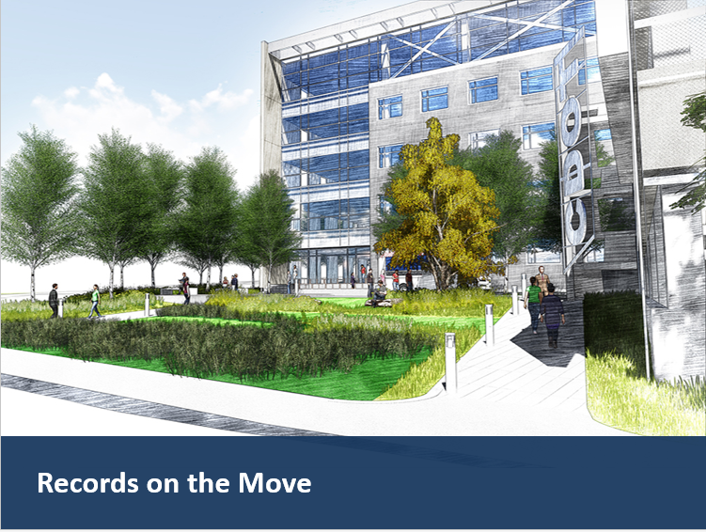
Next Course: Records on the Move!”
The next level of the course is “RECORDS ON THE MOVE!” in it you will learn:
How to determine whether a record should be scanned, stored or shredded (the 3-S’s!)
How to document records that have met their retention period and may be destroyed
How to box up records that may be scanned, stored or shredded
Notes:
Notes:
The Records on the Move eLearning is the next course in your training on Records Management. In order to take the course you will need to have a link. This will be provided to you in the near future.

Slide 43
Coming Soon!
To assist you in your role as a Record Coordinator we will be:
Providing training on how to complete additional forms such as the Scanning Spreadsheet, Destruction Inventory, Records Retention and Records Destruction box labels
Conducting training on how to scan documents
Conducting outreach on electronic document management systems at CDOT (including SharePoint and ProjectWise)
Notes:
Notes:
As the date of the move comes closer, we will be helping you with the move by providing a variety of services to help you prepare your records.

Slide 44
Questions?
?
?
?
Notes:
Notes:
Now let’s review the parking lot questions. If there are any questions that have not been answered, then they will be answered via email within three working days.

