Slide 1
Reasonable Suspicion Pre-Training
Notes:
Welcome! And congratulations on your new positon as a manager or supervisor at CDOT. This course is designed to help you understand the actions you need to take if you suspect on of you employees is under the influence of drugs or alcohol in the workplace. This course is call Pre-training because you will still need to take the full Reasonable Suspicion training within six months. We will discuss how to do this at the end of the course. That being said, let’s get started!

Slide 2
Learning Logistics
Learning Logistics
Section 1 – Identifying the Signs of Impairment
Section 2 – Actions to Take
Conclusion
Notes:
This course is broken out into two different sections. In the first section you will learn about how to identify the most common signs that an employee is impaired. In the second section we will discuss the actions you need to take, how to talk to the employee and who you need to contact. In the conclusion, you will learn how to sign up for the full training and who to contact if you have additional questions. Now let’s look at how to navigate the course.

Slide 3
Navigation, Resources and Glossary
Before we begin, let’s look at the resources available to you
Notes:
As you go through the course there are a couple of items you can use to help you learn. The first is the Resources link as indicated by the red arrow. This link contains copies of all of the documents referenced in this course.
The Glossary tab displays an alphabetical list of terms that are used throughout the course. Anytime you are uncertain about a term, this is the best place to look. Unlike the resources link clicking on the glossary does not pause the course.
If you want to navigate, use the previous or next buttons or click on the slide you want to navigate to under the menu tab. There is also a search field located at the bottom of the Menu tab that brings up all of the slides related to your search. The progress bar displays your progress within a slide.
If for any reason, you need to close the course before you have completed it, you will be returned to the page you were on once you log back in. Now let’s move on to what you will learn in this course.

Slide 4
Course Learning Objectives
At the end of this course, you should be able to:
Describe what reasonable suspicion is
Identify the signs an employee is impaired
List the actions you need to take if you suspected an employee is impaired
Describe how to talk to the employee
Explain the limits of your authority and the actions you should and should not take
Describe how to sign up for the full course and the timeframe
Notes:
Upon completing this course you should have a understanding of each of the objectives on this slide. Please take a minute to review these before you continue. When you are done, click the next button to continue the course.

Slide 5
Section 1 – Identifying the Signs of Impairment
Learning Logistics
Section 1 – Identifying the Signs of Impairment
Section 2 – Actions to Take
Conclusion
Notes:
Now let’s look at the first section of the course. In this section you will learn how to identify the signs that an employee is impaired.

Slide 6
Section 1 - Learning Objectives
At the end of this section, you should be able to:
Describe what reasonable suspicion is
Describe the process of objectively observing the employee for signs of impairment
Identify the signs of alcohol, marijuana, stimulant and depressant impairment and use
Notes:
Upon completing this section you should have an understanding of the objectives on this slide. Please take a minute to review these before you continue. When you are done, click the next button.

Slide 7
Why is this important
Why reasonable suspicion training important because:
Up 8.7% of full time workers age 18 to 64 % have abused alcohol within the past year
8.6% have used illicit drugs.
Employees under the influence are not able to preform their work safely
Our employees work is in view of the public and an impaired employee makes a very poor impression.
Notes:
So why is this course important? It is important because according to combined data from 2008 to 2012 of the National Drug-Free Workplace Alliance, up 8.7% of full time workers age 18 to 64 % abused alcohol within the past year and 8.6% have used illicit drugs. Additionally, it is important because an employee who is under the influence is not able to preform their work safely and the public and their coworkers may be impacted. And finally, their the perception of the public. Many of our employees work is in view of the public and an impaired employee makes a very poor impression. Now let’s look at the legal requirements of this is important.

Slide 8
49 CFR 382.603
The U.S. Department of Transportation requires:
All employee in safety sensitive position to be subject to drug and alcohol testing
All Supervisors and Managers must have one hour of training on alcohol and one hour of Drug (controlled substances) training
Notes:
The U.S. Department of Transportation requires that all employees who are in safety sensitive positions be subject to drug and alcohol training. It also requires that all managers and supervisors have one hour of training on identifying the signs of both alcohol and drug use. What the U.S. Department of Transportation does not mention is the timeframe of the training. Because we are not able to provide reasonable suspicion training to you immediately, this training will help to prepare you on the steps you need to take until you are able to take the full training and be certified. Now that we know why we taking this training let’s look at when you need to need to do.

Slide 9
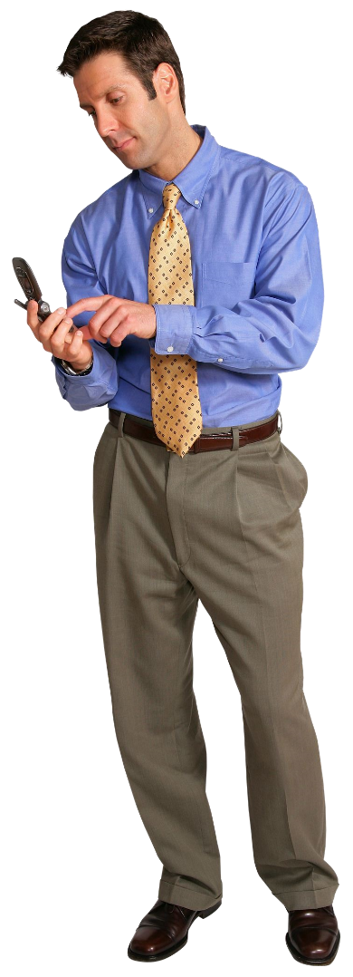
What we are Asking you to do
Until you take the full Reasonable Suspicion training we are asking you to:
Keep an eye out for any employee who may be under the influence of drugs or alcohol
Report any reasonable suspicions to your Appointing Authority immediately
Notes:
For the purposes of the this training we are asking you to do two things until you take the full Reasonable Suspicion training. This first is to keep an eye out for any employees who may be under the influence of drugs or alcohol while they are at work. Second we are asking you to report any employee you suspect of the using drugs or alcohol while at work to an appointing authority immediately. Let’s get started by looking at what reasonable suspicion as this is how you will make the determination on if the Appointing Authority needs to be called.

Slide 10
Reasonable Suspicion
Reasonable Suspicion is defined as:
“The behavior of the employee results in you being suspicious of them using a substance such as alcohol or other drugs based on specific and objective observations that you can clearly describe”.
Notes:
For the purposed of this course, Reasonable suspicion is where the behavior of the employee results in you being suspicious of them using a substance such as alcohol or other drugs based on specific and objective observations that you can clearly describe. Because your objective observations are important let’s talk about this now.

Slide 11
Objective Observation
Objective Observations are:
What is currently happening with the employee that you observe.
Observations include:
Appearance
Behavior
speech
body odors
Notes:
Objective observations are physical characteristics that you observe that are happening with the employee “right now”. In other words, you should not consider the past actions of the employee or what other people are telling you about the employee or rumors about the employee.
If an employee is under the influence of drugs or alcohol, it is likely you will be able to make this determination based on your observations. The first is the appearance of the employee. This may manifest as red eyes, changes in pupil, sweaty skin and rapid breathing. Next is the behavior of the employee. Is their behavior different then normal, for example hyperactivity, uncoordinated movements. Drugs and Alcohol may also have an affect on Speech which includes inability to communicate effectively and loud or slurred communication. In many cases, the you may smell the drugs or alcohol on the employee this is especially likely with alcohol and marijuana. And finally you should be on the look out for other physical observations such as drug paraphernalia or actions that are inconsistent with how the employee would normally act. Now let’s look at the signs or symptoms of specific drugs.

Slide 12
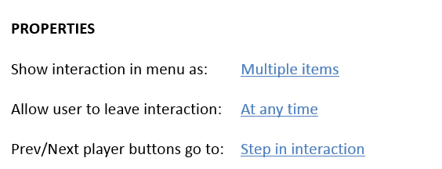
Drug Characteristics

Slide 13
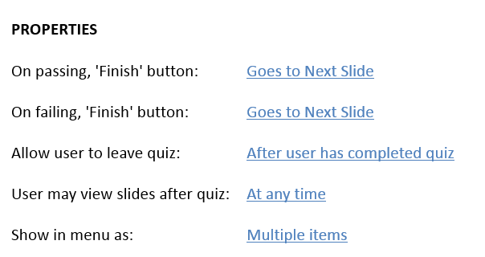
S1_Q1_Section One Quiz

Slide 14
Section 2 - Actions to Take
Learning Logistics
Section 1 – Identifying the Signs of Impairment
Section 2 – Actions to Take
Conclusion
Notes:
Now that we know what to look for let’s learn about the actions we need to take to make sure the employee is safe.

Slide 15
Section 2 - Learning Objectives
At the end of this section, you should be able to:
Explain the limits of your authority and the actions you should and should not take
List the actions you need to take if you suspected an employee is impaired
Describe how to talk to the employee
Notes:
Upon completing this section you should have an understanding of the objectives on this slide. Please take a minute to review these before you continue. When you are done, click the next button.

Slide 16
So what is an Incident?
An incident is when:
Your objective observations, lead you to believe that an employee is under the influence of drugs of alcohol
Notes:
So what is an incident? An incident is when your objective observations lead you to believe that an employee may be under the influence of drugs or alcohol. This can be the smell of alcohol on one of your employee’s breath or an employee show the symptoms of drug use based on your objective observations.
Now let’s look at what both reasonable suspicion and objective observations are. So you can make the determination if you need to contact your Appointing Authority with your suspicions.

Slide 17
What not to do…
Under no circumstances should you:
Ignore the incident – You have a duty to inform
Tell the employee to go home – This may cause harm
Notes:
Before we go into the actions you should do let’s discuss the actions you should not do. This first, and most import, is for you not to ignore the incident. Under no circumstances should you ignore the incident because the employee is a “good guy” or this is the first time something like this has happened. If you suspect that an employee is under the influence of drugs or alcohol then you need to

Slide 18
What Actions do I take
Notes:
So what actions do you take
For the purposes of the this training we are asking you to do two things until you take the full Reasonable Suspicion training. This first is to keep an eye out for any employees who may be under the influence of drugs or alcohol while they are at work. Second we are asking you to report any employee you suspect of the using drugs or alcohol while at work to an appointing authority immediately. Let’s get started by looking at what reasonable suspicion as this is how you will make the determination on if the Appointing Authority needs to be called.

Slide 21
Congratulations!
You have completed the course!
If you have questions contact us at:
Elbert.Hunt@state.co.us
Notes:
Congratulations! You have completed the “Reasonable Suspicion Pre-training”. If you have any questions about the content of this training please email Elbert with your questions.

