Slide 1
Progressive Discipline

Slide 2
Lesson Objectives
Define the steps involved in progressive discipline
Effectively document unacceptable behavior or performance
List proactive methods to prevent the hiring of problem employees
Identify resources to help in the progressive discipline process
1

Slide 3
Progressive Discipline
The steps involved
When is it needed? (and not?)
What is your role?
Practice.
Notes:
Define the steps involved in progressive discipline
Effectively document unacceptable behavior or performance
List proactive methods to prevent the hiring of problem employees
Identify resources to help in the progressive discipline process

Slide 4
Explanation of
Progressive Discipline
A formal process
Of giving opportunities
Within a specified period of time
With increasingly serious consequences
2

Slide 5
Why Do We Need
Progressive Discipline?
To shape and improve employee performance toward achieving organizational objectives
To hold employees accountable
To treat employees fairly
3

Slide 6

5 Key Areas
Expectations:
Documentation:
Fair Warning:
Problem-Solving:
Fairness:
4
Notes:
Expectations: How was the employee informed? Documentation: How were problems documented?
Fair Warning: How was the employee informed about problems?
Problem-Solving: What efforts were made to resolve problems?
Fairness: Was the process fair?
Were all the rules and procedures followed?
Was the employee treated the same as other employees in similar situations?
Did the punishment fit the offense?

Slide 7
Foundations of
Progressive Discipline
Performance Expectations
Performance Monitoring and Documentation
Performance Feedback
5
Notes:
Based on CDOT’s Performance Management Process until “Sanctions”

Slide 8
The Process
How it Should Begin
Informal
Verbal Correction
Examples
6

Slide 9
Performance issues
Step 1
– For a first offense –
Most of the time, a verbal warning
A private meeting
  with the employee and Supervisor or Lead Worker
  informal.
6

Slide 10
Step 1 continued
“Do’s”
Do:
Ask questions
Get the employee’s perceptions
Explore any extenuating circumstances
Ensure that your and CDOT’s expectations are clear and understood.

Slide 11
Step 1 continued
“Don’ts”
Don’t:
Interrupt the employee
Show any preconceived ideas of guilt
Mistake rumors and hearsay as facts

Slide 12
Step 1 continued
What was the offense?
Has there been a pattern?
Is the employee properly trained?
Are there personal issues?
  (CSEAP recommendations?)

Slide 13
Step 1 continued
At meeting’s end:
Again explain expectations
Explain what needs to be done to correct the situation
Explain the deadline for action
Document EVERYTHING!
Tell the employee that you don’t expect to have this discussion again

Slide 14
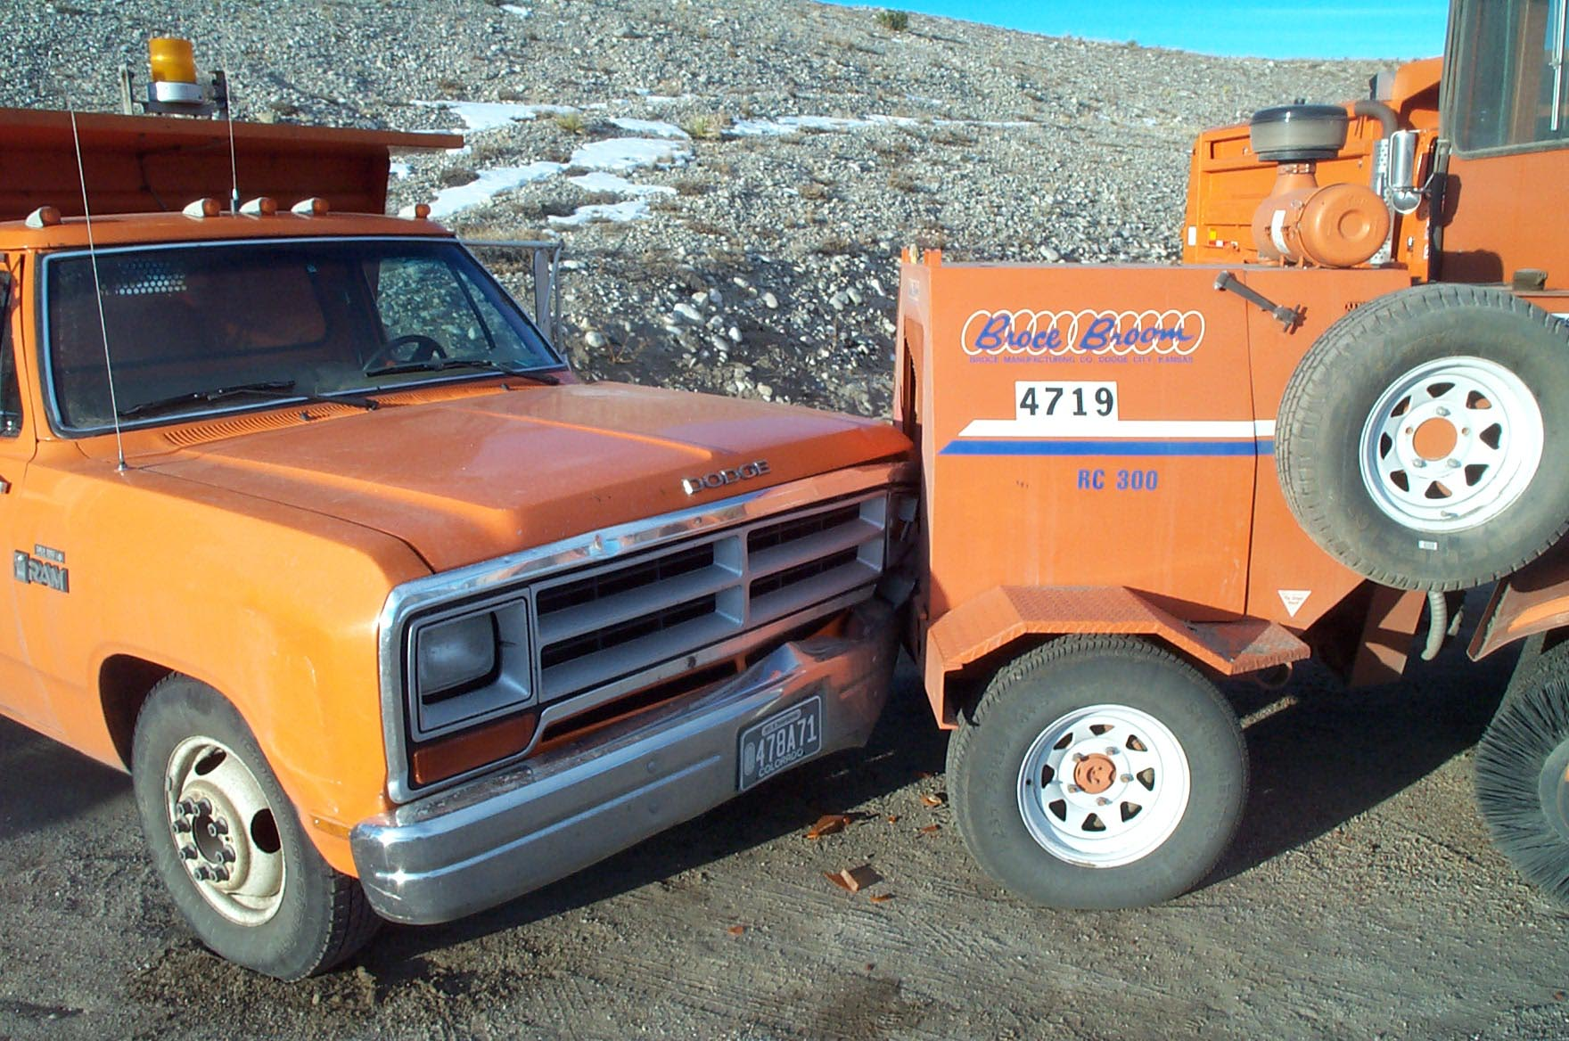
Exceptions
Automatic Corrective Action
Backing Accidents

Slide 15
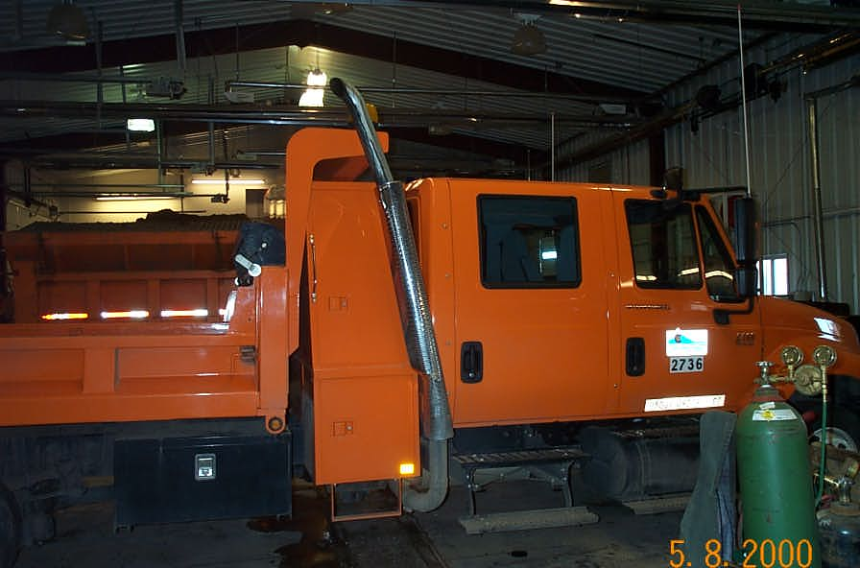
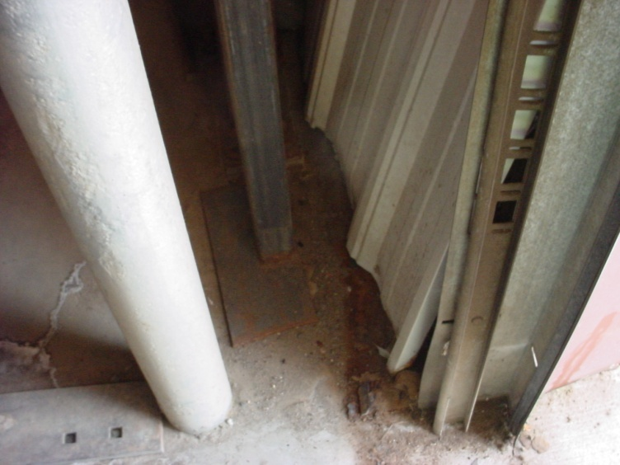
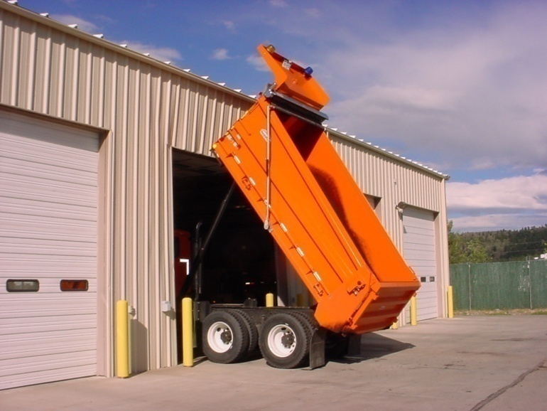
Exceptions continued
Garage door and building damage

Slide 16
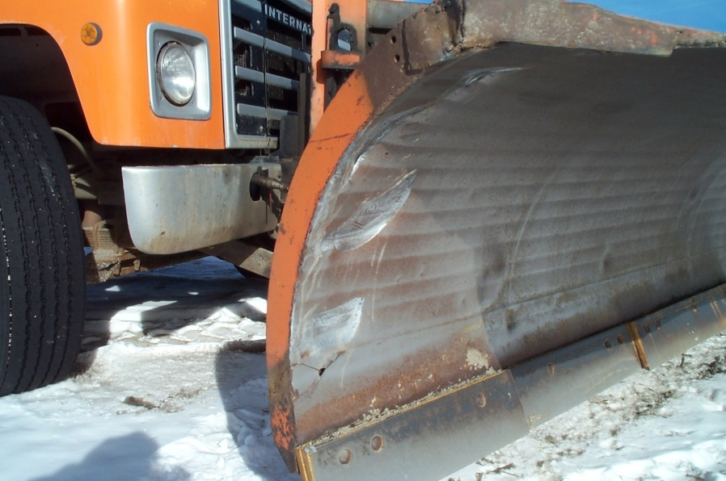
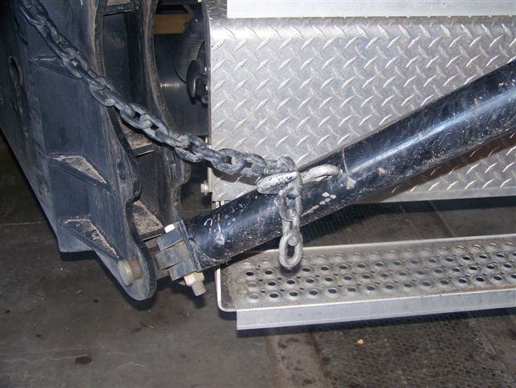
Exceptions continued
Moldboard damage
Failure to chain wing

Slide 17
Exceptions
One of the most important exceptions is the failure to report an accident or incident causing damage or injury
This will cause an immediate Corrective Action.

Slide 18
Second or more serious offense
Step 2
Talk with employee again
Tell the employee what specific changes are needed
Make sure the employee understands all the conditions

Slide 19
Step 2 continued
If it is a training issue:
  What do we need to do?
  What does the employee need to do?
If it is a performance issue:
  Are our expectations reasonable?
  Does he understand what is expected?
  Is the employee trying to improve?

Slide 20
Step 2 continued
After the meeting fill out a PDF explaining:
  The problems
  The corrections to be made
  The length of time given to improve
Review a PDF

Slide 21
Step 2 continued
Why write a PDF after the meeting?
Issues that weren’t apparent before
Employee won’t think he wasn’t given a fair chance to be heard
Conditions for improvement could be agreed upon by all parties

Slide 22
The problem persists
Step 3
Time for more serious action
Formal meeting with employee and Supervisor (and Lead worker)

Slide 23
Step 3 continued
Past warnings reviewed
Corrections that should have been made
Problem or behavior reviewed

Slide 24
Step 3 continued
Performance Improvement Plan
Filled out and reviewed with employee
Can be informally presented at Steps 1 and 2 but should be mandatory at Step 3
Overview Performance Improvement Plan Document

Slide 25
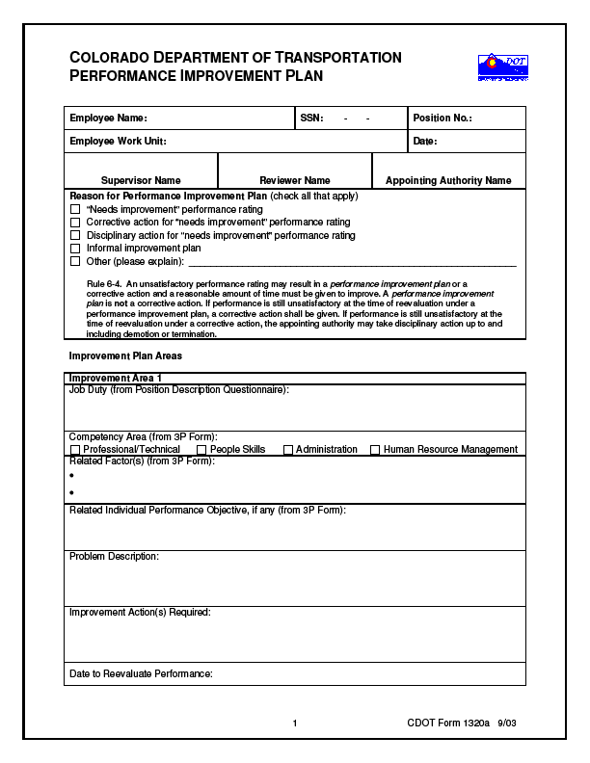
Performance Improvement Form

Slide 26
Step 3 continued
PDF form filled out – again
A Corrective Action may or may not be recommended at this time
Personnel Rules do not require any specific number of Corrective Actions be given before Disciplinary Action

Slide 27
Corrective Action
What is it?
Examples
When to Use
7-8

Slide 28
What Next?
Employee breaks a rule, policy or procedure
Can go directly to Supervisor, Superintendent or RTD, depending on severity
How do we decide what action to take?

Slide 29
Violations and severity
Did the employee know, or should he have known the procedure….?
Was he trained properly?
If a training issue – actions to take are proper training and proper documentation
Should always be done at Step 1 level

Slide 30
Employee properly trained
Depending on severity…
  Go directly to Step 2 or Step 3
For a blatant disregard of a policy or safety rule…
  Definitely request the presence of a Supervisor, who will decide on Superintendents’ involvement
  Examples – alcohol, harassment, violence

Slide 31
Disciplinary Action
What is it?
Types
State Board Rule 6-10
9-10

Slide 32
Factors for type of discipline
Severity
Employee's previous record
Is this repetitive?
What type of discipline would most effectively improve performance?

Slide 33
Progressive Discipline
Relies on the following:
  Employee must know the expectations
  Communication – nip bad habits early
  Maintain adequate documentation
  Investigate all circumstances

Slide 34
Progressive Discipline
Relies on the following: (continued)
  Administer discipline as soon as possible
  Precede formal discipline with warning
  Warn of the result of failure to improve

Slide 35
Document-Document-Document
The Importance
Elements
  Who
  What
  Where
  When
Examples
11-12

Slide 36
Practice
What is the appropriate course(s) of action?
13-15

Slide 37
Things to remember
If we do a Performance Improvement Plan
  Document the progress
  Help the employee meet training requirements
A Corrective Action is not meant to harm the employee, but to correct or improve performance

Slide 38
Things to remember
Disciplinary Actions
  Affect pay, status, tenure up to and including termination
  Cannot be issued without proper documentation which includes
    a training plan
    a chance to improve
  Depends on severity
  Must go through the Personnel Rules (R-6-10)

Slide 39
Points to Consider
Expectations
Documentation
Fair Warning
Problem-Solving
Fairness
Process
Disciplinary Action
Corrective/Disciplinary
Grievance
Dispute Resolution Process
16-18

Slide 40
Preventive Measures
Before You Hire
After the Hire
Poor Performance
  Probationary Employee
  Certified Employee
19-20

Slide 41
Resources
CHRM website
http://www.dot.state.co.us/CHRMEmpCorner/Performance_Mgt.cfm
Supervisor or next level supervisor
Regional Civil Rights manager
Your Appointing Authority
Human Resources Legal (303) 757-6909

Slide 42
Remember
We want to help
If the employees cannot or will not improve, we can’t do anything with them unless we have documented
  the problems
  the efforts we’ve made
  the lack of progress the employee has made…
This is Progressive Discipline

Slide 43
Questions?

Slide 44

Delegation Model
TASK (How complex) (How many steps)
Trust with
analysis
IMPORTANCE
(Consequences)
(Whose Project)
(High/Medium/Low)
PERSON
(How experienced)
(New person)
(Done it before)
Notes:
Brief Slide
Delegation is one of the most important management techniques. It pursues two major goals: One it provides the manager's time to do more productive tasks and two you can professionally grow the employee Delegation is the mechanism that powers growth. Unfortunately, delegation is often accompanied by issues. Here are the typical ones:
It is simply not done. Most managers don't delegate at all and continue working long hours trying to do everything themselves. It negatively impacts their professional growth, because these managers cannot find time to start working on higher-level tasks.
Delegating wrong activities. Some activities you should do.
Delegating to a wrong person. Select a person who has the necessary skills, and who is willing to take more responsibilities. Usually, managers underestimate capabilities of their reports.
Throwing the task "over the wall". You cannot simply tell your report "starting from Monday you are responsible for X" and hope that from now on it will be done right. Successful delegation requires good planning, execution, and control.

Slide 45

Setting Expectations
Wait to be told. or Do exactly what I say. or Follow these
instructions precisely. ****
2. Look into this and tell me the situation. I'll decide.
Look into this and tell me the situation. We'll decide
together.
Notes:
1. Wait to be told." or "Do exactly what I say." or "Follow these instructions precisely."
*****This is instruction. There is no delegated freedom at all.
2 "Look into this and tell me the situation. I'll decide."
This is asking for investigation and analysis but no recommendation. The person delegating retains responsibility for assessing options prior to making the decision.
3 "Look into this and tell me the situation. We'll decide together."
This is has a subtle important difference to the above. This level of delegation encourages and enables the analysis and decision to be a shared process, which can be very helpful in coaching and development.

Slide 46
Setting Expectations
Tell me the situation and what help you need from me in
assessing and handling it. Then we'll decide.
Give me your analysis of the situation (reasons, options, pros and cons) and recommendation. I'll let you know whether you can go ahead.
Decide and let me know your decision, and wait for my go-ahead before proceeding.
Notes:
4. Tell me the situation and what help you need from me in assessing and handling it. Then we'll decide.
This is opens the possibility of greater freedom for analysis and decision- making, subject to both people agreeing this is appropriate. Again, this level is helpful in growing and defining coaching and development relationships.
5. Give me your analysis of the situation (reasons, options, pros and cons) and recommendation. I'll let you know whether you can go ahead.
Asks for analysis and recommendation, but you will check the thinking before deciding.
6. Decide and let me know your decision, and wait for my go-ahead before proceeding.
The other person is trusted to assess the situation and options and is probably competent enough to decide and implement too, but for reasons of task importance, or competence, or perhaps externally changing factors, the boss prefers to keep control of timing. This level of delegation can be frustrating for people if used too often or for too long, and in any event the reason for keeping people waiting, after they've inevitably invested time and effort, needs to be explained.

