Slide 1
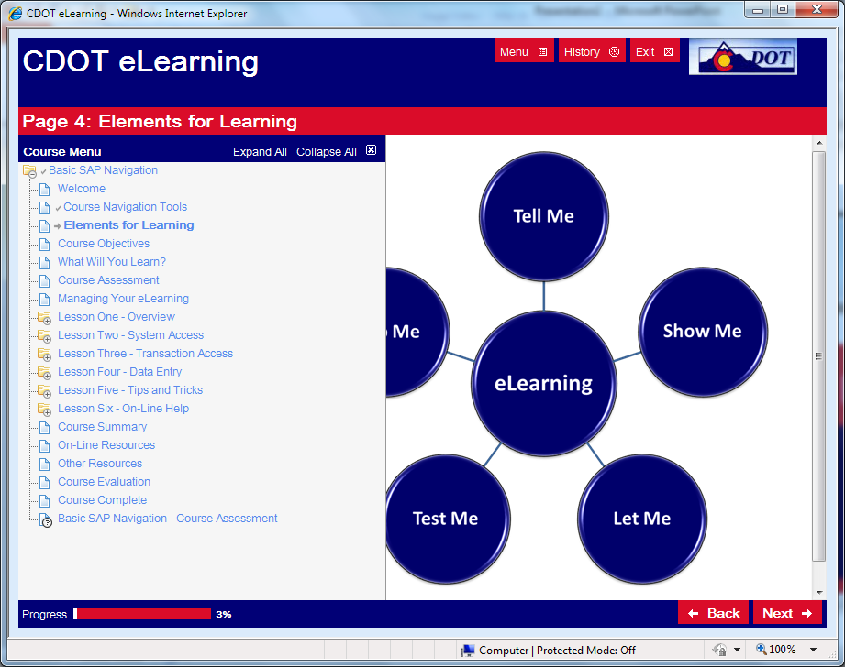
Take a moment to acquaint yourself with the course’s navigation tools.
Roll your cursor over the highlighted navigation tools for an explanation of its purpose.
No Audio

Slide 3
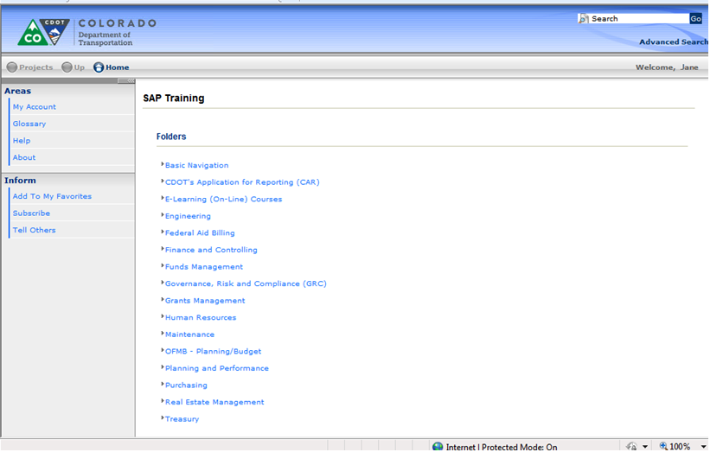

Slide 4
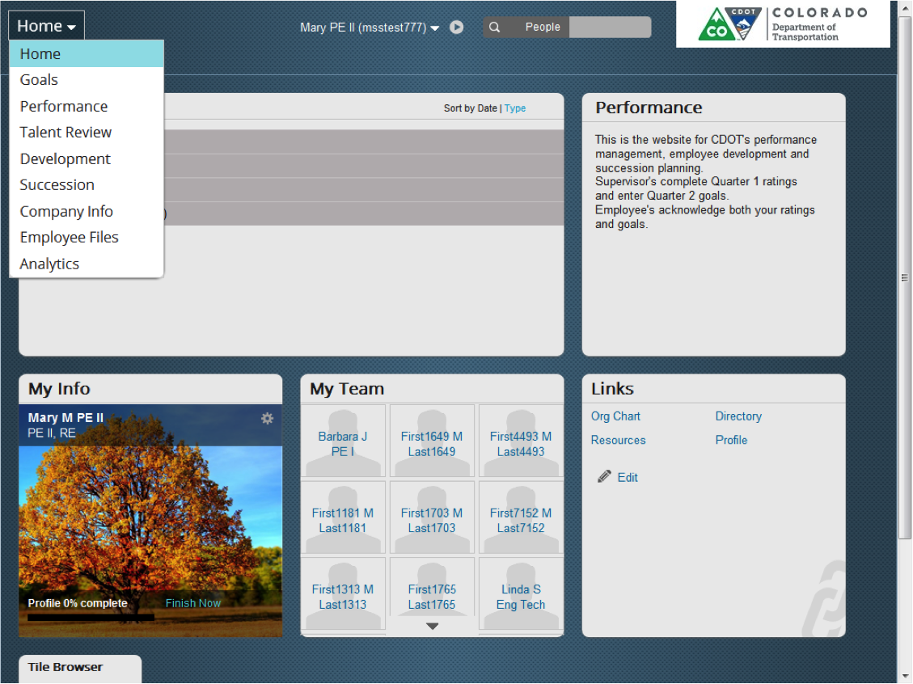

Slide 5
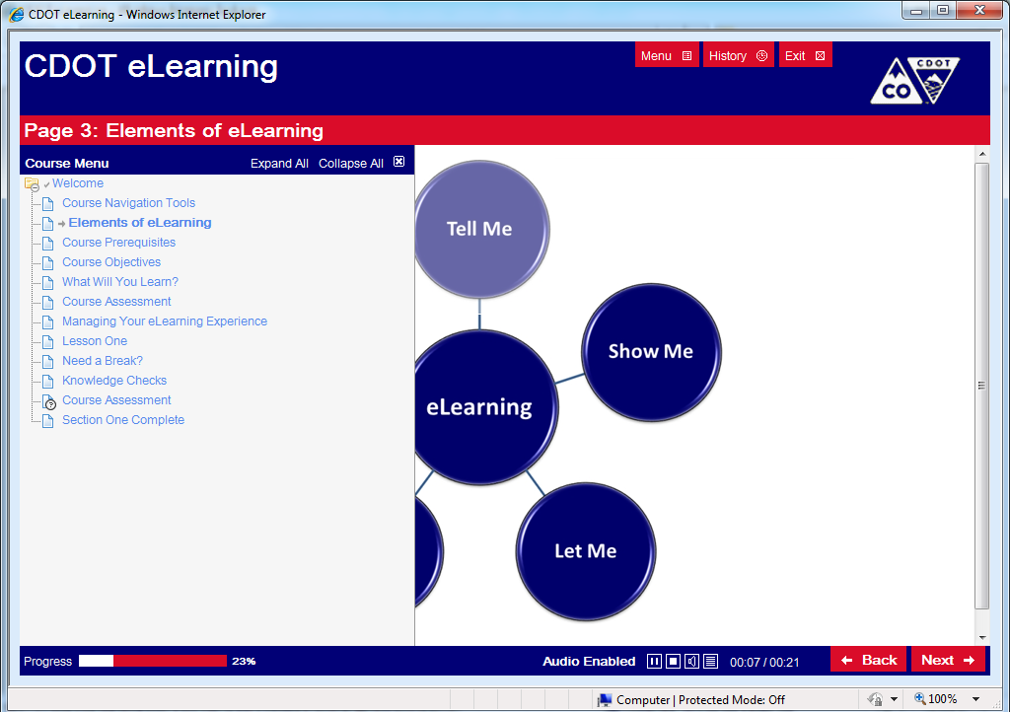
Roll your cursor over the highlighted navigation tools for an explanation of each tool’s purpose.
Audio

Slide 7
Roll your cursor over the graphic for a more detailed description of the tools used for each of the elements in your learning process.
eLearning
Tell Me
Show Me
Let Me
Help Me
Test Me

Slide 10
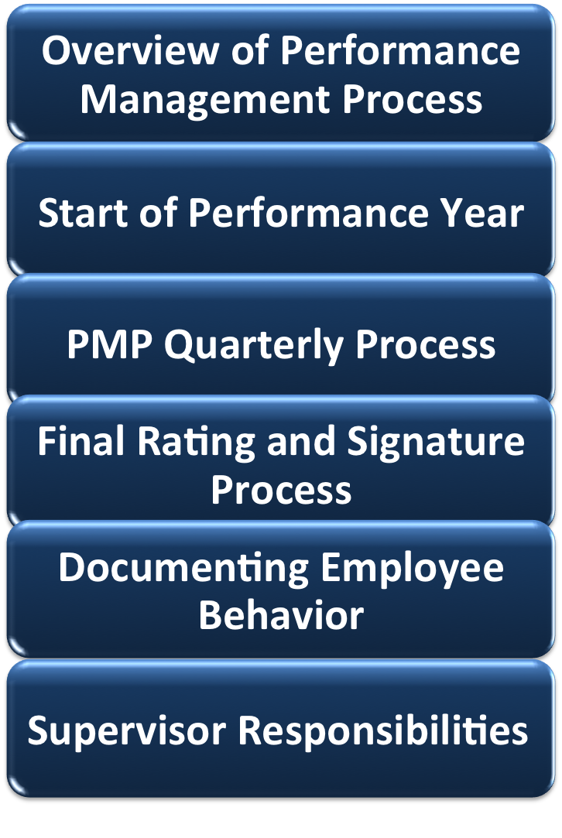
Overview of Performance Management Process
Start of Performance Year
PMP Quarterly Process
Final Rating and Signature Process
Documenting Employee Behavior
Supervisor Responsibilities

Slide 12
XXXX
XXXX
XXXX
XXXX
XXXX

Slide 13
Start of Performance Year
PMP Quarterly Process
Final Rating and Signature Process
Documenting Employee Behavior
Supervisor Responsibilities

Slide 14
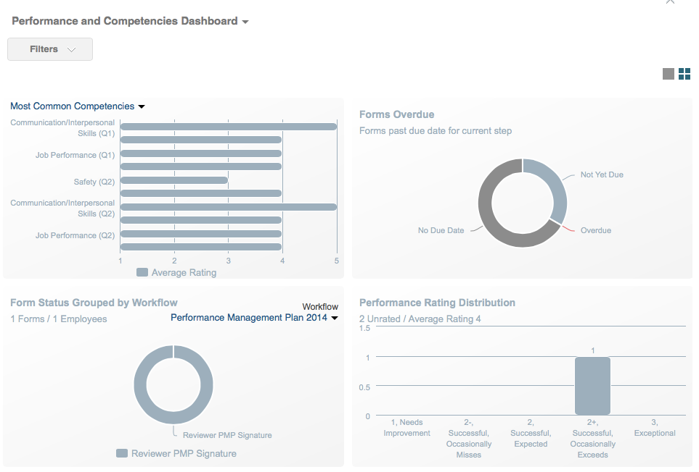

Slide 15
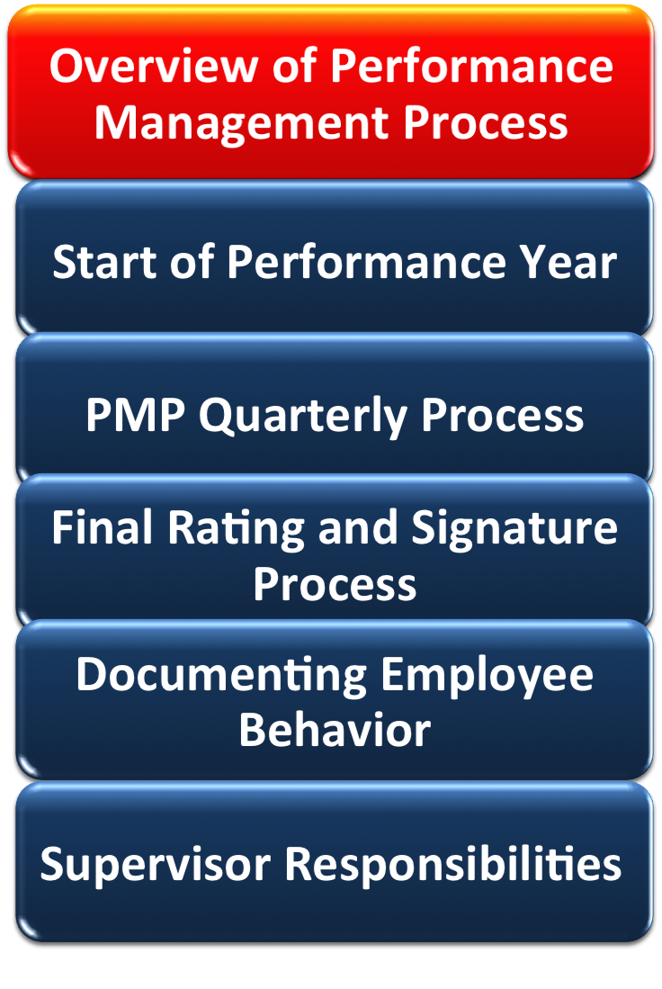

Slide 16
Overview of Performance Management Process
xxxx
xxxx
xxxx
xxxx
Untitled.png

Slide 17
Overview of Performance Management Process
PMP Quarterly Process
Final Rating and Signature Process
Documenting Employee Behavior
Supervisor Responsibilities
Start of Performance Year

Slide 18
Overview of Performance Management Process
Start of Performance Year
Final Rating and Signature Process
Documenting Employee Behavior
Supervisor Responsibilities
PMP Quarterly Process

Slide 19
Overview of Performance Management Process
Start of Performance Year
PMP Quarterly Process
Documenting Employee Behavior
Supervisor Responsibilities
Final Rating and Signature Process

Slide 20
Overview of Performance Management Process
Start of Performance Year
PMP Quarterly Process
Final Rating and Signature Process
Supervisor Responsibilities
Documenting Employee Behavior

Slide 21
Overview of Performance Management Process
Start of Performance Year
PMP Quarterly Process
Final Rating and Signature Process
Documenting Employee Behavior
Supervisor Responsibilities

Slide 22
Term | Definition
Performance Management Plan (PMP) | A document that houses all of the Performance Goals and Competencies for the Performance year. Including the rating and comments made by the Supervisor, Employee and 2nd Level Manager.
Rating | A quarterly and final evaluation of the Employee’s performance throughout the performance year made by the Supervisor and supported through comments.
Development Goal | An optional goal made by the Supervisor or the Employee to help the employee develop new skills. It may cross quarters or performance years depending upon the goal.
S.M.A.R.T. Goal | An acronym used by the Supervisor when creating a goals so that it is: Specific, Measurable, Attainable, Relevant and Time-bound
Performance Goal | A goal created by the Supervisor that is based on the performance of an Employee. The goal must be accomplish within the quarter it is assigned.
Performance Year | The year starting on April 1st and ending on March 31th where all CDOT employees are evaluated on job performance at quarterly intervals.

Slide 24
Reviewer
Reviews recommended performance rating
Provides additional comments
Appointing Authority
Resolves any 2nd level disputes
Reviews Supervisor’s Employee rating
System Admin
Creates PMP forms
Sends email notification to Supervisors
Supervisor
Creates PMP forms, ratings and notes
Provides comments on ratings
Sets all PMP Meetings
Creates additional forms (PIP and PD)

Slide 25
Performance Management Plan
Quarterly Performance Goals (1 to 2)
Job Performance Expectations *
Safety *
Accountability/Credibility *
Communication/ Interpersonal Skills *
Optional Development Goals
Customer Service *
Work Leading Supervision * ★
* Competency
★ Supervisors Only

Slide 26
Performance Management Plan
Job Performance Expectations *
Safety *
Accountability/ Credibility *
Communication/ Interpersonal Skills *
Customer Service *
Work Leading Supervision * ★
* Competency
★ Supervisors Only

Slide 27
Competencies Ratings
Performance Goals Ratings
Next Bi-annual Evaluation Performance Management Plan
New Bi-annual Goals

Slide 29
Quarterly Review Dates
Quarter | Quarter Open / Close | Quarterly Review Meeting Occurs | Manager Creates Goals / Evaluates PMP | Employee Acknowledges PMP
1 | 04/01 to 06/30 | 07/01 to 07/10 | 07/10 | 07/17
2 | 07/01 to 09/30 | 10/01 to 10/10 | 10/10 | 10/17
3 | 10/01 to 12/30 | 01/10 to 01/10 | 01/10 | 10/17
4 | 01/01 to 03/31 | 04/01 to 04/10 | 04/10 | 04/17

Slide 32
Bi-annual Review Dates
Evaluation | Open / Close | Bi-annual Evaluation | Supervisor Creates Evaluates PMP |  | Employee Acknowledges PMP
Mid-year | 04/01 to 09/30 | 10/01 to 10/10 | 10/10 |  | 10/17
Year-end | 10/01 to 03/31 | 03/15 to 04/01 | 04/01 |  | N/A
Final Performance Review
Step |  |  | Due by | Action
Year-end rating review |  |  | 4/1 | Supervisor meets with Employee to review year-end ratings
Performance rating recommendation |  |  | 4/01 | Supervisor develops final rating recommendation and speaks with reviewer
Performance rating decision |  |  | 4/08 | Supervisor, reviewer finalize Employee’s final Performance rating
Employee is notified of final rating Supervisor |  |  | 04/15 | Supervisor Signs PMP
Employee acknowledges rating |  |  | 04/22 | Employee signs PMP / Supervisor reviews comments
Performance Planning
Step |  |  | Due by | Action
System Admin Releases Next Performance Year |  |  | 03/15 | System Admin sends email
New Performance Year Begins |  |  | 04/01
Next Year Performance Plan Meeting |  |  | 03/15 to 04/01 | Supervisor edits and writes goals for next Performance Year

Slide 34
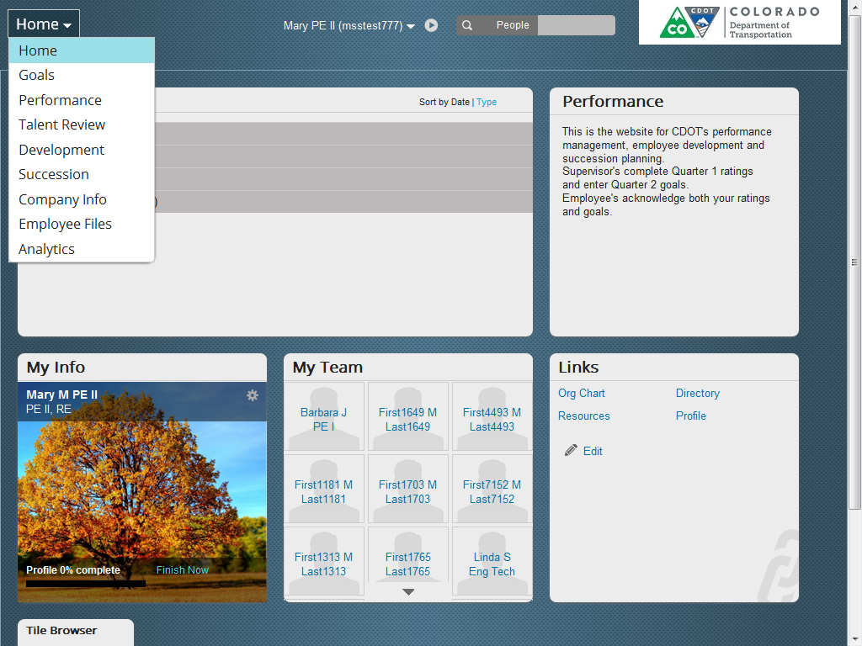
Notes:
The Home drop-down takes you to the most commonly used pages. These include:
Home – Takes you back to the Home page regardless of where you are in the system
Goals – Displays your Performance Goals for the year
Performance – Allows you to display forms and see the status of all open forms
Development – displays your optional Development goals
Succession - Display an organizational chart of your employees
Company Info – Display an organizational chart of you employees
Employee Files - Displays you employee details and an organizational chart of
Analytics- Display summary information such as forms overdue, where forms are in workflow and performance and Competency dashboards
Account Navigation drop-down – allows you to log out of the system
People – allows you to search for an employee by first or last name
Performance – Provides details about what is due
My info – Clicking in the Cog icon allows you change your profiles, goals and display an organizational chart
My Team – contains tiles that display your employees and, once clicked on, the details of the employee’s such as notes, and profiles, PMP and Organizational chart

Slide 35
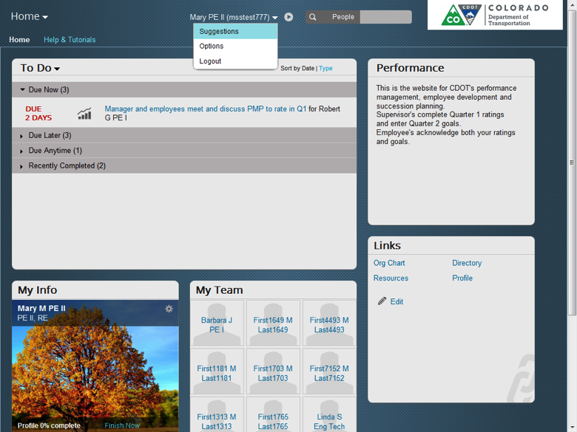

Slide 36
Start of performance Plan Year
Employee
Acknowledges Performance Plan and adds comments
System Admin
Notifies Supervisors of Performance Plan Year Start
Supervisor and Employee
Meet to discuss the Employee’s PMP for the year
Supervisor
Reviews Employee Comments
Supervisor
Sends Performance Plan Meeting request to Employee
Prepares for Performance Plan Meeting
Supervisor
Creates PMP in SuccessFactors by adding Performance Goals, Development Goals and comments based on Performance Plan Meeting

Slide 37
PMP

Slide 41
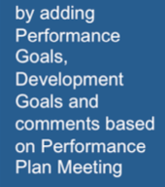

Slide 45
2nd Level Manager
Reviews recommended performance rating
Provides additional comments
Appointing Authority
Resolves any 2nd level disputes
Reviews Supervisor’s Employee rating
Employee
Participates in all meetings
Acknowledges (signs) PMP forms and ratings
Provides rating comments
Supervisor
Creates PMP forms, ratings and notes
Provides comments on ratings
Sets all PMP Meetings
Creates additional forms (PIP and PD)

Slide 46
Specific - Goals must be clear, concise, and simple to understand. Someone not familiar with your work area should be able to read the goal quickly and easily and understand the nature of the work
Measurable - Goals must be measurable and quantifiable wherever possible. Examination of completed work should lead to a determination of whether goals were accomplished. Manager and employee need to agree on the measurement.
Achievable - Although goals should stretch and challenge an employee’s capabilities, they must be within reach.
Relevant - Must be in alignment with Unit Work Plan, Regional and Division goals, and the overall CDOT Vision and Objectives.
Time-bound - Goals should be time-bound and trackable. Manager and employee should be able to monitor progress toward the goals in order to allow mid-course corrections.
S
M
A
R
T

Slide 48
Quarterly Review Process
Employee
Acknowledges bi-annual review and adds comments
Supervisor
Reviews Employee Comments
Supervisor
Sends Meeting request to Employee
Prepares for Performance Plan Meeting
Supervisor
Rates/comments on the Employee’s Performance Goals
Rates/comments on the Competencies based on performance
Supervisor and Employee
Meet to discuss the Employee’s Performance on the bi-annual evaluation of Performance Goals and Competencies
Add Performance Goals for the next period to PMP

Slide 56
Review Unit Work Plan
Review Changes to PMP
Conduct Bi-annual Goal Evaluation
Create New Bi-annual Goals
Review Competency
Review Unit Work Plan
Review Changes to PMP
Conduct Bi-annual Goal Evaluation
Create New Bi-annual Goals
Review Competency
Review Unit Work Plan
Review Changes to PMP
Conduct Bi-annual Goal Evaluation
Create New Bi-annual Goals
Review Competency
Review Unit Work Plan
Review Changes to PMP
Conduct Bi-annual Goal Evaluation
Create New Bi-annual Goals
Review Competency
Review Unit Work Plan
Review Changes to PMP
Conduct Bi-annual Goal Evaluation
Create New Bi-annual Goals
Review Competency
Review Unit Work Plan
Review Changes to PMP
Conduct Bi-annual Goal Evaluation
Create New Bi-annual Goals
Review Competency

Slide 57
Review Unit Work Plan
Review Changes to PMP
Conduct Bi-annual Goal Evaluation
Create New Bi-annual Goals
Review Competency
Exceptional (5 stars)
Successful Occasionally Misses (4 stars)
Successful Expected (3 stars)
Successful Occasionally Misses Expectations (2 stars)
Needs Improvement (1 star)
3
2+
2
2-
1
Notes:
3 This rating represents a consistently exceptional employee with documented performance achievements or an employee who shows consistently superior achievement(s) beyond the regular assignment. Employees at this level make exceptional contribution(s) and have a significant and positive impact on the performance of the unit or the organization and may materially advance the mission of the organization. This employee provides a model for excellence and helps others to do their jobs better. Peers, immediate supervision, higher-level management and others can readily recognize such a level of performance. This should be used when, for example, an employee regularly performs beyond his or her job expectations, or when there’s been an extraordinary contribution that enhances processes or procedures used on a larger scale.
2+ This rating level encompasses those employees whose performance on a competency is in between successful and exceptional. At times, performance highlights exceptional work by demonstrating superior achievement; however, not consistently enough to warrant a Level 3. This rating should be used when an employee does very well those items listed in his or her PDQ and PMP form.
2 This rating level encompasses a range of expected performance. It includes those employees who exhibit competent work behaviors, skills, and assignments for the job as well as those employees who are successfully developing in the job. These employees are meeting all the expectations, standards, requirements, and objectives in their performance plan and, on occasion, may exceed them. This is an employee who reliably performs the job assigned.
2- This rating level encompasses those employees whose performance on a competency is in between needs improvement and successful. At times performance slides below meeting all the expectations, standards, requirements, and objectives on their performance plan; however, not enough to warrant a Level 1.
1 Unsuccessful employee needs improvement.

Slide 58
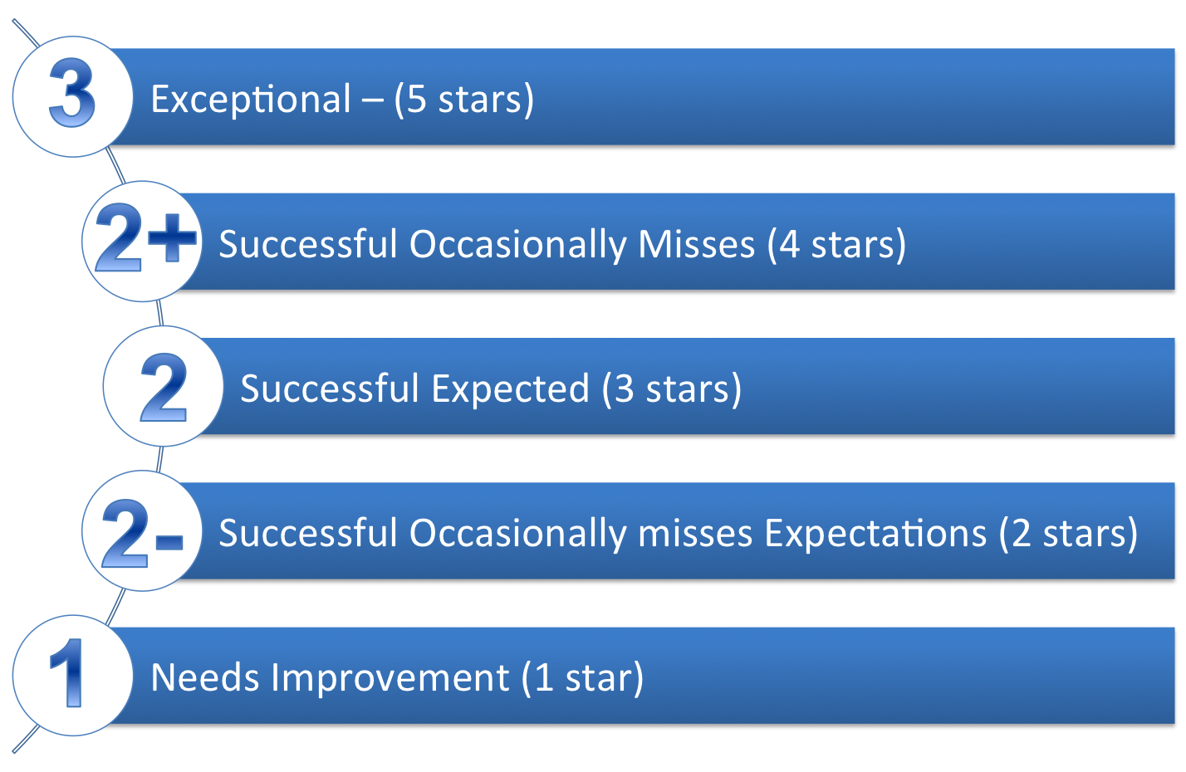
Review Unit Work Plan
Review Changes to PMP
Review this Quarter Goals
Create New Goals for Next Quarter
Review Competency
Review Optional Development Goals

Slide 59
Review Unit Work Plan
Review Changes to PMP
Conduct Bi-annual Goal Evaluation
Create New Bi-annual Goals
Review Competency
Specific - Goals must be clear, concise, and simple to understand. Someone not familiar with your work area should be able to read the goal quickly and easily and understand the nature of the work
Measurable - Goals must be measurable and quantifiable wherever possible. Examination of completed work should lead to a determination of whether goals were accomplished. Manager and employee need to agree on the measurement.
Achievable - Although goals should stretch and challenge an employee’s capabilities, they must be within reach.
Relevant - Must be in alignment with Unit Work Plan, Regional and Division goals, and the overall CDOT Vision and Objectives.
Time-bound - Goals should be time-bound and trackable. Manager and employee should be able to monitor progress toward the goals in order to allow mid-course corrections.
S
M
A
R
T

Slide 60
Rating Error | Description / Example
Strictness or Leniency | This is defined as the tendency to rate all employees too low or too high. For example, rating all employees as Level 3 – Exceptional.
Halo / Horns | This is the tendency to allow a single good or bad aspect of an employee’s performance to affect all other, including unrelated, aspects of the employee’s performance. For example, regularly providing breakfast for the staff unfairly affects ratings in other unrelated areas in a positive manner.
Recency of Events | This tendency allows a recent event to disproportionately affect the employee’s overall performance rating. For example, a single complaint from a customer biases the employee’s overall rating for the entire evaluation period.

Slide 61
Supervisor
Enters Final Ratings and Comments
Supervisor and Employee
Meet to discuss the Employee’s Final Ratings
Reviewer
Reviews Supervisor Ratings and Comments
As required suggests changes
Supervisor
Modifies PMP if required
Signs final PMP
Employee
Signs the PMP by May 8th
Supervisor
Ensures Employee Signs
Manager Sigs Final PMP
Final PMP resides in the Inbox of the Supervisor and Employee

Slide 62
Final Review Process
Supervisor
Sends Performance Review Meeting request to Employee
Supervisor and Employee
Meet to discuss the Employee’s Final Performance Review
Employee
Signs the Final PMP Rating
Supervisor
Ensures Employee Signs Final PMP
Supervisor
Enters Final Ratings and Comments
Supervisor
Releases the Final Performance Review to the Employee
Reviewer and Appointing Authority
Reviews Supervisor Ratings and Comments
As required suggests changes

Slide 65
Exceptional (5 stars)
Successful Occasionally Misses (4 stars)
Successful Expected (3 stars)
Successful Occasionally Misses Expectations (2 stars)
Needs Improvement (1 star)
3
2+
2
2-
1

Slide 69
Employee unable to sign final rating | Employee refuses to sign PMP form | Employee disagrees with final rating | Failure of a supervisor to give a final rating
If an employee is unable to sign the PMP form containing the final rating due to, e.g., medical leave, the supervisor contacts their HR Specialist so the form can be manually routed for completion. The HR Specialist will provide a notation regarding the circumstances involved. | If an employee refuses to sign the PMP form, the supervisor contacts their HR Specialist so the form can be manually routed for completion. The HR Specialist will provide a notation regarding the circumstances involved. The supervisor’s rating stands as the employee’s final performance rating unless the employee successfully challenges the rating | An employee can provide a comment saying they disagree with the final rating and electronically acknowledge the form. The rating stands as the employee’s final rating unless the employee successfully challenges the rating by following the dispute resolution process. | Absent extraordinary circumstances, failure by a supervisor to provide a timely rating may result in a corrective action, disciplinary action, and/or ineligibility for a salary adjustment (Personnel Board Rule 6-5).

Slide 71
Supervisor and Employee
Meet to discuss the reason for the Performance Improvement Plan
Supervisor
Creates the Performance improvement Plan and sends to Employee
Employee
Acknowledges Performance Improvement Plan
Supervisor
Completes the Performance Improvement Plan by documenting the results of the Plan

Slide 72
Supervisor and Employee
Meet to discuss the reason for the Performance Document
Supervisor
Creates the Performance Document and sends to Employee
Employee
Acknowledges Performance Improvement Plan
Supervisor
Reviews Employee Comments
Signs Performance Document

Slide 73
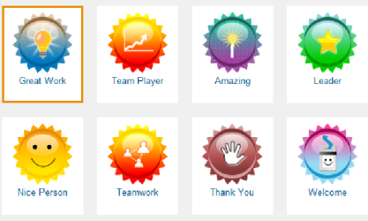
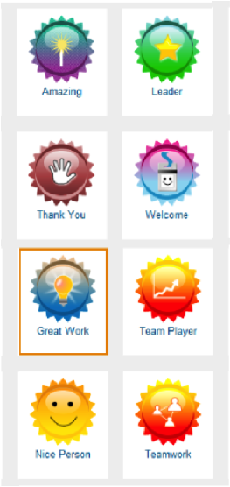

Slide 74
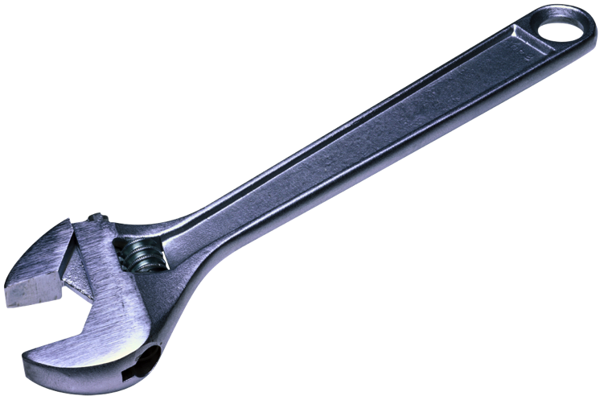

Slide 77
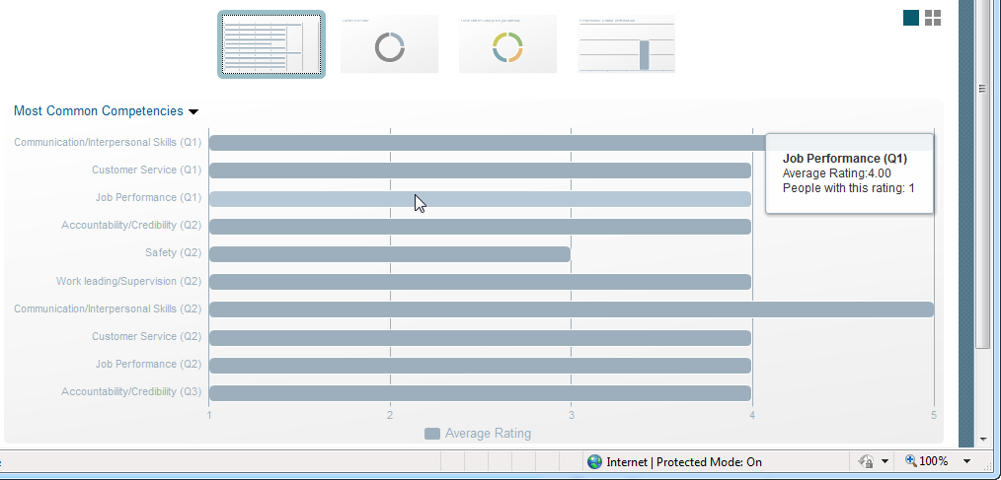

Slide 78
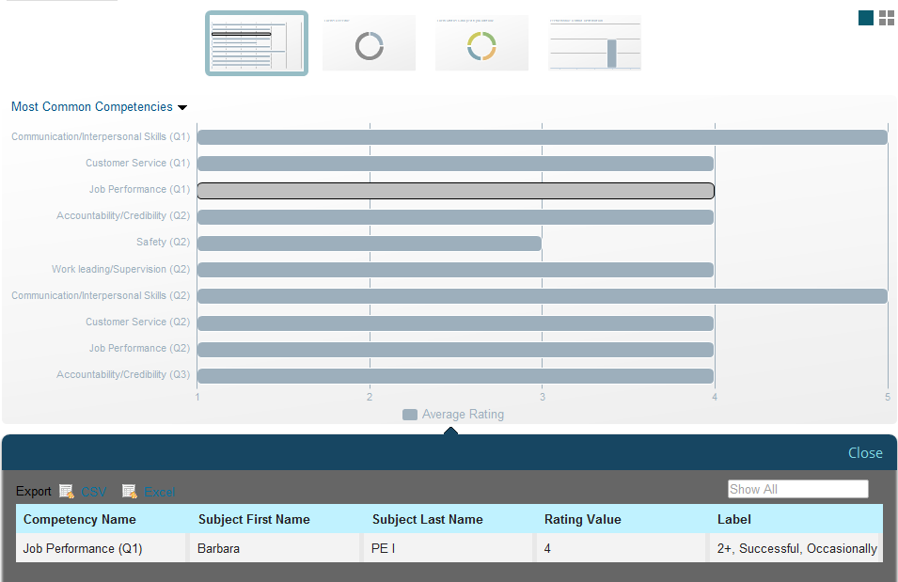

Slide 83
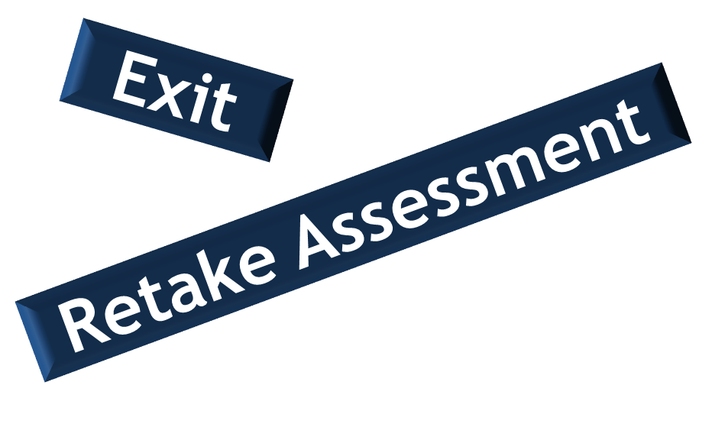

Slide 86
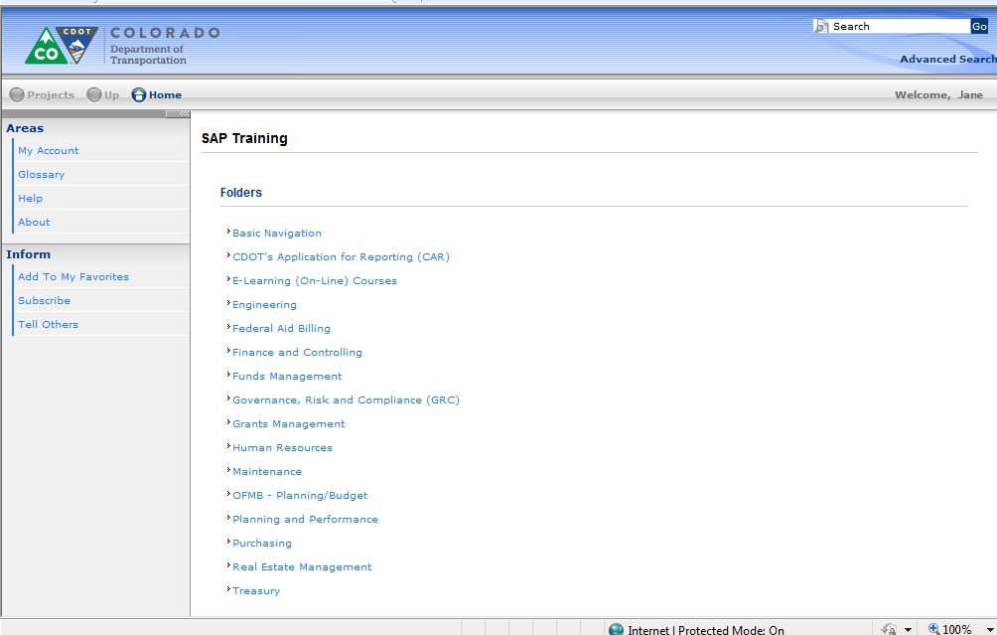

Slide 87
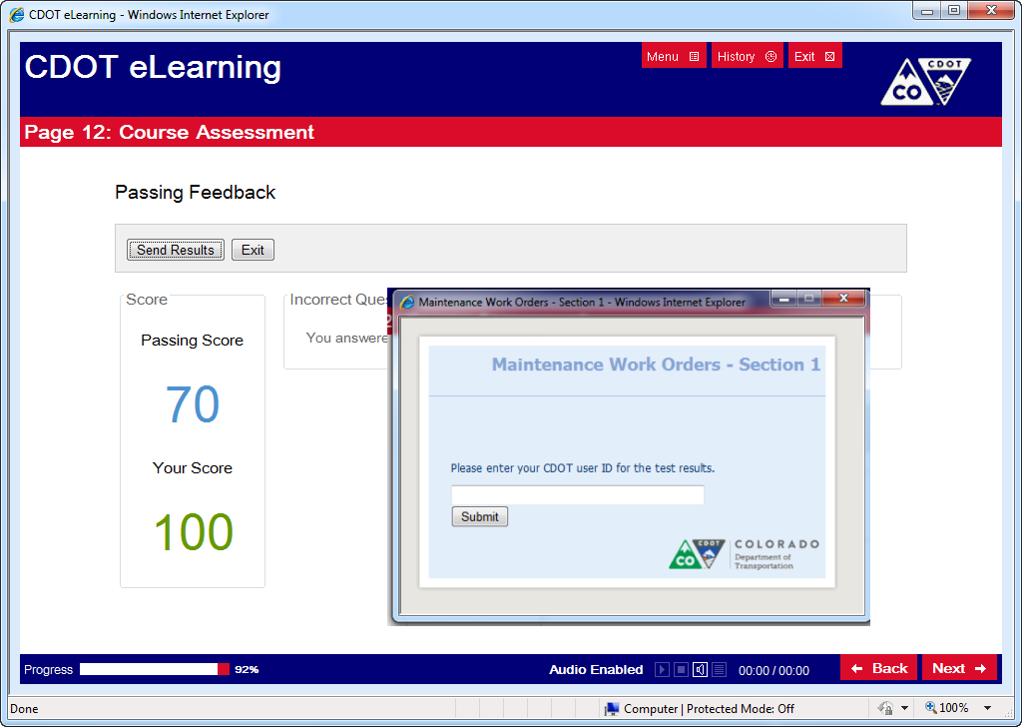
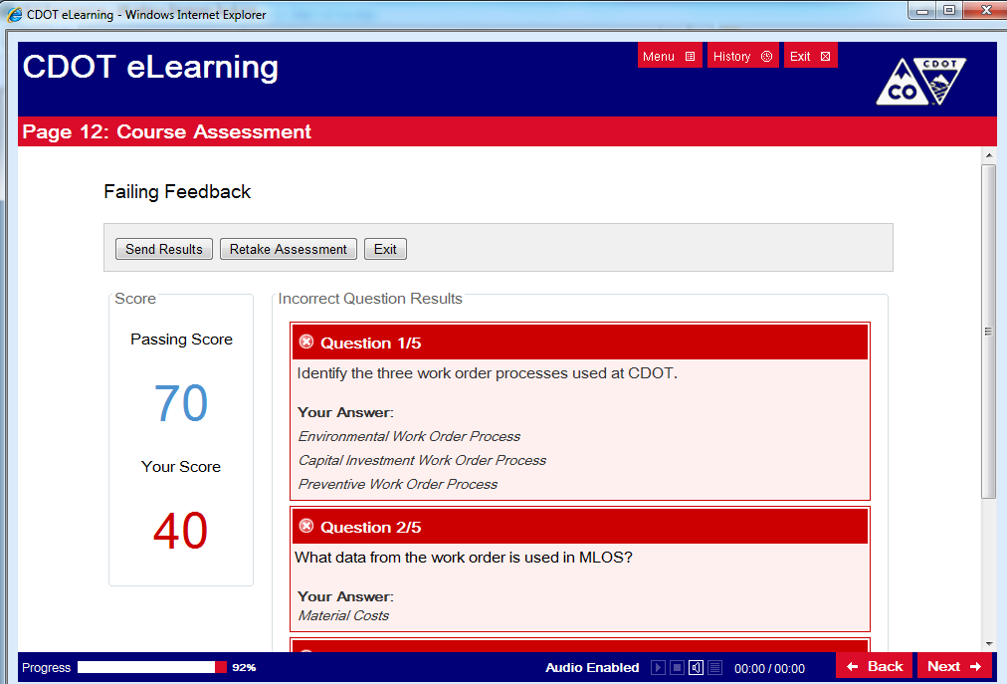

Slide 88
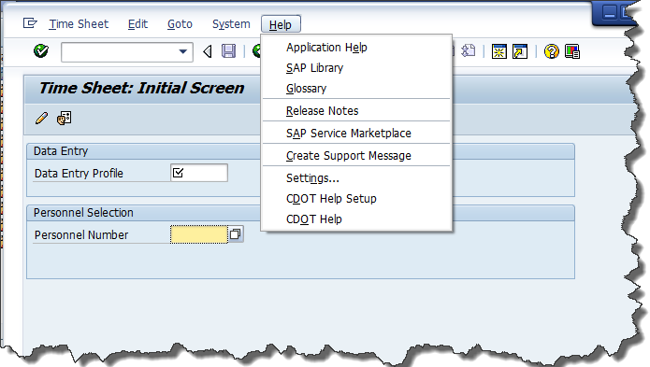

Slide 89
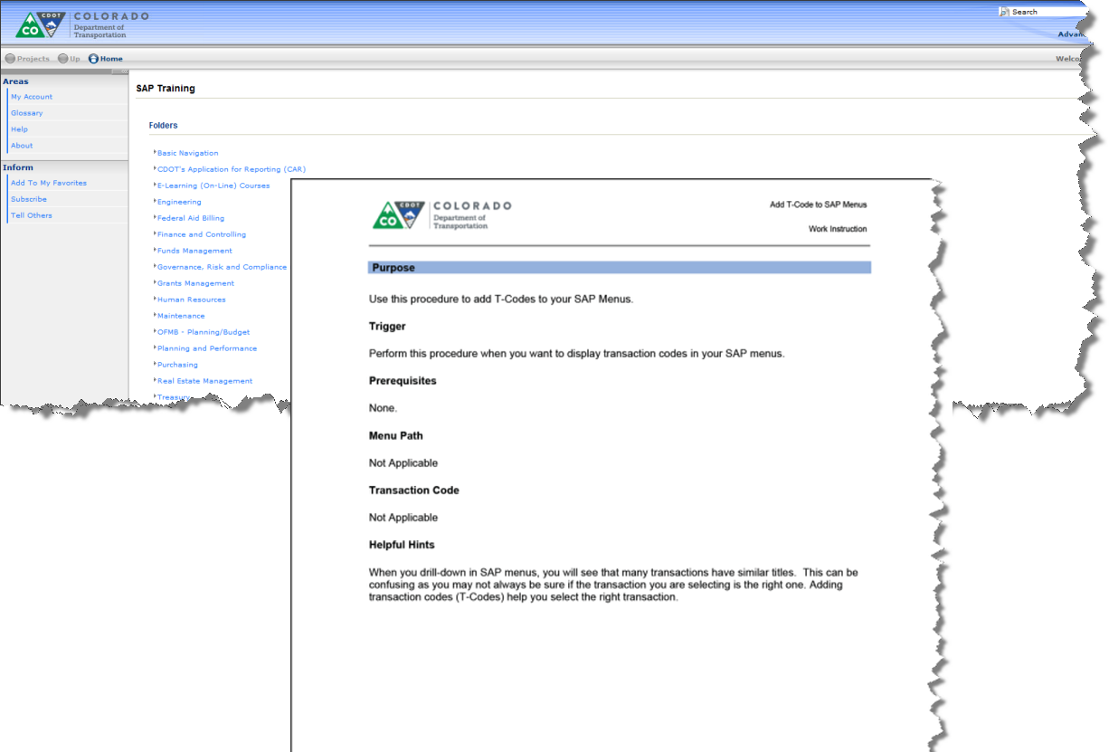

Slide 90
