Slide 1
TSM&O Evaluation
Region traffic representative Training
Notes:
Welcome to TSM&O Evaluation training. We plan to spend about an hour and a half providing you with information you will need as a Region Traffic Representative to effectively execute this process.
This is a recorded session, so I’d like to remind people to submit questions via zoom. We will have a few check points along the way to answer live questions.
I’d like to introduce everyone in the room that will participating in the training today.

Slide 2
Optional File Download
Would you like a copy of this file to reference?

Slide 3
Topics
TSM&O Evaluation Background & Timeline
Why TSM&O Evaluation Process?
What is the TSM&O Evaluation?
Project Managers’ Roles and Responsibilities
Region Traffic Representatives’ (RTR) Roles and Responsibilities
Resources for the RTR
Please submit questions via Zoom to be addressed at the end of the section
Notes:
Use Charles from PM training

Slide 4
TSM&O Evaluation Background & Timeline
We are here now
2014-June 2015
June 2015
Sept 29-Oct 1
Oct-Dec
January 2016+
Operations Clearance Pilot Program
Lean Rapid Improvement Event
All Region Implementation Planning Workshop
TSM&O Implementation
Preparation
TSM&O Evaluation for All Projects
Sponsor Coalition formed
Operations Clearance process piloted
Initiated process refinement
TSMO Evaluation not Clearance
Process integrated with CDOT project planning process
Region Traffic Representative identified as point person for TSMO Evaluation
SAP Milestone for TSMO Evaluation
Align regions on TSMO Evaluation process
Define clear roles and accountability
Develop Implementation and Communications Plans
Identify and refine:
TSMO Evaluation process details
Checklists/ questionnaires
Documentation requirements
TSMO Evaluation required for all projects in Design Scoping after Feb 1, 2015
Training provided for PMs and RTRs
Process metrics initiated
Ongoing refinement
Executive Sponsors:
Ryan Rice
Josh Laipply
Contributors:
  Region Traffic Engineers
  Program Engineers
  Resident Engineers
  Project Development
  HQ Safety, Operations, and ITS
Notes:
Use PM training

Slide 5
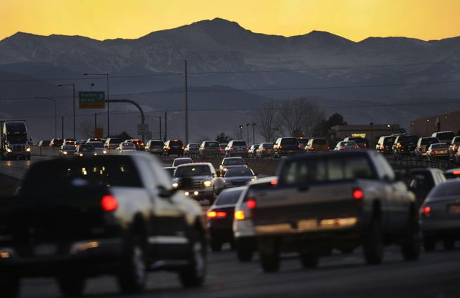
Why TSM&O Evaluation?
CDOT leaders have recognized that we cannot build our way out of future congestion and must employ new innovations, recognized improvement strategies and technology to safely move increased traffic volumes
The purpose of the TSM&O Evaluation is to evaluate the project area and make recommendations to the project team that improves reliability, safety, quality of life, and traveler information
Mobility and safety improvement and innovation is a national trend and CDOT is at the forefront of this movement
Colorado’s front range population is projected to increase 50% by 2050 while freeways and older streets have little room for expansion.
-Sunday Denver Post, Dec. 20, 2015
TSM&O Video
Let’s hear the perspective of CDOT executive sponsors Ryan Rice and Josh Laipply on this important initiative.
Notes:
Use PM training

Slide 6
Video From Our Sponsors
Notes:
Use PM training

Slide 7
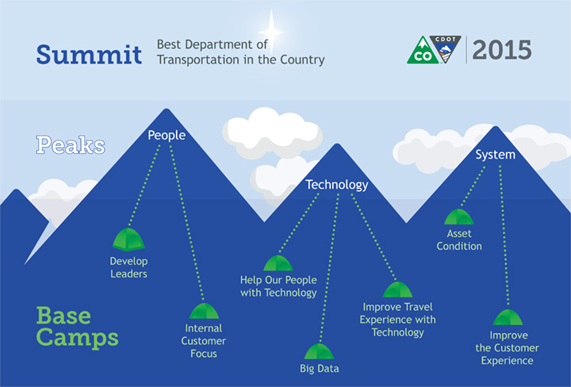
CDOT’s 3 Peaks
Notes:
We have all been hearing about CDOT’s 3 Peaks. The TSM&O Evaluation spans across many initiatives and here is how they relate
Under the People Peak, improving upon our internal customer focus will expand the skills of our people by providing an understanding each others roles and responsibilities.
Under the Technology peak, recommendations will move us towards improving the travel experience using technology
Finally, under the System peak, the Evaluations will help improve the customer experience. Examples include better real-time travel information, improved reliability, and moving toward zero deaths
By considering safety, ITS, and operations early and throughout the design process, CDOT will optimize its limited resources to make the right decisions for transportation improvements and deliver the best projects possible for the public.

Slide 8
What is a TSM&O Evaluation and when does it start?
Safety
Operations
ITS
The Transportation Safety Management &Operations (TSM&O) Evaluation consists of three parts; Safety, Operations, and ITS analyses
The TSM&O Evaluation Process is aligned with the CDOT Project Development Process and will be included in the manual
The TSM&O Evaluation will evaluate the project area and make recommendations to the project team for improvements related to Safety, Operations, and ITS
Beginning January 1, 2016 all projects with a Design Scoping Review on or after February 1, 2016 will require a TSM&O Evaluation.
TSM&O Evaluation
Recommendations
Improvements Incorporated in Project
Notes:
Use PM training

Slide 9
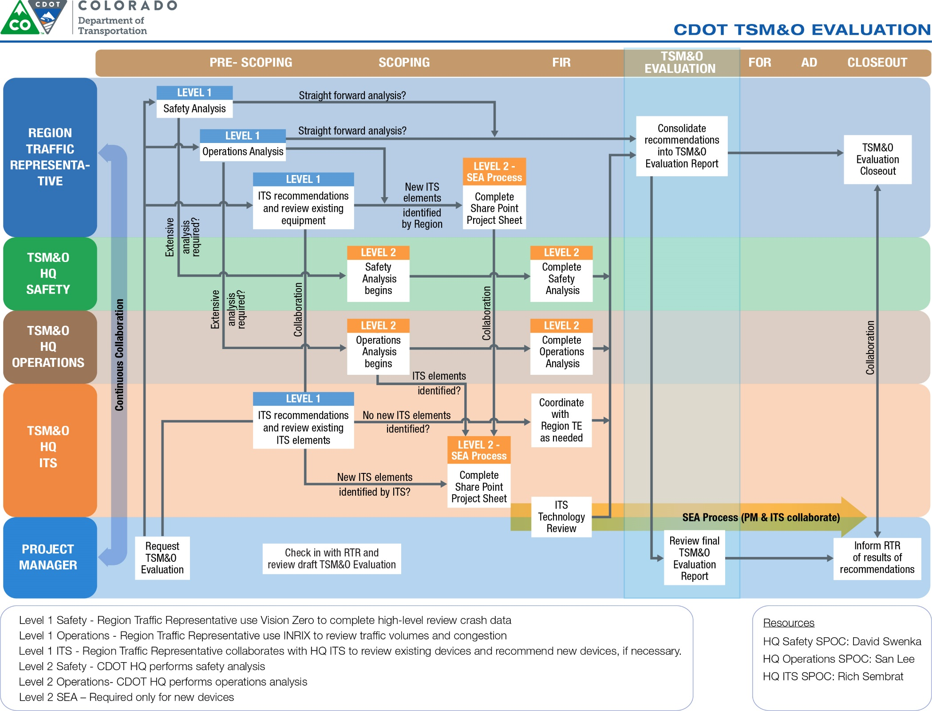
Notes:
Use PM training

Slide 10

Who performs a TSM&O Evaluation?
The Region Traffic Representative (RTR) for a particular project will complete a Level 1 TSM&O Analysis
Based upon the Level 1 analysis, the RTR may initiate a Level 2 analysis from HQ Support Groups
If new or existing ITS devices are identified, a Level 2 ITS analysis will be required. For new ITS devices, a Level 2 ITS analysis may include a Systems Engineering Analysis (SEA), in accordance with FHWA requirements
Notes:
Use PM training

Slide 11

Project Manager Responsibilities
Establish the TSM&O milestone in SAP
Request TSM&O Evaluation
Collaborate with RTR and review final TSM&O Evaluation Report
Coordinate with RTR to complete TSM&O closeout
Note: See TSM&O Design Bulletin for details on how to establish the SAP milestone
Notes:
Use PM training

Slide 12
RTR Responsibilities
Setup the TSM&O Evaluation
Perform Level 1 Safety, ITS, and Operations Analyses
If the Region desires new ITS elements, then the RTR initiates the SharePoint project sheet.
If necessary, request Level 2 Safety, ITS, or Operations Analysis
Consolidate Recommendations into TSM&O Evaluation Report and transmit to PM
TSM&O Evaluation Closeout
Notes:
Start of Section 2.
Script:
All right, let’s get back to it. This is the start of the RTR specific training. In this section, we’ll go over all of the RTR responsibilities during the TSM&O Evaluation process and how to conduct them. Check out the top row of the flow chart. First we’ll tell you how to initiate and set up the TSM&O Evaluation, then how to perform the Level 1 Safety, ITS, and Operations Analyses, how to request a Level 2 Analysis and consolidate all recommendations into the final TSM&O Evaluation report. Finally, we will describe the TSM&O Evaluation closeout process that you as the RTR will conduct in cooperation with the project manager.
As a reminder, we will have a few check points along the way, so please keep submitting your questions. Here we go!

Slide 13

Setup the TSM&O Evaluation
PM will request TSM&O Evaluation via email
The email request will be sent to the RTR Point of Contact (RTR POC) for the region, as well as the ITS POC
The RTR POC will assign an RTR to conduct the TSM&O Evaluation
RTR POC: Copy the PM on the email assigning an RTR so the PM knows who is conducting the TSM&O Evaluation. If the RTR POC is conducting the TSM&O Evaluation, notify the PM.
In SAP Timesheets, document all TSM&O Evaluation time spent by including Rec Order 200664
  This is for tracking purposes only
Notes:
The first step for the RTR is to set up the TSM&O Evaluation.
During the pre-scoping stage of the project, the Project Manager will send a TSM&O Evaluation Request to the Region Traffic Engineer Point of Contact (RTR POC). This will come to the RTR POC in the form of an email attachment. The RTR POC may act as the RTR and conduct the evaluation themselves, or may assign a different person.
It is important for the PM to know who is conducting the TSM&O Evaluation. We ask that the RTR POC notify the PM if they are conducting the TSM&O Evaluation themselves, or copy the PM on the email that assigns an RTR to the TSM&O Evaluation.
Additionally, please use the Rec Order 200664 in your timesheet any time you are working on the TSM&O Evaluation.

Slide 14
Setup the TSM&O Evaluation
Create a TSM&O Evaluation Folder in the HQ TSM&O (TRAFTSMOEVAL) shared drive at:
\\public\traftsmoeval\evaluations
Folder Structure:
SHXXX\SHXXXX_YYYYY-YYYYY_(ZZZZZ)
XXX = State Highway Number
XXXX = State Highway Number and Section (e.g. SH070A, SH285D)
YYYYY = Milepoint Limits (e.g. MP 0.00 to MP 1.52 = 00000-00152, MP 90.50 to 112.00 = 09050-11200)
ZZZZZ = Project Sub Account Number (if not available, folder name will be SHXXXX_YYYYY-YYYYY)
Save the TSM&O Evaluation Request in this folder
It is important to create the project folder and save the TSM&O Evaluation Request and TSM&O Evaluation spreadsheet upon receipt of the Request so that ITS is able to begin their analysis.
Notes:
Once the RTR is assigned and the RTR receives the TSM&O Evaluation Request from the PM, the process can be initiated.
The first step is for the RTR to create the folder where ALL TSM&O Evaluation related materials will be saved. This folder will be used throughout the TSM&O Evaluation lifecycle.
The RTR should access the intranet and navigate to the folder shown in the slide. In the “Evaluations” folder, there is already a folder created for each state highway in Colorado. Navigate to the state highway for your TSM&O Evaluation. This is signified with the SHXXX forward slash in the folder path shown in the slide.
In the appropriate SHXXX folder, create a new folder for the TSM&O Evaluation. The folder naming convention is shown in the slide. It is important to follow this naming convention and use the Highway, Section, Milepoint limits, and Project Subaccount number, because this folder name will be used to search and find TSM&O evaluation recommendations.
Once the folder is created, save the TSM&O Evaluation Request in the folder. Next step!

Slide 15
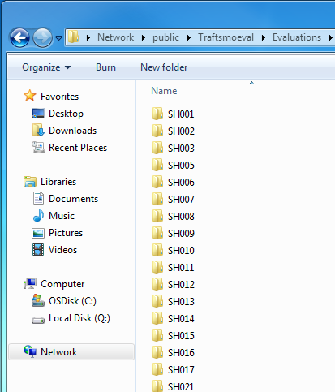
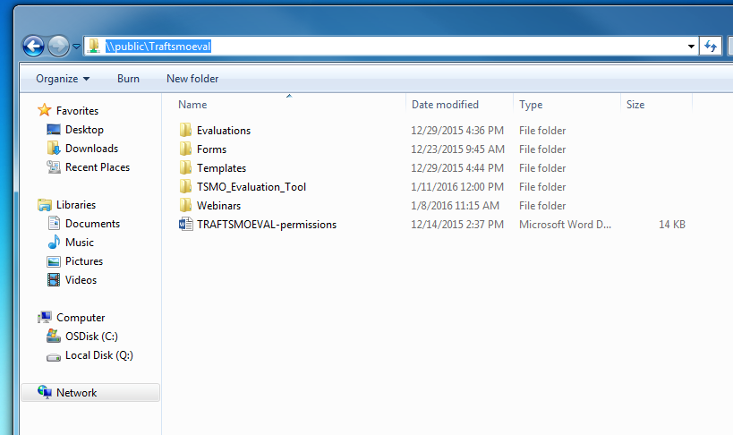
Setup the TSM&O Evaluation
Notes:
Here are some screenshots of the headquarters folder structure. If you follow the link on the main page, you will be taken to the folder structure on the left. The folder structure on the right shows the state highway folders where the RTR will create the TSM&O Evaluation Folder

Slide 16
Setup the TSM&O Evaluation
Download the latest version of the TSM&O Evaluation spreadsheet tool at:
http://cdot.dot.state.co.us/business/tsm-o/evaluation/resources
Always download the latest version. The tool will be updated as corrections are identified.
Save the TSM&O Evaluation Spreadsheet Tool in the TSM&O Evaluation Folder
Notes:
Script: Once the project folder has been created, you will need to download the TSM&O Evaluation spreadsheet tool. We ask that you download a new copy of this spreadsheet from the CDOT website before beginning a new project because we will be placing new versions online as it is refined over time. Next, save a copy of the spreadsheet tool in your project folder.

Slide 17
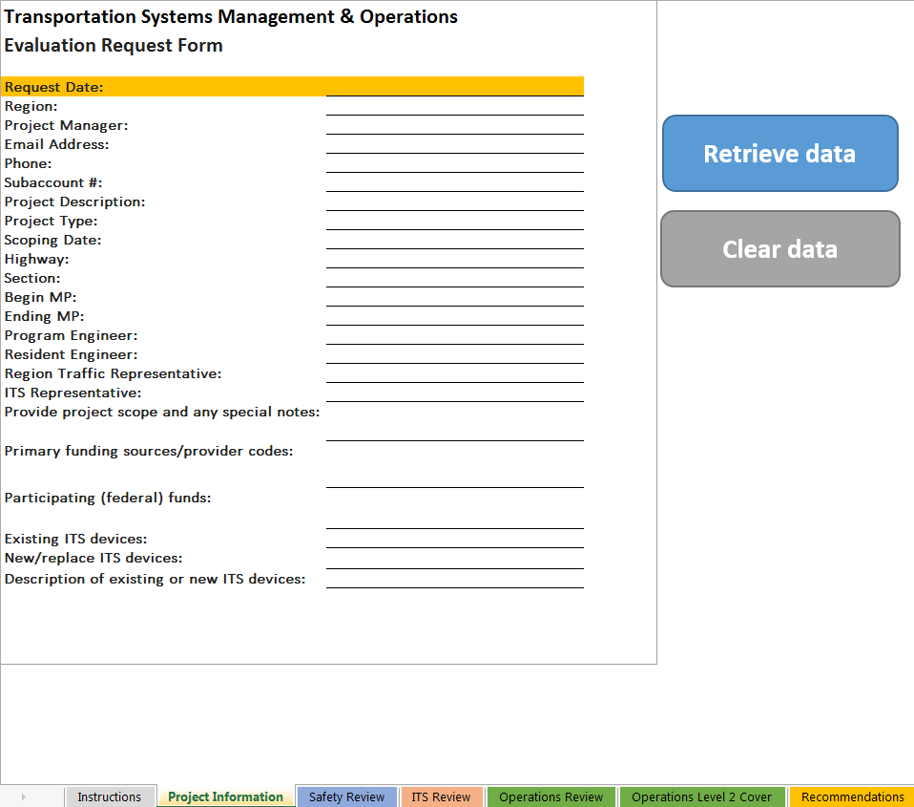
Setup the TSM&O Evaluation
Open the TSM&O Evaluation Tool
Review and reference the Instructions Tab as needed throughout the process
Make sure the TSM&O Evaluation Request is saved in the same folder and closed
Click on the Project Information Tab
Click “Retrieve Data”
Navigate to current folder
Click “OK”
Data fills in automatically
Fill in the Request Date (the date of the request email)
Notes:
Now it is time to open the TSM&O Evaluation spreadsheet tool. The first tab holds instructions for using the tool that can be referenced at any time throughout the process.
The second tab, “Project Information” is shown on the screen. In order to avoid duplicating work, you can pull in the information from the TSM&O Evaluation Request Form that the Project Manager sent you into this sheet automatically. Simply click the blue “Retrieve data” button and navigate to your project folder where you saved the TSM&O Evaluation Request Form. Click on that folder and click “OK.” The information from the Request Form should automatically fill in the blanks. The last step on this page is to fill in the Request Date, which is highlighted in orange. You should use the date on the email where you received the TSM&O Evaluation Request Form.

Slide 18
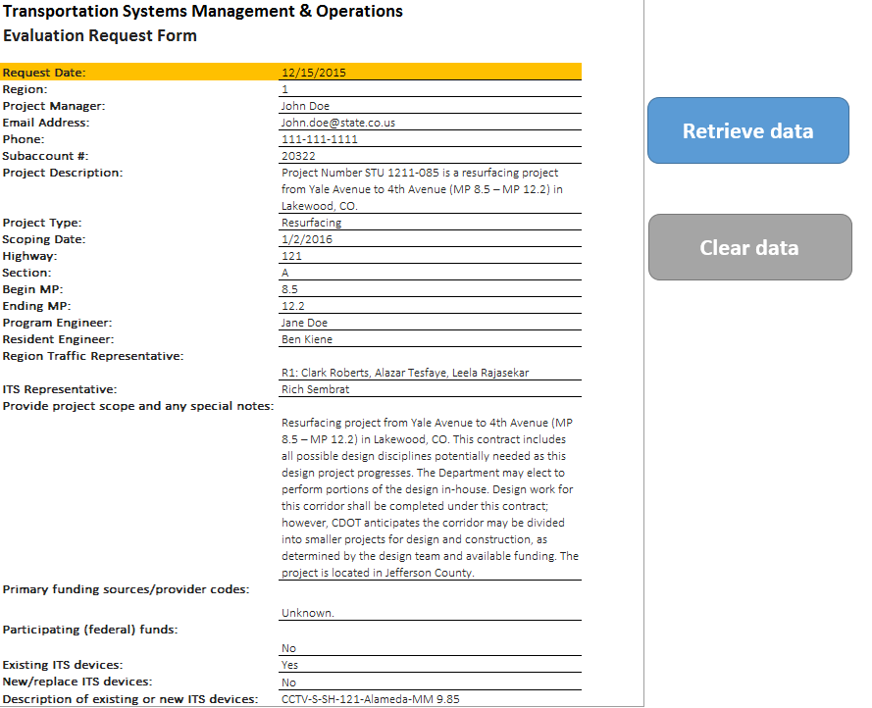
Setup the TSM&O Evaluation
Populated Project Information Tab
Notes:
Script:
This is what the populated project information tab should look like.
You are now ready to begin your evaluation!

Slide 19
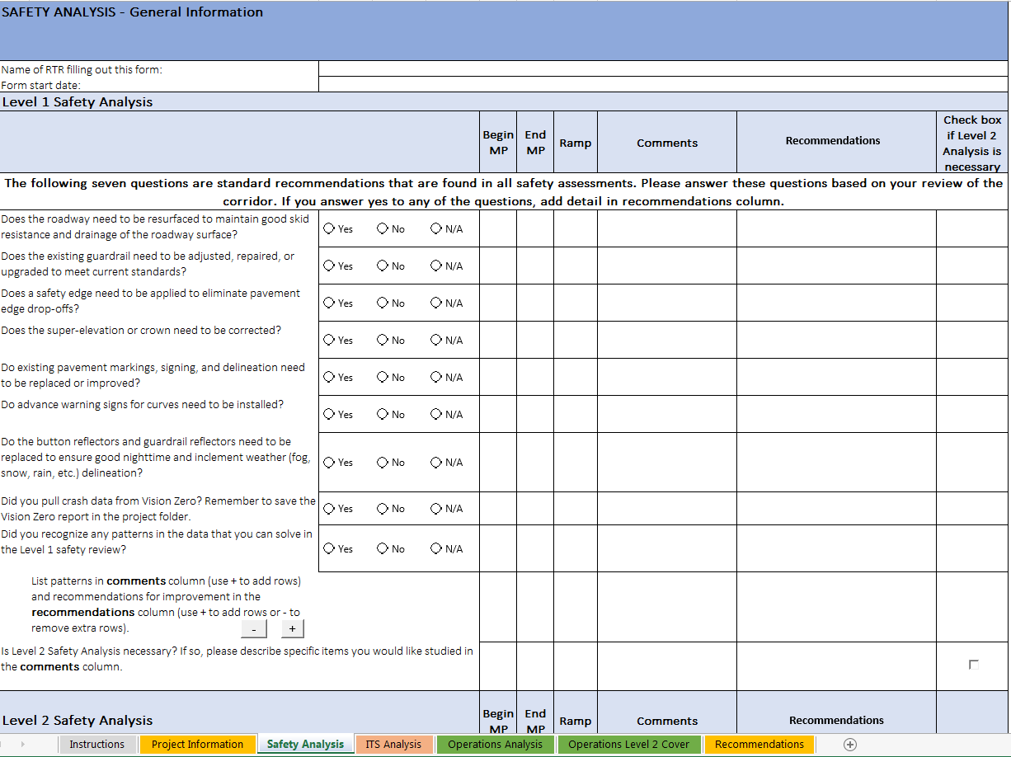
Perform Level 1 Safety Analysis
Notes:
Let’s now turn our attention to each analyses in the TSM&O Evaluation Process.
We’ll begin with the the Safety Analysis portion of the TSM&O Evaluation. This is the 3rd tab on the spreadsheet tool. Ideally, the Level 1 Safety Analysis will be completed before scoping.

Slide 20
Perform Level 1 Safety Analysis
Fill out your name and the date the form was started
Answer each question with “Yes”, “No”, or “N/A”
Pull crash data from Vision Zero and store the report in the TSM&O Evaluation Folder
Add specific Recommendations in the “Recommendations” column
Other relevant information may be added to the “Comments” column
If you would like a Level 2 Safety Analysis for any of the topics:
  Check the box in the last column
  Write specific topics for analysis in the “Comments” column
Notes:
Split into two slides with different graphics?
Any specific instructions besides pull crash data from vision zero? Do you want to tell them to perform the analysis?
You will start the Level 1 Safety Analysis by filling out your name and the date that the analysis was started. We ask that you complete these boxes for project tracking purposes.
Next, answer each question using the option buttons for “Yes,” “No,” or “Not Applicable (N/A).” Add specific recommendations for the project in the “Recommendations” column. A special feature that is only present in this tab is that if you click “Yes” to any of the first seven questions, a recommendation auto-populates in the recommendations column. You are free to change the text or remove it if you’d like to. Any other relevant information that is not a recommendation can be added under the “Comments” column.
The first seven questions in the Level 1 Safety Analysis relate to typical recommendations that could be found on most Safety Assessments. They ask about topics like guardrail, existing pavement markings, roadway surface, etc. The last two questions ask about the VisionZero reports. To answer these questions, you’ll need to study the existing crash data in VisionZero and identify any crash patterns, if possible.
If you would like to initiate a Level 2 Safety Analysis (which would be similar to an existing Safety Assessment), check the box in the far right column. Any specific topics that you would like studied in the Level 2 Safety Analysis should be noted in the “Comments” column. From here, you will need to work with CDOT Headquarters Staff to determine who will complete the report.

Slide 21
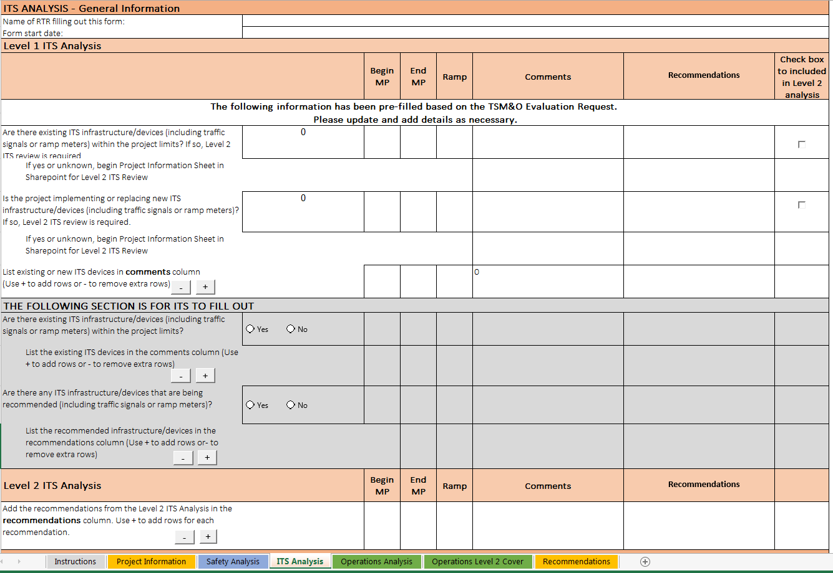
Perform Level 1 ITS Analysis
Notes:
Script: Now we will move on to the ITS Analysis portion of the TSM&O Evaluation. This is the 4th tab on the spreadsheet tool. Similar to the Safety Analysis, the Level 1 ITS Analysis should be completed as soon as possible. With this analysis, it is imperative to get it done in advance because FHWA may need to review the project and provide additional comments or recommendations.

Slide 22
Perform Level 1 ITS Analysis
Fill out your name and the date the form was started
Some of the cells will auto populate from the Project Information tab. These may be overridden at the discretion of the RTR.
List all existing ITS infrastructure on the corridor
If there is new or existing ITS infrastructure, a Level 2 review is required.
If a Level 2 ITS review is required, provide specific instructions in the Comments column
If the Region would like new ITS infrastructure, the RTR will initiate the Sharepoint project information sheet
Notes:
As with the Safety Analysis, begin the Level 1 ITS Analysis by filling out your name and the date that the analysis was started.
The Level 1 ITS Analysis asks about the presence of existing ITS infrastructure or devices, or if the project plans to install or replace infrastructure or devices. These questions will be initially answered by the PM in the Evaluation Request Form, so the answers the PM provided will autopopulate in this tab. As the RTR, you can change the answers to these questions, as necessary. If you know of any existing or proposed devices within the project limits, you are required to begin the SharePoint Project Sheet. This includes existing or proposed signals or ramp meters – if there are any signals or ramp meters within project limits, you will need to begin the SharePoint Project Sheet for these types of devices as well.
Next you can add specific recommendations for the project in the “Recommendations” column. Any other relevant information that is not a recommendation can be added under the “Comments” column.

Slide 23
Perform Level 1 ITS Analysis
ITS will report if there are existing infrastructure/devices within project limits and find out if anyone within their group would like to recommend any new devices.
A SharePoint Project Sheet must be started by the RTR if there are existing infrastructure/devices within project limits. ITS will complete the SharePoint Project Sheet if there are any new devices they are recommending
The SharePoint Project Sheet can be found at: http://connects/sites/TSMO/ITSEval/SitePages/Home.aspx
Notes:
Script:
Looking back at the process flowchart, the PM sends the TSM&O Evaluation Request to ITS at the same time that they send it to the RTR. ITS will consult with their database and report any existing infrastructure or devices within the project limits in the gray section of this sheet. If there are known existing devices, ITS will also notify you to begin the SharePoint Project Sheet.
They will also circulate the Evaluation Request within their group to see if any managers want to suggest adding a device. They will be given 5 business days to provide comments or recommendations in the spreadsheet.
Again, if there are any existing devices or infrastructure within project limits, you, the RTR, are required to begin the SharePoint Project Sheet. However, if ITS recommends any new infrastructure or devices, they will begin the SharePoint Project Sheet. If ITS managers do not want to add a device, ITS will notify you that Level 1 Analysis for ITS has no elements identified.

Slide 24
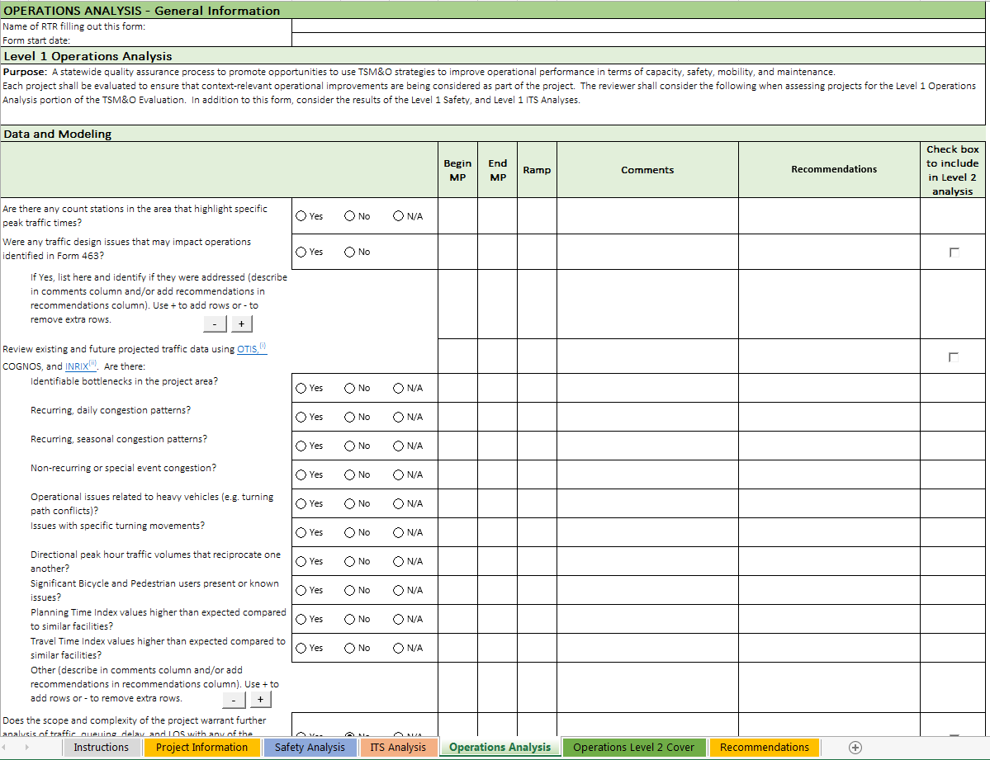
Perform Level 1 Operations Analysis
Notes:
Let’s move on to the Operations Analysis portion of the TSM&O Evaluation. This is the 5th tab on the spreadsheet tool. Once again, it is important to get the Level 1 Analysis complete by scoping.

Slide 25
Perform Level 1 Operations Analysis
Fill out your name and the date the form was started
Answer each question with “Yes”, “No”, or “N/A”
Save relevant traffic data (INRIX, OTIS, etc) in the TSM&O Evaluation Folder
Add specific Recommendations in the “Recommendations” column
Other relevant information may be added to the “Comments” column
If you would like a Level 2 Operations Analysis for any of the topics:
  Check the box in the last column
  Write specific topics for analysis in the “Comments” column
The tab titled “Operations Level 2 Cover” will be used as the cover page to the Level 2 Operations Analysis
Notes:
Once again, you will start the Level 1 Safety Analysis by filling out your name and the date that the analysis was started.
Just like the Safety Analysis, answer each question using the option buttons for “Yes,” “No,” or “Not Applicable (N/A).” Add specific recommendations for the project in the “Recommendations” column. Any other relevant information that is not a recommendation can be added under the “Comments” column.
If you would like to initiate a Level 2 Operations Analysis check the box in the far right column for any specific topics that you would like studied in the Level 2 Operations Analysis. Please add detail on what you would like studied in the “Comments” column. We will discuss the Level 2 Analysis more later in the training.

Slide 26
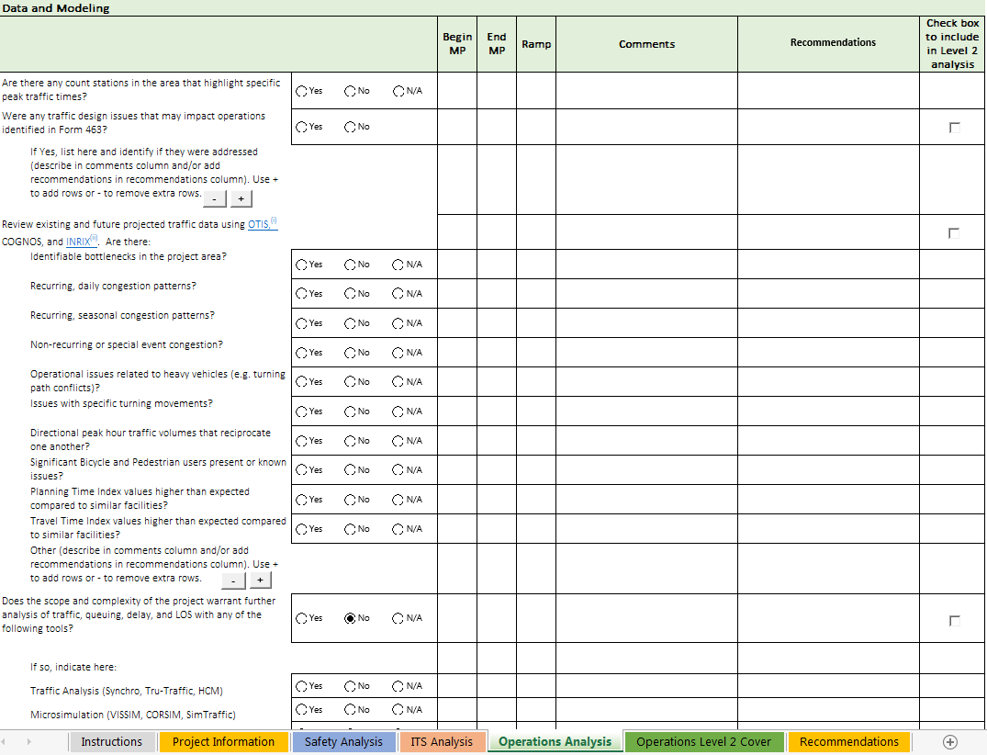
Perform Level 1 Operations Analysis
Data and Modeling
Notes:
Let’s look closer at the Level 1 Operations Analysis.
The Level 1 Operations Analysis is broken up into 4 sections and is based on the original operations checklist that was created early in the formation of this process.
The first section is Data and Modeling. These questions refer to the existing traffic data and if there are any recognizable patterns. Throughout this tab, there are links to helpful website that may aide in answering these questions. In this section there is a link to OTIS and INRIX. Both of these sites have different and valuable traffic data that can help indicate peak travel times, potential bottlenecks, and more. We will have additional training on these sites, and others mentioned today, in the future.

Slide 27
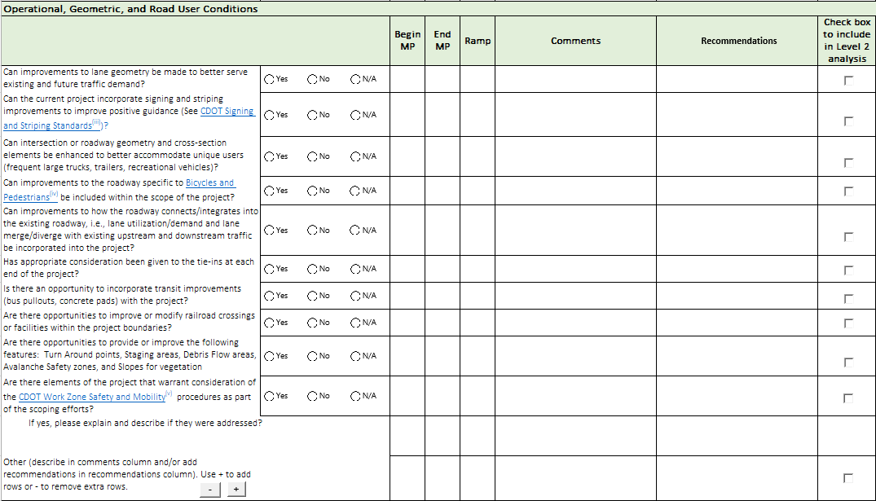
Perform Level 1 Operations Analysis
Operational, Geometric, and Road User Conditions
Notes:
The next section is Operational, Geometric, and Road User Conditions.
The questions in this section relate to the existing geometric conditions and ask if there are opportunities to improve, in order to solve operational issues on the project. Some examples of improvement opportunities that could be leveraged on your project are bike and ped upgrades, staging or debris flow areas, intersection geometry, etc.

Slide 28
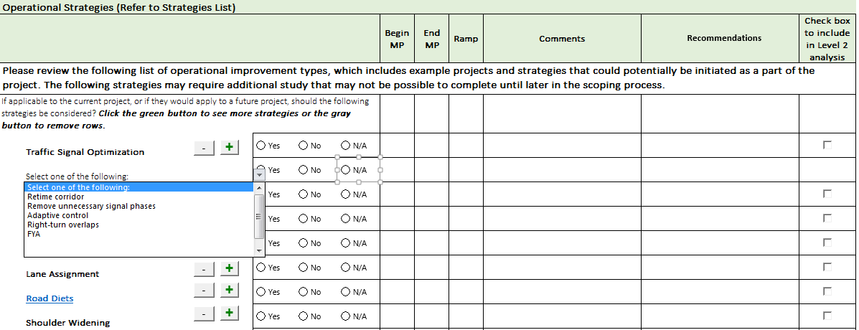
Perform Level 1 Operations Analysis
Operational Strategies
  Click on the green + button to view additional strategies will appear under that category
Notes:
The 3rd section, operational strategies, hold a series of strategies that Muller Engineering created that could help traffic operations in your project. The bold text is a topic and by clicking on the green plus button you can see additional strategies that relate to the main topic.
If you think any of these strategies could help improve traffic operations within the project limits, on this project or a future one, select it from the drop down list and add comments and recommendations. If you would like any of the topics to be studied as part of the Level 2 Operations Analysis, click the box on the right.
…Nate expand here?

Slide 29
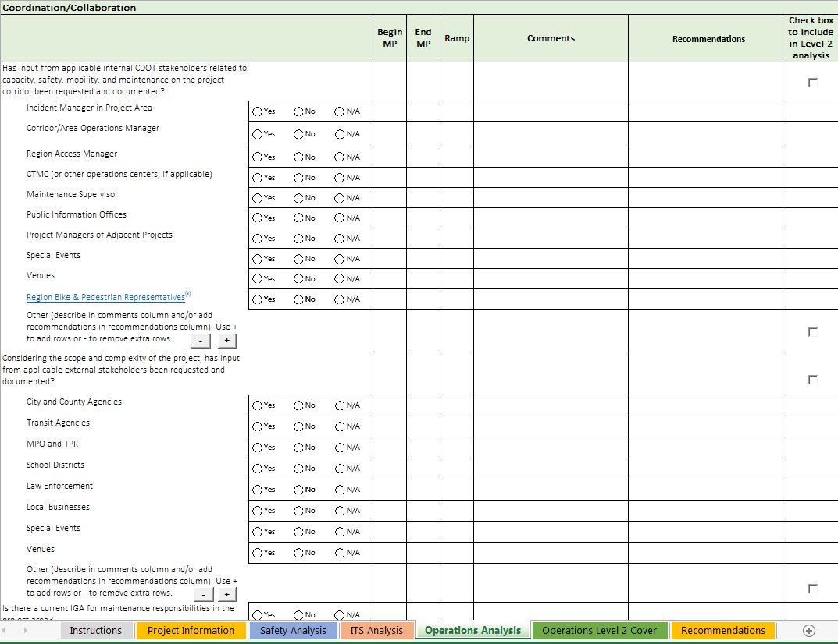
Perform Level 1 Operations Analysis
Coordination and Collaboration
Notes:
The last section is coordination and collaboration. This section lists potential stakeholders (internal and external to CDOT) that may have input for the project to improve capacity, safety, mobility, and/or maintenance along the project.
Depending on the scope and complexity of the project, it may or may not be necessary for you to contact all of the stakeholders listed in this section. Your project manager may have some insight into who would be valuable to connect with from this list as well.
That is the conclusion of the Level 1 Operations Analysis. Remember, if you would like to initiate a Level 2 Operations Analysis check the box in the far right column for any specific topics that you would like studied in the Level 2 Operations Analysis and work with HQ to determine who would be the best individual to complete this document.

Slide 30
Requesting a Level 2 Analysis
To request a Level 2 Safety Analysis, transmit the completed form to David Swenka
To request a Level 2 ITS Analysis, transmit the completed form to Rich Sembrat
To request a Level 2 Operations Analysis, transmit the completed form to San Lee
Save completed Level 2 Analysis and supporting documentation in the TSM&O Evaluation folder.
Notes:
In each section of the TSM&O evaluation, the RTR may want a more in depth analysis of a particular topic. As previously described, the RTR will check the box requesting a Level 2 analysis, and use the comments section to describe in what they would like analyzed.
The completed TSM&O Evaluation Tool is then transmitted to each appropriate party to initiate the Level 2 analysis. David Swenka for Level 2 safety, Rich Sembrat for Level 2 ITS, and San Lee for Level 2 Operations.
Level 2 analysis for Safety, ITS, and Operations will be supported by the TSM&O branch.
Once the completed Level 2 Analysis are received, the RTR should save the files and supporting documentation in the TSM&O Evaluation folder.

Slide 31
Inserting Level 2 Analysis Recommendations
It is the responsibility of the RTR to insert recommendations from Level 2 Safety, ITS, and Operations recommendations into each tab in the TSM&O Evaluation Tool
Notes:
It is the responsibility of the RTR to insert recommendations from Level 2 Safety, ITS, and Operations analysis into each tab in the TSM&O Evaluation Tool.
Safety, ITS, and Operations recommendations are inserted into the appropriate column, and rows may be added as necessary.

Slide 32
Consolidate Recommendations into TSM&O Evaluation Report and transmit to PM
Notes:
Now that all Safety, ITS, and Operations recommendations are inserted into each tab of the TSMO Evaluation Tool, we are ready to consolidate recommendations into the TSM&O Evaluation Report.
As you can see from the flow chart, we are nearing the end of the process. At this point, the RTR has conducted the necessary Level 1 analysis (using the tool), and the RTR has received all requested Level 2 Analysis from supporting staff at TSM&O.

Slide 33
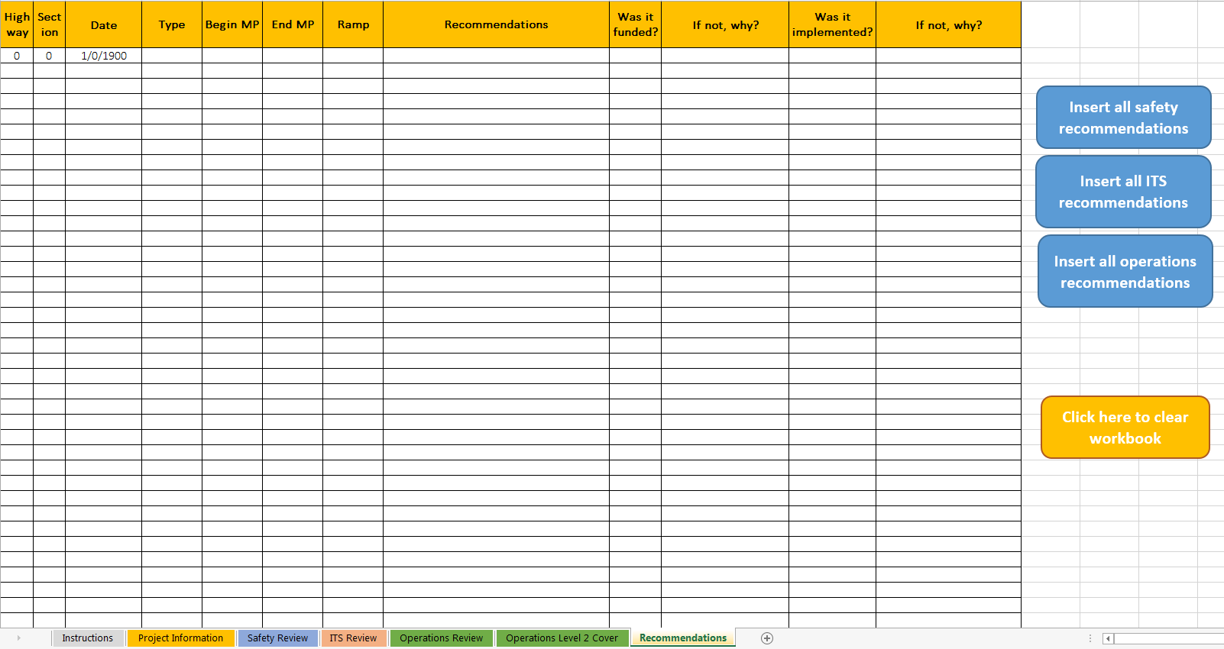
Consolidate Recommendations into TSM&O Evaluation Report and transmit to PM
Make sure all recommendations from Level 2 analyses are inserted into the appropriate tabs
In the Recommendations tab, click on each button to automatically import the highlighted columns
Transmit the completed file to the PM
Notes:
After you insert all recommendations into the appropriate tab, you are ready to make the evaluation tool do its thing.
In the recommendations tab, there are buttons to automatically insert recommendations from the Safety, ITS, and Operations Tabs. Click each button, and the first 12 columns will populate with recommendations.
After this is complete, all recommendations from Level 1 and Level 2 analysis are documented, and the file is ready to transmit to the Project Manager.
Transmit the whole TSM&O Evaluation Tool file to the Project Manager via email. We are almost done!

Slide 34
TSM&O Evaluation Closeout
  At project advertisement, the PM will notify the RTR of which TSM&O recommendations were incorporated into the project design
  The RTR will complete the TSM&O Evaluation and file it for future use
Notes:
After receiving the completed TSM&O Evaluation, the PM will coordinate with all parties necessary to determine if recommendations can be funded and implemented. The RTR may be consulted during this process…so don’t forget your recommendations too quickly!
Shortly after project advertisement, the PM will notify the RTR of which recommendations were funded, and which will be constructed.
The next slide shows what the RTR should do with this information.

Slide 35
TSM&O Evaluation Closeout
In coordination with the PM, the RTR will fill in the highlighted columns
Notes:
After discussing each recommendation with the PM, the RTR will fill in every line in the last four columns of the recommendations tab.
These columns are a key step in this process. As more projects take part in the TSMO Evaluation, more data will be generated, and more potential solutions will be identified. Recommendations that are not funded or implemented will be cataloged for future consideration.

Slide 36
Resources to Support the RTR
HQ TSM&O:
Safety- David Swenka
Operations- San Lee
ITS- Rich Sembrat
Consultant support
Project Development:
Neil Lacey
Ryan Sorensen
Notes:
There is a significant support group that has been involved in the development of the TSM&O Evaluation Process. That group isn’t going away, and will be in place to support the RTRs as they start performing the TSM&O Evaluations.
Besides your respective traffic engineers, David Swenka, San Lee, and Rich Sembrat are available to assist with process related questions, as well as processing the Level 2 analysis requests.

Slide 37
Wrap Up and Next Steps
  Training acknowledgement
  Survey
  Next Steps
    Consult the January 2016 TSM&O Evaluation Design Bulletin for detailed information
    Be prepared to perform TSM&O Evaluations for projects in design scoping after Feb 1
Note: This training is required for all CDOT Region Traffic Representatives. We will record the names of participants to add to the CDOT training records following the session. Please make sure that we have your name as a participant.
Notes:
Here are the next steps we are asking of you….
To take credit for this webinar, please take the survey that will be emailed out soon. We are also working to incorporate this in CDOT’s SAP learning portal.
As your next steps, please print out the workflow for reference and consult the Design Bulletin for detailed information.
Also, please be prepared to perform the TSM&O Evaluations for all projects scoped after February 1st !
Charles, any final words before we proceed?

Slide 38
Thank You
  Thank you!
Notes:
Insert Charles slide.

