Slide 1
Leadership Goals
Notes:
Notes:

Slide 2
Course Agenda
Learning Logistics
Section 1 – Course Introduction
Section 2 – Why Does CDOT have Leadership Goals
Section 3 – Choose and Plan your Goal
Conclusion
Notes:
Notes:

Slide 3
Course Learning Objectives
At the end of this section, you should be able to:
Recall the reason why all supervisors have a statewide supervisory/leadership goal
Communicate why you choose to change
Apply the tools and behaviors required to change
Practice the different behaviors
Recognize that you cannot do this alone
Awareness
Desire
Knowledge
Ability
Reinforcement
Notes:
Notes:

Slide 4
Instructor Introductions
Please take a moment to meet:
Tawnya Deherrera
Erin Hardin
Lynn Livingston
Amanda Parkhurst-Strout
Susan Maxfield
Beverly Wyatt
Melanie Vigil
Notes:
Notes:

Slide 5
Learning Logistics
Classroom participation encouraged; ask, answer, and participate in the discussion
HR staff to participate in exercises
Your book has both HR presentations for the week
Leadership Goals and Leveraging the PMP
Exercise data sheets for in-class exercises
Resources to use while working on your goals
Notes:
Notes:

Slide 6
Section 1 – Course Introduction
Learning Logistics
Section 1 – Course Introduction
Section 2 – Why Does CDOT have Leadership Goals
Section 3 – Choose and Plan your Goal
Conclusion
Notes:
Notes:

Slide 7
Did you know…
Notes:
Notes:
Supervisor PMP was pre-loaded with the goal: Develop one habit to strengthen or break that improves your supervision or leadership skills by Sept 30th.
You can leave this goal written generically or you and your supervisor can write a more specific goal. You cannot delete the supervisory goal.
The second goal on My Plan is to assist a direct report in improving. Starting in the month of May, I will have 3 employees learning new job duties. If you supervise supervisors, you can help them with their PMP goal (e.g. coaching, mentoring).

Slide 8
Your Contributions to Learning
Have you ever tried to:
You need to:
Value the change
Strategize the change
Identify with the change
It is Your Choice:
https://www.youtube.com/watch?v=wQLHwSphu-M
Notes:
Notes:
Have you ever tried to get someone else to change a behavior? I can lecture and plead with you all kinds of logical and emotional reasons why you should listen and change…. But until you have your own reason the change will not happen.

Slide 9
Course Agenda
Learning Logistics
Section 1 – Course Introduction
Section 2 – Why Does CDOT have Leadership Goals
Section 3 – Choose and Plan your Goal
Conclusion
Notes:
Notes:

Slide 10
Section 2 - Learning Objectives
At the end of this section, you should be able to:
Recall why CDOT supervisors were all assigned a Supervisory/Leadership goal on their performance management plans.
Identify Your WHY
Awareness
Notes:
Notes:
The why this was added to the PMP:
The best DOT in the country
Communicate supervisor behavioral expectations
D.U.D.s
Individual Leadership Plan
TM III MTA Needs Assessment
Elimination of Performance Management quarterly meetings
The Desire to change is internal; only you can decide and choose to make a change:
Commitment
Compliance
Belief
Competition
Money
Popularity
Job Security
Happiness

Slide 11
Best DOT in the Country
The best DOT in the county needs the best leaders.
Awareness
Notes:
Notes:

Slide 12
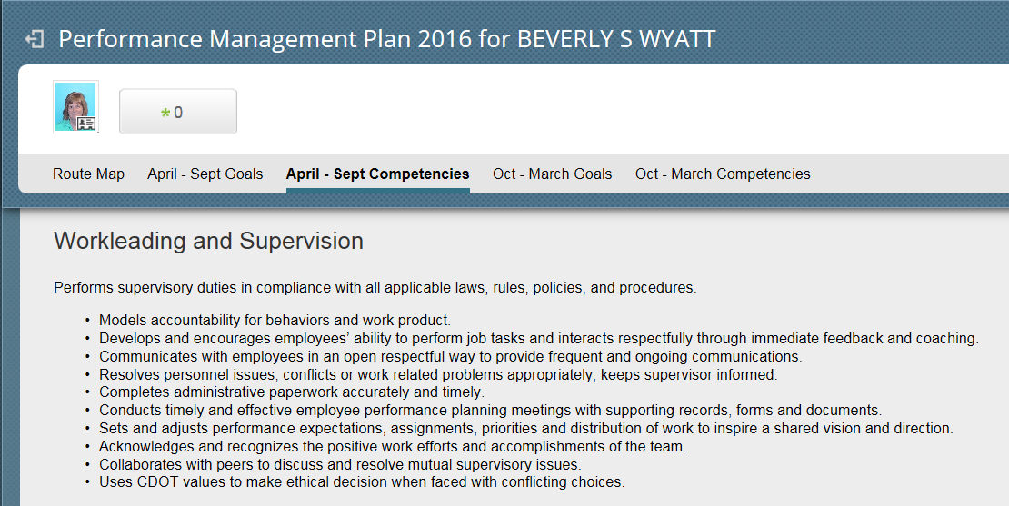
Communicate Supervisor Behavioral Expectations
Awareness
Notes:
Notes:

Slide 13
D.U.D.s
Dangerous, Unproductive or Dysfunctional behaviors (D.U.D.s)
Awareness
Notes:
Notes:

Slide 14
What kind of Supervisor are you?
Good Boss | Bad Boss
Great Listener | Doubter
Encourager | Secretive
Communicator | Intimidating
Courageous | Bad Temper
Sense of Humor | Self-centered
Show Empathy | Indecisive
Decisive | Blames
Takes Responsibility | Arrogant
Humble | Mistrusts
Shares Authority | Blank Stares
Notes:
Notes:

Slide 15
Individual Leadership Plan
Awareness
Notes:
Notes:
Answer the question to yourself:
Did you get an accountability partner and have you followed through on your leadership goal?

Slide 16
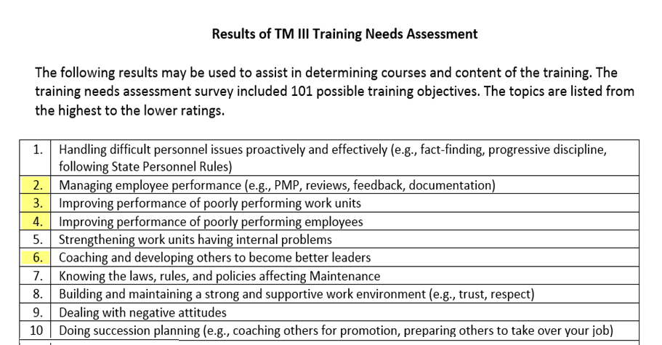
MTA Needs Assessment
Awareness
Notes:
Notes:

Slide 17
What Has Changed?
The best DOT in the country
Communicate - behavioral expectations
Eliminate - Dangerous Unproductive Dysfunctional Behaviors (D.U.D.s)
Accountability - Individual Leadership Plan
Address - TM III MTA Needs Assessment
Awareness
Notes:
Notes:

Slide 18
What’s your Why?
Commitment
Compliance
Belief
Competition
Money
Popularity
Job Security
Happiness
Desire
Notes:
Notes:
Knowing your why is an important first step in figuring out how to achieve the goals that excite you and create a life you enjoy living,. Indeed, only when you know your ‘why’ will you find the courage to take the risks needed to get ahead, stay motivated when the chips are down, and move your life onto an entirely new, more challenging, and more rewarding trajectory.

Slide 19
Course Agenda
Learning Logistics
Section 1 – Course Introduction
Section 2 – Why Does CDOT have Leadership Goals
Section 3 – Choose and Plan your Goal
Conclusion
Notes:
Notes:

Slide 20
Section 3 - Learning Objectives
At the end of this section, you should be able to:
List the six sources of influence that help you change.
Improve a supervisory behavior
Break a habit
Knowledge
Notes:
Notes:

Slide 21
Why We Fail to Change Our Behavior
Why we fail to change our behaviors
Lack the motivation
Lack the skill
Lack the support
Lack the reinforcement
Influencer Explained in just two minutes
Hand Washing - Influencing Behavior Change
Knowledge
Notes:
Notes:
Two minute video on the six sources of influence
https://www.youtube.com/watch?v=yH8XTwLOoVk
Six minute video on hand washing: A child using the sources of influence on other children to encourage washing hands before eating a cupcake
https://www.youtube.com/watch?v=o-N57TtyToE

Slide 22
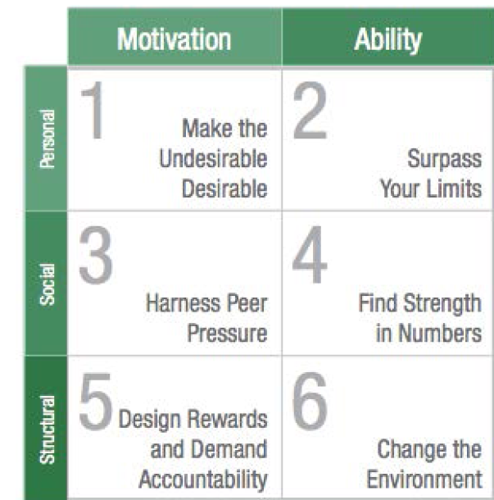
Influencer: The Power to Change Anything
Six sources of Influence © VitalSmarts
Knowledge
Notes:
Notes:

Slide 23
Change Anything
Six sources of Influence © VitalSmarts
Knowledge
Notes:
Notes:

Slide 24
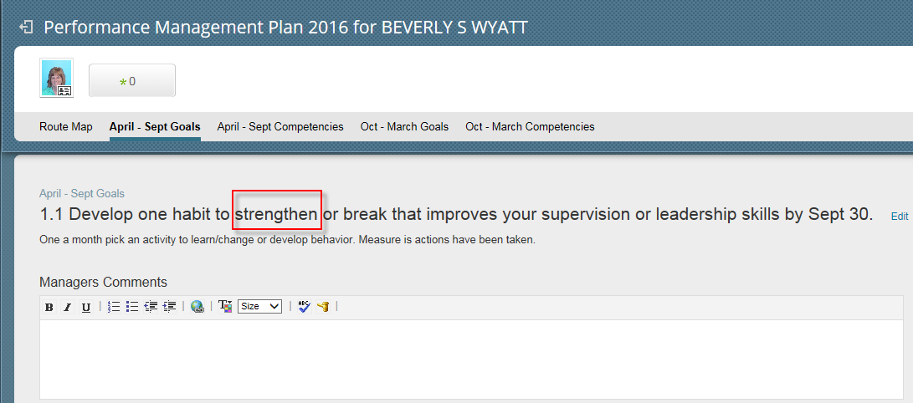
Improve a Behavior
Ability
Notes:
Notes:

Slide 25
Exercise One - Improve a Behavior
Turn to Tab 1: Exercise One: Improve a Behavior
Rank order the behavioral statements 1 – 10; with 1 being the behavior you demonstrate consistently.
Find and read your page.
As a group fill out at least 4 of the 6 boxes.
Be prepared to share your answers
Ability
Notes:
Notes:
Tab 1: Exercise One: Improve a Behavior
The following pages are divided into a definition of the behavior, why you might want to work on that behavior, examples of what to do (how) and then the influencer table.

Slide 26
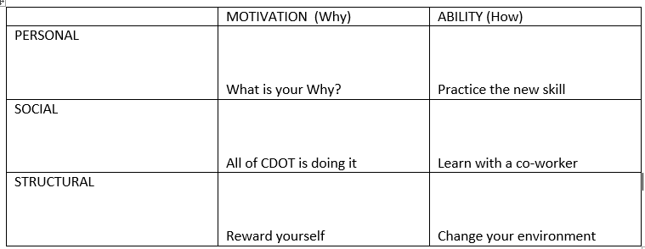
Answer
Notes:
Notes:
Each group will present 4 statements that they created to assist in improving the behavior.

Slide 27
How to Escape Failure
Goals are not one time events. It takes lots of motivation, practice, and rewards.
Learn: Webinars, books, talk to a friend, Ted Talks, training
Practice: Replace with a new behavior, create a schedule to practice, create milestones
Teach others: Share your new knowledge with others
Ask for help:
Ability
Notes:
Notes:
Resources tab list books, links, and online learning that could be used to create the support needed to change behavior.

Slide 28
Peter Drucker
“We spend a lot of time teaching leaders what to do. We don’t spend enough time teaching leaders what to stop. Half the leaders I have met don’t need to learn what to do. They need to learn what to stop.”
Management expert Peter Drucker, as quoted by Marshall Goldsmith in What Got You Here Won’t Get You There, 2007
Knowledge
Notes:
Notes:

Slide 29
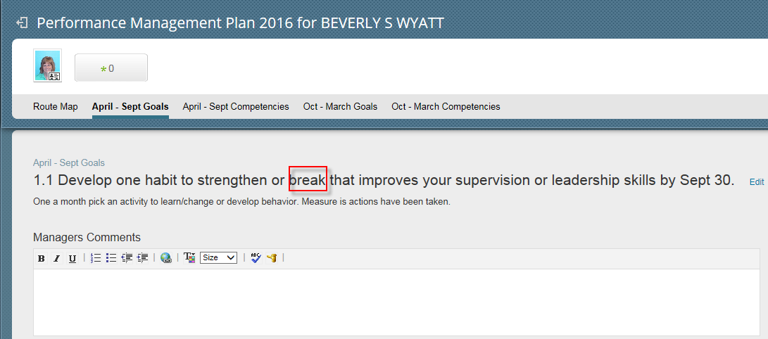
Break a Behavior
Ability
Notes:
Notes:

Slide 30
How to Eliminate the Negative
Apologize
Tell others your plan to change
Listen before you speak, do not interrupt
Do not use the words, no, but or however
Be present
Say thank you
Follow up and ask for feedback – how am I doing
Ability
Notes:
Notes:
Goals are not one time events. Leaving class this week with not change your behavior or accomplish your PMP goal. It is just the start of a long deliberate process.

Slide 31
Exercise Two – Break One Bad Habit
Turn to Tab 2 Exercise Two: Break One Bad Habit
Read the 20 Annoying Interpersonal Behaviors Stop and choose the one or two that you can hear others complaining about
Turn to a neighbor and ask:
...would you suggest two ideas that I can implement in the future to help me?
Ability
Notes:
Notes:
Tab 2 Exercise Two: Break One Bad Habit
Think about your past interactions with folks at work or home – what is that person constantly nagging you about.
Interpersonal Behaviors require an interaction with others. You will not know if you are successful or failing unless you listen to what others are saying.
Ask for two suggestions that might achieve a positive change.
I would like to stop interrupt others when I have questions about what they are saying, would you suggest two ideas that I can impellent in the future to help me?

Slide 32
Answer
Provide support to others
Ask for help
Notes:
Notes:

Slide 33
Course Agenda
Learning Logistics
Section 1 – Course Introduction
Section 2 – Why Does CDOT have Leadership Goals
Section 3 – Choose and Plan your Goal
Conclusion
Notes:
Notes:

Slide 34
Conclusion
You should now be able to:
Recall the reason why all supervisors have a statewide supervisory/leadership goal
Communicate why you choose to change
Apply the tools and behaviors required to change
Practice the different behaviors
Recognize that you cannot do this alone
Awareness
Desire
Knowledge
Ability
Reinforcement
Notes:
Notes:

Slide 35
Where Can I Get Help – People?
For additional assistance contact:
Your Direct Supervisor
Co-workers
HR Specialist
Family
Friends
Notes:
Notes:

Slide 36
Other online Help Resources
The following resources are available:
https://www.mindtools.com/
http://www.trainingrewards.com
https://youtube.com/
Notes:
Notes:

Slide 37
Questions?
?
?
?
Notes:
Notes:

