Slide 2
Creating an eLearning Course Using Articulate
Notes:
Notes:
This course is designed to teach participants how to develop an eLearning course using Articulate. Upon completing this course you will be able to:
Understand what training templates are available for you to use.
How to use the training templates to create an eLearning course using Articulate Studio ’13.
Printing and publishing a course once you are done with creating the course.

Slide 4
Course Agenda
Learning Logistics
Section 1 – Introduction
Section 2 – CDOT Training Templates
Section 3 – Introduction to Studio ‘13
Section 4 – Prepare Presentation for eLearning
Section 5 – Create Glossary
Section 6 – Add Resource Documents
Notes:
Notes:
This course is designed to teach participants how to develop an eLearning course using Articulate. The course is a full day course and is composed of the following sections:
Learning Logistics – This section takes about 10 minutes to complete and introduces the content of the course, provides introductions, and what the learning expectations are of both the participants and the instructor.
Section 1: Introduction – The introduction takes about 20 minutes to complete and introduces the high-level concepts which are used to support learning in each of the sections.
Section 2: CDOT Training Templates - This section takes about 40 minutes to complete and describes the training templates used to create an instructor lead course. It also describes the connection points between the templates, where they are located and your role in the training development process.
Section 3: Introduction to Studio ‘13 - This section takes about 60 minutes to complete and introduces participants to the Articulate Studio ’13, how to navigate the interface, what slides to keep and change and the available help resources.
Section 4: Prepare Presentation for eLearning – This section takes about 30 minutes to complete and describes the process of converting an ILT presentation into an eLearning course.
Section 5: Create Glossary – This section takes about 20 minutes to complete and describes the process of creating a glossary and changing the PowerPoint course into an eLearning.
Section 6: Add a Resource Document – The introduction takes about 20 minutes to complete and describes how to insert a resource document into the eLearning course.

Slide 5
Course Agenda
Section 7 – Create Engage Interaction
Section 8 – Create and Insert Audio
Section 9 – Add Annotation
Section 10 – Add Quiz using Quizmaker
Section 11 – Print and Publish Course
Section 12 – Conclusion
Notes:
Notes:
This course is designed to teach participants how to develop an eLearning course using Articulate. The course is a full day course and is composed of the following sections:
Section 7: Create Engage Interaction – This section takes about 30 minutes to complete and explains the process of converting exercises and demonstrations into screencasts and video narration.
Section 8: Create and Insert Audio - This section takes about 60 minutes to complete. This section describes how to create a script using either Studio ’13 or Audacity to record and add narration to a course.
Section 9: Add Annotation – This section takes about 30 minutes to complete and provides details on how to annotate (add movement) to a slide.
Section 10: Add Quiz using Quizmaker - This section takes about 30 minutes to complete describes the process of reviewing and adding an assessment to an eLearning course using Quizmaker.
Section 11: Print and Publish Course – This section takes about 30 minutes to complete and describes the different ways you are able to publish your course for review, preview and upload to the Learning Management System (LMS).
Section 12: Conclusion – This section takes about 10 minutes to complete and summarizes the course. It also provides details about where you can get additional help.

Slide 6
Course Learning Objectives
Upon completing this course, you should be able to:
Identify training terms and concepts associated with eLearning
Describe the new ILT templates and how they are used
Explain the process for creating eLearning from a PowerPoint
Identify the connection points between all of the training documents including the PowerPoint and eLearning course
Insert a Glossary, Resource Document, Quiz and Interaction using the appropriate Component of Studio ‘13
Use Studio ’13 to create an eLearning course from an ILT
Publish the eLearning in various outputs
Notes:
Notes:
Upon completing this course you should be able to perform each of the learning objectives. This will be confirmed at the end of the course.

Slide 7

Participant Introductions
Please take a moment to share:
Your name and role at CDOT
    What would you like to get from the course?
    What is your comfort level with this training?
Notes:
Notes:
Your Name_________________________________________________________
Your Role at CDOT ___________________________________________________
What would you like to get from the course?
_______________________________________________________________
_______________________________________________________________
_______________________________________________________________
What is your comfort level with the development of eLearning courses?
______________________________________________________________________________________________________________________________________________________________________________________________________

Slide 8
Learning Logistics
Regular breaks built into the class schedule
Classroom participation encouraged; ask, answer, and participate in the discussion
Exercises to practice development of training materials
Parking lot used to capture questions for
in-class follow-up
Notes:
Notes:
This course is scheduled to take the full day. There are regular breaks built into the schedule, but if you need to step away please feel free to do so.
Please feel free to ask any questions you may have during the course.
The section to the right of your manual contains an area for your notes and the answers for your questions.
During the course please keep side conversations to a minimum and share your experience with the whole class. This is what make for a great course!
During the course we will practice the development of an eLearning course using the recently created Affirmative Action course.
The “Parking Lot” is used to capture questions that may require a longer answer than we have time for in this course. All of the questions will be answered within 2 days of the course.
CDOT has five licenses for Articulate Studio ‘13 and they are installed on these computers.

Slide 9
Your Contributions to Learning
Please respect the other participants by silencing your cell phones
Focus on the course, please use the Internet and email over lunch and break times
Please delay your side conversations until break times
If you need to step out, Please return promptly
Notes:
Notes:
Please turn off or silence any electronic devices.
Please refrain from browsing the Internet, sending/reading text messages, or sending/reading e-mails during class.
If you have a question, or comment, please ask it of the whole group instead of the person next to you. Many times if there is something you do not understand everyone can benefit from an explanation.

Slide 11
Course Agenda
Learning Logistics
Section 1 – Introduction
Section 2 – CDOT Training Templates
Section 3 – Introduction to Studio ‘13
Section 4 – Prepare Presentation for eLearning
Section 5 – Create Glossary
Section 6 – Add Resource Documents
Notes:
Notes:
This course is designed to teach participants how to develop an eLearning course using Articulate. The course is a full day course and is composed of the following sections:
Section 1: Introduction – The introduction takes about 20 minutes to complete and introduces the high-level concepts which are used to support learning in each of the sections.
Section 2: CDOT Training Templates - This section takes about 40 minutes to complete and describes the training templates used to create an instructor lead course. It also describes the connection points between the templates, where they are located and your role in the training development process.
Section 3: Introduction to Studio ‘13 - This section takes about 60 minutes to complete and introduces participants to the Articulate Studio ’13, how to navigate the interface, what slides to keep and change and the available help resources.
Section 4: Prepare Presentation for eLearning – This section takes about 30 minutes to complete and describes the process of converting an ILT presentation into an eLearning course.
Section 5: Create Glossary – This section takes about 20 minutes to complete and describes the process of creating a glossary and changing the PowerPoint course into an eLearning.
Section 6: Add Resource Documents – The introduction takes about 20 minutes to complete and describes how to insert a resource document into the eLearning course.

Slide 12
Section 1 Learning Objectives
At the end of this section, you should be able to:
Describe the terms and concepts used to develop training content
List the roles responsible for creating training materials
State the stages the training development process for eLearning
Identify what training templates are available
Understand at a high-level what Articulate Studio ‘13 is and how it is used to develop training
Identify the connection between the PowerPoint template and the components (Presenter, Quizmaker, Replay and Engage) of Articulate Studio ‘13
Notes:
Notes:
Each of the learning objectives corresponds to a slide, or series of slides, in this section of the course.
By the end of this section you should be able to perform each of the listed objectives with the support of the training materials.
The section learning objectives are tied directly to the course objectives reviewed at the end of the course.

Slide 13
Terms and Concepts
Term | Definition
Articulate Studio ’13 | A suite of software utilizing PowerPoint to create eLearning courses. Articulate Studio ’13 is comprised of the Presenter, Quizmaker, Engage and Replay.
Articulate Presenter ’13 | A program displayed as a tab on the PowerPoint Ribbon allowing you to create eLearning by adding narration, video, characters and web objects. The PowerPoint presentation can then be published to create an eLearning course.
Articulate Quizmaker ’13 | A program used to create quizzes, surveys and other assessments embedded into a course.
Articulate Engage ’13 | A program used to add interactions to processes, terminology or lists.
Notes:
Notes:
Tab 01 - Terms and Concepts
The following terms are critical to your understanding of this section of the course.
Additional terms are located in the Terms and Concepts document located in the reference materials.
If you do not understand the term, please ask for additional clarification.
The Terms and Concepts document contains more terms than are listed in the course and should be reviewed to help with your learning.

Slide 14
Terms and Concepts
Term | Definition
Articulate Replay ’13 | A program used to create screencasts using the computers webcam and screen activity or a combination of the two.
Audacity | A freeware program used to create and edit sound and sound files.
Course | A series of sections (lessons) used to teach skills and knowledge for a task or process.
eLearning | A type of training delivered entirely through electronic hardware, software or a combination of both.
Notes:
Notes:
Tab 01 - Terms and Concepts
The following terms are critical to your understanding of this section of the course.
Additional terms are located in the Terms and Concepts document located in the reference materials.
If you do not understand the term, please ask for additional clarification.
The Terms and Concepts document contains more terms than are listed in the course and should be reviewed to help with your learning.

Slide 15

Roles Responsible for Creating Training
The following roles are responsible for creating training:
SME - Creates content and reviews the eLearning
eLearning Training Developer – Creates eLearning content and reviews
Evaluator – Reviews the content of the course
Notes:
Notes:
The following roles are responsible for the creation of eLearning.
SME – The SME is responsible for providing content that is turned into an eLearning course. This can come from a variety of sources such as a Word document, PowerPoint, or assistance with the creation of the curricula. The SME works with the eLearning Training Developer to develop the ILT course and it is reviewed by the team as part of the review process. In turn the SME reviews the completed eLearning course to ensure the content is accurate and is consistent with the original ILT created by the SME.
eLearning Training Developer – The eLearning Training Developer is responsible for the development of the eLearning course by converting the existing PowerPoint into an eLearning using Articulate Studio ’13. Once the PowerPoint has been converted into an eLearning, the eLearning Training Developer has the SME review the final course and incorporates the feedback into the course. In the event the eLearning Training Developer is the SME then the course needs to be reviewed by an evaluator who is familiar with the content.
Evaluator – The Evaluator reviews the course. The Evaluator may also be used when a course needs to be reviewed for content. An Evaluator may be used by the SME as well as the eLearning Training Developer if further review of a course is required.

Slide 16
SME PowerPoint Training Development
The training development process:
Consists of five stages (as shown in the graphic below)
Is not a linear process and you may have to go back one or even two steps to move forward
Need Assessment
Design
Development
Implement
Evaluate
Notes:
Notes:
Creating a Course Using Training Templates Guide (TAB 02 – Completed Curricula for this Course)
The five stages of the SME PowerPoint training development process are:
Needs Assessment: During this stage you determine who is your audience what is the content of the training and how it will be delivered. The training curricula is used to capture the information from the needs assessment. During this stage you should answer the following questions:
Who is your audience for the training you are developing?
What is the gap between what the audience currently knows and what they need to know?
How will the training fill the gap?
What is the best way to delver the training
Design: During this stage the training curricula is used to develop the outline or goal of the course. The course description describes the audience and the the knowledge gap for example, “This course is designed to help CDOT Employees in HR to develop training materials using predefined templates.” The sections of the course are then created to break down the training into smaller sections. During this stage you should answer the following questions:
What do you need to include in the content of the course?
How will you delver the training to your audience?
How long will the course be?
What are the sections of the course that will address the knowledge gap?
What are the objectives of each of the sections of the course?
Continued on the next page

Slide 17
SME PowerPoint Training Development
The training development process:
Consists of five stages (as shown in the graphic below)
Is not a linear process and you may have to go back one or even two steps to move forward
Need Assessment
Design
Development
Implement
Evaluate
Notes:
Continued from previous page
Development: The development of the course begins with the curricula and carries on into the development of the PowerPoint presentation and any additional materials (forms, policy documents, demonstrations and exercises) you need to create or bring into the training. If you make a change to the design of the course, you will need to change to curricula to reflect the change. During this stage you need to answer the following questions:
Are the sections of the course in the correct order?
Are there changes to the design based on the development of the course?
Have I included all of the supporting content?
What is the best way to present the material (pictures and graphics)?
Implement: During the implementation stage you are delivering the content of the course. This stage includes you practicing the course. During this stage you may discover that a change needs to be made to the content or timing of the course. Questions you need to ask during this stage include:
Is there too much or too little time allocated to a section or topic?
Are the examples, exercises or demo relevant to the audience?
Is there a better way to describe the topic?
Is there a change to the course structure that will make it easier for the participants to understand the content?
Evaluate: Evaluation occurs at each stage of the training design process. For example asking for a review of the curricula or deciding to make a change to the course as you design the presentation to make it flow better for your audience. Additionally you should ask either formally or informally at the end of the course if it meets the needs of your audience. If there are changes to be made, you should make them as soon after the delivery of the course as possible. Questions you should ask during this stage include:
Is there a change to the course if made that would help the participant better understand the content?
Are there any changes (typos, grammar, error) suggested during the course I need to make?
What do I need to change based on comments from the participants?

Slide 18
eLearning Training Development
The eLearning training development process:
Consists of four stages (shown below)
Differences between SME PowerPoint and eLearning
  SME PowerPoint is only created from the Curricula
  eLearning is created from a source document such as:
    The completed SME PowerPoint
    A Word Document containing the course details
    A Curricula
Evaluate
Design
Development
Implement
Notes:
Notes:
TAB 02 – Multi-section Course eLearning PPT
TAB 03 – Single-section Course eLearning PPT
TAB 04 – Crosswalk between Instructor Lead and eLearning Multi-section PPT
The graphic above shows the stages of the development of an eLearning course from the SME PowerPoint. This is different than the develop cycle used by the SME (Needs Assessment, Design, Develop Implement and Evaluate) because the course has already been developed and is being evaluated for its conversion into an eLearning course before going thorough a modified design process or if is being created from a word document containing the details of the course.
Evaluate: During this stage the content from the source document is evaluated.
For the SME PPT this involves a review to determine which slides need to be removed (Hidden, Participant Introductions, Your Contributions to Learning, and Questions) and which of the slides need to changed or rebuilt so they work as an eLearning course. The slide notes are also reviewed to determine if there is enough content for the development of a script and the content slides are reviewed to see if there is the opportunity to create interactions using Engage. Additionally, the questions are evaluated to determine if they work for eLearning. The final step is to review the exercise and demos to determine if they work for an eLearning course or can be converted into interactive exercises using Engage.
For the Curricula and the Word Document the process of creating the eLearning the course begins with the correct PowerPoint being selected and determining which content will be turned into interactions.
Continued on next page

Slide 19
eLearning Training Development
The eLearning training development process:
Consists of four stages (as shown below)
Differences between the SME PowerPoint and eLearning
  SME PowerPoint is created from the Curricula
  eLearning is created from the complete SME PowerPoint
Evaluate
Design
Development
Implement
Notes:
Continued from previous page
During this stage the following questions need to be answered:
Are there any gaps between the development of the eLearning course and the SME Presentation that need to be addressed?
What are the slides that do not relate to eLearning and need to be removed?
What are the objectives of the course?
What are the slides that need to be annotated or changed so they work for eLearning?
Are there any content slides that can be consolidated by converting into an Engage ‘13 interaction?
Is there enough content in the Notes section of the slide to create the script or will more information be required from the SME?
Are there assessment questions and exercises for each of the sections of the course?
Does the structure of the course make sense for an eLearning course?
Design: During this stage the SME PowerPoint is converted into the eLearning template. All slides not related to the eLearning course are removed and placeholder slides are created for content that is going to be added or changed. All of the sections are created, and if required the sections are restructured. During this stage you should answer the following questions:
What do you need to include in the content of the course?
Is the content of the course in the right order to support eLearning?
Is there any way to simplify the course for eLearning?
How long will the course be?
Are there any gaps that need to be addressed before the course can be converted to an eLearning?
Are the Course and Section objectives relevant to an eLearning course or do they need to be changed?
Development: The development of the course with the eLearning template. The placeholders for the eLearning are converted into the eLearning format. The Terms and Concepts slide are turned into the glossary and deleted. Content slide are annotated as required and turned into Engage Interactions as necessary. The notes are removed and replaced with scripts for the eLearning . The “Tabs” are used to create the Resource section of the presentation. Questions are converted into the eLearning format using Quizmaker. And finally Engage is used to convert Exercises and Demo slides. During this stage you need to answer the following questions:
Are the sections of the course in the correct order?
Are there changes to the design based on the development of the eLearning course?
Have I included all of the supporting content as resource materials?
Have I included all of the questions in Quizmaker?
What is the best way to present the material (pictures and graphics)?
Have all the notes been converted to scripts?
Is annotation required for slides with narration?
Continued on the next page

Slide 20
eLearning Training Development
The eLearning training development process:
Consists of four stages (as shown below)
Differences between the SME PowerPoint and eLearning
  SME PowerPoint is created from the Curricula
  eLearning is created from the complete SME PowerPoint
Evaluate
Design
Development
Implement
Notes:
Continued from previous page
Implement: During the implementation stage you are publishing the content of the course in MS word, Previewing or publishing the course. During this stage you need to ask:
Can the course be viewed from the LMS?
Is the Published content displaying as intended?
What is the best skin for the audience?
Are there any changes I need to make based on the review?

Slide 21
ILT Training Templates
A template is a pre-formatted document that includes over-writable descriptions. The following templates exist:
Curricula
ILT PowerPoint
Terms and Concepts
Resource Materials Table of Contents
Notes:
Notes:
Creating a Course Using Training Templates Guide (TAB 2 - Curricula Template)
Creating a Course Using Training Templates Guide (TAB 3 - PowerPoint Template)
Creating a Course Using Training Templates Guide (TAB 4 - Terms and Concepts Template)
Creating a Course Using Training Templates Guide (TAB 5 - Resource Materials Table of Contents Template)
A template is a document that has been pre-formatted and automatically creates a new version of itself. The following is a list of the templates with a description that has been created for you to use:
Curricula – The curricula template is used as an outline for the course. It also contains a description of what you need to enter in each of the fields of the template. When you click on the description text, it turns blue and you can replace the description text with your content.
PowerPoint - The PowerPoint template has all of the slides you need to create a course from the curricula. It contains all of the slides for the learning logistics, course introduction, three sections and a conclusion. If you need to have more than three sections you can copy all of the section slides until you have the number of sections you need. The Notes section has also been modified to allow you to create the training manual.
Terms and Concepts – This document is a table that houses a list of the terms and their definitions in a preformatted table.
Resource Materials Table of Contents – This template is used to create the table of contents and the cover page for all of the materials you want to include in your manual. There should be one tab created for each reference document. This document will be combined with the printed (Notes view) of the PowerPoint to make the manual.

Slide 22

eLearning Training Templates
Four eLearning templates exist:
PowerPoint (Articulate)
  Multi and Single section
Quizzes
Engage Interactions
Articulate Skin Templates
Notes:
Notes:
TAB 2 - Multi-section Course eLearning PPT
TAB 3 - Single-section Course eLearning PPT
A template is a document that has been pre-formatted and automatically creates a new version of itself. The following is a list of the templates with a description that has been created for you to use:
PowerPoint (Articulate) – This template is designed to be used for the creation of eLearning. It is used in conjunction with the PowerPoint and includes additional slides to facilitate the creation of eLearning.
Multi-section – The multi-section PPT is used for any course with more than one section. This template should be used when there is more than one concept and more than one section.
Single-section – The single-section PPT is used for a course with one section. Ideally, this should be a very simple course with fewer than 15 content slides and one concept.
Quizzes – There are two types of quiz templates Knowledge Checks used throughout the course and the Course Assessment used once to evaluate.
Engage Interactions – These are not truly templates, but are designed to be used as such. A file has been created for each of the interactions in the same style and format of the course. When using these copy and paste this to the content folder and re-title the file before you upload it to your course.
Articulate Skin Templates – The skin is the content that is around the slide. When you select the skin, choose based it based on:
a multi or single section course
If there is sound

Slide 23

What is Articulate Studio ‘13
Articulate Studio is an eLearning authoring tool it:
Consists of Presenter, Quizmaker, Engage and Replay
Is accessed through a ribbon on PowerPoint
Can be published to the LMS
Output displays as slides within the presentation and as files
Notes:
Notes:
Articulate Studio ’13 uses PowerPoint as a base to develop eLearning. The tool is comprised of several programs that can be accessed through PowerPoint. The details of each are below:
Presenter – This program is integrated with PowerPoint and is used to add media and interactions into your course, annotate content through simple menus, create glossaries and reference documents and record and edit narration. All of the actions are accessed and performed through PowerPoint. To learn more about what you can do with Presenter go to https://www.articulate.com/products/presenter.php
Quizmaker – This program is accessed through the Articulate ribbon in PowerPoint. Once accessed, this allows you to create questions and and group them together to create a quiz. The results of the quiz can be set up as graded or non-graded. The individual questions are then displayed as slides within the presentation. To learn more about what you can do with Quizmaker go to https://www.articulate.com/products/quizmaker.php
Engage - This program is accessed through the Articulate ribbon in PowerPoint. The program is used to create interactions where the participant can click on the screen to access additional details about a process. There are many different templates (checklists, diagrams, FAQs and tabbed images) you can use to allow people to interact with the content. To learn more about what you can do with Engage go to https://www.articulate.com/products/engage.php
Replay – Replay is used to create screencasts, audio and video to give participants the ability to see both the screen and a video of the instructor as they perform a transaction. The resulting video can then be mixed to show the two clips at one time or be shown as a picture-in-picture. To learn more about what you can do with Replay go to https://www.articulate.com/products/replay.php

Slide 24
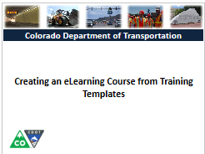
Connection Between Instructor Led and eLearning
If you are converting an ILT Course to an eLearning:
Many of the slides are the same
Refer to the Crosswalk for help on what to convert
If you create a new course use the appropriate template
Notes:
Notes:
TAB 04 – Crosswalk between Instructor Lead and eLearning Multi-section eLearning PPT
The following is a list of slides that are found in the template and are common to each of the sections of the course. For slides in the Title section, Learning Logistics and Conclusion refer to the Crosswalk between Instructor Lead and eLearning Multi-section PPT document.
Course Title - The Course Title slide is converted to a home page where the each of the sections of the course may be accessed.
Course Agenda – This slide becomes the highest level within the outline for the section when the participant goes into the Outline view of the course. It also serves as the introduction to the course with the description for the section becoming the script for the slide.
Learning Objectives – The Learning Objectives are annotated so they appear in the order they are read on the script.
Terms and Concepts – This slide is removed once the content has been added to the glossary. The Glossary may also be built from the Terms and Concept Document.
Standard Content Slides – Content slides are annotated and changed as required with the notes being converted into the script for the slide as required. Any of the “tab” documents are added as a reference documents in the order they appear in the course.
Exercises and Demos – Are kept and converted into interactive demonstrations using Engage or Replay.
Knowledge Checks – All of the knowledge check slides are entered into the Quizmaker and inserted into the course at the end of each of the sections.

Slide 25
Check Your Knowledge
How many eLearning PowerPoint Templates are there?
Two (multiple and single section)
What are the programs of Articulate Studio ‘13?
Presenter, Quizmaker, Engage and Replay
Notes:
Notes:
Question One
How many eLearning PowerPoint Templates are there?
Answer One
Two (multi and single section)
Question Two
What are the programs that comprise Articulate Studio ‘13?
Answer Two
Presenter, Quizmaker, Engage and Replay

Slide 27
Course Agenda
Learning Logistics
Section 1 – Introduction
Section 2 – CDOT Training Templates
Section 3 – Introduction to Studio ‘13
Section 4 – Prepare Presentation for eLearning
Section 5 – Create Glossary
Section 6 – Add Resource Documents
Notes:
Notes:
This course is designed to teach participants how to develop an eLearning course using Articulate. The course is a full day course and is composed of the following sections:
Section 2: CDOT Training Templates - This section takes about 40 minutes to complete and describes the training templates used to create an instructor lead course. It also describes the connection points between the templates, where they are located and your role in the training development process.
Section 3: Introduction to Studio ‘13 - This section takes about 60 minutes to complete and introduces participants to the Articulate Studio ’13, how to navigate the interface, what slides to keep and change and the available help resources.
Section 4: Prepare Presentation for eLearning – This section takes about 30 minutes to complete and describes the process of converting an ILT presentation into an eLearning course.
Section 5: Create Glossary – This section takes about 20 minutes to complete and describes the process of creating a glossary and changing the PowerPoint course into an eLearning.
Section 6: Add Resource Documents – The introduction takes about 20 minutes to complete and describes how to insert a resource document into the eLearning course.

Slide 28
Section 2 Learning Objectives
At the end of this section, you should be able to:
Define the terms and concepts for templates and checklists
Describe “where we are going” with the templates and checklists
Identify all of the available templates and checklists
Access the training templates and checklists
Describe your role in the training materials evaluation process
Explain how the templates are connected
Apply naming and versioning to the training documents
Notes:
Notes:
Each of the learning objectives corresponds to a slide, or series of slides, in this section of the course.
By the end of this section you should be able to perform each of the listed objectives with the support of the training materials.
The section learning objectives are tied directly to the course objectives reviewed at the end of the course.

Slide 29
Terms and Concepts
Term | Definition
Training Development Process | The process by which training is developed. It consists of five stages: needs assessment, design, development, implement and evaluate.
Template | A preset format for a document or presentation used to increase consistency and save time.
Format | The style or appearance of a document or presentation
Course | A series of lessons used to teach skills and knowledge for a task or process.
Style | A predefined format of text in PowerPoint or Word used to maintain a consistent format to the presentation or document.
Notes:
Notes:
TAB 01 - Terms and Concepts
The following terms are critical to your understanding of this section of the course.
Additional terms are located in the Terms and Concepts document located in the reference materials.
If you do not understand the term, please ask for additional clarification.
The Terms and Concepts document contains more terms than are listed in the course and should be reviewed to help with your learning.

Slide 30
Terms and Concepts
Term | Definition
Slide Master | A predefined format used in PowerPoint to help in the development of a presentation.
Notes | Notes used to help the training developer or SME to deliver the course.
Flow Chart Shapes | Predefined shapes in Microsoft office used to define a process. Refer to the Chart of flowchart shapes for a full description of each available shape.
Curricula | A document that describes the content of the course and the individual sections of which it is comprised.
Section | The smallest unit of a course used to describe a specific task or process.
Notes:
Notes:
TAB 01 - Terms and Concepts
The following terms are critical to your understanding of this section of the course.
Additional terms are located in the Terms and Concepts document located in the reference materials.
If you do not understand the term, please ask for additional clarification.
The Terms and Concepts document contains more terms than are listed in the course and should be reviewed to help with your learning.

Slide 31
Where are we going with Templates
Templates are used to:
Create a consistent look and feel to all training content
Increasingly, important with the use of Articulate to create eLearning
Aid in the design and development of course content for non-trainers
Notes:
Notes:
All of the training templates and checklist have been created to allow SMEs to create a training. The instruction design has been built into the course. Part of the process, is for the OED team serve as a resource for the development of the materials.
The review process of the SME materials occurs during two review stages:
The first review is after the curricula is completed by the SME. The review of the curricula by the OED team ensures the design is sound before the course is developed. The curricula developed by the SME is know as a “strong” curricula. This is very detailed and provides an outline of what the course will look like in final form.
The second review is a final review of the PowerPoint presentation after it has been completed. This review is conducted with the PowerPoint Self-review, Question Review and Image Review checklist by the OED team member or the SME. The focus of the review is to look at the structure and quality of the course and to provide positive feedback on the design of the course.

Slide 32
Training Templates
A template is a pre-formatted document that includes over-writable descriptions.
The following templates exist:
Curricula
PowerPoint
Terms and Concepts
Resource Materials Table of Contents
eLearning
Notes:
Notes:
Creating a Course Using Training Templates Guide (TAB 2 - Curricula Template)
Creating a Course Using Training Templates Guide (TAB 3 - PowerPoint Template)
Creating a Course Using Training Templates Guide (TAB 4 - Terms and Concepts Template)
Creating a Course Using Training Templates Guide (TAB 5 - Resource Materials Table of Contents Template)
Creating a Course Using Training Templates Guide (TAB 6 - eLearning Template)
A template is a document that has been pre-formatted and automatically creates a new version of itself. The following is a list of the templates with a description that has been created for you to use:
Curricula – The curricula template is used as an outline for the course. It also contains a description of what you need to enter in each of the fields of the template. When you click on the description text, it turns blue and you can replace the description text with your content.
PowerPoint - The PowerPoint template has all of the slides you need to create a course from the curricula. It contains all of the slides for the learning logistics, course introduction, three sections and a conclusion. If you need to have more than three sections you can copy all of the section slides until you have the number of sections you need. The Notes section has also been modified to allow you to create the training manual.
Terms and Concepts – This document is a table that houses a list of the terms and their definitions in a preformatted table.
Resource Materials Table of Contents – This template is used to create the table of contents and the cover page for all of the materials you want to include in your manual. There should be one tab created for each reference document. This document will be combined with the printed (Notes view) of the PowerPoint to make the manual.
eLearning Template – This template is designed to be used for the creation of eLearning. It is used in conjunction with the PowerPoint and includes additional slides to facilitate the creation of eLearning.

Slide 33
Curricula Template
The curricula has been created as:
An outline for the development of the course
A resource that allows you to review the design of a course prior to the SME developing a course
A way to quickly develop a course with sound training design
A way to answer course development questions
Notes:
Notes:
Creating a Course Using Training Templates Guide (TAB 02 – Curricula Template)
Creating a Course Using Training Templates Guide (TAB 08 – Sample Curricula for this Course)
A curricula is used to capture all of the documentation you will need in order to create your course.
It serves as an outline for all of the topics and allows you to talk about the course with others before you begin the development of the course.
Is critical to create as it is the backbone of development to the process of developing training based upon this course.
The curricula is also important to complete because:
It organizes the SME thoughts and what they want the course to do prior to actually working the development.
Gives one central location to track all development.
Serves as a checklist for the development of the course by the SME.
Is very tightly integrated with the process of development of all of the templates and processes for designing a course.
It allows Non-Trainers to answer the follow questions prior to the development of the course.
Who is the audience for the training?
What do they need to know?
How do I confirm they understand?
What training materials do they need?
How long is it going to take?

Slide 34
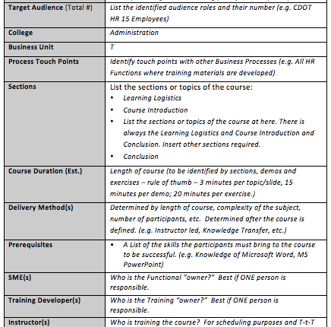
Curricula Template - Overview
The Course Overview:
Describes the logistics of the course
Who you will have help you
Notes:
Notes:
Creating a Course Using Training Templates Guide (TAB 02 – Curricula Template)
Creating a Course Using Training Templates Guide (TAB 08 – Sample Curricula for this Course)
The Curricula Template is comprised of the following sections. Refer to TAB 02 of your participant guide for a sample of the Curricula Template and TAB 08 for a sample of a completed curricula.
Course Overview - This section provides the who, what, when and how of your course. The template contains a description of how to complete each of the fields. Clicking on the text in that describes what to place in the field allows you to replace the text.
Course Purpose: This should answer the question “why am I here” for the participant. When writing the course purpose start with the following phrase. “This course is designed to…” The summarize your course. The course purpose for this course is: “This course is designed to teach participants how to take an idea and create a course using training templates”.
Course Objectives: This is a high level summary of what the participants can expect to learn from your course. It should answer the question “What am I going to learn” for the participant. The objectives of this course are:
Identify training terms and concepts
Describe the training development processes at a high-level
Describe the connection points between the curricula and PowerPoint Template
Understand how to use the Curricula, PowerPoint, and other templates and its components
Describe how to create an Instructor Guide from the Completed Participant Guide
Describe how to prepare and send the completed course for printing
Continued on next page

Slide 35
Curricula Template - Overview
The Course Overview:
Describes the logistics of the course
Who you will have help you
Notes:
Continued from previous page
Learning logistics - This section has been filled in as many of the slides for this section have already been created for you in the presentation. The Learning logistics section contains the following fields:
Section: This is the title of the section. This has been filled in for you and should not be changed.
Time: This is how long this section should take to complete. This has been filled in for you based on the section objective and should not be changed.
Section Objectives: This section has also been filed in for you with the default objectives.
Terms and Concepts: There are no Terms and Concepts covered in this section. The overall terms and concepts for the course are covered in the course introduction.
Supporting Documentation: This section has been filled in for you with a overview of the Participant Guide. When you walk through this section you should show the participants their guide and walk through the contents at a high-level.
Sections - A new section is created for each of the topics of the course. For all courses you need to have a minimum of four sections (Learning Logistics, Introduction, Section and Conclusion. On the curricula template the following fields need to be completed:
Section Title: This is title the for this section of the course
Time: This field will need to be completed after you have completed the rest of the section so the timing can be calculated. The total time of the course is based on three minutes for each of the section objectives (slides) and 15 minutes for a demo and 20 for an exercise. This timing is only a guide and may change the time to have more or less time.
Section Objective: These are the sub-topics for the course you are creating. Each of the objectives should be tied to the topic and placed in the order they will be presented. A minimum of one slide should be created for each objective that the participants will be able to do after taking the course. When creating the start each of the objectives with a verb. Refer to the table below for a sample list of verbs you can use for your course.
Terms and Concepts: Part of learning something new is developing the vocabulary you need to talk about the topic. List the items and provide definitions in this field. If you have already defined the term or concept in a previous section you do not have to list it again. This list of terms and concepts will be added to your presentation.
Supporting Documentation: Identify documents relating to section that need to be covered or provided to the participants. This can be any kind of document and may be created by you such as the list of terms and concepts or may be a policy document or form you need to cover. This section is where you would indicate if you are conducting a demo or exercise.
Continued on next page

Slide 36
Curricula Template - Overview
The Course Overview:
Describes the logistics of the course
Who you will have help you
Notes:
Continued from previous page
Conclusion - The conclusion is designed to allow you to summarize the course to the learning participants. It should not be longer than 10 minutes and should contain the following three topics:
A summary of the course using the learning objectives from the introduction.
A list of people and places where the participants can get help. You should have a least one person and may have optional online help resources such as webpages, videos or online documents.
A question slide at the end of the course to allow you to answer any questions you may have added to a parking lot or any questions about the course.

Slide 37
What is the PowerPoint Template
The PowerPoint template is a pre-formatted course designed to work with the training curricula to help you develop a consistent course
It contains the following:
  Pre-created sections
  Pre-formatted slides
  Pre-formatted views
  A consistent style and structure
Notes:
Notes
Creating a Course Using Training Templates Guide (TAB 03 – PowerPoint Template)
The PowerPoint template is designed to help you develop your course from the Curricula. The presentation is a heavily formatted and structured with pre-created sections and slides.
The PowerPoint template is designed to match the Curricula template in its structure. Each course must contain each of the following sections:
Title slides (Participant guide and Presentation)
Learning Logistics
Course Introduction
Section XX (as many as needed to cover the topic)
Conclusion
Refer to the curricula section if you need a description of the sections.
Prior to creating any content in the course you should copy the Section One of the course for each of the sections of your course other than the Title (slides 12 – 16) of the PowerPoint Template.
Each of the new sections you copy and paste should contain the following slides:
Title Slide
Title and Content
Course Agenda
Section XX Learning Objectives
Content slides based on the topic of the course
Terms and Concepts
Exercise XX
Check Your Knowledge
Slides that cover the topic of the section are entered between the Terms and Concepts and Exercise slide.

Slide 38
Pre-formatted Slides
Pre-formatted slides have been created Select Home → Layout to access the slides:
Title slide
Title and content (Left, Right and Bottom
Course agenda
Text and Content
Demo / Exercise
Process Flow
Question
Notes:
Notes:
Creating a Course Using Training Templates Guide (TAB 03 – PowerPoint Template)
To help with the development of the course pre-formatted slides have been created. The pre-formatted slides have a consistent look and all of the text on the slide has been formatted to be the same style as the rest of the presentation.
To insert a new slide of the same type go to the Home tab → New Slide
If the slide is not the layout you want select Home tab → Layout drop-down and left click on the style.
Note: When you select the new layout this will become the default for the next slide you create.
To import slides from different presentation deselect all slides and go to the Insert ribbon → New Slide (drop-down) → navigate to the presentation you want to import the from → select the slides you want to import.
The same slides are used in the eLearning course. The format should be used for the development of all training materials going forward. Using the same template for the PowerPoint reduces the amount of work required when transporting slides.

Slide 39
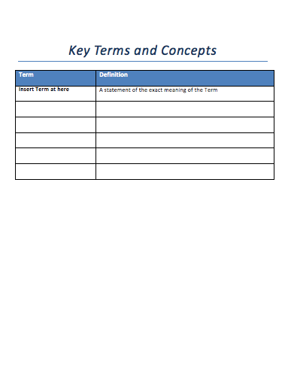
Terms and Concepts Template
The Terms and Concepts Template is:
Populated from the curricula
Used to create the Glossary
Must match the terms in your presentation
Use Edit → Paste Special when copying from the presentation to template
Notes:
Notes:
Creating a Course Using Training Templates Guide (TAB 04 – Terms and Concepts Template)
The Terms and Concepts Template is created after your Curricula. All of the terms are listed in alphabetical order, or if necessary, grouped in the order they appear in the course. Additional rows can be added to the document by:
Left clicking just to the right of the table
Pressings the enter key
This document is saved as a Word Template this means:
When you save the document you will be prompted to save the document. The original document is not be changed.
The instructional text in the first row can be selected and automatically replaced.
When you are creating the eLearning course from a PowerPoint document created by the SME, then the content of this document is placed in the glossary.
When using the Terms and Concept template:
All words in the Term column should be capitalized and in Bold unless the term requires it to be in lower case.
All definitions of the term should be made in sentence case.

Slide 40

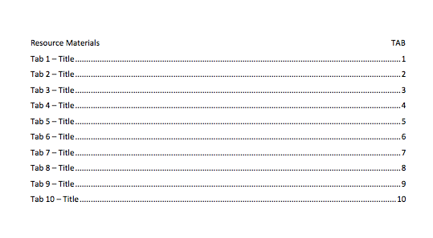
Resource Material Table of Contents
The Resource Material Table of Contents Template is:
Used to identify the tabs and tab sections
Created from the Curricula
Referenced in the PowerPoint as a tab
Notes:
Notes:
Creating a Course Using Training Templates Guide (TAB 05 - Resource Materials Table of Contents Template)
The Resource Materials Table of Contents Template is used to create the cover page for the tabs in your Manual. For each document that you want to include in your course, you need to index it in this document.
You do not need to insert the actual document you are indexing into the Resource Materials Table of Contents Document.
How to use the Template:
When you create the Resource Materials Table of Contents document:
Start on the second page with the titles of the sections.
Do not manually update the Table of Contents this should only be done by
Right clicking on the table of contents → Select “Update Field” → Select “Update Entire Table” → Click on “OK” bottom.
When printing the Resource Materials Table of Contents you have two options for printing:
Include it at the end of the PowerPoint printed in notes page view.
This is best when you do not have too many additional documents
Print it as a stand alone document.
This best when you have a large course with a lot of large reference documents.
If you print it as a stand alone document the Reproductive Work Orders for both the PowerPoint and the Resource Materials Table of Contents documents will need to be changed to reflect you do not want to print it as one document.

Slide 41
eLearning PowerPoint Templates
The eLearning templates are:
Designed to assist with the creation of an eLearning course from an SME PowerPoint
It is specifically formatted for eLearning and must be used if you want are creating an eLearning
Broken out in single and multiple section courses
Notes:
Notes
TAB 02 – Multi-section Course eLearning PPT Template
TAB 03 – Single-section Course eLearning
TAB 04 – Crosswalk between Instructor Lead and eLearning Multi-section eLearning PPT
The PowerPoint template is designed to help you develop your course from the PowerPoint developed by the SME.
A Crosswalk between Instructor Lead and eLearning Multi-section PPT template has been created to let you know which slides need to be added or removed.
The best approach is to copy the SME PowerPoint and insert the slides by section.
As you develop the course it is best to develop by the sections and selecting Insert → Slides from → Other Presentation to insert the section directly into the eLearning template.
If you are developing an eLearning without an SME then you must use the eLearning template to create the course.
Note: If you follow this type of development you will not be able to create a Participant guide as the notes section will house the script. The slide for the participant guide will need to be deleted or modified from the eLearning course unless one is created separately.

Slide 42

Checklists
In addition to the Templates the following Checklists have been created:
Question Review Checklist
Image Review Checklist
PowerPoint Self-Review Checklist
Notes:
Notes:
Creating a Course Using Training Templates Guide (TAB 09 – Image Review Checklist)
Creating a Course Using Training Templates Guide (TAB 10 - Question Review)
Creating a Course Using Training Templates Guide (TAB 11 – PowerPoint Self-Review Checklist)
The Checklists are designed to reinforce sound instructional design by the SME and allow them to review their own work as much as possible. The focus of the checklists is on the development of the PowerPoint because the curricula is reviewed by an OED team member. The following checklists have been created:
Image Review Checklist – The Image Review Checklist is used by the SME to review all of the images for quality and appropriateness.
Question Review Checklist – The Question Review Checklist is used by the SME to review all of the images for quality and appropriateness.
PowerPoint Self-Review Checklist – This checklist is used as a way for the SME to review the content of the course to make sure they have reviewed the course for the most common errors. It is then used by the member of the OED who is reviewing the course to as an initial starting point for the review. Additional feedback should written out and provided to the SME.

Slide 43
Review Process
Self-review Using Checklist
SME Review
SME Review Changes Made
Training Evaluation Review
Training Evaluator Changes Made
The review process consists of five steps
Each steps requires the version of the document to be renamed
Notes:
Notes:
Creating a Course Using Training Templates Guide (TAB 09 – PowerPoint Self-review Checklist)
The review process is important to to ensure the presentation is a perfect as possible in both content and form. In addition to the review you should plan some time after the delivery to make any changes. There are five stages to the review process.
Self-review using the the Checklist – A checklist has been created to help you with reviewing your course prior to sending it for review. The most common errors can be found using the check list.
SME Review – During this stage the SME reviews the course for the the content related to the topic to make sure it makes sense and it technically correct.
SME Review Changes – Upon receiving the course back from the SME you will need to make the recommended changes. If you disagree with a change you do not have to make it but please document the reason you are not doing so.
Training Evaluation Review - This review is to ensure your course is sound from an instructional design perspective. During this stage the training will use the PowerPoint Self-review Checklist and their own experience to review the course for their recommendations.
Training Evaluator Changes Made - Upon receiving the course back from the Trainer you need to make the recommended changes. If you disagree with a change you do not have to make it but please document the reason you are not doing so.

Slide 44
Accessing the Training Templates
All of the training templates can be found in the following locations:
\\public\rwdinfopaktraining
\\public\CHRM_PERCOM
Notes:
Notes:
When pulling information from the drive it is best to copy and paste the materials into a folder rather than open the file from the drive.
Both the curricula and the PowerPoint have been saved as a template. This requires that you save the file under another name.
In the event you do accidently delete a file please email Jason Prince at jason.prince@state.co.us so the file may be replaced.

Slide 45
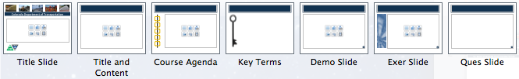
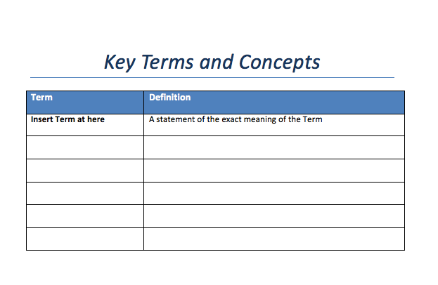
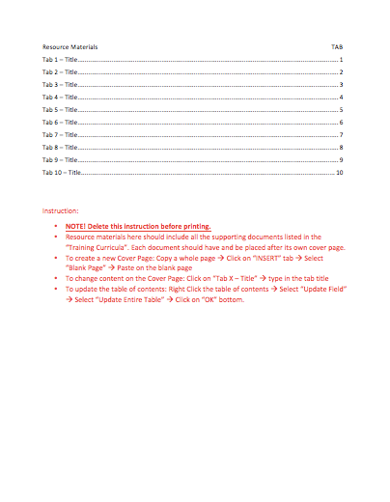
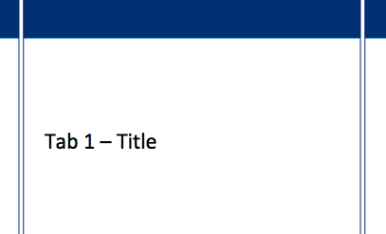
Connection Point Between Templates
Notes:
Notes:
Title Slide – This slide is edited from the Notes view of the Notes Page view and is hidden so it does not appear in the presentation. It is populated with the tile of the course of the name of the section.
Title and Contents – This is one of the four slides you can use for the content of the presentation. The other content slides are Text Left_Graphic Right, Text Right_Graphic Left and Text Top_Graphic Bottom. You are able to change any of these slides as you see fit. The only requirement is the use of Calibri font and slide background.
Terms and Concepts – The curricula houses all of the terms and the concept for the course. It is used to populate the Terms and Concepts slide in the presentation and the Terms and Concepts Template.
Demo and Exercise - The Demo and Exercise are identified in the Curricula as a document which will need development. They are then detailed in the course. You should provide enough detail about the exercise or demo to be able to describe it to the person conducting the review of the curricula.
Supporting Documents – All of the supporting documents should be listed in the curricula. When they are placed in the course they are assigned a tab number and are listed in the Resource Materials Table of Contents and Cover Pages Template.
The Forms, Policy and Other columns of the curricula may appear in any of the slides. When they do, they appear at the top of the notes page. Use the Star bullet, Bold the tab and the Number you use to replace the “XX” use the hyphen with a single space on both sides and then the title of the document. A sample is provided below.
TAB XX - Sample Document

Slide 46

Naming and Versioning Documents
When naming the PowerPoint and Curricula and other templates:
Start with the Date MMDDYYYY_Title of Course_Ver_0#
For Tab Documents use:
TAB_##_Name of Document
Notes:
Notes:
Document naming conventions are important because they allow you to keep track of the version of the document through the review process.
The date (MMDDYYYY) should be changed when you work on the document.
The version number (01) should be changed by both you and the reviewer so you can keep track of who has edited the document.
01 – Original
02 – SME Review
03 – SME Review Edit Changes
04 – Training Evaluator Review
05 - Training Evaluator Review Edit Changes
06 – Final
For Documents you are going to use for reference (TAB) use the following Naming convention.
TAB_##_ Name of Document
This naming convention allows you to place all of the document in the order in which they will be printed.

Slide 47
Check Your Knowledge
How many templates are available for you to use and what are they?
There are five templates. They are:
  Curricula
  PowerPoint
  Terms and Concepts
  Resource Materials – Table of Contents and Cover Pages
  eLearning
Notes:
Notes:
Question One
How many templates are available for you to use and what are they?
Answer One
There are five templates. They are:
Curricula
PowerPoint
Terms and Concepts
Resource Materials
eLearning

Slide 48
Check Your Knowledge
What is purpose of the curricula?
It is used to plan the development of the course.
What are the sections of the Curriculum?
Course Overview
Purpose and Objective
Learning Logistics
Course Introduction
Sections
Conclusion
Notes:
Notes:
Question One
What is purpose of the curricula?
Answer One
It allows you to plan the development of your course.
Question Two
What are the sections of the Curriculum?
Answer Two
Course Overview
Purpose and Objective
Learning Logistics
Course Introduction
Sections
Conclusion

Slide 50
Course Agenda
Learning Logistics
Section 1 – Introduction
Section 2 – CDOT Training Templates
Section 3 – Introduction to Studio ‘13
Section 4 – Prepare Presentation for eLearning
Section 5 – Create Glossary
Section 6 – Add Resource Documents
Notes:
Notes:
This course is designed to teach participants how to develop an eLearning course using Articulate. The course is a full day course and is composed of the following sections:
Section 3: Introduction to Studio ‘13 - This section takes about 60 minutes to complete and introduces participants to the Articulate Studio ’13, how to navigate the interface, what slides to keep and change and the available help resources.
Section 4: Prepare Presentation for eLearning – This section takes about 30 minutes to complete and describes the process of converting an ILT presentation into an eLearning course.
Section 5: Create Glossary – This section takes about 20 minutes to complete and describes the process of creating a glossary and changing the PowerPoint course into an eLearning.
Section 6: Add Resource Document – The introduction takes about 20 minutes to complete and describes how to insert a resource document into the eLearning course.

Slide 51
Section 3 Learning Objectives
At the end of this section, you should be able to:
Define the terms and concepts
Describe when the Articulate file is created and file types
Identify the folders and icons found on the Articulate Ribbon
Recognize the importance of slide selection
Identify where Articulate interacts with PowerPoint
Create an Articulate account to access additional content (need photo, email address, password and confirmation email)
Identify the help resources available to you as you develop the eLearning (Support, Community, Downloads Site)
Notes:
Notes:
Each of the learning objectives corresponds to a slide, or series of slides, in this section of the course.
By the end of this section, you should be able to perform each of the listed objectives with the support of the training materials.
The section learning objectives are tied directly to the course objectives reviewed at the end of the course.

Slide 52
Terms and Concepts
Term | Definition
Record Narration | An icon is used to access a menu to record or import narration into the presentation.
Annotations | Annotation highlight important content using arrows, checkmarks, crosses, rectangles, and spotlights and can also be timed to match audio within a course.
Add Annotations | An icon used to time when annotations appear within your presentation.
Sync Animations | Used to allow you to control when pictures or text display on a slide.
Import Audio | Allows you to import audio recorded outside of your course.
Notes:
Notes:
Tab 01 - Terms and Concepts
The following terms are critical to your understanding of this section of the course.
Additional terms are located in the Terms and Concepts document located in the reference materials.
If you do not understand the term, please ask for additional clarification.
The Terms and Concepts document contains more terms than are listed in the course and should be reviewed to help with your learning.

Slide 53
Terms and Concepts
Term | Definition
Audio Editor | Used to make changes to any imported or recorded audio in a presentation.
Quizmaker Quiz | Used to create quizzes, surveys and other assessments embedded into a presentation.
Engage Interaction | Used to add interactions to processes, terminology or lists to your presentation.
Character | A series of people in a variety of poses, shots used to enrich your presentation. These are best used when you have roles in your presentation.
Notes:
Notes:
Tab 01 - Terms and Concepts
The following terms are critical to your understanding of this section of the course.
Additional terms are located in the Terms and Concepts document located in the reference materials.
If you do not understand the term, please ask for additional clarification.
The Terms and Concepts document contains more terms than are listed in the course and should be reviewed to help with your learning.

Slide 54

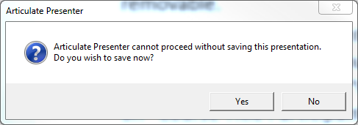
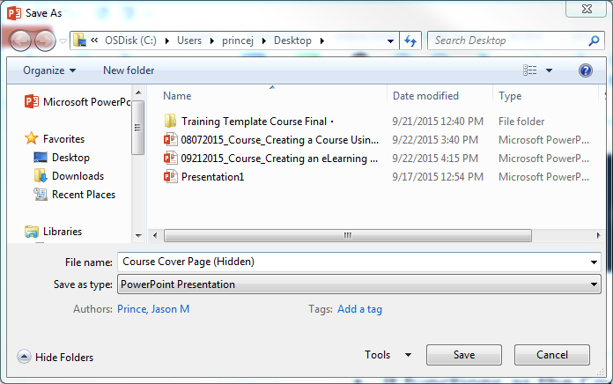
When is the Articulate File Created
The file remains as a PowerPoint until Articulate functionality is used.
Open the PowerPoint and access Articulate Functionality
Click “Yes”
Click “Save” to create the Articulate file
Notes:
Notes
The PowerPoint remains a PowerPoint. When Articulate functionality is accessed an Articulate file is created for the presentation. A separate file is created for each time you create a new interaction, or quiz. You can access the file through the presentation or directly through the file. When you access Articulate you are prompted with the message “Articulate Presenter cannot proceed without saving this presentation. Do you wish to save now?
If you select “No” then you are not able to complete the Articulate action. Selecting “Yes” bring a “save as page where you can name the Articulate document. This should be the same name as your presentation. Once this action is complete, an Articulate file is created and the articulate functionality works. To access the presentation you only need to click on the PowerPoint and you do not need to open the Articulate file.
The Articulate file should saved along with the original file in a folder that is on the local drive. There have been reports of errors occurring on shared and networked drives.

Slide 55

Articulate Icons
The following are the icons used by Articulate:
Engage interactions are displayed as green and can be housed in the presentation
and outside the presentation and imported. Templates have been created for you.
Presenter files are displayed as red and titled the same as the presentation. Only
one file is created for a courses and is created when Articulate functionality is
activated.
Quizmaker interactions are displayed as blue and can be housed in the presentation
and outside the presentation and imported. Templates have been created for you.
Replay interactions are displayed as purple and can be housed in the presentation
and outside the presentation and imported.
Notes:
Notes
TAB 05 – Articulate Icon List
The four icons in the slide above describe the icons used by the Articulate suite of software. Anytime functionality is activated for one of the programs, a file in created and stored in the folder that contains the PowerPoint presentation. When you create a new course:
Always start with creating a working folder for your course and place the renamed PowerPoint file in the folder.
Give your file a unique name using the naming conventions to help you identify the file.
Copy and paste the template files to the working folder to avoid bad links or overwriting the template.

Slide 56
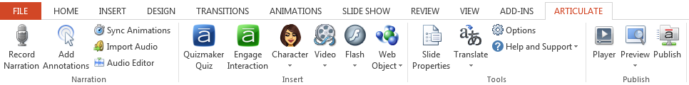
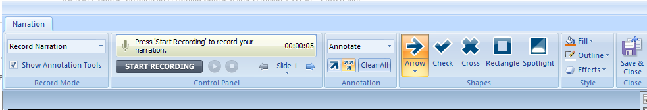
Articulate Functionality
Clicking on the icons in the Articulate tab:
Displays new windows with a tab
Additional functionality within PowerPoint
Additional Articulate programs
Notes:
Notes
TAB 05 – Articulate Icon list
The majority of the functionality of Articulate can be accessed from the Articulate ribbon. However, this is a gateway to additional ribbons as shown by the example above. Clicking on the Record Narration button, for example, displays the Narration ribbon which allows you to access additional functionality all related to recording and annotation.
When you exit the actions you have accessed through the Articulate ribbon you need to use the Save & Close button or the action is not saved.

Slide 57
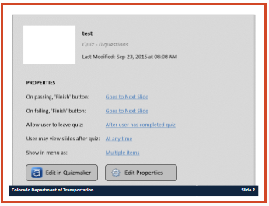
Slide Selection and Articulate Functionality
Much of the functionality of Articulate is:
Specific to the slide (not highlighted)
Used to create a new slide (highlighted blue)
Is used to make changes to the whole presentation (Highlighted green)
Notes:
Notes
TAB 05 – Articulate Icon list
In general, the functionality of Articulate is stored in the PowerPoint or the associated folder. Understanding what happens when you click on it is key to using Articulate successfully.
The areas of the Articulate ribbon that are not highlighted are stored directly on the slide.
The icons highlighted in blue take you outside of Articulate Presenter and into a new program. The content created in the program must be saved to return to the PowerPoint presentation. The two buttons at the bottom of the slide are then used to make changes to the content. The Edit in Quizmaker opens the content in Quizmaker. The Edit Properties allows you to make changes to the all of the properties of the slide listed in above the button. Additionally, a file is created to store this content.
The icons highlighted in green, make changes to the way the presentation displays when it is published and provides publishing options. The changes made to this section are not displayed anywhere in the PowerPoint.

Slide 58
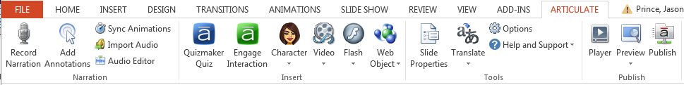
Identify Folders in the Articulate Ribbon
There are four main folders in the Articulate ribbon:
Narration – allows you to record a script and animate objects on a slide
Insert – controls the how the user interacts with the content of the course
Tools – allows you to edit the timing of the slides, how the user interacts with the course
Publish – allows you to preview and publish your course
Notes:
Notes
TAB 05 – Articulate Icon list
There are four main folders in the Articulate ribbon. Each of the folders allow you to access additional functionality and are grouped according to actions you may want to take. If you are uncertain about an icon within a folder then you can hover the cursor over the icon for details about the icon. Details about each of the folders are below:
Narration – This folder contains all of the icons used to record narration and time both the slides and any annotations or animations you may have added to your presentation.
Insert – This folder allows you to access and add additional objects to the presentation, such as characters, videos, flash and web objects. Additionally, you are able to add quizzes using Quizmaker and interactions through Engage.
Tools – This folder is used to control the way the user interacts with the course, and the look and feel of the course.
Publish – Publish allows you to preview what the course will look like and make changes to the skin of the course and add additional tabs to the skin such as resource documents and the glossary. From here you can also choose what you will publish (Word document, web, or to the LMS).

Slide 59
Narration Folder
Record Narration – used to record and add narration
Add Annotation – adds symbols to highlight key points
Sync Animations – used to manage animations added from the animations tab
Import Audio – used to import audio files
Audio editor – a simple editor for audio narration.
Notes:
Notes:
TAB 05 – Articulate Icon list
Now let’s go into detail on the icons within the Narration folder.
Record Narration – This is one of to ways you can add narration to the presentation. When you record narration the default timing of the slide changes to the length of the script you are recording. You are also able to select the Show Annotations option to highlight a detail on the screen.
Add Annotation – Adding annotations is used to draw the attention of the participant to an area of the screen. This is done through the use of arrows, checks, rectangles, spotlights timed with the script. Because this occurs during the narration this is best done while you record narration.
Sync Animations – This allows you to change the timing of animations you may have created using the animations tab. This is most commonly used to highlight the narration of a conversation between characters with or without recorded narration.
Import Audio – This button is used to import audio files into the presentation. The files can be in most audio formats.
Audio Editor – The audio editor is a tool that allows you to edit audio and edit, merge and add to sound files.

Slide 60
Insert Folder
Quizmaker – allows one or more questions to be inserted
Engage – insert an interaction into the presentation
Character – allows you to choose from 9 characters in three different poses
Video – imports user created or video files into the presentation
Flash – imports flash files
Web Objects – imports web objects
Notes:
Notes
TAB 05 – Articulate Icon list
Quizmaker – Quizmaker is used to add interactive questions for both knowledge checks and assessment. This is also used to replace the questions slide produced by the SME. You are able to insert as many quizzes as needed throughout the course. There are two options for the questions the graded and survey questions. If you select survey, the question is not used for assessment. If you select graded then you must also assign a value to the question for the assessment. For help on how to create an assessment go to Section 10 Add a Quiz Using Quizmaker.
Engage – Engage is used to insert interactions into the presentation. You can enter as many Engage interactions as are need create your eLearning. Engage interactions work best for tables of information, dialog between two people and process flows. To learning about how to create an Engage interactions go to Section 7 Create an Interaction Using Engage.
Character – This displays a list of nine characters that have three types of poses (headshot, torso and full) with a variety of expressions. The characters can be used in conjunction with the animations and dialog boxes from the Shapes icon on the Insert ribbon to create an interactive dialog. This is most useful to replace a demo slide or a scenario.
Video – This allows you to insert a video you have on your computer into the presentation. Please be sure to make sure the video is not under copyright before it is inserted into the course.
Flash – This allows you to insert a Flash file you have on your computer into the presentation. Please be sure to make sure the file is not under copyright before it is inserted into the course. Note the file extension for flash is .swf.
Web Object – This allows you to insert a web address into your presentation. You are also able to chose if it opens in a new window of time it so it appears automatically after the narration. When importing a link be sure to test how, or if, the link displays using the Test Link… button.

Slide 61
Tool Folder
Slide Properties - used to change the advancement of the slide, and slide playlist, control and menus
  The edit menu button displays the player properties
Options – allows you to control the timing and publish the slide
Help and Support – displays online help and support
Notes:
Notes
TAB 05 – Articulate Icon list
Slide Properties –is used to change almost any aspect of a slide. If you are uncertain about where to find a feature of Articulate this is the best place to start looking for details. Selecting Slide properties takes you to a menu where you are able to lock the editing of the slide, change how the user is able to advance (timing of the slide or manual) identify the presenter (useful for scripts with two or more people and the printed storyboard), create a playlist of one or more sounds tracks, and create branches. You are also able to change the skin to allow the menu, glossary, resources and notes to display.
Options – allows you to change the amount of time the slide displays and has a shortcut to the publishing button.
Help and Support –allows you to access the extensive list of help documentation available to answer any of your questions. If you need a specific link go to the Technical Help Questions slides for a description of the types of help resources you can find on the Articulate site.

Slide 62
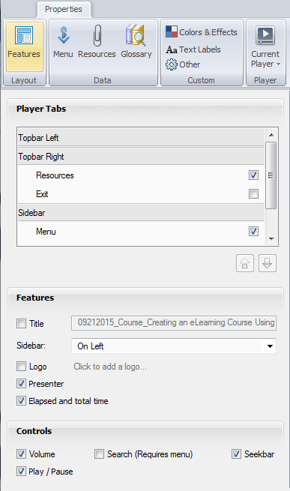
Changes to Format
For Articulate font changes:
Color and Effects button to change the font
Works at the course level
Does not change font of quizzes, simulations or interactions
For PowerPoint font changes
Use Reset
Notes:
Notes
TAB 05 – Articulate Icon list
During the process of transferring materials or creating content the font may change. This occurs when:
Slides are not imported correctly so they keep the source formatting.
Quizzes are not copied from the template.
Interactions are not created from the template.
Slides are copied into the PowerPoint.

Slide 63
Publish Folder
Player – this provides options on how to change the skin presentation and import templates
Preview – displays how the slide will look
Publish – publishes the file into a range of different formats
Notes:
Notes
TAB 05 – Articulate Icon list
Player - This button is the best place to go if you want to make changes to the “look and feel” of your presentation. From this button the properties menu displays where you can change where the toolbars display, if a glossary, resource documents and notes display. You are also able to change all of the text, text labels and color schemes of the course.
Preview – This displays how the slide you are working on will look, sound and interact with the participant. Selecting the drop-down under the Preview button also allows you to choose one, three or a range of slides to display.
Publish – Allows you to publish the course in a variety of ways. The options that are available to you are web, LMS, CD, and Word.

Slide 64
Articulate and PowerPoint Integration
Articulate Quizmaker, Engage and Presenter are fully integrated with PowerPoint:
All design, transitions and animations can be saved and used in Articulate
Selecting preview (Articulate tab) allows you to see the way the slide displays
  Transitions are displayed if you choose to preview more than one slide
Saving the PowerPoint and automatically saves the Articulate file
Articulate Replay is not integrated with PowerPoint
  Once a Articulate Replay file is published it is inserted as an MP4 file
Notes:
Notes
When you are creating your presentation most of the initial design work can and should be done in PowerPoint using the existing CDOT Templates.
At any point in the design process, if you access Articulate functionality, you are prompted to save the file as an articulate file. It is best practice to have your presentation and all of the associated documents in one folder that is located on your computer. There have been some reported instances where files stored on a network drive have had issues.
Replay is a separate program and the files created using the program need to be published before they are inserted into the course. The file output is MP4 video.

Slide 65


Access Articulate Community
Articulate has a community of support to help you with developing eLearning at https://community.articulate.com
To create an account click
Enter your email address, first and last name and a password
Click
Notes:
Notes
The links above may require you to have an account to access the site. The process to create an account is simple and requires the following information:
Email address
First and Last Name
User assigned password
An optional picture for your profile

Slide 66
Help Resources
The following table contains links to Technical and Instructional Design resources for Articulate
Program | Technical Help | Instructional Design Help
Presenter ’13 | http://www.articulate.com/support/presenter-13 | https://community.articulate.com/hubs/presenter
Quizmaker ‘13 | http://www.articulate.com/support/quizmaker-13 | https://community.articulate.com/hubs/quizmaker
Engage ’13 | http://www.articulate.com/support/engage-13 | https://community.articulate.com/hubs/engage
Replay ’13 | http://www.articulate.com/support/replay | https://community.articulate.com/hubs/replay?parent=articulate-studio
Notes:
Notes
The links are for the Instructional design resources of the E-learning Heroes community. This is a great resource if you have questions about how to design your course or need to see samples of what others have produced. The link to the discussion forum is: https://community.articulate.com/discuss
The best place to start is the discussion forum if you have a questions that is not specific to any one product.

Slide 67
Check Your Knowledge
When does the PowerPoint have an associated Articulate file?
When Articulate functionality is accessed
How many folders are there in the Articulate ribbon?
Four (Narration, Insert, Tools and Publish)
Notes:
Notes:
Question One
When does the PowerPoint have an associated Articulate file?
Answer One
When Articulate functionality is accessed.
Question Two
How many folders are there in the Articulate ribbon?
Answer Two
Four (Narration, Insert, Tools and Publish)

Slide 69
Course Agenda
Learning Logistics
Section 1 – Introduction
Section 2 – CDOT Training Templates
Section 3 – Introduction to Studio ‘13
Section 4 – Prepare Presentation for eLearning
Section 5 – Create Glossary
Section 6 – Add Resource Documents
Notes:
Notes:
This course is designed to teach participants how to develop an eLearning course using Articulate. The course is a full day course and is composed of the following sections:
Section 4: Prepare Presentation for eLearning – This section takes about 30 minutes to complete and describes the process of converting an ILT presentation into an eLearning course.
Section 5: Create Glossary – This section takes about 20 minutes to complete and describes the process of creating a glossary and changing the PowerPoint course into an eLearning.
Section 6: Add Resource Documents – The introduction takes about 20 minutes to complete and describes how to insert a resource document into the eLearning course.

Slide 70
Section 4 Learning Objectives
At the end of this section, you should be able to:
Identify the different inputs for an eLearning
Identify the different PowerPoint templates
Identify how to choose the correct templates when developing a course
Identify which slides need to be removed, changed or rebuilt using the Crosswalk
Import eLearning slides to replace Presentation slides
Notes:
Notes:
Each of the learning objectives corresponds to a slide, or series of slides, in this section of the course.
By the end of this section, you should be able to perform each of the listed objectives with the support of the training materials.
The section learning objectives are tied directly to the course objectives reviewed at the end of the course.

Slide 71
Terms and Concepts
Term | Definition
Training Development Process | The process used to create training consisting of the following stages: needs assessment, design, development, implement and evaluate.
Template | A preset format for a document or presentation used to increase consistency and save time.
Format | The style or appearance of a document or presentation.
Course | A series of lessons used to teach skills and knowledge for a task or process.
Style | A predefined format of text in PowerPoint or Word used to maintain a consistent format to the presentation or document.
Notes:
Notes:
TAB 01 - Terms and Concepts
The following terms are critical to your understanding of this section of the course.
Additional terms are located in the Terms and Concepts document located in the reference materials.
If you do not understand the term, please ask for additional clarification.
The Terms and Concepts document contains more terms than are listed in the course and should be reviewed to help with your learning.

Slide 72
Inputs and Templates
When you receive the request the actions you take depend on the input and the course design as shown below.
Input 1
Word Document
Develop Curricula for Multi-section course Optional for Single
Input 2
Assigned SME
Input 3
PPT created by SME not in Template
Single section PPT Template
Single section Articulate template
Single or Multi
Audio
Input 4
PPT created by SME in PPT Template
Multi-section PPT Template
Multi-section Articulate Template
Notes:
Notes
There are four ways in which you may get assigned the development of an eLearning:
When you receive a Word Document it may be in the form of a rough outline of the training. If it is for:
A single section course you may proceed without a curricula and develop the course. When the course is developed used the storyboard to show the design options to the SME.
A multi-section course it would be best to develop the curricula for the course.
If you are assigned an SME create a curricula before the development of the course.
For the third input the content of the course needs to be reviewed and the content of the course transitioned into the eLearning template.
If the notes are focused on the instruction of the course then they will have to be changed before it is turned into a script.
For fourth option, the content needs to be reviewed and then transitioned into the eLearning. This is the easiest option as the notes can be used for the development of the script.
Refer to the Crosswalk between Instructor Led and eLearning Template for details about the changes you need to make to the course to convert it into an eLearning.
Continued on the next page

Slide 73
Inputs and Templates
When you receive the request the actions you take depend on the input and the course design as shown below.
Input 1
Word Document
Develop Curricula for Multi-section course Optional for Single
Input 2
Assigned SME
Input 3
PPT created by SME not in Template
Single section PPT Template
Single section Articulate template
Single or Multi
Audio
Input 4
PPT created by SME in PPT Template
Multi-section PPT Template
Multi-section Articulate Template
Notes:
Continued from Previous Page
Once you have determined the development approach the next choice is if it is a single or multiple section course PowerPoint template:
For a single section course use the single section course PowerPoint Template
This is a abbreviated course a separate template was created with many of the slides required by a multiple section course removed or altered.
For a multiple section course use the multi-section course PowerPoint Template.
This template is more robust and contains three predesigned sections which you can copy and paste to make more sections. This course is an example of a multiple section course for an Instructor lead training.
The final step is to determine if you are going to have audio in the course.
A separate template for sound has been created for each of the courses. Templates change the look and feel of the Articulate skin. You will learn more about how to import a template in section 11 of this course.
For courses without audio the volume, play/pause, and seek bar will not display.
For the courses with audio, these are not disabled.

Slide 74
eLearning PowerPoint Templates
SMEs have one PowerPoint template for ILT course development
This is referred to as the “PowerPoint”
It is designed to be used with the Multiple section PowerPoint template
Two (single and multiple) eLearning PowerPoint Templates exist:
Designed to assist with the creation of an eLearning course from an SME PowerPoint
Are specifically formatted for eLearning
To help you convert an SME PowerPoint into the eLearning template a crosswalk has been created to show you how
Notes:
Notes
TAB 02 – Multi-section Course eLearning PPT
TAB 03 – Single-section Course eLearning
TAB 04 – Crosswalk between Instructor Lead and eLearning Multi-section eLearning PPT
The PowerPoint templates are designed to help you develop your course from the PowerPoint developed by the SME.
A Crosswalk between Instructor Lead and eLearning Multi-section PPT template has been created to let you know which slides need to be added or removed.
The best approach is to copy the SME PowerPoint and insert the slides by section.
As you develop the course it is best to develop by the sections and selecting Insert → Slides from → Other Presentation to insert the section directly into the eLearning template.
If you are developing an eLearning without an SME then you must use the eLearning template to create the course.
Note: If you follow this type of development you will not be able to create a Participant guide as the notes section will house the script. The slide for the participant guide will need to be deleted or modified from the eLearning course unless one is created separately.

Slide 75
Choosing the Correct Template
Choose a Single section if:
The course covers one topic or concept
It needs to be brief or developed rapidly
If there are only a few topics covered
Content has been written out in a Word document
Choose the Multiple section if:
There are multiple processes to review
There are multiple sections in the curricula
There are multiple audiences
Notes:
Notes
TAB 06 – Adding a Template to an Articulate Course
Choosing the correct template is important because it influences how you will design the course and how the participant learns. Refer to the slide above for when to choose a single of multiple section template. The exercises in the course use the single section template created from a Word document provided by an SME.

Slide 76
Exercise 1
PowerPoint Template Review
Roles:
Training Developer
Scenario:
In this exercise, you are reviewing:
The Single-section PowerPoint Template
The Multi-section PowerPoint Template
Notes:
Notes
TAB 02 – Single-section PowerPoint Template
TAB 03 – Multi-section PowerPoint Template
TAB 06 – Adding a Template to an Articulate Course
In this exercise, we are going to review the PowerPoint Templates available for you to use. If you would like, open the template and follow along.
A copy of the files can be found in the Exercise One PowerPoint Template Review folder.

Slide 77
Crosswalk
The Crosswalk:
Displays the slide from the ILT next to the corresponding eLearning slide
Explains the difference between the two
Outlines actions you need to take
Notes:
Notes
TAB 04 – Crosswalk between Instructor Lead and eLearning Multi-section PPT
The crosswalk is used to help you identify the actions you need to take to convert an ILT to an eLearning. This is not limited to the slides, but also includes actions you may need to take for the notes section. It also contains helpful hints. In some cases, there may not be a equivalent slide this is indicated by “N/A” and the reason why is explained in the difference column.

Slide 78
Exercise 2 - Review Crosswalk
Roles:
Training Developer
Scenario:
In this exercise, you are performing the following actions:
Reviewing the Crosswalk
Notes:
Notes
TAB 04 – Crosswalk between Instructor Led and Multi-section eLearning PPT
In this exercise, we are going to review the crosswalk and discuss how it is used for the Multi-section course. When you are creating a single section course, you do not have to use the crosswalk and can create your course from the Single-section Course eLearning template.
A copy of the files can be found in the Exercise Two - Review Crosswalk folder.

Slide 79
Importing Slides into the Template
When importing a presentation:
Only perform this when the templates do not match
Always create a source folder
Use the Layout and reset buttons to restore the source formatting
1. Create a project folder for the course
2. Copy and paste the PPT template into the project folder
3. Copy and paste the slides you need into the PPT template
5. Save file
4. Add Articulate functionality and delete duplication
Notes:
Notes
TAB 07 Import a Slide into the Template
Articulate resides as a ribbon within PowerPoint. When you access the Articulate functionality within a presentation an Articulate file is created. The steps in the process are:
Create a project folder for the course – Please do not skip this step in the process. As you work on the course, and add Articulate functionality, the files reside outside of the course and are stored in the same location as the PowerPoint document. By creating the project folder, you are also creating one location for all of the files.
Copy and paste the PPT template into the project folder – Do not use the original source file. Saving the file in one location saves all of Articulate files to this location
Copy and paste the slides you need into the PPT template – When you copy and paste the slides into the presentation the formatting of the slide may change. You may still need to make changes using the Layout and Reset button to make the slides match the template slides. When you import slides it is best to do this by slide or by section. This makes it easier to track the changes you are making to the course.
Add Articulate functionality and delete duplication – This applies to any of the slides such as quizzes, processes converted into Engage interactions, ect. When the content is converted then delete the source content from the slide.
Save file – finally, all you need to do is to save the file. The Articulate file associated with the presentation is stored in the source folder.

Slide 80
Exercise 3
Import Slides into the Template
Roles:
Training Developer
Scenario:
In this exercise, you will learn how to:
Import existing slides from a ILT Training into the Single Section Course eLearning template
Replace the duplicate side with the SME content
Notes:
Notes
TAB 07 – Import a Slide into the Template
Working File (AA ILT Training Source and Single-section Course eLearning template)
In this exercise we are going to:
Open the Single-section Course eLearning template and import slides from the AA ILT Training course.
Delete the duplicate files.
When you are done select Save.

Slide 81


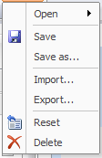
Import or change an Articulate Template
To import a new Player template select:
Player → Current Player → Import → then navigate to the template
To change a template select:
Player → Current Player → Open → then the template you want to use
Note: Articulate always uses the selected Player template until it is changed
Notes:
Notes:
TAB 06 – Adding a Template to an Articulate Course
In addition to the PowerPoint you may need to add a Player template to the course or change the existing one.
To import a new template select Player → Current Player → Import → then navigate to the template.
To change a template select Player → Current Player → Open → then just select the template you want to use.
When working with a new course always verify the template. Articulate defaults to the last template used.
The easiest way to verify the correct template is to preview the player.
Selecting the Export option saves the current style as a template.

Slide 82
Exercise 4
Import Articulate Player (Skin) Template
Roles:
Training Developer
Scenario:
In this exercise, you will learn how to:
Change the default player template to the One Section
Replace the duplicate side with the SME content
Notes:
Notes
TAB 06 – Adding a Template to an Articulate Course
Working Files (AA ILT Training Source and Single-section Course eLearning template)
In this exercise you are going to:
Open the Single-section Course eLearning template and import the needed slides from the AA ILT Training course.
Delete the duplicate Files.
When you are done select save and leave the file open. From this point on you will have the templates in Articulate.

Slide 83
Check Your Knowledge
What are the names of the two PowerPoint templates?
Single-section Course eLearning and Multi-section Course eLearning
What is the Crosswalk?
A document designed to show you how to create an eLearning from an Instructor Led Training
Notes:
Notes:
Question One
What the names of the two PowerPoint Templates?
Answer One
Single-section Course eLearning and Multi-section Course eLearning
Question Two
What is the Crosswalk?
Answer Two
A document designed to show you how to create an eLearning from an Instructor Led Training.

Slide 85
Course Agenda
Learning Logistics
Section 1 – Introduction
Section 2 – CDOT Training Templates
Section 3 – Introduction to Studio ‘13
Section 4 – Prepare a Presentation for eLearning
Section 5 – Create Glossary
Section 6 – Add Resource Documents
Notes:
Notes:
This course is designed to teach participants how to develop an eLearning course using Articulate. The course is a full day course and is composed of the following sections:
Section 5: Create Glossary – This section takes about 20 minutes to complete and describes the process of creating a glossary and changing the PowerPoint course into an eLearning.
Section 6: Add Resource Documents – The introduction takes about 20 minutes to complete and describes how to insert a resource document into the eLearning course.

Slide 86
Section 5 Learning Objectives
At the end of this section, you should be able to:
Define terms and concepts
Explain the connection between the Terms and Concepts slide in the PowerPoint and the Glossary in Studio ‘13
Practice creating and maintaining the glossary
Notes:
Notes:
Each of the learning objectives corresponds to a slide, or series of slides, in this section of the course.
By the end of this section, you should be able to perform each of the listed objectives with the support of the training materials.
The section learning objectives are tied directly to the course objectives reviewed at the end of the course.

Slide 87
Terms and Concepts
Term | Definition
Glossary | An alphabetical list of terms or concepts found in the eLearning course.
Skin | A custom appearance used to change the look and feel of the eLearning. Articulate Studio ‘13 allows you to change the element of the skin to allow the glossary, resource document and a table of content to display.
Notes:
Notes:
Tab 01 - Terms and Concepts
The following terms are critical to your understanding of this section of the course.
Additional terms are located in the Terms and Concepts document located in the reference materials.
If you do not understand the term, please ask for additional clarification.
The Terms and Concepts document contains more terms than are listed in the course and should be reviewed to help with your learning.

Slide 88
Connection Between Terms and Concepts and eLearning
The Terms and Concepts slide in the Presentation and the Glossary share the same content
The process below describes how to create the Glossary
Compare all Terms and Concepts slides against the Terms and Concept Document
Errors
Add the eLearning Glossary to the eLearning Template
Delete ILT Terms and Concepts Slides
Resolve Discrepancies with the SME
Add Terms and Concepts as a Resource Document
Notes:
Notes:
The Terms and Concepts slides are used as the content for the Glossary in Studio ’13. The Terms and Concept document should also be reviewed and uploaded as a reference document. To add a reference document to your eLearning, go to Lesson 7 Add a Resource Document. When creating the glossary:
The terms are automatically alphabetized.
Is limited to 500 terms.
May be added to the Skin (preferred) or created in Engage and inserted directly into the presentation as a slide.

Slide 89
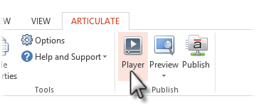


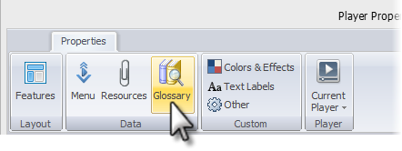
Creating the Glossary from the Terms and Concepts Content
To create the glossary:
Select the Articulate tab
Select Player
Select Glossary
Select Create
Copy and paste the definition from the Terms and Concept slide
Notes:
Notes:
TAB 08 – Create a Glossary Term
The Terms and Concepts slides from each of the sections of the course form the basis for the Glossary in the eLearning presentation. The process for the creation of the Glossary is comprised of four steps. They are:
Compare the Terms and Concepts slide against the Terms and Concept document – Comparing the two documents is an important step as one document may not have been updated when the course edits occurred.
Resolve Discrepancies with SME – If one of the terms has more that one definition or they do not match exactly match then work with the SME to resolve the issue.
Add the Glossary to the eLearning Template – Articulate Studio ‘13 does not allow a glossary to be saved to the project file, so it must be created for each project and if copied does not carry over to the copied project.
Add, edit or delete glossary terms – All of the terms are from the Presentation Terms and concepts slides need to be cut and pasted into the eLearning templates.

Slide 90
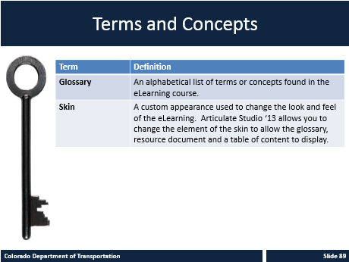
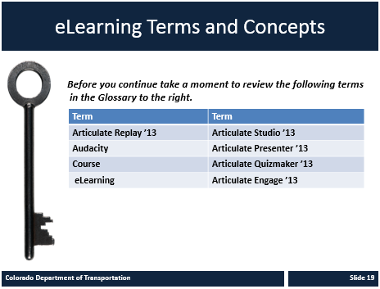
Adding the eLearning Terms and Concept Slide
ILT Terms and Concepts Slide
eLearning Terms and Concepts
Notes:
Notes
The slide for the ILT Terms and Concepts is on the left. When you are creating a eLearning course you do not need to have the definitions because the terms are accessed from the Glossary.
Because the participant still needs to know the Terms and Concepts the eLearning Terms and Concepts slide has been created. This slide does not have the definition of the term. Instead it references the Glossary and provides a list of the terms the Participant needs to understand before they start the section.
A complete list of the Terms and Concepts is also stored as a reference document for the participant.

Slide 91
Exercise 5 - Maintain Glossary
Roles:
Training Developer
Scenario:
In this exercise, you are:
Adding a term to the Articulate Glossary
Editing or deleting a Glossary term
Deleting the ILT Terms and Concepts slide
Notes:
Notes
TAB 08 – Create a Glossary Term
TAB 09 – Edit or Delete a Glossary Term
This exercise is broken out into several exercises:
Add the terms in the first section into the glossary using the Add a Glossary Terms work instruction.
Edit or Delete one of the terms you added using the Edit or Delete Work Instruction.
Deleting any unnecessary Terms and Concepts slides.
A copy of the terms we are adding to the course is in the exercise 5 folder.

Slide 92
Check Your Knowledge
Which button on the Articulate ribbon allows you to access the glossary?
The Player icon
Notes:
Notes:
Question One
Which button on the Articulate ribbon allows you to access the glossary?
Answer One
The Player Icon

Slide 94
Course Agenda
Learning Logistics
Section 1 – Introduction
Section 2 – CDOT Training Templates
Section 3 – Introduction to Studio ‘13
Section 4 – Prepare Presentation for eLearning
Section 5 – Create Glossary
Section 6 – Add Resource Documents
Notes:
Notes:
This course is designed to teach participants how to develop an eLearning course using Articulate. The course is a full day course and is composed of the following sections:
Section 6: Add Resource Documents – The introduction takes about 20 minutes to complete and describes how to insert a resource document into the eLearning course.
Section 7: Create Engage Interaction – This section takes about 30 minutes to complete and explains the process of converting exercises and demonstrations into screencasts and video narration.

Slide 95
Section 6 Learning Objectives
At the end of this section, you should be able to:
Define terms and concepts
Explain the connection between the Tabs in the PowerPoint and the Resource link in Studio ‘13
Identify which documents in the PowerPoint should and should not be brought into the Studio ’13 Course
Practice creating and maintaining a Resource document
Notes:
Notes:
Each of the learning objectives corresponds to a slide, or series of slides, in this section of the course.
By the end of this section, you should be able to perform each of the listed objectives with the support of the training materials.
The section learning objectives are tied directly to the course objectives reviewed at the end of the course.

Slide 96
Terms and Concepts
Term | Definition
Resource | Any document or Link imported into the course as a learning aid. Also known as “Tab” documents in the Instructor Lead Training Templates Course.
Notes:
Notes:
Tab 01 - Terms and Concepts
The following terms are critical to your understanding of this section of the course.
Additional terms are located in the Terms and Concepts document located in the reference materials.
If you do not understand the term, please ask for additional clarification.
The Terms and Concepts document contains more terms than are listed in the course and should be reviewed to help with your learning.

Slide 97
Connection Between “Tab” Document and Resource Documents
Resource documents are populated from the resource materials from the ILT course and the Course Guide
Additional Resource documents may be added to the course as required
Review the Course and Confirm all Reference Document are available
Retitle the Course Guide as Tab 00 _Title of Course and add as a Reference Document
Create Additional Reference Documents, as required, and add to the eLearning Course
Notes:
Notes:
All of the documents from the ILT should be added to the eLearning course, as Reference documents. When adding Reference documents keep the following in mind:
The Course Guide should be added as a Reference Document Titled as “Course Guide Title of Course”.
All of the Reference Documents from the ILT Course should keep the same name as the title of the file. This is done to keep the reference to the file in the Course Guide active.
All documents created to support eLearning should Titled “Name of Document_eLearning” .
If there are forms or other documents that are located online, consider a link to the original document so if there are any changes to the document the course does not have to be updated.
Be sure to keep the original name of the file when you using the title field.

Slide 98
Which Document Should be Imported into the PowerPoint and Referenced
The following documents should be brought into the Presentation:
All documents from the ILT with the same name
The ILT Course Guide
Any additional materials created to support the eLearning training
When adding a Resource document
Do not change the name of existing documents
If you create a Resource document use “Name of Document”
Notes:
Notes
When you create the eLearning add all of the Resource documents from the original presentation. In addition, the original course should be added as a Resource document. During the development of the eLearning additional Resource materials may be created. If they are created they should be added to the course.

Slide 99
How Reference Documents are Referred to in the Presentation
When adding an ILT Resource document:
Do not change the name of existing documents
Confirm the Reference document is also referenced in the on the eLearning slide using “Name of Document”
When adding a Resource document to support eLearning:
Use only the name of the document and remove the “TAB_XX_”
On the slide using the “Name of Document”
Notes:
Notes
Unlike the glossary terms there is no reference slide for a Resource Document. This is why the Reference documents need to be referred to on the PowerPoint slide.

Slide 100
Exercise 6
Create and Maintain Resource Document
Roles:
Training Developer
Scenario:
In this exercise, you are performing the following actions:
Adding a Resource Document
Editing or deleting a Resource document
Notes:
Notes
TAB 10 – Add a Resource Document
TAB 11 – Edit or Delete a Resource Document
This exercise is broken out into several exercises:
The Resource document are added from the open Articulate Ribbon. Go to Player → Resources → Create Resource Document → then navigate to the document you want to add to the presentation.
A copy of the Resource Documents can be found in the exercise six lesson folder.

Slide 101
Check Your Knowledge
When creating an eLearning from an ILT course what should be removed from the name of the file?
“TAB_XX_” You should only keep the name of the file.
Notes:
Notes:
Question One
When creating an eLearning from an ILT course what should be removed from the name of the file?
Answer One
“TAB_XX_” You should only keep the name of the file.

Slide 103
Course Agenda
Section 7 – Create Engage Interaction
Section 8 – Create and Insert Audio
Section 9 – Add Annotation
Section 10 – Add Quiz using Quizmaker
Section 11 – Print and Publish Course
Section 12 – Conclusion
Notes:
Notes:
This course is designed to teach participants how to develop an eLearning course using Articulate. The course is a full day course and is composed of the following sections:
Section 7: Create Engage Interaction – This section takes about 30 minutes to complete and explains the process of converting exercises and demonstrations into screencasts and video narration.
Section 8: Create and Insert Audio - This section takes about 60 minutes to complete. This section describes how to create a script using either Studio ’13 or Audacity to record and add narration to a course.
Section 9: Add Annotation – This section takes about 30 minutes to complete and provides details on how to annotate (add movement) to a slide.
Section 10: Add Quiz using Quizmaker - This section takes about 30 minutes to complete describes the process of reviewing and adding an assessment to an eLearning course using Quizmaker.
Section 11: Print and Publish Course – This section takes about 30 minutes to complete and describes the different ways you are able to publish your course for review, preview and upload to the Learning Management System (LMS).
Section 12: Conclusion – This section takes about 10 minutes to complete and summarizes the course. It also provides details about where you can get additional help.

Slide 104
Section 7 Learning Objectives
At the end of this section, you should be able to:
Define Terms and Concepts
Describe the Engage Interaction types
Recognize when to use a interaction
Describe how to insert an interaction into your course
Notes:
Notes:
Each of the learning objectives corresponds to a slide, or series of slides, in this section of the course.
By the end of this section, you should be able to perform each of the listed objectives with the support of the training materials.
The section learning objectives are tied directly to the course objectives reviewed at the end of the course.

Slide 105
Terms and Concepts
Term | Definition
Engage | A Component of Studio ’13 used to create an interaction where the participant can click there way through a process.
Notes:
Notes:
Tab 01 - Terms and Concepts
The following terms are critical to your understanding of this section of the course.
Additional terms are located in the Terms and Concepts document located in the reference materials.
If you do not understand the term, please ask for additional clarification.
The Terms and Concepts document contains more terms than are listed in the course and should be reviewed to help with your learning.

Slide 106
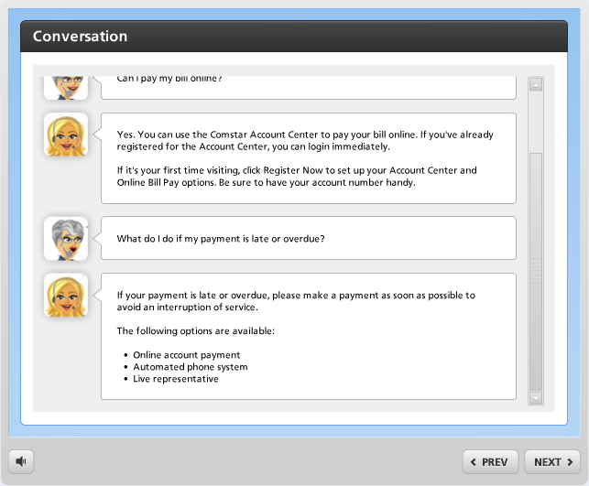
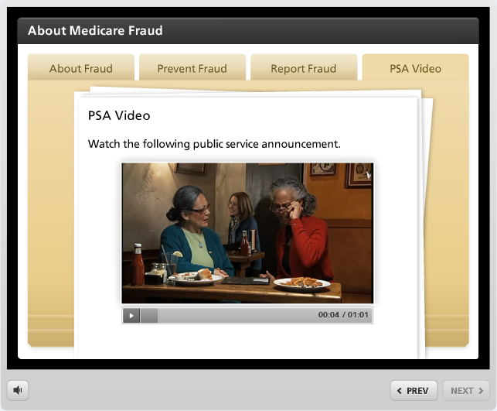
Engage Interaction Types
Engage Interactions:
There are twenty Engage Interaction types
Refer to the Understanding Interaction Types document for:
  Sample pictures
  Description
  Best use of interaction
Always use the templates when creating an interaction
Notes:
Notes
TAB 12 – Understanding Interaction Types
There are twenty Engage Interaction types. Each of the interaction types has been designed to assist you with a certain type of learning you want to occur.
Refer to the Understanding Interaction Types document for a detailed list of all of the interaction types, descriptions and best use of the interaction.
Document templates of each of the interactions have been created. When you create a new interaction always use the template. The template contains the formatting and the style to match all of the training templates that have been created. If you do not use the template the interaction will have to be recreated.

Slide 107
Discuss Engage Interaction Types
Roles:
Training Developer
Scenario:
In this exercise, you are performing the following actions:
Discuss the types of interactions in Engage
Notes:
Notes
TAB 12 – Understanding Interaction Types
Using the Understanding Interaction Types document discuss as a group what type of interactions would be best.
Refer to this document if you are having difficulty with the which type of interaction is best for what you want the learner to know.

Slide 108

When to Use Interactions
Interactions are used when:
There is more than one slide of similar content
Describing a process
An image can be used to describe multiple ideas
There is a checklist of items
You want to create a conversation
Notes:
Notes
Engage interactions can be used in the place of many of the slides in PowerPoint. However, they should be used sparingly throughout the presentation or they lose their impact. Remember throughout the presentation there are also quizzes, narration, slides, images and video to keep the Participant engaged with the eLearning.
When creating the interactions think of your audience and the content. Some audiences may need to have more interactions than others to stay engaged. Some of the audiences may be distracted and lose interest because of the interactions.
As a rule of thumb, if you are struggling to make an interaction work then it is a good indicator that it should be covered in a different way.
If you are building a course for a previously created course by an SME, look for the following lend themselves to interactive processes:
Exercises
Practices
Conversations
Group activities
Fill in of a form
Locating a form or policy
Discussion of sections of a process or form
Timeline of events
Frequently asked questions

Slide 109
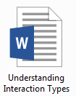

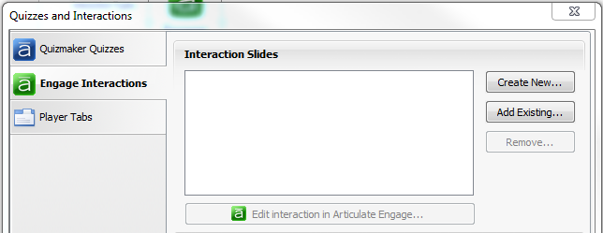
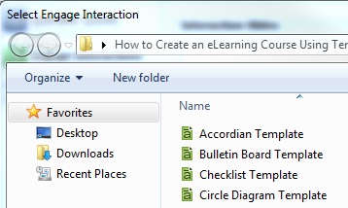
Inserting an Engage Interaction
There are five steps to adding an Engage Template to the PowerPoint
1
2*
3
5
Always copy and paste the template to your project folder
4
Notes:
Notes:
The process to insert a interaction is outlined below:
Choose the best type of interaction using the Understanding Interaction Types document.
Copy and paste the file to your project folder.
From the Articulate ribbon, select Engage Interaction.
From the Quizzes and Interactions screen, select add existing.
Navigate to your templates folder and select the appropriate template.
Select the Edit Interaction in Engage. This saves the file as an interaction within the PowerPoint.
Note: Unless You have a slide selected or the interaction displays at the end of the presentation.

Slide 110
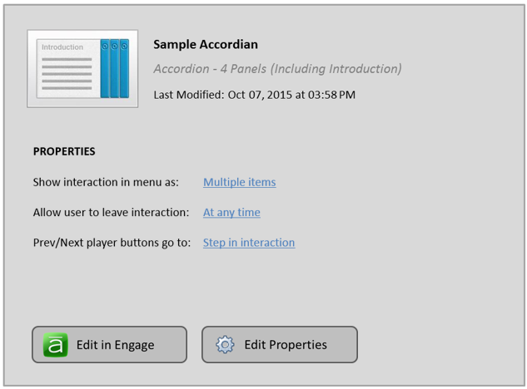
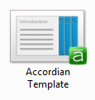
Inserted File
The inserted file (right):
Displays the type of interaction
How many panels
The properties
Note: This slide is a link to the file created and saved in the project folder as shown by the icon to the left
Notes:
Notes:
When you save the Engage Interaction, or any type of Articulate file the following slide is added to the presentation. You can access the file in one of two ways:
Click on the Edit in Engage button.
Go to your project folder and access the file.
Both of the options take you to the same file and the changes you make to the files are saved and can be accessed in either way.
You are also able to click on the Edit properties to make changes to the properties of the three items listed and you are able to:
Create a new interactions (both Quizmaker quiz and Engage).
Remove an interaction.
Add player tabs.
Access existing Interactions.
Once the file is associated with the file you can change the name of the file and this will not impact the properties of the file.

Slide 111
Exercise 7 - Insert an Engage Interaction into a Presentation
Roles:
Training Developer
Scenario:
In this exercise you are performing the following actions:
Inserting a Tabs Interaction (slide 5)
Inserting a Conversation Interaction (Slide 10)
Inserting an Accordion Interaction (slide 12)
Notes:
Notes
TAB 12 – Understanding Interaction Types
TAB 13 – Insert an Engage Interaction
This exercise is comprised for three different activities. All of the source materials for the files can be found in the Exercise Seven folder. This includes all:
Text
Image files
Engage Interaction Templates.
Instructions can be found at the end of the lesson in the Reference Document section.
Refer to the slide above for the slides we are replacing with an Engage interaction.
To review all of the interactions, go to https://community.articulate.com/series/articulate-engage-13 for details on each of the Engage interaction types.

Slide 112
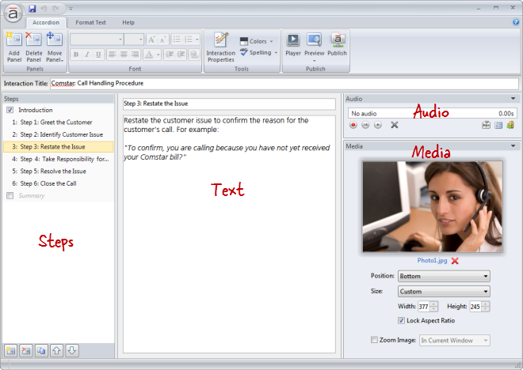
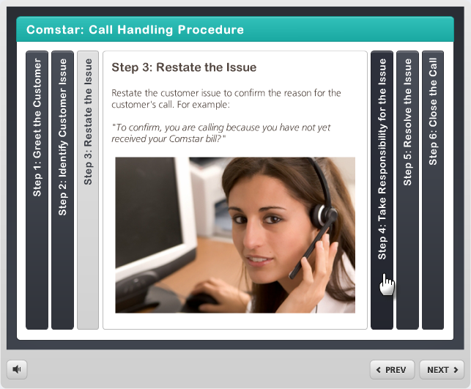
Interaction Views
File View
Published View
Notes:
Notes
There are two different views when you are creating an interaction. The file view and the published view.
The file view is the working view of the interaction. It is where:
The file is created and text, pictures, sound and video can be added to the interaction.
Steps and/or panels are added to the interaction.
Colors and the style of the interaction are maintained.
The published view is the display view of the interaction. It is where:
You can display the results of the changes you have made in the file view.
Participants to learn the content of the course.
The skin template you have selected is displayed.

Slide 113
Exercise 8 - Create and Maintain an Engage Interaction
Roles:
Training Developer
Scenario:
In this exercise you are creating and maintaining the following interactions:
Tabs
Conversation
Accordion
Notes:
Notes
TAB 12 – Understanding Interaction Types
TAB 14 – Create and Maintain Tabs Interaction
TAB 15 – Create and Maintain Conversation Interaction
TAB 16 – Create and Maintain Accordion Interaction
Using the Understanding Interaction Types document discuss as a group what type of interactions would be best.
Now let’s look over the Tabs, Conversation and Accordion interactions.
Go to https://community.articulate.com/series/articulate-engage-13 work instructions on other Engage interaction types.

Slide 114

Tips for Managing Interactions
When working with Interactions:
Always save to the local hard drive
Zip files to share
Keep Published content together
Keep names under the 260 character limit
Always create a project folder
Use the template!
Notes:
Notes
Save Local - Always save and publish to your local hard drive (typically your C: drive). Working on a network drive or an external (USB) drive can cause erratic behavior due to latency, such as file corruption, an inability to save changes, and loss of resources.
Sharing project Files - If you need to share a standalone interaction file with another developer, we recommend zipping it first. Then send the zip file to them through your preferred method (email, external drive, network drive, etc.). The developer who receives it should save it to their local hard drive and fully extract it before opening it in Engage.
If you need to share an interaction that's part of an Articulate Presenter course, create an Articulate Package first. Then send the package to the other developer.
Published Content - Viewing published content on your local hard drive or a network drive isn't supported. Security restrictions in these environments can cause various features in your content to fail. To avoid unexpected behavior during playback, host your content in the location for which it was published. For example, if you published for the web, upload your content to a web server; if you published for a learning management system (LMS), upload it to an LMS.
The published output for an interaction includes multiple files and folders. For your interaction to work properly, these files and folders must remain in the same organizational structure when you upload them to your server.
Continued on the next page

Slide 115
Tips for Managing Interactions
When working with Interactions:
Always save to the local hard drive
Zip files to share
Keep Published content together
Keep names under the 260 character limit
Always create a project folder
Use the template!
Notes:
Continued from previous page
File Paths and Naming Conventions - Be sure that the file paths to your projects and published output are well under the 260-character limit imposed by Microsoft Windows. (Publishing adds characters to the file path you selected. If it exceeds 260 characters, your published output will be incomplete.) Avoid using special characters, accents, or symbols in your file paths and file names.
Create Project Folder – Always create a project folder to keep all of the materials in place. All file created in PowerPoint that are associated with the presentation are saved to this file.
Use the Template – Using the template means you are ensured to have the same look and feel of the rest of the course.

Slide 116
Check Your Knowledge
What are the two views of the Engage Interaction called?
File and Published
What is the name of the document that tells you the best use for each interaction?
Understanding Interaction Types
Notes:
Notes:
Question One
What are the two views of the Engage Interaction called?
Answer One
File and Published
Question Two
What is the name of the document that tells you the best use for each interaction?
Answer Two
Understanding Interaction Types

Slide 118
Course Agenda
Section 7 – Create Engage Interaction
Section 8 – Create and Insert Audio
Section 9 – Add Annotation
Section 10 – Add Quiz using Quizmaker
Section 11 – Print and Publish Course
Section 12 – Conclusion
Notes:
Notes:
This course is designed to teach participants how to develop an eLearning course using Articulate. The course is a full day course and is composed of the following sections:
Section 8: Create and Insert Audio - This section takes about 60 minutes to complete. This section describes how to create a script using either Studio ’13 or Audacity to record and add narration to a course.
Section 9: Add Annotation – This section takes about 30 minutes to complete and provides details on how to annotate (add movement) to a slide.
Section 10: Add Quiz using Quizmaker - This section takes about 30 minutes to complete describes the process of reviewing and adding an assessment to an eLearning course using Quizmaker.
Section 11: Print and Publish Course – This section takes about 30 minutes to complete and describes the different ways you are able to publish your course for review, preview and upload to the Learning Management System (LMS).
Section 12: Conclusion – This section takes about 10 minutes to complete and summarizes the course. It also provides details about where you can get additional help.

Slide 119
Section 8 Learning Objectives
At the end of this section, you should be able to:
Define terms and concepts
Understand the Audio Development process
Understand how to prepare for a recording
Identify how to develop recordings (tips and tricks)
Understand how to use Studio ’13 to create a recording
Understand how to import a recording
Understand how to edit a recording
Notes:
Notes:
Each of the learning objectives corresponds to a slide, or series of slides, in this section of the course.
By the end of this section, you should be able to perform each of the listed objectives with the support of the training materials.
The section learning objectives are tied directly to the course objectives reviewed at the end of the course.

Slide 120
Terms and Concepts
Term | Definition
Audacity | A free multi-track editor used to record, edit and save sound files.
Script | The written text of the narration in a course.
Record Narration | The icon used to access the narration ribbon used to record and edit sound in Articulate
Notes:
Notes:
Tab 01 - Terms and Concepts
The following terms are critical to your understanding of this section of the course.
Additional terms are located in the Terms and Concepts document located in the reference materials.
If you do not understand the term, please ask for additional clarification.
The Terms and Concepts document contains more terms than are listed in the course and should be reviewed to help with your learning.

Slide 121
Creating a Script and Recording Audio
When recording audio:
Create a copy of the audio
Replace the Notes section of the PowerPoint with the script
Editing is done through the Audio editor
Create a Copy of the Presentation
Install Microphone and Prepare for Recording
Install Microphone and Prepare for Recording
Record Narration
Edit Narration using Audio Editor
Notes:
Notes
TAB 17 – Writing a Script
TAB 18 – Prepare for Recording
The process for adding audio is simple, but requires preparation so the process goes well. Refer to the process flow in the slide above for the steps in the process. There are two processes defined below depending on the software you use for the recording.
Articulate Audio Process:
Create a Copy of the Presentation – Creating a copy of the presentation preserves the original work of the presentation and the notes. This is only required if you are not creating a participant manual.
The participant manual is a guide for the user on how to complete a process. This guide is an example of a participant manual.
Write Scripts for Narrative Slides – Review the Writing a Script document and replace all the content from the notes section with the scripts.
Install Microphone and Prepare for Recording - The first time you plug in the microphone, refer to the set steps in the Prepare for Recording document
Record Narration – Record all of the narration following the scripts. To record select Articulate → Record Narration → Start Recording.
Edit Narration using Audio Editor – Once you have completed the recording for the slide and saved the file you can edit the sound using the Audio Edit feature found in the Narration folder.
Articulate → Audio Editor
Continued on next page

Slide 122
Creating a Script and Recording Audio
When recording audio:
Create a copy of the audio
Replace the Notes section of the PowerPoint with the script
Editing is done through the Audio editor
Create a Copy of the Presentation
Install Microphone and Prepare for Recording
Install Microphone and Prepare for Recording
Record Narration
Edit Narration using Audio Editor
Notes:
Continued from previous page
Audacity to record the narration:
Create a folder and store the audio files with the number of the slide as part of the title.
Save these to the file folder and save both the scripts and the audio files in the same folder.
Create a copy of the presentation and replace the notes section with the Script.
Add at least one second of silence both at the beginning and end of the narrative.
Use the import audio (Articulate → Import Audio) to import the Audio to the correct slide.

Slide 123

Prepare for Recording
To prepare for Recording
Install microphone (only required the first time)
Place microphone
Adjust Volume
Test by recording a sample
Notes:
Notes:
TAB 18 - Prepare for Recording
The first time you set up the microphone be sure to install the driver and use the following steps:
Plug in the microphone into the USB port.
Go to Start → Control Panel → Hardware and Sound → Sound → Recording
Right click on the Internal Microphone Array and select disable from the menu.
Right Click on the Microphone (blue Sno) and select enable.
Confirm the microphone works and test for sound.
When you are in the process of preparing for a recording, always check the Prepare for Recording document prior to recording. This document contains many helps and hints on how to set up the microphone and to create quality recordings.
Note: Always us the front right USB port whenever you use the microphone.

Slide 124





Recording in Articulate
When you record narration:
Click the Record Narration button to access the narration menu
Click Start Recording to begin
Click the same button to stop
Click Play to review the recording
To save the audio click Save and Close
Go to Audio Editor to edit the recording.
1
2
3
4
5
Notes:
Notes:
The hardest part of recording is the setup and confirming that the recording sounds correct. When you are recording:
Do all recordings in the same place.
If something just doesn't sound right confirm with me your process and we can troubleshoot any items you need help with.
Record some white space both before and after the narration.

Slide 125
Record Narration
Roles:
Training Developer
Scenario:
In this exercise, we are discussing how to:
Record narration
The documents to help you with narration
Notes:
Notes
TAB 19 – Record Narration
TAB 20 – Recording Narration in Audacity
The record narration is something best done in a quiet environment and not in the classroom. For this reason, please let me know when you do a recording and we can set up the environment and record the sound together.

Slide 126
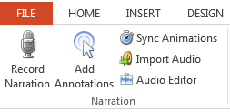
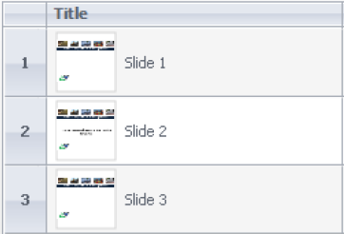
Import Audio File
Audio is imported when:
The file was recorded in Audacity
There is an existing sound file
The narrator does not have access to Articulate to record
Notes:
Notes:
TAB 21 – Import Audio File
The process for importing an audio file requires that you associate the sound file with the slide. When importing a sound file:
Expand the audiogram of the file and compare it against the other sound files in the presentation if to look s bigger or smaller than this is an indication it is too loud or soft.
Listen to the file and edit it if needed.
Always listen to the file and compare the sound to ensure the sound quality and level is comparable.
Refer to the Edit Audio file for help with the narration of the file.

Slide 127
Exercise 9 - Import Audio File
Roles:
Training Developer
Scenario:
In this exercise, we are importing an audio file:
Importing a previously recorded narration
Notes:
Notes
TAB 19 – Import Audio File
The record narration is something best done in a quite environment and not in the classroom. For this reason, please let me know when you do a recording and we can set up the environment and record the sound together.

Slide 128
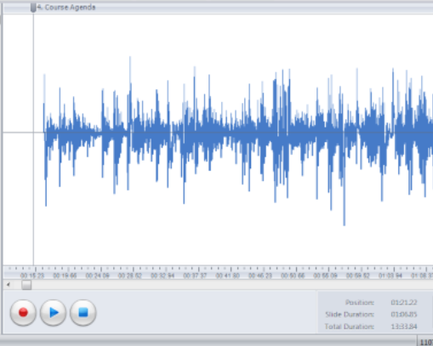
Editing the Audio File
Articulate includes the ability to edit audio. You can edit:
Volume
Transitions between slides
Delete sections of the audio and insert silence
Notes:
Notes
TAB 22 – Edit Audio File
The process to edit an audio file is the same if the file is imported into the presentation or if it is recorded in Audacity. When Working with the audio files:
Use the audiogram to verify the volume of the slides are the same.
Remember you can make changes to the entire presentation using ctrl+a.
Select the individual slide to make changes to only one slide.
Delete or add silence to the segments of the sound file.
Always listen to the file and make sure it is what you want before you save the file.
If you make changes to an audio file and save it you can always delete the file and insert it back into the presentation.

Slide 129
Exercise Ten - Edit Audio File
Roles:
Training Developer
Scenario:
In this exercise you are performing the following actions:
Adding silence to the beginning of a recording
Delete a segment of a recording
Adjust the volume of a slide
Notes:
Notes
TAB 22 – Edit Audio File
This exercise is broken out into several exercises:
Adding silence to the beginning of a recording
Delete a segment of a recording
Adjust the volume of a slide

Slide 130
Check Your Knowledge
True or false, The only way to add narration to you presentation is through Articulate?
False, you can import audio files
What is the name of the icon used to access the Narration functions of Articulate?
Record Narration
Notes:
Notes:
Question One
True or false, The only way to add narration to you presentation is through Articulate?
Answer One
False, you can import audio files
Question Two
What is the name of the icon used to access the Narration functions of Articulate?
Answer Two
Record Narration

Slide 132
Course Agenda
Section 7 – Create Engage Interaction
Section 8 – Create and Insert Audio
Section 9 – Add Annotation
Section 10 – Add Quiz using Quizmaker
Section 11 – Print and Publish Course
Section 12 – Conclusion
Notes:
Notes:
This course is designed to teach participants how to develop an eLearning course using Articulate. The course is a full day course and is composed of the following sections:
Section 9: Add Annotation – This section takes about 30 minutes to complete and provides details on how to annotate (add movement) to a slide.
Section 10: Add Quiz using Quizmaker - This section takes about 30 minutes to complete describes the process of reviewing and adding an assessment to an eLearning course using Quizmaker.
Section 11: Print and Publish Course – This section takes about 30 minutes to complete and describes the different ways you are able to publish your course for review, preview and upload to the Learning Management System (LMS).
Section 12: Conclusion – This section takes about 10 minutes to complete and summarizes the course. It also provides details about where you can get additional help.

Slide 133
Section 9 Learning Objectives
At the end of this section, you should be able to:
Define terms and concepts
Describe the process for adding an Annotation
Describe the difference between an Annotation and a PowerPoint Animation
Identify the types of Annotations added to a presentation
Practice creating and changing an annotation
Notes:
Notes:
Each of the learning objectives corresponds to a slide, or series of slides, in this section of the course.
By the end of this section, you should be able to perform each of the listed objectives with the support of the training materials.
The section learning objectives are tied directly to the course objectives reviewed at the end of the course.

Slide 134
Terms and Concepts
Term | Definition
Annotate | The process of adding movement to a slide using the icon, images and text found in Presenter ’13.
Animation | The process of adding movement to a slide using the icon, images and text found in PowerPoint. This movement and timing of the movement are then used by Studio ’13.
Notes:
Notes:
Tab 01 - Terms and Concepts
The following terms are critical to your understanding of this section of the course.
Additional terms are located in the Terms and Concepts document located in the reference materials.
If you do not understand the term, please ask for additional clarification.
The Terms and Concepts document contains more terms than are listed in the course and should be reviewed to help with your learning.

Slide 135


Adding Annotation Process
To add annotation to a slide:
Start with the approved script
Add annotation to the presentation after the recording has been made
Record Slide Narration
Edit Slide Narration
Have Slide Narration Approved
Add Annotation to Presentation
Notes:
Notes
Annotations can be added at the same time as the recording. It is not recommended however, because the it does not make for a good recording. The process for adding annotation is:
Record Slide Narration – The process begins with the recording of narration. If you do not have the timing of the slide that occurs with narration, then annotations cannot be added.
Edit Slide Narration – Prior to adding annotation to the slide the content the sound should be edited so you are working with a final sound file. This is important to the process because the editing process may change the timing of the narration of the slide and cause your annotations to be out of sync.
Have Slide Narration Approved – Before spending time on the annotation process, it is best to have the slide narration approved. This will save you time as changes to the recording may cause you to have to re-annotate the slide.
Add Annotation to Presentation – To add an annotation to a slide left click the Add Annotation button. This takes you to the narration menu where you are able to listen to the narration and add annotations during the process.

Slide 136
Annotation versus Animations
Annotations are:
A function of Articulate
Are use to highlight pictures or text
Are timed according to the narration
Highlight object already on the screen
Accessed through the Narration folder of the Articulate ribbon
Animations are:
A function of PowerPoint
Used to animate pictures or text
Timed based on the movement of the object or text
Accessed through Animations ribbon
Notes:
Notes
Annotation and Animations are frequently confused. Refer to the slide about for the differences between the two functions. This course only covers annotations.

Slide 137
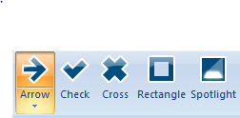
Types of Annotations
There are five style of annotation:
Arrow – Used to highlight
Check – Used to highlight a correct action
Cross – Used to highlight an incorrect action
Rectangle – Used to highlight an icon or section of the screen with the screen still shown
Spotlight – Used to draw exclusive attention to the object by darkening the rest of the screen
Notes:
Notes
There are five types of annotations that can be added to the screen. The type of annotation you use changes based on what you want to highlight with the annotation. Refer to the slide above for the best annotation to use. When you are using annotations remember less is more. While annotations may be useful to draw attention to a section of the screen, adding to many to your presentation can cause them to lose there effectiveness and can prove to be distracting to the Participant.

Slide 138



Changing the Annotation Appearance
To change the appearance of the Annotation:
Select the annotation
Change the appearance using the style folder icons
Annotate the slide
Save and close
Note: to remove annotations check
Notes:
Notes;
To change the appearance of an annotation:
Select the annotation you want to make changes. This is necessary because the style folder is dynamic and changes based on the chosen annotation.
Use the icons in the style folder to make changes to the appearance. (fill, outline, effect, outline and corners, etc.).
Note: Using the Effects button you are able to change the animation of the annotation (fade and bounce) and using Size button changes how big the annotation appears based on a percentage.
Left click on the slide to create the annotation effect.
Rules when using annotations:
Arrow and Cross Annotations should always have a fill of red and a white outline.
Check Annotations should have a green fill and a white outline.
Rectangle Annotations should always have a fill of red outline.
Spotlight – use the default.
If you need to remove the annotations and reset the timing select the Clear All button. This removes all of the annotations on the slide and allows you to start fresh.

Slide 139
Exercise 11 - Create Annotation
Roles:
Training Developer
Scenario:
In this exercise we are going to learn how to:
Add Annotations to a existing slide
Delete An Annotation
Notes:
Notes
TAB XX – Create Annotation
In this exercise, we are going to review how to work with an annotation and make changes to an annotation and add the annotation to a slide. In this exercise you are going to:
Add a check annotation to side two of the Affirmative Action course. The annotation should be added just before the bullets title is read.
Affirmative Action Commitment Statement
Affirmative Action Report and Plan
600.0 PD Equal Employment Opportunity and Affirmative Action

Slide 141
Course Agenda
Section 7 – Create Engage Interaction
Section 8 – Create and Insert Audio
Section 9 – Add Annotation
Section 10 – Add Quiz using Quizmaker
Section 11 – Print and Publish Course
Section 12 – Conclusion
Notes:
Notes:
This course is designed to teach participants how to develop an eLearning course using Articulate. The course is a full day course and is composed of the following sections:
Section 10: Add Quiz using Quizmaker - This section takes about 30 minutes to complete describes the process of reviewing and adding an assessment to an eLearning course using Quizmaker.
Section 11: Print and Publish Course – This section takes about 30 minutes to complete and describes the different ways you are able to publish your course for review, preview and upload to the Learning Management System (LMS).
Section 12: Conclusion – This section takes about 10 minutes to complete and summarizes the course. It also provides details about where you can get additional help.

Slide 142
Section 10 Learning Objectives
At the end of this section, you should be able to:
Define Terms and Concepts
Explain the process for converting Check Your Knowledge slides to Quizmaker quizzes
Describe the difference between Survey questions and Graded questions
Identify the templates used to create a Quizmaker quiz
Recognize what makes a good assessment question and a good answer
Practice creating a question and inserting it into the PowerPoint
Notes:
Notes:
Each of the learning objectives corresponds to a slide, or series of slides, in this section of the course.
By the end of this section, you should be able to perform each of the listed objectives with the support of the training materials.
The section learning objectives are tied directly to the course objectives reviewed at the end of the course.

Slide 143
Terms and Concepts
Term | Definition
Quizmaker | An Articulate program used to create quizzes and assessments and place them into the course
Scoring | A series of Graded Questions used to determine if the individual taking the training has sufficient understanding of the training content to “pass” the training. A minimum score of 70% is required to “pass”
Graded | Questions in a quiz combined with other questions used to determine if the participant passes the course.
Survey | A question that is not graded and used only to evaluate understanding.
Form View | A view of QuizMaker used to create preformatted Survey and Graded Questions.
Default Feedback | The response the participant will see if the response to the question is correct.
Notes:
Notes:
Tab 01 - Terms and Concepts
The following terms are critical to your understanding of this section of the course.
Additional terms are located in the Terms and Concepts document located in the reference materials.
If you do not understand the term, please ask for additional clarification.
The Terms and Concepts document contains more terms than are listed in the course and should be reviewed to help with your learning.

Slide 144
Converting Knowledge Checks to Quizmaker Questions
Knowledge Checks are converted into Quizmaker Quizzes
Survey questions are used at the end of each section
Graded questions are used only once and at the end of the course
Review the Questions in the ILT
Good question
Insert Quizmaker Survey Quiz after the Knowledge Check slide
Add Approved Questions to the Quizmaker Knowledge Check
Yes
Rewrite and review with the SME
Add a selection of the best questions to the Course Assessment Slide at the end of the course
No
Notes:
Notes
At the end of each of the sections of the ILT there are a series of questions asked by the instructor. As part of the process for converting the course into an eLearning these need to be converted into Quizmaker quizzes.
Start with reviewing the questions in the ILT for content. In some instances the question may not be usable for an eLearning course. If the question is not appropriate for an eLearning course then it must be re-written and reviewed with the SME who created the ILT course.
Once all of the questions have been approved and are ready, insert the Section XX Check Your Knowledge slide at the end of each of the sections using the template.
Do not create a Quiz for the Learning Logistics, Introduction, or Conclusion sections.
After you have created all of the Quizmaker quizzes delete all of the knowledge Check slides.
At the end of the course, add the Course Assessment slide and add a selection of the Survey Questions to the Assessment. If you do not have enough questions to for the quiz you may need to write out more questions and review them with the SME. These questions should also be added to the Section XX Check Your Knowledge slides once they are approved.

Slide 145



Survey versus Graded Questions
Survey questions:
Only used for knowledge checks
Occur at the end of sections
Repeat as many times as needed
Use only survey questions
Graded questions:
Only used for the Course Assessment
Occur once at the end of the course
Are used for assessment by LMS
Notes:
Notes
Articulate is limited to have only one Quizmaker quiz be used for the assessment by the LMS. To allow for additional (non-graded) questions to be asked, survey questions can be used throughout the course as knowledge checks.

Slide 146

Quizmaker Templates
There are two templates
Check Your Knowledge
Course Assessment
The templates are:
Created outside the course and imported into the course
Designed to save you the effort of formatting and designing a quiz
Notes:
Notes
There are two templates for Quizmaker slides in the PowerPoint templates you have been provided for eLearning. While both look the same and are also created the same way it is critical that you understand the difference between the two.
The Check Your Knowledge template:
Is designed to be used at the end of a section.
The results are not saved to the LMS.
Needs to provide feedback so the user knows if they are answering correctly (samples of the feedback are included in the template).
Should be one to three survey questions asked at the end of a section.
Saved are saved as a quiz file and not a template.
The Course Assessment template:
May only be used once at the end of the course.
Must be passed with a score of at least 70%.
May be taken as many times as needed to pass.
Consists of at least three questions.
Consist of the “best” of the Check Your Knowledge questions.
Based on the content of the course.

Slide 147

A Word about Questions
When writing questions for your course:
Ask questions related to the course
Make sure the participants know the answer
Be specific as possible
Keep it simple
Use questions to reinforce what you want the participant to take away
Use your Checklist!
Notes:
Notes:
Creating a Course Using Training Templates Guide (TAB 08 – Question Review Checklist)
The following is a list of review questions for each question you have developed. If you select a checkbox then you need to remove or rewrite the question.
Check the box below if the answer to the Question is “No”. If the answer to any of these questions is “No” remove of rewrite the question.
Is the question directly related to the course?
Do participants have the knowledge to answer the question?
Have you avoided double-barreled questions, as participants might want to respond differently to each part e.g. 'How did you feel about using packages A and B?'
Is the language simple and easy to understand so participants do not miss a question they don't understand?
Is the question short and direct?
Have you avoided yes/no questions (unless you want a yes/no answer)?
Is the question formats varied in order to encourage participants to think about each of their responses?
Check the box below if the answer to the Question is “Yes”. If the answer to any of these questions is “Yes” remove of rewrite the question.
Is the question ambiguous or open to different personal interpretations for example a question like 'Do you prefer tutorials or simulations?’
Does the question have an obvious answer?
Are there any 'Why? questions or strongly evocative questions which might make a participant defensive.

Slide 148
When Creating a Quiz
When creating a new quiz:
Don’t use the PowerPoint Quizmaker Quiz link
Save to your project folder
Delete the question slide after you import the Quizmaker file
Use the Template
Create New Quizmaker Quiz
Import the template
Save the File
Import into the Course
Notes:
Notes
To save you time, and improve the consistency of the presentations, Quizmaker templates have been created. The process to open a Quizmaker file consists of four steps as described in the slide above.
The most important thing to remember in this process is to create the new from the Quizmaker program as there is different functionality you need to use to import the template.

Slide 149
Exercise 12 - Create and Import Quiz
Roles:
Training Developer
Scenario:
In this exercise you are performing the following actions:
Create a quiz in Quizmaker
Adding the quiz to the Presentation
Notes:
Notes
TAB 24 – Create a Quiz from a Template
TAB 25 – Add a Quiz to the Presentation
This exercise is broken out into several exercises:
The process used to create a quiz in Quizmaker.
The process to add a quiz that you created to your presentation.

Slide 150
Check Your Knowledge
What are the two types of quizzes?
Survey (knowledge Check) and Graded (Course Assessment)
Why are there two types of quizzes?
To allow us to check for understanding of concepts and have it counted towards the evaluation.
Notes:
Notes:
Question One
What are the two types of quizzes?
Answer One
Survey and Graded.
Question Two
Why are there two types of quizzes?
Answer Two
To allow us to check for understanding of concepts and have it counted towards the evaluation.

Slide 152
Course Agenda
Section 7 – Create Engage Interaction
Section 8 – Create and Insert Audio
Section 9 – Add Annotation
Section 10 – Add Quiz using Quizmaker
Section 11 – Print and Publish Course
Section 12 – Conclusion
Notes:
Notes:
This course is designed to teach participants how to develop an eLearning course using Articulate. The course is a full day course and is composed of the following sections:
Section 11: Print and Publish Course – This section takes about 30 minutes to complete and describes the different ways you are able to publish your course for review, preview and upload to the Learning Management System (LMS).
Section 12: Conclusion – This section takes about 10 minutes to complete and summarizes the course. It also provides details about where you can get additional help.

Slide 153
Section 11 Learning Objectives
At the end of this section, you should be able to:
Define terms and concepts
Identify publishing settings
Understand the options available when publishing a course
Use Preview to display the presentation
Describe the various publishing formats
Describe the process to create a Zip file for publishing
Practice printing to MS Word
Notes:
Notes:
Each of the learning objectives corresponds to a slide, or series of slides, in this section of the course.
By the end of this section, you should be able to perform each of the listed objectives with the support of the training materials.
The section learning objectives are tied directly to the course objectives reviewed at the end of the course.

Slide 154
Terms and Concepts
Term | Definition
Preview | A display of what a course would look like if it were published. This is commonly used to test functionality you are creating.
Publish | The final view of the course in HTML 5, MS Word, or other format. Publishing is also done prior to uploading the final file into the LMS.
Notes:
Notes:
Tab 01 - Terms and Concepts
The following terms are critical to your understanding of this section of the course.
Additional terms are located in the Terms and Concepts document located in the reference materials.
If you do not understand the term, please ask for additional clarification.
The Terms and Concepts document contains more terms than are listed in the course and should be reviewed to help with your learning.

Slide 155

Identify Publishing Settings
Confirm you have the correct template for the type of course
Preview the entire course looking for errors
Select Publish to publish to LMS or Word (Storyboard)
Work with OED to upload or have Word Storyboard reviewed
Notes:
Notes:
The process for publishing a course is very simple.
Confirm you have the correct template for the type of course – During this stage you want to make sure you are using the correct template. For example, if you are doing a course without audio and only one section then you need to be using the “One Section Course Template No Sound”.
Preview the entire course looking for errors – During this step you want to select the preview option and select all slides. This allows you to see the course and determine if there are any errors.
Select Publish to publish to LMS or Work Format – This is the final step of working with Articulate if you are publishing to the LMS. If you are publishing a storyboard it needs to be reviewed and any changes made to the notes section of the course.
Work with OED and upload the course to the LMS – This is not one of the Articulate steps, but in order for the course to be taken it needs to be uploaded into the LMS.

Slide 156
Previewing a Presentation
The process for previewing a presentation is simple:
From the Articulate tab of an Open presentation select the preview drop-down
Choose the type of preview (Preview next three slides is most common)
A window displays with your selection
Notes:
Notes:
Review the above process to preview a presentation. This is done to see how that presentation displays once it is published.

Slide 157
Preview and Check the Template
Roles:
Training Developer
Scenario:
In this exercise you performing the following actions:
Preview the template
Confirming you have the correct template
Changing the current template
Notes:
Notes
TAB 26 – Add or Confirm Template
This exercise is broken out into several exercises:
Confirming you have the correct template
Changing the current template

Slide 158
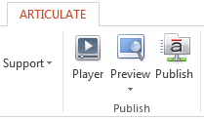
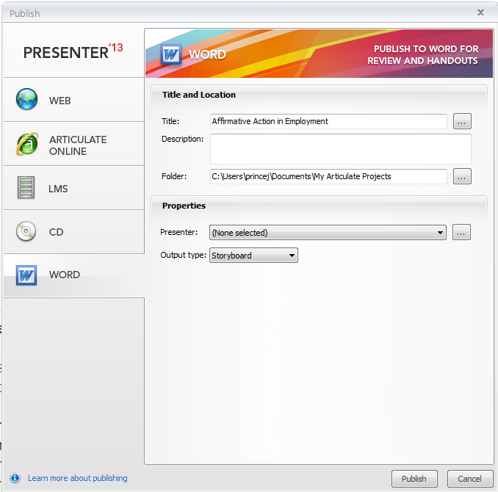
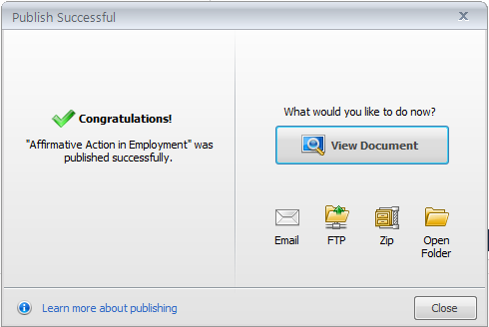
Storyboard
1
The storyboard is:
Created as a publishing option of Presenter
Used to verify content and the script
Created from the notes section of the PowerPoint
Displayed as a word table
2
4
3
5
6
Notes:
Notes:
The storyboard is used by the Training developer once the course has been completed. The storyboard is:
A review document between the Trainer and the SME to vet the script.
Created from the Notes section of the PowerPoint presentation.
Used only used with the Multi-Section Course Template with Sound and the One Section Template with Sound.
The script displays as the Notes tab in the course and in the Notes section in the PowerPoint.
Printed from the Articulate Tab → Publish → Word → Title → Output type → Publish → View Document.
The output of the file includes three rows
Row 1 contains the slide number, duration of the slide, and the way in which it advances
Row 2 contains the slide
Row 3 contains the script
It does not include any slides that are hidden, but create a blank row for slide and content.

Slide 159
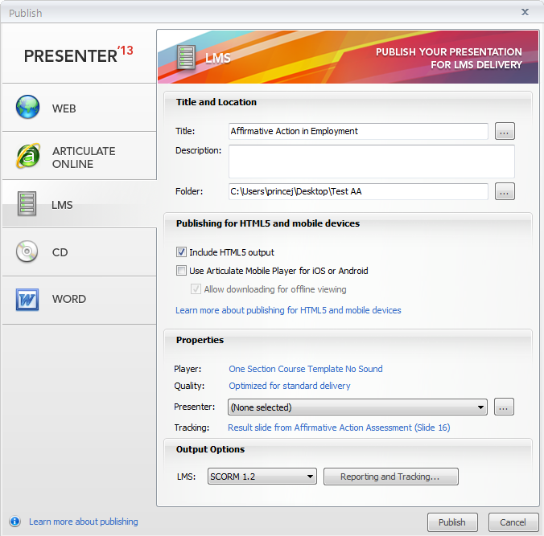
Zip File (LMS Upload)
1
The Zip File is:
Created after the LMS file has been created
Saved to the same folder as the LMS output file
Is the preferred file to use for the upload of the Course to the LMS
2
3
4
5
5
6
7
8
9
Notes:
Notes:
The ZIP file is used to transport the contents of a course to the LMS for upload. When you are creating the file it is saved to the same location and the folder where the LMS output file was saved. When creating the file:
Always create a folder for the ZIP file as shown in step four above.
Copy the folder to the thumb drive.
Never copy the Zip to the LMS directly from the thumb drive, instead copy the folder to the desktop.
Use the Zip file as the upload to the LMS.
If you want to view the published course you are able to view this from the Published (non-Zip) file and clicking on the presentation_html5 link. When viewing the file in this format, some of the look and feel of the course may be slightly different than the LMS.

Slide 160
Exercise 13 - Publishing the Presentation to a Zip file or MS Word Storyboard
Roles:
Training Developer
Scenario:
In this exercise you performing the following actions:
Publish to MS Word as a Storyboard
Publish as a Zip file
Notes:
Notes
TAB 27 – Publish to LMS as ZIP or MS Storyboard
This exercise is broken out into several exercises:
Copy and paste the eLearning Terms and Concepts slide into the Presentation that is being converted into an eLearning.
Add the terms in the first section into the glossary using the Add a Glossary Terms work instruction.
Edit or Delete one of the terms you added using the Edit or Delete Work Instruction.

Slide 161
Check Your Knowledge
Why is the ZIP file created?
To allow the course to be uploaded into the LMS
Notes:
Notes:
Question One
Why is the ZIP file created?
Answer One
To allow the course to be uploading into the LMS.

Slide 163
Course Agenda
Section 7 – Create Engage Interaction
Section 8 – Create and Insert Audio
Section 9 – Add Annotation
Section 10 – Add Quiz using Quizmaker
Section 11 – Print and Publish Course
Section 12 – Conclusion
Notes:
Notes:
This course is designed to teach participants how to develop an eLearning course using Articulate. The course is a full day course and is composed of the following sections:
Section 12: Conclusion – This section takes about 10 minutes to complete and summarizes the course. It also provides details about where you can get additional help.

Slide 164
Conclusion
You should now be able to:
Identify training terms and concepts associated with eLearning
Describe the new ILT templates and how they are used
Explain the process for creating eLearning from a PowerPoint
Identify the connection points between all of the training documents including the PowerPoint and eLearning course
Insert a Glossary, Resource Document, Quiz and Interaction using the appropriate Component of Studio ‘13
Use Studio ’13 to create an eLearning course from an ILT
Publish the eLearning in various outputs
Notes:
Notes:
The slide above contains what you should now be able to do. If you have questions about the content after the course, refer to the next slides for the names and contact information of the people who can help.
If you have question now, please ask. You will have another chance at the end of the course, after we discuss where you are able to get help and the the resources available to you.

Slide 165

Where Can I Get Help – People?
For additional assistance contact:
  Jason Prince
    Email: jason.prince@state.co.us
    Phone: 503-522-8448
  Beverly Wyatt
    Email: Beverly.wyatt@state.co.us
    Phone: 7-9677
Notes:
Notes:
Contact the resources above if you need help with:
Location of or use of the training templates
Help with the using Studio ‘13
Use of the image, question or PowerPoint checklists
General questions about the development of the training using the materials provided
Help with getting started with your course

Slide 166
Technical Help Resources
The following are online Technical help resources available to help you with creating your course:
Presenter ‘13 technical support can be found here
Quizmaker ‘13 support can be found here
Engage ‘13 support can be found here
To submit a case, chat to support or talk to a customer support representative click here
Notes:
Notes:
The links above may require you to have an account to access the site. The process to create an account is simple and requires the following information:
Email address
First and Last Name
User assigned password
An optional picture for your profile
The direct links for customer support are below.
The Presenter ‘13 link is: http://www.articulate.com/support/presenter-13
The Quizmaker ‘13 link is: http://www.articulate.com/support/quizmaker-13
The Engage ‘13 link is: http://www.articulate.com/support/engage-13
To submit a case, chat to support or talk to a customer support representative the link is: http://www.articulate.com/support/contact/

Slide 167
Instructional Design Help Resources
The following are online help resources available to help you with creating your course:
The Discussion Forums can be accessed by clicking here
Presenter ‘13 community can be found here
Quizmaker ‘13 support can be found here
Engage ‘13 support can be found here
Notes:
Notes:
The following are links to the E-learning Heroes community. This is a great resource if you have questions about how to design your course or need to see samples of what others have produced.
The best place to start is the discussion forum if you have a questions that is not specific to any one product.
The discussion forum link is: https://community.articulate.com/discuss
The Presenter ‘13 link is: https://community.articulate.com/hubs/presenter
The Quizmaker ‘13 link is: https://community.articulate.com/hubs/quizmaker
The Engage ‘13 link is: https://community.articulate.com/hubs/engage

Slide 168
Questions?
?
?
?
Notes:
Notes:
Now let’s review the parking lot questions. If there are any questions that have not been answered I will have an answer to you within the next week. If you have any questions about training after the course please contact me at jason.prince@state.co.us or just drop by and ask.

