Slide 1


How to Apply for a Job at CDOT
Notes:
Notes:
Welcome to the How to Apply for a Job at Colorado Department of Transportation course and thank you for your interest in working for us. This course is designed to help you understand what you need to do to apply for a job. Before we get into the content, let’s learn how to navigate the course.

Slide 2
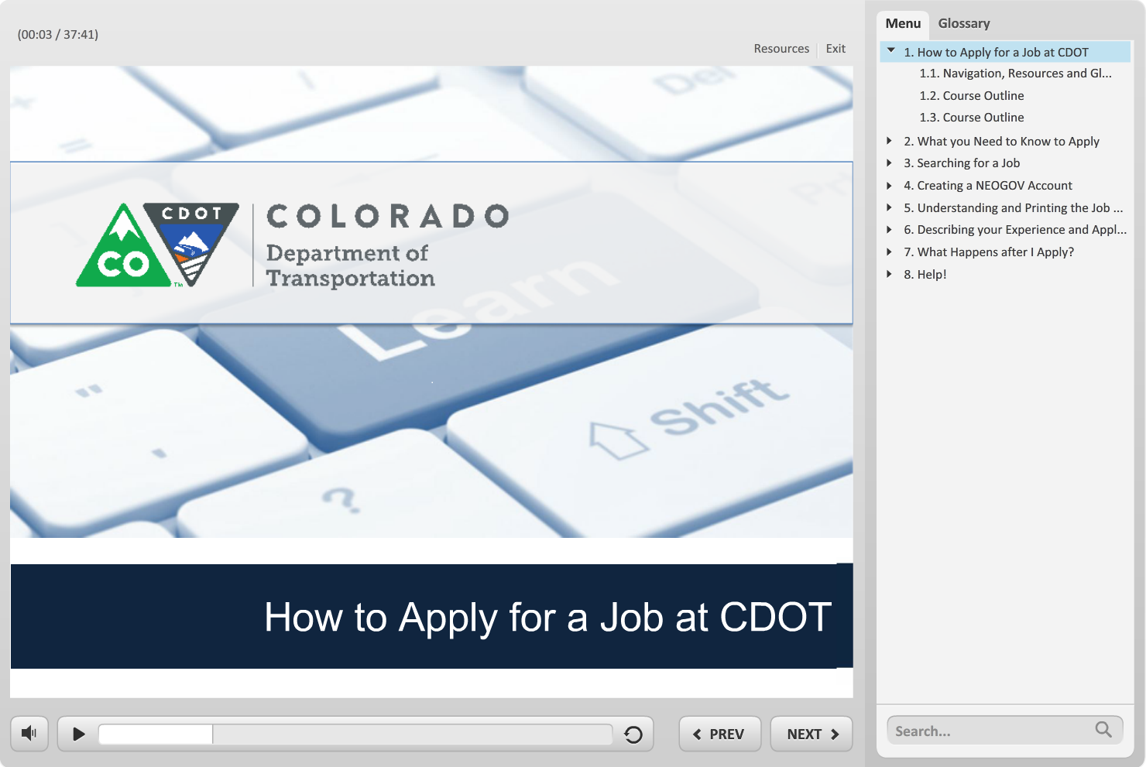
Navigation, Resources and Glossary
Before we begin, let’s look at the resources available to you
Notes:
As you go through the course there are a couple of items you can use to help you learn. The first is the Resources link as indicated by the red arrow. This link contains copies of all of the documents referenced in this course.
The Glossary tab displays an alphabetical list of terms that are used throughout the course. Anytime you are uncertain about a term, this is the best place to look. Unlike the resources link clicking on the glossary does not pause the course.
If you want to navigate, use the previous or next buttons or click on the slide you want to navigate to under the menu tab. There is also a search field located at the bottom of the Menu tab that brings up all of the slides related to your search. The progress bar displays your progress within a slide.
If for any reason, you need to close the course before you have completed it, you will be returned to the page you were on once you log back in. Now let’s move on to what you will learn in this course.

Slide 3


Course Outline
What you need to know to Apply
Searching for a Job
To Navigate the course click:
Next to continue
Green Buttons to display the section agenda
Blue Section Titles to go directly to a section
Creating a NEOGOV Account
Understanding and Printing the Job Announcement
Describing your Experience and Applying for a Job
What Happens After I Apply for a Job
Help!
Notes:
This course is divided into six sections and help. You can view the sections in any order, based on what you want to learn, or you can take the whole course by going through each section. If you want to see the topics within the section, click on the green button. And one more thing, you will be returned to this slide at the end of each section.

Slide 4
Course Outline
What you need to know to Apply
Searching for a Job
To Navigate the course click:
Next to continue
Green Buttons to display the section agenda
Blue Section Titles to go directly to a section
Creating a NEOGOV Account
Understanding and Printing the Job Announcement
Describing your Experience and Applying for a Job
What Happens After I Apply for a Job
Help!
Notes:
This section of the course covers what you need to know when you apply for a job at CDOT. This includes finding the State job page, what job you are eligible to apply, and when new jobs are posted.

Slide 5
What you Need to Know to Apply
The topics covered in this section include:
Locating the State job page
What jobs are available at CDOT
What jobs you eligible to apply for
What you need to prepare prior to applying
Residency requirements
When new jobs are posted
Notes:
Take a moment to review the topics for this section of the course. When you are done reviewing them, click the Next button to return to the course outline.

Slide 6
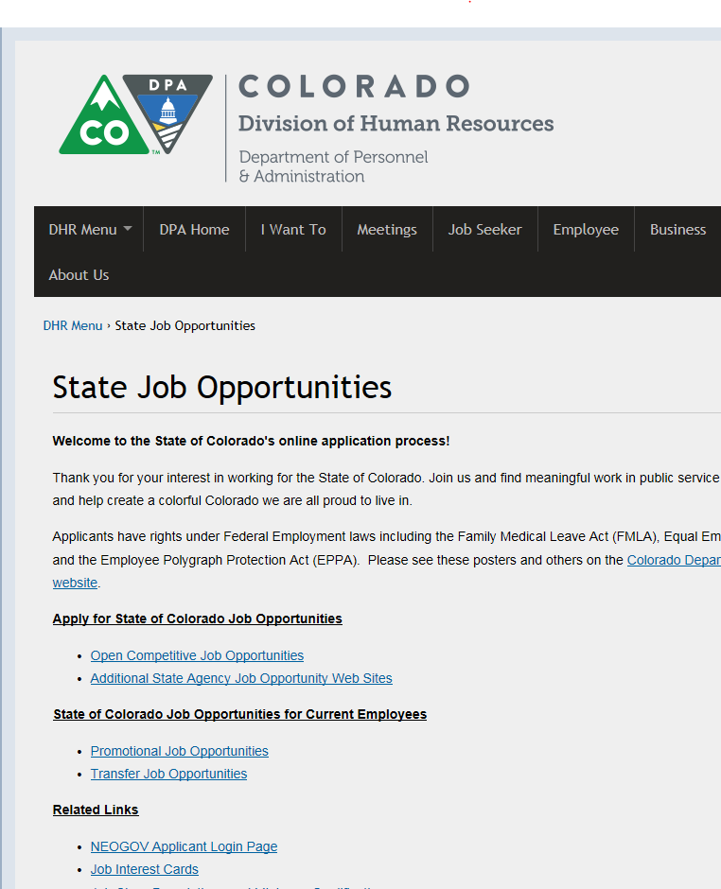
Locating the SOC Job Page
The State of Colorado job page can be found at: www.colorado.gov/dhr/jobs from here you can:
See all job opportunities for the State, including jobs at CDOT
Create a Job Interest card to be notified when a position matching your skills becomes available
Connect with help resources
Notes:
The State of Colorado’s job page can be found at www.colorado.gov/dhr/jobs and can be accessed from the link on this page. To make it easy to find, create a bookmark by going to the open page and then pressing the ctrl and the D key together to bookmark the site. By the way if you are not a CDOT employee, only open competitive positions are open to you. Let’s learn about that now.

Slide 7
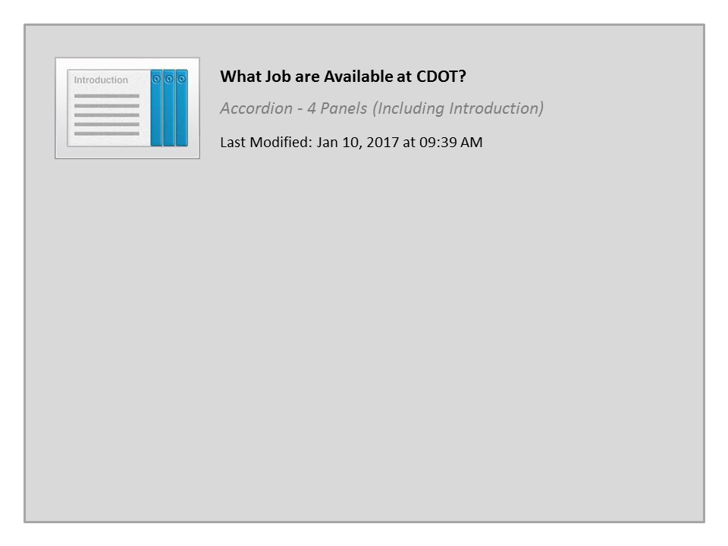
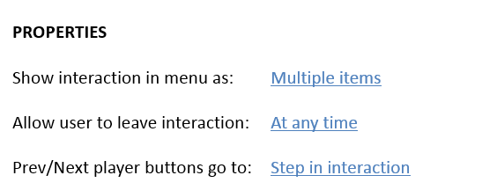


What Job are Available at CDOT?

Slide 8
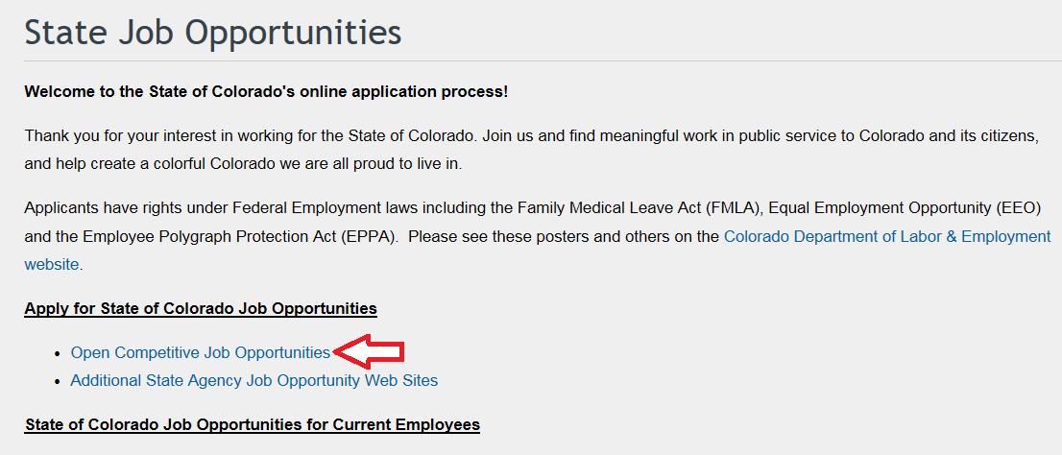
Jobs Open to all Job Applicants
Only open competitive jobs are open to all applicants
Notes:
Open Competitive jobs can be found on the jobs page under the “Apply for State of Colorado Job Opportunities” heading. This is indicated by the red arrow. Only Open Competitive Jobs are open to all everyone and Promotional and Transfer Job Opportunities are only open to internal applicants. Clicking on the open competitive link, takes you to a webpage where you can search for job.
Now let’s look at the residency requirement.

Slide 9
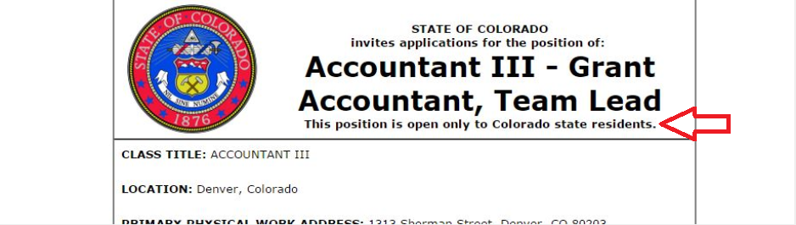
Residency Requirements
The State of Colorado requires all applicants to be Colorado residents, with the following exceptions:
Work is primarily performed within 30 miles of the border
It has been waived by the State Personnel Director or State Personnel Board
The residency requirement is listed under the job title as shown by the red arrow above
Notes:
The Colorado Constitution, requires applicants for state classified jobs be residents of Colorado, unless the position is primarily performing work 30 miles within the state border or the requirement is waived by the State Personnel Director or State Personnel Board.
The residency requirements of positions are listed under the job title of the printed job announcement as shown by the red arrow.

Slide 10
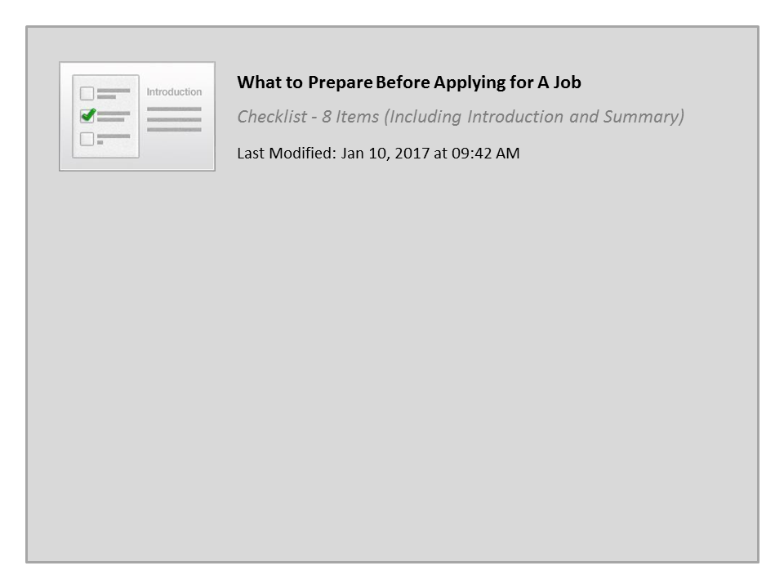
What to Prepare Before Applying for A Job

Slide 11

When are New Positions Posted
Positions may be posted anytime and for any duration.
To increase your chances of finding a position:
  Check the jobs page frequently
  Submit a Job Interest Card
  Complete the NEOGOV profile, as shown in the next section of the course
Notes:
Positons may be posted at any time and are posted for anywhere from a few days to a couple of weeks.
To increase your chances of finding a position that matches your skills check jobs page frequently, submit a Job Interest card and be prepared to apply by completing your NEOGOV profile based on what we the next section of the course.

Slide 12
Course Outline
What you need to know to Apply
Searching for a Job
To Navigate the course click:
Next to continue
Green Buttons to display the section agenda
Blue Section Titles to go directly to a section
Creating a NEOGOV Account
Understanding and Printing the Job Announcement
Describing your Experience and Applying for a Job
What Happens After I Apply for a Job
Help!
Notes:
This section of the course will show you how to search for a job at CDOT, filter your search and how to create a job interest card so we can contact you when a position you are interested in becomes available.

Slide 13
Searching for a Job
The topics covered in this section include:
“Searching for a job” using the search for a job field
Using the filter feature to refine your search (Location, Department, Job Category and Salary)
Identifying what to do if you do not find a job that matches your skills
Notes:
Take a moment to review the topics for this section of the course. When you are done reviewing them, click the Next button to view the section, or if you are only reviewing the objectives, select the Return to Course Outline button to select a different topic.

Slide 14

Searching for a Job
Notes:
Now’s let’s get started by searching for a job using a key word search. Starting from the main Job Opportunities page, locate the search field. This is just above the first job posting. Now, click on the search field the words “search” no longer display and you have a flashing cursor. Now enter the type of work you do. In this example, maintenance. Notice as you type the system makes suggestions about jobs matching your search criteria. Let’s click on the first suggestion, maintenance this populates the field. Notice the screen updates with your search results. It looks like there are still 56 jobs. You could look at each open position. But instead let’s filter the results.

Slide 15
Filter a Job Search
Notes:
Now let’s look at filter option to narrow down the job search. Filtering allows you to search for a job by location, Department, job category and even salary. First we want to clear the search. Click on the “X” next to the word maintenance in the search field. Now let’s set up filter by clicking on the Filter button. In this example, we are going to search for Maintenance positions within the Department of Transportation. Select department and then Department of Transportation. Note that the grey screen to the left updates and shows 20 postings. Now let’s select the job category link and then maintenance. Great! It looks like we are down to 10 jobs. Click anywhere to the left, the grey area to display the results of your search. You can combine any of the search criteria to find the right job in the best location. If no jobs display try widening your search. Now let’s learn how to create a job interest card.

Slide 16
Creating a Job Interest Card
Notes:
Now let’s learn how to create a job interest card. This allows you to be notified when a position you want becomes available. Click on arrow to the right of the menu and then the Job Categories/Job Interest Cards link. Be sure you are signed in. If you are not then you will be prompted to do so when you subscribe. Now, select the categories that match your skills in this example the Building Maintenance and Maintenance. Now click the green subscribe button. Be sure to double check your email address as this is how you will be contacted and click submit. You will now be sent emails about these type of jobs for the next 12 months.

Slide 17
Course Outline
What you need to know to Apply
Searching for a Job
To Navigate the course click:
Next to continue
Green Buttons to display the section agenda
Blue Section Titles to go directly to a section
Creating a NEOGOV Account
Understanding and Printing the Job Announcement
Describing your Experience and Applying for a Job
What Happens After I Apply for a Job
Help!
Notes:
In this section of the course you will learn how to create a NEOGOV account that you will need to apply for a position.

Slide 18
Creating a NEOGOV Account
The topics covered in this section include:
What is NEOGOV
Creating a NEOGOV account
Logging into an existing NEOGOV account
Notes:
Take a moment to review the topics for this section of the course. When you are done reviewing them, click the Next button to view the section, or if you are only reviewing the objectives, select the Return to Course Outline button to select a different topic.

Slide 19

What is NEOGOV?
NEOGOV is a software used by CDOT to:
Communicate our positions to the public
Track applications submitted by applicants
Help HR to assess the qualifications of the applicants
You use NEOGOV to:
Apply for a position
Check the status of your application
Notes:
NEOGOV is a software that is used by CDOT to communicate our positions to the public and for tracking the applications. You will use NEOGOV to submit your application and to check on the status.

Slide 20

What you Need for a NEGOV Account
To create a NEOGOV account you will need the following:
An email address
A unique user name
Password
If you do not have an email address go to https://accounts.google.com/signup to create one
Notes:
To create a NEOGOV account you need an email address and a unique user name. You must also have a password that is 8 characters in length that contains upper and lower case, symbols, and a number. If you do not have an email address click or enter the link in your browser to create one. Now let’s watch a brief video that shows you how to create your NEO account.

Slide 21

So What is NEOGOV?
NEOGOV is software used:
To allow applicants to apply for a position
By Human Resources to post applications and receive resumes

Slide 22
Creating your NEOGOV Account

Slide 23
Creating A NEOGOV Account

Slide 24

What you need to Sign into your Account
To sign in to your account you need to:
Navigate to the Job Opportunities page
Enter your user name or email address
Enter your password
Notes:
The next time you come to the Job Opportunities page you will need to sign into your account. To log in you need your user name or email address and your password. Now, let’s look at the sign in process and what to do if you forgot your user name or password.

Slide 25
Signing into your NEOGOV Account

Slide 26
Course Outline
What you need to know to Apply
Searching for a Job
To Navigate the course click:
Next to continue
Green Buttons to display the section agenda
Blue Section Titles to go directly to a section
Creating a NEOGOV Account
Understanding and Printing the Job Announcement
Describing your Experience and Applying for a Job
What Happens After I Apply for a Job
Help!
Notes:
In this section of the course you will learn about the job announcement, including how to print it out and what each of the different section mean.

Slide 27
Understanding and Printing the Job Announcement
The topics covered in this section include:
Printing an announcement
Describing what the different sections of the job announcement mean
Notes:
Take a moment to review the topics for this section of the course. When you are done reviewing them, click the Next button to view the section, or if you are only reviewing the objectives, select the Return to Course Outline button to select a different topic.

Slide 28

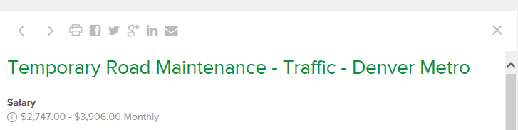

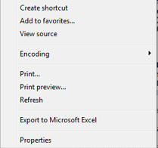
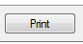
Printing an Announcement
1
2
R
3
4
5
Notes:
The process to print the announcement is simple. Start by opening the announcement by clicking on the link. From the top of the open announcement there is the print icon this is shown by the second arrow. A new window opens displaying the job announcement. Now right click on this window and select print. The print window display From here select the print button from the print options window. Now let’s look at the different sections of the job announcement.

Slide 29
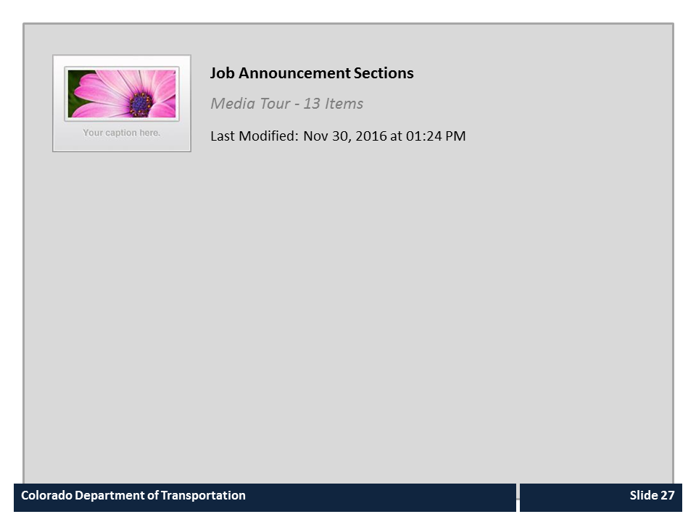
Job Announcement Sections

Slide 30
Course Outline
What you need to know to Apply
Searching for a Job
To Navigate the course click:
Next to continue
Green Buttons to display the section agenda
Blue Section Titles to go directly to a section
Creating a NEOGOV Account
Understanding and Printing the Job Announcement
Describing your Experience and Applying for a Job
What Happens After I Apply for a Job
Help!
Notes:
In this section of the course you will learn how to frame your experience, apply for a position and identify if you have a complete application.

Slide 31
Describing your Experience and Applying for a Job
The topics covered in this section include:
Describe your experience (using the job duty worksheet)
Using your NEOGOV profile to apply for a Job
Identifying if you have a complete application (responding to questions)
Notes:
Take a moment to review the topics for this section of the course. When you are done reviewing them, click the Next button to view the section, or if you are only reviewing the objectives, select the Return to Course Outline button to select a different topic.

Slide 32
Describing your Experience
When preparing your application:
Read the announcement thoroughly
Change your application so qualifications can easily be found
Don’t be shy
Use the Job Duty worksheet to help you state your experience
Notes:
Before you make changes to resume, be sure to read the announcement paying particular attention to the qualifications section. Each position is different and you should change your application to highlight your experience in relation to the position you are applying. Also, this is not the time to be shy. Stating your experience so is critical to you success as an applicant. The Job duty work sheet will help you state your experience. Let’s take a look at that now.

Slide 33
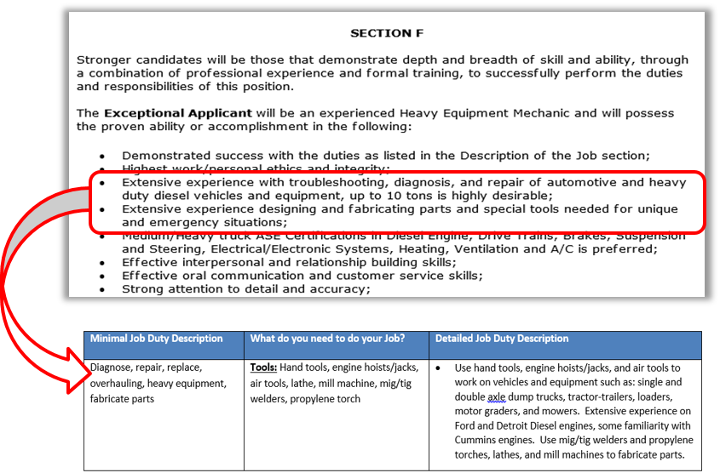
The Job Duty Worksheet
The Job Duty Worksheet:
Helps you to describe your experience
Match your skills to the skills listed in the announcement
Notes:
We have created a Job Duty worksheet to help you describe your experience. To use the worksheet, go to the section that contains the exceptional applicant list. Create a row for each of the bullets. Now describe what you did in your previous jobs that match each of the bulleted items. It is important to provide details of what you did and to be specific. Now fill in what you used to perform that task for example tools or software you used. The last step is to combine the two columns into narrative for your resume, as shown by the third column. Placing this in your resume as a bullet point or in your work experience gives us the detail we need to understand your work experience. A copy of the Job Duty Worksheet can be found by clicking on the resources link.

Slide 34
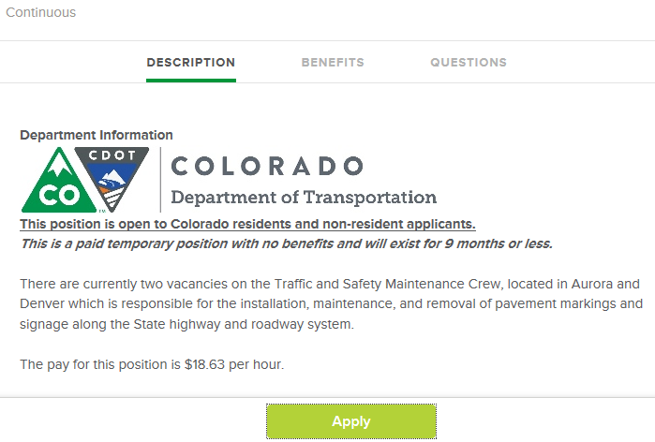
Using your NEOGOV Account to Apply for a Job
When you click the Apply button, you will be prompted to complete your application
Applications can be copied over to apply for other positions so all the information doesn't have to be re-entered each time
Should be updated for each position
Supplemental Application questions do not copy over
Notes:
When you click the Apply button, you will be prompted to complete your profile. Your profile information will be saved and can be used to apply for other positions. However you should make modifications to your profile for each position you apply as there may be differences in what is being sought. Let’s take a look at the selection process.

Slide 35
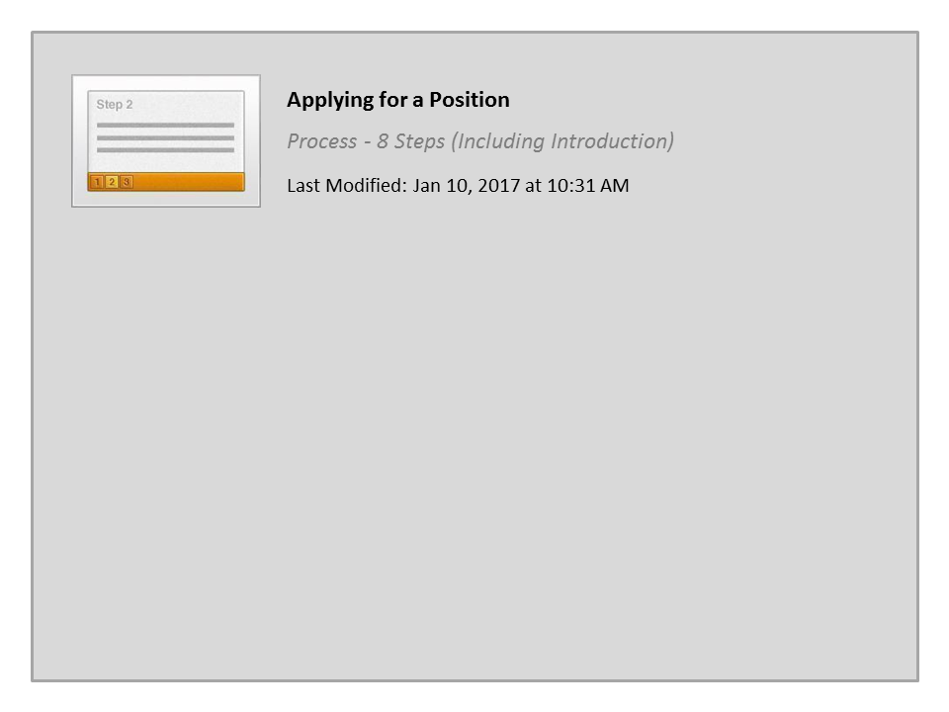
Applying for a Position

Slide 36
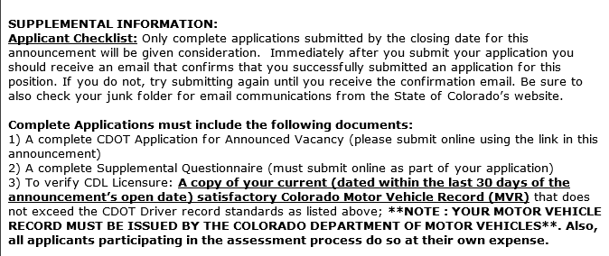
Identifying if you Completed your Application
Refer to the Applicant Checklist at the bottom of the announcement to confirm you have included all the required documents and information prior to submitting your application
Notes:
Remember, we want you to be successful. To help you we describe what you need to submit for a complete application. In addition to a complete application, we may require answers to supplemental questions and verification of licenses. If your application is not complete then you will be not be considered. This completes the section. Click the next button to return to the Course Outline slide.

Slide 37
Course Outline
What you need to know to Apply
Searching for a Job
To Navigate the course click:
Next to continue
Green Buttons to display the section agenda
Blue Section Titles to go directly to a section
Creating a NEOGOV Account
Understanding and Printing the Job Announcement
Describing your Experience and Applying for a Job
What Happens After I Apply for a Job
Help!
Notes:
In this section of the course you will learn about what happens after you apply for a position, including the timeline of the application process, and what the different letters sent to you by HR mean.

Slide 38
What Happens after I Apply?
The topics covered in this section include:
What are the timelines of the application process
What happens after you apply for a job
Describe what the letters from HR mean
Notes:
Take a moment to review the topics for this section of the course. When you are done reviewing them, click the Next button to view the section, or if you are only reviewing the objectives, select the Return to Course Outline button to select a different topic.

Slide 39

Recruitment Timelines
Upon submitting your application, you will be notified
You will also be notified of all stages, and if you have moved on
The timeframe from application to hire depends a variety of factors such as the size of the recruitment and number of steps
Notes:
If you indicated you want an email notification, you will be immediately notified via email that your application has been received. You will also receive notification at each stage of the recruitment process if you are moving forward or have not been selected. There are a variety of factors on when you will be notified next such as the size of the applicant pool, the number of assessment steps, etc. It can take anywhere from a few weeks to a few months from time of application to hire.

Slide 40

After you Apply…
After you apply:
The minimum qualification are reviewed.
A comparative analysis of your application occurs
The eligible list is created
The top six applicants are referred to the hiring manager
The top applicant is sent a job offer
Notes:
After you submit your application, the minimum qualifications are reviewed and a comparative analysis is conducted. This is where your application is evaluated against the position requirements. This could also be an Oral Board or structured interview where your application will be evaluated by three to five Subject Matter Experts. Once the process is complete. The most qualified applicants are placed on an eligible list and the top six are referred to the hiring manager for additional review. Now, let’s take a look at the types of communication you may receive.

Slide 41
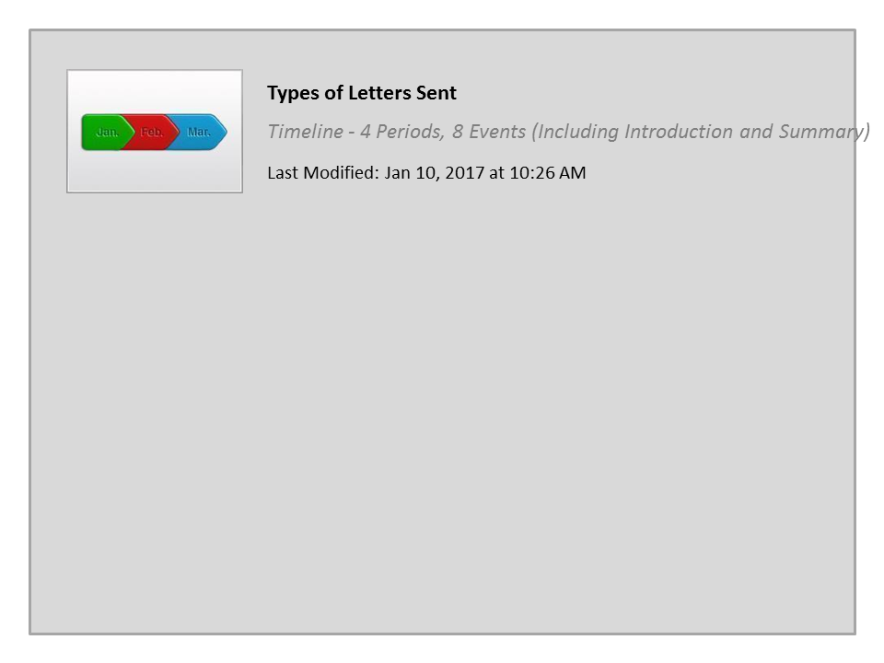
Types of Letters Sent

Slide 42
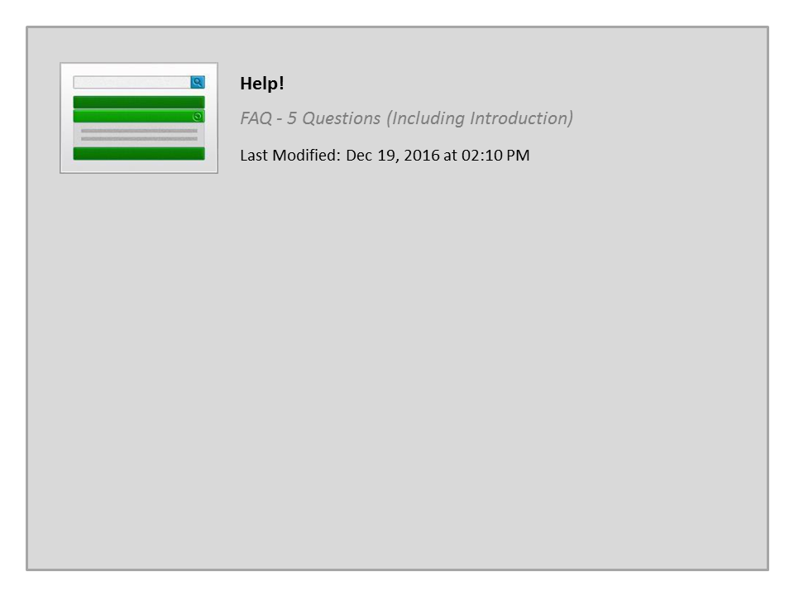
Help!

