Slide 1


Introduction to Workers’ Compensation
Notes:
Notes:
Welcome to the Introduction to Workers’ Compensation course! This course is designed to help CDOT managers and supervisors gain a basic understanding of Workers’ Compensation and when it is applicable to an employee.

Slide 2
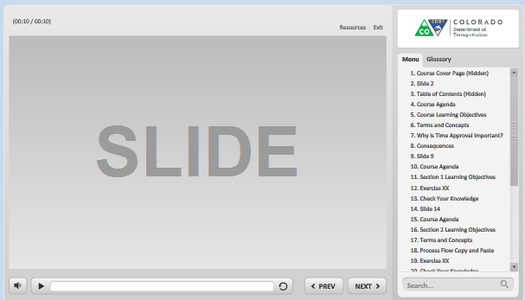
Navigation, Resources and Glossary
Before we begin, let’s look at the resources available to you
Notes:
As you go through the course there are a couple of items you can use to help you learn. The first is the Resources link as indicated by the red arrow. This link contains copies of all of the documents referenced in this course.
The Glossary tab displays an alphabetical list of terms that are used throughout the course. Anytime you are uncertain about a term, this is the best place to look. Unlike the resources link clicking on the glossary does not pause the course.
If you want to navigate, use the previous or next buttons or click on the slide you want to navigate to under the menu tab. There is also a search field located at the bottom of the Menu tab that brings up all of the slides related to your search. The progress bar displays your progress within a slide.
If for any reason, you need to close the course before you have completed it, you will be returned to the page you were on once you log back in. Now let’s move on to what you will learn in this course.

Slide 3
Course Learning Objectives
At the end of this course, you should be able to:
Explain what workers’ compensation is
Identify what workers’ compensation covers
Describe what triggers a workers’ compensation claim
Identify the actions you should take if an employee is injured
Explain the role of the employee and the supervisor in workers’ compensation
Identify common red flags to let Risk know about
Identify contacts if you need help with workers’ compensation
Notes:
Take a moment to review the topics for this section of the course. When you are done reviewing them, click the Next button to return to the course outline.

Slide 4

What is Workers’ Compensation?
A form of insurance that provides an employee injured at work with wage replacement and medical benefits which include:
Medical Expenses
Partial wage replacement during temporary disability
Mileage reimbursement
In some cases, maintenance care at end of claim
Permanent impairment benefits, if applicable
Survivor benefits if the employee is deceased
Notes:
Workers’ Compensation is a form of insurance that provides an employee who has been injured at work with wage replacement and medical benefits. What workers’ compensation does cover for the employee is medical expenses, partial wage replacement during periods of temporary disability, mileage reimbursement , and in some cases may provide maintenance care at the end of the claim, permanent impairment benefits if applicable and survivor benefits if the employee is deceased. Now that we know what workers’ compensation is, let’s look at what it covers

Slide 5


What does Workers’ Compensation Cover?
Workers’ Compensation covers:
Injuries and occupational illnesses arising out of and in the course and scope of employment
Workers’ Compensation does not cover:
Personal injuries
Pre-existing conditions
Injuries where the cause is unknown (idiopathic injuries)
Notes:
Workers’ compensation covers all injuries and occupational illnesses arising out of and in the course and scope of employment. This means that the employee must have been performing an obligation or condition of employment that caused the injury and that the employee must have been working. Workers’ compensation does not cover personal injuries, pre-existing conditions or injuries where the cause is unknown. Now let’s answer a quick question before we look at what triggers a workers’ compensation claim.

Slide 6
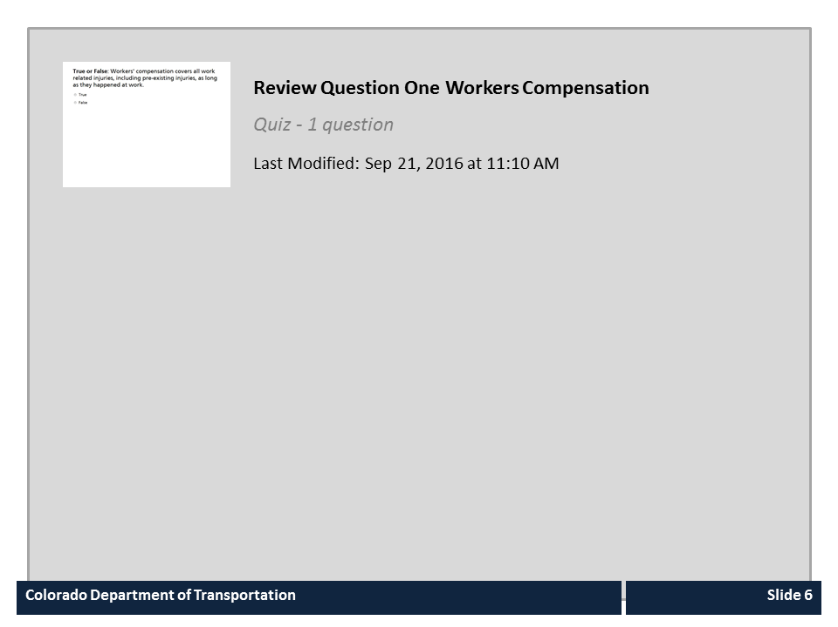
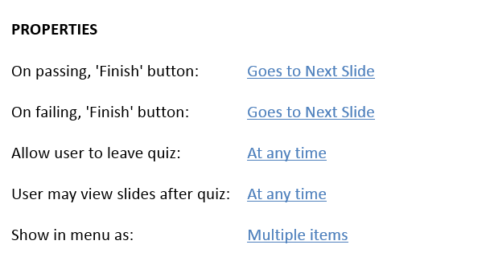


Review Question One Workers Compensation

Slide 7

What Triggers a Workers’ Compensation Claim
A workers’ compensation claim is triggered when an employee:
Reports an injury or illness and
Seeks medical treatment
If medical treatment is not sought then a worker compensation claim will not be filed
Notes:
So what triggers a workers’ compensation claim? For a workers’ compensation claim to occur there has to be a work related injury or illness. When this occurs, the actions of the employee determine if it is an accident or an incident. An accident is when an employee is injured and both reports the injury and seeks medical treatment from an authorized treatment provider. An incident is when the employee only reports a work related injury. So why is this distinction important? It is because a claim will not be filed with the insurance carrier until the employee seeks medical attention.

Slide 8

Reporting an Injury/Emergency
Reporting an injury or emergency:
If the employee is able, they should verbally report an injury or illness
If the employee is unable to report, any employee with knowledge of the injury must report to a supervisor
The supervisor must contact Risk Management at 303-757-9340 if:
  An employee is transported by ambulance
  There are fatalities
  Multiple employees injured
  An employee is hospitalized
Notes:
Now let’s look a reporting an injury or emergency. It is the responsibility of each employee to immediately report to their supervisor any occupational illness or injury that causes pain and may prevent the employee from working. In the event the employee is unable to contact the supervisor they should continue up the chain of command until are able to notify a supervisor. If the employee is incapacitated, any employee having knowledge of the injury should notify a supervisor as soon as possible. As a supervisor, you must notify Risk Management if an employee is transported by ambulance, if there is a fatality, multiple employees are injured or an employee is hospitalized.

Slide 9
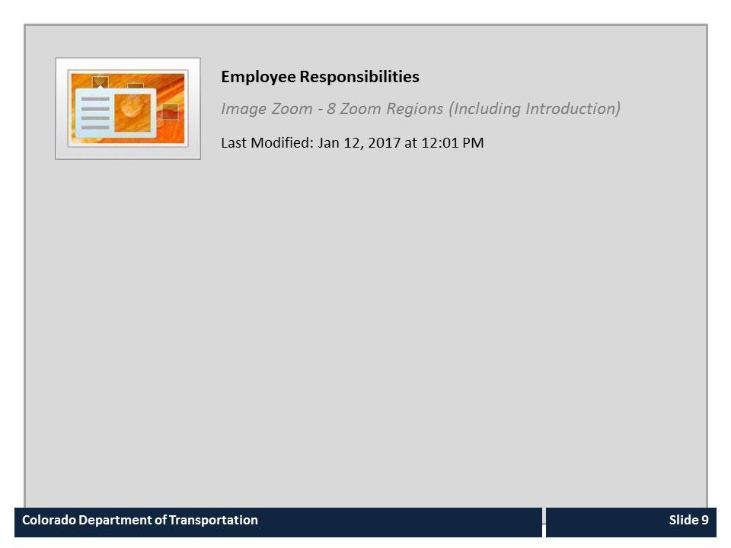
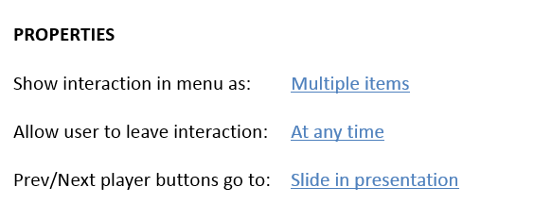

Employee Responsibilities

Slide 10

Supervisor Responsibilities

Slide 11
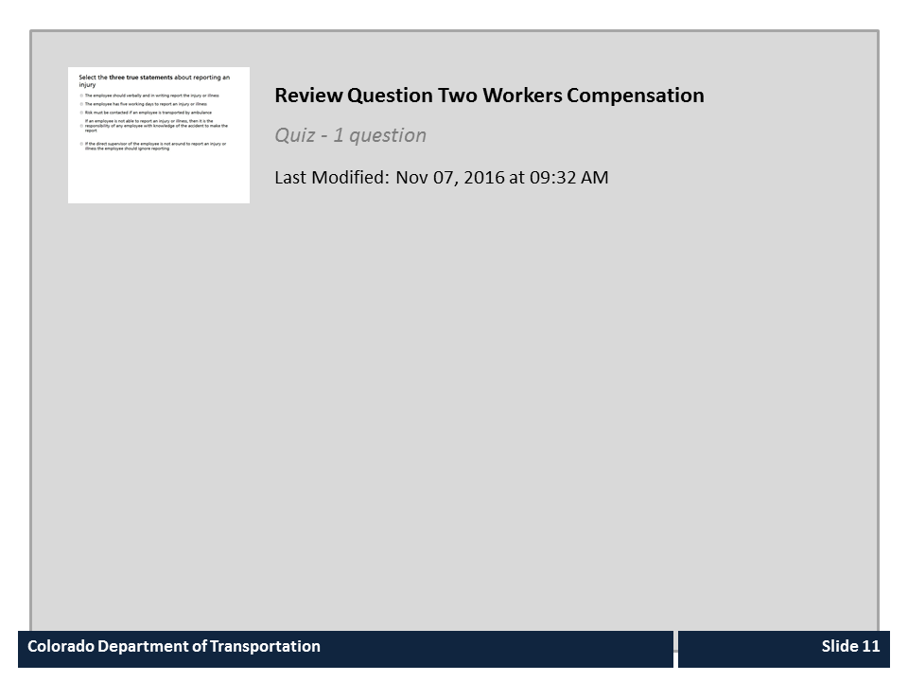
Review Question Two Workers Compensation

Slide 12

Let Risk know if…
Let Risk if any of the following apply to a claim:
A new employee files a claim
Friday injury not reported until Monday
Quickly hires an attorney
Story Changes / Conflicting Descriptions
Pre-existing conditions similar to the injury
History of claims – same time each year
No witnesses
Secondary employment or Hobbies
Unusual Coincidence between date of injury and need for personal time off
Financial problems
Late Reporting
Notes:
While it is rare, there have been cases where fraud has occurred. Workers’ Compensation fraud is defined as an intentional misrepresentation to gain workers’ compensation benefits. Because fraudulent claims typically arise from deliberate, faked or exaggerated injuries, Work injuries reported as job related, working for another employer while collecting benefits and providing false statements. Please be on the lookout for and report to Risk Management if any of the items listed on the slide apply to a claim. Now let’s look at who you should contact of you need help with workers’ compensation.

Slide 13

Guidance and Assistance
For general workers’ compensation questions contact:
The Risk Management Office at 303-757-9340
For reporting multiple injuries, an injury requiring an ambulance, or fatality contact:
Risk Management at 303-757-9340 and follow the notification of serious accident guidelines which can be found by clicking HERE
Notes:
Please direct all of your inquires about worker’s compensation to the Risk Management office at 303-757-9340. If there is need to report multiple injures, an injury requiring an ambulance, use the same number to find out the best point of contact, even if it is after hours. There are also guidelines for reporting a serious accident, which can be found by clicking on the word “here”.

Slide 14
Course Learning Objectives
You should now be able to:
Explain what workers’ compensation is
Identify what workers’ compensation covers
Describe what triggers a workers’ compensation claim
Identify the actions you should take if an employee is injured
Explain the role of the employee and the supervisor in workers’ compensation
Identify common red flags to let Risk know about
Identify contacts if you need help with workers’ compensation
Notes:
Now that you have competed the course you should be able to describe each of the items on the bulleted list. When you are done click the next button to continue.

Slide 15

Course Complete
Congratulations, you have completed CDOT’s Introduction to Worker’s Compensation training!
To confirm you have completed the course, close the course and confirm you have taken it from your course catalog.
Notes:
Congratulations, you have completed the Introduction to Workers’ Compensation training! You will receive credit for this course once you close the window.

