Slide 1


Introduction to Family Medical Leave
Notes:
Welcome to the Introduction to Family Medical Leave course! This course is designed to help CDOT managers and supervisors understand Family Medical Leave and the protections it affords employees. It also covers the actions that trigger FML and the process used to determine if an employee qualifies.

Slide 2
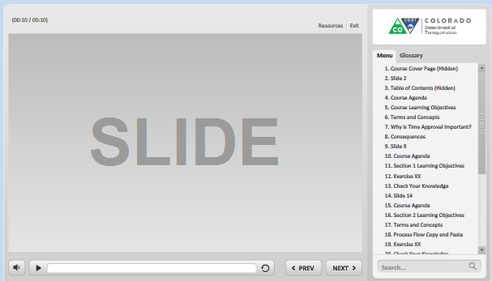
Navigation, Resources and Glossary
Before we begin, let’s look at the resources available to you
Notes:
As you go through the course there are a couple of items you can use to help you learn. The first is the Resources link as indicated by the red arrow. This link contains copies of all of the documents referenced in this course.
The Glossary tab displays an alphabetical list of terms that are used throughout the course. Anytime you are uncertain about a term, this is the best place to look. Unlike the resources link clicking on the glossary does not pause the course.
If you want to navigate, use the previous or next buttons or click on the slide you want to navigate to under the menu tab. There is also a search field located at the bottom of the Menu tab that brings up all of the slides related to your search. The progress bar displays your progress within a slide.
If for any reason, you need to close the course before you have completed it, you will be returned to the page you were on once you log back in. Now let’s move on to what you will learn in this course.

Slide 3
Course Learning Objectives
At the end of this course, you should be able to:
Describe what Family Medical Leave is and the protections it affords an employee
Identify what actions trigger FML and when it applies
Describe what is used to determine if an employee qualifies for FML
Explain the role of the supervisor in the FML process
Identify what not to ask your employee about an FML event
Identify who to contact if you need help with FML
Notes:
Take a moment to review the topics for the course. When you are done reviewing them, click the Next button to continue.

Slide 4
What is FMLA?
FMLA is a Federal law that permits employees to take up to 12 weeks of unpaid leave with job protection for their own use or for the care of a qualified individual
  Health insurance continues as if the employee has not taken leave, but employee must pay their portion while on unpaid leave
  FML allows Job restoration to the same or equivalent position
  No retaliation is allowed
The State of Colorado provides 13 weeks (520 hours) of unpaid leave with job protection per rolling 12 month period
Notes:
The Family and Medical Leave Act (FMLA) of 1993 is a federal law that permits employees to take up to 12 weeks of unpaid leave with job protection. Colorado provides an additional week of leave for a total of 13 weeks of unpaid leave with job protection. As the name suggests, the reason for the leave must be related to family and medical issues. During the time the employee is covered under FML their health insurance continues as if they have not taken leave, but the employee must pay a portion of the health insurance while they are on unpaid leave. If the employee has to leave work they must be restored to the same or equivalent position upon returning. Also retaliation is not allowed and FML an it must not be a consideration in employment decisions. One of the primary benefits of FMLA is job protection, in that it entitles employees to take job-protected leave for a qualified family member or medical leave for themselves.
In order for an employee to take Family Medical Leave it must be requested by the qualifying individual, there must be a qualifying condition and the employee must be eligible to take the leave. Now that we know what FMLA is, let’s look at what it is not.

Slide 5

What is NOT FMLA
FMLA is not:
A new leave granted to an employee
Optional for an employee
Fair Labor Standards Act
Workers Compensation
Notes:
FML is not a new leave type granted to the employee. The employee must code their leave as FML. Additionally, FML is not optional for the employee, meaning that the employee cannot waive their rights to FML. When there is a qualifying event and the employee is determined as qualified they use FML to code time on their timesheet.
FML is not related to FLSA, which is the Fair Labor Standards Act which establishes overtime and record keeping requirements. Also, FML is not the same as Workers Compensation which may run concurrently with FML depending on the circumstances of the employee. Now let’s answer a quick review question, before moving on to what triggers an FML event.

Slide 6
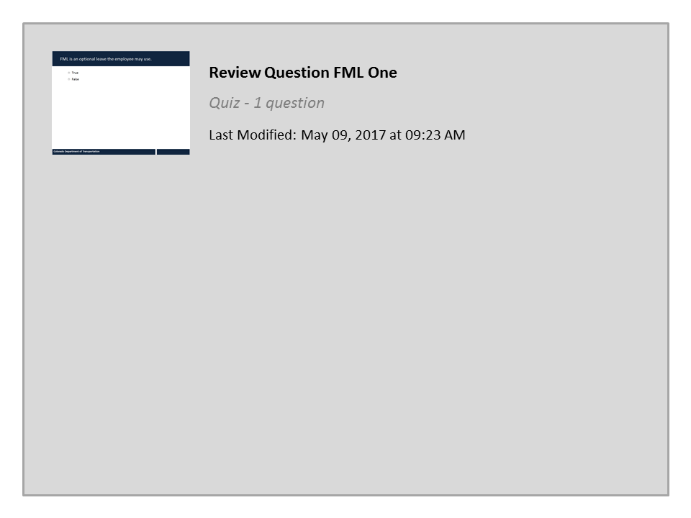
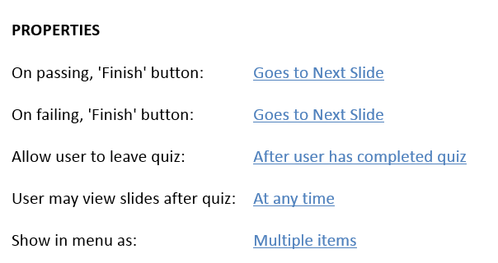


Review Question FML One

Slide 7

FML Initiation Triggers
FML is triggered when an employee:
Is sick more than 3 full consecutive work days
Requests leave for a foreseeable personal health reason
Requests extended leave to care for a qualifying family member with a serious health condition
Workers’ Comp files first report of injury or claim number memo
Military Deployment
Military family member illness /injury
Military family member veteran treatment
Notes:
As a supervisor you are responsible for being on the lookout for events that may trigger leave designated as FML. Most importantly, this includes notifying the FML Liaison if the employee is sick for more than three full consecutive work days or if the employee notifies you they will be impacted by any of the reasons listed on this slide. Please take a minute to review the events which may trigger a FML event. If you are uncertain if an event is going to trigger FML, you should contact your FML Liaison and ask. When you are done click the next button to continue and learn about what qualifies an employee for FML protected leave.

Slide 8
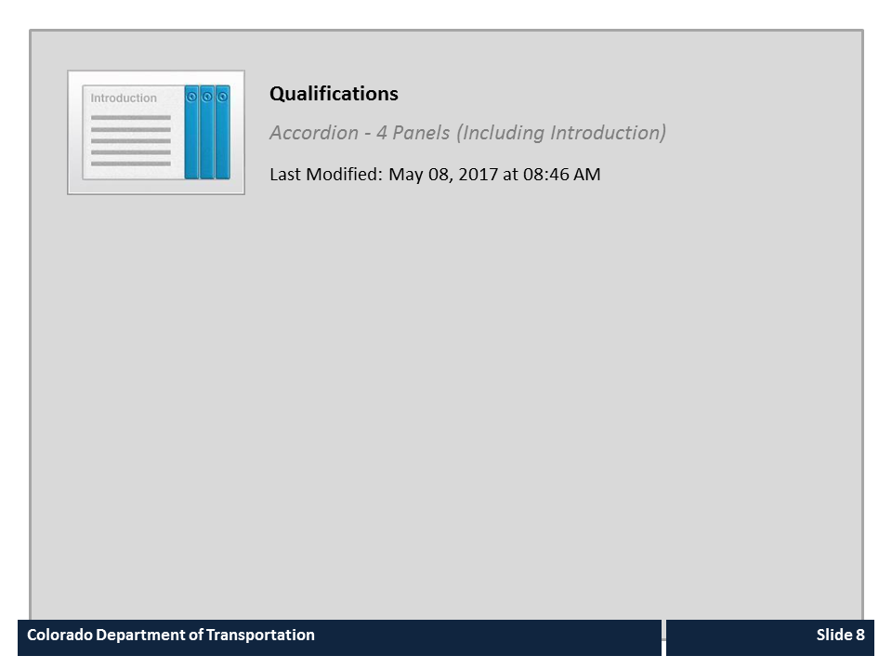
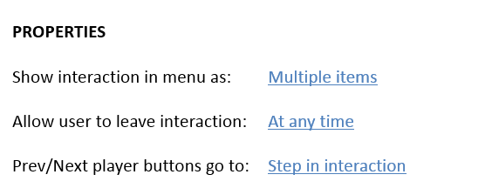

Qualifications

Slide 9

Supervisor Responsibilities
The Supervisor is responsible for:
Maintaining confidentiality
Communicating to the FML Liaison:
  FML needs of Employee
  If the Employee has used more than three consecutive days of sick leave
  Injuries on the job
Approving the Employee’s timesheet and accommodating work schedule
Provide duty statements from Employee’s PDQ
Notes:
As a supervisor, you have certain responsibilities if you notice or are notified of an event that may need to be coded as Family Medical Leave. The most important is that you maintain the confidentiality of the event. This means that you should not discuss this with other employees and should only ask about what is related when communicating the FML needs of the employee.
In addition, you will need to work with the FML Liaison and answer questions they may have about the leave the employee is taking, injuries on the job, time entry and providing duty statements from the employee’s PDQ to determine if the employee is able to perform all of the essential functions of their position.

Slide 10
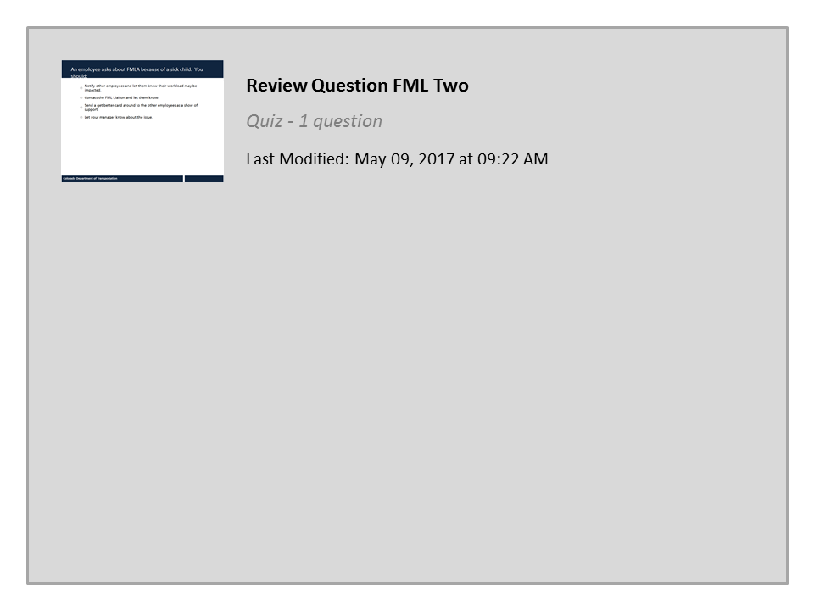
Review Question FML Two

Slide 11
How does FML Work
Trigger Event Occurs
Supervisor or Employee Notifies FML Liaison
FML Forms Sent to Employee by FML Liaison
Employee Sends Forms Back within 15 Days
FML Coverage is Approved or Rejected
If Approved, FML can be Applied to Leave and Approved By Supervisor
Renewal at the End of One Year if Applicable
FML Liaison Sends Designation Notice and Letter
Notes:
The following is a high level overview of how FML works. This is not the entire process, only the events that are important to the supervisor. When you are done reviewing the process, click next to learn about what you should not ask an employee about FML.

Slide 12

Questions not to ask your Employee
Questions to avoid asking include:
Anything to do with age, marital or family status
The diagnosis of the employees
Asking about medications
Anything about a disability
Anything about physical or mental impairments
Notes:
During the FML process you may be tempted to find out more about what is happening to the employee. While this is perfectly natural, because we care about our employees, there are some questions that must be avoided. If you are uncertain about what you are able to ask reach out to the FML liaison. Take a moment to review the list and click continue when you are done.

Slide 13

Guidance and Assistance
For general FML questions contact:
Your Regional FML Liaison by clicking HERE
For questions about policy and Medical Providers:
Contact the FML Program Manager at 303-512-5449
Notes:
For most of the questions you have about FML you should contact your FML Liaison this can be done by clicking the “here”. This will take to a list of FML liaisons by region. While you are on the page it would be a good idea to bookmark this page in case you need help latter. If you have questions about FML policy or contacting medical providers contact the FML Program Manager Christine Andersen.

Slide 14
Course Learning Objectives
You should now be able to:
Describe what Family Medical Leave is and the protections it affords an employee
Identify what actions trigger FML and when it applies
Describe what is used to determine if an employee qualifies for FML
Explain the role of the supervisor in the FML process
Identify what not to ask your employee about an FML event
Identify who to contact if you need help with FML
Notes:
Now that you have competed the course you should be able to describe each of the items on the bulleted list. When you are done click the next button to continue.

Slide 15

Course Complete
Congratulations, you have completed CDOT’s Introduction Family Medical Leave Training!
To confirm you have completed the course, close the course and confirm you have taken it from your course catalog.
Notes:
Congratulations, you have completed the Introduction Family Medical Leave training! You will receive credit for this course once you close the window.

