Slide 1


Introduction to Civil Rights Legislation
Notes:
Notes:
Welcome to the Introduction to Civil Rights Legislation course! This course is designed to help CDOT managers and supervisors gain a basic understanding of Civil Rights laws and how they are applicable to the workplace.

Slide 2
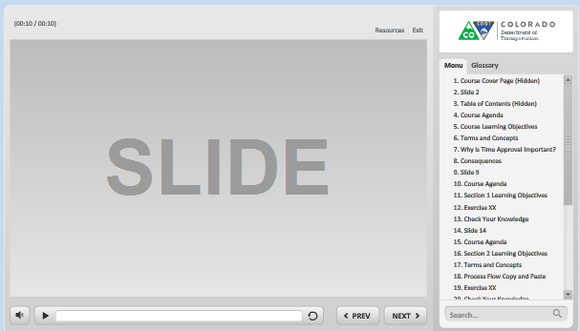
Navigation, Resources and Glossary
Before we begin, let’s look at the resources available to you
Notes:
As you go through the course there are a couple of items you can use to help you learn. The first is the Resources link as indicated by the red arrow. This link contains copies of all of the documents referenced in this course.
The Glossary tab displays an alphabetical list of terms that are used throughout the course. Anytime you are uncertain about a term, this is the best place to look. Unlike the resources link clicking on the glossary does not pause the course.
If you want to navigate, use the previous or next buttons or click on the slide you want to navigate to under the menu tab. There is also a search field located at the bottom of the Menu tab that brings up all of the slides related to your search. The progress bar displays your progress within a slide.
If for any reason, you need to close the course before you have completed it, you will be returned to the page you were on once you log back in. Now let’s move on to what you will learn in this course.

Slide 3
Course Learning Objectives
At the end of this course, you should be able to:
Describe the laws applicable to the supervisor for Title VII of the Civil Rights Act of 1964, Age Discrimination in Employment Act of 1967, Genetic Information Nondiscrimination Act of 2008
Describe the American with Disabilities Act and what a disability is and the program areas under ADA
Explain what may be unfair treatment and what to do if it occurs
Describe what retaliation is and what to do if it occurs
Identify who to contact if you have questions
Notes:
In your role as a supervisor it is important for you to understand the content of this course and how it is applied in the work place.

Slide 4
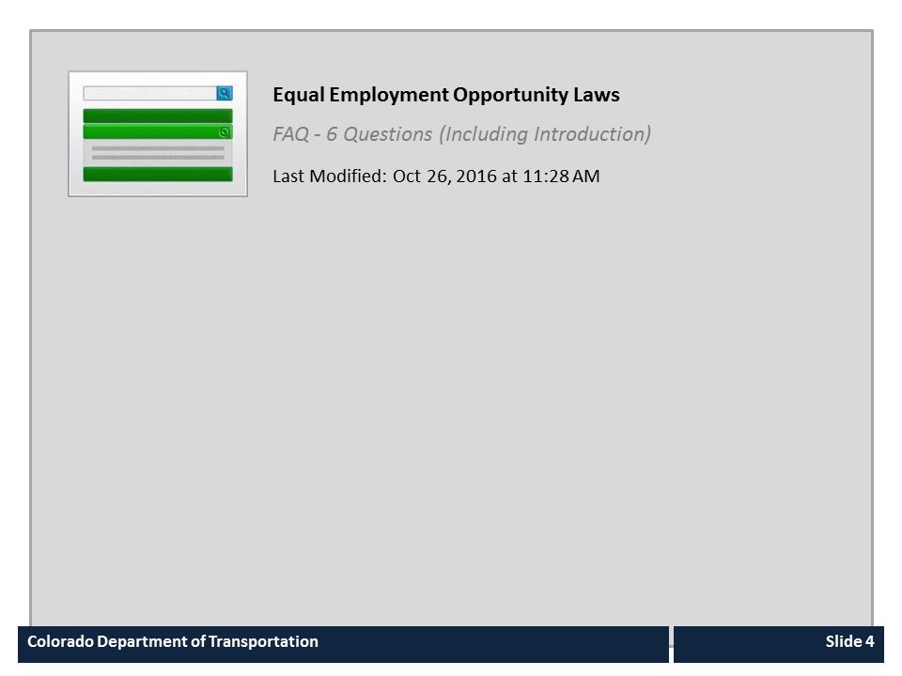
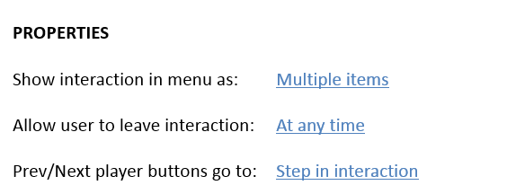


Equal Employment Opportunity Laws

Slide 5
Americans with Disabilities Act
The American with Disabilities Act is:
A federal law that provides Equal Employment Opportunity to individuals with disabilities and makes it unlawful to discriminate in all employment practices based on disability
Requires reasonable accommodations to individuals with disabilities
Notes:
Now let’s look at the Americans with Disabilities act or as it is more commonly known ADA. ADA requires that CDOT to provide a reasonable accommodation such as a change to the work environment or the way processes are customarily done to allow the person with a disability to enjoy equal employment opportunities.
Now that we know what the law is let’s look at what is defined as a disability.

Slide 6

What is a Disability According to ADA
An individual with a disability is a person who:
Has a physical or mental impairment that substantially limits one or more major life activities
Has a record of such an impairment, or
Is regarded as having such an impairment
Notes:
According to ADA an individual with a disability is a person who, has a physical or mental impairment that substantially limits one or more major life activities, a record of such an impairment, or is regarded as having such an impairment.

Slide 7
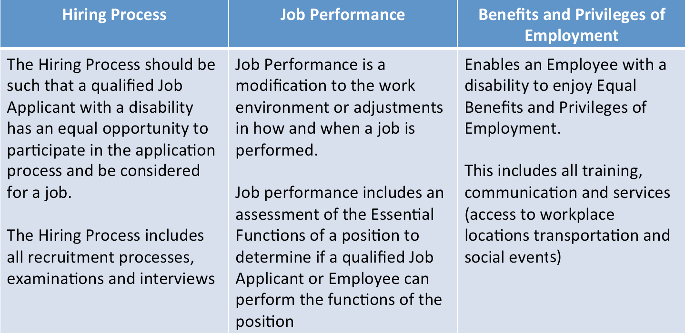
Program Areas under ADA
There are three general program areas of covered under ADA:
Notes:
There are three different Program areas covered under ADA where a reasonable accommodation may apply.
Let’s start with the Hiring Process. Regardless of the type of position and method to fill it, the Hiring Process needs to be inclusive and free of discrimination. ADA applies to all stages of filling a position including advertisements for positions, recruitment, tests, written exams, both formal or informal oral interviews, and any other type of job demonstration.
The most commonly known area for ADA is when it applies to Job Performance. If an Employee needs assistance to perform their job, a modification or adjustment to how or when the work is performed may be implemented under the ADA. The type of modification is based on an individual assessment of the Employee and considers the Essential Functions of the position with or without an accommodation.
The least known program area where ADA applies is for Benefits and Privileges of Employment. Simply put, this means that an Employee with a disability should be given the same opportunities, training, communication, access to services and the like, as similar Employees without a disabilities.

Slide 8
Pregnancy Workers Fairness Act
The Pregnancy Workers Fairness Act is a State law that provides Equal Employment Opportunity to employees or applicants who are:
Pregnant
Physically recovering from a childbirth or a related condition
Have a condition related to pregnancy
Notes:
In addition to the Federal Rights legislation, the State of Colorado has passed the Pregnancy Workers Fairness Act. This Act makes it a discriminatory or unfair employment practice if an employer fails to provide reasonable accommodations to an applicant or employee who is pregnant, physically recovering from childbirth, or a related condition. The act provides provisions for what is considered a reasonable accommodation, such as more frequent or longer breaks, modification of equipment or seating, limitations on lift and light duty or transfer and assistance of labor or modified work schedule. Refer to the “Notice for Employers to use in Order to be in Compliance with HB 16-1438” under the resources link to learn more.

Slide 9

The Duty to Act
The Supervisor is responsible for:
Reporting any discrimination you see, hear or are made aware of to Employee Relations or your Civil Rights Manager
Setting the example for your employees
Contacting Employee Relations or your Civil Rights Manager if you have questions or do not know how to proceed
Notes:
As a supervisor, you are responsible for reporting any discrimination you see, hear or are made aware of to Employee Relations or your Civil Rights Manager. This is critical because you may be held personably liable for not addressing the complaint. You should also set the example for your employees by not participating in any actions which may be questionable and coaching employee on appropriate behavior.
Additionally, you are not alone. If you need help or are uncertain about how to proceed then do not hesitate to contact Employee Relations or your Civil Rights Manager if you need help. Now let’s answer a quick question before we discuss retaliation.

Slide 10
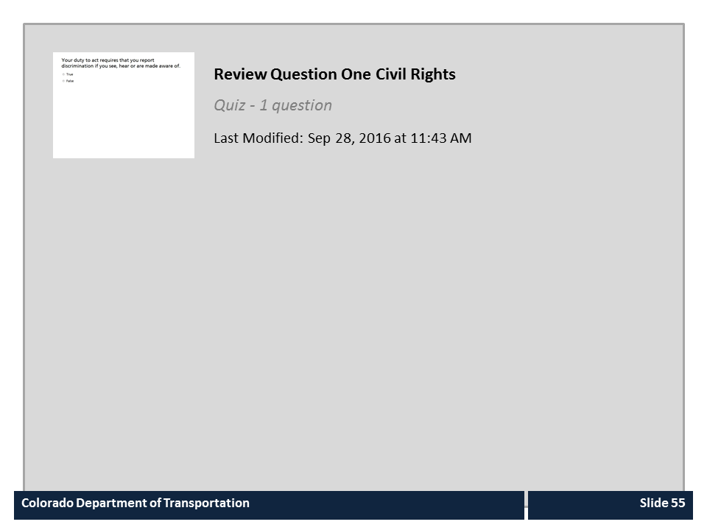
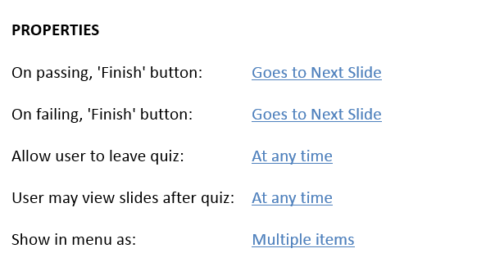

Review Question One Civil Rights

Slide 11

Retaliation
Retaliation is when an supervisor or employer takes adverse action against an employee for filing a complaint
To avoid retaliation complaints ask yourself:
  Would your best employee be treated this way?
  Is there a documented reason for the action?
  Would an unbiased observer find the action you were taking reasonable?
Notes:
With each of the laws discussed in this section, there is the potential for an employee to file a complaint of discrimination. Retaliation occurs after an employee files a complaint and the employer takes actions that have a negative impact on the employee such as demotion, firing, actions that impact an employees pay and even firing the employee. The process to avoid retaliation complaints is simple. First, ask yourself is this the way you would treat your best employee. Next make sure there is a documented reason for the action you are taking. For example if the employee was rude to customers, you would want to make sure you had documentation of this prior to taking action.
It might also be helpful to think about the issue as if you were an unbiased observer in order to make a decision about proceeding with the action. Now let’s take a look at who you should contact if you need help with any of the topics covered in this section of the course.

Slide 12

Where Can I Get Help (People)
For help contact the Civil Rights Manager or ADA Liaison for your region using the link below:
http://intranet.dot.state.co.us/employees/Contacts/documents/crm-contacts
For policy questions contact:
Christine Andersen 303-512-5449
Notes:
If you are uncertain about what the best course of action to take when applying Civil Rights Legislation to the workplace contact your Civil Rights Manager/ ADA Liaison for your region using the number above. For policy questions contact Christine Andersen the manager of Employee Relations. Now let’s move on to the conclusion of the course.

Slide 13
Course Learning Objectives
You should be able to:
Describe the laws applicable to the supervisor for Title VII of the Civil Rights Act of 1964, Age Discrimination in Employment Act of 1967, Genetic Information Nondiscrimination Act of 2008
Describe the American with Disabilities Act and what a disability is and the program areas under ADA
Explain what may be unfair treatment and what to do if it occurs
Describe what retaliation is and what to do if it occurs
Identify who to contact if you have questions
Notes:
Now that you have competed the course you should be able to describe each of the items on the bulleted list. When you are done click the next button to continue.

Slide 14

Course Complete
Congratulations, you have completed CDOT’s Introduction to Civil Rights Legislation Training!
To confirm you have completed the course, close the course and confirm you have taken it from your course catalog.
Notes:
Congratulations, you have completed the Introduction to Civil Rights Legislation training! You will receive credit for this course once you close the window.

