Slide 1
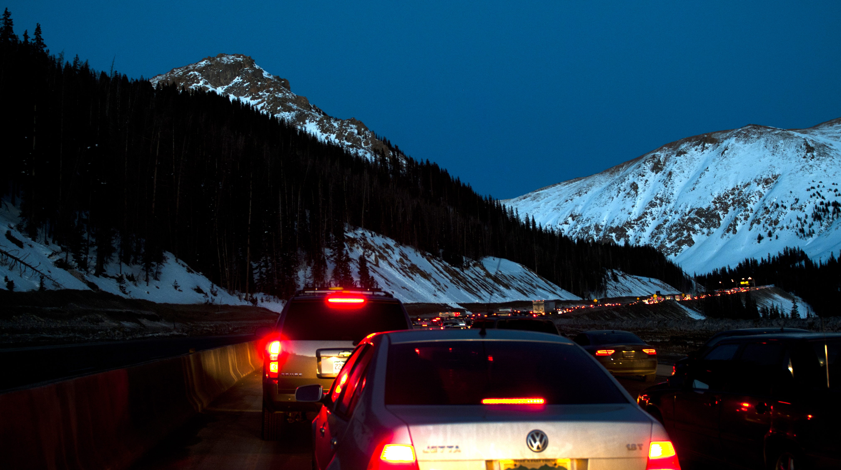
Your Role in Risk Management
Developed by the CDOT Office of Risk Management
Training 2015

Slide 2
OBJECTIVES
Introduction
CDOT Overview Financial Impact
Responding to Incidents/Accidents
Conducting Investigation for Incidents/Accidents
Reporting Online
Modified Duty
Reporting Lost Time

Slide 3
OFFICE OF TRANSPORTATION SAFETY
Risk Management Team
Tracie Smith Risk Manager
Donna Goodwin Sr. Risk Management Specialist
Ken Schrecengost Risk Management Specialist
Linda Kostic Risk Management Specialist
Lori Hartley Data Administrator
Priscilla Talich Data Specialist
VACANT Risk/Safety Technician
CDOT Headquarters
4201 E Arkansas Ave., Room 274
Denver, CO 80222
Main Phone: 303-757-9340

Slide 4
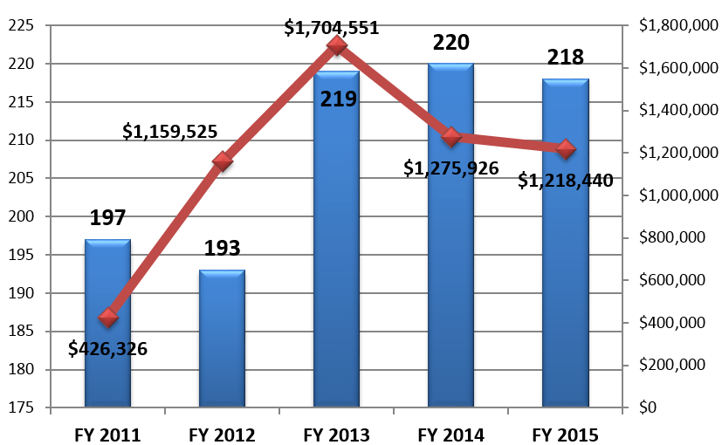
CDOT COSTS
Property Allocation
Notes:
Ken will talk more about this, but we do have property insurance.
5K deductible – means we pay for damaged property under $5K out of the budget,
Over 5K we might be able to recover some from insurance over the 5K deductible
Might be able to recover damages from a third party if they are responsible for damages and have insurance and within policy limits.
And what a lot of people don’t understand is we do not carry auto insurance.
there is no insurance that covers CDOT vehicles – we own the vehicles.
we pay out of pocket for those loses
We try to recover damages from a third party if they are at fault
But they may be uninsured, damages may be over policy limits, they may later claim you were at fault and we have to fight the claim,
or we may have negotiate the recovery amount.

Slide 5
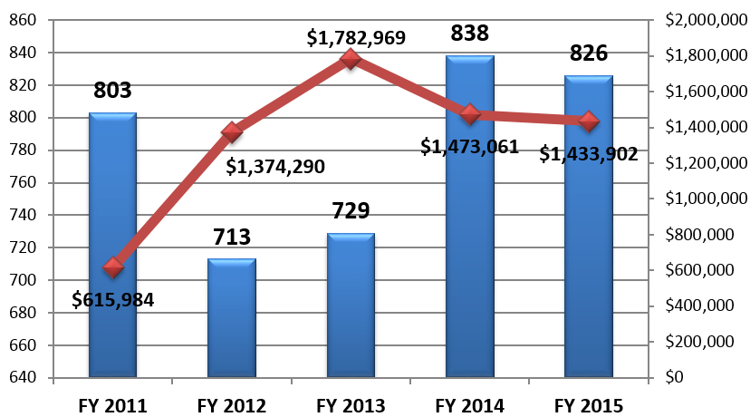
CDOT COSTS
Liability Allocation
Notes:
This is the amount we spend on liability claims
when we cause bodily injury or damage property.
Ken will also talk more general liability claims and the CGIA, and how to document events properly

Slide 6
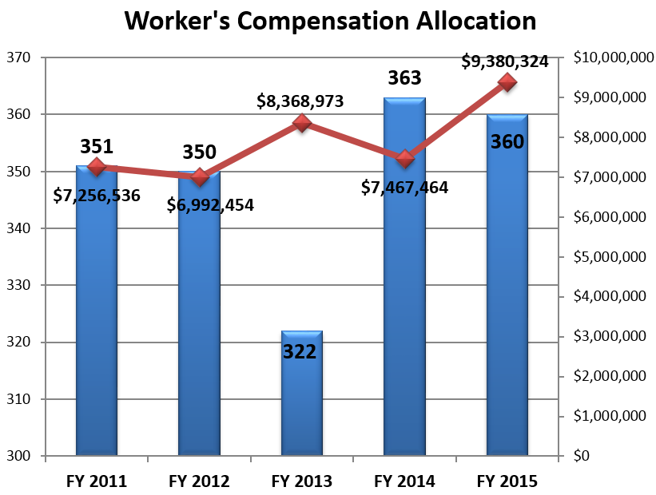
CDOT COSTS
Workers’ Compensation Allocation
Notes:
Here are some numbers for CDOT’s WC allocations - most costly and continue to rise.

Slide 7
  Colorado Governmental Immunity Act (CGIA)
The CGIA establishes governmental immunity for public entities (including CDOT)
CGIA Define Eight Waived Areas of Immunity
Allows for Limited Recover of Damages when negligence is proven by the citizen.
Waived Areas
Operation of motor vehicle by public employee
Dangerous condition of public highway, roads, streets

Slide 8
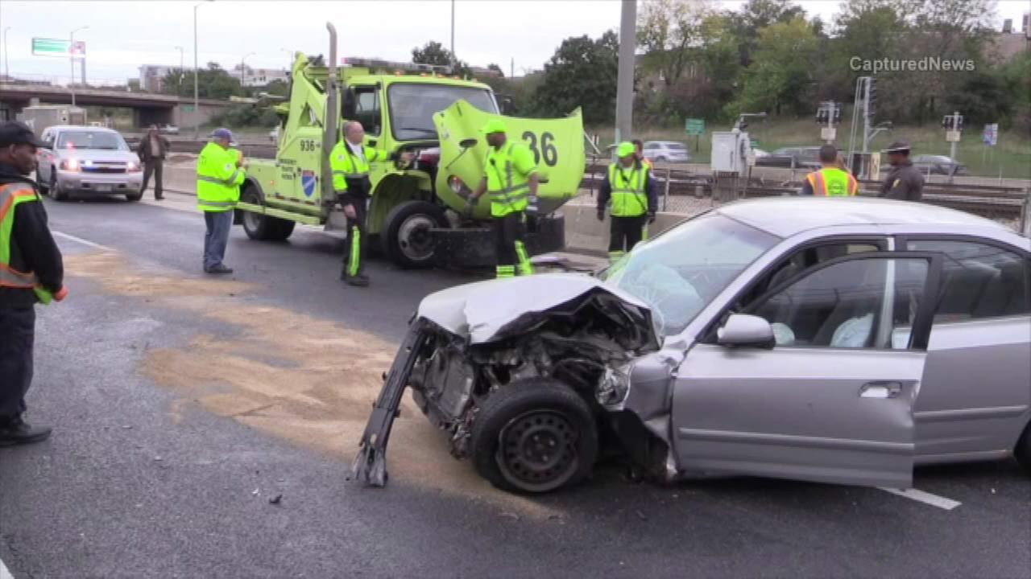
RESPONDING TO INCIDENT/ACCIDENT

Slide 9
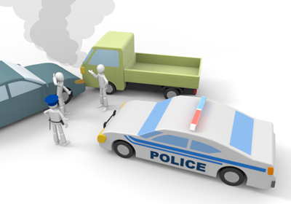
Auto and Property Claims
    Police MUST be notified!
        Follow Up and Obtain Police Report
    Identify State Fleet Vehicles
    CDL Post-Accident Procedures
    Obtain Photos and Witness Statements
    Liability Claims
        3rd Party is involved - Do not discuss aspects of the accident, provide statements or admit liability – refer them to the police report
        Preserve Documents (ARB Reports, Photos, Statements)
        Document Safe Operations, i.e. Plow Blade was down, Amber Lights were on, etc.
        Do Not Create Unnecessary Documents and Emails of Personal Opinion
Notes:
Auto Liability Claims are for CDOT Vehicles and State Fleet Vehicles
Must notify police, especially if 3rd party is involved, even on private property
They may not respond on private property, but then that MUST be documented to show due diligence
Be sure to identify if a State Fleet vehicle or CDOT vehicle is damage because you will also need the DPA vehicle accident report form if state fleet
Be sure all CDL Post-Accident Procedures are followed
Alert CDOT Risk Management immediately of any positive drug/alcohol tests.
Obtain photos and witness statements
GIA - Important to note on report - amber lights on, was the plow blade down, were you in the course of plowing, was there proper signage and traffic control, was your speed controlled and appropriate, road conditions, safety measures in place these items can impact decisions made on citation or liability claims that fall under the GIA

Slide 10
Serious Accidents
and Emergencies
Serious Accidents
  Initiate the Serious Accident Notification
Emergencies
  Fatalities
  Employee is Transported by Ambulance
  Multiple Employees Injured
  Employee is Hospitalized
  Total Loss of Vehicle, Equipment or Structure
Call Risk Management 303-757-9340 Main Line
OR Tracie Smith Cell 720-308-2575
Notes:
ALL CDOT EMPLOYEE EVENTS, AND ALL CDOT CONTRACTOR OR CITIZEN EVENTS WITHIN A WORK ZONE
 Fatality (MUST CALL CDOT RISK MANAGER AND THE OTS DIRECTOR; LEAVE MESSAGE IF NO ANSWER)
 2 or more CDOT employees, contract employees, or citizens injured - Non-Life Threatening
 Major Injury to CDOT employee, contractor, or citizen - Life Threatening = ER/Hospitalization/Flight for life
IDENTIFY and provide the information if available:
 CDOT Employee Name(s) Contractor Employee Name(s)
 Citizen Name(s)(if known):
 Event took place in CDOT Work Zone
INFRASTRUCTURE/PROPERTY
 Serious damage requiring emergency repair, highway closure or significant traffic flow disruption; i.e. bridge failure, sinkhole, rock slide or major impact to a structure, etc.
 Total vehicle or building loss; due to major fire, flood, etc.
 Hazmat spill with reportable quantity equal to or greater than reporting quantities defined by Colorado Dept. of Public Health and Environment
Example:
Name of injured contractor, citizen or employee(s): John DOE – CDOT Employee ONLY
CDOT Cone Zone for contractor: Yes
Contractor: Construction Firm Name
Date/Time of the incident: 02/13/2013 0500
Location of the incident (hwy/mile marker): I70 and Sheridan, Denver, CO
Contact person name and phone number: Tony Devito 303-123-4321
Brief description of the incident (who, what, when): John was STRUCK BY CITIZEN VEHICLE on I70 John in ROUTE TO ST ANTHONY’S VIA AMULANCE (Potentially Life Threatening).

Slide 11
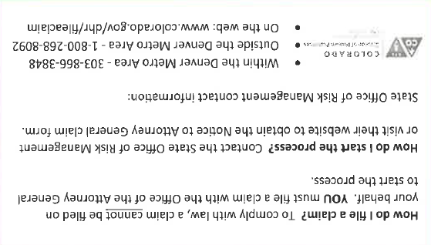
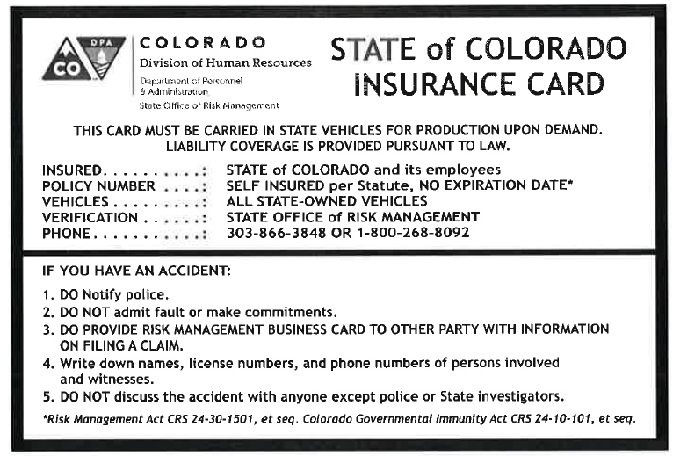
State Office of Risk Management
Insurance and Liability Claim Cards
Liability Claim Card
Give to Citizen
This Tells them How to File a Claim
Proof of Insurance Card
And Reminds Employee
What to do in Case of Accident
Notes:
Has everyone seen these? Should be in every vehicle
If you are involved in an accident provide these cards to a 3rd party
State Risk Management Business Card
Tells them how file a claim with state risk
State of CO Vehicle Proof of Insurance card
Be sure to exchange insurance information and get
names and address of 3rd party or witness statements if possible.
Witnesses may help to prove you were blameless in the accident.
Make no comment or statement regarding the accident except to police or a representative of the State

Slide 12
Auto and Property Claims - Responding Supervisors
    Estimate Costs
        Call Shop Manager if unsure
        Track all expenses to include CDOT Materials, Equipment, and Labor (Work Order Accuracy) if applicable
    Theft or Vandalism
        Must be Report to Local Law Enforcement
        Follow up and Obtain Police Report
    Take Action to Deter Further Loss
        For Example: turn off water to a flooded building, etc.
    Take Action to Preserve Evidence
        For Example: Have a disabled vehicle towed to a secure facility for further investigation, place a malfunctioning or defect equipment in a locked cabinet for further investigation, etc.
Notes:
When filing the report we must have an estimated cost of damages
Call your shop foreman if you are unsure
Any theft or vandalism must be reported to the local law enforcement
Take any necessary action to preserve evidence, such as malfunctioning/defective equipment
It is your responsibility to ensure an accurate detailed report of the incident/accident

Slide 13
Work Related Injury/Illness Response -
Supervisors - What To Do?
Medical Attention for the Employee
Initiate Serious Accident Notification/Emergency Protocols
Which Hospital was the Employee Taken to?
Call Police? Call Superintendent? Call Risk Mgmt?
CDL Post-Accident Testing – Refer to PD
Employee Incident Statement CDOT form 777
Authorized Treating Provider (ATP) List?
Witness Statements? Photos?
Where was the vehicle taken?
***All of this info will be needed later for CDOT’s Online Accident Reporting System***

Slide 14

Work Related Injury Compliance
CDOT Authorized Treating Providers
Statutorily Employers may Designate Providers
  MUST choose a CDOT ATP for medical care
  May choose any provider from the list
  May not go to your own Doctor
  Follow Medical Treatment Guidelines
  Determine causality
  Work Restrictions – Provide Report
  Employee MUST be Given ATP List within 7 Days of the Injury!

Slide 15
WC - Supervisors Responsibility
Supervisors
Obligation to Report a Claim if an Employee Reports a Work Related Injury
Workers’ Compensation Act
    Penalties could be assessed for late reporting
Employee has 4 days to report injury – IN WRITING
    Gold Poster – WARNING
    Loss 1 day wage replacement benefits for each day late
Employer has 10 days to report injury
    $1000 a day for everyday late!
CDOT Policy
  MUST report immediately - within same work shift!
  Call your supervisor or the next supervisor up until you reach someone! Don’t wait!
  Complete the Employee Incident Statement 777

Slide 16
Incident / Accident Classification
Incident vs. Accident
Injuries are classified into two categories:
INCIDENT - Any person who reports a work related injury and does not seek medical treatment.
  STILL NEED TO REPORT!!!
ACCIDENT - Any person who reports a work related injury and does seek medical treatment. Medical treatment is defined as emergency room, urgent care room, authorized treating provider.
Notes:
Refer to ACCIDENT DEFINITIONS

Slide 17
Multiple Incidents & Occurrences
Occurrence
Is one event that generates multiple claims.
Examples:
Hail storm damages several vehicles and/or buildings
Accident involving vehicle, property and employee
  Occurrence Acts as Primary Claim
Counts as one claim vs. multiple for reporting purposes
Alert Risk with an estimate of number of claims
Notes:
There could be injury to employee, injured citizen, damaged property, damaged vehicle, all in one accident making it one occurrence.

Slide 18

CONDUCTING THE
INVESTIGATION

Slide 19
Liability Claims
CDOT causes damage to a Citizen
    Bodily Injury or Property
    Report potential Liability claims
        CDOT Employee Complete Incident Statement 777
        Detailed facts only
        Tell the reader what happened
        Do not discuss any aspects with the citizen!
        Notice of Liability Claim Memo requesting information
Notes:
LIABILITY – Citizen Injury or Citizen Property Damage
If a CDOT employee damages citizen or their property (Liability-L) It is your responsibility to complete a report - All accidents regardless of damages must be reported
Injury or damage to private citizens or their property (Liability – L)
This accident type is submitted to CDOT Risk as an Incident. Once a liability claim is filed by the citizen through State Risk then it becomes a claim.
Citizen Injury or Property to Citizen - Liability Incident
Employee must complete Employee Incident Statement form #777
Supervisor must complete Origami Online Investigation
Complete Vehicle Accident Report only if State Fleet Vehicle is involved
Provide photos, police reports & witness Statements Witness Statement form #1404
Citizens may also file liability claims to the State Office of Risk Management
NOT CDOT Risk Management
Do not engage in discussing aspects of any liability claim with them.
However, if after giving the citizen the information they continue to pursue the issue with you – refer them to CDOT Risk.

Slide 20
Accident
Classification and Definition
Injury or loss to CDOT equipment, vehicles, property or employees.
Any event where an employee, equipment, vehicles or property sustained damage or costs were incurred - indirect or direct.
Report all events where a private citizen is involved or their property is damaged.
Equipment and vehicles that have normal wear and tear will not be reported or captured.
Normal wear and tear as a result of normal use or aging is not covered.
Damage to the vehicle body is not considered normal wear and tear.

Slide 21
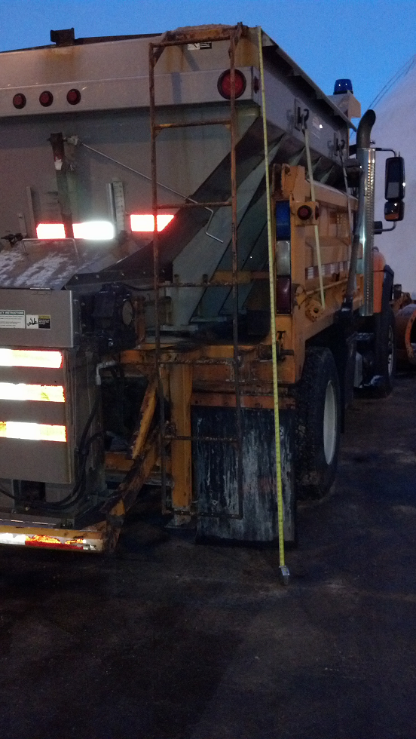
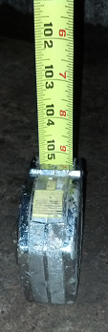
Supervisors must complete thorough Investigations
Notes:
During your investigation you need to consider:
What were the weather conditions?
Was there snow on the ground, was the ground uneven, was the ground wet or icy?
Was the employee twisting, straining, reaching?
Items carried or handled by the employees – how much did they weigh?
How long was the employee working on a specific task that day?
Were there witnesses?

Slide 22
Be Aware of Red Flags
If there are concerns about the claim notify Risk Mgmt
Late Reporting
A new employee files a claim
Friday injury not reported until Monday morning
Quickly hires an attorney
Story Changes / Conflicting Descriptions
Pre-existing conditions that is similar to the injury
History of claims – same time each year
No witnesses
Secondary employment or Hobbies
Unusual coincidence between date of injury and need for personal time off

Slide 23
Safety Rule Violations
Educate Your Employees
Reduction in WC Wage Replacement Benefits
  Medical Care Covered
  Workers’ Compensation disability wage replacement benefit – may be reduced by 50%
  No Injury Leave Benefit
  Must use “Make Whole” Leave
OBEY ALL OF CDOT’s SAFETY RULES

Slide 24
WC Claim Challenges
When is a claim Denied?
If it is determined that the injury is not work related or if there are questions about whether or not is it work related, the claim may be tentatively denied pending further investigation.
Injuries where it is not clear if the injury arose “Out of or within the Course of Employment”
  Cause of Injury is unclear
  Previous injury to the same body part
  Cumulative Trauma
  Late Reporting
Medical Releases – Employee must sign and return ASAP!
Notes:
If the employee has an attorney you need to restrict your conversations with the employee to benefit, policy type questions and answers.
Do not discuss the case specifics with the employee.

Slide 25

REPORTING ONLINE
ORIGAMI – Risk Management Information System

Slide 26
REPORTING ONLINE
ORIGAMI - RMIS
Maintain and manage all Risk claim data:
  Worker’s Compensation
  Auto Liability
  Property Damage and Recovery
  General Liability
  Crime
Supply reports to CDOT management, RSO, etc.
  Regional Safety Reports
  Quarterly Commission Reports
  Management Reports

Slide 27
REPORTING ONLINE
ORIGAMI - RMIS
Claim will be entered directly into the CDOT
Accident Reporting System.
  Supervisory Investigation Report (1403)
Upload attachments:
  Employee Incident Statement (777)
  Police Reports
  Witness Statements
  Photos, etc.

Slide 28
REPORTING ONLINE
ORIGAMI - RMIS
Claims can be entered online via the
employee intranet by the supervisor or
designee.
http://intranet/business/risk- management/cdot-accident-reporting-system
Never to be completed by the employee!

Slide 29


MODIFIED DUTY

Slide 30
Modified Duty
What is it?
Modified Duty is temporary work for employees with compensable Workers’ Compensation claims who cannot perform the essential functions of their position based on the work restrictions from the Authorized Treating Provider (ATP).
Statistics
Injured Workers who are off work:
  6 months or more – 50% return to work
  1 year or more – 25% return to work
  2 years – 0% return to work

Slide 31
Modified Duty
Benefits
  Employer Benefits
  Reduces workers’ compensation costs
  Reduces lost days from work
  Reduces costs of hiring temporary replacement workers
  Improves workplace productivity
  Improves rate of return to full duty
  Employee Benefits
  Reduces the use of Injury and/or Make Whole Leave
  Transitional work aids in recovery process
  Improves self esteem and attitude
  Learn new skills and network

Slide 32
Modified Duty
Overview
Modified Duty
Based on restrictions from the ATP
Needs to be meaningful work or tasks
Work may be assigned work unit or another, or across multiple, i.e. maintenance, traffic, business office, etc.
Driving State vehicle tasks must be identified and approved by the ATP
May offer full- or part-time schedules
Work location may be different than regular work location and may require a longer commute distance
Transportation to / from work is not covered
May not exceed 6 months in duration from start date.

Slide 33
Determining if Modified Duty is an Option
The Appointing Authority or Designee reviews the restrictions identified by the Authorized Treating Provider (ATP) on the Work Status Report (WSR).
Do the restrictions prevent the employee from performing ALL essential functions of their Position Description Questionnaire (PDQ)?
If the restrictions DO NOT prevent the employee from performing ALL essential functions, the employee can return to work “regular duty” and modified duty is not necessary.
If the restrictions DO prevent the employee from performing ANY essential functions, the employee CANNOT return to work regular duty and “Modified Duty” is an option.

Slide 34
Modified Duty
5 Steps
  AA/Designee(s) Determination - Can it be offered?**
  Task Letter – Prepare and mail to the ATP and employee
  Return of the Task Letter – Approved/Not approved
  Offer Letter – Mail certified or Hand-deliver to employee
  Withdraw Letter – Prepare a Withdrawal Letter when modified duty is not longer needed or 6 months has expired.
  ** Attorney Represented Employees
  Contact the Risk Management Specialist
  Risk Management Specialist must complete process!
Notes:
.

Slide 35
Modified Duty Determination – Step 1
AA/Designee(s) determines if Modified Duty can be offered
  Based work restrictions from Authorized Treating Provider (ATP)
  Identified on the Work Status Report (WSR)
Position Description Questionnaire (PDQ)
  Can the employee perform ALL essential functions in the PDQ?
  YES - the employee can return to work regular duty
    No Modified duty is necessary
  NO - the employee CANNOT return to work regular duty
    Yes Modified Duty is an option!

Slide 36
Modified Duty
Task Letter – Step 2
Task Description
  Describe for the ATP
    Task Matrix for common TM duties
  Clearly identify any tasks that require the use of a State vehicle
    Format: The task: physical attributes; and description of task including tools/equipment used
  Commute distance
  Can not be more than 50 miles in one direction greater than the pre-injury commute.
  Transportation to and from work
  Not provided under Workers’ Compensation
  Extenuating Circumstances - May be cost prohibited
  Work Schedule and number of hours worked per day
  ATP must also determine if appropriate
  Must mail to the ATP and employee at the same time!

Slide 37
Modified Duty
Return of Letter – Step 3
Did the ATP make any changes to the tasks or schedule?
Review any ATP notes:
  More restrictions based on a particular task
  No driving tasks due to medications or physical ability
  Must be able to alternate between sitting / standing
  Limit bending to X number of times per hour
  May only work X number of hours per day
  Re-evaluate - Can modified duty still be offered?
  Questions or Concerns
  Contact Risk Management
  Do not contact the physician

Slide 38
Modified Duty
Offer Letter – Step 4
Determine Type of Offer Letter
  Hand Delivered
  Mailed Certified (and regular mail)
  Offer Letters must identify
  Shift days and hours worked per day
  Base Pay – No reduction in Base Pay
    Employees may receive additional funds from TPA
  Report by Date
    3 days from Hand Delivered Date / 5 days from Mail Certified Date
      May return voluntarily prior to the formal start date if feasible
  Return to Work - Submit Return to Work CSU
  Failure to Return to Work - Notify Risk immediately!

Slide 39
Modified Duty
Withdrawal – Step 5
Withdraw Modified Duty
  Assignment is complete or no longer available
  Restrictions change and/or for surgery
  Restrictions change return to regular duty
  Maximum Medical Improvement (MMI)
  Six months maximum has been reached

Slide 40
Modified Duty Risk Management Web Page
Modified Duty Section
Modified Duty PD 89.3
User’s Guide
Task Matrix
Task Letter
  Notes
  Template
Offer Letter
Hand Delivered
  Notes
  Template
Offer Letter
Mailed Certified
Template
Offer Requirements
Withdrawal Letter
Training Presentation
Changes Coming
Revised PD
Revised User’s Guide
Please note:
No changes to templates or verbiage may be made!

Slide 41

REPORTING LOST TIME

Slide 42
Lost Time is reported on the Claim Status Update (CSU) Form
Why is the CSU Required?
Under the Colorado Workers’ Compensation Act the employee is eligible for wage replacement benefits based on the time lost from work for a compensable workers’ compensation claim.
Wage replacement benefits must be reported and paid in a timely manner or CDOT could be penalized.
CDOT developed and uses the CSU form to track & report an injured employee’s lost time.

Slide 43
Injury Leave
Under State Personnel Rule P-5-39, State employees are entitled to multiple benefits, including “injury leave” for use with a compensable workers’ compensation claim.
  Injury Leave = 90 Occurrences
  Approximately 18 weeks of paid leave
  Receive full accruals of leave and holidays Paid
  Regular Base Salary directly from CDOT

Slide 44
Tracking Lost Time
Less than 24 hours off work
  Time is charged to SL, AL, Comp Time, Alt. Holiday, LWOP
Exceed 24 hours off work (25th hr)
  May be eligible for Injury Leave
  Compensability may need to be addressed
Exceed 80 hours off work (81st hr)
  First 24 hours Restored
Documenting Time
  No documentation = no injury leave
  Employee MUST provide proof of all appointments and supply the amount of time used.
Notes:
Less than 24 hours off work
Time is charged to SL, AL, Comp Time, Alt. Holiday, LWOP
Exceed 24 hours off work (25th hr)
May be eligible for Injury Leave
Compensability may need to be addressed
Exceed 80 hours off work (81st hr)
Will also pick up the first 24 hours off work and restore sick/annual leave
Compensability may need to be addressed
Documenting Time
Employee MUST provide proof of all appointments
Employee MUST provide the amount of time used for the appointment and reasonable travel time
No documentation/time = no injury leave will be approved!
Only appointment time and reasonable travel time will be covered
Any additional time taken will be coded to Annual/Sick leave as required
Supervisor will record time on a Claim Status Update (CDOT Form 975)
CDOT Risk Management will issue Approval memos for coding to injury leave or make whole as these critical events are reached

Slide 45
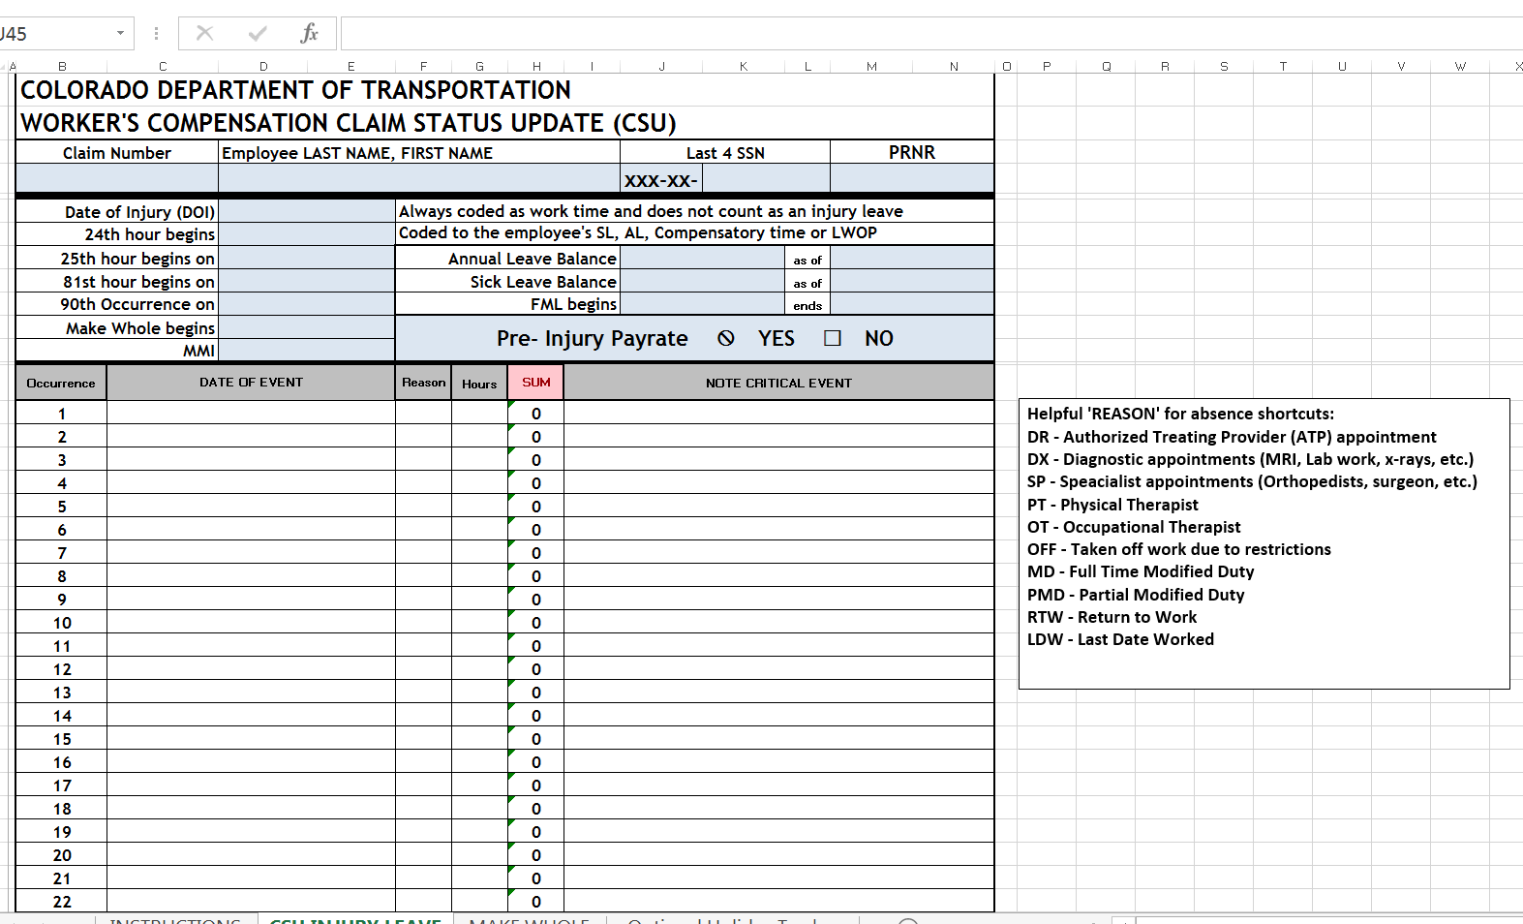
Claim Status Update Form
Notes:
Tracking sheet that supervisors and timekeepers use to track appts. it’s out on the Risk website
Great tool for tracking your own claim.

Slide 46
At the End of a WC Claim
What to Expect at the End of a Claim
Maximum Medical Improvement (MMI)
When the treating physician release you from care
  Medical Maintenance Care
  Permanent Work Restrictions (if applicable)
    Do they prevent performance of the essential functions?
    ADA process handled by regional Civil Rights Manager
CDOT - MMI Approval Memo
  Review the approval to ensure all time is accounted for

Slide 47
RECAP OF RISK TRAINING
CDOT Overview Financial Impact
Responding to Incidents/Accidents
Conducting Investigation for Incidents/Accidents
Reporting Online
Modified Duty
Reporting Lost Time

Slide 48

Questions?

