Slide 2
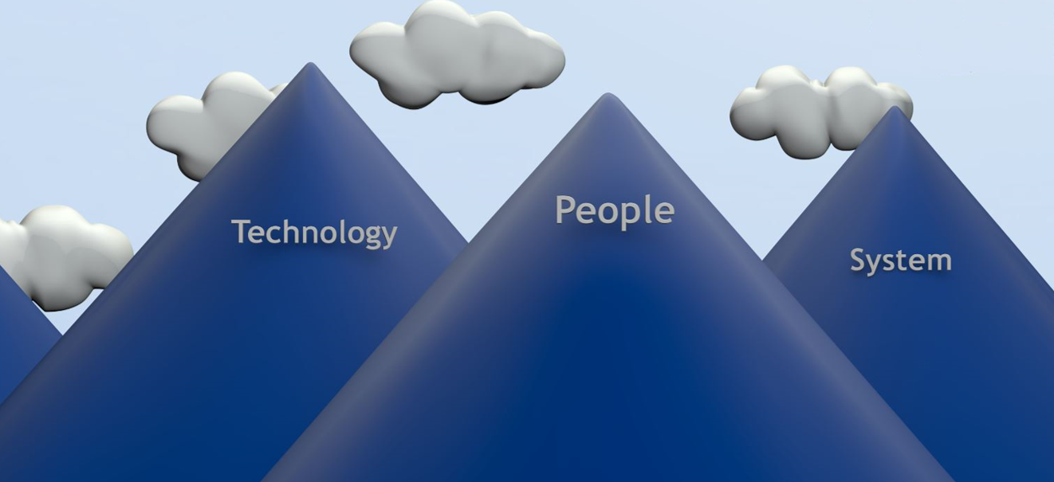
To Save Lives and to Make People's Lives Better
Best Department of Transportation in the Country for all Customers
Notes:
Narrator:
“In fulfilling that purpose, we are climbing the summit to be the Best Department of Transportation in the Country for all of our Customers.“

Slide 3
Best Department of Transportation in the Country for all Customers
Notes:
Narrator:
“In fulfilling that purpose, we are climbing the summit to be the Best Department of Transportation in the Country for all of our Customers.“

Slide 4
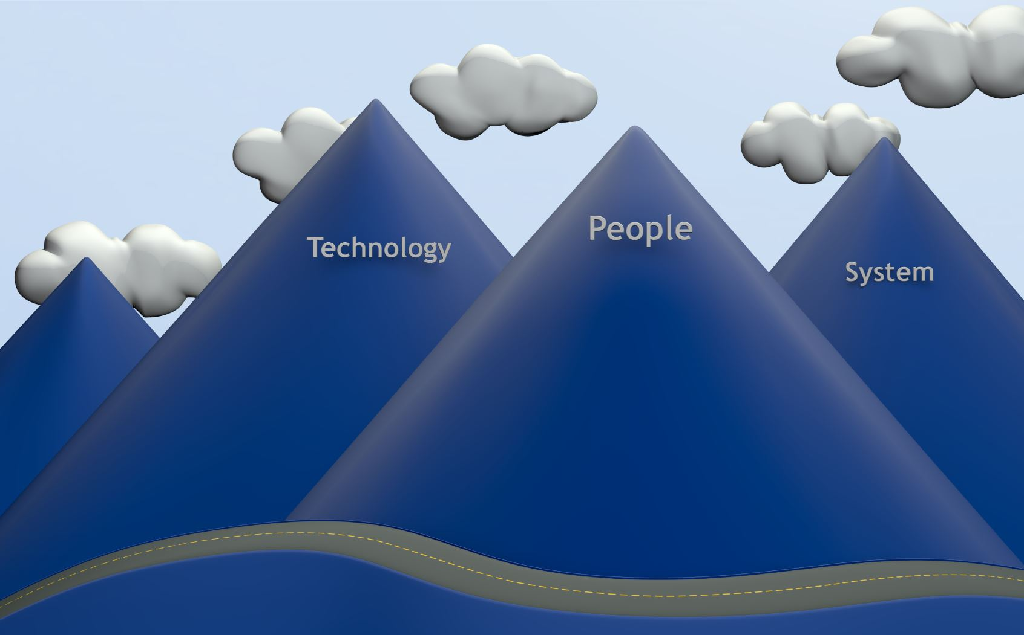
Notes:
Narrator:
And Every year, and in every season, one of the most visible things that CDOT does is plow roads and coming to the aid of drivers in distress.
Here is a typical scenario:
Mother’s voice:
Dear CDOT
I am writing to you because one of your drivers got my family out of a really bad situation and I wanted to make sure that you knew what that great employee did for us. I was heading down the highway with two very young children. We hit some black ice and completely slid off the road and down a hill into some trees. A CDOT driver came along and noticed the tracks left by my truck going off the road and investigated. Had he not stopped, I honestly don’t even want to think what would have happened. Our truck was not visible from the road and I could not climb that icy slope to flag down help in the freezing cold, much less with two infants. That CDOT driver actually pulled both all of us out of the wrecked car and up that slope and in our state of shock, he got us in his vehicle with heat. He contacted the state patrol and he stood out in the cold and waited for a tow truck and the trooper to arrive, which took quite a while! Without his help, I think we could have frozen to death on that hill side. He didn't leave until our family came to get us. He made sure we were safe and sound. We are so fortunate to have upstanding people like him keeping our roads safe!”
Narrator:
That was a happy ending to what could have been a tragic event, had that CDOT driver not been there.
But have you ever stopped to consider what it takes to get that CDOT driver to that motorist in trouble?

