Slide 1
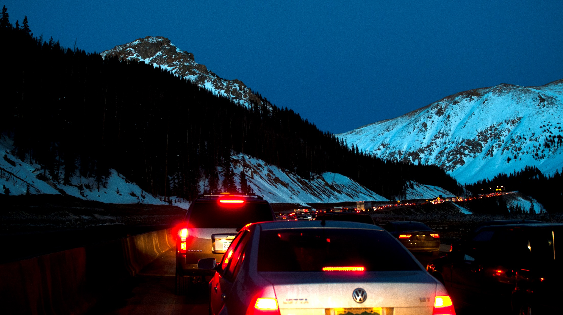
The Faces of CDOT
Notes:
Introduction or presentation title slide.

Slide 2
Concept
Use a real-life, road side assistance event (motorist in distress during a blizzard) to illustrate the connectedness of all CDOT employees to that positive outcome.
Presentation will be built in Prezi for a more dynamic affect, with a voice over narration track.

Slide 3
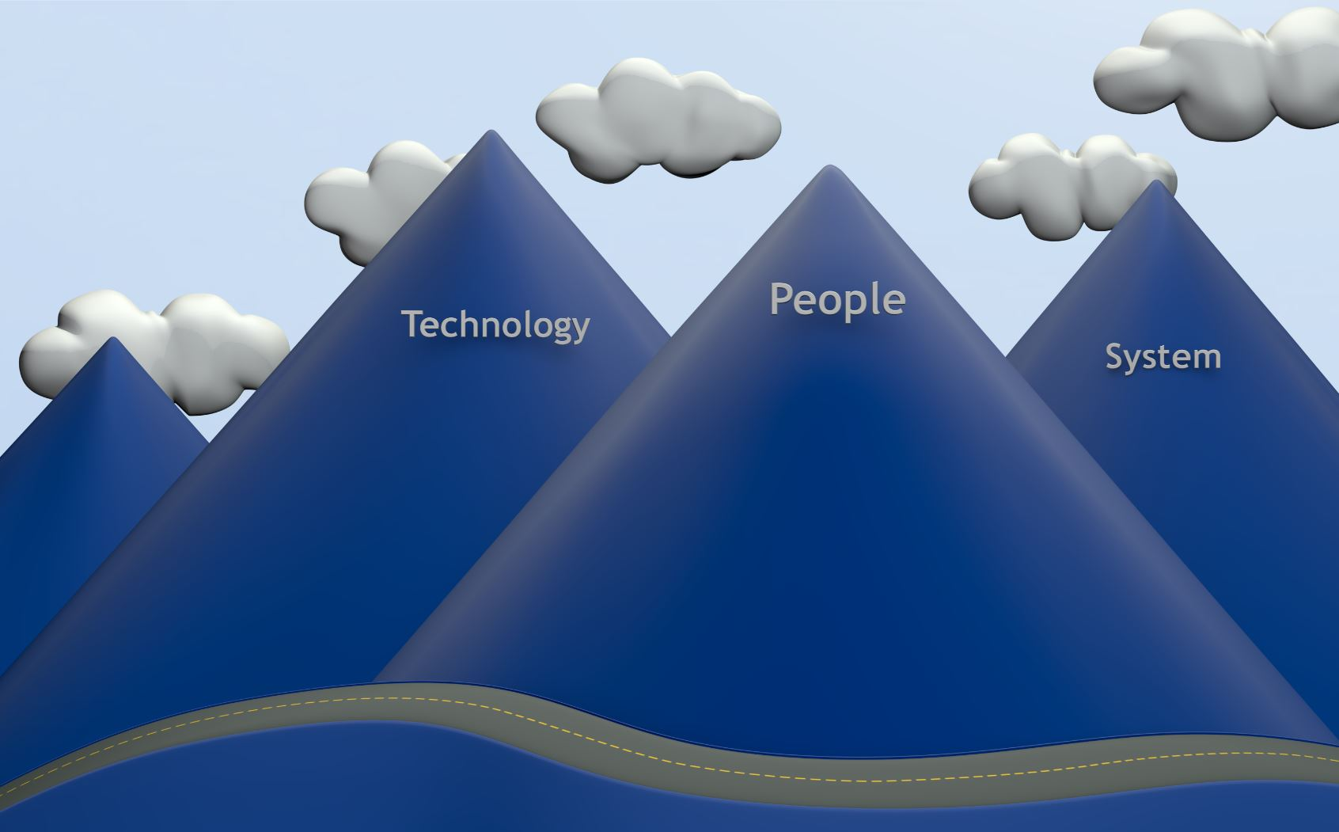

Slide 4


Slide 5
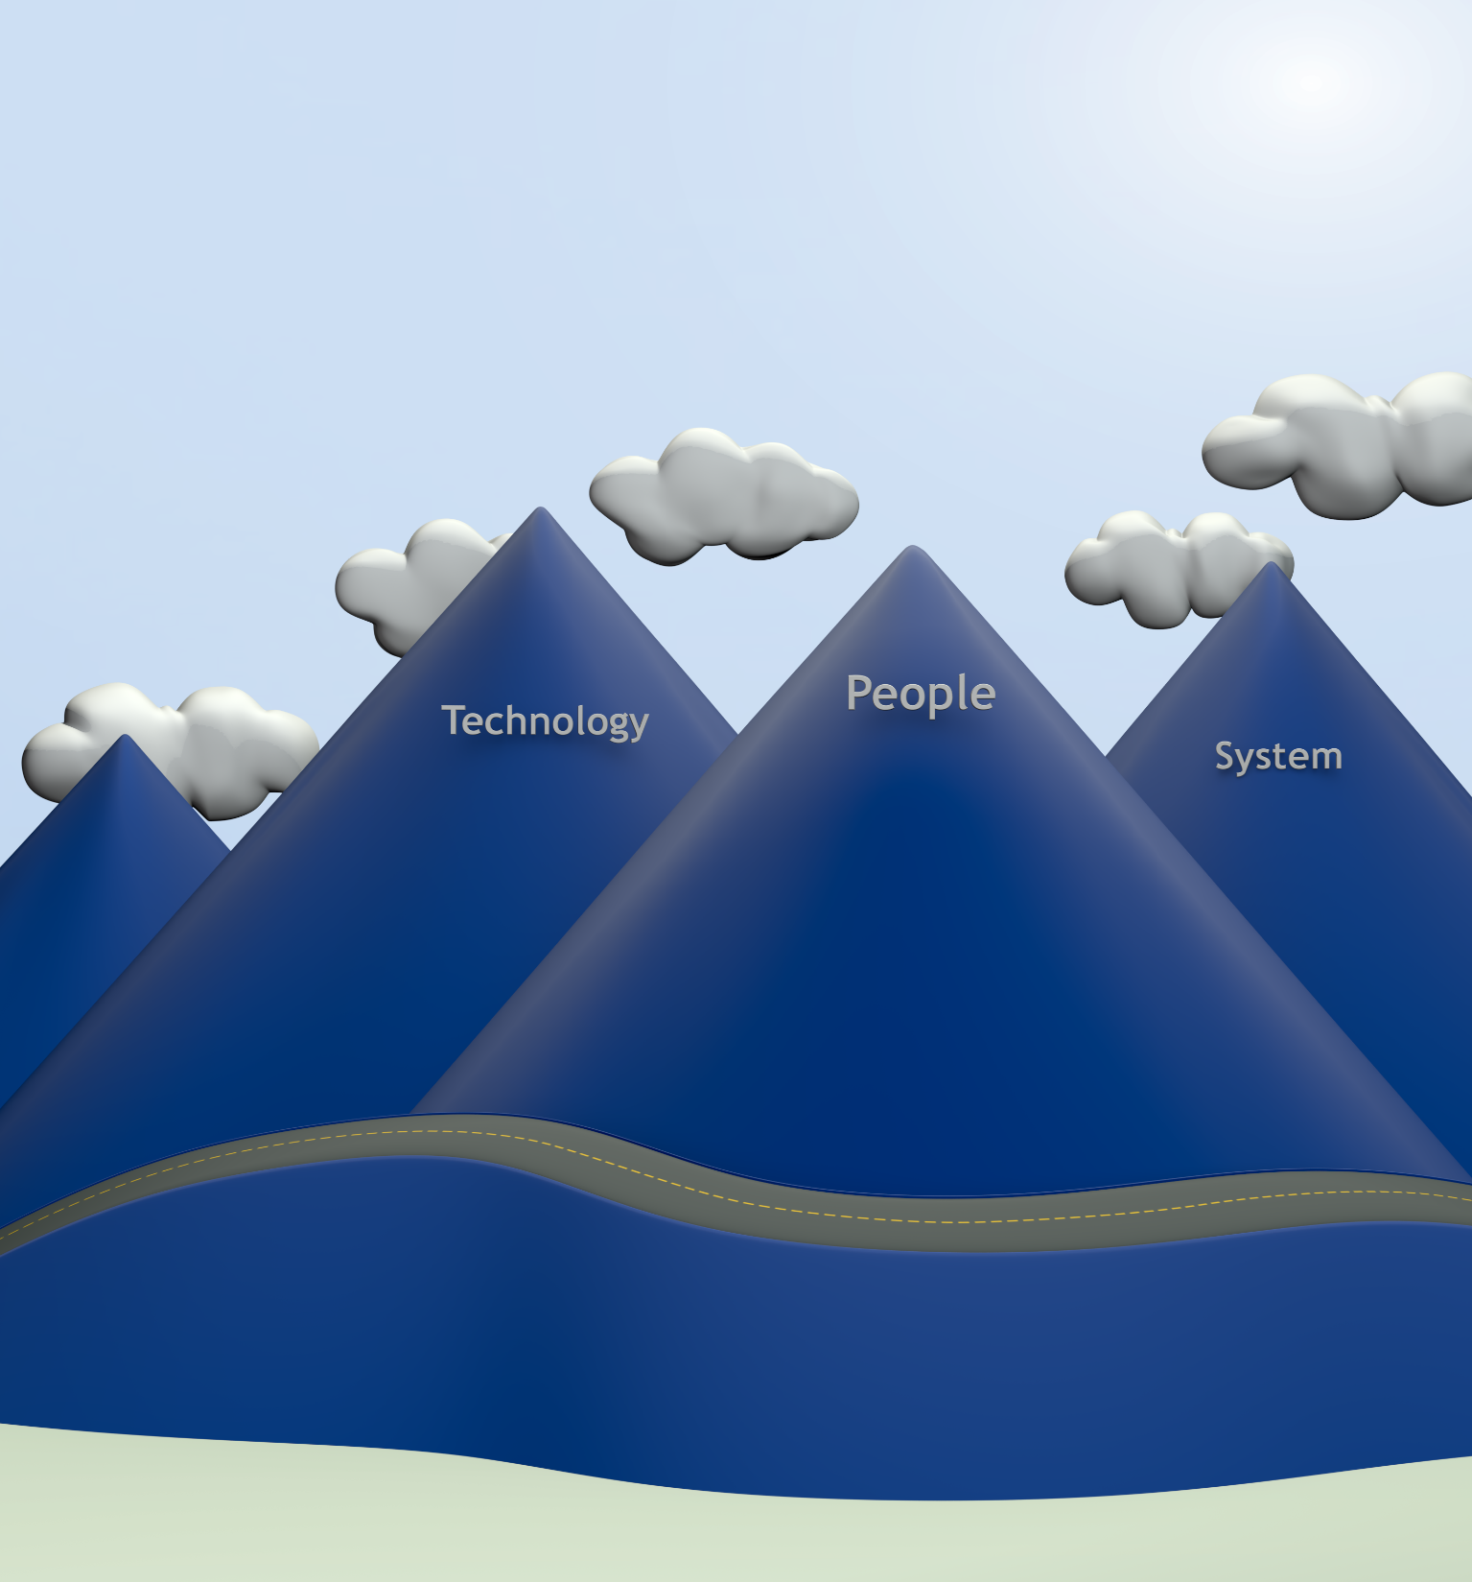

Slide 6
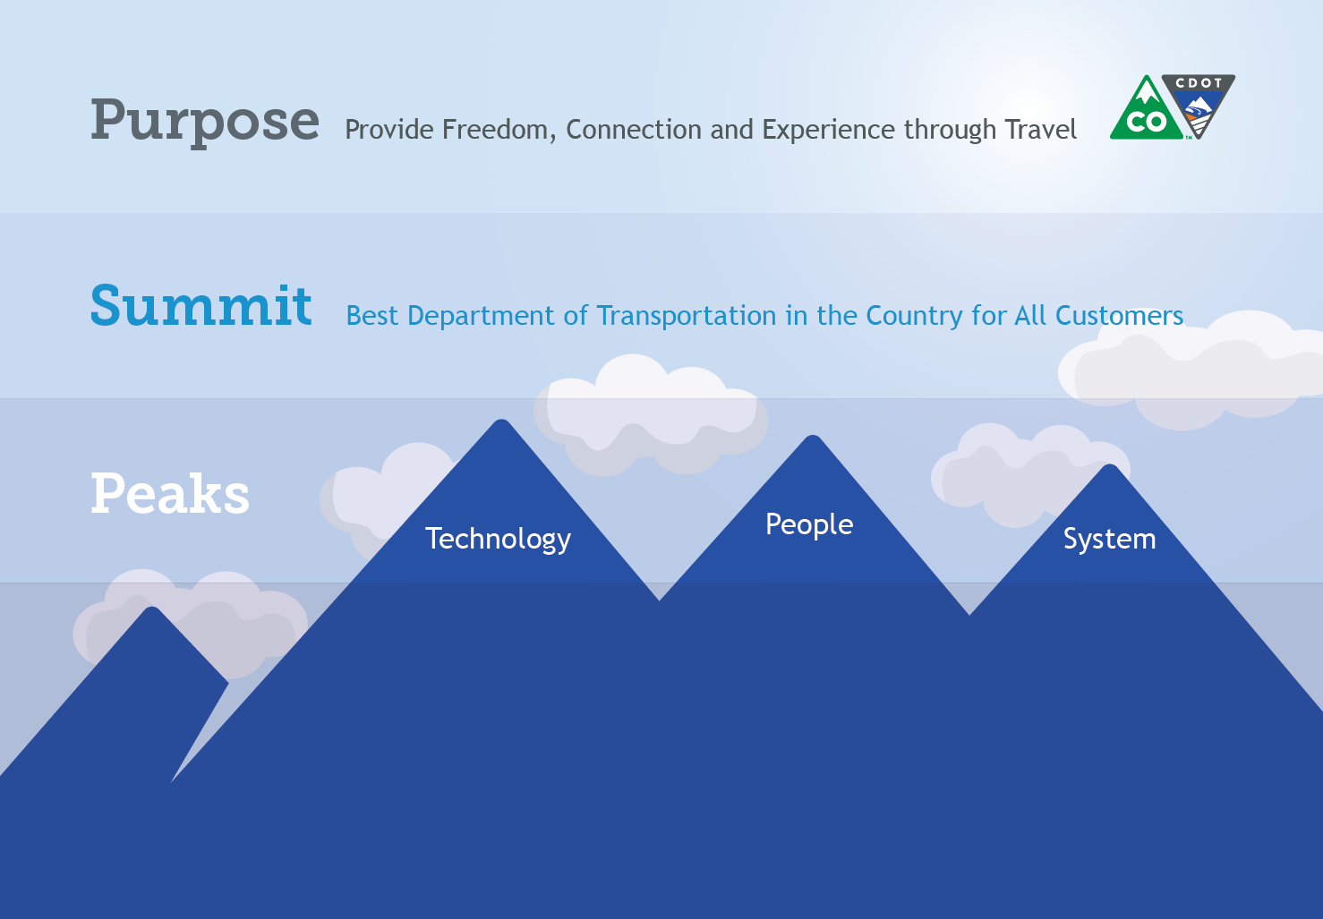
Notes:
Narrator: Our 3000 are dedicated to a common purpose: Provide Freedom, Connection and Experience through Travel

Slide 7
Notes:
Narrator: In fulfilling that purpose, we strive to be the best DOT in the county,

Slide 8
Notes:
And together we are climbing three peaks to get there: People, Technology and System
From these peaks we design, build, and operate a multi-modal transportations system upon which millions depend on every minute of every day.

Slide 9
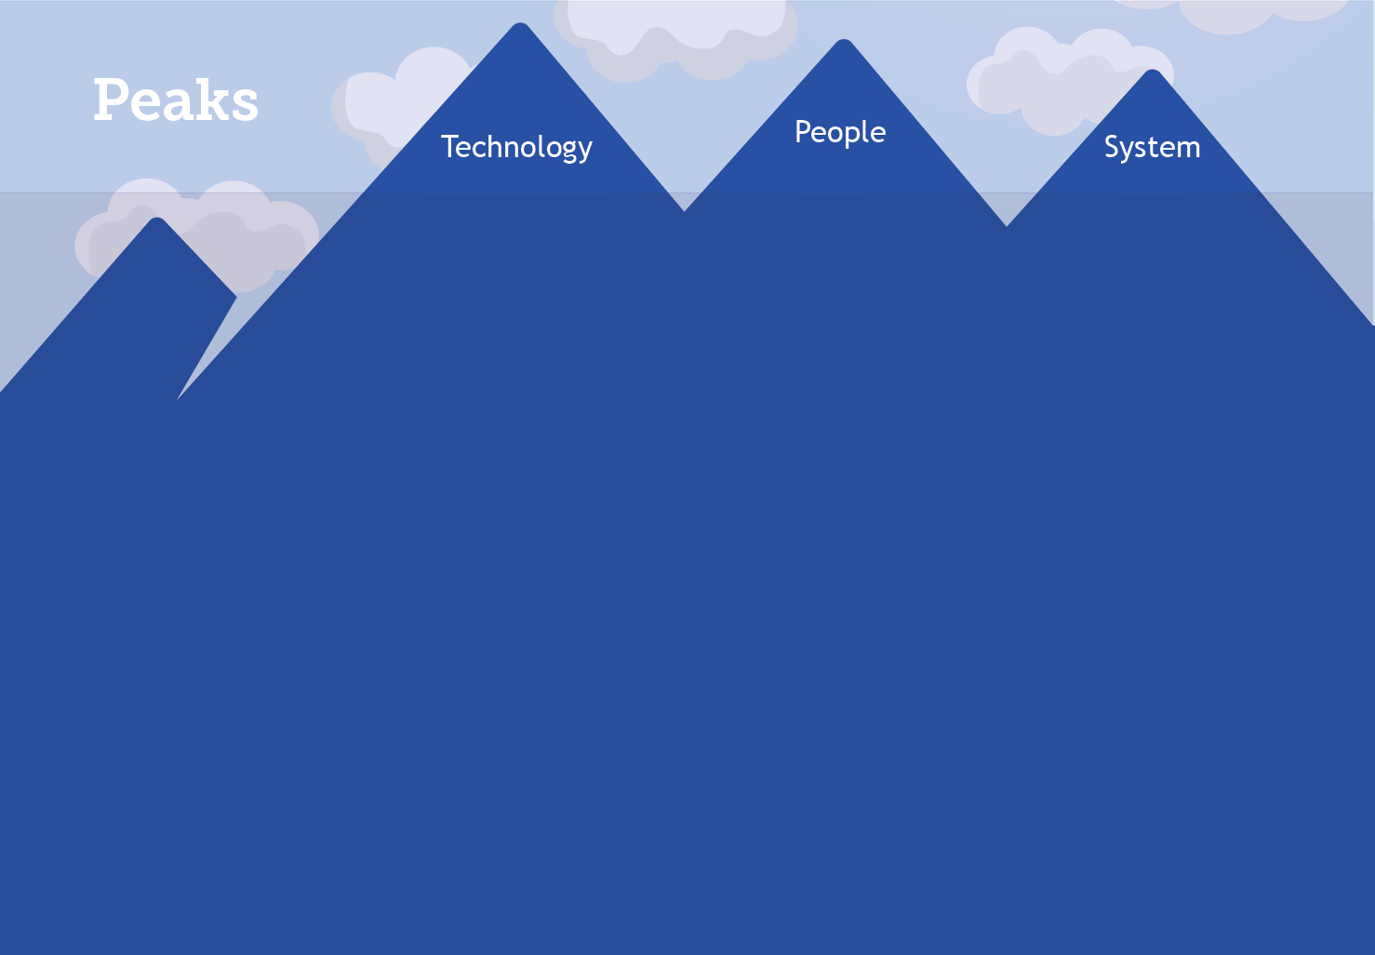
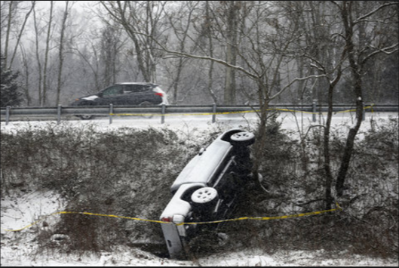
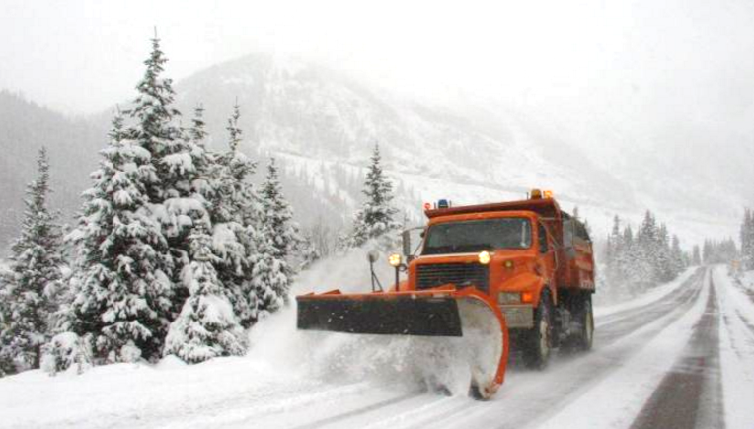
Notes:
Sure, we all know that, but have you ever stopped to consider how all 3000 of us come to the aid of one, at a typical day at CDOT.
Every year, and in every season, one of the most visible things that CDOT does comes to the aid of drivers in distress.
Here is a typical example:
“ I am writing to you because one of your drivers got my family out of a really bad situation and I wanted to make sure you knew what that great employee did for us. I was heading down the interstate with two very young children and a friend. We hit some black ice and completely slid off the road down a huge hill into some trees. The CDOT driver saw the tracks going off the road and investigated. Had he not stopped, I honestly don’t even want to think what would have happened. Our truck was not visible from the road and I could not climb that icy slope to flag down help, much less with two infants. He actually pulled both all of us out of the wrecked car up that slope and in our state of shock he got us in his vehicle with heat. He spoke to the highway patrol and he stood out in the cold and waited for triple A and highway patrol to arrive, which took quite a while! We would have been frozen! We couldn't have gotten help with out his assistance even if we were able to climb that hill which I doubt I could have done alone with my baby as I kept sliding (he had to pull me up) but even if we had we would have waited over an hour in the cold on the dangerous road side!! He was truly a hero! He didn't leave until he spoke with highway patrol and our families came to get us. He made sure we were safe and sound. When I asked him for his address to send a thank you gift he declined and told me he was glad to help and to pay it forward! How amazing is that! We are so fortunate to have an upstanding young man like him keeping our roads safe! I asked for his bosses email because I just thought he deserved at least some recognition, if not a parade in his honor or a metal for heroism! Please keep employing people like Jason! He will always be our hero, I was so scared and so upset and he was really there for us when we were in a time of need. I wish I had more eloquent words to describe his bravery and altruism but hopefully my story will be enough for you to understand what a truly awesome human being Jason is!
Warm Regards,

Slide 10

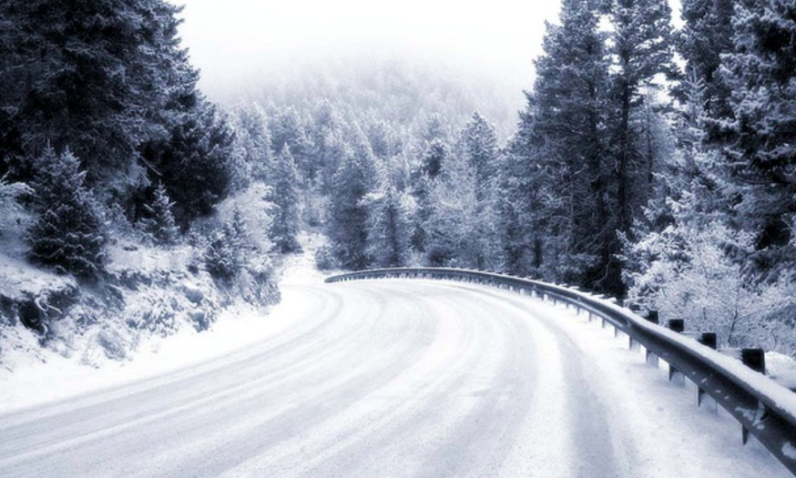
Notes:
That’s a great story! But what did it take to get both the motorist and the plow driver there?
Well, it starts with a road, but how does that get there?

Slide 11
Notes:
Well, it starts with a road, but how does that get there?
Well, it takes all of these people,
Budget - Barella
Procurement - Roth
Contracting - Dingle
Property Management - Chenery
Survey - Manadarich
Right of Way – Appraisal – Cichello
Right of Way – Access – Mary Heinlein
Environmental - Erickson
Utilities - Mckinney
Roadway Design – Swacroft, Valentini
Program Delivery - higaside
Performance Planning – Pakbaz
Project Development - Aloala
Project Support - Sankar
Traffic Safety -
Roadway Construction - Carter
Geotechnical and Hydraulics - Javier
Staff Bridge - Armenderiz
Local Agency Liaision -
Civil Rights – Arcila
Lanscape - Ryer
Plus a bunch others

Slide 12




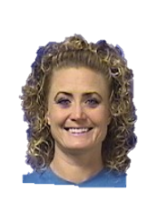



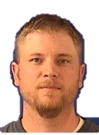










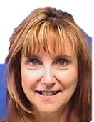

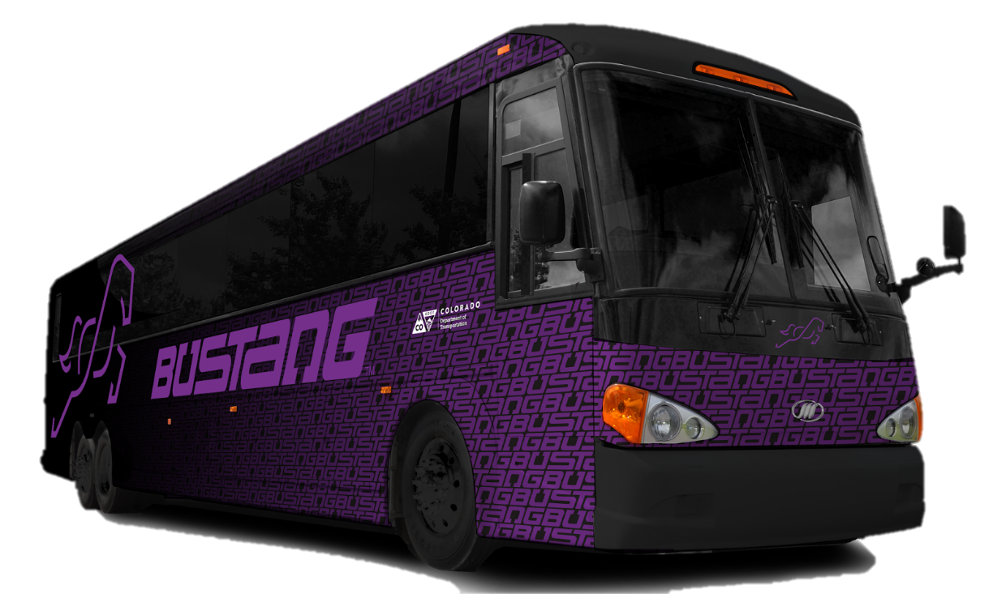

Slide 13
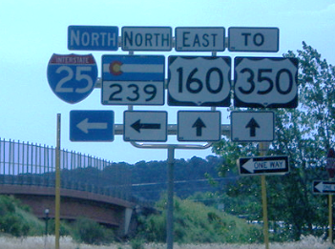
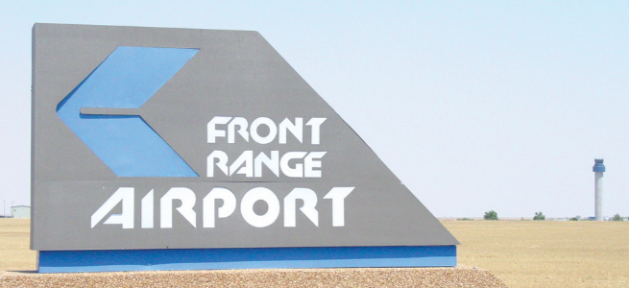
Notes:
Once you have roads and transportation modes, what does it take to operate them as a system?
Well, it takes of these people plus a whole lot more.

Slide 14
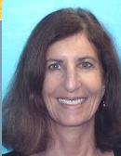
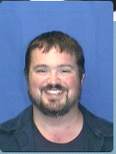
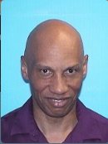
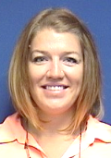
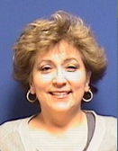
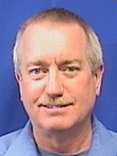
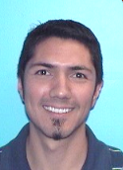
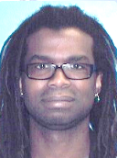
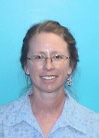
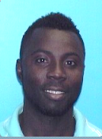
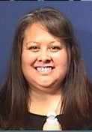
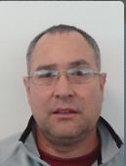
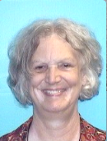
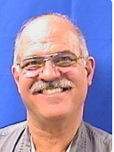
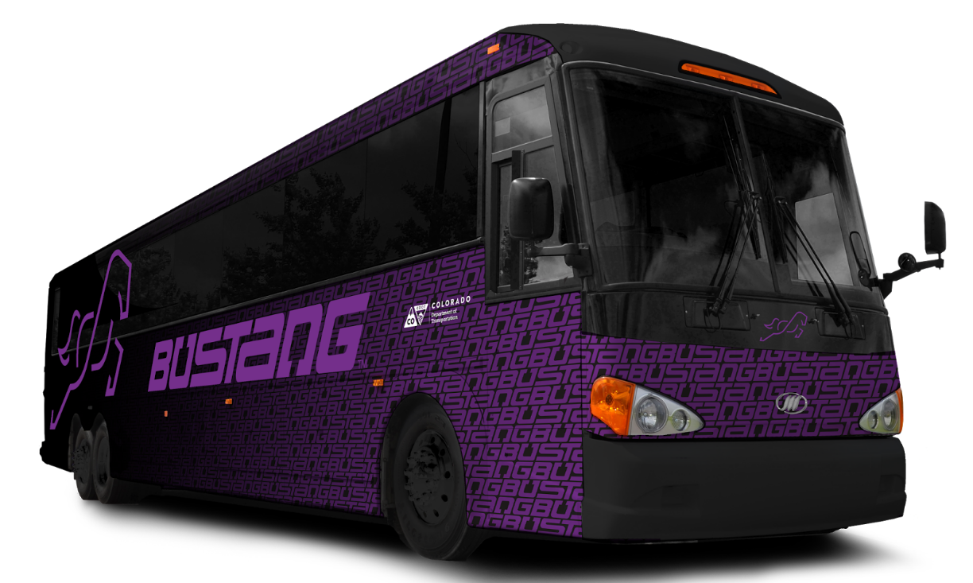
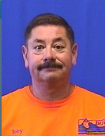
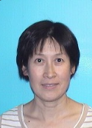
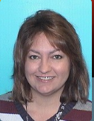
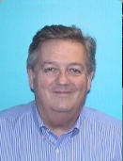
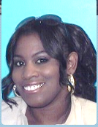
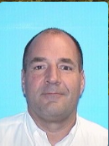
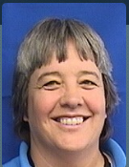
Notes:
Once you have roads and transportation modes, what does it take to operate them as a system?
Well, it takes of these people plus a whole lot more.
Structural Trades – F Martinez
Intermodal planning – Hoffman
Corridor Management – Neilson
Traffic Analysis – Aguilar
Environmental Analysis – Waldman
Aeronautics – Eldridge
HTPE – Delgado
Gov Relations – Malbry
Corridor Operations – Largent
Bus Operations – Timlin
RoadX – Kozinski
Business Operations – Johnson
Audit – Nnuro
Print Shop- Leigh
IT Services – Chen
Business Office – Martinez
Electrical trades – Castiglione
Purchasing – Mathews
Facilities – Espinoza
Project Development – Mahoney
Grants Administration – Erez
Materials Testing – Shafer
Program Administration – Creecy
Tunnel Operations - Dennie

Slide 16

















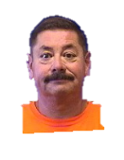
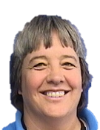






Slide 17

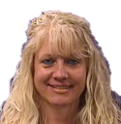



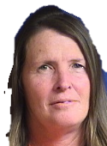






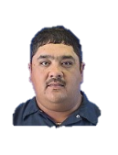













Slide 18
Notes:
And what does it take to get a plow on the scene to help that stranded motorist?
These people, and a whole lot more.
Risk Management – Goodwin
Safety – Simpson
Program Support – Carlberg
Office Managers – Carrillo
Communications – Wilson
Accting – Daviss
HR – Schakel
Permits – Williams
Sign Shop – Eyl
Process Improvement – Malloy
Engineering support – Walker
Fleet management – Neuschwanger
Machining Trades - S Martinez
Signing and Stripping – Miller
Bridge Crew – Franklin
Heavy Equipment Operators – Wiggins
Mechanics – Wood
Materials Handlers – Allen
Business Office – Krajecki
Admin Support – Montoya
Incident Command – Igel
And of course the plow drivers

Slide 19
3,837,488 Licensed Colorado Drivers
XX Residents
XX million travelers
28 billion miles of vehicle travel annually
$200+ Billion in freight transits
Notes:
Here is the big picture

Slide 20
I AM
TEAM CDOT
Notes:
Graphic spelling “I am Team CDOT” using the images of CDOTers as pieces of the mosaic

Slide 21
I AM
TEAM CDOT
Notes:
Graphic spelling “I am Team CDOT” using the images of CDOTers as pieces of the mosaic
Narration: “I am Team CDOT. I support:
3,837,488 Licensed Colorado Drivers
$200+ Billion in freight transits SOURCE: U.S. Department of Transportation, Bureau of Transportation Statistics and Federal Highway Administration, Freight Analysis Framework, version 3.6, available at http://faf.ornl.gov/fafweb/FUT.aspx as of September 2015.
Maintains, repairs and plows over 23,000 total lane miles of highway
* Maintains 3,447 bridges
* Oversees 28 billion miles of vehicle travel annually
* Plows about 6 million lane miles each year
* Spends $69 million annually on snow removal
* Keeps over 35 mountains passes open year-round
* Monitors 278 of 522 avalanche paths
$11 million in federal grants for transit operators and
$41 million in federal aviation grants for airports
* Manages over $5 million in federal grants for safe driving programs
Maintains, repairs and plows over 23,000 total lane miles of highway
* Maintains 3,447 bridges
* Oversees 28 billion miles of vehicle travel annually
* Plows about 6 million lane miles each year
* Spends $69 million annually on snow removal
* Keeps over 35 mountains passes open year-round
* Monitors 278 of 522 avalanche paths
* Administers about $11 million in federal grants for transit operators and $41 million in federal aviation grants for airports
* Manages over $5 million in federal grants for safe driving programs
1,800/ 184/ 8/ 2,637/ 30/ 865/ 269/ 1,316/ 3 x 1K registered vehicles private
7,181 478,720 97,410 583,311 7,237 590,548 commercial

Slide 22
I AM
TEAM CDOT
We serve
3,837,488 Licensed Colorado Drivers
XX Residents
XX million travelers
28 billion miles of vehicle travel annually
$200+ Billion in freight transits
Notes:
Graphic spelling “I am Team CDOT” using the images of CDOTers as pieces of the mosaic
Narration: “I am Team CDOT. I support:
3,837,488 Licensed Colorado Drivers
$200+ Billion in freight transits SOURCE: U.S. Department of Transportation, Bureau of Transportation Statistics and Federal Highway Administration, Freight Analysis Framework, version 3.6, available at http://faf.ornl.gov/fafweb/FUT.aspx as of September 2015.
Maintains, repairs and plows over 23,000 total lane miles of highway
* Maintains 3,447 bridges
* Oversees 28 billion miles of vehicle travel annually
* Plows about 6 million lane miles each year
* Spends $69 million annually on snow removal
* Keeps over 35 mountains passes open year-round
* Monitors 278 of 522 avalanche paths
$11 million in federal grants for transit operators and
$41 million in federal aviation grants for airports
* Manages over $5 million in federal grants for safe driving programs
Maintains, repairs and plows over 23,000 total lane miles of highway
* Maintains 3,447 bridges
* Oversees 28 billion miles of vehicle travel annually
* Plows about 6 million lane miles each year
* Spends $69 million annually on snow removal
* Keeps over 35 mountains passes open year-round
* Monitors 278 of 522 avalanche paths
* Administers about $11 million in federal grants for transit operators and $41 million in federal aviation grants for airports
* Manages over $5 million in federal grants for safe driving programs
1,800/ 184/ 8/ 2,637/ 30/ 865/ 269/ 1,316/ 3 x 1K registered vehicles private
7,181 478,720 97,410 583,311 7,237 590,548 commercial

Slide 23


Slide 24
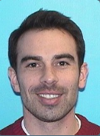
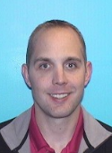
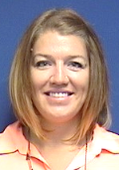
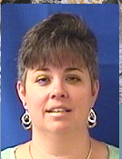

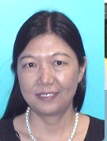
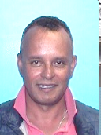
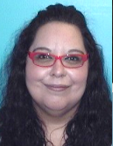
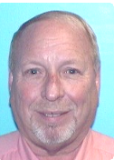
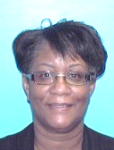































































































TEAM CDOT

Slide 25

TEAM CDOT

Slide 26

TEAM CDOT

Slide 28

TEAM CDOT
TEAM CDOT

Slide 29
TEAM CDOT

Slide 30


Slide 32

Notes:
Narrator:
“
Introduce the motorist in distress scenario
Set up the concept that the roadside rescue had the entire CDOT Team behind it to make it possible

Slide 33
Notes:
Narrator:
“
Introduce the motorist in distress scenario
Set up the concept that the roadside rescue had the entire CDOT Team behind it to make it possoble

Slide 34



Slide 35

Notes:
Brief Illustration of the unit’s role in supporting the roadside event.

Slide 36
Notes:
Brief Illustration of the unit’s role in supporting the roadside event.

Slide 37
Notes:
Brief Illustration of the unit’s role in supporting the roadside event.

