Slide 1


Expectations of a CDOT Supervisor
Notes:
Notes:
Welcome to the Expectations of a CDOT Supervisor course! This course is designed to help you understand the roles and responsibilities of being a supervisor at CDOT. Before we get into the content, let’s learn how to navigate the course.

Slide 2
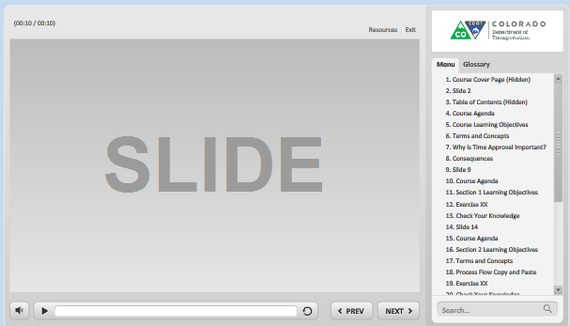
Navigation, Resources and Glossary
Before we begin, let’s look at the resources available to you
Notes:
As you go through the course there are a couple of items you can use to help you learn. The first is the Resources link as indicated by the red arrow. This link contains copies of all of the documents referenced in this course.
The Glossary tab displays an alphabetical list of terms that are used throughout the course. Anytime you are uncertain about a term, this is the best place to look. Unlike the resources link clicking on the glossary does not pause the course.
If you want to navigate, use the previous or next buttons or click on the slide you want to navigate to under the menu tab. There is also a search field located at the bottom of the Menu tab that brings up all of the slides related to your search. The progress bar displays your progress within a slide.
If for any reason, you need to close the course before you have completed it, you will be returned to the page you were on once you log back in. Now let’s move on to what you will learn in this course.

Slide 3
Course Learning Objectives
Upon completing this course you should be able to:
Explain how supervision is vital to CDOT being able to achieve its goals and objectives
Describe the roles and responsibilities of the Supervisor
Explain the role of the supervisor as an advocate of CDOT and their employees
Identify and explain the components of the supervision competency on CDOT’s performance appraisal form
Describe when to communicate information to employees and the channels available to do so
Identify the actions you can take to transition from the role of the employee to that of the supervisor
Notes:
In your role as a supervisor, it is important to be able to apply the each of the learning objectives of the this course. Take a moment to review the learning objectives of the course. Upon completing this course you will have a chance to review them and see if they were met.

Slide 4
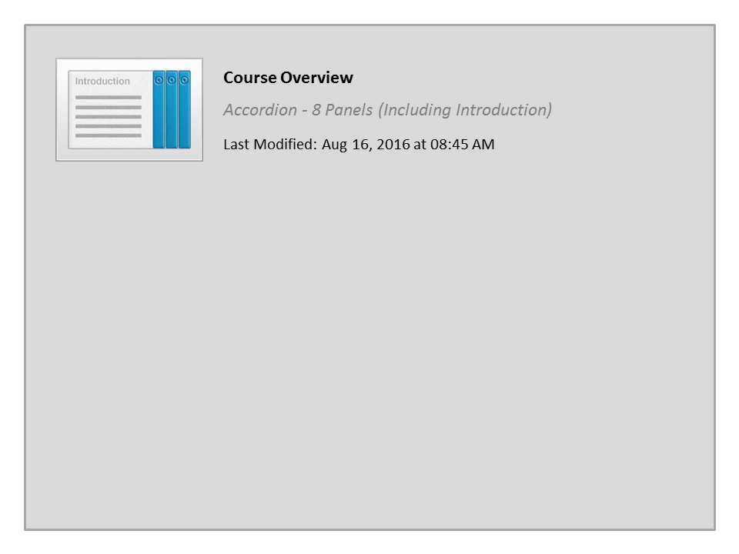
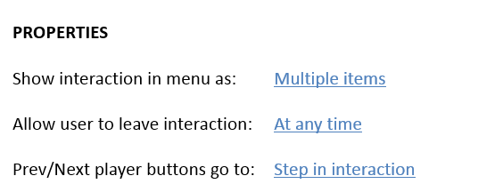


Course Overview

Slide 5

Course Assessment
Throughout the course, you will have an opportunity to test your knowledge
At the end of the course, there will be an assessment to:
  Verify your knowledge
  Validate you have completed the course
Notes:
And one last thing, before we continue on to the course. Throughout the course you will be asked to verify your knowledge of the content in the course by answering questions. At the end of the course you will be asked to complete an assessment. The assessment will be used to verify you have knowledge of the content of the course and is also used by the LMS to validate that you have taken the course. Now let’s move on to the course introduction section.

Slide 6
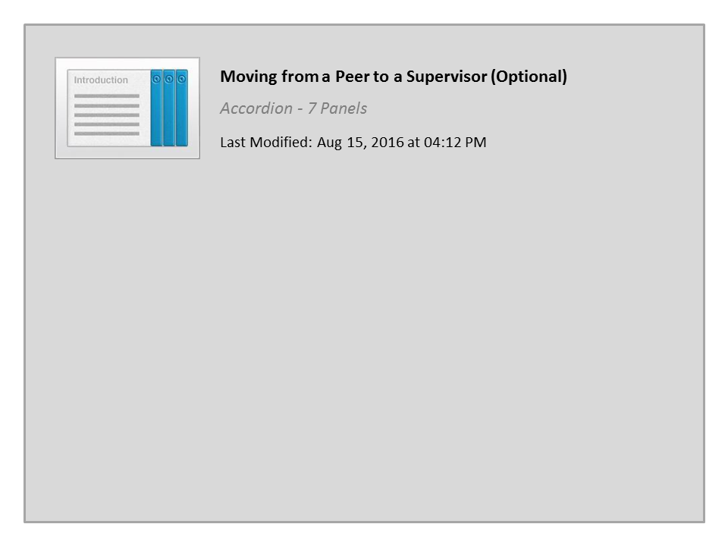
Moving from a Peer to a Supervisor (Optional)

Slide 7
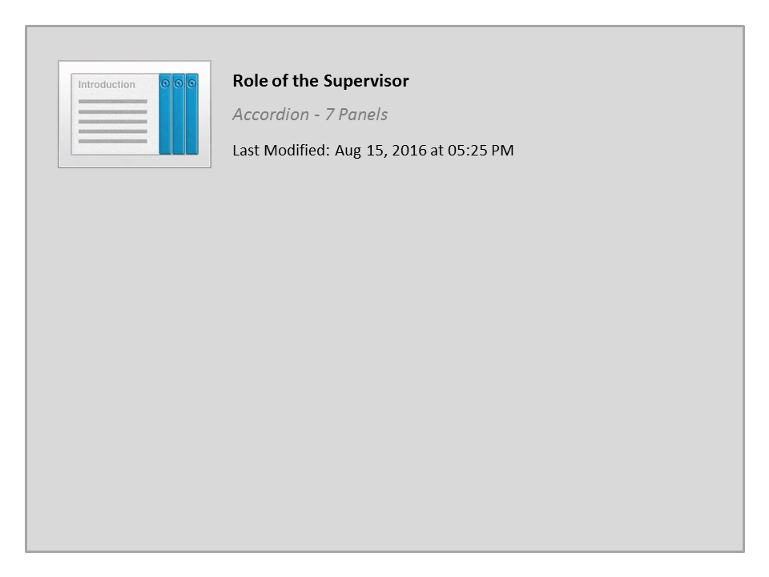
Role of the Supervisor

Slide 8
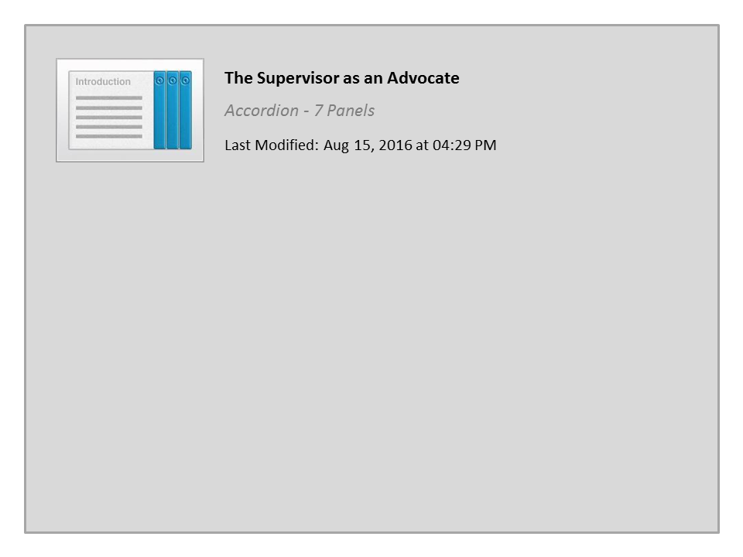
The Supervisor as an Advocate

Slide 9
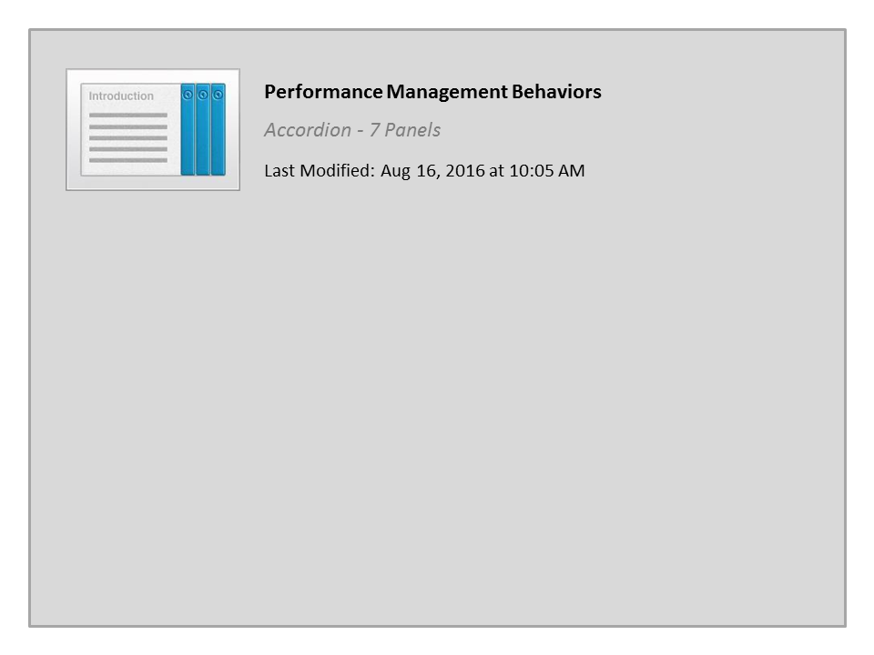
Performance Management Behaviors

Slide 10
Work Leading and Supervision Competency
The Supervisory competency:
Was added by CDOT in addition to the five main competencies required by the State of Colorado
Encompasses all manager or supervisor job classes
Must be evaluated on the PMP for all managers and supervisors
Accountability Credibility
Work Leading / Supervision
Job Performance Expectations
Safety
Customer Service
Communication Interpersonal Skills
Notes:
Although we don’t often think about it, Performance Management is the process where we align the employee with the goals and objectives of CDOT’s strategic plan and to a larger degree the State of Colorado. Part of a well-crafted Performance Management Plan is to inform the employee of what is expected of them in terms of their performance. It is for this reason CDOT added a competency called “Leading and Supervison” to the annual performance appraisal. In this section of the course we will look at each of the bulleted items in the supervisory competency and explain what they mean to you as a supervisor. Now, let’s get started with modeling accountability for behaviors.

Slide 11

Model Accountability
1: Model accountability for behaviors
Responsible for your work and actions
Demonstrating you plan ahead
Communicating what needs to be accomplished
When you model accountability as a leader, you are:
Notes:
The word “Accountability” means being held answerable for our actions and accomplishing goals and assignments. Supervisors model Accountability in most everything they do. When you complete your assigned tasks on time and with good quality, you are demonstrating accountability for your work. When you accept responsibility for a mistake you have made and resolve to make it right, you are demonstrating accountability for your actions.
Also, when you model accountability to employees you are showing that you plan ahead. Remember, accountability is not something that is assigned at the end of a project or task, it starts at the beginning when you agree to take on the work.
Accountability is also about communication. Outlining what you are accountable for requires communication about what you are going to do. When you ask a member of your team to be accountable for a task, be sure to communicate clearly what they need to do to be successful.
Now let’s look at performance management.

Slide 12
Performance Management
2: Conduct timely and effective employee performance planning meetings with supporting records, forms and documents
The role of the supervisor in performance management is to:
Ensure the employee must have a performance plan within 30 days of hire
Meet with your employees regularly
Complete the final review by March 31st of each calendar year
Conduct a planning meeting that includes a discussion of:
  Department goals
  Work Unit plan
  Employee’s Position Description Questionnaire
  Employee’s goals and competency expectations
Click Here to review performance management dates, requirement and guides
Notes:
As a supervisor, you play an important role working with employees to manage their performance. This is accomplished through Performance Management. Performance Management is the process of communication throughout the year about the development and performance of an employee. Performance Management is important to CDOT because it is how we develop our employees and communicate the type of work they should be doing and how it supports the organization. Performance Management occurs when you set expectations and goals with the employee and how it relates to the goals of CDOT and your work group. A critical component is to document relevant information of both desirable and non-desirable behavior so that it is not forgotten during reviews. For information on performance management go the Performance Management page located at http://intranet.dot.state.co.us/employees/performance-management. Now let’s take a look at developing employees through feedback and coaching.

Slide 13
Feedback and Coaching
3: Develop and encourages employees’ ability to perform job tasks and interactions through feedback and coaching
When providing feedback or coaching an employee, make sure it is:
Based on observance of behavior, not assumptions
Work related
Based on the behavior and not the person
Effective feedback
Candid
Specific
Positive
Timely / Frequent
Action focused
Job-related
Notes:
Feedback from a supervisor is the main way employees knows how they are performing. Therefore, one of the most important roles of a supervisor is to give effective feedback. The graphic on the right side of the screen shows what makes up effective feedback.
Feedback that is candid is honest and direct. Every employee deserves to know where they stand in terms of how you view their performance, so supervisors should not avoid a difficult performance conversation or “sugarcoat” a difficult message. By being honest and direct about your feedback to the employee you do not leave room for misunderstandings about how the actions of the employee are positive or need improvement.
When you are coaching an employee or providing feedback, tell the employee specifically what they have done. For example instead of saying “Great job this week!” you could say, “I noticed that this week you took an extra tool with you, this made a difference in completing the project on time. Great job on thinking ahead and being proactive!” In addition to letting your employees know what they are doing right, it is a great management tool because it also lets them know you are paying attention to the work they are doing.
It is also important to be positive when you provide feedback. This is easy to do when it is positive feedback or coaching on something the employee has learned. However, being positive is also important when there is change the employee needs to make. Being positive about the change shows that you believe the employee will make the change. It also shows that you are willing to work with them.
Also, make sure to try and provide the feedback or coaching as close to the event as possible. If an employee needs to make a change or improvement in their performance, the sooner they find out about it, the sooner they can take action. If an employee has done something very well, the sooner they receive positive feedback, the more rewarding it feels.
As a supervisor or manager, it is up to you to communicate to your employees frequently enough so they know how they are doing. But how much feedback you provide ultimately depends on the employee. For example, you may need to have more frequent communication with a new employee or an employee who is struggling than with an employee who is doing well and understands their position well.
It is also important that you focus on the actions the employee can take to improve. Provide examples of the actions the employee has done and actions that may be done differently. This reinforces the positive behavior and when improvement is required allows the employee to model the behavior and show they are taking action on feedback you are providing. In other words, provide them with the tools they need to make the change.
And lastly, feedback and coaching must be Job Related. Keeping feedback focused on the job helps to depersonalize the information and is more likely to reduce a defensive reaction from the employee.
If you would like more information about providing feedback click on the resources link and select the Giving feedback document. Now let’s look at communicating with employees.

Slide 14

Communication
4: Communicate with employees in an open respectful way to provide frequent and ongoing communications
Ongoing communication is:
Given in a respectful manner, especially for difficult messages
Critical to the employee understanding what they need to do
Accomplished through weekly meetings, one-on-ones, coaching sessions, discussion of goals, emails and hallways chats
Notes:
Supervisors are expected to communicate with employees in an open, respectful way to provide frequent and ongoing communications. The next section of this course will go into more detail about the supervisor’s role as Communicator. For now, the key words to focus on here are “respectful” and “ongoing.” Recall that Respect is a CDOT value and involves being kind and civil with all employees. Supervisors sometimes need to deliver difficult messages and should do so with consideration for how the information may impact the employee.
Ongoing informal communication is critical to the success of your employees. It provides the employee the ability to make the small adjustments necessary throughout the year the employee needs to make changes. This is also where much of the communications about the tasks the employee needs to understand can occur. Ongoing communication also allows the employee to make changes before their actions need to be resolved through other means. As a supervisor you benefit because when the time to evaluate employees comes there are no surprises.
Now let’s look at the process of resolving Personnel Issues and Conflict.

Slide 15

Resolving Personnel Issues and Conflict
5: Resolve personnel issues, conflicts or work related problems appropriately; keeps supervisor informed
When discussing personnel issues or a conflict provide employees with:
Why – Provide context on how the behavior impacts others at CDOT
Immediate – Keep the feedback as close to the event as possible
Think Small - Think about the chain of events that leads to success or failure
Specific – Do not make your employees guess about behavior; provide details
Notes:
Whether we like it or not, personnel issues and conflicts are bound to happen, and it is often up to the supervisor to manage the resolution of such issues.
When counseling an employee on their behavior or conflict remember use the acronym W.I.T.S, which stand for Why, Immediate, Think Small, and Specific. Employees need to understand why the issue or conflict at hand is a problem for the unit or for other employees. By explaining the impact of their behavior, you are creating motivation to change. Issues and conflicts need to be addressed as close to the event as possible. However, you do want to allow yourself time to document the behavior and prepare for the conversation. Although we want resolution to conflict to begin right away, sometimes the best way to make a change is to think small and make the changes over time after each of the smaller events have been mastered. And finally, be as Specific as possible. Tell them specifically what they have done right or what they can do differently.

Slide 16

Completing Paperwork Accurately and Timely
6: Completing administrative paperwork accurately and timely
When completing paper work:
Confirm all of the required fields are correct and completed
Save a copy for your records if the form is not part of an information system
Set a reminder for reoccurring tasks such as timesheets
To find forms go to the CDOT forms page at: http://intranet.dot.state.co.us/resources/CDOT-forms
Notes:
Completing paperwork and getting it right the first time is one of the last things we think about when it comes to supervision. So why is it so important? Most of the paperwork we complete at CDOT is required so we have the data we need as an organization to accomplish tasks such as pay our employees or receive Federal funding. In most cases, the paperwork you complete as a supervisor is for the organization such as the PDT (Promotion, Demotion or Transfer) or they may be for ourselves, such the benefit paperwork for open enrollment. Regardless of the form it needs to completed correctly, or if you are the approver, it needs to be verified to ensure it is correct. Inaccurate paperwork can cause delays in payment both to CDOT, our employees and our vendors and can have serious consequences to the our organization.

Slide 17
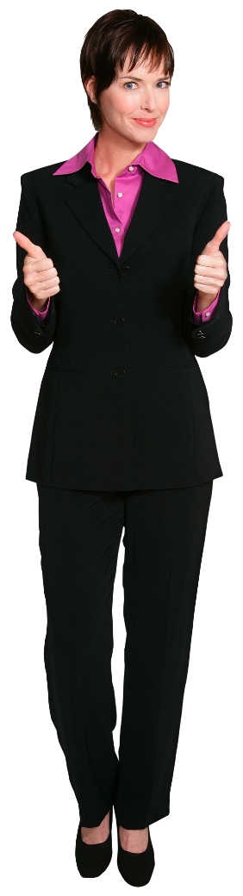
Acknowledge Accomplishments
7: Acknowledge and recognize the positive work efforts and accomplishments of the team
When an employee does something right:
Say something
Provide feedback be specific
Tie it to CDOT Values
Document it!
Employee recognition programs include:
Monthly Division/Workshop recognition
Leadership coins
Statewide employee recognition
Lean Everyday Ideas
Notes:
As a supervisor there is a tendency to look at only the actions that employees are doing wrong. But when was the last time you took the time to talk to an employee to let them know what they are doing right? In employee surveys, one of the biggest complaints employees have is that they are not acknowledged for what they do right. This may be obvious, but when something goes right, it is usually because of the efforts of the team.
When you are acknowledging an accomplishment, let the employee know exactly what they have done right and don’t just say “good job”. What specifically did the employee do right? For example, “Mark, I noticed how patient you were when explaining how to fill in a work order. That’s great teamwork and really helped me because I have to approve them. Thanks!”
When giving recognition, tie it into the core CDOT values to reinforce how important these values are. Finally, document the behavior. When you document, you are more likely to remember and can cite examples on the employee’s performance appraisal. CDOT is currently in the process of creating an employee recognition program. This program, once it goes live, will formalize current efforts in place. Now let’s review collaborating with your peers.

Slide 18

Collaborate to Resolve Issues
8: Collaborate with peers to discuss and resolve mutual supervisory issues
Having a good relationship where you are able to resolve issues can be accomplished by:
Establish trust and respect
Seek out the common issues
Seek collaboration not blame
Notes:
As a supervisor you are part of a team that works with other supervisors and employees. While this may not be listed as a job duty, it is critical to your success. There are several things you can do to make sure collaboration happens.
The first is to build trust and respect with your peers. This is done directly through your own actions, by making and keeping commitments and by treating others with respect. A foundation of trust and respect will go a long way when issues arise. Think of how difficult it is to resolve a conflict with someone you don’t trust.
The second thing you can do is to seek out common issues you can resolve by either sharing information you have that can be used to solve a problem, or being open to ask for help and listening to the solutions that may be offered to you. Remember, most likely the issues you are having are shared by other supervisors.
A third thing you can do is to make yourself available to other supervisors to discuss and strategize together. Conflicts rarely go away on their own. If you have a conflict, be sure to resolve it as quickly as possible so it does not carry over into other projects and hamper your relationships with other members of your team.
Seek out collaboration with the other member of your team. This is done by working on shared projects. When you do this remember to communicate with others about the project and what needs to be accomplished. And don’t forget to celebrate when you are successful. This keeps the motivation high and creates an opportunity to bond.
Now let’s look at the last item, using CDOT Values to resolve conflict.

Slide 19

CDOT Values
9: Use CDOT values to make ethical decision when faced with conflicting choices
CDOT Values:
Safety
People
Integrity
Customer Service
Excellence
Respect
Notes:
And last but not least is using CDOT’s values to guide how we do work. The values are more than just words. They are there to guide us when we are not quite sure of what to do. Values shape the behaviors of all of our employees and are the common bond to keep us aligned with the work we do. If you have not already done so, please review the policy on our values in the resources section of this course.

Slide 20

Communication

Slide 21

Conclusion

Slide 22
Conclusion
You should now be able to:
Explain how supervision is vital to CDOT being able to achieve its goals and objectives
Describe the roles and responsibilities of the Supervisor
Explain the role of the supervisor as an advocate of CDOT and their employees
Identify and explain the components of the supervision competency on CDOT’s performance appraisal form
Describe when to communicate information to employees and the channels available to do so
Identify the actions you can take to transition from the role of the employee to that of the supervisor
Notes:
Now that you have competed the course you should be able to describe each of the items on the bulleted list. Now let’s look at where you can get help.

Slide 23
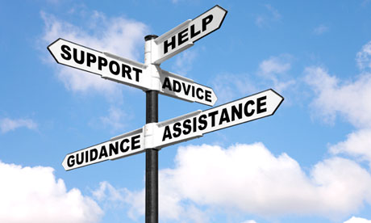
Where Can I Get Help (People)
For additional assistance contact:
Region | Name | Email | Phone
One | Kathy M. Williams | kathy.williams@state.co.us | 303-757-9386
Two | Mary Vigil | mary.vigil@state.co.us | 719-546-5432
Three | Chip Brazelton | chip.brazelton@state.co.us | 970-683-6210
Four | Juliet Sheets | juliet.sheets@state.co.us | 970-350-2156
Five | Jason Benally | jason.benally@state.co.us | 970-385-1403
Notes:
If you are uncertain about how to supervise an employee the best person to contact is your manager. If you need additional help contact the Civil Rights Manager for your region. Now let’s look at other training courses on leadership you can take.

Slide 24
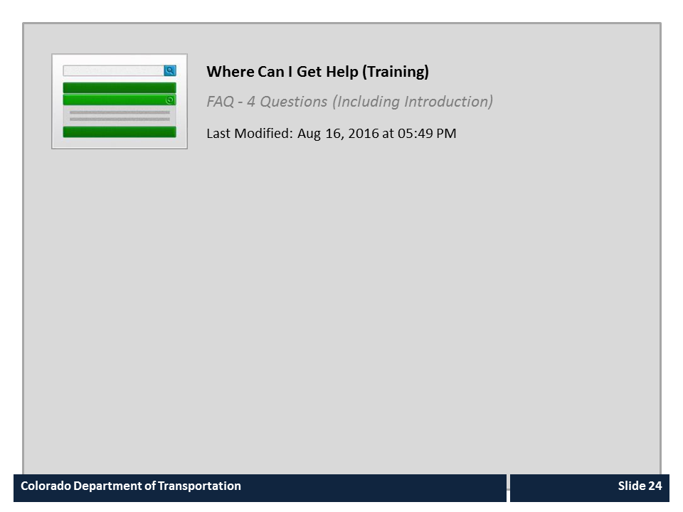
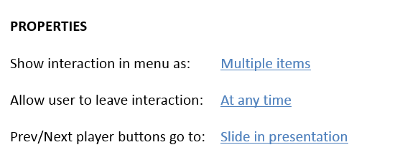
Where Can I Get Help (Training)

Slide 25

Course Complete
Congratulations, you have completed CDOT’s Expectations of a Supervisor Training!
To confirm you have completed the course, complete the following assessment.
For course credit, you must achieve a score of at least 70%. Please remember you can take the course as many times as you want until you achieve this score.
And remember, once you click the “Submit” button the question is locked and you can no longer change your selection.
Notes:
Congratulations, you have completed the Expectations of a Supervisor course! In order to maintain a record of your successful completion of the course, you must complete the following assessment. You may take the assessment as many times as you want, until you are happy with the results.

