Slide 1


Introduction to SAP Time Entry
Notes:
Notes:
Welcome to the Introduction to SAP Time Entry course! This course is designed to provide you with the skills you need to enter your time to ensure you are paid promptly and correctly. The course is for Maintenance, Engineering and Support employees and provides specific examples of each type of time entry. The course will take you between one and a half to two hours to complete. If you do not have this much time, don’t worry about it, you are able to stop this course at anytime and when you come back you can start where you left off. Now let’s get started with the course

Slide 2
Learning Logistics
Section 1 – Time Entry Overview
Section 2 – Time Entry Process
Section 3 – Work Time Entry
Section 4 – Leave Time Entry
Section 5 – Timesheet Verification
Notes:
This course is broken out into the Learning Logistics introduction and five sections on time entry:
In the Learning Logistics section you will learn about the prerequisites, navigational tools and objectives for the course.
The Time Entry Overview section you will show you why time entry is important to you and to CDOT, the rules and policies governing time entry and how time entry and this course relate to the mission, vision and values of CDOT.
The Time Entry Process section you teach you about the time entry process including deadlines, the roles and responsibilities. You will also complete the Employee Time Entry Guide using your Employee Time Statement. The information gathered on the guide will be used throughout the course to help you understand how to enter your time.
In the Work Time Entry Section, you will learn about how to navigate and enter time on your timesheet,
In section four, Leave Time Entry, you will learn about the types of leave available to you, how they accrue and how to enter leave. You will also learn about how to use the Leave Summary and Use or Lose reports to determine how much leave you have available.
In the Timesheet Verification section you will learn how to verify the status of your timesheet, read common errors and what the process is for making changes.
The final section, the Conclusion, summarizes what you have learned and where you can find help.

Slide 3
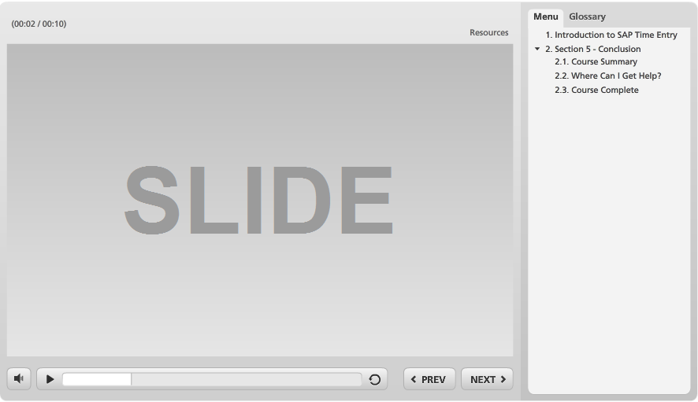
Navigation, Resources and Glossary
Before we begin, let’s look at the resources available to you
Notes:
As you go through the course, there are a couple of items you can use to help you learn. The first is the Resources link as indicated by the red arrow. This link contains copies of all of the documents referenced in this course.
The Glossary tab displays an alphabetical list of terms that are used throughout the course. Anytime you are uncertain about a term, this is the best place to look. Unlike the resources link clicking on the glossary does not pause the course.
If you want to navigate, use the previous or next buttons or click on the slide you want to navigate to under the menu tab. There is also a search field located at the bottom of the Menu tab that brings up all of the slides related to your search. The progress bar displays your progress within a slide.
If for any reason, you need to close the course before you have completed it, you will be returned to the page you were on once you log back in. Now let’s move on to what you will learn in this course.

Slide 4
Prerequisites
Prior to taking this course you should have taken:
SAP Basic Navigation course
Notes:
Being able to navigate SAP is critical to your success in this course. If you have not already done so, please take the SAP Basic Navigation course when you are able.

Slide 5
Course Learning Objectives
At the end of this course, you should be able to:
Explain why time entry is important to the Employee and to CDOT
Describe the roles and responsibilities in the time entry process
Identify common errors on your timesheet
Enter and release attendance and absences in SAP
Use best practices for making sure your timesheet is correct
Identify who to contact if you have questions about time and leave
Notes:
Upon completing this course you should have a understanding of each of the objectives on this slide. Please take a minute to review these before you continue. When you are done, click the next button to continue the course.

Slide 6

Course Design
Throughout the course you will be asked to make decisions based on the type of employee you are. This has been done to:
Customize the course based on your needs
Shorten the duration of the course
Make additional content available to you should you want to review it based on future needs
Click the button below to continue the course.
Continue
Notes:
Now let’s cover one more thing before moving on to the Time Entry Overview section. Throughout the course you will see slides like this one that ask you to make a choice about the content you view. Based on the decisions you make the content of the course will be customized to reflect how you enter time. All you have to do is click on the button based on the directions on the slide. Now let’s get started by clicking on the “Continue” button.

Slide 7
Section 1 - Time Entry Overview
Learning Logistics
Section 1 – Time Entry Overview
Section 2 – Time Entry Process
Section 3 – Work Time Entry
Section 4 – Leave Time Entry
Section 5 – Timesheet Verification
Conclusion
Notes:
This course is broken out into the Learning Logistics introduction and five sections on time entry:
In the Learning Logistics section you will learn about the prerequisites, navigational tools and objectives for the course.
The Time Entry Overview section you will show you why time entry is important to you and to CDOT, the rules and policies governing time entry and how time entry and this course relate to the mission, vision and values of CDOT.
The Time Entry Process section you teach you about the time entry process including deadlines, the roles and responsibilities. You will also complete the Employee Time Entry Guide using your Employee Time Statement. The information gathered on the guide will be used throughout the course to help you understand how to enter your time.
In the Work Time Entry Section, you will learn about how to navigate and enter time on your timesheet,
In section four, Leave Time Entry, you will learn about the types of leave available to you, how they accrue and how to enter leave. You will also learn about how to use the Leave Summary and Use or Lose reports to determine how much leave you have available.
In the Timesheet Verification section you will learn how to verify the status of your timesheet, read common errors and what the process is for making changes.
The final section, the Conclusion, summarizes what you have learned and where you can find help.

Slide 8
Section 1 Learning Objectives
At the end of this section, you should be able to:
Describe why time entry is important to you
Identify why time entry is important to CDOT
Explain the rules and policies associated with time entry
Notes:
Take a moment to review the learning objective for this section. When you are done, click the Next button to continue.

Slide 9
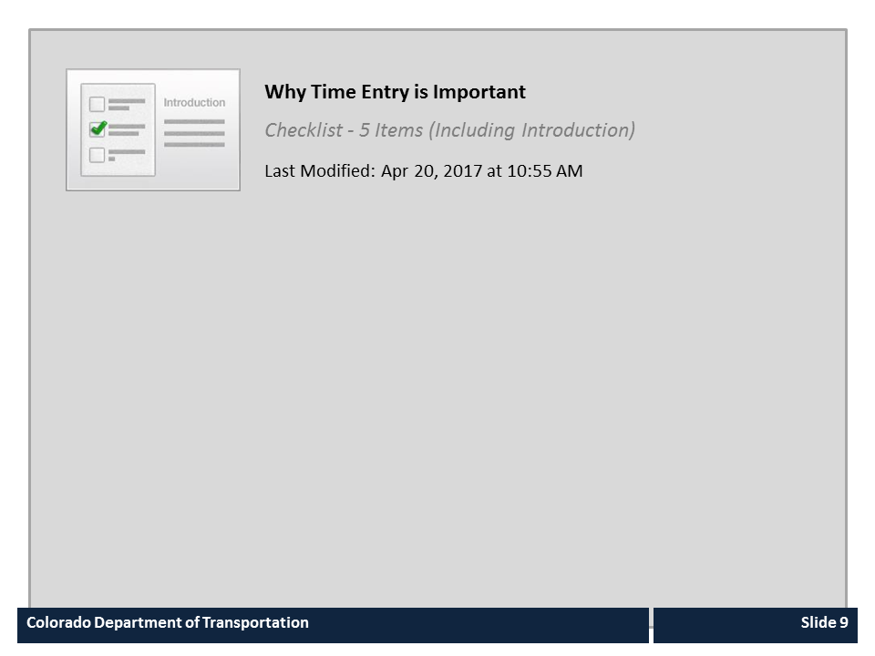
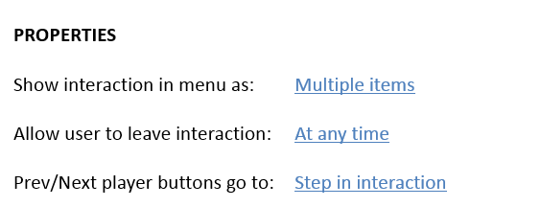


Why Time Entry is Important

Slide 10

Consequences
If you do not enter your time correctly:
You may not be paid right the first time
Some or all of your pay may be delayed
You might have to pay money back to the State
Your leave accruals may be incorrect
CDOT will not be able to account for labor costs and recover the funds used to pay for your work
Notes:
Now let’s look at what could happen if you do not enter your time correctly. It is CDOT’s responsibility to pay you, but if you do not enter your time correctly then CDOT has no way to do so. If the time entry results in you getting paid less, then you will have to wait until the next pay period. If there is an overpayment then you might have to pay the overpayment back. Additionally, because some of your leave accruals are based on the time you work they may be incorrect. And finally, CDOT will not be able to account for their labor costs and they may not be able to recover some of the funds that are used to pay for the work you perform.

Slide 11
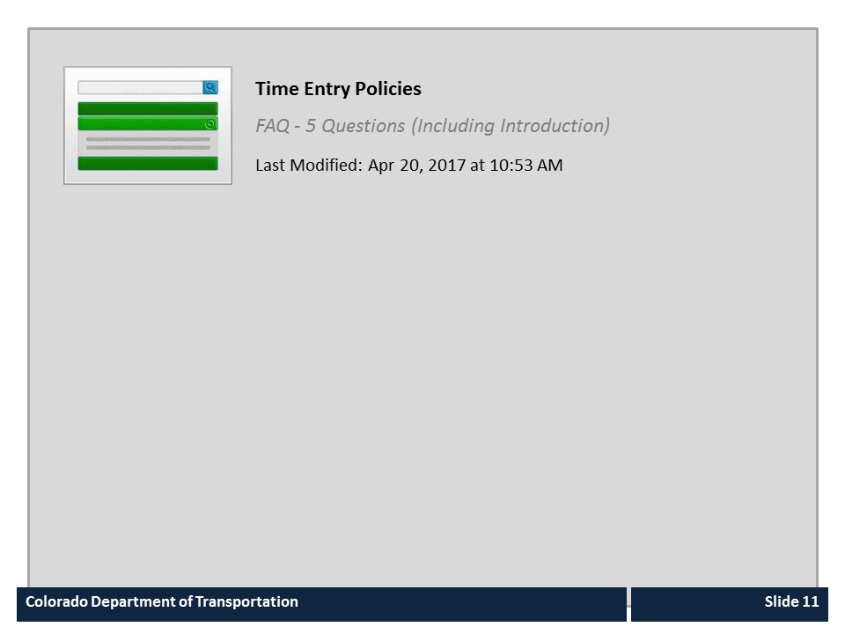
Time Entry Policies

Slide 12
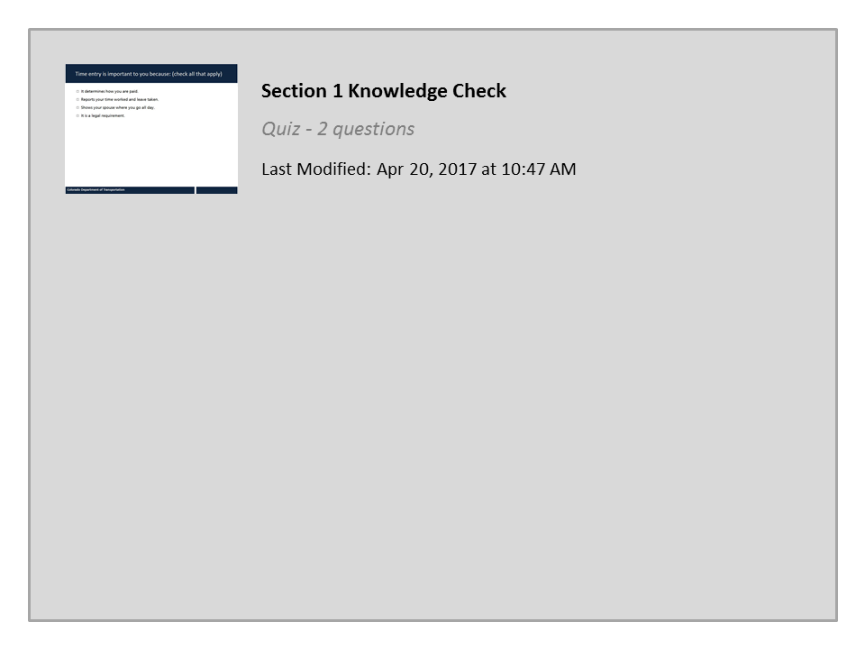
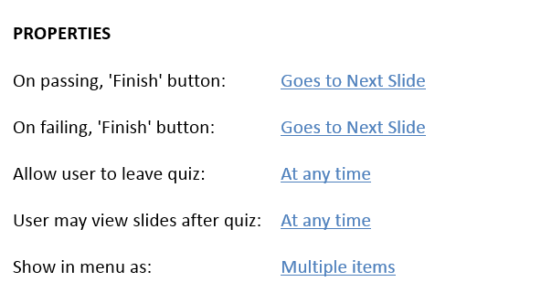

Section 1 Knowledge Check

Slide 13
Section 2 – Time Entry Process
Section 1 – Time Entry Overview
Section 2 – Time Entry Process
Section 3 – Work Time Entry
Section 4 – Leave Time Entry
Section 5 – Timesheet Verification
Notes:
This course is broken out into the Learning Logistics introduction and five sections on time entry:
In the Learning Logistics section you will learn about the prerequisites, navigational tools and objectives for the course.
The Time Entry Overview section you will show you why time entry is important to you and to CDOT, the rules and policies governing time entry and how time entry and this course relate to the mission, vision and values of CDOT.
The Time Entry Process section you teach you about the time entry process including deadlines, the roles and responsibilities. You will also complete the Employee Time Entry Guide using your Employee Time Statement. The information gathered on the guide will be used throughout the course to help you understand how to enter your time.
In the Work Time Entry Section, you will learn about how to navigate and enter time on your timesheet,
In section four, Leave Time Entry, you will learn about the types of leave available to you, how they accrue and how to enter leave. You will also learn about how to use the Leave Summary and Use or Lose reports to determine how much leave you have available.
In the Timesheet Verification section you will learn how to verify the status of your timesheet, read common errors and what the process is for making changes.
The final section, the Conclusion, summarizes what you have learned and where you can find help.

Slide 14
Section 2 Learning Objectives
At the end of this section, you should be able to:
Use your Employee Time Statement to identify your personal data used for time entry
Complete the Employee Time Entry Guide with your personal time entry information
Describe the time entry process and timelines
Describe time entry roles and the responsibilities
Explain how work schedules impact time entry and pay
Describe when you are paid
Notes:
Take a moment to review the learning objective for this section. When you are done, click the Next button to continue.

Slide 15
Employee Time Entry Worksheet
The Employee Time Entry Worksheet:
Is your guide to how you enter time
Requires you to access your Time Entry Statement to complete
Can be stored on your desktop or printed when complete
Click the image to the left to open the Employee Time Entry Worksheet
Notes:
Not all employees enter time the same way. For example, an employee in Maintenance who is a winter permanent part-time employee earns overtime, while an employee in HR may not. Because different groups of employees enter time differently, we have created a worksheet to help you understand more about how you enter time. Before you continue the course, please click on the left side of the screen to open a copy of the Employee Time Entry Worksheet. You must do this before you continue the course.
When you have completed your Employee Time Entry Worksheet you can print the file or you can save it to your desktop to view later. To complete the worksheet you will need to display your Time Statement. Let’s take a look at how to do that now.

Slide 16
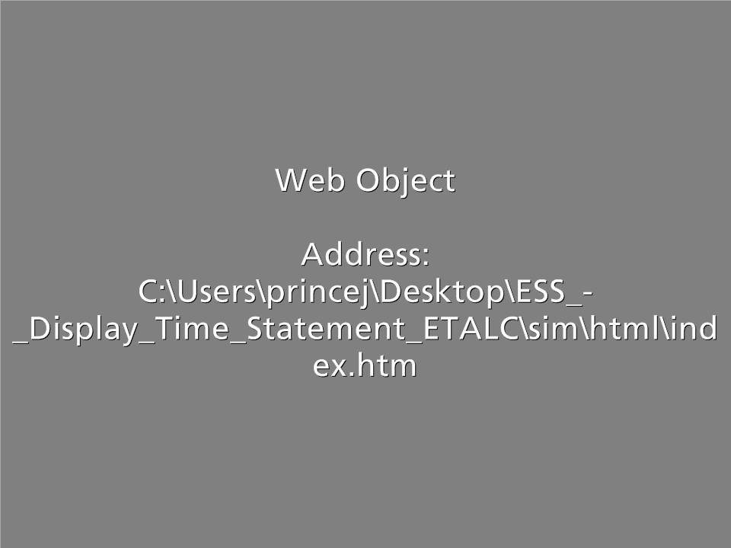
Demo: Display Time Statement
Scenario:
In this scenario you are checking your Time Statement to view the time you entered the last pay period
Notes:
Now lets look at the Time Statement. Click on the word Practice, when you do a new window will open. When it does click on the Allow blocked content button located on the bottom of the page. When you are done, click on the End Lesson button and you will be returned back to this course after the window closes.

Slide 17
Now it’s Your Turn…
Click here to go to the SAP Portal
Using the buttons to the left:
Using the first button, sign into the SAP Portal and go to your own Time Statement
Using the second button, open and complete the Employee Time Entry Worksheet, based on your Time Statement
Click here to open the Employee Time Entry Worksheet
Notes:
Now that you have seen both the Employee Time Entry Worksheet and have practiced how to display the Time Statement, take a moment to access your Time Statement and complete your Employee Time Entry Worksheet. To help you with the process we have included buttons you can click to take you to the login page for the SAP portal and a link to open the work sheet. If you need help you can click the back button to view the demo showing you how to display your Time Statement.

Slide 18
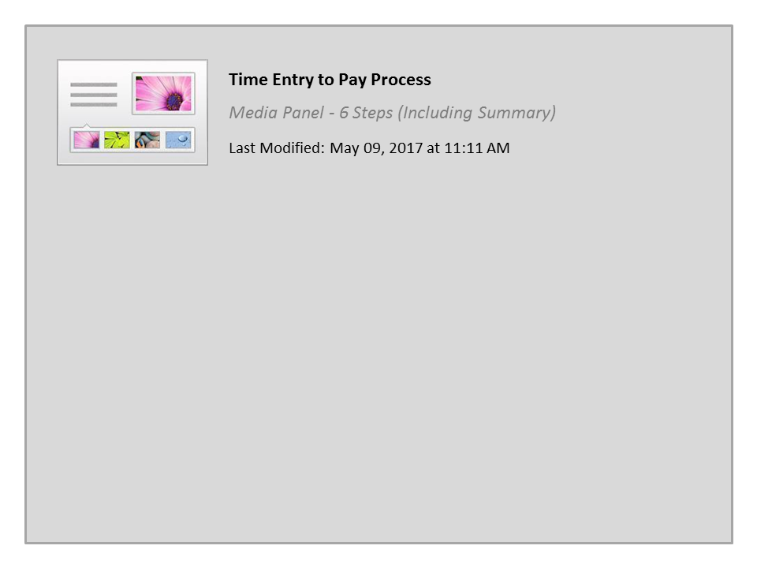
Time Entry to Pay Process

Slide 19

Time Entry Deadlines
If you are a Full Time Employee:
All time should be entered weekly
All entries and revisions must be approved by 5:00pm on the second day of the following month
If you are a Temporary, Winter Part-time, Permanent Part-time:
All time should be entered daily
All entries and revisions must be approved by 5:00pm Monday
If you are using Leave Without Pay (LWOP):
All time should be entered by the 15th of the current month LWOP is being used
Notes:
The type of employee you are drives your time entry deadline. Review line six of your employee Time Entry Worksheet. If you are a full-time employee, then you should enter your time weekly and all of your time entries and revisions must be approved by 5:00pm on the second day of the following month. If you are a Temporary, Winter Part-time or are a Permanent Part-time employee then you should enter your time at least daily and all of your entries must be approved by your supervisor by 5:00pm Monday. If you are using Leave without pay, the your time must be entered and approved by the close of business on 15th of the current month the leave is being used.

Slide 20

Your Role in the Time Entry Process
Your role in the time entry process is:
Enter your time weekly if you are a full-time employee and daily if you are not
Enter your time by the time entry deadline
Verify your time has been entered correctly
Confirm your time has been approved by your supervisor
Talk to your Supervisor prior to changing the hours you normally work
Notes:
The most important thing you can do is to enter your time within the time entry deadline. For full-time employees this is daily. If you are a permanent part-time, Winter Part-time or Temporary you need to enter your time at least weekly. Also, please enter verify your time entries to ensure they are correct and because we are a team be sure to check that your time has been approved. Also it is important for you to talk to your supervisor if you are going to change the hours you would normally work including if your are taking leave. It is also a good idea to enter your time in advance if you are going on leave and will not be present when for a payroll deadline. Now that you understand your role in the time entry process lets take a look at some of the others.

Slide 21
Other Roles in the Time Entry Process
Supervisor/ Appointing Authority
Timekeeper
Notes:
Your Supervisor is responsible for approving or rejecting your time and leave and verifying that your time entry is correct. They also have a deadline to approve your time so if there is a change help them out by making the requested change as quickly as possible. In some cases, such as military or bereavement leave your time may not be approved by your supervisor and is instead routed to your appointing authority for approval. Regardless of the whether your time is approved by your Supervisor or the Appointing Authority the goal is the same to get you paid correctly. The last role in the time entry process is that of the time keeper. Your timekeeper is there is answer any questions you may have about time entry. Your timekeeper is listed on the header of the your Time Statement and is list on line three of your completed Employee Time Entry Worksheet.

Slide 22
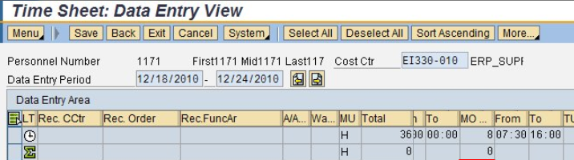
How Your Work Schedule Impacts Time and Pay
Your work Schedule impacts your time and pay by:
Preventing you from entering planned working time A/A types during unplanned time and visa versa
Making you shift eligible if over half of your shift is in 2nd or 3rd
Dictates when you can enter on call because this cannot be entered during planned working time
Notes:
Your work schedule shows the time you are scheduled to work and the time you are not. The time you are scheduled to work is planned time. The time you are not is unplanned time. For your planned time your are only able to enter time that applies to your work schedule such as working time and leave, but you could not enter overtime for example. For unplanned time, you would be able to enter overtime, but you would not be able to regular working time or leave because you are not scheduled to work.

Slide 23

When you are Paid
If you are a Full-time Employee:
You are paid monthly
Click HERE to download the monthly pay schedule
If you are Temporary, Winter Part-time or Permanent Part-time Employee:
You are paid bi-weekly
Click HERE to download the bi-weekly pay schedule
Notes:
If you are a Full-time employee then you are paid monthly. If you are a Temporary, Winter Part-time or Permanent Part-time employee. Click on the link for your employee type to download the monthly pay schedule.

Slide 24
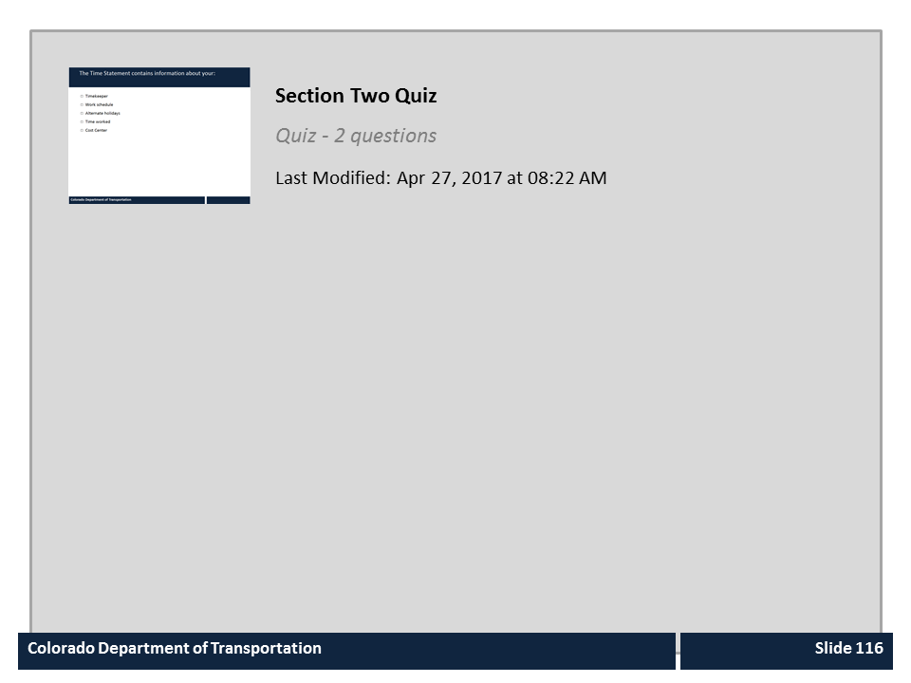
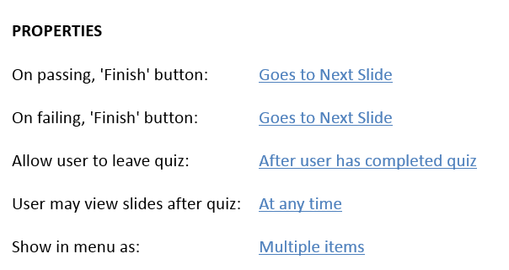
Section Two Quiz

Slide 25
Learning Logistics
Learning Logistics
Section 1 – Time Entry Overview
Section 2 – Time Entry Process
Section 3 – Work Time Entry
Section 4 – Leave Time Entry
Section 5 – Timesheet Verification
Conclusion
Notes:
This course is broken out into the Learning Logistics introduction and five sections on time entry:
In the Learning Logistics section you will learn about the prerequisites, navigational tools and objectives for the course.
The Time Entry Overview section you will show you why time entry is important to you and to CDOT, the rules and policies governing time entry and how time entry and this course relate to the mission, vision and values of CDOT.
The Time Entry Process section you teach you about the time entry process including deadlines, the roles and responsibilities. You will also complete the Employee Time Entry Guide using your Employee Time Statement. The information gathered on the guide will be used throughout the course to help you understand how to enter your time.
In the Work Time Entry Section, you will learn about how to navigate and enter time on your timesheet,
In section four, Leave Time Entry, you will learn about the types of leave available to you, how they accrue and how to enter leave. You will also learn about how to use the Leave Summary and Use or Lose reports to determine how much leave you have available.
In the Timesheet Verification section you will learn how to verify the status of your timesheet, read common errors and what the process is for making changes.
The final section, the Conclusion, summarizes what you have learned and where you can find help.

Slide 26
Section 3 Learning Objectives
At the end of this section, you should be able to:
Explain how to access and navigate the timesheet including the header and icons
Identify your work schedule
Identify needed data for working time by functional area (Maintenance, Engineering, and Support)
Enter, release, and save time entries on the time sheet
Explain overtime policies and determine if you are eligibility
Define comp time and explain eligibility
Explain when and how to use wage types
Notes:
Upon completing this section you should have an understanding of the objectives on this slide. Please take a minute to review these before you continue. When you are done, click the next button.
SUGGESTED CHANGE:
5TH BULLET: s/b “… if you are eligible”

Slide 27
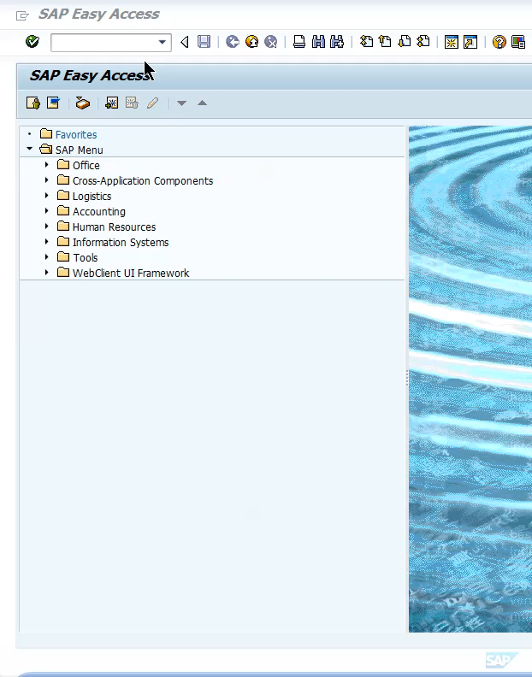
Accessing the Timesheet
To access your time from SAP:
Log into SAP
Enter T-code CAT2 in the Command field
Click the Enter button
Supervisors Only: In CAT2, you are taken to the Initial Screen before going to your timesheet. Check for YOUR name and SAP number before clicking Edit and continuing to your timesheet.
Notes:
After logging into SAP, type CAT2 in the command field and then click the Enter button. Once in your timesheet, you are able to enter, release and save your time. If you are a Supervisor please review the supervisor only note on the slide for additional steps for accessing your timesheet.

Slide 28
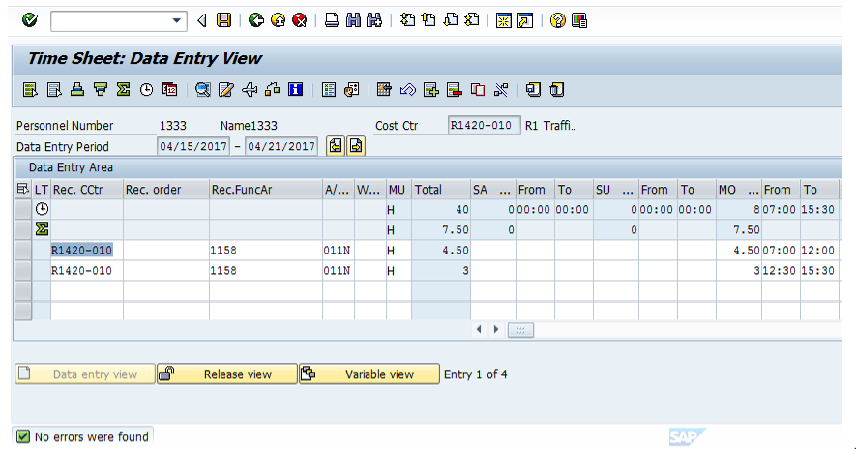
Navigating the Timesheet
Click on timesheet icons below to learn more.
Notes:
When you start entering time you will see a timesheet similar to the one here. Click on any of the icons with a red box to learn more. When you are done click on the next button to continue.

Slide 29
Navigating the Timesheet
Click on timesheet icons below to learn more.
The Enter button is used to verify your entries after you have completed a time entry.

Slide 30
Navigating the Timesheet
Click on timesheet icons below to learn more.
The Save button is used to save the time you have entered. Note: You still need to release your time to your supervisor for approval.

Slide 31
Navigating the Timesheet
Click on timesheet icons below to learn more.
The Weekdays On/Off button is used to change the days of the week, (i.e. SA) to calendar dates, (i.e. 4/15).

Slide 32
Navigating the Timesheet
Click on timesheet icons below to learn more.
The Check Entries button is used to verify any time entries you have made. Messages display in the lower left corner of the screen.

Slide 33
Navigating the Timesheet
Click on timesheet icons below to learn more.
The Previous Screen (left) and Next Screen buttons (right) buttons take you back one week or forward ones week so you are able to view other data periods.

Slide 34
Navigating the Timesheet
Click on timesheet icons below to learn more.
The Select All icon highlights all of your time entries so you are able to release all time at once.

Slide 35
Navigating the Timesheet
Click on timesheet icons below to learn more.
The Scroll Bar, when you left click and drag, displays additional days where time entry is required.

Slide 36
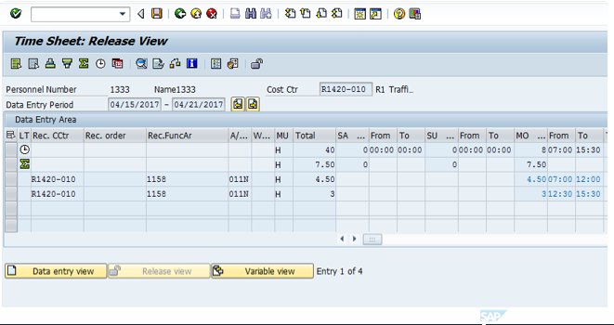
Navigating the Timesheet
Click on timesheet icons below to learn more.
The Release view button takes you to where you release your time. This is the only view that displays the Release view button that allows you to send your time to your Supervisor for approval.

Slide 37
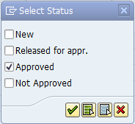
Navigating the Timesheet
Click on timesheet icons below to learn more.
The Variable View button displays the Select Status box where you see the status of your time by checking or unchecking the boxes. In this example, only time your supervisor has approved will be displayed.

Slide 38
Navigating the Timesheet
Click on timesheet icons below to learn more.
The Data Entry view button takes you back to your timesheet where you enter your time. When the timesheet field is white, as in this view, you are in Data Entry View as shown by the arrow in the header.

Slide 39
Navigating the Timesheet
Click on timesheet icons below to learn more.
All System messages display in the lower left corner of the screen. It is a good idea to review this section when you save or release your time.

Slide 40
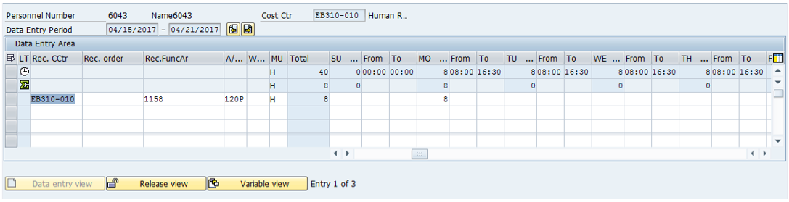
Navigating the Data Entry View of the Timesheet
Click on any of the fields with a red box to learn more.
Notes:
Now that we have gone through the navigation of the timesheet, let’s look specifically at the area of the timesheet where you enter time. This is known as the data entry area. For those of you who have entered time before, don’t worry if the timesheet we are looking at is not exactly the same as yours. The first line of the timesheet, as indicated by the arrow is your work schedule. The work schedule is the time you are required to account for using a combination of time entry and leave. The total column shows the number of hours you must account for during the week in this case 40. Now lets look at the first day, Sunday, the zero in the Sunday indicates this is a non-working day. This is also why the From and To fields are showing as zero. Now let’s move on to the first work day of the week, Monday, as you can see there is an eight in this field. This indicates that the number of hours this person needs to work. The From and To fields shows the hours this person is required to account for during the week. The first white line is where you enter your time. When you enter your time it should be done using a 24 hour clock or military time. This is why the to time displays as 16:30 instead of 4:30pm. Hours entered and checked then add to the second blue line, the worked hours line. The worked hours line also adds all hours in the middle blue Total column. To learn about the type of entry fields click on any of the red boxes.
Suggestion: Have the timesheet image show Saturday as the first (unscheduled) day. All users will see Saturday when they first get into the timesheet.

Slide 41
Navigating the Data Entry View of the Timesheet
Click on any of the fields with a red box to learn more.
The Data Entry Period is the week you are entering your time. The default is always the current week. Click the Previous and Next screen buttons to the right of this field displays additional weeks.

Slide 42
Navigating the Data Entry View of the Timesheet
Click on any of the fields with a red box to learn more.
The Work Schedule row displays your assigned work schedule and total hours to account for in the week, usually 40 hours. A combination of time worked and/or leave must be entered based on the daily From and To times columns and Daily Total hours under the days of the week columns.

Slide 43
Navigating the Data Entry View of the Timesheet
Click on any of the fields with a red box to learn more.
The Cost Center is your default home receiving cost center, or where your time is automatically charged if not indicated by other entries on your timesheet. Your home cost center is listed on your timesheet as indicated by the white arrow.

Slide 44
Navigating the Data Entry View of the Timesheet
Click on any of the fields with a red box to learn more.
This is the Receiving Functional Area column. It is used to describe the type of work you are performing and is also used to report expenses.

Slide 45
Navigating the Data Entry View of the Timesheet
Click on any of the fields with a red box to learn more.
This is the Attendance/Absence column. It is used by the system to track your absences and working time. For attendances, the “N” (Non-Participating) means it is not billed to a Federal Grant. “P” means it will be billed.
Notes:
Suggestion:
…billed to a Federal Grant. (add period)

Slide 46
Navigating the Data Entry View of the Timesheet
Click on any of the fields with a red box to learn more.
The Totals Row displays the total number of hours you entered daily and for the week. In this example, the black arrow points to a weekly total of 8 hours. The green arrow, pointing to the “0,” indicates no time has been entered for Tuesday.
.

Slide 47
Navigating the Data Entry View of the Timesheet
Click on any of the fields with a red box to learn more.
The Wage Types field is used only if you are On Call or if you have a 2nd or 3rd shift work schedule and have to attend mandatory events during 1st shift hours.

Slide 48
Navigating the Data Entry View of the Timesheet
Click on any of the fields with a red box to learn more.
The Time Entry area is where you enter the start and end times you worked, any leave you have taken, and overtime if you are eligible. Round entries to quarter hour (:00, :15, :30 or :45).

Slide 49
Time Entry
Using line two of your Employee Time Entry Worksheet, click on the button that matches your assignment.
Maintenance or Tunnel
Engineering or Project Support
Maintenance Support or Project Support
Temporary
Notes:
Now let’s get into how you enter time based on your employee type. Using line two of your Employee Time Entry Worksheet select the personnel subarea that matches your assignment. If you are a Temporary employee select this option regardless of where you are assigned.

Slide 50
Types of Time Entered by Maintenance
A Work Order (DOT1 or Preventative)
  Includes the work order number, an activity number, and a work center number, A/A type and working time
Cost Center
  Can be used to record administrative work, such as training or admin work
  Requires entry of the Receiving Cost Center, Receiving Functional Area, A/A Type and Working hours (From and To)
On Call
  Used only to record time the employee was on call
  Requires entry of the Receiving Cost Center, Receiving Functional Area, Wage Type 4099 and hours (From and To)
Notes:
As a maintenance employee the majority of your time will be recorded to a work order. A work order time entry includes the work order number, an activity number, and a work center number. As with all employee types, the A/A type needs to be entered correctly. An exception to the required A/A type is on call entries. These require a Cost Center and Receiving Functional Area. All on call entries are charged to the Wage Type 4099.

Slide 51
Work Orders and Time Entry
As a Maintenance or Tunnel Employee:
All of your working time is typically entered to a work order
All other work orders will transfer the time to your timesheet
Preventative work orders must be entered on the timesheet
Time cannot be entered or transferred unless a work order has been created and released
Maintenance Staff -
Creates and releases the work order
All Other Work Orders:
Transfer to the timesheet
Employee reviews and enters
Employee -
Releases and saves time to the work order in the timesheet
Preventative Work Orders:
Do not transfer to the timesheet
Employee enters in timesheet
Notes:
In general as a Maintenance or Tunnel employee you will be entering your time to a work order. When you in some cases this is transferred to the timesheet and in others, such as preventative, if needs to be entered. Regardless of the type of work order, time cannot be transferred unless a work order has been created and released.

Slide 52
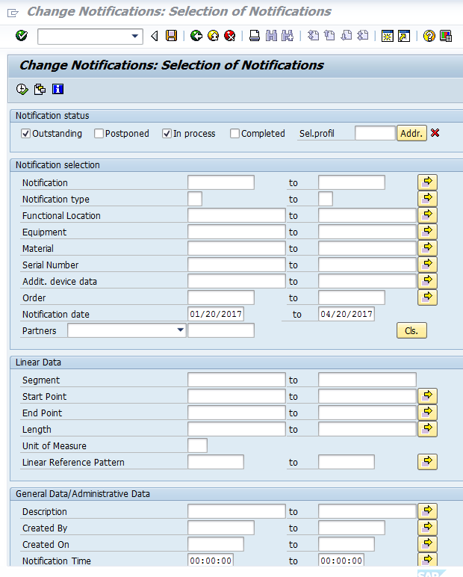
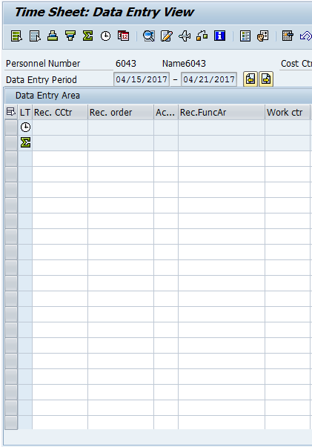
Time Transfer of DOT1 Work Orders
Time transfer occur three times a day they are:
6:00 a.m.
6:00 p.m.
Midnight
Notes:
When does time transfer from a DOT1 work order to your timesheet? SAP uses the time transfer program to transfer your time to your timesheet. This program runs daily at 6 a.m., 6 p.m. and midnight. It transfers the operations time from all released and approved DOT1 work orders. The time ONLY transfers time ONE time. It does not transfer times that are changed in the work order after the time transfer program has run. These are the changes that need to be updated manually in your timesheet.

Slide 53
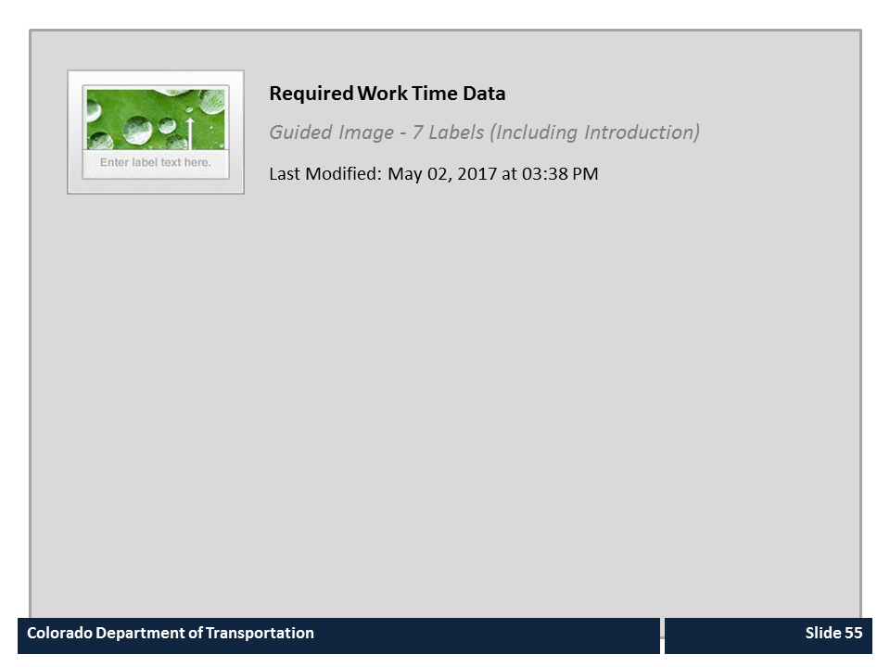
Required Work Time Data

Slide 54

Validating the DOT1 Work Order
When entering time to a DOT1 work order verify the:
Work Order Number
Activity
Work Center
Working time (To and From)
A/A Type
Notes:
As mentioned earlier, the DOT1 work order automatically populates based on the created work order. Because things change, you need to review the work order to make sure that everything is correct. This involves review the work order number to make sure the correct work order was charged, the activity to verify the correct work was done and the work center to make sure the right person did the work. If any of this is wrong you should not enter time against the work order and should instead contact your Supervisor to have the information corrected. Additionally, there are a couple of items that are in your control you can change. These are the A/A type, your working time. Make sure this correct when you do your time entry.

Slide 55
CAT2 – Verify and Enter Time to a Work Order
Scenario: In this example, you are changing the amount of time you took on a DOT1 work order from 9 hours to 10 hours. You are also entering the 10 hours you worked on a preventative work order.
Notes:
Now lets look changing the time for a DOT1 work order and then entering a preventative work order . Click on the word Practice, when you do a new window will open. When it does click on the Allow blocked content button located on the bottom of the page. When you are done, click on the End Lesson button and you will be returned back to this course after the window closes.

Slide 56
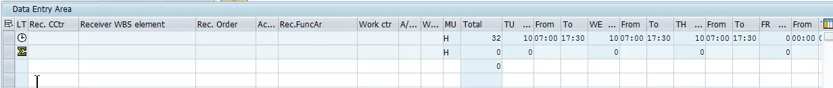
Entering Time to a Cost Center
Enter time to a cost center:
Is used to record safety meetings or training
Requires entry in the following fields:
    Receiving Cost Center
    Receiving Functional Area
    A/A Type
    Working hours (From and To)
Notes:
Most of the time, as a Maintenance or Tunnel employee, you will enter your time to work orders. In some cases, such as safety meetings or training, you may need to enter your time to a cost center. If you are entering to you home cost center, it is located on your timesheet just to the right of your personnel number. In addition to the cost center you will need to enter the receiving functional Area, A/A Type and the working hours. ow let’s practice entering your time to a cost center.

Slide 57
CAT2 – Enter Time to a Cost Center
Scenario: In this scenario, you went to an all day training and you are entering the hours against your home cost center.
Notes:
Now we are going to practice entering and releasing you time to a cost center. Click on the word Practice, when you do a new window will open. When it does click on the Allow blocked content button located on the bottom of the page. When you are done, click on the End Lesson button and you will be returned back to this course after the window closes.

Slide 58

Overtime and the Timesheet
Overtime is:
Paid at 1.5 times your regular rate of pay
Entered on the timesheet in the A/A Type field using code 014N or 014P
Approved verbally by your Supervisor prior to you working it
Described in PD 1230.0 and 1230.2
Notes:
Overtime is paid when you work outside of your normal planned work time. You are paid time and half for this work. All overtime must be authorized by your Supervisor prior to being worked and is coded on your timesheet using code 014N or 014P. If you want to learn more about overtime rules they are described in PD 1230.0 and 1230.2.

Slide 59
CAT2 – Enter Overtime
Scenario: In this scenario, you are entering overtime because the all-day training course went over one hour.
Notes:
Now we are going to practice entering overtime. Click on the word Practice, when you do a new window will open. When it does click on the Allow blocked content button located on the bottom of the page. When you are done, click on the End Lesson button and you will be returned back to this course after the window closes.

Slide 60
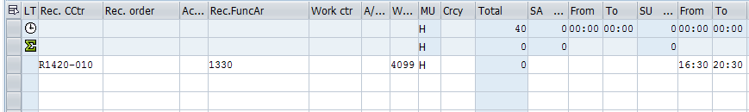
Entering On-call Time
On-Call
Must be authorized by your supervisor
What fields to enter on your timesheet
Receiving Cost Center
Only entered during non-working time
Employee must be available to work
Entered as wage type 4099
Receiving Functional Area
Wage Type (4099)
Hours on call in the From and To field
Notes:
Wage types are another time entry type used in maintenance. These are used INSTEAD of an A/A type. CDOT uses two Wage Types - one for On-Call time and one for Work Schedule Premium Pay time.
On-call must be approved by your supervisor, must only be entered on non-working time and wage type 4099 is entered.

Slide 61
Wage Types and your Timesheet
Work Schedule Premium Pay
May only be entered on working time
What fields to enter on your timesheet
Receiving Cost Center
Paid for 1st shift if you have a 2nd or 3rd shift work schedule
Entered as wage type 7002 (2nd shift) and 7003 (3rd shift)
Receiving Functional Area
Hours of the event in the From and To field
Wage type 7002 (2nd shift) or 7003 (3rd shift)
Notes:
Employees who are scheduled to work 2nd or 3rd shift but work 1st shift due to a qualifying event taking place between the hours of 6AM and 4PM may be eligible to receive shift pay for the hours worked on 1st shift. Examples of qualifying events are Safety meetings, mandatory trainings, and Remembrance events. Mandatory overtime due to snow or other routine maintenance operations is not eligible for the shift premium. When entering the shift premium, be sure to verify that only the hours worked on 1st shift are entered with the wage type for the qualifying event and the total hours coded to the wage type match the number of the hours worked for the qualifying event.

Slide 62
CAT2 - Enter On-call Time
Scenario: In this scenario, you are entering the on-call time you worked on Friday and are releasing and saving your time.
Notes:
Now lets look at how you enter a release you time when you are on-call. Click on the word Practice, when you do a new window will open. When it does click on the Allow blocked content button located on the bottom of the page. When you are done, click on the End Lesson button and you will be returned back to this course after the window closes.

Slide 63

Under Construction
This section of the course is under development
Click the next button to return to the Time Entry slide
Notes:
This section of the course is under development and will be ready soon. Click the next button to return to the Time Entry slide and make another selection.

Slide 64
Section 4 – Leave Time Entry
Section 1 – Time Entry Overview
Section 2 – Time Entry Process
Section 3 – Work Time Entry
Section 4 – Leave Time Entry
Section 5 – Timesheet Verification
Notes:
This course is broken out into the Learning Logistics introduction and five sections on time entry:
In the Learning Logistics section you will learn about the prerequisites, navigational tools and objectives for the course.
The Time Entry Overview section you will show you why time entry is important to you and to CDOT, the rules and policies governing time entry and how time entry and this course relate to the mission, vision and values of CDOT.
The Time Entry Process section you teach you about the time entry process including deadlines, the roles and responsibilities. You will also complete the Employee Time Entry Guide using your Employee Time Statement. The information gathered on the guide will be used throughout the course to help you understand how to enter your time.
In the Work Time Entry Section, you will learn about how to navigate and enter time on your timesheet,
In section four, Leave Time Entry, you will learn about the types of leave available to you, how they accrue and how to enter leave. You will also learn about how to use the Leave Summary and Use or Lose reports to determine how much leave you have available.
In the Timesheet Verification section you will learn how to verify the status of your timesheet, read common errors and what the process is for making changes.
The final section, the Conclusion, summarizes what you have learned and where you can find help.

Slide 65
Section 4 Learning Objectives
At the end of this section, you should be able to:
Describe the SAP leave approval process
Describe the roles and responsibilities in CDOT leave process
Identify types of leave that are accrued and the approval process
Explain leave-without-pay (LWOP) process and deadline
Identify approval process for other types of leave and how work schedules impact leave
Identify CDOT holidays and how they affect the timesheet
List the leave types available to you
Enter, release and save absence time in SAP
Notes:
Take a moment to review the learning objectives for this section. When you are done, click the Next button to continue.

Slide 66
What is Leave?
Leave is when you take time off from your normally scheduled hours
The State provides leave as a paid benefit
Leave tracks absences on your timesheet
Leave can only be entered during scheduled hours
Accrued (sick annual)
Leave may be paid or unpaid
Refer to the leave procedural directive 1204.2 for more information
Notes:
So what is leave? Leave is a paid benefit that is available for you to use. When you enter leave you enter it on your timesheet because it is tracked the same way as working time. In some cases, such as sick and annual leave, your leave will accrue over time if you do not use it. In other cases such as holiday, bereavement and jury leave this is available to you only when the holiday or the need occurs. Depending on what kind of employee you are your paid leave benefits may vary. If you have questions about the types of leave you are eligible for refer to procedural directive 1204.02.

Slide 67
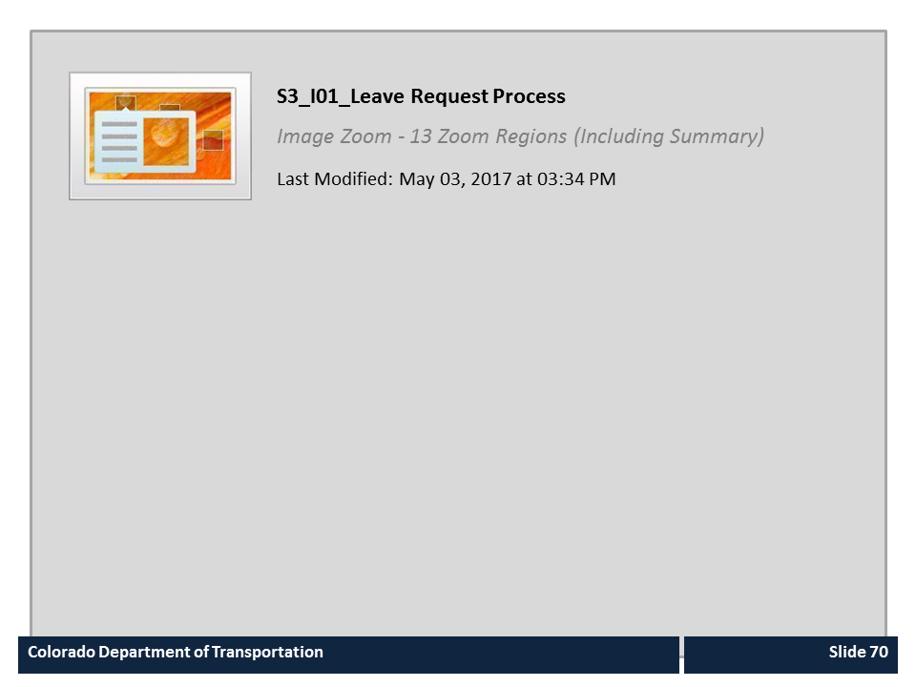
S3_I01_Leave Request Process

Slide 68
Time and Leave Approval Process
Employee Discusses Leave with Supervisor
Appointing Authority Receives and Approves or Rejects Leave
Talk to your Supervisor for Reason
Employee Enters and Verifies Leave Request
Yes
No
SAP Email Sent
Is Admin or unpaid leave requested?
SAP Email Sent
Is Leave
Approved?
SAP Verifies Leave Quota for Requested Leave
No
Yes
Supervisor Receives Email and Approves or Rejects Leave
SAP Adjusts Leave Bank
If Needed Employee Enters Corrections and Releases and Saves Request

Slide 69
Types of Accruals and Leave
Using line six of your Employee Time Entry Worksheet, click on your employee group to learn about your leave accruals:
Permanent Full-time
Permanent Part-time
Temporary
Winter Permanent Part-time
Notes:
The types of leave that you get and the rate at which it is earned is dependent upon the type of employee you are. If you know your employee group please select it now. If you are not certain, it can be found under Item six of your Employee Time Entry Worksheet.

Slide 70

Accrual - Permanent Full-time
As a Permanent Full-time employee:
You receive full accruals when you are paid 40 hours per week for an entire month
Your leave is prorated if you start in the middle of the month
Accruals change based on your years of service
Notes:
As a Permanent Full-time employee you receive full accruals when you work full-time for an entire month. If your are starting off in the middle of the month your leave will be prorated based on what you worked. Your accruals are based off of years of service for annual leave and while you sick is based on the years of service.

Slide 71

Accrual – Permanent Part-Time
As a Permanent Part-time employee your leave is prorated based on the hours you work:
  Accruals are based on Full-time work of 40 hours per week per month
  As a Permanent Part-time your accrual is based on the percentage of full-time work you do
  For example, if you work 20 hours a week and the full time sick leave accrual is 6.66 hours per month you would accrue 3.33 hours per month
Notes:
As a Permanent Part-time employee your leave is prorated based on the number of hour you work. For example a Permanent Full-time employee earn 6.66 hours of sick leave each month. If you worked 20 hours a week your accrual would be half of that, 3.33 hours. Now let’s talk about the types of leave you are eligible to accrue.

Slide 72
Accrual – Winter Permanent Part-time
As a Winter Permanent Part-time employee:
You receive full accruals when you work 40 hours per week for an entire month (160 hours)
If you start in the middle of the month, then your leave would be prorated to be one half of the 160 hour to 80 hours:
  The full time (160 hours) accrual of sick leave would be 6.66 hours per month if you worked 80 hours you would receive 3.33 hours for the month
Notes:
As a Winter Permanent-Part time employee your leave accruals are the same as a Full-Time Permanent employee when you work the full forty hours per week for an entire month. The only difference is that your leave may be prorated based on the total number of hours you work in the month. For example you would receive the full accrual of sick leave of 6.66 hours when you work 160 hours a month or four 40-hour weeks. If you started in the middle of the month, and worked full-time for two weeks your sick leave would be prorated because you only worked 80 hours. This means you would receive half of the 6.66 hours or 3.33 hours of sick leave. This would be the same for the rest of your accruals as well. Now let’s look at the types of leave you accrue.

Slide 73

Leave Quotas
Each type of accrued leave has its own bank
Quota banks track leave accrual and usage
You can only spend leave that is in your bank
Leave is accrued monthly based on your paid hours
Annual
Sick
Comp
Alt Holiday
Notes:
You deposit into and withdraw from multiple leave banks. Like a bank account, your balances can go up or down. Annual and sick leave are earned automatically on the last day of each month. Your earn rate varies based on your paid hours in the month and your years of service. This earned leave time is then available for you to use at a later date. Other accrued leave types include, alternate holiday time and comp time.

Slide 74
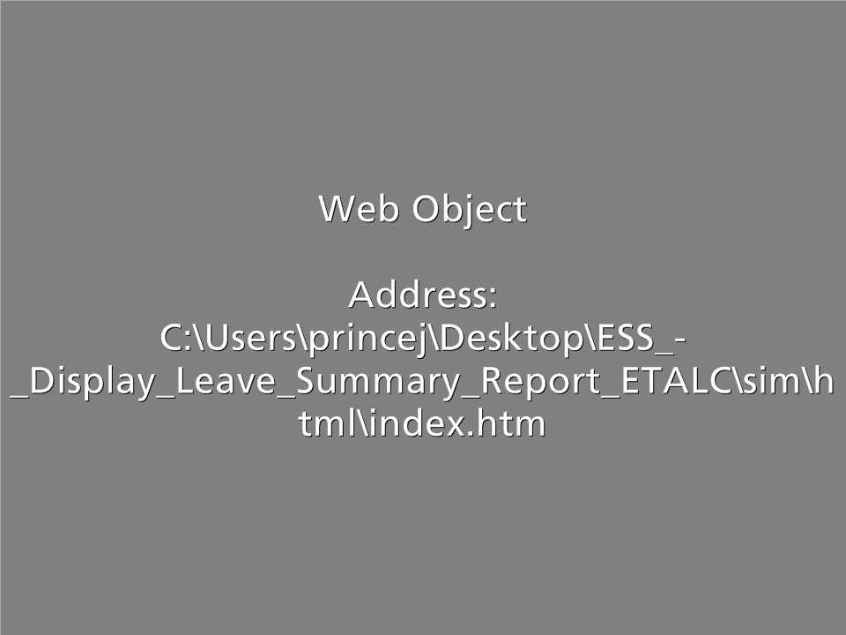
Display the Leave Summary Report
Scenario: You want to use annual leave, but are uncertain about how you have available.
Notes:
Now lets look at displaying the Leave Summary Report. Click on the word Practice, when you do a new window will open. When it does click on the Allow blocked content button located on the bottom of the page. When you are done, click on the End Lesson button and you will be returned back to this course after the window closes.

Slide 75
Roles and Responsibilities in the Leave Process
Employee
Supervisor
Appointing Authority
Timekeeper
Notes:
Now that you are familiar with the process let’s look at the roles in more detail. There are a lot of roles working together to ensure the leave process goes smoothly. The first role is that of the employee. As an employee you must enter your leave requests according to the needs of your department and workgroup. Keep in mind this might change based on the kind of leave you are requesting. This might be as informal as letting your supervisor know that you plan on taking a vacation day in a couple of weeks or have regular doctor appointments scheduled over the next couple of months. Regardless of the process, there are a few things you should always do. Let your supervisor know as soon as possible if you are taking leave. If you a or a family member are sick and you are taking leave let your supervisor know as soon as possible so they are able to cover your work. And finally, pay close attention to your leave balances to avoid end of the year issues. All of the leave used must be approved by a Supervisor or in certain circumstances the by the Appointing Authority. The Timekeeper is there to help you with any questions you have about leave and verify the entry and approval process go smoothly. Now that you understand the process and the roles, let’s look at the types of leave you can take.

Slide 76
Communication is Key
Employee
Supervisor
As an Employee you are responsible for:
Understanding your workgroup’s leave processes and supervisor expectations
Checking your Leave Summary report before requesting leave
Timely communicating you are taking leave
Entering your leave request correctly and on time
Quickly responding to timesheet errors
Verifying your timesheet has been approved
Your Supervisor is responsible for:
Communicating your workgroup’s leave processes and expectations
Verifying eave request entries
Approving or rejecting your employee’s leave request
Quickly responding to timesheet errors
Notes:
Communication about the leave process is critical. As a employee, you need to make sure that you have talked to your Supervisor about leave so that you understand the process for your workgroup.

Slide 77
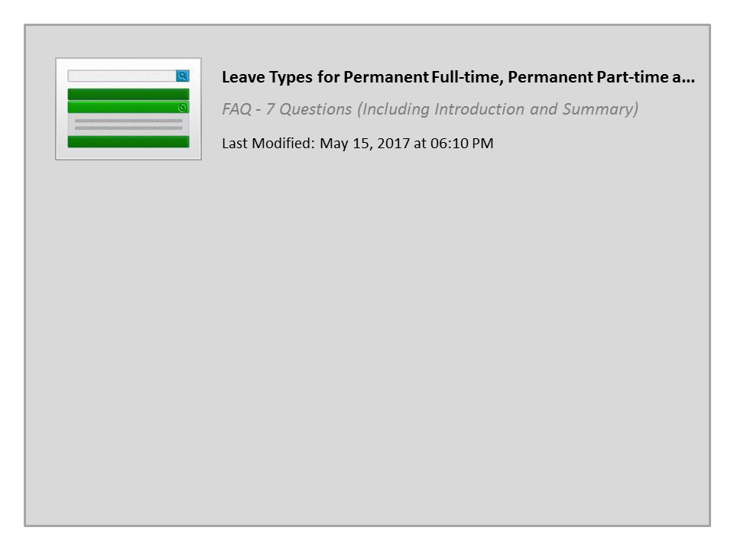
Leave Types for Permanent Full-time, Permanent Part-time and Winter Permanent Part-time

Slide 78
CDOT Holidays
Public Holidays
Independence Day
Labor Day
Columbus Day
Veterans Day
Thanksgiving Day
Christmas Day
New Year Day
Martin Luther King Day
President’s Day
Memorial Day
The list to the left are the public Holidays for all Permanent Full-time, Permanent Part-time and Winter Permanent employees.
Click HERE for a list with dates for this and the next fiscal year.
Notes:
Permanent Full-time, Permanent Part-time or Winter Permanent employees are eligible to take all of the Holidays listed on the left of the screen. If you would like a list with the dates click on the word Here and a webpage will display with the holidays for the current and next years’ holidays.

Slide 79
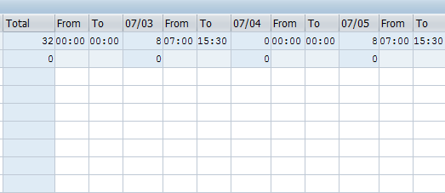
CDOT Holidays and Your Timesheet
On a holiday your timesheet will:
Reduce your work schedule by eight hours (see red circle)
Display hours if you normally work more than eight hours in your work schedule
Show the correct number of hours you need to work
Notes:
If you are normally scheduled to work on a day that a holiday falls then your work schedule will be reduced by eight hours. You do not need to enter anything on you timesheet to get paid for the holiday. If you are normally scheduled to work more than eight hours on the day of a holiday you must work the additional hours or use leave to cover the hours. For example, if you worked a 10 hour day on Monday and this was the holiday you would be required to account for the two extra hours by working the two hours or by entering leave. The timesheet will show the correct number of hours planned based on your assigned work schedule.

Slide 80
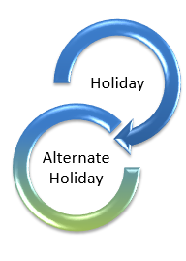
Alternate Holidays
Can only be used by Permanent Full-time employees
If you work on, or are scheduled off on the same day as a State holiday, you are given up to 8 hours of holiday leave
If you are normally scheduled off, then 8 hours of holiday leave is automatically displayed on your timesheet
If the holiday is worked, entering A/A Type 061N or 061P creates an Alternative Holiday leave bank
Enter 141P or 141N to use the bank
Holiday
Alternate Holiday
Notes:
If you are a full time employee and are normally scheduled off on the day a holiday falls, you will automatically earn eight hours of alternate holiday leave. Alternate Holiday is time earned when you work on a State holiday or are scheduled to be off on the same day as a State holiday. You will be given up to 8 hours of holiday leave to use in the future. Just note that the holiday you worked must be approved by the Supervisor prior to being used.

Slide 81
Additional Leave
Administrative
Bereavement
Family Medical
Jury
Leave Grant
Exempt Time Off
Injury / Make Whole
Military
Victim Protection
In addition to the types of leave already discussed, there are other types of leave available to you
Click the Resources link to display Understanding Leave Types Reference.
Notes:
The table on this slide shows you additional leave types that are available to you. Because these are less common we have created a reference guide for you. Click on the Resources link and then select the Understanding Leave Types Reference document. The guide includes the name of the leave type, a brief description of when it would be used, who is eligible for the leave, the Attendance and Absence Codes used to enter the leave and what you need to know about when you are using the leave.

Slide 82
Create a Leave Request
Scenario:
You have been selected for Jury duty and need to enter your leave prior to your service.
Notes:
Now that we understand the types of leave that are available let’s look at how to enter leave into the system. To enter leave you will need to know the type of leave you are entering. In this example, you have been selected for jury duty. As with some leaves you may need to provide documentation to your supervisor. In this case, you need to provide your jury summons.

Slide 83

“Zero out” Approved Leave
Zeroing out an existing approved leave entry you ensures:
There is record of the change and change approval
Your Supervisor is automatically notified of the timesheet change
The time is credited back to your leave bank
Notes:
There may be times when you plan to take leave and then change your plans after you’ve entered the leave, it’s been approved and the leave has been deducted from that leave bank. If this occurs you need to “Zero out” your leave. When you “zero out” a leave entry, the leave is returned to your leave bank, there is a record of this change and your supervisor is notified of the change to your timesheet.

Slide 84
“Zero out” Approved Leave
Scenario:
You have been selected for Jury duty for two days, but you were not selected. You are “zeroing out” the leave you did not take.

Slide 85
TEMP EMPLOYEE SECTION

Slide 86
Roles and Responsibilities in the Leave Process
Employee
Supervisor
Appointing Authority
Timekeeper
Notes:
Now that you are familiar with the process let’s look at the roles in more detail. There are a lot of roles working together to ensure the leave process goes smoothly. The first role is that of the employee. As an employee, you must enter your leave requests according to the needs of your department and workgroup. As a Temporary employee, the only leave you will enter on your timesheet is Jury and Administrative. If you are taking time off for another reason you need to let your supervisor know as soon as possible. Your supervisor and timekeeper are there to help you with any questions you have.

Slide 87
Communication is Key
Employee
Supervisor
As an Employee you are responsible for:
Understanding your workgroup’s leave processes and supervisor expectations
Timely communicating you are taking leave
Entering your leave (Jury or Administrative) request correctly and on time
Quickly responding to timesheet errors
Verifying your leave has been approved
Your Supervisor is responsible for:
Communicating your workgroup’s leave processes and expectations
Approving or rejecting your leave request
Quickly responding to timesheet errors
Verifying your leave (Jury or Administrative) request entry
Notes:
Communication about the leave process is critical. As a employee, you need to make sure that you have talked to your Supervisor about leave so that you understand the process for your workgroup.

Slide 88
Temporary Employee Leave
The State provides two types of paid leave:
  Jury
  Administrative
Do not accrue annual or sick leave
State holidays are not paid
Only Jury and Administrative leave are entered on your timesheet
All other leave types are not entered on your timesheet, but must be communicated to your supervisor
Notes:
As a Temporary Employee you need to enter Jury and Administrative leave because you are paid for this type of leave. Because you do not receive other types of leave they do not and should not be entered on your timesheet. However, if you are taking time off you need to communicate this to your supervisor.

Slide 89
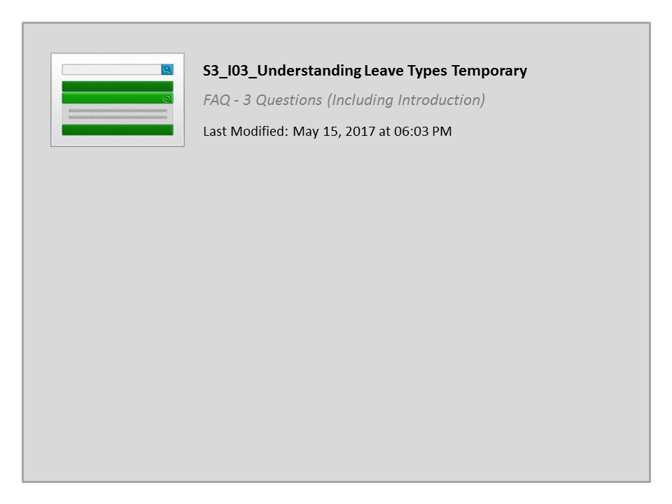
S3_I03_Understanding Leave Types Temporary

Slide 90
Create a Leave Request
Scenario:
You have been selected for Jury duty and need to enter your leave prior to your service.
Notes:
Now that you understand the types of leave that are available let’s look at how to enter leave into the system. To enter leave you will need to know the type of leave you are entering, in this example, you have been selected for jury duty. As with some leave types you may need to provide documentation to your supervisor. In this case, you need to provide your jury summons.

Slide 91
“Zero out” Approved Leave
Zeroing out an existing approved leave entry you ensures:
There is record of the change and change approval
Your Supervisor is automatically notified of the timesheet change
The time is credited back to your leave bank
Notes:
Because you have to enter leave before you take it, there may be times when things change and you end up working instead of taking leave. If this occurs you need to “Zero out” your leave. When you do this you leave the record of the change, your supervisor is notified of the change to your timesheet and your leave is returned to your leave bank

Slide 92
“Zero out” Approved Leave
Scenario:
You entered Thursday as sick leave, but ended up feeling better and came into work. Your Supervisor is not sure if she approved the time so you are checking the approval status of the time to determine how you should make the change.

Slide 93
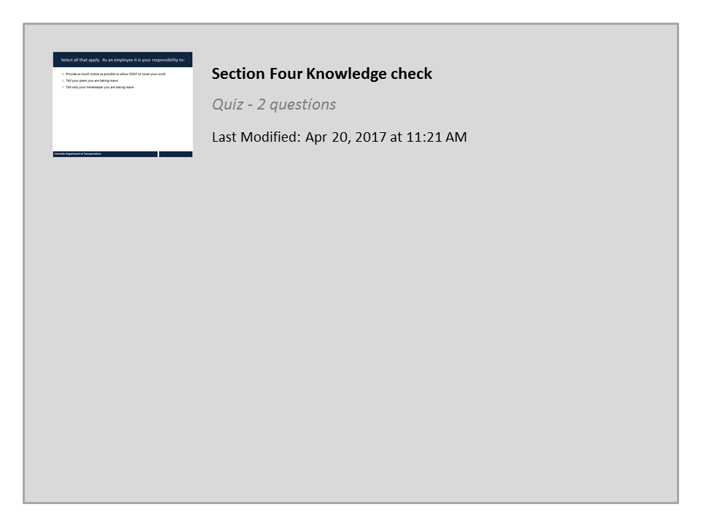
Section Four Knowledge check

Slide 94
Section 5 - Timesheet Verification
Section 1 – Time Entry Overview
Section 2 – Time Entry Process
Section 3 – Work Time Entry
Section 4 – Leave Time Entry
Section 5 – Timesheet Verification
Notes:
This course is broken out into the Learning Logistics introduction and five sections on time entry:
In the Learning Logistics section you will learn about the prerequisites, navigational tools and objectives for the course.
The Time Entry Overview section you will show you why time entry is important to you and to CDOT, the rules and policies governing time entry and how time entry and this course relate to the mission, vision and values of CDOT.
The Time Entry Process section you teach you about the time entry process including deadlines, the roles and responsibilities. You will also complete the Employee Time Entry Guide using your Employee Time Statement. The information gathered on the guide will be used throughout the course to help you understand how to enter your time.
In the Work Time Entry Section, you will learn about how to navigate and enter time on your timesheet,
In section four, Leave Time Entry, you will learn about the types of leave available to you, how they accrue and how to enter leave. You will also learn about how to use the Leave Summary and Use or Lose reports to determine how much leave you have available.
In the Timesheet Verification section you will learn how to verify the status of your timesheet, read common errors and what the process is for making changes.
The final section, the Conclusion, summarizes what you have learned and where you can find help.

Slide 95
Section 5 Learning Objectives
At the end of this section, you should be able to:
Verify the status of your timesheet entries
Describe the difference between planned working time and actual working time
Identify common errors on your timesheet
Explain when time entries need to be revised and explain the process for changing time entries
Notes:
Take a moment to review the learning objective for this section. When you are done, click the Next button to continue.

Slide 96

Verify Your Time
When verifying your timesheet make sure:
All scheduled hours are accounted for
All time is approved
SAP helps verify timesheet entries based on time rules.
This helps prevent you from making time entry mistakes
SAP does not prevent all errors - pay attention!
You are accountable for your time entry and verification
Notes:
Before you save and verify your time, you should make sure you have accounted for all of you time entry and that all of the time has been approved. SAP will help you with the verification of time by verifying your time against the time entry rules. While this helps to eliminate some of the most common errors, it does not eliminate all errors and does not replace a good review of what you have entered. Remember, when you enter time you are accountable for the entry and verification of your timesheet and that the time you enter is the how you will be paid.

Slide 97
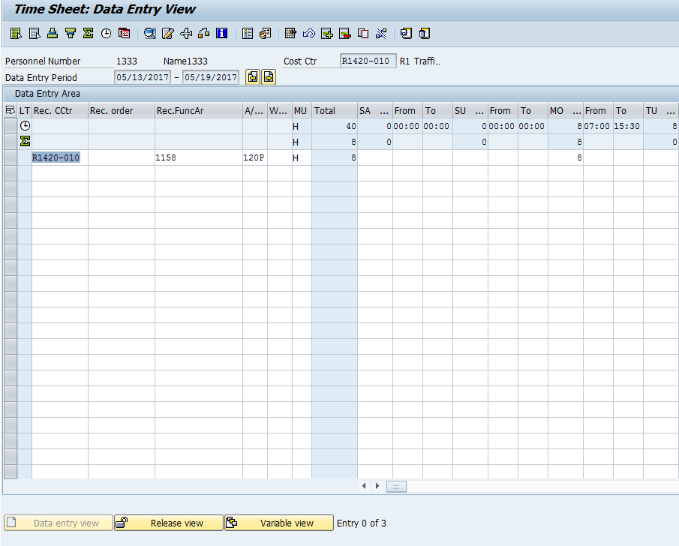
Planned and Actual Time
Notes:
Another way to avoid time issues is to understand the information on your timesheet. Your planned time is based on your assigned work schedule. This is the first row with the clock, your target hours, shows you the number of hours you are expected to work for the week in the total column. The actual hours, the second row, with the green sum icon will add up the number of hours you enter on the timesheet for the week in the total column. The actual hours should meet or exceed the target hours through a combination of leave or working time. If your planned hours exceed your target hours, be sure to review your timesheet to determine if leave or overtime needs to be adjusted. The exception is bi-weekly employees, who are not always required to meet their target hours for the week.

Slide 98
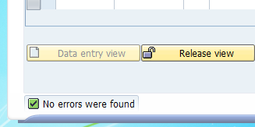
SAP Timesheet Messages
When verifying your time entries, check for messages on your screen:
No errors were found
Review entries and continue
Errors exist and must be
fixed before continuing
Notes:
SAP generates messages to ensure time is entered on your timesheet correctly. Some of these messages provide general information while others are errors that must be fixed before you are able to release and save your time entries. When you verify the status of the time there are three types of messages, each with their own icons, that you need to know about. The icon that displays to the left of the message tells you what kind of message it is . The most common is the green checkbox. This is an informational message that indicates that no errors were found and you can proceed with releasing and saving your time entry. The next is the yellow warning, which displays if you need to review your entries before you continue. This message will not stop you from entering your time, it is only a warning. The last icon is a the red exclamation point. This is a hard stop and means you have an error and will not be able to release and save your time. When you are entering time pay attention to these messages as they are your first line of defense in entering time correctly. Let’s take a look at some of the most common warning and error messages for time entry and how to resolve them.

Slide 99

Comp Time

Slide 100
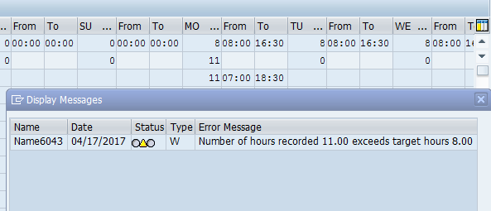
Number of Hours Exceed Work Schedule
What it is:
When more hours are entered than are in your daily work schedule
Type of message:
Warning (Review and Change/Save)
What to do:
Read the message!
Verify the start and end times entered on the timesheet are correct
Verify the correct A/A Type is used
Notes:
SAP expects you to work the number of hours planned based on your daily work schedule. When you work more hours than planned, the system generates this warning message. Because this is only a warning message you are able to click enter and the system will accept the hours. If you are not eligible for overtime, and you worked the hours this is your best option. If you worked over 40 hours for the week and are overtime eligible, then you may want to code the additional hours as overtime. To do this, enter the hours you worked as regular working time and the remaining hours outside of your work schedule, as overtime. In this example, you would have three hours of overtime, and the message will still appear when you release and save your time.

Slide 101
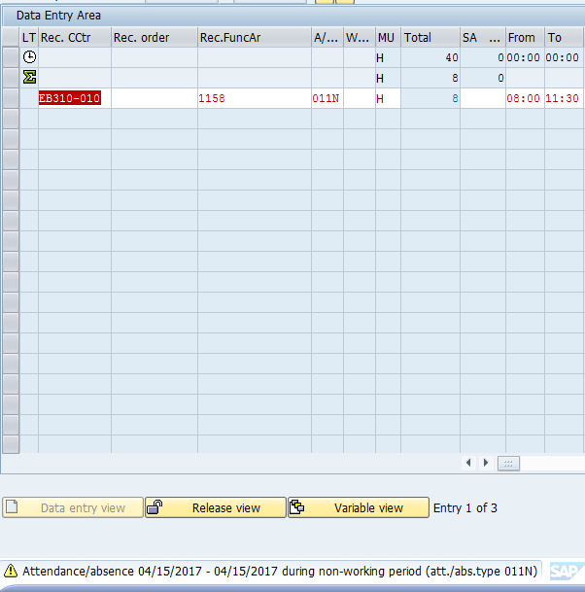
Attendance to a Non-working Time
What it is:
Working time is entered on
a non-work day
Type of message:
Warning (Review and Change/Save)
How to fix it:
Read the message!
Verify the start and end times entered on the timesheet are correct
Verify the correct A/A Type is used
Click “Enter” to clear the message
Notes:
When you enter time on a day you are scheduled off SAP generates a warning message because you are not expected to work on this day. This is just a warning message to review your time. Since this is only a warning, you can click enter to accept the hours after reviewing for accuracy. If the hours and A/A type are entered correctly then you will need to click enter for every non-work day entry to return to your timesheet and release your time.

Slide 102
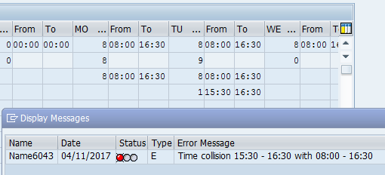
Time Collisions
What it is:
A time collision is when two time entries overlap
Type of message:
Hard Stop (must be fixed to save)
How to fix it:
Review the error message for the date and time of the collision
Change the times so they do not overlap
Notes:
Let’s look at some of the most common timesheet errors. The first is a time collision. This occurs when two time entries overlap. In this example, regular working time was entered for 8:00 to 16:30. There was also sick time entered from 15:30 to 16:30. Because the sick leave and the regular working time are both entered from 15:30 to 16:30 then SAP is telling you to make a correction because you can not be on leave and work at the same time. This kind of error is easy to fix. All you need to do is change the sick or regular working time so they do not overlap.

Slide 103
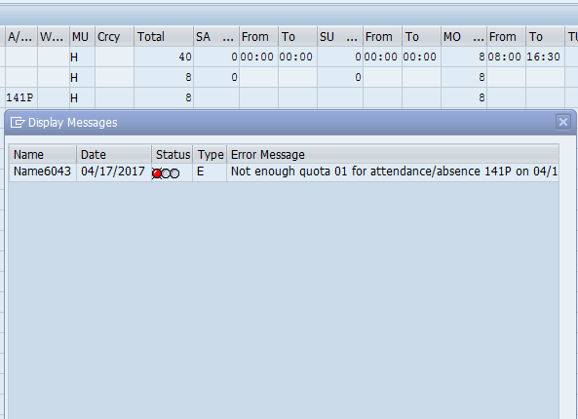
Not Enough Quota
What it is:
You have not earned enough of the type of leave you want to use
Type of message:
Hard Stop (must be fixed to save)
How to fix it:
View error message to see the type of leave that is unavailable
View the Leave Summary Report to see your available leave balances
Talk to your Supervisor or Timekeeper for options
Notes:
When you are entering leave you must have leave available in your leave bank before you can code it to your timesheet. For example, if you wanted to take 40 hours of vacation a month from now and currently have only 32 hours of annual leave in your leave bank, then you would only be able to enter 32 hours of annual leave. You will have to wait until leave is accrued again to enter the additional 8 hours. Remember you cannot use leave prior to the date it is earned. If you do not have enough leave then you should contact your Supervisor or Timekeeper for assistance.

Slide 104
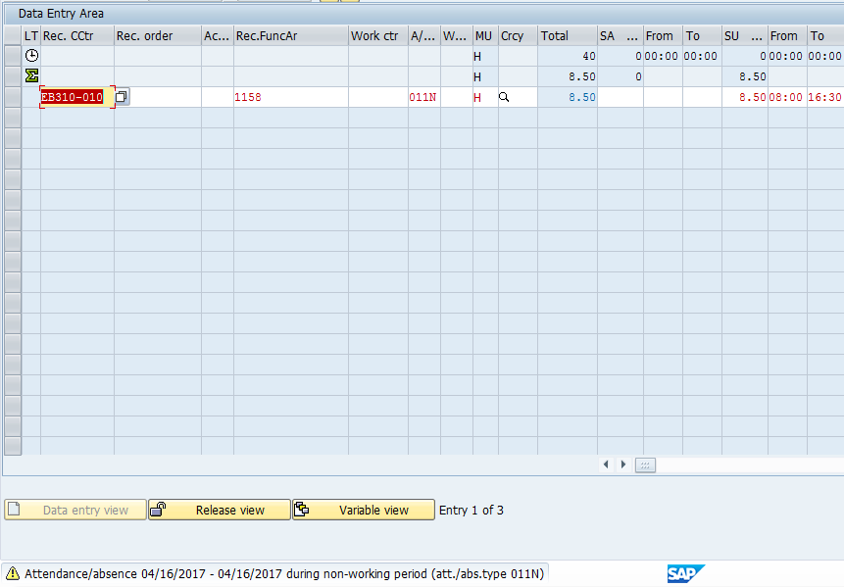
Absence to a Non-Working Time
What it is:
Leave is entered during unscheduled hours
Type of message:
Hard Stop (must be fixed to save)
How to fix it:
Read the message!
Delete the leave entered
Enter leave only during planned hours
Notes:
If you try to enter leave when you are not scheduled to work this message will display. To accurately report when you are on leave you must have the correct work schedule assigned. If you need to have your work schedule changed, contact your supervisor.

Slide 105
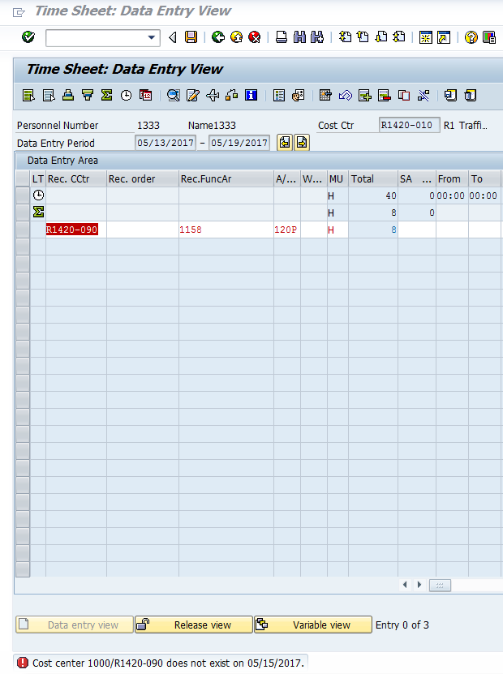
Invalid Work Order or Cost Center
What it is:
The Work Order, WBS element or Cost Center is not valid
Type of message:
Hard Stop (must be fixed to save)
How to fix it:
Verify the correct Work Order or Cost Center
If your work order or cost center is correct, contact your timekeeper
If your work order or cost center is NOT correct, update your timesheet
Notes:
In some cases, you may encounter that a work order, WBS element, or cost center is closed, invalid, or does not exist. When you get this error, you should verify your entry to determine if it is correct and if it is then contact your timekeeper to let them know there is a problem. By entering your time as soon as it worked, and correcting errors promptly you can avoid this error. If the work order, WBS element or cost center is not correct enter the correct one to clear the error. You must fix or delete the entry before you can continue entering time or exit the timesheet.

Slide 106
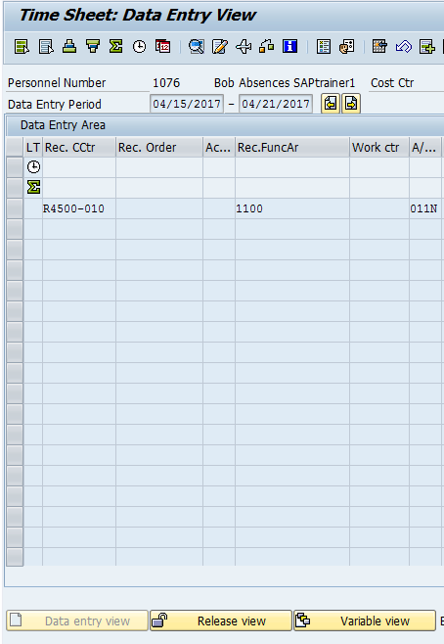
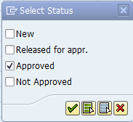

Variable View (checking the status of your time)
Clicking on the Variable view button displays the status of your time entries. Select the status you want to view:
New – Displays “in process” entries
Released for appr. – Displays time you have released to your supervisor (but is not approved)
Approved – Displays the time approved by your supervisor
Not Approved – displays all unapproved time
1
2
3
Notes:
One way to verify you are paid correctly is to verify your timesheet has been approved by the payroll deadlines. This is done by checking on the variable view button as shown by the with the first arrow. Once you click this button, the Select Status screen will display as shown by the second arrow. From here you can check the status of your time. It is best to select only one status at a time. Once a status has been selected, click on the green check mark and the entries in that status will be displayed in blue text as shown by third arrow. For example if you check the Approved status, all time entries that have been approved will be displayed in blue. The other helpful statues you can display are New, which displays time that is in process and Released for approval, which is time you have released to your supervisor, but has not yet been approved. It is best to check on Tuesday as the weekly approval deadline is on Monday and prior to any payroll deadlines.

Slide 107
Display Timesheet (Variable View)
Notes:
Now let’s go into your timesheet to show you how to use the variable view to determine if the time you have submitted has been released for approval, approved of not approved.

Slide 108
Timesheet Change Process
If time has been approved, zero-out the time, enter the correct time and release both entries
OR
If time or leave has not been approved or has been rejected, make the change
Yes
Additional changes
Yes
Zero Out Leave or Change Work Time
Contact Supervisor
Supervisor Approves Entries/Zeroes
Incorrect Time Entry
No
Time Approved
Change the time entry
Release and Save Time
Done
No
Notes:
If you discover you have made an error, or the actual time you have worked changes, then you need to change your timesheet. Determine the status of the time entry that needs to change. If you find that your time has been approved then you will need to zero-out the approved time entry and release the zero time for approval. Approval of the zero time will clear the incorrect entry. After the zero is approved enter the correct time and release and save your timesheet. If it has not been approved or has been rejected you can make the change to your time immediately and release and save your timesheet. If you are making an adjustment to leave, your supervisor will receive an email from SAP about the change. If you are making a change to any approved time entry, you should let your supervisor know so they can approve the updated time entries.

Slide 109

Timesheet Revisions
The scroll-back limits for timesheet revisions are:
2 weeks for bi-weekly paid employees
5 weeks for monthly paid employees
12 weeks for your Timekeeper
Current period Start
You timesheet
Timekeepers
Paid Monthly
Paid Bi-weekly
Timekeepers can change to 12 weeks
Monthly paid employee can go back 5 weeks to make changes
Bi-weekly can go back 2 weeks to make changes
Contact your Timekeeper
Contact your Timekeeper
Notes:
We all make mistakes sometimes. If you are paid bi-weekly (Permanent Part-time, Winter Part-time or Temporary employee), then you are able to make changes 2 weeks prior to the current week. If you are paid monthly (Full-time employee), which can be found on line 11 of the Employee Time Entry Worksheet, then you can make changes to your timesheet five weeks prior to the current week. Your Timekeeper is able to make any changes in SAP up to 12 weeks beyond the current period. If you need to change your timesheet beyond 12 weeks contact your timekeeper. This is why it is important to keep your timesheet current.

Slide 110
Change Approved Time
Notes:
Now that the process to change your time has been covered, let’s look at how to zero out time that has already been approved by your supervisor.

Slide 111
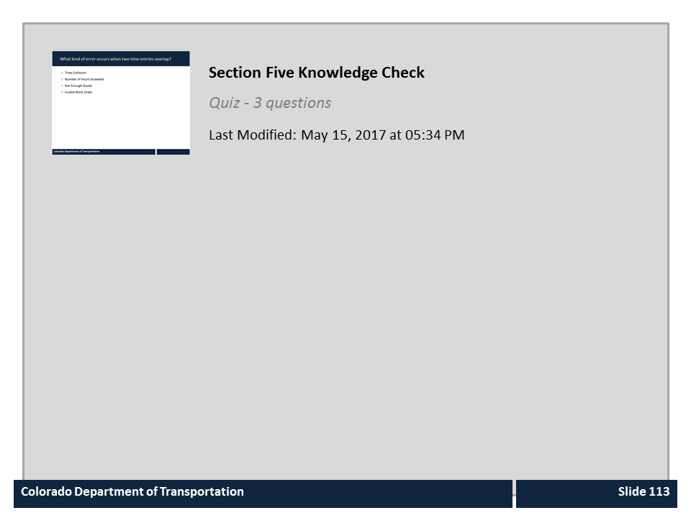
Section Five Knowledge Check

Slide 112
Learning Logistics
Section 1 – Time Entry Overview
Section 2 – Time Entry Process
Section 3 – Work Time Entry
Section 4 – Leave Time Entry
Section 5 – Timesheet Verification
Notes:
This course is broken out into the Learning Logistics introduction and five sections on time entry:
In the Learning Logistics section you will learn about the prerequisites, navigational tools and objectives for the course.
The Time Entry Overview section you will show you why time entry is important to you and to CDOT, the rules and policies governing time entry and how time entry and this course relate to the mission, vision and values of CDOT.
The Time Entry Process section you teach you about the time entry process including deadlines, the roles and responsibilities. You will also complete the Employee Time Entry Guide using your Employee Time Statement. The information gathered on the guide will be used throughout the course to help you understand how to enter your time.
In the Work Time Entry Section, you will learn about how to navigate and enter time on your timesheet,
In section four, Leave Time Entry, you will learn about the types of leave available to you, how they accrue and how to enter leave. You will also learn about how to use the Leave Summary and Use or Lose reports to determine how much leave you have available.
In the Timesheet Verification section you will learn how to verify the status of your timesheet, read common errors and what the process is for making changes.
The final section, the Conclusion, summarizes what you have learned and where you can find help.

Slide 113
Course Summary
You should now be able to:
Explain why time entry is important to the Employee and to CDOT
Describe the roles and responsibilities in the time entry process
Identify common errors on your timesheet
Enter and release attendance and absences in SAP
Use best practices for making sure your timesheet is correct
Identify who to contact if you have questions about time and leave
Notes:
Take a minute to review what you have learned from the course. If there is anything that is unclear, you can use the menu to navigate to the section or use the search feature. When you are done, click the Next button to review the resources available to help you with time and leave approval.

Slide 114

Where Can I Get Help?
For additional assistance contact:
  Rachel Grafton:
    Email: Rachel.Grafton@state.co.us
    Phone: 7-9081
The following resources are also available:
Work Schedule Report to find the Timekeeper of a specific employee
Payroll Office
Notes:
Notes:
Remember, you are not alone. If you run into technical problems or have policy questions, contact Rachel Grafton at extension 7-9081. Other resources available to help you include, your HR Timekeepers and the Payroll Office. A list of timekeepers can be found in the Work Schedule Report under the Resources link. For Payroll related questions, use the Payroll Office Contact link, which is also located in the resources tab. If you have not already done, so it would be a good idea to bookmark these resources before you continue.
Now let’s look at what you need to do to get credit for the course.

Slide 115

Course Complete
Congratulations, you have completed the Introduction to SAP Time Entry course!
To confirm you have completed the course, complete the following assessment.
For course credit, you must achieve a score of at least 70%. Please remember you can take the course as many times as you want until you achieve this score.
And remember, once you click the “Submit” button the question is locked and you can no longer change your selection.
Notes:
Congratulations on completing the Introduction to SAP Time Entry course! The final step is for you to take a short quiz to get credit for this course. You must get a score of at least 70% to pass and you can take it as many times as you like. Good Luck!

