Slide 1
Notes:
This is a hidden slide, and only available in Notes Page View.
It functions as the Cover Page of the Conclusion Section. This slide remains here and is not removable.
To customize the notes content in Notes Page View: Click on “VIEW” tab → Select “Notes Page” → Double click the page, an Microsoft Word document would pop up → Click on “Course Title” and type in the training course title → Click on the margins or close word. The changes you made will be automatically saved into PowerPoint.
Notes:
SAP Time Entry for Maintenance
Maintenance Training Academy
Fiscal Year, 2018

Slide 2
SAP Time Entry for Maintenance
Maintenance Training Academy
FY2018
Notes:
Instructor Notes:
This is the introduction to the course. Take a moment to:
Introduce yourself if you are not know to all of the participants
State that the course will take four hours to complete with breaks
Assess the experience of the participants by asking:
Who has not entered time in SAP?
Who has 1 week to 3 months experience entering time?
Who has 3 to 6 months experience?
This course is designed to help Maintenance personnel:
Understand how to enter time and leave to ensure prompt and accurate pay
Resolve common timesheet issues
Understand the approve processes and deadlines
This course is expected to take about four hours to complete with breaks.

Slide 3
Table of Contents (Hidden)
Notes:
This is a hidden slide, and only available in Notes Page View.
It functions as the Table of Contents of the training course. This slide remains here and is not removable.
To customize notes content in the Notes Page View: Click on “VIEW” tab → Select “Notes Page” → Manually type in the Section Number, Title Name, and according Notes Page Number → To add more lines: Click the “LAYOUT” tab, select “Insert Below” or “Insert Above” up to your choice.

Slide 4
Course Agenda
Section 1 – Review of SAP Time Entry Course
Section 2 – Overtime and Wage Types
Section 3 – Timesheet Collisions and the Work Order
Section 4 – Leave Entry and Alternate Holiday
Section 5 – Earning and Using Comp Time
Notes:
Instructor Notes:
Remind the participants this course builds on the skills they learned in the Introduction to SAP Time Entry course.
Provide a brief explanation of each of the sections based on the following:
Section 1 – Reviews the main concepts of the SAP Time Entry course and reviews the concepts introduced by the eLearning
Section 2 - Explains how to enter time to a work order and when you should enter overtime and wage types; work schedules and how to enter and release time in SAP
Section 3 - Describes the process of time entry changes and how collisions can be caused by the work order
Section 4 - Identifies the process to enter leave and alternate holidays into the timesheet
Section 5 –Describes how maintenance employees earn comp time and additional regular time and the process for changing time entries
This course is broken out into five sections. They are:
Section 1 – Introduction to SAP Time Entry as introduced by the eLearning
Section 2 - Explains how to enter time, work orders and when you should enter overtime, wage types, work schedules and how to enter and release time in SAP
Section 3 - Describes the process of time entry changes and how collisions can be caused by the work order
Section 4 - Identifies the process to enter leave and alternate holidays into the timesheet
Section 5 –Describes how maintenance employees earn comp time and additional regular time and the process for changing time entries.

Slide 5
Course Learning Objectives
At the end of this course, you should be able to:
Describe the time entry process at a high level including the roles and responsibilities
Identify the required data for entering time to a work order
Describe how and when to enter overtime and shift premium pay
Describe the process for changing entries in your timesheet caused by collisions with the work order
Find an existing work order in SAP
Describe the process for entering hours to a holiday or alternate holiday
Describe how comp time is earned and entered in SAP
Use the Leave Summary Report to display your accruals
Notes:
Instructor Notes:
Take a moment to review the objectives and explain this is accomplished through:
Demonstrations, exercise and questions asked throughout the course
Real-life scenarios based on common time entry errors
Discussions with each other on how to resolve common problems
Explain that is the responsibility of the participant to ensure they are able to enter time correctly and this course is a tool to help them be paid correctly.
The list shows the high level learning objectives for the course.
Upon completing the course you should be able to perform each of the listed objectives.
This slide repeats at the end of the course and you will be:
provided the opportunity to ask questions
Review concepts that were not understood
Asked if you are able to accomplish each of the objectives

Slide 6
Prerequisites
Prior to taking this course you should have taken:
SAP Basic Navigation course
Introduction to SAP Time Entry
Notes:
Instructor Notes:
Explain the following:
Being able to navigate SAP is critical to your success in this course. If you have not already done so, please take the SAP Basic Navigation course when you are able.
If you have not already done so you should take the Introduction to SAP Time Entry course to be able to understand how to enter time and leave into SAP
If you have not already done so, you should take the following courses so you are able to navigate SAP and enter time:
SAP Basic Navigation
Introduction to SAP Time Entry

Slide 7
Learning Logistics
Please ask questions and participate in the discussion
Participate in exercises to practice what is being taught
A Parking lot is used to capture questions that will be covered later in the course
Notes:
Instructor Notes:
Briefly review the content of the slide and explain:
The overall duration of the course and how often you plan to allow for breaks
Remind the participants this is their course and it is their participation that makes the course more interesting
Discuss how the parking lot is used to capture questions which are covered later in the course
Breaks will be provided throughout the course
Instructions will be provided before each scenario and exercise
Datasheets and other handouts will be provided at the time of the exercise

Slide 8
Your Contributions to Learning
Respect participants by silencing your cell phones
Use the Internet and email over break times
Delay your side conversations until break times
Attend the entire course to obtain credit for successful course completion
Notes:
Instructor Notes:
Remind the participants to:
Turn off, or silence your cell phones
Refrain from browsing the Internet, sending/reading text messages, or sending/reading e-mails during class
Participate in the course and listen, and ask questions to the whole group
Get credit for the course they cannot miss more than 15 minutes
During the course, please:
Silence phones and tablets
Use the computers only for training purposes
Participate and ask questions
Attend the entire course to get credit

Slide 9
Terms and Concepts
Throughout the course we will be introducing new terms and concepts
If you don’t know what a term means:
Please ask (if you are uncertain, you are not the only one)
The Introduction to SAP Time Entry course contains a glossary of terms
A Glossary of Key Terms is located at the end of the course
Notes:
Instructor Notes:
Tab 01 – Terms and Concepts
The most common terms and concepts have been collected at the end of the course for the instructor
Encourage participants to ask about terms used in the course
Remind participants the Introduction to SAP Time Entry course contains resources that can help them with time entry
If you do not know a term or concept ask
The Introduction to SAP Time Entry course contains a glossary with the most common time entry terms
A glossary of key terms is located in the glossary of this course

Slide 10
Notes:
This is a hidden slide, and only available in Notes Page View.
It functions as the Cover Page of the Conclusion Section. This slide remains here and is not removable.
To customize the notes content in Notes Page View: Click on “VIEW” tab → Select “Notes Page” → Double click the page, an Microsoft Word document would pop up → Click on “Course Title” and type in the training course title → Click on the margins or close word. The changes you made will be automatically saved into PowerPoint.
Notes:
Section 1
Review of SAP Time Entry Course

Slide 11
Course Agenda
Section 1 – Review of SAP Time Entry Course
Section 2 – Overtime and Wage Types
Section 3 – Timesheet Collisions and the Work Order
Section 4 – Leave Entry and Alternate Holiday
Section 5 – Earning and Using Comp Time
Notes:
Instructor Notes:
Inform the participants that:
This is the first section of the course and is a review of the eLearning course the participants have already taken
It should take about 15 to 20 minutes to complete
The following is the course agenda.
This section of the course should take about 15 to 20 minutes to complete.

Slide 12
Section 1 - Learning Objectives
At the end of this section, you should be able to:
Describe the time entry process, roles and their responsibilities
Describe the importance of the work schedule
Describe the types of time entry
Explain the importance of the Employee Time Entry Worksheet
Enter and release working time
List the payroll deadlines for Maintenance employees
Notes:
Instructor Notes:
Review each of the learning objectives and explain that they correspond to a slide, or a series of slides, in this section of the course
By the end of this section, you should be able to perform each of the listed objectives with the support of the training materials
The section objectives are tied directly to the course objectives reviewed at the end of the course
These are the learning objectives for this section. By the end of the section you should be familiar with each of the objectives.
These objectives are tied to the course objectives which will be reviewed at the end of the course.

Slide 13
Time Entry to Pay Process and Responsibilities
Enters Time Worked
SAP
Validates and Transfers Time Entries
Supervisor
Approves and Rejects Time
Timekeeper
Posts Payments
Payroll
Helps All Roles with Time Entry
Employee
Notes:
Instructor Notes:
This is an animated slide when you advance to the next slide, the role will move to the responsibility. Work your way down the list and ask the participants to match the process to the role. The bolded items below are the answers and are in the order of the left side of the slide. Use the bulleted list to provide additional details about the responsibility of the role.
Enters Time Worked - Employee
Accounts for all of the leave and work time based on their work schedule
Saves their time (both released and unreleased)
Releases their time so their Supervisor can approve it
Communicating to their Supervisor about any time entry that is different prior to submitting
SAP - Validates and Transfers Time Entries
SAP validates time entries by checking for missing information
SAP also validates time entries against the rules for time entry by employee type
Supervisor - Approves Time and Rejects Time:
Supervisor reviews submitted time
Supervisor approve or reject time based on policy and their knowledge of your working time or leave taken
This process continues until all of your time or leave is approved
SAP – Validates and Transfers Time Entries:
Adjusts your leave banks, if applicable
Prepares your time for Payroll processing
Payroll – Posts Payments
Payroll pays the you based on your time entry
Posts changes to general ledger accounts
Timekeeper – Helps All Roles with Time Entry
Timekeepers are present throughout the process to help you with questions and understanding the requirements of time entry.
Provides assistance throughout the process to all roles
Answers questions about time from any of the roles
Works with the employee where there is more complex time entry processes
The time entry process begins when you enter your time and ends when you are paid.
It is comprised of five main steps they are:
Time entry,
Data validation,
Approval of time,
Transfer and
Evaluation and posting of payment.
The time data is reviewed during each of the steps with the goal of incorrect time entries being corrected and you being paid correctly.

Slide 14
Time Entry to Pay Process and Responsibilities
Enters Time Worked
Tells you how to Enter Time and Leave
Employee
Validates and Transfers Time Entries
Makes Sure you are Paid Correctly
SAP
Approves and Rejects Time
Talks to Supervisor about Time Questions
Supervisor
Posts Payments
Helps with Complex Time Entry
Payroll
Helps All Roles with Time Entry
Timekeeper
Notes:
Instructor Notes:
This is an animated slide when you advance to the next slide, the responsibility will move to the role. The bolded items below are the answers and are in the order of the left side of the slide. Use the bulleted list to provide additional details about the responsibility of the role. When all of objects have moved discuss the connection between the roles.
Employee – Talks to Supervisor about time questions
As a employee you should always enter your time as close to working it so you remember what you did. Employees should:
Make sure that all of their time has been submitted and approved by the payroll deadline
Talk to their Supervisor about the time that should be entered
Supervisor – Tells you how to enter time and leave
In most cases, your Supervisor approves the time you work:
Exceptions are unpaid leave and administrative leave, approved by the Appointing Authority
Making sure you are working the right work schedule
Setting time aside to talk to you about the expectations they have about time entry and leave
Timekeeper
The Timekeeper helps with complex time entry:
Works with you on the time entry process by answering all of the questions you and your supervisor may have about time
Works with you directly if you have more complex time entries
Payroll
Payroll works with all roles to make sure you are paid correctly for the time you have entered
Working with you or your timekeeper and Supervisor directly
Time entry is a team effort that requires all of the roles working together to make sure you are paid. There are four main roles in the time entry process, they are:
Employee:
As an employee you should always enter your time after working it so you remember what you did.
Supervisor / Appointing Authority
In most cases, your Supervisor approves the time you work, makes sure you are working the right work schedule Your Supervisor should set some time aside to talk to you about the expectations they have about time entry and leave.
Timekeeper
Your Timekeeper is responsible for working with you on the time entry process by answering all of the questions you and your supervisor may have about time.
Payroll
Payroll is responsible for making sure you are paid correctly for the time you have entered. In this role, they may work with your Timekeeper and/or Supervisor directly.

Slide 15
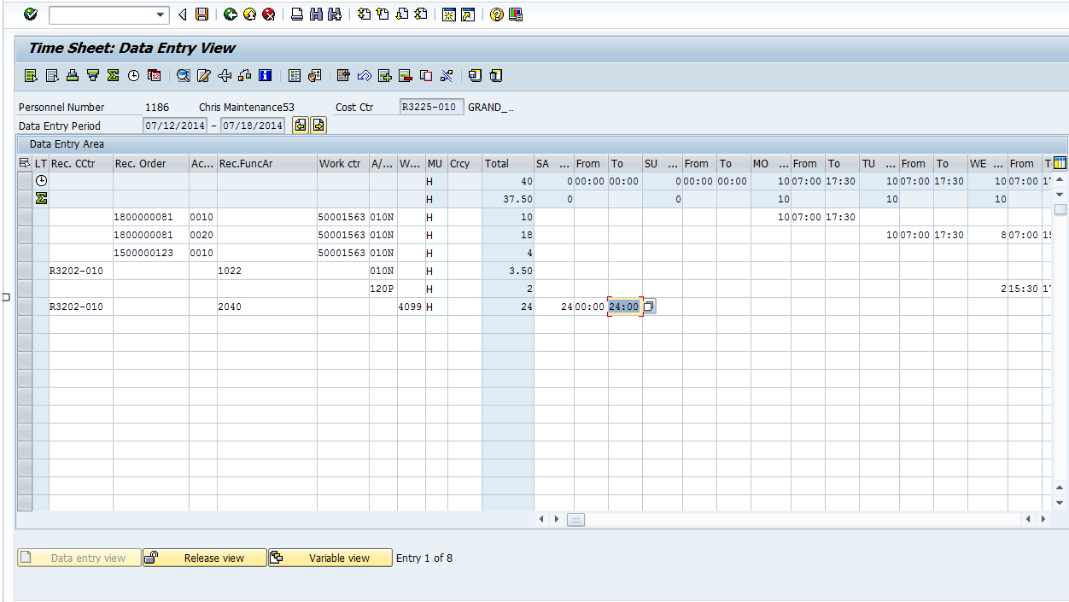
Your Work Schedule
True or False:
There is a line on your timesheet that allows you to see your work schedule.
True or False:
Your work schedule shows the time you are scheduled to work and the time you are not.
True or False:
Only working time counts towards your total hours worked in the week.
TRUE
False
False
Notes:
Instructor Notes:
This is an animated slide with three questions. When you click the Next button the question will change to an answer. This is the process for all three questions.
When asking the questions, don’t give the answer, but draw it out of the participants. Also when participants provide the right answer, give a reason why it is correct.
Your work schedule shows the time you are scheduled to work and the time you are not.
False – Your work schedule shows only the time you are required to account for using a combination of time worked and leave.
There is a line on your timesheet that allows you to see your work schedule.
True – The first line of your timesheet displays your work schedule.
Only working time counts towards your work schedule.
False – You must account for all of the time in your work schedule using a combination of working time and leave.
Your work schedule shows the time you are scheduled to work and the time you are not.
The time you are scheduled to work is planned time
The time you are not is unplanned time
For your planned time you are only able to enter time that applies to your work schedule. However. you would not be able to enter overtime during time you are scheduled to work.
During unplanned time, you would be able to enter overtime.

Slide 16
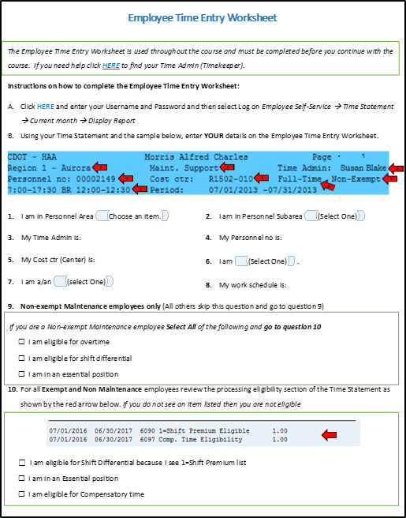
Employee Time Entry Worksheet
The Employee Time Entry Worksheet:
Is your guide to how YOU enter time
Requires you to access your Time Statement to complete
Notes:
Instructor Notes:
Ask how many of the participants have completed the Employee Time Entry Worksheet that was included in the “Intro to SAP Time Entry” course. Check to see if they have questions.
Explain that not all employees enter time the same way.
Provide the following example, or one of your own “For example, an employee in Maintenance who is a winter permanent part-time employee earns overtime, while an employee in the HR department may not”
Explain that the Employee Time Entry Worksheet is designed to help participants better understand how enter time and is found in the “Intro to SAP Time Entry” eLearning course
Encourage participants who have not already completed the Employee Time Entry Worksheet, to do so as soon as are able after class
If you have not completed the Employee Time Entry Worksheet, please do so as soon as you are able.
The Employee Time Entry worksheet can be found in the Employee Time Entry eLearning

Slide 17
Types of Time Entry
1
2
3
4
Notes:
Instructor Notes:
Explain this is a sample of time for a Maintenance employee and discuss what is required for each type of time entry.
Arrow 1 (Work Order entry)
Explain there are three types of work orders: DOT1, Preventive and Fleet:
DOT1 work orders, require an employee to verify the A/A type and time to make sure it is correct based on what they actually worked because the time is transferred from the work order to the timesheet
Preventive and Fleet work orders, do not transfer to your timesheet so you need to add those time entries to your timesheet
Arrow 2 (Cost Center entry)
Explain that time is entered to a cost center for safety meetings or training
Point out that the home cost center is located in the timesheet header, just to the right of your personnel number
Explain that in addition to the cost center the receiving functional Area, A/A Type and the working hours need to be entered
Arrow 3 (Entering Leave)
Explain leave is entering using an A/A type.
Examples of A/A Types include Sick (120P) and Annual Leave (130P) although there are other types of leave
Arrow 4 (Entering Wage Types)
When time is entered to a Wage Type you need to enter the Receiving Cost Center, Receiving Functional Area, the Wage Type and times
CDOT has three Wage Types: 4099 (On-call), 7002 (2nd Shift) and 7003 (3rd Shift)
Wage types 7002 and 7003 are only entered if your work schedule is 2nd or 3rd shift and you are required to attend a mandatory event during first shift hours
The slide to the left contains four types of time that you may enter as a Maintenance employee. They are:
Arrow 1 (Work Order entry)
This is an example of a work order entry for time.
Arrow 2 (Cost Center entry)
This is an example of time entry to a cost center. In some cases, such as safety meetings or training, you may need to enter your time to a cost center.
Arrow 3 (Leave Entry)
This is an example of entering leave into the timesheet. When you enter leave you do so by entering in an A/A type.
Arrow 4 (Wage Type Entry)
This is an example of time entry to a wage type. When you enter time to a wage type you must enter a Receiving Cost Center, Receiving Functional Area, the Wage Type and time.
CDOT has three Wage Types:
4099 (On-call)
7002 (2nd Shift)
7003 (3rd Shift)
Wage types 7002 and 7003 are only entered if your work schedule is 2nd or 3rd shift and you are required to attend a mandatory event during first shift hours

Slide 18
Work Orders and Time Entry
All of your working time is typically entered to a work order
DOT1 work orders transfer the time to your timesheet
Preventive/Fleet work orders are entered on the timesheet
Time cannot be entered or transferred unless a work order has been created
Maintenance Staff -
Creates and releases the work order
DOT1 Work Orders:
Transfer to the timesheet
Employee reviews and enters
Employee -
Releases and saves time to the work order in the timesheet
Preventive/Fleet Work Orders:
Do not transfer to the timesheet
Employee enters in timesheet
Notes:
Instructor Notes:
This is a review, keep the discussion at a high level. Discuss each of the following:
Most Maintenance and Tunnel time is entered to a work order, exceptions include (Safety Meetings and Training)
How it helps CDOT to track labor costs and work activities
Time cannot be entered or transferred until the work order has been created and released in SAP
Review the graphic and explain each of the bullets for the graphic and add any experience you may have had that can help the participant to learn. For example, being contact by your supervisor because you did not release you time.
Maintenance Staff
Are required to ensure their time is entered to their timesheet either via the work order or by entering the time directly
All time must be entered and released by the payroll deadlines. Failure to do can impact when you are paid for special pay.
DOT1 Work Orders
Transfer to the timesheet at 06:00, 18:00 and Midnight
The employee is responsible for the correct entry this means reviewing the time transferred from the work order
Preventive and Fleet Work Orders
Do not transfer to the timesheet, so the time must be entered by the employee
Review these entries to make sure they are correct
Employee Releases and Saves Time to the Work Order in the Timesheet
If the employee does not save time then it will need to be re-entered
Time must be released and that this is how the supervisor is notified to approved
As a Maintenance or Tunnel employee:
The work order must exist before the time is entered
Time is entered to a DOT1 or Preventive work order
DOT1 work orders transfer to the timesheet three times a day:
06:00
18:00
Midnight
Preventive work orders do not populate to the worksheet you must enter the time
Work Orders require entry in the following fields:
Work Order Number
Activity
Work Center
A/A Type
Working time (To and From)

Slide 19
Time Entry Deadlines
If you are a Full-time Employee:
All time should be entered weekly
All entries and revisions must be approved by 5:00 pm on the second day of the following month
If you are a Temporary, Winter Part-time, Permanent Part-time:
All time should be entered daily
All entries and revisions must be approved by 5:00 pm Monday
If you are using Leave Without Pay (LWOP):
All time entries (everything for the month) must be entered and approved by the 15th of the current month in which LWOP is being used
Notes:
Instructor Notes:
Walk through the time entry deadlines:
Explain each of the time entry deadlines from the slide
Provide an example of each of the deadlines and what is means
Explain that each role employee, supervisor, timekeeper and payroll
Important:
If you use Leave Without Pay for any reason then your time entry deadline changes to the 15th of the month where LWOP is being used.
Different employees have different deadlines for time entry and approval of working time.
Full-time employees
Entered weekly
Due 5:00pm 2nd day of following month
Temp, Winter and PPT
Entered daily
Approved by 5:00pm Monday
If you use Leave Without Pay for any reason then your time entry deadline changes to the 15th of the month where LWOP is being used.

Slide 20
Notes:
This is a hidden slide, and only available in Notes Page View.
It functions as the Cover Page of the Conclusion Section. This slide remains here and is not removable.
To customize the notes content in Notes Page View: Click on “VIEW” tab → Select “Notes Page” → Double click the page, an Microsoft Word document would pop up → Click on “Course Title” and type in the training course title → Click on the margins or close word. The changes you made will be automatically saved into PowerPoint.
Notes:
Section 2
Overtime and Shift Premium Pay

Slide 21
Course Agenda
Section 1 – Review of SAP Time Entry Course
Section 2 – Overtime and Wage Types
Section 3 – Timesheet Collisions and the Work Order
Section 4 – Leave Entry and Alternate Holiday
Section 5 – Earning and Using Comp Time
Notes:
Instructor Notes:
Inform the participants that:
This is the second section of the course
It explains how to enter time to a DOT1 and Preventive work order and when you should enter overtime and wage types and work schedules and how to enter and release time in SAP
It should take about 40 to 45 minutes to complete

Slide 22
Section 2 - Learning Objectives
At the end of this section, you should be able to:
Recognize the required data for work order time entry
Explain how work orders are used to populate timesheets
Identify when to enter regular or overtime
Describe how wage types are used and impact pay
Notes:
Instructor Notes:
Review the section objectives with the participants
These are the learning objectives for this section. By the end of the section you should be familiar with each of the objectives.
These objectives are tied to the course objectives which will be reviewed at the end of the course.

Slide 23
Section 2 - Scenario
In this scenario, you are a 2nd shift employee entering a week of time worked:
A DOT1 work order populated your time sheet on Monday and Tuesday.
Tuesday’s time shows nine regular hours worked; one hour should be changed to overtime.
On Wednesday and Thursday, you worked on a preventive work order.
Before work on Thursday, you were on-call.
On Friday, you had a mandatory safety meeting on 1st shift and are entering your attendance time to a cost center.
On Friday, you are also entering the 2nd shift wage type because you are assigned to a 2nd shift work schedule.
Notes:
Instructor Notes:
Explain to participants that in this section of the course they are going to learn how to enter and fix your time entries by working through a scenario.
The scenario includes the most common time entry situations for Maintenance employees, but is not designed to cover every type of time or leave they may enter or need to correct.
The main concepts participants will learn are what to do if:
The work order populates with more hours than you are scheduled to work in the day
You need to enter a preventive work order in your time sheet
You need to enter on-call pay
You need to enter time worked to a cost center
You enter shift premium pay wage type (2nd and 3rd shift) for mandatory events attended on 1st shift
In this section of the course you are going to learn how to enter and fix your time entries by working through a scenario.
The scenario includes the most common time entry situations, but is not designed to cover every type of time or leave you may enter or need to correct.
While working on the scenario, we encourage you to share what you know and to work together to come up with the correct time entry.

Slide 24
Exercise 1 – Log into the SAP Portal and Access the Timesheet
You are entering your time for the week and need to access your time sheet through the SAP Portal. Log on to the system and access your time sheet.
Notes:
Instructor Notes:
Demo: 5 minutes
Exercise 10 minutes
Using SAPUSER102 and the directions highlighted in the Exercise Directions show participants how to log into the system
Remind participants they should not log off of the system but if they do on accident they can log back on using the instructions in the Exercise Directions

Slide 25
Data Required for a Work Order
When entering time to a work order verify/enter the:
Work Order Number
Activity
Work Center
A/A Type
Working Time (From/To)
Notes:
Instructor Notes:
Explain the following:
Maintenance employee, typically enter your time to a work order
All fields must be entered or checked depending on the work order
If the information is not correct it must be corrected because errors will impact employee pay and/or the budget
If you are not sure the entry is correct contact your supervisor
Provide an explanation of the fields required to enter or review for a work order as indicated by the red arrows
Receiving Work Order – Work order the time is being charged to. It is important the correct work order is entered on the time sheet because the your time may be charged to the wrong budget
Activity – Operation or line item in the work order. Identifies who does the work and for how long. For DOT1 work orders it also identifies the date and start/end times
Work Center – Your “5000 number”. Attached to your position. This number identifies who did the work
Day/Date –Identifies total hours worked for this line item
From – Identifies when the work started. Entered in military time (0:00 – 24:00)
To – Identifies when the work ended. Entered in military time (0:00 – 24:00)
As a Maintenance employee, you typically enter your time to a work order. Regardless of the type of work order, you must review or enter data in the following fields:
Receiving Work Order – Work order the time is being charged to. It is important you enter the correct work order. If you don’t then your time may be charged to the wrong budget.
Activity – Operation or line item in the work order. Identifies who does the work and for how long. For DOT1 work orders it also identifies the date and start/end times.
Work Center – Your 5000 number. Attached to your position. This number identifies who did the work.
Day/Date –Identifies total hours worked for this line item.
From – Identifies when the work started. Entered in military time (0:00 – 24:00)
To – Identifies when the work ended. Entered in military time (0:00 – 24:00)
If you are not sure about what you are entering contact your Supervisor for help.

Slide 26
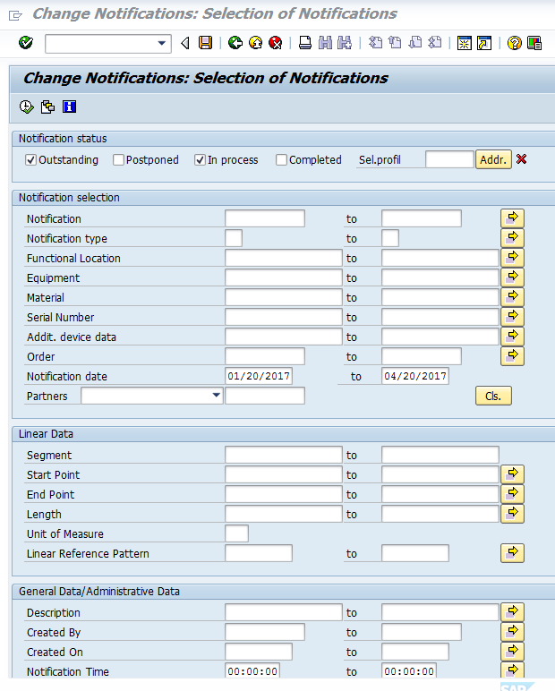
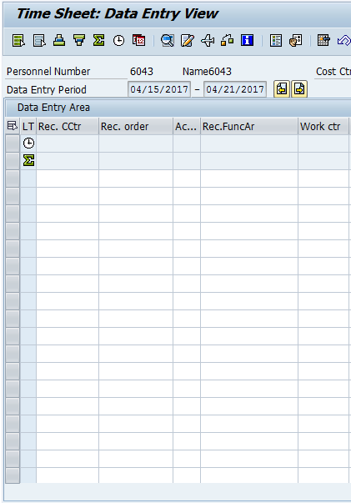
Work Orders and Time Entry
There are three types of work orders DOT1, Fleet and Preventive
DOT1 – Transferred from the work order
Preventive/Fleet – Require timesheet entry
6:00 AM
6:00 PM
Midnight
Notes:
Instructor Notes:
Explain the following:
Work is completed and then entered to a work order
DOT1 Work orders the time is populated from the work order
SAP automatically transfers the time to your timesheet three times a day at 6:00 AM, 6:00 PM and Midnight.
Preventive and Fleet work orders required fields include:
Rec. Order, Activity, Work Center, A/A Type and Working Time (From/To) yourself based on the information you are provided
Time cannot be entered or transferred until the work order has been created and released in SAP
Time can be manually changed in the timesheet and/or the work order
SAP doesn’t validate the changes against both of the documents
There are three types of work orders DOT1, Fleet and Preventive.
For DOT1 Work orders the time is populated from the work order and SAP automatically transfers the time to your timesheet three times a day at 6:00 AM, 6:00 PM and Midnight.
For Preventive/Fleet work orders you must do the entry to the required fields (Rec. Order, Activity, Work Center, A/A Type and Working Time (From/To) yourself based on the information you are provided.
Regardless of the Work Order type, time cannot be entered or transferred until the work order has been created and released in SAP.

Slide 27
Overtime
Overtime occurs when your working time, including paid leave taken, exceeds 40 hours in a work week. It is:
Based on your weekly hours worked, not daily hours
Entered as 014N or in the A/A type field
Approved verbally by your supervisor prior to working
Paid at 1.5 times the hourly rate
Notes:
Instructor Notes:
Explain that overtime:
Occurs when the working time (time worked and paid leave used) exceeds 40 hours in a given work week
Is not based on the day, it is possible that your daily working time may exceed your scheduled working time and you do not receive overtime for the week
Provide the following example or one of your own:
Example: If you work four ten hour days and ended up working one extra hour on Monday, but left one hour early on Tuesday, you would not receive overtime
Can be any combination of Paid A/A types including annual leave, sick leave, ect.
Overtime occurs when the working time (time worked and paid leave used) exceeds 40 hours in a given work week.
Is not based on the day, it is possible that your daily working time may exceed your scheduled working time and you do not receive overtime for the week.

Slide 28
Exercise 2 – Verify and Change Work Order Hours in the Timesheet
A DOT1 work order populated to your time sheet on Monday and Tuesday. Tuesday’s time shows 9 hours worked, all coded to time worked, instead of 8 hours worked and 1 hour of overtime. You are changing the last hour of Tuesday’s time to overtime and then changing the existing work order to 8 hours to match your work schedule.
Notes:
Instructor Notes:
Demo: 5 minutes
Exercise 10 minutes
Using SAPUSER102 and the directions highlighted in the Exercise Directions show participants how to verify and change work order hours
During the demo highlight the scenario on the timesheet before you make changes
Explain that the hours for Monday populated as expected, but Tuesday needs to change
Highlight the difference between the DOT1 and Preventive work order
Explain that it is the responsibility of the employee to check the time populated on the timesheet to ensure it is correct
When you finish, explain that the action ends with checking the time and not logging off

Slide 29
Exercise 3 – Enter Preventive Work Order Hours
On Wednesday and Thursday your time was charged to a preventive work order so you need to enter your time in the time sheet.
Notes:
Instructor Notes:
Demo: 5 minutes
Exercise 10 minutes
Using SAPUSER102 and the directions highlighted in the Exercise Directions show participants how to enter preventive work order hours
Highlight that you saved the entries in the last exercise and now you need to get back into the CAT2 timesheet
Use the ECC tab to show entering CAT2 into the command field
During the demo highlight the scenario on the timesheet before you make changes
Explain that the hours need to be entered on a preventive work order and they do not populate
Highlight the difference between the DOT1 and Preventive work order
When you finish, explain that the action ends with checking the time and not logging off

Slide 30
Wage Types and your Time Sheet: On-call Time
On-Call
Must be authorized by your supervisor
What fields to enter on your timesheet
Receiving Cost Center
Only entered on non-working time
Employee must be available to work
Entered as wage type 4099
Receiving Functional Area
Wage Type (4099)
Hours on call in the From and To field
Notes:
Instructor Notes:
Review the On-call section of the slide and stress the following:
The time must be approved by the supervisor
Cannot be entered on working time
Entered as wage type 4099
Using the What fields to enter on your timesheet and the image describe the fields that must be entered for on-call time (Receiving Cost Center, Receiving Functional Area, Wage Type 4099 and the hours on-call (from and To fields)
On-call must be approved by your supervisor, must only be entered on non-working time and wage type 4099 is entered.

Slide 31
Exercise 4 – Enter On-call Time
On Thursday you were asked by your supervisor to work on-call for one hour before your shift because of an absence of a co-worker. You need to enter the hours you were on-call.
Notes:
Instructor Notes:
Demo: 5 minutes
Exercise 10 minutes
Using SAPUSER102 and the directions highlighted in the Exercise Directions show participants how to enter on-call time
Highlight that you saved the entries in the last exercise and now you need to get back into the CAT2 timesheet
Use the ECC tab to show entering CAT2 into the command field
During the demo highlight the scenario on the timesheet before you make changes
Explain that the hours need to be entered to on-call time are entered to a wage type because they are not an attendance or absence (A/A type)
Highlight the difference between the A/A types and Wage types
When you finish, explain that the action ends with checking the time and not logging off

Slide 32
Entering Time to a Cost Center
Is used to record safety meetings or training
Requires entry in the following fields:
Receiving Cost Center
Receiving Functional Area
A/A Type
Working hours (From and To)
Notes:
Instructor Notes:
Explain the following
Most working time in Maintenance is entered to work orders
Safety meetings and training are typically charged to the home cost center
Explain the cost center will be provided to them or the home cost center can be found on the timesheet
Use the graphic to show the fields which must be entered:
Rec. CCtr (Receiving Cost Center)
Rec. Func. Ar (Receiving Functional Area)
A/A Type
Working Hours (From and To)
Safety meetings and training are not typically recorded to a work order instead they are charged to the home cost center to record the costs.
If you are uncertain about what your home cost center is it is located to the right of your personnel number on top of your timesheet.
When entering time to a cost center, you need to enter data in the following fields:
Rec. CCtr (Receiving Cost Center)
Rec. Func. Ar (Receiving Functional Area)
A/A Type
Working Hours (From and To)

Slide 33
Wage Types and your Time Sheet: Premium Pay
Work Schedule Premium Pay
May only be entered for working time
What fields to enter on your timesheet:
First line (qualifying event hours):
Paid for qualifying events on 1st shift if you have a 2nd or 3rd shift work schedule
Entered as wage type 7002 (2nd shift) or 7003 (3rd shift)
Receiving Functional Area
Hours of the event in the From and To field
Next line (premium pay hours):
Receiving Cost Center
Wage type 7002 (2nd shift) or 7003 (3rd shift)
Total hours of the event in the daily total field
Notes:
Instructor Notes:
Review the following:
Wage types are another time entry type used in maintenance
Are used INSTEAD of an A/A type
CDOT uses three Wage Types:
4099 for On-Call time
7002 and 7003 for work schedule premium pay
Employees who are scheduled to work 2nd or 3rd shift but work 1st shift due to a qualifying event taking place between the hours of 6AM and 4PM may be eligible to receive Work Schedule Premium Pay
Premium pay is NOT paid for overtime due to snow or routine maintenance operations
The number of hours entered must match the worked towards the qualifying event
When reviewing the slide stress that Premium Pay requires two line of time entry
Wage types are used INSTEAD of an A/A type. CDOT uses three Wage Types:
One for On-Call time
Two for Work Schedule Premium Pay
Employees who are scheduled to work 2nd or 3rd shift but work 1st shift due to a qualifying event taking place between the hours of 6AM and 4PM may be eligible to receive Work Schedule Premium Pay for the hours worked on 1st shift.
Examples of qualifying events are Safety meetings, mandatory trainings, and Remembrance events.
Required overtime due to snow or other routine maintenance operations is not eligible for the shift premium.
When entering the shift premium code, be sure to verify that only the hours worked on 1st shift are entered with the wage type for the qualifying event and the total hours coded to the wage type match the number of the hours worked for the qualifying event.

Slide 34
Exercise 5 – Enter Time to a Cost Center
You need to enter the time you worked on Friday when you attended a mandatory training on first shift for 8 hours.
Notes:
Instructor Notes:
Demo: 5 minutes
Exercise 10 minutes
Using SAPUSER102 and the directions highlighted in the Exercise Directions show participants how to enter time to a cost center
Highlight that you saved the entries in the last exercise and now you need to get back into the CAT2 timesheet
Use the ECC tab to show entering CAT2 into the command field
During the demo highlight the scenario on the timesheet before you make changes
Explain when the time needs to be entered to a cost center by paraphrasing what was cover on the previous slide
When you finish, explain that the action ends with checking the time and not logging off

Slide 35
Exercise 6 – Enter 2nd Shift Wage Type
You are assigned to the second shift. On Friday you had a mandatory safety meeting on 1st shift from 07:00 to 15:00 and are entering your time using the second shift wage type 7002. You are also releasing and saving your time for the week.
Notes:
Instructor Notes:
Demo: 5 minutes
Exercise 10 minutes
Using SAPUSER102 and the directions highlighted in the Exercise Directions show participants how to enter on-call time
Highlight that you saved the entries in the last exercise and now you need to get back into the CAT2 timesheet
Use the ECC tab to show entering CAT2 into the command field
During the demo highlight the scenario on the timesheet before you make changes
Explain that the hours on 2nd shift are entered to a wage type because they are not an attendance or absence (A/A type)
Highlight the difference between the A/A types and Wage types
When you finish, explain that the action ends with checking the time and not logging off

Slide 36
Check Your Knowledge
Who is responsible for entering and releasing time in the timesheet?
You are!
Instead of an A/A Type, what do you enter if you are on-call?
A Wage Type
Notes:
Instructor Notes:
This is an animated slide with the first question showing.
Click enter to display the answer or the next question
Ask the question and let the participants come up with the answers.
If an answer is incorrect do not say “no” or “wrong”, instead provide encouragement such as “Not quite” or “Close”
This slide is animated with question show clicking on next will display the answer and then the next question
There are two questions and answers. They are:
Question 1: Who is responsible for entering and releasing time in the timesheet?
Answer: You are!
Question 2: Instead of an A/A Type, what do you enter if you are on-call?
Answer: A Wage Type, (4099)
There are two questions. Write the answer to the question in the answer section:
Question 1: Who is responsible for entering and releasing time in the timesheet?
Answer:
Question 2: Instead of an A/A Type, what do you enter if you are on-call?
Answer:

Slide 37
Notes:
This is a hidden slide, and only available in Notes Page View.
It functions as the Cover Page of the Conclusion Section. This slide remains here and is not removable.
To customize the notes content in Notes Page View: Click on “VIEW” tab → Select “Notes Page” → Double click the page, an Microsoft Word document would pop up → Click on “Course Title” and type in the training course title → Click on the margins or close word. The changes you made will be automatically saved into PowerPoint.
Notes:
Section 3
Timesheet Collisions and the Work Order

Slide 38
Course Agenda
Section 1 – Review of SAP Time Entry Course
Section 2 – Overtime and Wage Types
Section 3 – Timesheet Collisions and the Work Order
Section 4 – Leave Entry and Alternate Holiday
Section 5 – Earning and Using Comp Time
Notes:
Instructor Notes:
Inform the participants that:
This is the third section of the course
It describes the process of time entry changes and how collisions can be caused by the work order
It should take about 25 to 30 minutes to complete

Slide 39
Section 3 - Learning Objectives
At the end of this section, you should be able to:
Identify what a collision is and explain the three types of error messages
Describe the process for Time Entry changes
Identify how to check the status of your time entries
Explain how to “zero out” or delete a time entry
Access a work order from the timesheet
Notes:
Instructor Notes:
Review the section objectives with the participants
These are the learning objectives for this section. By the end of the section you should be familiar with each of the objectives.
These objectives are tied to the course objectives which will be reviewed at the end of the course.

Slide 40
Section 3 - Scenario
In this scenario, you found a collision on your timesheet caused by the work order your supervisor entered. The start time of the work order is the same time you were on-call. To resolve the issue you are checking the status of the on-call time and the start time of the work order.
Notes:
Instructor Notes:
Review the scenario with the participants
Explain to participants that they will learn the following from this scenario:
Identifying when a time collision occurs
Checking the status of you time
Determining if you need to “zero out” or delete time
Reviewing the work order from the timesheet
The scenario includes the most common time errors, but is not designed to cover every type of time or leave you may enter. While working on the scenario we encourage you to share what you know and to work together to come up with the correct time entry.
The main concepts you will learn in this scenario are:
Identifying when a time collision occurs
Checking the status of you time
Determining if you need to “zero out” or delete time
Reviewing the work order from the timesheet

Slide 41
SAP Timesheet Messages
When verifying your time entries, check for messages on your screen:
No errors were found
Review entries and continue
Errors exist and must be
fixed before continuing
Notes:
Instructor Notes:
Explain that SAP generates messages to ensure time is entered on your timesheet correctly in the lower left-hand corner of the screen.
Explain each of the three messages using the information below:
The most common is the green checkbox. This is an informational message that indicates that no errors were found and you can proceed with releasing and saving your time entry.
The yellow warning, which displays if you need to review your entries before you continue. This message will not stop you from entering your time, it is only a warning.
The Red error is a hard stop and means you will not be able to release and save your time. When you are entering time pay attention to these messages as they are your first line of defense in entering time correctly.
SAP generates messages to ensure time is entered on your timesheet correctly.
There are three types of messages, each with their own icon, that you need to know about.
The green checkbox is an informational message that indicates that no errors were found and you can proceed with releasing and saving your time entry.
The yellow warning, which displays if you need to review your entries before you continue. This message will not stop you from entering your time, it is only a warning.
The Red error is a hard stop and means you will not be able to release and save your time.
When you are entering time pay attention to these messages as they are your first line of defense in entering time correctly

Slide 42
Time Collisions
What it is:
A time collision is when two time entries overlap
Type of message:
Error (must be fixed to save)
How to fix it:
Review the error message for the date and time of the collision
Change the times so they do not overlap
Notes:
Instructor Notes:
Using the “What it is” section, explain that SAP can only process one entry for a given period and a collision is when two time entries overlap
Using the screenshot, provide the following example or provide one of your own, “Regular working time was entered for 8:00 to 16:30. There was also sick time entered from 15:30 to 16:30. Because the sick leave and the regular working time are both entered from 15:30 to 16:30 then SAP is telling you to make a correction because you can not be on leave and work at the same time”.
Using the “How to fix it” section of the slide, explain how to fix the issue
Explain that the error message is a hard stop and must be fixed before time can be entered
Timesheet collisions occur when two time entries overlap.
This kind of error is easy to fix. All you need to do is change the sick or regular working time so they do not overlap.

Slide 43
Timesheet Change Process
If time has been approved, zero-out the time, enter the correct time and release both entries
OR
If time or leave has not been approved or has been rejected, make the change
Yes
Additional Changes
Yes
Zero Out Leave or Change Work Time
Contact Supervisor
Supervisor Approves Entries/Zeroes
Incorrect Time Entry
No
Time Approved
Change or Delete the Time Entry
Release and Save Time
Done
No
Notes:
Instructor Notes:
Explain that errors occur on the timesheet for a variety of reasons. When you discover an error or your actual work time changes then you will need to make a change to your timesheet. The first step is to determine if the time has been approved or not.
Is the Time Approved: To determine if time has been approved, double click on the entry. The Cell Information screen displays the Processing status field. If the time is showing as 20 Released for approval or 10 In Process then you are able to make the change by following the “No” track. If it is displaying as 30 Approved, then you will need to zero out the time following the “No” track.
Unapproved Time Steps: If the time has not been approved then all you need to do is change the time entry. When you are done you will then need to release and save your time.
Approved Time Steps: If the time is approved, then you need to “zero out” the incorrect entry. Then enter the correct time and release and save your timesheet. If it has not been approved or has been rejected you can make the change to your time immediately and release and save your timesheet. If you are making an adjustment to leave, your supervisor will receive an email from SAP about the change. If you are making a change to any approved time entry, you should let your supervisor know so they can approve the updated time entries.
The first step in the timesheet change process is to determine if the time has been approved.
Unapproved Time Steps: If the time has not been approved then all you need to do is change the time entry. When you are done you will then need to release and save your time.
Approved Time Steps: If the time is approved, then you need to clear the incorrect entry. After the zero is approved enter the correct time and release and save your timesheet. If it has not been approved or has been rejected you can make the change to your time immediately and release and save your timesheet. If you are making an adjustment to leave, your supervisor will receive an email from SAP about the change. If you are making a change to any approved time entry, you should let your supervisor know so they can approve the updated time entries.

Slide 44
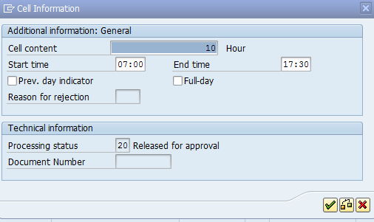
Checking the Status of Time
To check the status of time:
Double click on the From or To time cell
Review the Processing status field
10 - In process
20 - Released for Approval
30 - Approved
Notes:
Instructor Notes:
Go into the timesheet and show the process for checking the status of time by:
Double left clicking on a time entry to display the cell information
Open the matchcode for the Processing Status field and show the other status options
Explain that this should done every time you are making a change to time entered on your timesheet and if the time displays in the Processing Status field as:
10 - In process – You may change or delete the time
20 - Released for Approval – You may change or delete the time
30 - Approved – You must not delete the time entry. If you need to change the time entry, first “zero out” the time. Then you can add the correct entry.
The process to determine the status of the time is to double left click on the Start or end time in the cell and review the Processing status field. This should always be done every time you are making a change to time entered on your timesheet.
If the time displays in the Processing Status field as:
10 - In process – You may change or delete the time
20 - Released for Approval – You may change or delete the time
30 - Approved – You must not delete the time entry. If you need to change the time entry, first “zero out” the time. Then you can add the correct entry

Slide 45
“Zero out” Working Time
Zeroing out an existing time entry ensures:
There is record of the change and approval
The correct time can be entered, released and approved
Both the zero and the new time entry are approved by your supervisor
Notes:
Instructor Notes:
Explain to participants that if the time has been approved, then it needs to be zeroed out to return the time to your bank.
Provide the following example, or use one of your own, “You had planned to go on vacation, but your child was sick so you can into work. The leave you entered was approved by your supervisor so you would need to zero it out to have the leave returned to your leave bank”.
Explain that when you “zero out” a leave entry, the leave is returned to your leave bank, there is a record of this change and your supervisor is notified of the change to your timesheet.
There may be times when you plan to take leave and then change your plans after you’ve entered the leave, it’s been approved and the leave has been deducted from that leave bank. If this occurs you need to “Zero out” your leave. When you “zero out” a leave entry, the leave is returned to your leave bank, there is a record of this change and your supervisor is notified of the change to your timesheet.

Slide 46
Deleting Unapproved Time
Before deleting a time entry, you must check the status of the time entry:
Only “in process” and “released for approval” entries can be deleted
Click the row button to highlight the row
Click delete button to delete the row
Notes:
Instructor Notes:
DO Not delete approved entries!! This applies only to in process and released for approval entries
Explain that Time should only be deleted when you are certain that it has not been approved by your supervisor.
Go to SAP and double click on any time that is on the timesheet to show the status of the time entry
Show the participants the delete button and how to select a row, but do not delete any time in the timesheet by completing the action.
Time should only be deleted when you are certain that it has not been approved by your supervisor.
This is done by checking on the status of the time by double left click on the hours field. If the time has not been approved you are able to select the row and then the delete button.

Slide 47
Timesheet Revisions
The scroll-back limits for timesheet revisions are:
2 weeks for bi-weekly-paid employees
5 weeks for monthly-paid employees
12 weeks for your Timekeeper
Current period Start
You timesheet
Timekeepers
Paid Monthly
Paid Bi-weekly
Timekeepers can scroll back 12 weeks
Employees paid monthly can scroll back 5 weeks to make changes
Employees paid Bi-weekly can scroll back 2 weeks to make changes
Contact your Timekeeper
Contact your Timekeeper
Notes:
Instructor Notes:
Explain that time should be entered on a regular basis to avoid making errors and forgetting the time you worked
Use the example, “what color shirt did you wear two weeks ago”?
Using the graphic and the notes below provide the deadlines for a change depend on the type of employee and how long ago the errors occurred
If you are paid bi-weekly (Permanent Part-time, Winter Part-time or Temporary employee), then you are able to make changes 2 weeks prior to the current week
If you are paid monthly (Full-time employee), which can be found on line 11 of the Employee Time Entry Worksheet, then you can make changes to your timesheet five weeks prior to the current week
Your Timekeeper is able to make any changes in SAP up to 12 weeks beyond the current period. If you need to change your timesheet beyond 12 weeks contact your timekeeper
If you are paid bi-weekly (Permanent Part-time, Winter Part-time or Temporary employee), then you are able to make changes 2 weeks prior to the current week.
If you are paid monthly (Full-time employee) then you can make changes to your timesheet five weeks prior to the current week.
Your Timekeeper is able to make any changes in SAP up to 12 weeks beyond the current period. If you need to change your timesheet beyond 12 weeks contact your timekeeper.

Slide 48
Reviewing the Work Order from the Timesheet
To display the work order from the timesheet:
Double click on the Rec. Order in the timesheet
The selected work order displays
Click on the Operations tab to display the time data
Click the Back button to return to the timesheet
Notes:
Instructor Notes:
Demo that the timesheet links directly to the display mode of the work order in display mode
Open the timesheet and show how to open a work order using the DOT1 work order at the top of the page. This is first receiving order.
Explain how to display the work order from the timesheet :
Double clicking on the Rec. Order of work order you want to display
When you access the work order it will display on the Header Data tab
To display the time data for the work order click on the Operations tab
When you want to return to the timesheet click the Back button
Using your own experience explain a time when you needed to view the work order and show any other details you feel might be helpful
When reviewing the work order the employee should ensure the:
Operation Activity to ensure it is correct
Work center is the right one
Dates and times are correct for DOT1 work orders
If you need to make an update you can so, but they will not occur on the timesheet until the time transfer has occurred if the time transfer program has already ran for that work order then the timesheet needs to be manually updated
The process to review the work order from the timesheet is simple.
Double left click on the Rec. Order of work order you want to display.
When you access the work order it will display on the Header Data tab.
To display the time data for the work order click on the Operations tab.
When you want to return to the timesheet click the Back button.

Slide 49
Demo 1 – Correcting a Time Collision
You were on-call before your Monday shift and then called into work an hour before your scheduled start. You discovered that you should have entered working time from 3:00 PM to 4:00 PM instead of on-call time.
In this Demo, we are going into your timesheet and verifying the time approval status, reviewing the work order start time and correcting the error.
Notes:
Instructor Notes:
Demo: 10 minutes
INSTRUCTOR ONLY:
Use PERNR 1182 to access the timesheet for Chris Maintenance99
Ask the participants to WATCH the demo
Open CAT2. (>Maintenance Tab > Time Management > Time Sheet Entry) – Quickly remind students that they DO NOT SEE the PerNr selection when they access CAT2 with their user names.)
Collapse the left navigation pane.
Enter Personnel Number – 1182 - Chris Maintenance99.
Navigate to week 07/22/2017 – 07/28/2017. Timesheet is already populated on Monday with one line of four hours of On-call Wage Type – 4099 to a cost center and a second line of eight hours worked time to a work order.
Check status of On-call hours by double-clicking in the Monday From hours cell.
Note “Approved” status.
Click Continue button.
Check status of worked time by double-clicking in the Monday To hours cell.
Note “In Process” status.
Click Continue button.
Click Release view button.
Note dialog box with red collision error: “Time collision 15:00 - 23:30 with 12:00 - 16:00.” Point out the overlapping times and remind participants that this SAP message means the error must be fixed before releasing and saving the time.
Click Continue button.
Highlight 16:00 in Monday To field.
Type “15:00.”
Click Check Entries button. Box with “No errors” should appear.
Click Continue button.
Click Release View button.
Click Select All button.
Click Release button. Note message “2 times were released:” the in process worked time and the changed on-call time.
Click Save button.
Remind participants that because the on-call time was already approved, the supervisor will need to be notified to approve the time again.

Slide 50
Check Your Knowledge
What does it mean if you receive this message when saving your timesheet?
Review the entries, respond if needed and continue
If you are in your timesheet, how can you check the status of your time entries?
Double click on the From or To time cell for the time you want to review
What time statuses may be deleted and not zeroed out?
Only “in process” and “released for approval” entries can be deleted. All others must be zeroed out.
Notes:
Instructor Notes:
This is an animated slide with the first question showing.
Click enter to display the answer or the next question
Ask the question and let the participants come up with the answers.
If an answer is incorrect do not say “no” or “wrong”, instead provide encouragement such as “Not quite” or “Close”
This slide is animated with question show clicking on next will display the answer and then the next question
There are three questions and answers. They are:
Question 1: What does it mean if you receive this “warning” message when saving your timesheet?
Answer: Review the entries, respond if needed and continue
Question 2: If you are in the timesheet, how can you check the status of your time entries?
Answer: Double click on the From or To time cell for the time you want to review
Question 3: What are the times statuses may be deleted and not zeroed out?
Answer: Only “in process” and “released for approval” entries can be deleted. All others must be zeroed out
There are two questions. Write the answer to the question in the answer section:
Question 1: What does it mean if you receive this message when saving your timesheet?
Answer:
Question 2: If you are in your timesheet, how can you check the status of your time entries?
Answer:
Question 3: What time statuses may be deleted and not zeroed out?
Answer:

Slide 51
Notes:
This is a hidden slide, and only available in Notes Page View.
It functions as the Cover Page of the Conclusion Section. This slide remains here and is not removable.
To customize the notes content in Notes Page View: Click on “VIEW” tab → Select “Notes Page” → Double click the page, an Microsoft Word document would pop up → Click on “Course Title” and type in the training course title → Click on the margins or close word. The changes you made will be automatically saved into PowerPoint.
Notes:
Section 4
Leave Entry and Alternate Holiday

Slide 52
Course Agenda
Section 1 – Review of SAP Time Entry Course
Section 2 – Overtime and Wage Types
Section 3 – Timesheet Collisions and the Work Order
Section 4 – Leave Entry and Alternate Holiday
Section 5 – Earning and Using Comp Time
Notes:
Instructor Notes:
Inform the participants that:
This is the fourth section of the course
It uses scenarios to help you better understand the leave process and how alternate holidays are entered into the timesheet
It should take about 40 to 45 minutes to complete

Slide 53
Section 4 - Learning Objectives
At the end of this section, you should be able to:
Explain how to enter working time and leave during a holiday week
Describe how employees are compensated when working a holiday
Explain the impact of overtime during a holiday week
Notes:
Instructor Notes:
Review the section objectives with the participants
These are the learning objectives for this section. By the end of the section you should be familiar with each of the objectives.
These objectives are tied to the course objectives which will be reviewed at the end of the course.

Slide 54
What is Leave?
Leave is when you take time off from your normally scheduled hours
The State provides leave as a paid benefit
Tracks absences on your timesheet
Can only be entered during scheduled hours
Earned or need-based
May be paid or unpaid
Refer to the leave procedural directive 1204.2 for more information
Notes:
Instructor Notes:
Give the following details about leave to the participants:
Leave is a paid benefit that is available for you to use
Leave is entered on your timesheet because it is tracked the same way as working time
In some cases, such as sick and annual leave, your leave will accrue over time if you do not use it
In other cases such as Administrative and Jury Leave this is available to you only when the need occurs
Annual, Alternate Holiday and Comp time can be used for any purpose
Sick should only be used for health-related purposes of your and your family
Additional leave types are available and are typically used for a specific purpose, such as bereavement
Leave is a paid benefit that is available for you to use. When you enter leave you enter it on your timesheet because it is tracked the same way as working time.
In some cases, such as sick and annual leave, your leave will accrue over time if you do not use it. In some cases, such as sick and annual leave, your leave will accrue over time. In other cases such as bereavement and jury leave this is available to you only when the need occurs. Depending on what kind of employee you are your paid leave benefits may vary.
If you have questions about the types of leave you are eligible for refer to procedural directive 1204.02.

Slide 55
Leave Quotas
Each type of accrued leave has its own bank
Quota banks track leave accrual and usage
You can only spend leave that is in your bank
Leave is accrued monthly based on your paid hours
Annual
Sick
Comp
Alt Holiday
Notes:
Instructor Notes:
Use the graphic on the slide to explain that when you earn leave it is deposited into and withdrawn from multiple leave banks. Like a bank account, your balances can go up or down
Annual and sick leave are earned automatically on the last day of each month.
Leave may not be used until it has been earned
Your earn rate varies based on your paid hours in the month and your years of service
This earned leave time is then available for you to use at a later date
Other accrued leave types include, alternate holiday time and comp time
LWOP does not count towards leave accruals
When you earn leave it is deposited into and withdrawn from multiple leave banks. Like a bank account, your balances can go up or down.
Annual and sick leave are earned automatically on the last day of each month.
Your earn rate varies based on your paid hours in the month and your years of service. This earned leave time is then available for you to use at a later date.
Other accrued leave types include, alternate holiday time and comp time.

Slide 56
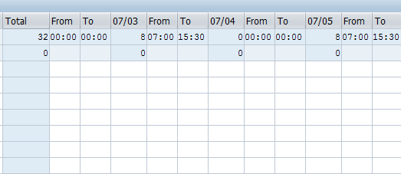
CDOT Holidays and Your Timesheet
On a holiday (red circle) your timesheet will:
Reduce your work schedule by eight hours (see red arrow)
Display remaining hours in a day if you normally scheduled for more than eight hours
Show the correct number of hours you need to work
Notes:
Instructor Notes:
Use the graphic in the slide to show if you are normally scheduled to work on a day that a holiday falls then your work schedule will be reduced by eight hours.
You do not need to enter anything on you timesheet to get paid for the holiday
If you are normally scheduled to work more than eight hours on the day of a holiday you must work the additional hours or use leave to cover the hours.
Provide the following example:
If you worked a 10 hour day on Monday and this was the holiday you would be required to account for the two extra hours by working or entering leave. The timesheet will show the correct number of hours planned based on your assigned work schedule.
If you are normally scheduled to work on a day that a holiday falls then your work schedule will be reduced by eight hours.
You do not need to enter anything on you timesheet to get paid for the holiday. If you are normally scheduled to work more than eight hours on the day of a holiday you must work the additional hours or use leave to cover the hours.
The timesheet will show the correct number of hours planned based on your assigned work schedule.

Slide 57
Alternate Holidays
Can only be used by Permanent Full-time employees
If the holiday falls on a scheduled workday, and you work that day, you can code up to 8 hours of Alternate holiday
If you are normally scheduled off, then 8 hours of holiday leave is banked automatically
It is possible to automatically bank alternate holiday and get paid overtime for time coded on the holiday
If the holiday is worked, entering A/A Type 061N or 061P creates an Alternative Holiday leave bank
Enter 141P to use the leave
Can only be used after it is earned and approved
Notes:
Instructor Notes:
Full time employee who are normally scheduled off on the day a holiday falls, automatically earn eight hours of alternate holiday leave. Alternate Holiday is time earned when you work on a State holiday or are scheduled to be off on the same day as a State holiday. You can earn up to 8 hours of holiday leave to use in the future.
Explain the following about the use of Alternate Holiday:
Because Alternate Holiday doesn’t carry-over to the next fiscal year it should be used first in the fiscal year it is earned
The holiday you worked must be approved by the Supervisor before being used.
Cannot be used until after the Alternate Holiday is earned and approved
You can’t use alternate holiday retroactively (before you earn it)
There are two codes in SAP
061N of 061P creates the alternative Holiday bank
0141P uses the holiday bank
If you are a full time employee and are normally scheduled off on the day a holiday falls, you will automatically earn eight hours of alternate holiday leave.
Alternate Holiday is time earned when you work on a State holiday or are scheduled to be off on the same day as a State holiday.
You will be given up to 8 hours of holiday leave to use in the future. Just note that the holiday you worked must be approved by your Supervisor prior to being used.

Slide 58
Exercise 7 – Section 4 - Time Entry Scenarios
It is a holiday week, and you worked on the holiday. You are entering your time according to one of the assigned scenarios below. You are normally:
Scheduled off on the day the holiday falls and need to code overtime
Scheduled off on the day the holiday falls and code 40 hours in the week
Scheduled on the day the holiday falls and want to code an alternate holiday
Normally scheduled on the day the holiday falls and need to code overtime
Notes:
Instructor Notes:
Scenario: 25 to 30 Minutes:
Review each of the scenarios
Break the class out into 4 groups
Have each group assign one person to enter the time into SAP
Scenario A – Sapuser98 – PERNR 1181
Scenario B – Sapuser99 – PERNR 1182
Scenario C – Sapuser96 – PERNR 1179
Scenario D – Sapuser97 – PERNR 1180
Have each group navigate to the Labor day holiday week (09/04/2017) using the Next Screen or Previous screen
Assign one scenario and facilitator (A, B, C and D) to each the four groups
Have the four groups review their scenario and allow time for any questions before they begin
Allow the group 15 minutes to complete the exercise
During the exercise move about the room and answer questions or help from the groups or the group facilitator about entering the information correctly
Identify one instructor for each of the groups to have the participants reach a consensus about the correct answer
Bring the groups back together and discuss the results of the exercise using the next four slides.

Slide 59
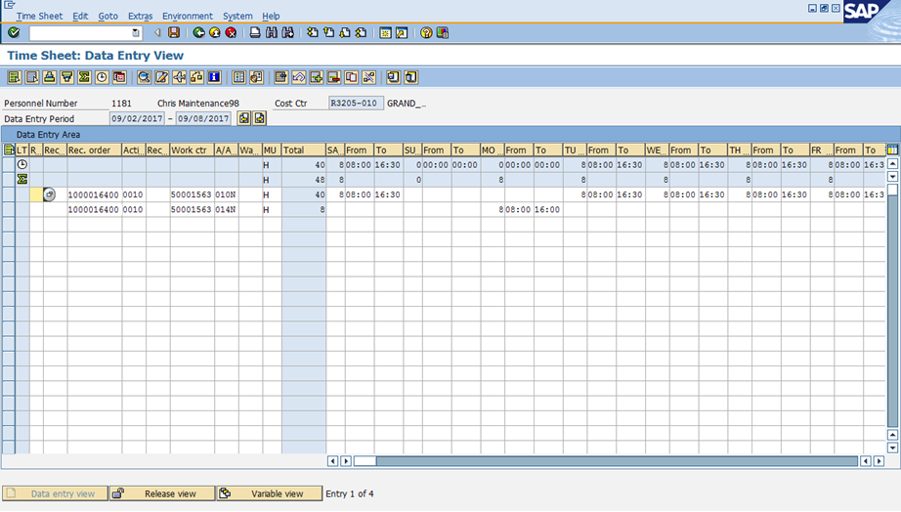
Scenario A
You are on a Tuesday through Saturday, five day, eight hour work schedule. It is a holiday week. You are normally scheduled off on the Monday holiday, but were called into work 8 hours on the holiday towards a work order. After considering your options, your supervisor has approved paid overtime. During your normal work schedule you have already worked 40 hours towards a work order.
Notes:
Instructor Notes:
STOP: Display this slide after the participates have gone through the scenario because the answers display
The slide has two actions. The first is the scenario, and the second with the screenshot of the correct time in the timesheet
When you click to go to the next slide the correct time entry for the scenario displays
Briefly review the scenario
Scheduled off on the day the holiday falls and need to code overtime
Explain how the timesheet is correct for the scenario

Slide 60
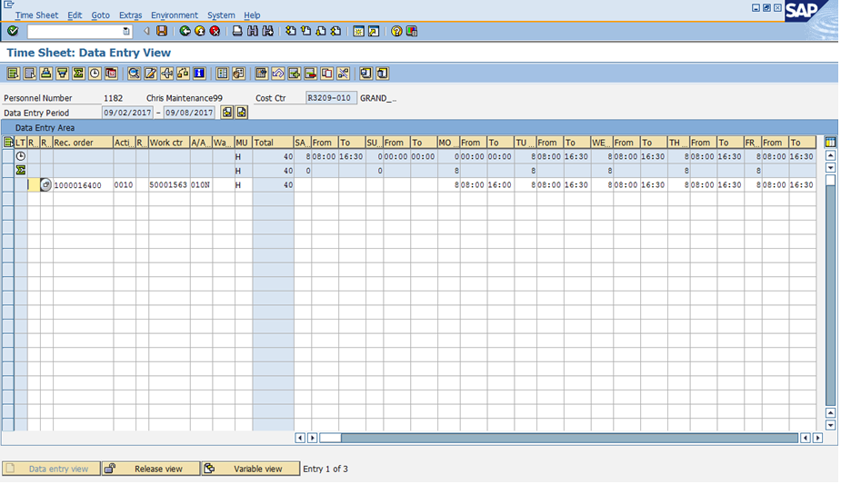
Scenario B
You are on a Tuesday through Saturday, five day, eight hour work schedule. It is a holiday week. You are normally scheduled off on the Monday holiday, but were asked work 8 hours on the holiday towards a work order. You didn’t work on your normal Saturday, anticipating that you would have to work on the Monday holiday. You worked 32 hours the rest of the scheduled week on a work order. Use the following information as a guide to complete the exercise by entering your time for the week.
Notes:
Instructor Notes:
STOP: Display this slide after the participates have gone through the scenario because the answers display
The slide has two actions. The first is the scenario, and the second with the screenshot of the correct time in the timesheet
Briefly review the scenario
Scheduled off on the day the holiday falls and code 40 hours in the week
When you click to go to the next slide the correct time entry for the scenario displays
Explain how the timesheet is correct for the scenario

Slide 61
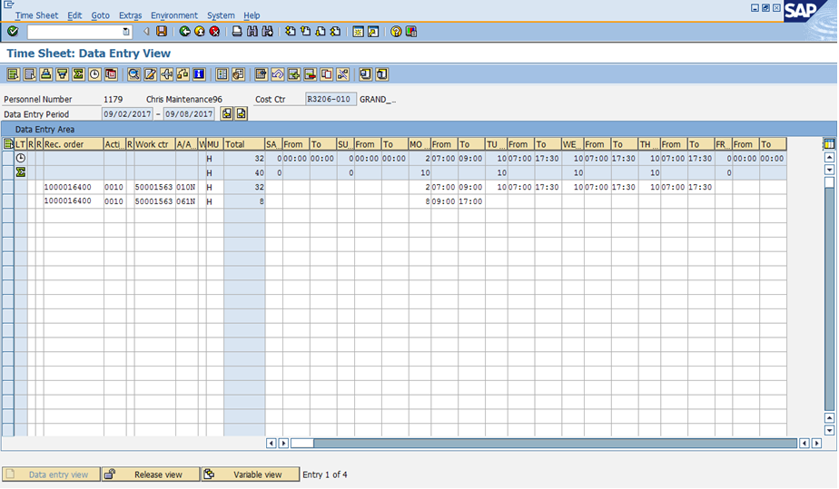
Scenario C
You are on a Monday through Thursday, four day, 10 hour work schedule. It is a holiday week. You are normally scheduled to work on the Monday the holiday falls, and you are asked to work 10 hours on a work order instead of taking the holiday off. After considering your options, your supervisor has approved the Alternate Holiday quota so you can take time off at a later date. During your normal work schedule, you worked the expected 32 hours. Use the following information as a guide to complete the exercise by entering your time for the week.
Notes:
Instructor Notes:
STOP: Display this slide after the participates have gone through the scenario because the answers display
The slide has two actions. The first is the scenario, and the second with the screenshot of the correct time in the timesheet
Briefly review the scenario
Scheduled on the day the holiday falls and want to code an alternate holiday
When you click to go to the next slide the correct time entry for the scenario displays
Explain how the timesheet is correct for the scenario

Slide 62
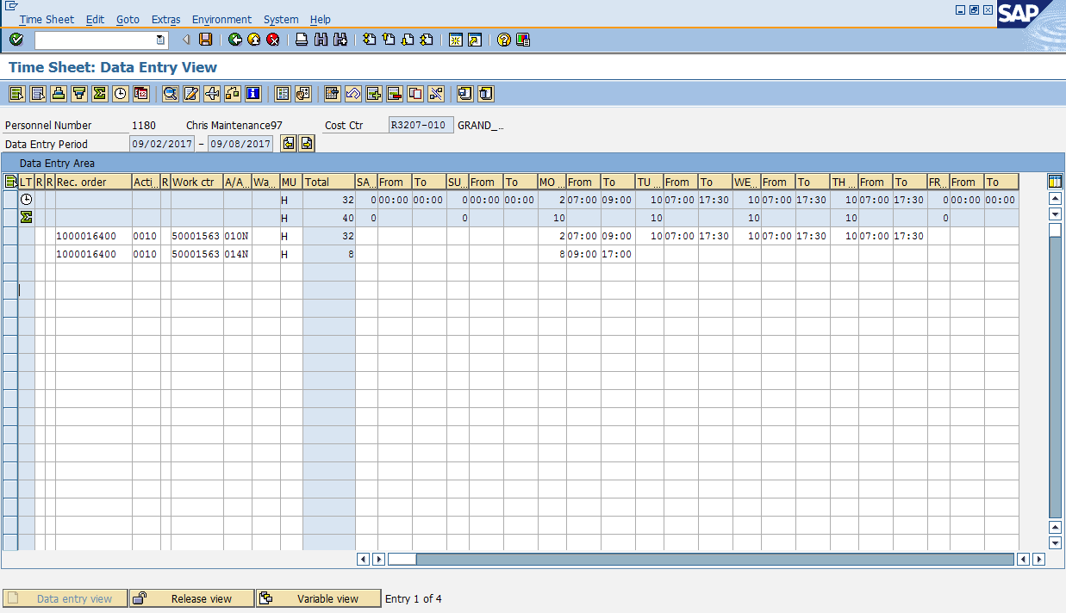
Scenario D
You are on a Monday through Thursday, four day, 10 hour work schedule. It is a holiday week. You are normally scheduled to work on the Monday the holiday falls, and you are asked to work 10 hours on a work order instead of taking the holiday off. After considering your options, your supervisor has approved paid overtime. You worked 32 hours the rest of the scheduled week on a work order. Use the following information as a guide to complete the exercise by entering your time for the week.
Notes:
Instructor Notes:
STOP: Display this slide after the participates have gone through the scenario because the answers display
The slide has two actions. The first is the scenario, and the second with the screenshot of the correct time in the timesheet
Briefly review the scenario
Normally scheduled on the day the holiday falls and need to code overtime
When you click to go to the next slide the correct time entry for the scenario displays
Explain how the timesheet is correct for the scenario

Slide 63
Notes:
This is a hidden slide, and only available in Notes Page View.
It functions as the Cover Page of the Conclusion Section. This slide remains here and is not removable.
To customize the notes content in Notes Page View: Click on “VIEW” tab → Select “Notes Page” → Double click the page, an Microsoft Word document would pop up → Click on “Course Title” and type in the training course title → Click on the margins or close word. The changes you made will be automatically saved into PowerPoint.
Notes:
Section 5
Earning and Using Comp Time

Slide 64
Course Agenda
Section 1 – Review of SAP Time Entry Course
Section 2 – Overtime and Wage Types
Section 3 – Timesheet Collisions and the Work Order
Section 4 – Leave Entry and Alternate Holiday
Section 5 – Earning and Using Comp Time
Notes:
Instructor Notes:
Inform the participants that:
This is the fifth section of the course
It describes how maintenance employees earn comp time and additional regular time and the process for changing time entries
It should take about 40 to 45 minutes to complete

Slide 65
Section 5 - Learning Objectives
At the end of this section, you should be able to:
Explain CDOT’s Comp Time rules
Understand Comp Time attendance (“Cap”) and absence quotas
Enter comp time worked
Enter comp time used
Explain when additional regular time should be entered
Describe the process for Time Entry changes
Change time entry using A/A types
Notes:
Instructor Notes:
Review the section objectives with the participants
These are the learning objectives for this section. By the end of the section you should be familiar with each of the objectives.
These objectives are tied to the course objectives which will be reviewed at the end of the course.

Slide 66
Section 5 - Scenario
Your supervisor reminded you that you worked more than eight hours last Wednesday. You were approved to enter the one hour of overtime as Comp Time worked.
Also, you entered 2 hours Comp Time Used on the Monday of the current week in which you also worked 2 hours over on Friday. You are approved for overtime but are unsure how to code the week to be paid for the overtime.
Review the Leave Summary report to understand Comp Time attendance quota (Earning Cap) and absence quota (leave used).
Notes:
Instructor Notes:
Review the scenario with the participants.
The main concepts you will learn in this scenario are:
Entering Comp Time worked in a previous week
How Comp Time work is earned and used
Tracked in the Leave Summary Report
Determining how Comp Time should be used in a week with overtime
Determining if you need to “zero out” or change an entry
When to use Additional Regular Hours
In this section of the course you are going to learn how to enter and fix your working time by working through a scenario.
The scenario includes the most common time situations, but is not designed to cover every type of time or leave you may enter. While working on the scenario, we encourage you to share what you know and to work together to come up with the correct time entry.

Slide 67
What is Comp Time?
Compensatory Time (Comp Time) is:
An option for an employee who is paid over 40 hours to be compensated with future time off instead of cash.
Calculated at one-and-a-half times the amount of the hours worked
An agreement between the employee and the Appointing Authority
Earned by entering 031N
Used by entering 110P
Notes:
Instructor Notes:
Comp time is an option for an employee who works over 40 hours and wants to be compensated with future time off instead of by a cash payment.
Clarify the following about Comp Time:
You must have an approved Comp Time agreement submitted to CDOT HR before you can earn and code this time
When you want to enter Comp Time on your timesheet you need to enter a different code when you work the time (031N) than when you use it (110P)
Comp Time is an option for a Non-exempt employee who works overtime to be compensated with future time off instead of by a cash payment. You must have an approved comp time agreement submitted to CDOT HR before you can earn and code this time. Once that agreement is in place, for every hour of overtime worked and coded as Comp Time worked, you’ll get a credit for one and half times that amount in leave time – with a maximum of 24 hours credited per fiscal year. This is outlined in the Comp Time policy 1230.2 and is available on the CDOT website.
When you want to enter Comp Time on your timesheet you need to enter a different code when you work the time (031N) than when you use it (110P).

Slide 68
Entering Comp Time
When entering Comp Time populate these Fields:
Receiving Order
Activity
Work Center
A/A Type (031N)
Working hours (From and To)
Notes:
Instructor Notes:
Using the graphic on the slide explain the fields that need to be completed when entering Comp Time. When entering time to a Comp Time you need to enter data in the following fields.
Receiving Order that time is charged against
Activity from the entered work order
Work Center responsible for doing the work
A/A Type – 031N for Comp Time (earned)
Working Hours (From and To) they must not fall within their scheduled working time
When entering time to a Comp Time you need to populate these fields.
Receiving Order
Activity
Work Center
A/A Type
Working Hours (From and To)

Slide 69
Exercise 8 – Enter Comp Time Worked
Your supervisor reminded you that you worked more than eight hours on the Wednesday’s preventive work order. You were approved to enter the one hour of overtime as comp time worked.
Notes:
Instructor Notes:
Demo: 5 minutes
Exercise 10 minutes
Using SAPUSER102 and the directions highlighted in the Exercise Directions show participants how to enter comp time worked
During the demo highlight the scenario on the timesheet before you make changes
Explain when the time needs to be entered as Comp Time by paraphrasing what was covered on the previous slides
When you finish, explain that the action ends with checking the time and not logging off

Slide 70
When Using Comp Time
For Maintenance and Tunnel employees, Comp Time is:
Limited to 16 hours of Comp Time hours worked and 24 hours leave earned per fiscal year
Not to be used in same week it is worked
Not counted towards determining overtime for the week
Limited to 24 hours banked per fiscal year
Tracked in your Leave Summary report
Entered as A/A Type 110P (Absence)
Notes:
Instructor Notes:
Maintenance and Tunnel employees are essential employees who may earn Comp Time for up to 16 hours worked each fiscal year.
Clarify the following about Comp Time:
You must have an approved Comp Time Agreement submitted to CDOT HR before you can earn and code this time
Comp Time is coded instead of overtime
For every hour of overtime worked and coded as Comp Time worked, you’ll get a credit for one and half times that amount in leave time – with a maximum of 24 hours credited per fiscal year. This is outlined in the Comp Time policy 1230.2 and is available on the CDOT website.
Plan to use your Comp Time in the current fiscal year so its payout doesn’t affect your area’s budget for the following year
When you want to enter Comp Time on your timesheet you need to enter a different code when you work the time (031N) than when you use it (110P)
Maintenance and Tunnel employees are essential employees who may earn Comp Time for up to 16 hours worked each fiscal year.
For every hour worked and coded to comp time earned, the employee earns 1.5 hours of Comp Leave, so 16 working hours equates to 24 leave hours.
Maintenance and tunnel employees are not allowed to earn and use more than 24 hours of accrued Comp Leave in a fiscal year. Any accrued Comp Time remaining the end of the current fiscal year will be paid out to the employee through regular payroll processing in the following fiscal year.
Plan to use your Comp Time in the current fiscal year so its payout doesn’t affect your area’s budget for the following year.

Slide 71
Demo 2 – Display Comp Time on the Leave Summary Report
In this example, you are uncertain if you are close to the 16 hours worked for the fiscal year, so you view your Leave Summary Report to determine how much Comp Time you have banked to date.
Notes:
Instructor Notes:
Demo: 5 Minutes
Instructor: Use SAP User 102 – PERNER 1185
Click the Employee Self-Service Tab
Click the link for Leave Summary Report. Start from the FY Earning Cap (bottom) and work your way up.
Point out the reports column headers do not apply to the FY Earning Cap
Review Comp Time FY Earning Cap
Accrued (How many hours they can accrue / Always has 16 hours)
Used (How many hours coded as Comp Time worked)
Remaining (How many remaining that can be coded to Comp Time Worked)
Review MTC Comp Time
Accrued (total hours available to use)
Used (What has been coded as Comp Time Used)
Remaining (Balance available)
This is a Demo of how to read Comp Time on the Leave Summary report.

Slide 72
Exercise 9 – Change Comp Time in Same Week with Overtime
You entered 2 hours Comp Time Used for leave on the Monday. You also worked 2 hours over your normal schedule on Friday. You are approved for overtime, but are unable to earn overtime in the same week comp time is taken. In order to be paid overtime for the additional two hours on Friday, you need to change the Comp Time Used A/A Type to Annual Leave.
Notes:
Instructor Notes:
Demo: 5 minutes
Exercise 10 minutes
Using SAPUSER102 and the directions highlighted in the Exercise Directions show participants how to enter comp time worked
During the demo highlight the scenario on the timesheet before you make changes
Highlight how to navigate to the next week of time
Explain when the time needs to be entered
Tell participants they can log out of SAP after they complete the exercise

Slide 73
Additional Regular Hours
Additional regular hours are:
Hours paid at the regular hourly rate
Used when an essential employee codes Comp Time Used (A/A Type 110P) and codes more than 40 hours in a week
Coded using A/A Type 051N/P (Additional Regular)
[
Notes:
Instructor Notes:
Explain the following:
Maintenance employees are essential employees
Additional regular hours are regular hours worked that are paid at your straight hourly rate, not the overtime rate
Additional regular hours exist because the State Personnel Rules do not allow for leave to be counted towards the 40 hours required prior to receiving overtime. However, for essential employees, like Maintenance, all leave counts except Comp Time Used because this is compensation and not time. As a result when an essential employee has coded Comp Time Used in the same week they worked over 40 hours, so they can’t code that same amount of time to overtime.
Additional regular hours are regular hours worked that are paid at your straight hourly rate, not the overtime rate.
Additional regular hours exist because the State Personnel Rules do not allow for leave to be counted towards the 40 hours required prior to receiving overtime.
However, for essential employees, like Maintenance, all leave counts except Comp Time Used because this is compensation and not time. As a result when an essential employee has coded Comp Time Used in the same week they worked over 40 hours, so they can’t code that same amount of time to overtime.

Slide 74
Notes:
This is a hidden slide, and only available in Notes Page View.
It functions as the Cover Page of the Conclusion Section. This slide remains here and is not removable.
To customize the notes content in Notes Page View: Click on “VIEW” tab → Select “Notes Page” → Double click the page, an Microsoft Word document would pop up → Click on “Course Title” and type in the training course title → Click on the margins or close word. The changes you made will be automatically saved into PowerPoint.
Notes:
Conclusion

Slide 75
Course Agenda
Section 1 – Review of SAP Time Entry Course
Section 2 – Overtime and Wage Types
Section 3 – Timesheet Collisions and the Work Order
Section 4 – Leave Entry and Alternate Holiday
Section 5 – Earning and Using Comp Time
Notes:
Instructor Notes:
Inform the participants that:
Explain to the participants that this section summarizes the course and explains where you can get help if you need it.
It should take about 5 to 10 minutes to complete
This section is the course summary it contains:
The course summary
Resources where you can get help
The parking lot review and question and answer

Slide 76
Conclusion
You should now be able to:
Describe the time entry process at a high level including the roles and responsibilities
Identify the required data for entering time to a work order
Describe how and when to enter overtime and shift premium pay
Describe the process for changing entries in your timesheet caused by collisions with the work order
Find an existing work order in SAP
Describe the process for entering hours to a holiday or alternate holiday
Describe how comp time is earned and entered in SAP
Use the Leave Summary Report to display your accruals
Notes:
Instructor Notes:
Review the course objectives with the participants and confirm they have been met
If there are questions answer them as the come to you
When answering questions keep all discussions brief and at a high level
.
The slide contains what you should now be able to do with the help of the training material.
If you have a question about the objectives, please ask.
After this course refer to the next slide for the name and contact information of the people who can help.

Slide 77
Learning Activity: Course Evaluation
It is critical to CDOT to receive your feedback on this class
Kudos, critiques and recommendation for improvement
Please take 5 – 10 minutes to complete the evaluation at http://saptraining → Participant Feedback form for Introduction to SAP Time Entry
Notes:
Instructor Notes:
The final class activity is to complete the course evaluation.
Demo the correct path http://saptraining Participant Feedback Form for Introduction to SAP Time Entry. This is the
Instructors: please explain to participants the they may see a screen titled “RWD Workspace” that prompts the users to save their settings. This happens the first time someone goes to the SAP training website. Please have them click on Save. They will then see the SAP training website.
Ensure you have the participants complete course evaluation before the end of the course.

Slide 78
Where Can I Get Help?
For general questions contact:
Your Supervisor
Your Timekeeper by clicking HERE
Payroll can be contacted by clicking HERE
For technical assistance contact:
Human Resources at 7-9230
Notes:
Instructor Notes:
Remind the participants that they are not alone in the time entry process
Explain how each role is able to help and click on the links when applicable:
The participant’s Supervisor can answer many general questions about time entry
The participant’s Timekeepers can be identified and contacted using the link in their notes
Payroll can also be contacted by the link in the notes, but typically this is done after talking to the Supervisor or Timekeeper and being directed to do so
If the participant is having technical issues they can contact HR at extension 7-9230
There are four roles that can help you with your time entry. They are:
Your Supervisor
Your Timekeeper using this link: http://intranet.dot.state.co.us/business/center-for-human-resources-management/chrm-reports/work-schedule-report/view
Payroll using this link:
http://intranet.dot.state.co.us/business/payroll/payroll-contacts

Slide 79
Questions?
?
?
?
Notes:
Instructor Notes:
Review the parking lot you created and answer any of the questions you have questions you have time to answer.
Remind participants that the eLearning course is a resource that can answer many of their questions.
If you have any questions about the hiring process after the class, contact your HR Specialist. The link to the contact details can be found at:
http://intranet.dot.state.co.us/business/center-for-human-resources-management/hr-manager-toolkit/recruiting-and-hiring

Slide 80
Notes:
This is a hidden slide, and only available in Notes Page View.
It functions as the Cover Page of the Conclusion Section. This slide remains here and is not removable.
To customize the notes content in Notes Page View: Click on “VIEW” tab → Select “Notes Page” → Double click the page, an Microsoft Word document would pop up → Click on “Course Title” and type in the training course title → Click on the margins or close word. The changes you made will be automatically saved into PowerPoint.
Notes:
Glossary of Terms

