Slide 1


Introduction to SAP Time Entry
Notes:
Notes:
Welcome to the Introduction to SAP Time Entry course! This course is designed to provide you with the skills you need to enter your time to ensure you are paid promptly and correctly. The course is for Maintenance, Engineering and Support employees and provides specific examples of each type of time entry. The course will take you between one and a half to two hours to complete. If you do not have this much time, don’t worry about it, you are able to stop this course at anytime and when you come back you can start where you left off. Now let’s get started with the course

Slide 2
Learning Logistics
Section 1 – Time Entry Overview
Section 2 – Time Entry Process
Section 3 – Work Time Entry
Section 4 – Leave Time Entry
Section 5 – Timesheet Verification
Notes:
This course is broken out into the Course Introduction and five sections on time entry:
In the Learning Logistics section you will learn about the prerequisites, navigational tools and objectives for the course.
The Time Entry Overview section you will show you why time entry is important to you and to CDOT, the rules and policies governing time entry and how time entry and this course relate to the mission, vision and values of CDOT.
The Time Entry section you teach you about the time entry process including deadlines, the roles and responsibilities. You will also complete the Employee Time Entry Worksheet using your Employee Time Statement. The information gathered on the worksheet will be used throughout the course to help you understand how to enter your time.
In the Work Time Entry section, you will learn about how to navigate and enter time on your timesheet,
In section four, Leave Time Entry, you will learn about the types of leave available to you, how they accrue and how to enter leave. You will also learn about how to use the Leave Summary and Use or Lose reports to determine how much leave you have available.
In the Timesheet Verification section you will learn how to verify the status of your timesheet, read common errors and what the process is for making changes.
The final section, the Conclusion, summarizes what you have learned and where you can find help.

Slide 3
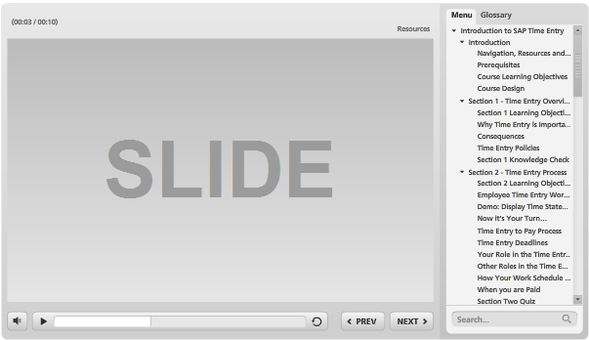
Navigation, Resources and Glossary
Before we begin, let’s look at the resources available to you
Notes:
As you go through the course, there are a couple of items you can use to help you learn. The first is the Resources link as indicated by the red arrow. This link contains copies of all of the documents referenced in this course.
The Glossary tab displays an alphabetical list of terms that are used throughout the course. Anytime you are uncertain about a term, this is the best place to look. Unlike the resources link clicking on the glossary does not pause the course.
If you want to navigate, use the previous or next buttons or click on the slide you want to navigate to under the menu tab. There is also a search field located at the bottom of the Menu tab that brings up all of the slides related to your search. The progress bar displays your progress within a slide.
If for any reason, you need to close the course before you have completed it, you will be returned to the page you were on once you log back in. Now let’s move on to the prerequisites of the course.

Slide 4
Prerequisites
Prior to taking this course you should have taken:
SAP Basic Navigation course
Notes:
Being able to navigate SAP is critical to your success in this course. If you have not already done so, please take the SAP Basic Navigation course when you are able.

Slide 5
Course Learning Objectives
At the end of this course, you should be able to:
Explain why time entry is important to the Employee and to CDOT
Describe the roles and responsibilities in the time entry process
Identify common errors on your timesheet
Enter and release attendance and absences in SAP
Use best practices to make sure your timesheet is correct
Identify who to contact if you have questions about time and leave
Notes:
Upon completing this course you should have a understanding of each of the objectives on this slide. Please take a minute to review these before you continue. When you are done, click the next button to continue the course.

Slide 6

Course Design
Throughout the course you will be asked to make decisions based on the type of employee you are. This has been done to:
Customize the course based on your needs
Shorten the duration of the course
Make additional content available to you should you want to review it based on future needs
Click the button below to continue the course.
Continue
Notes:
Now let’s cover one more thing before moving on to the Time Entry Overview section. Throughout the course you will see slides like this one that ask you to make a choice about the content you view. Based on the decisions you make the content of the course will be customized to reflect how you enter time. All you have to do is click on the button based on the directions on the slide. Now let’s get started by clicking on the “Continue” button.

Slide 7
Section 1 - Time Entry Overview
Section 1 – Time Entry Overview
Section 2 – Time Entry Process
Section 3 – Work Time Entry
Section 4 – Leave Time Entry
Section 5 – Timesheet Verification
Notes:
In the Time Entry Overview section you will learn you why time entry is important to you and to CDOT, the rules and policies governing time entry and how time entry and this course relate to the mission, vision and values of CDOT.

Slide 8
Section 1 - Learning Objectives
At the end of this section, you should be able to:
Describe why time entry is important to you
Identify why time entry is important to CDOT
Explain the rules and policies associated with time entry
Notes:
Take a moment to review the learning objective for this section. When you are done, click the Next button to continue.

Slide 9
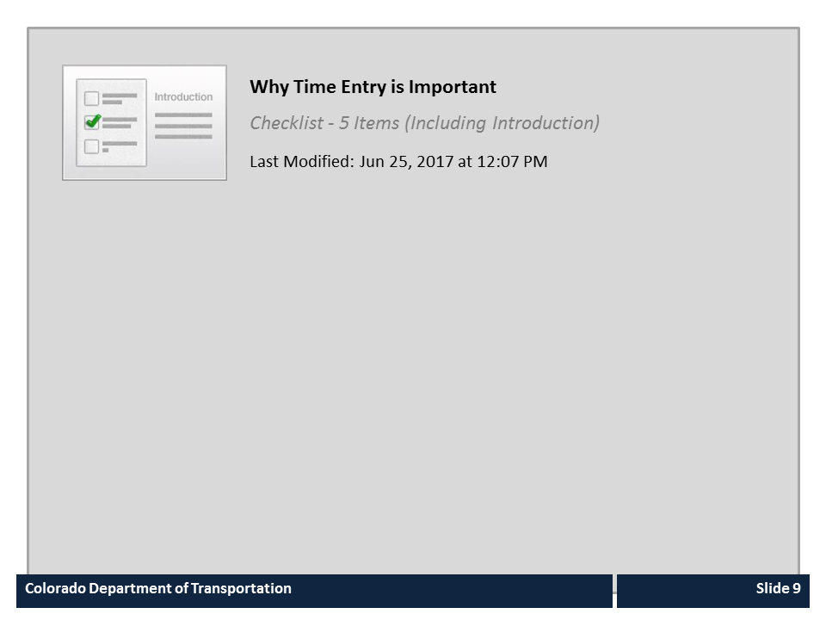
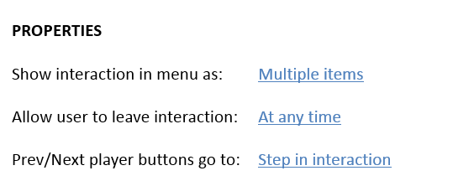


Why Time Entry is Important

Slide 10

Consequences
If you do not enter your time correctly:
You may not be paid right the first time
Some or all of your pay may be delayed
Overpayments must be returned to the state
Your leave accruals may be incorrect
CDOT will not be able to account for labor costs and recover the funds used to pay for your work
Notes:
Now let’s look at what could happen if you do not enter your time correctly. It is CDOT’s responsibility to pay you, but if you do not enter your time correctly then CDOT has no way to do so. If the time entry results in you getting paid less, then you will have to wait until the next pay period. If there is an overpayment then you will need to pay the overpayment back. Additionally, because some of your leave accruals are based on the time you work they may be incorrect. And finally, CDOT will not be able to account for their labor costs and they may not be able to recover some of the funds that are used to pay for the work you perform.

Slide 11
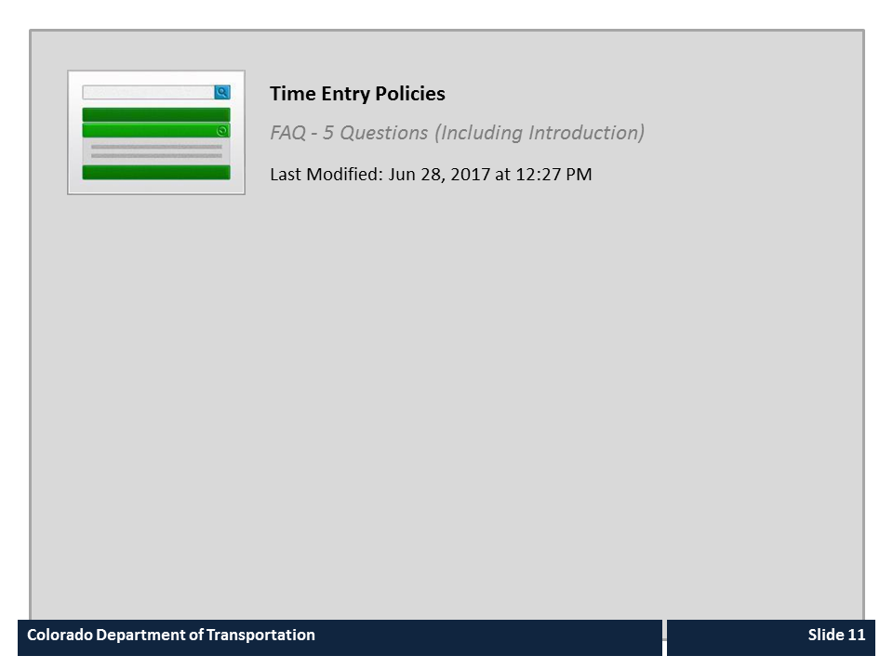
Time Entry Policies

Slide 12
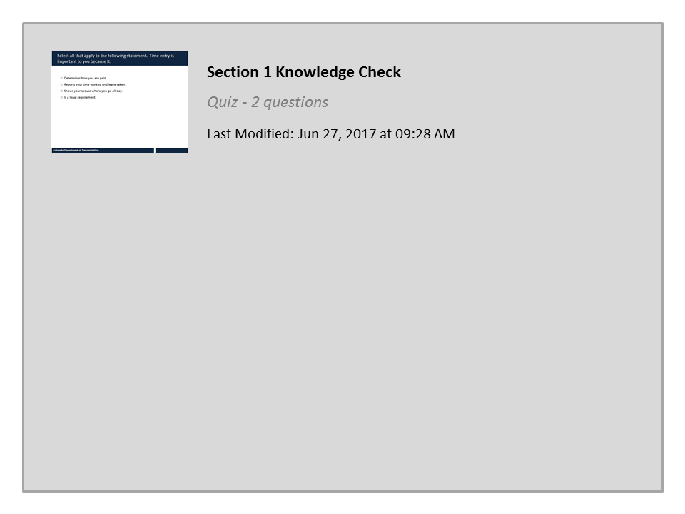
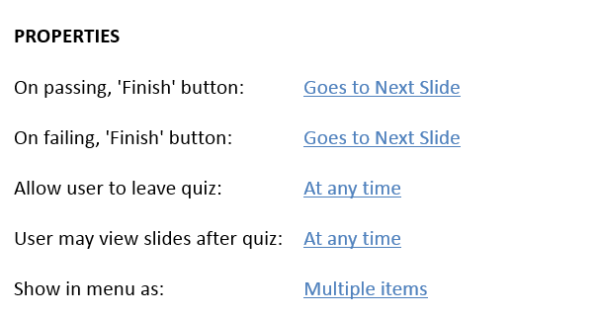

Section 1 Knowledge Check

Slide 13
Section 2 – Time Entry Process
Section 1 – Time Entry Overview
Section 2 – Time Entry Process
Section 3 – Work Time Entry
Section 4 – Leave Time Entry
Section 5 – Timesheet Verification
Notes:
The Time Entry Process section teaches you about the time entry process including deadlines, roles and responsibilities. You will also complete the Employee Time Entry Guide using your Employee Time Statement. The information gathered on the worksheet will be used throughout the course to help you understand how to enter your time.

Slide 14
Section 2 - Learning Objectives
At the end of this section, you should be able to:
Use your Employee Time Statement to identify your personal data used for time entry
Complete the Employee Time Entry Worksheet with your personal time entry information
Describe the time entry process and timelines
Describe time entry roles and responsibilities
Explain how work schedules impact time entry and pay
Describe when you are paid
Notes:
Take a moment to review the learning objectives for this section. When you are done, click the Next button to continue.

Slide 15
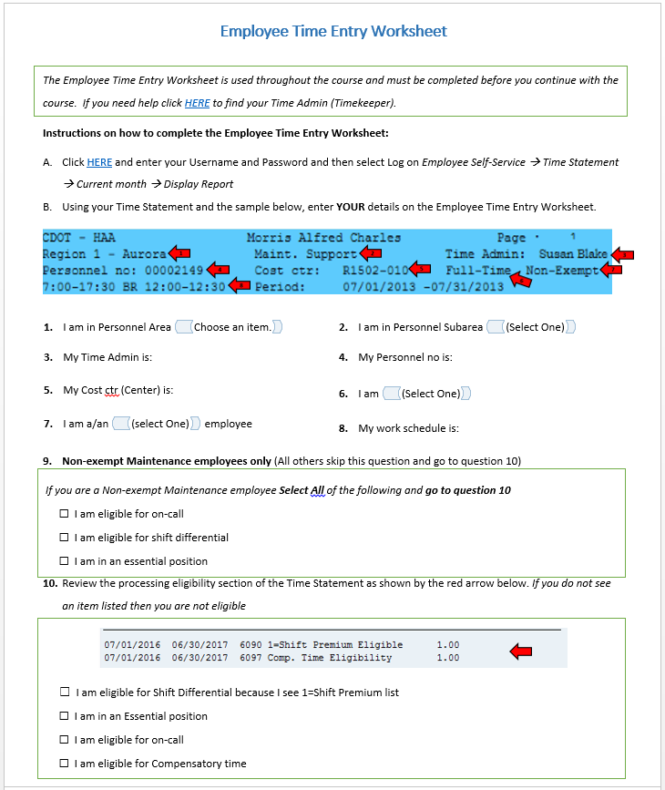
Employee Time Entry Worksheet
The Employee Time Entry Worksheet:
Is your guide to how you enter time
Can be stored on your desktop or printed when complete
Requires you to access your Time Entry Statement to complete
Click the image to the left to open the Employee Time Entry Worksheet
Notes:
Not all employees enter time the same way. For example, an employee in Maintenance who is a winter permanent part-time employee earns overtime, while an employee in HR may not. Because different groups of employees enter time differently, we have created a worksheet to help you understand more about how you enter time. Before you continue the course, please click on the left side of the screen to open a copy of the Employee Time Entry Worksheet. You must do this before you continue the course.
In this course you will have the chance to complete your Employee Time Entry Worksheet. When you’re finished, you can print the file or you can save it to your desktop to view later. To complete the worksheet you will need to display your Time Statement. Let’s take a look at how to do that now.

Slide 16
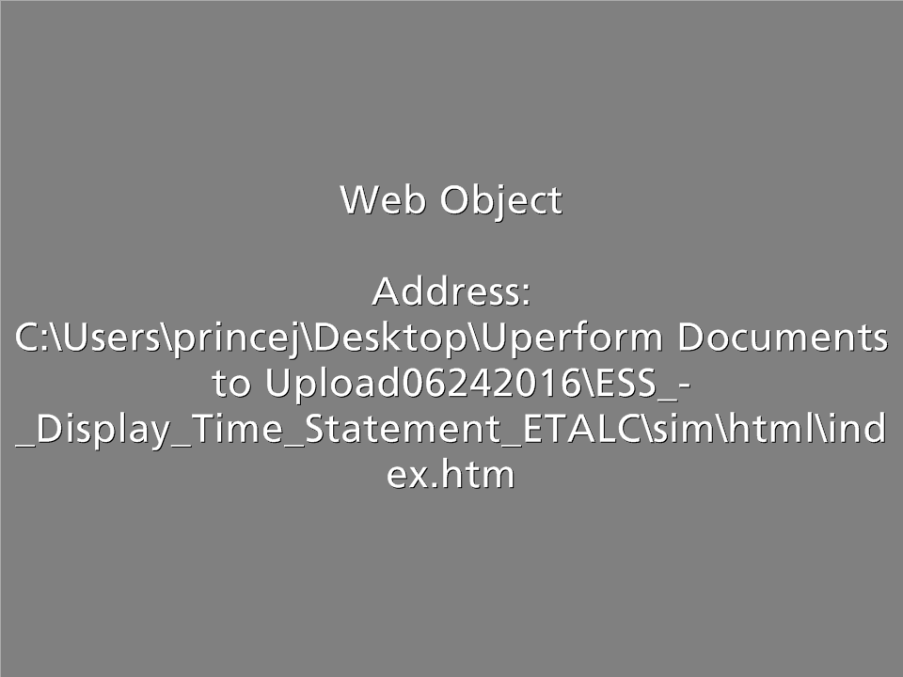
Demo: Display Time Statement
Scenario:
You are checking your Time Statement to view the time you entered the last pay period.
Notes:
Now let’s look at the Time Statement. Click on the word Practice and a new window will open. At the bottom of this window, there will be a button called Allow blocked content. Click that button to continue. When you are done with this demo , click on the End Lesson button and you will be returned back to this course after the window closes.

Slide 17
Now It’s Your Turn…
Click here to go to the SAP Portal
Using the buttons to the left:
Using the first button, sign into the SAP Portal and go to your own Time Statement.
  Enter your User Name and Password and then click Log on
  Click the Employee Self-Service tab and select the Time Statement in the Working Time section
Using the second button, open and complete the Employee Time Entry Worksheet, based on your Time Statement.
Click here to open the Employee Time Entry Worksheet
Notes:
Now that you have seen both the Employee Time Entry Worksheet and how to display the Time Statement, take a moment to access your Time Statement and complete your Employee Time Entry Worksheet. To help you with the process we have included buttons you can click to take you to the login page for the SAP portal and a link to open the worksheet. If you need help you can click the back button to view the demo showing you how to display your Time Statement.

Slide 18
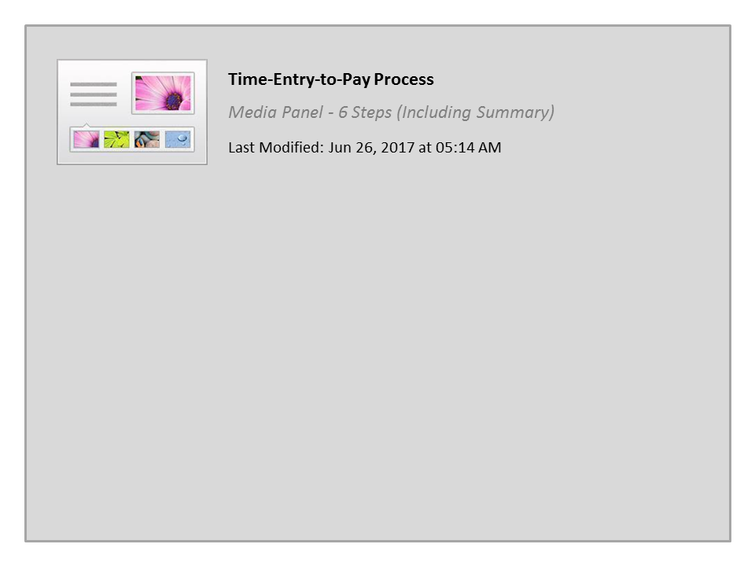
Time-Entry-to-Pay Process

Slide 19

Time Entry and Approval Deadlines
If you are a Full-time Employee:
All time should be entered at least weekly
All entries and revisions must be approved by 5:00pm on the second day of the following month
If you are a Temporary, Winter Part-time, Permanent Part-time:
All time should be entered and released daily
All entries and revisions must be approved by 5:00pm Monday
If you are using Leave Without Pay (LWOP):
All time should be entered, released and approved by the 15th of the current month LWOP is being used
Notes:
The type of employee you are drives your time entry deadline. Review line six of your Employee Time Entry Worksheet. If you are a full-time employee, then you should enter your time weekly and all of your time entries and revisions for the month must be approved by 5:00pm on the second day of the following month. If you are a Temporary, Winter Part-time or are a Permanent Part-time employee then you should enter your time at least daily and all of your entries must be approved by your supervisor by 5:00pm Monday. If you are using leave without pay, your time must be entered and approved by the close of business on the 15th of the month the leave is being used.

Slide 20

Employee Responsibilities
In addition to entering time and meeting the payroll deadlines, you also need to:
Verify your time has been entered correctly
Confirm your time has been approved by your supervisor
Talk to your Supervisor prior to changing the hours you normally work
Notes:
In addition to meeting time entry deadlines, you also need to verify your time entries to ensure they are correct and that your time has been approved. Also it is important for you to talk to your supervisor if you are going to change the hours you would normally work including if your are taking leave. It is also a good idea to enter your time in advance if you are going on leave and will not be present for a payroll deadline. Now that you understand your role in the time entry process let’s take a look at some of the others.

Slide 21

Supervisor / Appointing Authority Responsibilities
The Supervisor / Appointing Authority is responsible for:
Approving or rejecting time and leave
Verifying the time and leave entered is correct
Making sure time is approved by the payroll deadline
Notes:
Your Supervisor is responsible for approving or rejecting your time and leave and verifying that your time entry is correct. They also have a deadline to approve your time so, if there is a change, help them out by making the requested change as quickly as possible. In some cases, such as military or bereavement leave your time may not be approved by your Supervisor and is instead routed to your Appointing Authority for approval. Regardless of the whether your time is approved by your Supervisor or the Appointing Authority the goal is the same, to get you paid correctly. The last role in the time entry process is that of the timekeeper.

Slide 22

Timekeeper Responsibilities
The Timekeeper is responsible for:
Answering questions about the time entry process
Addressing timesheet issues with you and the supervisor
You can find your timekeeper’s name in the header of your time statement
Notes:
The Timekeeper plays a critical role in the Time-Entry-to-Pay process. Timekeepers ensure deadlines are met, answer employee questions when their supervisors can't and work closely with Payroll to resolve time entry issues. If your Timekeeper calls you about a time entry issue be sure to call her back promptly. It could impact whether you get paid correctly.

Slide 23
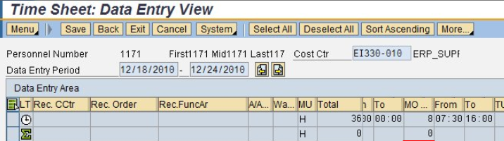
How Your Work Schedule Impacts Time and Pay
SAP uses the work schedule to calculate your pay. It contains rules that are used to calculate overtime, shift differential and other special pay.
Work schedules prevent employees from entering overtime during planned working hours and from entering leave outside planned working hours. Also, on-call hours must be recorded outside an employee's planned working hours.
Notes:
SAP uses the work schedule to calculate your pay. It contains rules that are used to calculate overtime, shift differential and other special pay.
Work schedules prevent employees from entering overtime during planned working hours and from entering leave outside planned working hours. Also, on-call hours must be recorded outside an employee's planned working hours.

Slide 24

When You Are Paid
If you are a Full-time Employee:
You are paid on the last working day of the month (except in June)
For more detailed information about the monthly pay schedule go to:
  http://intranet.dot.state.co.us/business/payroll/Payroll_Sch_Monthly/view
If you are a Temporary, Winter Part-time or Permanent Part-time Employee:
You are paid bi-weekly
For more detailed information about the bi-weekly pay schedule go to:
  http://intranet.dot.state.co.us/business/payroll/Payroll_Sch_Biweekly/view
Notes:
If you are a Full-time employee then you are paid monthly. If you are a Temporary, Winter Part-time or Permanent Part-time employee you are paid bi-weekly . Click on the link for your employee type to download the monthly pay schedule.

Slide 25
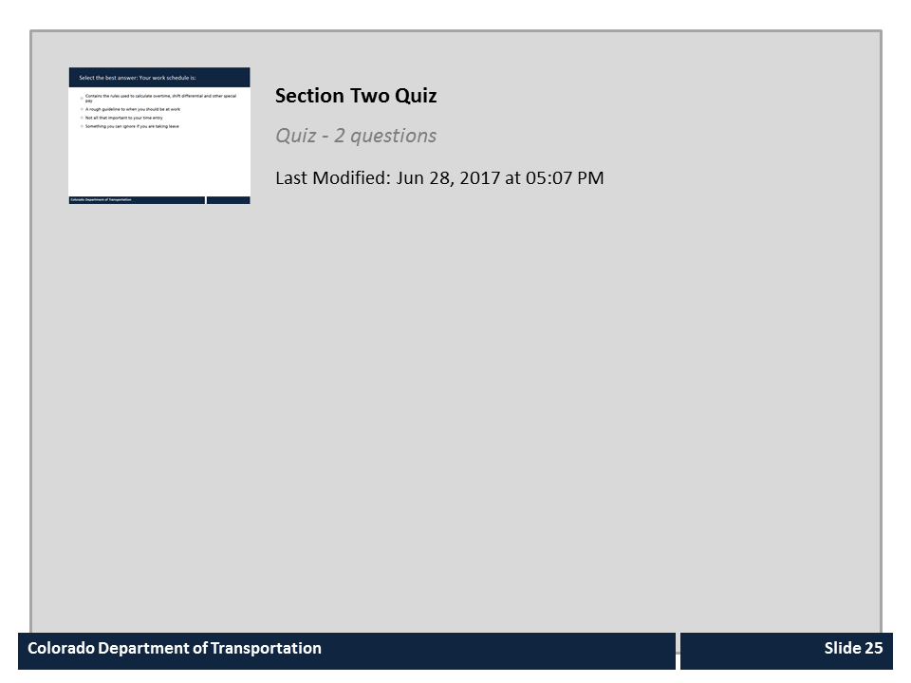
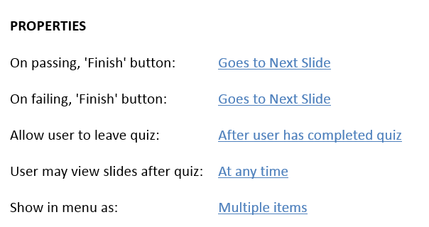
Section Two Quiz

Slide 26
Section 3 - Work Time Entry
Learning Logistics
Section 1 – Time Entry Overview
Section 2 – Time Entry Process
Section 3 – Work Time Entry
Section 4 – Leave Time Entry
Section 5 – Timesheet Verification
Conclusion
Notes:
The Work Time Entry section you will learn about the time entry process including deadlines, the roles and responsibilities. You will also complete the Employee Time Entry Worksheet using your Employee Time Statement. The information gathered on the worksheet will be used throughout the course to help you understand how to enter your time.

Slide 27
Section 3 - Learning Objectives
At the end of this section, you should be able to:
Explain how to access and navigate the timesheet
Locate your work schedule in your timesheet
Identify needed data for working time by functional area (Maintenance, Engineering, and Support)
Enter, release, and save time entries on the timesheet
Explain overtime policies
Define comp time and explain eligibility
Explain when and how to use wage types
Notes:
Upon completing this section you should have an understanding of the objectives on this slide. Please take a minute to review these before you continue. When you are done, click the next button.
SUGGESTED CHANGE:
5TH BULLET: s/b “… if you are eligible”

Slide 28
Accessing the Timesheet
To access your time from SAP:
In SAP enter T-code CAT2 in the Command field
Click the Enter button
Supervisors Only: In CAT2, you are taken to the Initial Screen before going to your timesheet. Check for YOUR name and SAP personnel number before clicking
Edit to go to your timesheet.
Notes:
Now that we have learned about the time entry process, and your role in it. Let’s look at the timesheet. After logging into SAP, type CAT2 in the command field and then click the Enter button. Once you are in your timesheet, you are able to enter, release and save your time. If you are a Supervisor please review the supervisor only note on the slide for additional steps for accessing your timesheet.

Slide 29
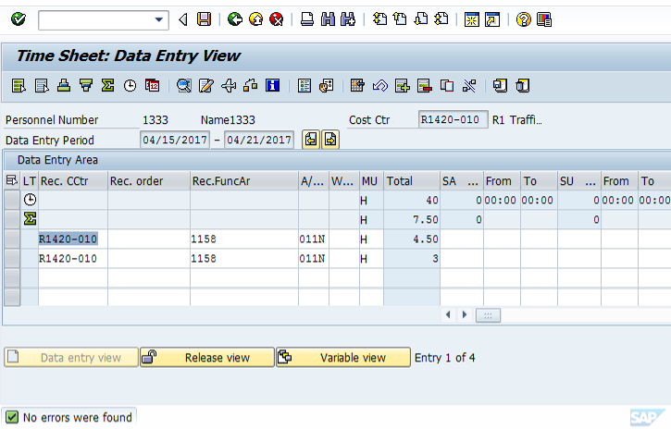
Navigating the Timesheet
The timesheet is broken out into four main sections:
Toolbars and buttons
Basic information
Data Entry Area
View buttons
Notes:
The timesheet is a tool for recording working times and tasks. While it may look confusing at first it is broken out into four major sections. The first is the toolbars and buttons which allow you to save and check your time. The second is your basic information, such as your Personnel Number Cost Center and the Data Entry Period. The third is the Data Entry Area, this is where you enter your time. The fourth section contains the view buttons, which take you to different views of the timesheet. Now that you are familiar with the timesheet, let’s look at the timesheet in more detail.

Slide 30
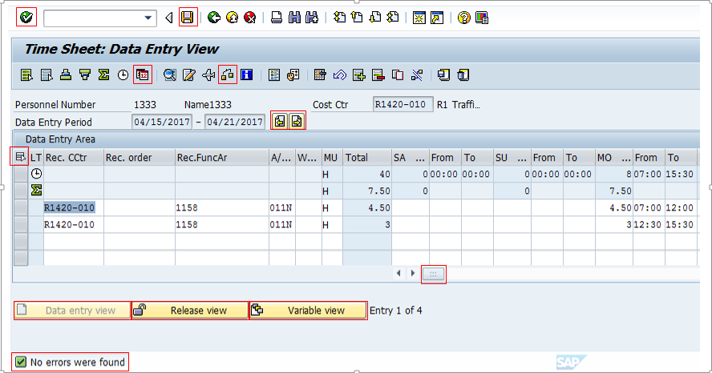
Navigating the Timesheet
Click on icons highlighted with a red box to learn more.
Notes:
When you start entering time you will see a timesheet similar to the one here. Click on any of the icons or fields with a red box to learn more. When you are done click on the next button to continue.

Slide 31
Navigating the Timesheet
Click on icons highlighted with a red box to learn more.
.
The Enter button is used to verify your entries on the timesheet.

Slide 32
Navigating the Timesheet
Click on icons highlighted with a red box to learn more.
The Save button is used to save the time you have entered. Note: You can save all time entries whether or not they have been released. If you save time entries that haven't been released be sure to remember to go back into SAP to release those time entries so that you supervisor can approve them before the payroll deadline.

Slide 33
Navigating the Timesheet
Click on icons highlighted with a red box to learn more.
The Weekdays On/Off button is used to change the days of the week, (i.e. SA) to calendar dates, (i.e. 4/15).

Slide 34
Navigating the Timesheet
Click on icons highlighted with a red box to learn more.
The Check Entries button is used to verify any time entries you have made. Messages display in the lower left corner of the screen.

Slide 35
Navigating the Timesheet
Click on icons highlighted with a red box to learn more.
The Previous Screen (left) and Next Screen buttons (right) buttons take you back one week or forward one week so you are able to view other data periods.

Slide 36
Navigating the Timesheet
Click on icons highlighted with a red box to learn more.
The Select All icon highlights all of your time entries so you are able to release all time at once.

Slide 37
Navigating the Timesheet
Click on icons highlighted with a red box to learn more.
The Scroll Bar, when you click and drag, displays additional days in the week where time entry is required.

Slide 38
Navigating the Timesheet
Click on icons highlighted with a red box to learn more.
The Data Entry view is where you enter your time. When the timesheet field is white, as in this view, you are in Data Entry View as shown by the arrow in the header.

Slide 39
Navigating the Timesheet
Click on icons highlighted with a red box to learn more.
The Release View button takes you to the screen where you release your time entries. This is the only view that displays the Release button that allows you to send your time to your Supervisor for approval.

Slide 40
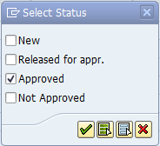
Navigating the Timesheet
Click on icons highlighted with a red box to learn more.
The Variable View button displays the Select Status box where you see the status of your time by selecting the time entry status you want to see. In this example, only time your supervisor has approved will be displayed.

Slide 41
Navigating the Timesheet
Click on icons highlighted with a red box to learn more.
All System messages display in the lower left corner of the screen. It is a good idea to review this section when you save or release your time.

Slide 42
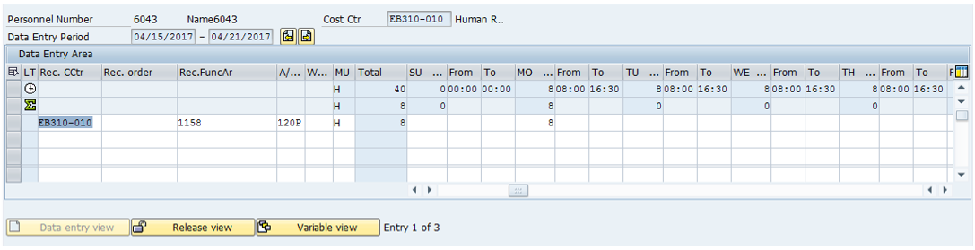
Work Schedule and the Timesheet
The Work Schedule Displays:
Total hours for the day
Total expected hours
Your start and end time for each day (from and to fields)
Notes:
Now that we have gone through the navigation of the timesheet, let’s look specifically at the area of the timesheet where you enter your time. This is known as the data entry area. For those of you who have entered time before, don’t worry if the timesheet we are looking at is not exactly the same as yours.
The first line of the timesheet, as indicated by the arrow, is your work schedule. The work schedule is the time you are required to account for using a combination of time worked and leave. The total column shows the number of hours you must account for during the week according to your work schedule, in this case its 40. Now let’s move on to the first work day of the week, Monday, as you can see there is an eight in this field. This indicates the daily scheduled hours. The From and To fields shows the hours this person is required to account for during the day.

Slide 43
Data Entry View of the Timesheet
The Data Entry area of the timesheet is where you:
Enter your time
View the time you have entered for the week
Notes:
Now lets look at where you enter time this is the first white line. When you enter your time it should be done using a 24 hour clock or military time. This is why the to time displays as 16:30 instead of 4:30pm. Hours to be entered and checked then added to the second blue line, the worked hours line. The worked hours line also adds all hours in the middle blue Total column. Now that you are familiar with the data entry section, let’s look at the data entry view in more detail.

Slide 44
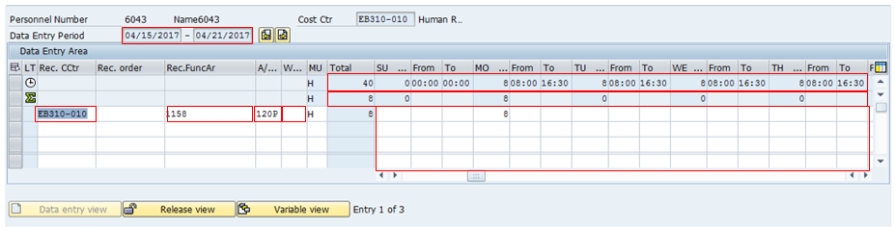
Navigating the Data Entry View of the Timesheet
Click on any of the fields with a red box to learn more.
Notes:
To learn more about your timesheet click on any of the red boxes to learn more. When you are done click on the next button to continue.

Slide 45
Navigating the Data Entry View of the Timesheet
Click on any of the fields with a red box to learn more.
The Data Entry Period is the week you are entering your time. Clicking the Previous and Next screen buttons to the right of this field displays additional weeks.

Slide 46
Navigating the Data Entry View of the Timesheet
Click on any of the fields with a red box to learn more.
The Work Schedule row displays your assigned work schedule and total hours to account for in the week, usually 40 hours. A combination of time worked and/or leave must be entered based on the daily From and To times based on the daily total hours.

Slide 47
Navigating the Data Entry View of the Timesheet
Click on any of the fields with a red box to learn more.
The Cost Center is where your time is charged if it you are not entering your time to a work order or project. Your home cost center is listed on your timesheet as indicated by the white arrow.

Slide 48
Navigating the Data Entry View of the Timesheet
Click on any of the fields with a red box to learn more.
This is the Receiving Functional Area column. It is used to describe the type of work you are performing and is also used to report expenses.

Slide 49
Navigating the Data Entry View of the Timesheet
Click on any of the fields with a red box to learn more.
This is the Attendance/Absence column. It is used by the system to track your attendances and absences. For attendances, the “N” (Non-Participating) means it is not billed to a Federal Grant. “P” means it will be billed.
Notes:
Suggestion:
…billed to a Federal Grant. (add period)

Slide 50
Navigating the Data Entry View of the Timesheet
Click on any of the fields with a red box to learn more.
The Totals Row displays the total number of hours you entered daily and for the week. In this example, the black arrow points to a weekly total of 8 hours. The green arrow, pointing to the “0,” indicates no time has been entered for Tuesday.
.

Slide 51
Navigating the Data Entry View of the Timesheet
Click on any of the fields with a red box to learn more.
The Wage Types field is used only if you are On-Call or if you have a 2nd or 3rd shift work schedule and have to attend mandatory events during 1st shift hours.

Slide 52
Navigating the Data Entry View of the Timesheet
Click on any of the fields with a red box to learn more.
The Time Entry area is where you enter the start and end times you worked, any leave you have taken, and overtime if you are eligible. Time entries should be made in 15 minute intervals (00, :15, :30 or :45).

Slide 53
Time Entry
Using line two of your Employee Time Entry Worksheet, click on the button that matches your assignment.
Maintenance or Tunnel
Engineering or Project Support
Maintenance Support or Program Support
Temporary
Notes:
Now let’s get into how you enter time based on your employee type. Using line two of your Employee Time Entry Worksheet select the personnel subarea that matches your assignment. If you are a Temporary employee select this option regardless of where you are assigned.

Slide 54
Types of Time Entered by Maintenance
A Work Order
  Includes the work order number, an activity number, and a work center number, A/A type and working time
Cost Center
  Can be used to record administrative work, such as training or safety meetings
  Requires entry of the Receiving Cost Center, Receiving Functional Area, A/A Type and Working time (From and To)
On-call
  Used only to record time the employee was on-call
  Requires entry of the Receiving Cost Center, Receiving Functional Area, Wage Type 4099 and hours (From and To)
Notes:
As a maintenance employee the majority of your time will be recorded to a work order. A work order time entry includes the work order number, an activity number, and a work center number as well as the A/A type and your working time.
Your time can also be charged to a cost center when you attend training or safety meetings. This type of time entry requires the receiving cost center and functional area, an A/A type and your working time.
An exception to the required A/A type is on-call entries. On-call entries require a Cost Center and Receiving Functional Area. All on-call entries are charged to the Wage Type 4099.

Slide 55
Work Orders and Time Entry
As a Maintenance or Tunnel Employee:
All of your working time is typically entered to a work order
DOT1 work orders will transfer the time to your timesheet
Preventative work orders must be entered on the timesheet
Time cannot be entered or transferred unless a work order has been created and released
Maintenance Staff -
Creates and releases the work order
DOT1 Work Orders:
Transfer to the timesheet
Employee reviews and enters
Employee -
Releases and saves time to the work order in the timesheet
Preventative Work Orders:
Do not transfer to the timesheet
Employee enters in timesheet
Notes:
In general you will be entering your time to a work order. In some cases time is transferred to the timesheet and in others, such as preventative, if needs to be entered. Time cannot be transferred to the timesheet unless a work order has been created and released.

Slide 56
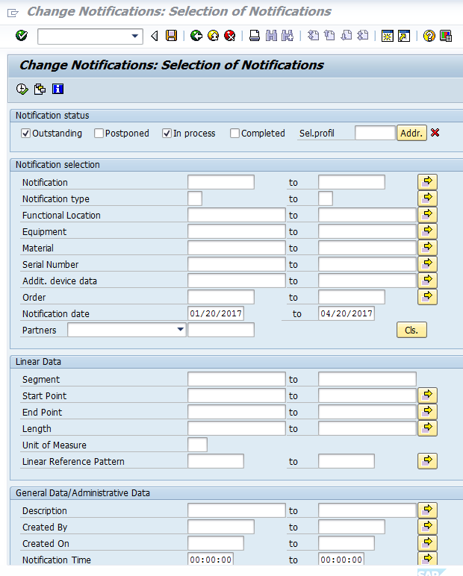
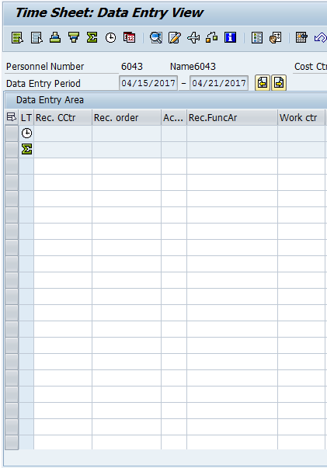
Time Transfer and DOT1 Work Orders
Time transfer occur three times a day
6:00 a.m.
6:00 p.m.
Midnight
Notes:
When does time transfer from a DOT1 work order to your timesheet? SAP uses the time transfer program to transfer your time to your timesheet. This program runs daily at 6 a.m., 6 p.m. and midnight. It transfers the operations time from all released and approved DOT1 work orders. The time in a work order only transfers once. It does not transfer times that are changed in the work order after the time transfer program has run. These are the changes that need to be updated manually in your timesheet.

Slide 57
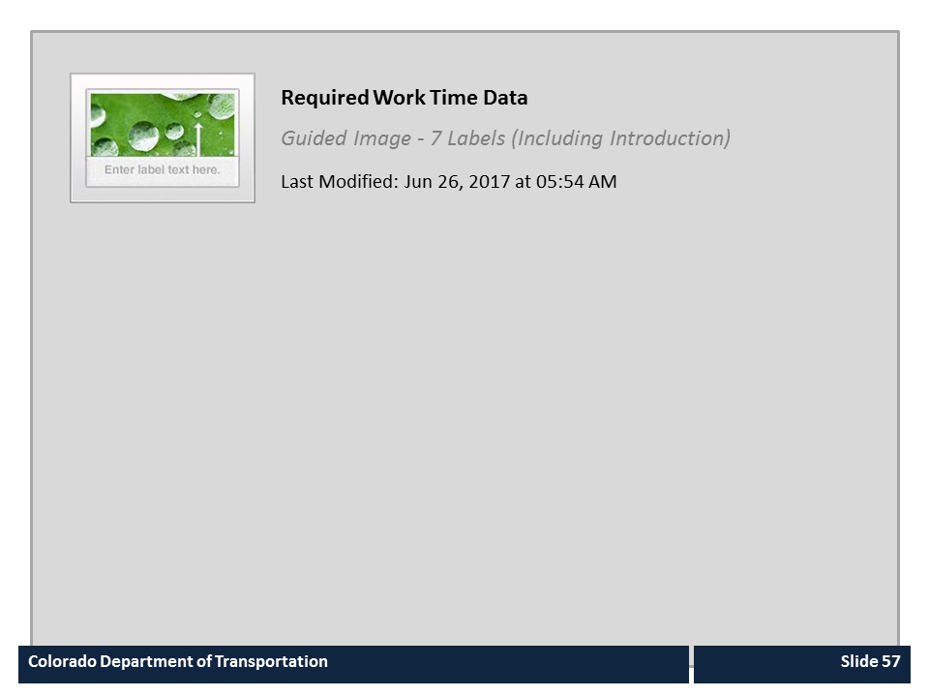
Required Work Time Data

Slide 58

Validating the DOT1 Work Order
When reviewing time transferred by DOT1 work order, verify the:
Work Order Number
Activity
Work Center
A/A Type
Working time (To and From)
Notes:
As mentioned earlier, the DOT1 work order automatically populates timesheets based on the created work order. Because things change, you need to review the work order to make sure that everything is correct. When reviewing the work order number make sure the correct work order was transferred, and review the activity to verify the correct work was done. You should also review the work center to make sure the right person did the work. Additionally, there are a couple of items that are in your control you can change. These are the A/A type, and your working time. Please make sure this is correct when you do your time entry. If any information from the work order is incorrect, contact your supervisor.

Slide 59
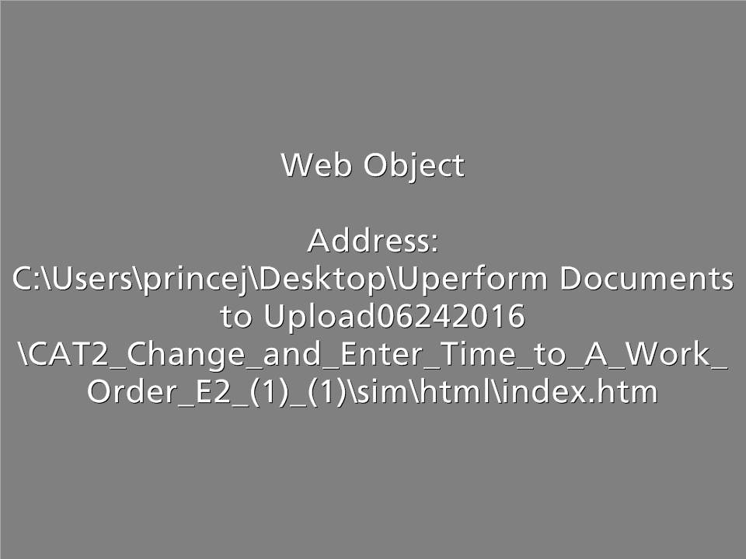
CAT2 – Verify and Enter Time to a Work Order
Scenario: You are changing the amount of time you worked on a DOT1 work order from 9 hours to 10 hours and are entering the 10 hours to a preventive work order.
Notes:
Now let’s look at changing the time for a DOT1 work order and then entering time charged to a preventive work order. When you are done with this exercise , click on the End Lesson button and you will be returned back to this course after the window closes.

Slide 60
Entering Time to a Cost Center
Maintenance employees use a cost center to charge time to safety and mandatory training
Required fields are:
    Receiving Cost Center
    Receiving Functional Area
    A/A Type
    Working hours (From and To)
Notes:
Most of the time, as a Maintenance or Tunnel employee, you will enter your time to work orders. In some cases, such as safety meetings or training, you may need to enter your time to a cost center. If you are entering time to your home cost center, it is located on your timesheet just to the right of your personnel number. In addition to the cost center you will need to enter the receiving functional Area, A/A Type and the working hours. Now let’s practice entering your time to a cost center.

Slide 61
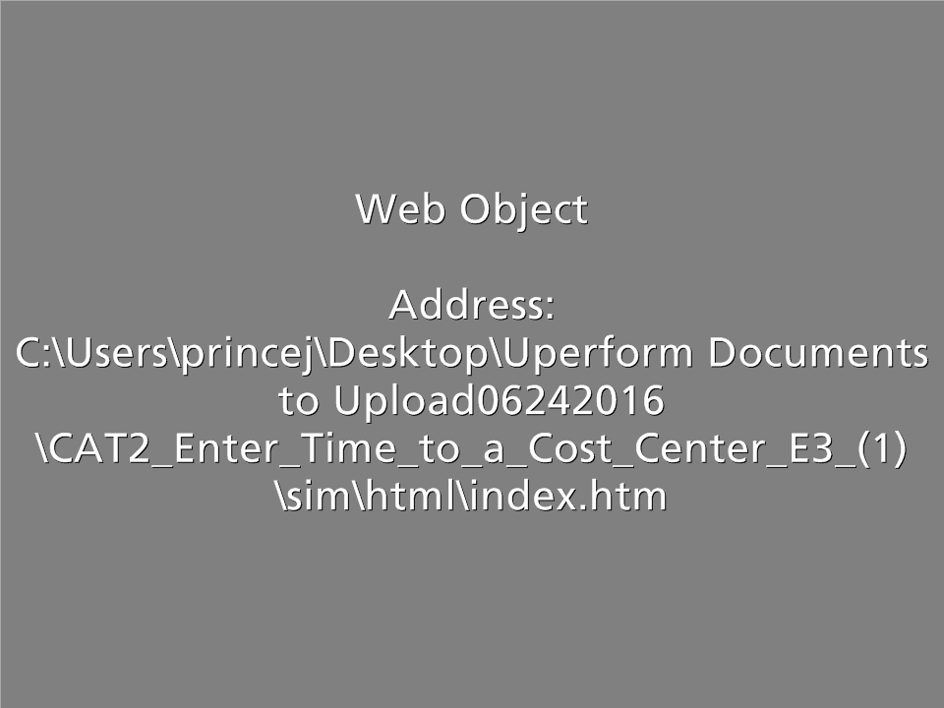
CAT2 – Enter Time to a Cost Center
Scenario: You went to an all-day training and you are entering time to your home cost center.
Notes:
Now we are going to practice entering and releasing your time to a cost center. Click on the word Practice, when you do a new window will open. When it does click on the Allow blocked content button located on the bottom of the page. When you are done, click on the End Lesson button and you will be returned back to this course after the window closes.

Slide 62
Overtime and the Timesheet
Overtime is:
Paid at 1.5 times your regular rate of pay
Entered on the timesheet using code 014N or 014P in the A/A Type field
Approved verbally by your Supervisor in advance
Described in PD 1230.0 and 1230.2
Notes:
Overtime is paid when you work outside of your normal planned work time. You are paid time and a half for this work. All overtime must be authorized by your Supervisor prior to being worked and is coded on your timesheet using code 014N or 014P. If you want to learn more about overtime rules they are described in PD 1230.0 and 1230.2.

Slide 63
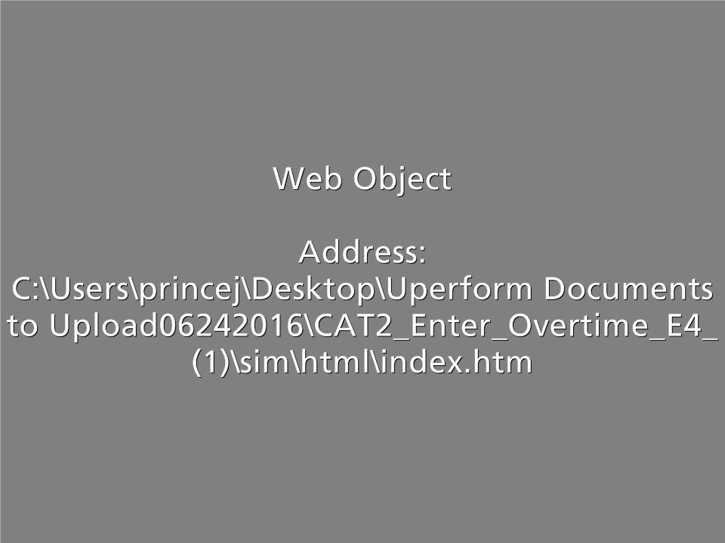
CAT2 – Enter Overtime
Scenario: You are entering overtime because the all-day training course went over one hour.
Notes:
Now we are going to practice entering overtime. Click on the word Practice, when you do a new window will open. When you are done, click on the End Lesson button and you will be returned back to this course after the window closes.

Slide 64
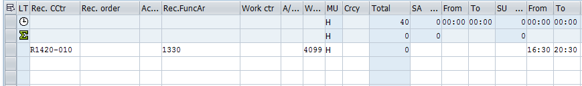
Entering On-call Time
On-call
Must be authorized by your supervisor
What fields to enter on your timesheet
Receiving Cost Center
Only entered during non-working time
Employee must be available to work
Entered as Wage Type 4099
Receiving Functional Area
Wage Type (4099)
Hours on call in the From and To field
Notes:
Wage types are another time entry type used in maintenance. These are used INSTEAD of an A/A type. CDOT uses two kinds of Wage Types - one for On-Call time and one for Work Schedule Premium Pay time.
On-call must be approved by your supervisor, must only be entered on non-working time and wage type 4099 is entered.

Slide 65
Work Schedule Premium Pay
Work Schedule Premium Pay
May only be entered on working time
What fields to enter on your timesheet
Receiving Cost Center
Ensures payment of 2nd or 3rd shift differential when you attend a qualifying event during the 1st shift
Entered as Wage Type 7002 (2nd shift) and 7003 (3rd shift)
Receiving Functional Area
Total Hours of the event in the day field
Wage Type 7002 (2nd shift) or 7003 (3rd shift)
Notes:
Employees who are scheduled to work 2nd or 3rd shift but work 1st shift due to a qualifying event may be eligible to receive shift pay for the hours worked on 1st shift. Examples of qualifying events are Safety meetings, mandatory trainings, and Remembrance events. Mandatory overtime due to snow or other routine maintenance operations is not eligible for the shift premium. When entering the shift premium, be sure to verify that only the hours worked on 1st shift are entered with the wage type for the qualifying event and the total hours coded to the wage type match the number of the hours worked for the qualifying event.

Slide 66
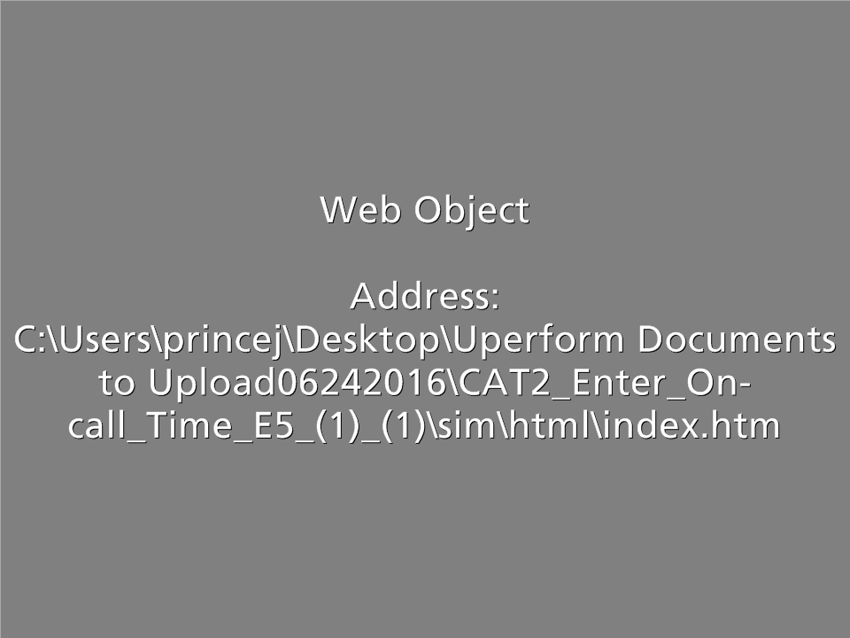
CAT2 - Enter On-call Time
Scenario: In this scenario, you are entering the time you were on-call on Friday.
Notes:
Now let’s look at how you enter and release you time when you are On-Call. Click on the word Practice, when you do a new window will open. When you are done, click on the End Lesson button and you will be returned back to this course after the window closes.

Slide 67
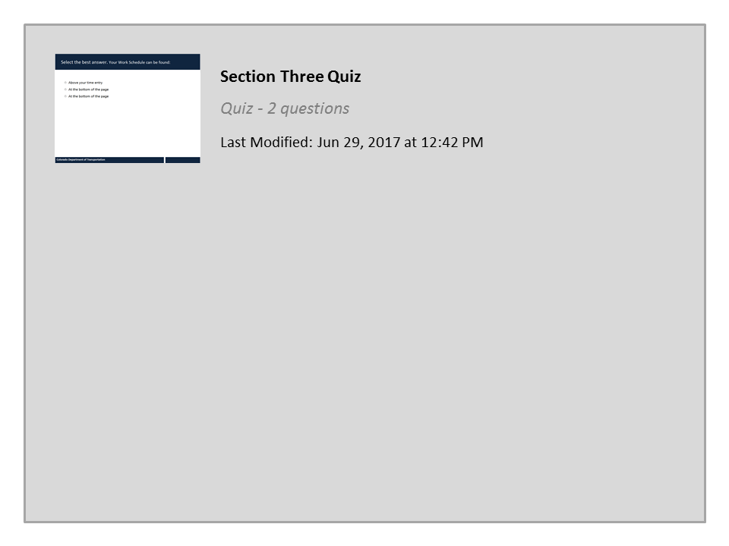
Section Three Quiz
Notes:
Now lets answer a few questions before we continue. There is no sound in other questions in the knowledge check.

Slide 68

Under Construction
This section of the course is under development
Click the next button to return to the Time Entry slide
Notes:
This section of the course is under development and will be ready soon. Click the next button to return to the Time Entry slide and make another selection.

Slide 69
Section 4 – Leave Time Entry
Section 1 – Time Entry Overview
Section 2 – Time Entry Process
Section 3 – Work Time Entry
Section 4 – Leave Time Entry
Section 5 – Timesheet Verification
Notes:
In section four, Leave Time Entry, you will learn about the types of leave available to you, how they accrue and how to enter leave. You will also learn about how to use the Leave Summary and Use or Lose reports to determine how much leave you have available.

Slide 70
Section 4 - Learning Objectives
At the end of this section, you should be able to:
Describe the SAP leave approval process
Describe the roles and responsibilities in CDOT leave process
Identify types of leave that are accrued and the approval process
Explain the leave-without-pay (LWOP) process and deadline
Identify approval process for other types of leave and how work schedules impact leave
Identify CDOT holidays and how they affect the timesheet
List the leave types available to you
Enter, release and save absence time in SAP
Notes:
Take a moment to review the learning objectives for this section. When you are done, click the Next button to continue.

Slide 71
What is Leave?
Leave is when you take time off from your normally scheduled hours
The State provides leave as a paid benefit
Tracks absences on your timesheet
Can only be entered during scheduled hours
Earned or need-based
May be paid or unpaid
Refer to the leave Procedural Directive 1204.2 for more information
Notes:
So what is leave? Leave is a paid benefit that is available for you to use. When you enter leave you enter it on your timesheet because it is tracked the same way as working time. In some cases, such as sick and annual leave, your leave will accrue over time. In other cases such as bereavement and jury leave this is available to you only when the need occurs. Depending on what kind of employee you are your paid leave benefits may vary. If you have questions about the types of leave you are eligible for refer to Procedural Directive 1204.02.

Slide 72
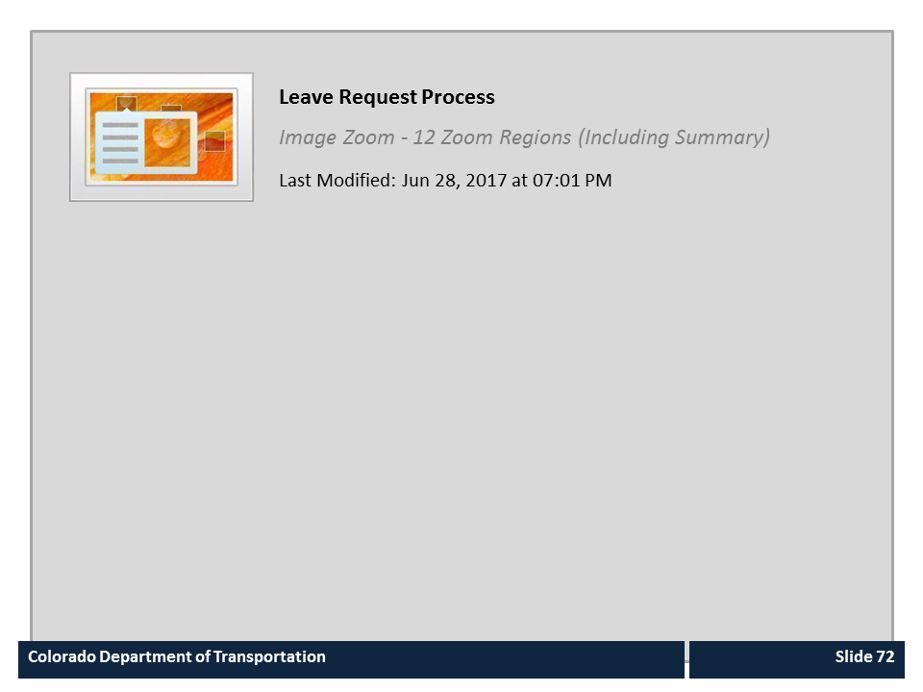
Leave Request Process

Slide 73
Time and Leave Approval Process
Employee Discusses Leave with Supervisor
Appointing Authority Receives Email and Approves or Rejects Leave
Talk to Your Supervisor
Employee Enters Leave
Yes
No
SAP Email Sent
Is Admin or unpaid leave requested?
SAP Email Sent
Is Leave
Approved?
SAP Verifies Leave Quota for Requested Leave
No
Yes
Supervisor Receives Email and Approves or Rejects Leave
SAP Processes Leave Entries
Employee Enters Releases and Saves Request

Slide 74
Types of Accruals and Leave
Using line six of your Employee Time Entry Worksheet, click on your employee group to learn about your leave accruals:
Permanent Full-time
Permanent Part-time
Temporary
Winter Permanent Part-time
Notes:
The types of leave that you get and the rate at which it is earned is dependent upon the type of employee you are. If you know your employee group please select it now. If you are not certain, it can be found under Item six of your Employee Time Entry Worksheet.

Slide 75

Accrual - Permanent Full-time
As a Permanent Full-time employee:
You receive full accruals when you are paid 40 hours per week for an entire month
Your leave is prorated if you start in the middle of the month
Accrual rates for annual leave change based on your years of service.
Notes:
As a Permanent Full-time employee you receive full accruals when you work full-time for an entire month. If your are starting off in the middle of the month your leave will be prorated based on what you worked. Your accruals are based off of years of service for annual leave while your sick is based on a set rate.

Slide 76

Accrual – Permanent Part-Time
As a Permanent Part-time employee your leave is prorated based on the hours you work:
  Accruals are based on Full-time work of 40 hours per week per month
  As a Permanent Part-time your accrual is based on the number of hours you work
  Example: If you work 20 hours a week and the full time sick leave accrual is 6.66 hours per month you would accrue 3.33 hours per month
  Accrual rates for annual leave change based on your years of service.
Notes:
As a Permanent Part-time employee your leave is prorated based on the number of hour you work. For example a Permanent Full-time employee earn 6.66 hours of sick leave each month. If you worked 20 hours a week your accrual would be half of that, 3.33 hours. Now let’s talk about the types of leave you are eligible to accrue.

Slide 77
Accrual – Winter Permanent Part-time
As a Winter Permanent Part-time employee:
You receive full accruals when you work 40 hours per week for an entire month
Your leave is prorated if you do not work 40 hours per week for an entire month
  Example: In a month with 160 hours the full accrual of sick leave would be 6.66 hours. If you worked 80 hours then your accrual for that month would be 3.33 hours.
  Accrual rates for annual leave change based on your years of service.
Notes:
As a Winter Permanent-Part time employee your leave accruals are the same as a Full-Time Permanent employee when you work the full forty hours per week for an entire month. The only difference is that your leave may be prorated based on the total number of hours you work in the month. For example you would receive the full accrual of sick leave of 6.66 hours when you work 160 hours a month. If you started in the middle of the month, and worked full-time for two weeks your sick leave would be prorated because you only worked 80 hours. This would be the same for Annual leave. This is also same for the rest of your accruals as well. Now let’s look at the types of leave you accrue.

Slide 78

Leave Quotas
Each type of accrued leave has its own bank
Quota banks track leave accrual and usage
You can only use leave after it’s earned
Leave is accrued monthly based on your paid hours
Annual
Sick
Comp
Alt Holiday
Notes:
You deposit into and withdraw from multiple leave banks. Like a bank account, your balances can go up or down. Annual and sick leave are earned automatically on the last day of each month. Your earn rate varies based on your paid hours in the month and your years of service. This earned leave time is then available for you to use at a later date. Other accrued leave types include, alternate holiday time and comp time.

Slide 79
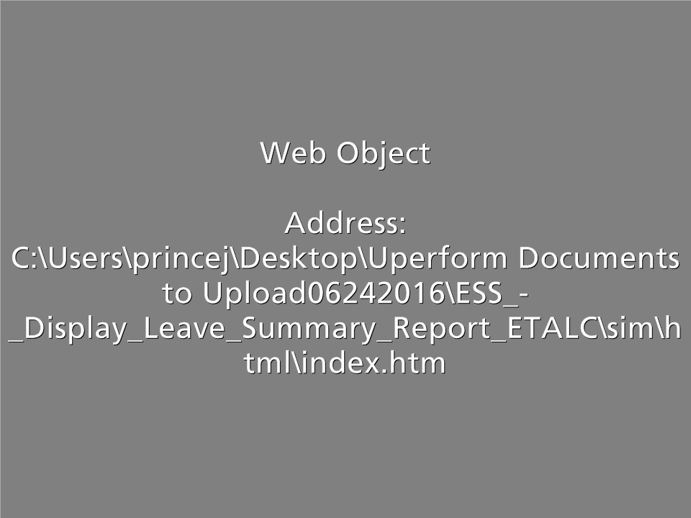
Display the Leave Summary Report
Scenario: You are uncertain about how much leave you have earned. Check your Leave Summary report to see how much annual leave is available to you.
Notes:
Now let’s look at displaying the Leave Summary Report. Click on the word Practice, when you do a new window will open. When you are done, click on the End Lesson button and you will be returned back to this course after the window closes.

Slide 80
Roles and Responsibilities in the Leave Process
Employee
Supervisor
Appointing Authority
Timekeeper
Notes:
Like with the Time Entry Process, there are several roles working together to ensure the leave process goes smoothly: You (the Employee), your Supervisor, your Timekeeper and your Appointing Authority.

Slide 81
Leave Process: Employee and Supervisor
Employee
Supervisor
As an Employee you are responsible for:
Understanding your workgroup’s leave processes and supervisor expectations
Checking your Leave Summary report before requesting leave
Communicating you are taking leave
Entering your leave request correctly and on time
Quickly responding to timesheet errors
Verifying your timesheet has been approved
Your Supervisor is responsible for:
Communicating your workgroup’s leave processes and expectations
Verifying leave request entries
Contacting employee quickly in case of timesheet errors
Approving or rejecting your employee’s leave request
Notes:
Communication about the leave process is critical. As a employee, you need to make sure that you talk to your Supervisor about leave so that you understand the process for your workgroup. Employees also must enter leave requests according to the needs of the department and workgroup. Keep in mind this might change based on the kind of leave you are requesting. This might be as informal as letting your supervisor know that you plan on taking a vacation day in a couple of weeks or have regular doctor appointments scheduled over the next couple of months. Regardless of the leave type, let your supervisor know as soon as possible when you plan to take leave. If there is an issue with your timesheet, you need to correct it quickly. And, finally you should always verify that your time has been approved.
The supervisor is responsible for communicating all time and leave expectations to you and for approving or rejecting your leave requests promptly. Also if there is an error, your supervisor should let you know as soon as possible so the error can be fixed.

Slide 82
Leave Process: Timekeeper and Appointing Authority
Appointing Authority
Timekeeper
Your Timekeeper is responsible for:
Verifying that all of your leave has been entered
Confirming all of the leave entered has been approved by the supervisor or appointing authority
Resolving any issues that may have occurred during the leave entry process
Answering questions about leave from the employee and the supervisor
Your Appointing Authority is responsible for:
Communicating certain leave request expectations
Contacting supervisor to better understand reasons for absences
Approving or rejecting certain leave types
Notes:
Your timekeeper is there to verify that all leave has been entered and approved by time entry deadlines. Timekeepers also answer questions and help resolve issues with leave. And finally, the appointing authority is responsible for approving certain types of leave requests.

Slide 83
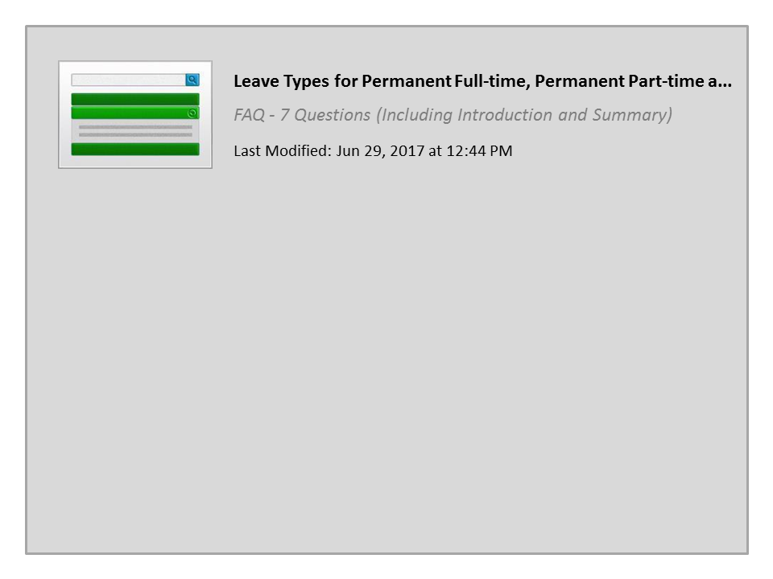
Leave Types for Permanent Full-time, Permanent Part-time and Winter Permanent Part-time

Slide 84
CDOT Holidays
Public Holidays
Independence Day
Labor Day
Columbus Day
Veterans Day
Thanksgiving Day
Christmas Day
New Year Day
Martin Luther King Day
President’s Day
Memorial Day
The list to the left are the public Holidays for all Permanent Full-time, Permanent Part-time and Winter Permanent Part-time employees.
Click HERE for a list with dates for this and the next fiscal year.
Notes:
Permanent Full-time, Permanent Part-time or Winter Permanent Part-time employees are eligible to take all of the Holidays listed on the left of the screen. If you would like a list with the dates click on the word Here and a webpage will display with the holidays for the current and next fiscal year.

Slide 85
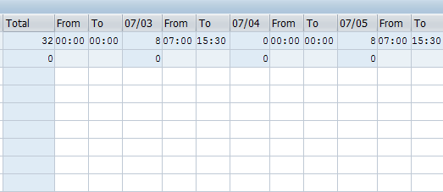
CDOT Holidays and Your Timesheet
On a holiday, your timesheet will:
Reduce your work schedule by eight hours (see red circle)
Display hours if you normally work more than eight hours in your work schedule and show the correct number of hours you need to work
Notes:
If you are scheduled to work on a day that a holiday then your work schedule will be reduced by eight hours. You do not need to enter anything on you timesheet to get paid for the holiday. If you are scheduled to work more than eight hours on the day of a holiday you must account for the additional hours. For example, if you're scheduled to work a 10-hour day on Monday that is a holiday you must either work or take leave for the remaining two hours. The timesheet will show the correct number of hours planned based on your assigned work schedule.

Slide 86
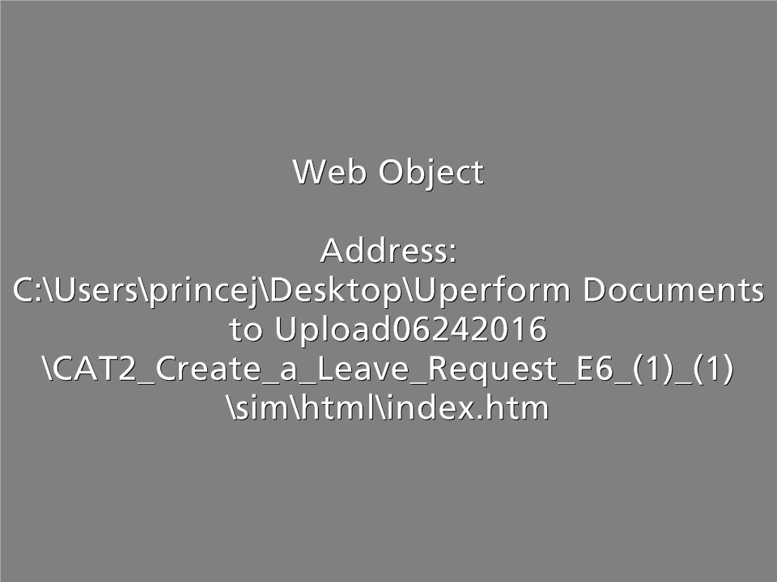
CAT2 - Create a Leave Request
Scenario:
You have been selected for Jury duty and need to enter your leave.
Notes:
Now that we understand the types of leave that are available let’s look at how to enter leave into the system. In this example, you have been selected for jury duty, but only served for four hours. As with some leaves you may need to provide documentation to your supervisor. In this case, you need to provide your jury summons.
Click on the word Practice, when you do a new window will open. When you are done, click on the End Lesson button and you will be returned back to this course after the window closes.

Slide 87

“Zero out” Approved Leave
Zeroing out an existing approved leave entry ensures:
Your Supervisor is automatically notified of the timesheet change
The time is credited back to your leave bank
There is record of the change and change approval
Notes:
There may be times when you plan to take leave but your plans change after you’ve entered the leave, and it’s been approved deducted from that leave bank. If this occurs you need to “Zero out” your leave. When you “zero out” a leave entry, the supervisor must approve the zero to have the leave returned to your leave bank. This also creates a record of this change.

Slide 88
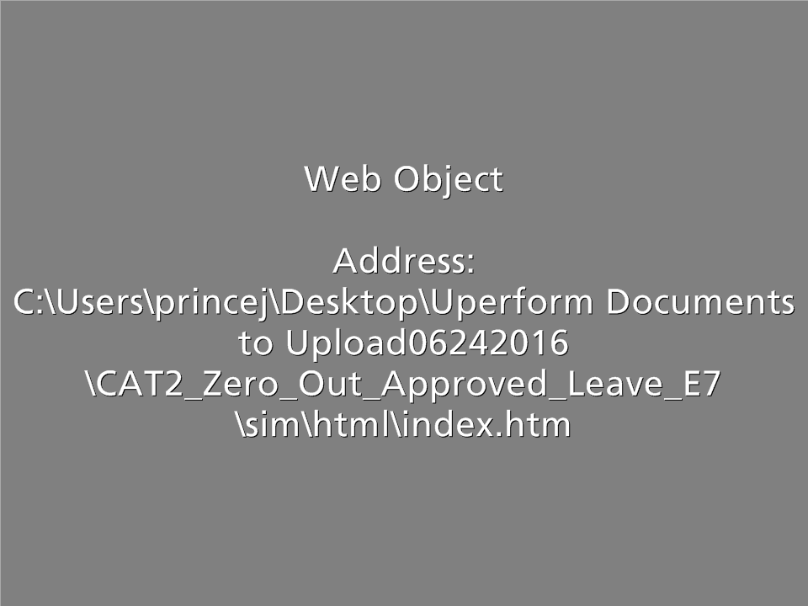
CAT2 - “Zero out” Approved Leave
Scenario: You entered Thursday as sick leave, but ended up working so you are zeroing out the time.
Notes:
In this example, you are entered Thursday as sick leave, but ended up working so are zeroing out the time.
Click on the word Practice, when you do a new window will open. When you are done, click on the End Lesson button and you will be returned back to this course after the window closes.

Slide 89
TEMP EMPLOYEE SECTION

Slide 90
Roles and Responsibilities in the Leave Process
Employee
Supervisor
Appointing Authority
Timekeeper
Notes:
Now that you are familiar with the process let’s look at the roles in more detail. There are a lot of roles working together to ensure the leave process goes smoothly. The first role is that of the employee. As an employee, you must enter your leave requests according to the needs of your department and workgroup. As a Temporary employee, the only leave you will enter on your timesheet is Jury and Administrative. If you are taking time off for another reason you need to let your supervisor know as soon as possible. Your supervisor and timekeeper are there to help you with any questions you have.

Slide 91
Leave Process: Employee and Supervisor
Employee
Supervisor
As an Employee you are responsible for:
Understanding your workgroup’s leave processes and supervisor expectations
Checking your Leave Summary report before requesting leave
Communicating you are taking leave
Entering your leave request correctly and on time
Quickly responding to timesheet errors
Verifying your timesheet has been approved
Your Supervisor is responsible for:
Communicating your workgroup’s leave processes and expectations
Verifying leave request entries
Contacting employee quickly in case of timesheet errors
Approving or rejecting your employee’s leave request
Notes:
Communication about the leave process is critical. As a employee, you need to make sure that you talk to your Supervisor about leave so that you understand the process for your workgroup. Employees also must enter leave requests according to the needs of the department and workgroup. Keep in mind this might change based on the kind of leave you are requesting. This might be as informal as letting your supervisor know that you plan on taking a vacation day in a couple of weeks or have regular doctor appointments scheduled over the next couple of months. Regardless of the leave type, let your supervisor know as soon as possible when you plan to take leave. If there is an issue with your timesheet, you need to correct it quickly. And, finally you should always verify that your time has been approved.
The supervisor is responsible for communicating all time and leave expectations to you and for approving or rejecting your leave requests promptly. Also if there is an error, your supervisor should let you know as soon as possible so the error can be fixed.

Slide 92
Leave Process: Timekeeper and Appointing Authority
Appointing Authority
Timekeeper
Your Timekeeper is responsible for:
Verifying that all of your leave has been entered
Confirming all of the leave entered has been approved by the supervisor or appointing authority
Resolving any issues that may have occurred during the leave entry process
Answering questions about leave from the employee and the supervisor
Your Appointing Authority is responsible for:
Communicating certain leave request expectations
Contacting supervisor to better understand reasons for absences
Approving or rejecting certain leave types
Notes:
Your timekeeper is there to verify that all leave has been entered and approved by time entry deadlines. Timekeepers also answer questions and help resolve issues with leave. And finally, the appointing authority is responsible for approving certain types of leave requests.

Slide 93
Temporary Employee Leave
The State provides two types of paid leave:
  Jury
  Administrative
Do not accrue annual or sick leave
State holidays are not paid
Only Jury and Administrative leave are entered on your timesheet
All other leave types are not entered on your timesheet, but must be communicated to your supervisor
Notes:
As a Temporary Employee you need to enter Jury and Administrative leave because you are paid for this type of leave. Because you do not receive other types of leave they do not and should not be entered on your timesheet. However, if you are taking time off you need to communicate this to your supervisor.

Slide 94
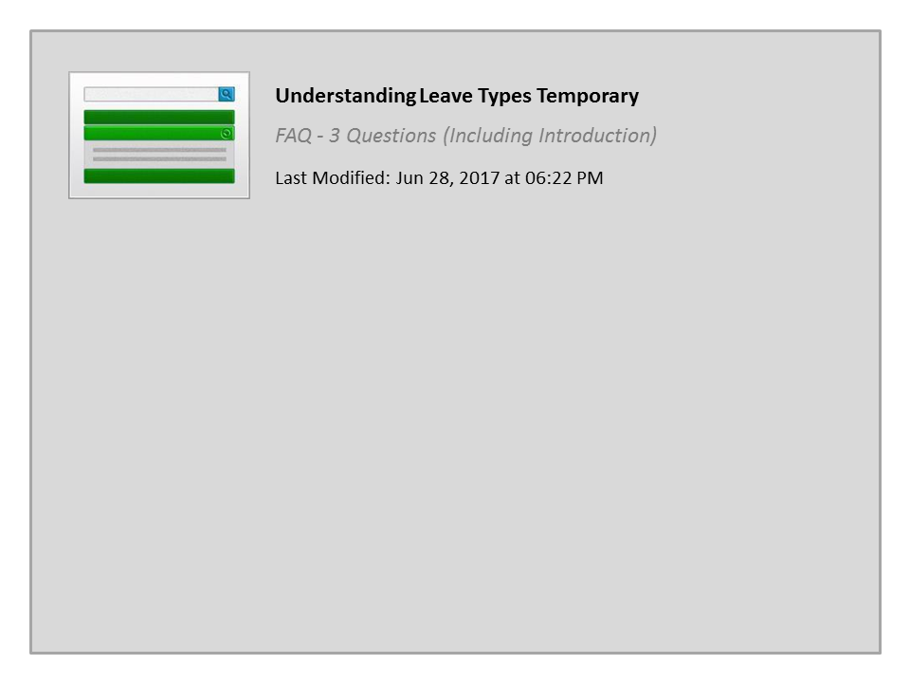
Understanding Leave Types Temporary

Slide 95
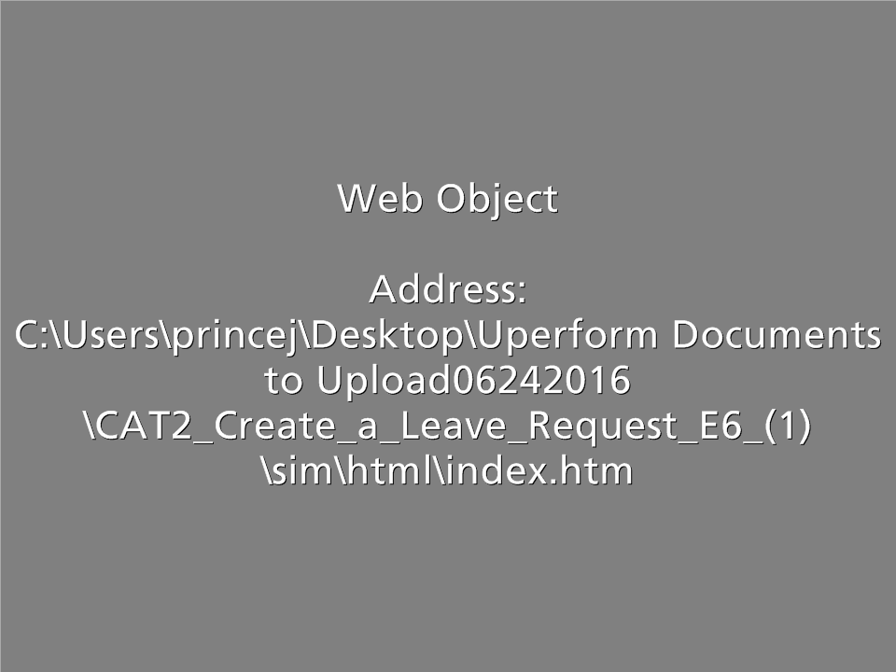
Create a Leave Request
Scenario:
You have been selected for Jury duty and need to enter your leave prior to your service.
Notes:
Now that you understand the types of leave that are available let’s look at how to enter leave into the system. To enter leave you will need to know the type of leave you are entering, in this example, you have been selected for jury duty. As with some leave types you may need to provide documentation to your supervisor. In this case, you need to provide your jury summons.

Slide 96
“Zero out” Approved Leave
Zeroing out an existing approved leave entry you ensures:
There is record of the change and change approval
Your Supervisor is automatically notified of the timesheet change
The time is credited back to your leave bank
Notes:
Because you have to enter leave before you take it, there may be times when things change and you end up working instead of taking leave. If this occurs you need to “Zero out” your leave. When you do this you leave the record of the change, your supervisor is notified of the change to your timesheet and your leave is returned to your leave bank

Slide 97
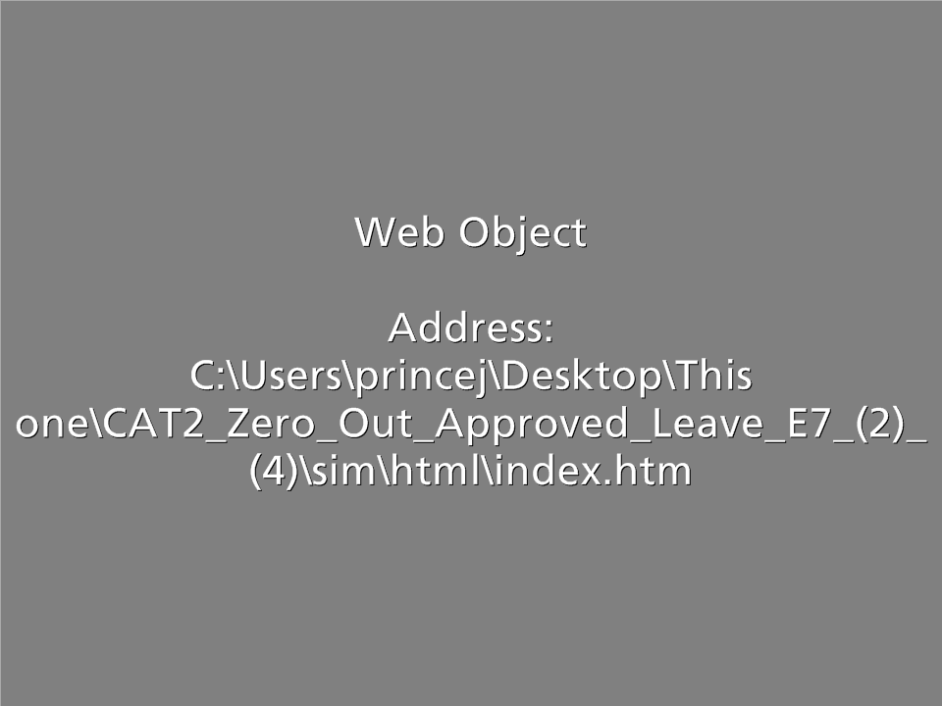
CAT2 - “Zero out” Approved Leave
Scenario: You entered Thursday as sick leave, but ended up working so you are zeroing out the time.
Notes:
In this example, you are entered Thursday as sick leave, but ended up working so are zeroing out the time.
Click on the word Practice, when you do a new window will open. When you are done, click on the End Lesson button and you will be returned back to this course after the window closes.

Slide 98
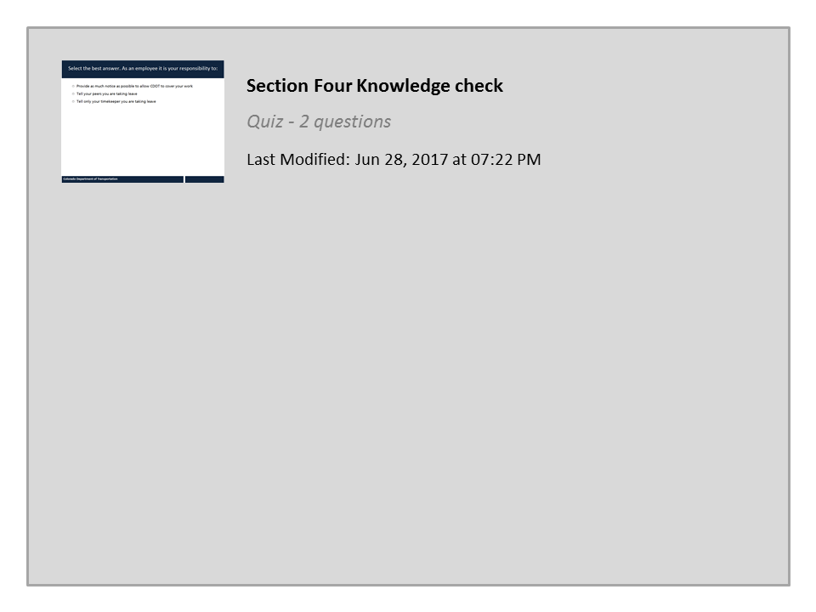
Section Four Knowledge check

Slide 99
Section 5 - Timesheet Verification
Section 1 – Time Entry Overview
Section 2 – Time Entry Process
Section 3 – Work Time Entry
Section 4 – Leave Time Entry
Section 5 – Timesheet Verification
Notes:
In the Timesheet Verification section you will learn how to verify the status of your timesheet, read common errors and what the process is for making changes.

Slide 100
Section 5 - Learning Objectives
At the end of this section, you should be able to:
Verify the status of your timesheet entries
Describe the difference between planned working time and actual working time
Identify common errors on your timesheet
Explain when time entries need to be revised
Explain the process for changing time entries
Notes:
Take a moment to review the learning objective for this section. When you are done, click the Next button to continue.

Slide 101

Verify Your Time
When verifying your timesheet make sure:
All scheduled hours are accounted for
All time is approved
SAP helps verify timesheet entries based on time rules.
This helps prevent you from making time entry mistakes
SAP does not prevent all errors - pay attention!
You are accountable for your time entry and verification
Notes:
Before you save and verify your time, you should make sure you have accounted for all of you time entry and that all of the time has been approved. SAP will help you with the verification of time by verifying your time against the time entry rules. While this helps to eliminate some of the most common errors, it does not eliminate all errors and does not replace a good review of what you have entered. Remember, when you enter time you are accountable for the entry and verification of your timesheet and that the time you enter is the how you will be paid.

Slide 102
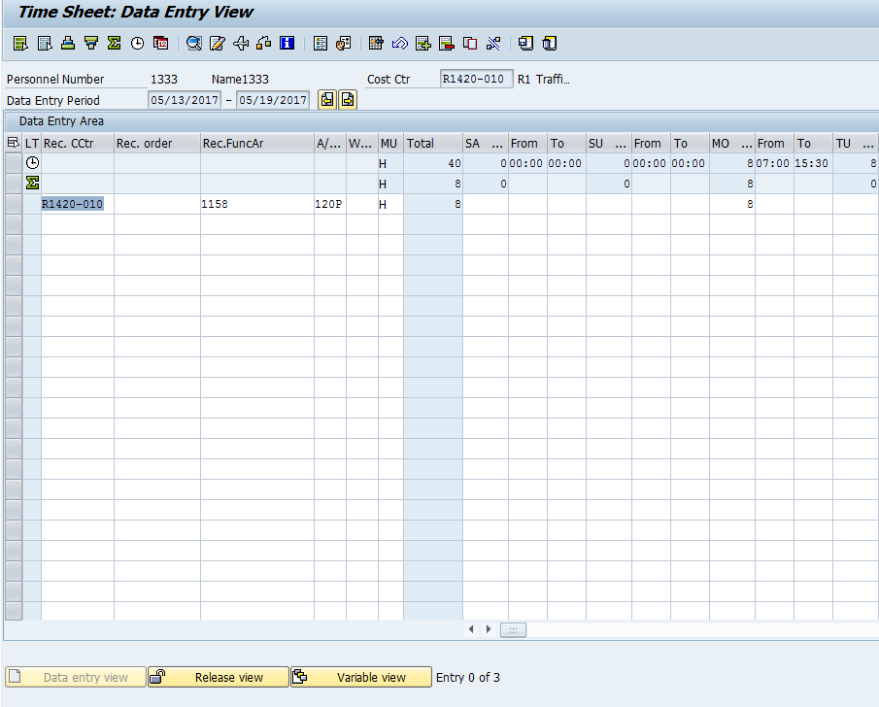
Planned and Actual Time
Notes:
Another way to avoid time issues is to understand the information on your timesheet. Your planned time is based on your assigned work schedule. This is the first row with the clock, your target hours, shows you the number of hours you are expected to work for the week in the total column. The actual hours, the second row, with the green sum icon will add up the number of hours you enter on the timesheet for the week in the total column. The actual hours should meet or exceed the target hours through a combination of leave or working time. If your planned hours exceed your target hours, be sure to review your timesheet to determine if leave or overtime needs to be adjusted. The exception is bi-weekly employees, who are not always required to meet their target hours for the week.

Slide 103
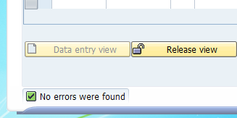
SAP Timesheet Messages
When verifying your time entries, check for messages on your screen:
No errors were found
Review entries and continue
Errors exist and must be
fixed before continuing
Notes:
SAP generates messages to ensure time is entered on your timesheet correctly. Some of these messages provide general information while others are errors that must be fixed before you are able to release and save your time entries. When you verify the status of the time there are three types of messages, each with their own icons, that you need to know about. The icon that displays to the left of the message tells you what kind of message it is . The most common is the green checkbox. This is an informational message that indicates that no errors were found and you can proceed with releasing and saving your time entry. The next is the yellow warning, which displays if you need to review your entries before you continue. This message will not stop you from entering your time, it is only a warning.
The last icon is a the red exclamation point. This is a hard stop and means you have an error and will not be able to release and save your time. When you are entering time pay attention to these messages as they are your first line of defense in entering time correctly. Let’s take a look at some of the most common warning and error messages for time entry and how to resolve them.

Slide 104
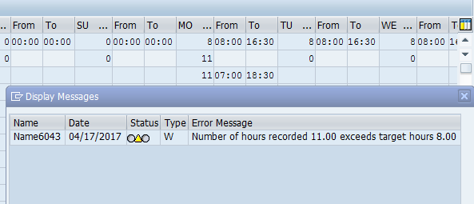
Number of Hours Exceed Work Schedule
What it is:
When more hours are entered than are in your daily work schedule
Type of message:
Warning (Review and Change/Save)
What to do:
Read the message!
Verify the start and end times entered on the timesheet are correct
Verify the correct A/A Type is used
Notes:
SAP expects you to work the number of hours planned based on your daily work schedule. When you work more hours than planned, the system generates this warning message. Because this is only a warning message you are able to click enter and the system will accept the hours. If you are not eligible for overtime, and you worked the hours this is your best option. If you worked over 40 hours for the week and are overtime eligible, then you may want to code the additional hours as overtime. To do this, enter the hours you worked as regular working time and the remaining hours outside of your work schedule, as overtime. In this example, you would have three hours of overtime, and the message will still appear when you release and save your time.

Slide 105
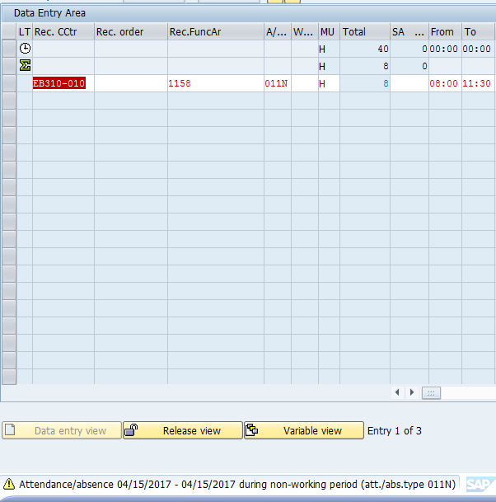
Attendance to a Non-Working Time
What it is:
Working time is entered on
a non-work day
Type of message:
Warning (Review and Change/Save)
How to fix it:
Read the message!
Verify the start and end times entered on the timesheet are correct
Verify the correct A/A Type is used
Click “Enter” to clear the message
Notes:
When you enter time on a day you are scheduled off SAP generates a warning message because you are not expected to work on this day. This is just a warning message to review your time. Since this is only a warning, you can click enter to accept the hours after reviewing for accuracy. If the hours and A/A type are entered correctly then you will need to click enter for every non-work day entry to return to your timesheet and release your time.

Slide 106
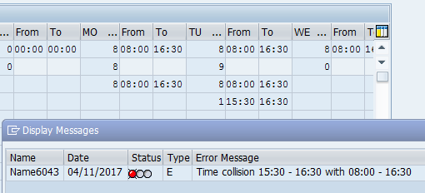
Time Collisions
What it is:
A time collision is when two time entries overlap
Type of message:
Error Message (must be fixed to save)
How to fix it:
Review the error message for the date and time of the collision
Change the times so they do not overlap
Notes:
Let’s look at some of the most common timesheet errors that must be fixed for you to continue to enter your time. The first is a time collision. This occurs when two time entries overlap. In this example, regular working time was entered for 8:00 to 16:30.
There was also sick time entered from 15:30 to 16:30. Because the sick leave and the regular working time are both entered from 15:30 to 16:30 then SAP is telling you to make a correction because you can not be on leave and work at the same time. This kind of error is easy to fix. All you need to do is change the sick or regular working time so they do not overlap.

Slide 107
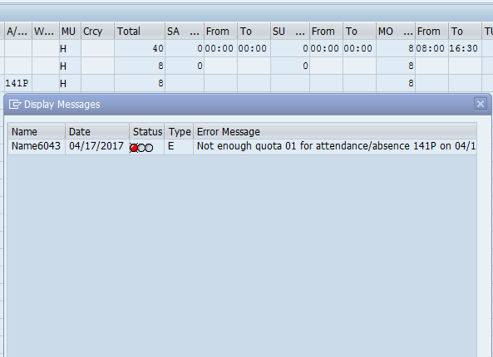
Not Enough Quota
What it is:
You have not earned enough of the leave type you want to use
Type of message:
Error message (must be fixed to save)
How to fix it:
View error message to see the leave type that is unavailable
View the Leave Summary Report to see your available leave balances
Talk to your Supervisor or Timekeeper for options
Notes:
When you are entering leave you must have leave available in your leave bank before you can code it to your timesheet. For example, if you wanted to take 40 hours of vacation a month from now and currently have only 32 hours of annual leave in your leave bank, then you would only be able to enter 32 hours of annual leave. You will have to wait until leave is accrued again to enter the additional 8 hours. Remember you cannot use leave prior to the date it is earned. If you do not have enough leave then you should contact your Supervisor or Timekeeper for assistance.

Slide 108
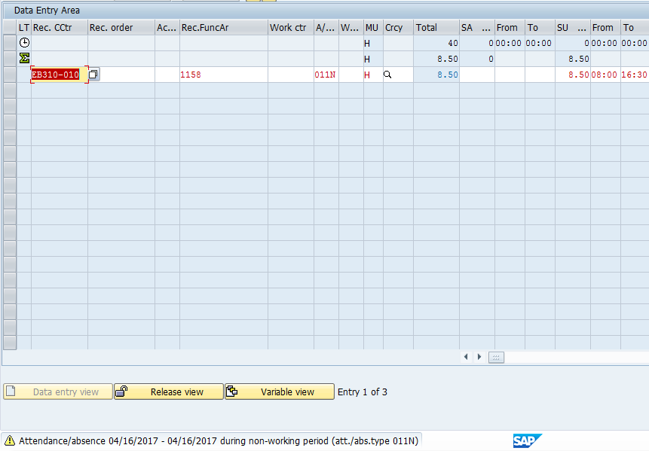
Absence to a Non-Working Time
What it is:
Leave is entered during unscheduled hours
Type of message:
Error message (must be fixed to save)
How to fix it:
Read the message!
Delete the leave entered
Enter leave only during planned hours
Notes:
If you try to enter leave when you are not scheduled to work this message will display. To accurately report when you are on leave you must have the correct work schedule assigned. If you need to have your work schedule changed, contact your supervisor.

Slide 109
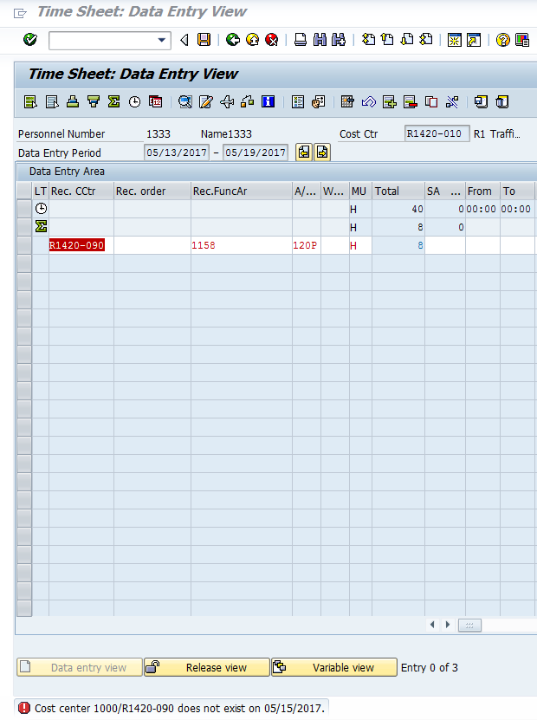
Invalid Work Order or Cost Center
What it is:
The Work Order, WBS element or Cost Center is not valid
Type of message:
Error message (must be fixed to save)
How to fix it:
Verify the correct Work Order or Cost Center
If your work order or cost center is correct, contact your timekeeper
If your work order or cost center is NOT correct, update your timesheet
Notes:
In some cases, you may encounter that a work order, WBS element, or cost center is closed, invalid, or does not exist. When you get this error, you should verify your entry to determine if it is correct and if it is then contact your timekeeper to let them know there is a problem. By entering your time as soon as it worked, and correcting errors promptly you can avoid this error. If the work order, WBS element or cost center is not correct enter the correct one to clear the error. You must fix or delete the entry before you can continue entering time or exit the timesheet.

Slide 110
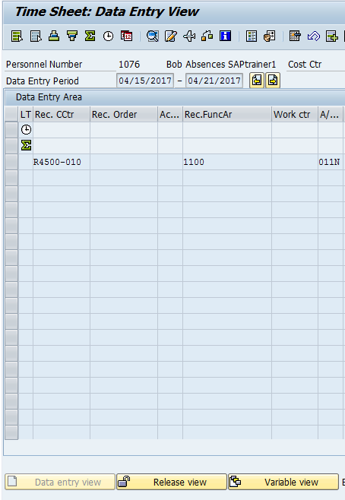
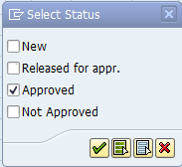

Variable View (checking the status of your time)
Clicking on the Variable view button displays the status of your time entries. Select the status you want to view:
New – Displays “in process” entries
Released for appr. – Displays time you have released to your supervisor (but is not approved)
Approved – Displays the time approved by your supervisor
Not Approved – displays all unapproved time
1
2
3
Notes:
One way to confirm you are paid correctly is to verify your timesheet has been approved by the payroll deadlines. This is done by checking on the variable view button as shown by the with the first arrow. Once you click this button, the Select Status screen will display as shown by the second arrow.
From here you can check the status of your time. It is best to select only one status at a time. Once a status has been selected, click on the green check mark and the entries in that status will be displayed in blue text as shown by third arrow.
For example if you check the Approved status, all time entries that have been approved will be displayed in blue. The other helpful statues you can display are New, which displays time that is in process and Released for approval, which is time you have released to your supervisor, but has not yet been approved.
It's a good idea to check the approval status of your time entries on a weekly basis.

Slide 111
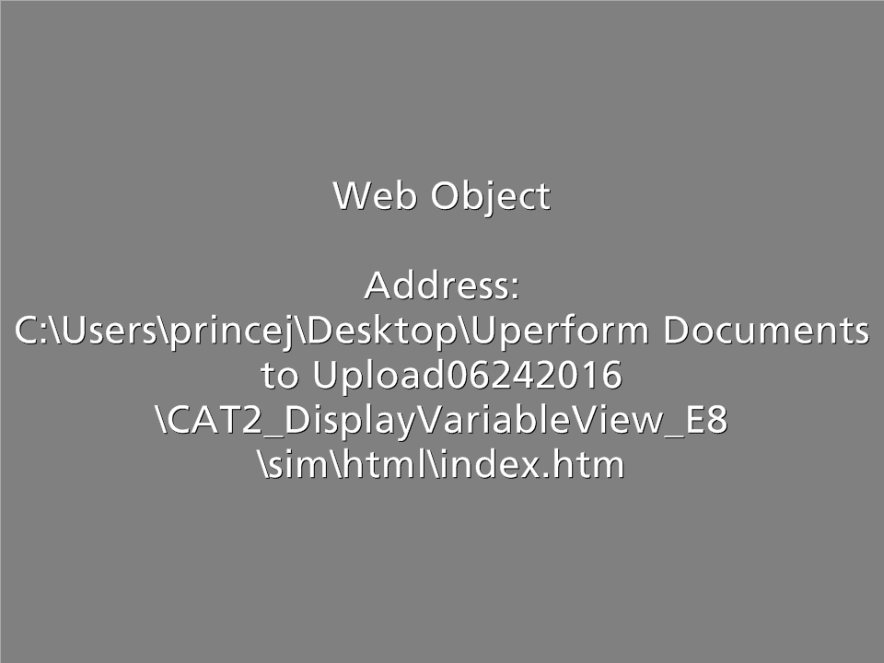
CAT2 - Display Timesheet (Variable View)
In this scenario, you want to check to see if the time you entered has been approved.
Notes:
Now let’s go into your timesheet to show you how to use the variable view to determine if the time you have submitted has been released for approval, approved of not approved.
Click on the word Practice, when you do a new window will open. When you are done, click on the End Lesson button and you will be returned back to this course after the window closes.

Slide 112
Timesheet Change Process
If time has been approved, zero-out the entry, enter the correct time and release both entries
OR
If time has not been approved or has been rejected, make the change
Yes
Additional Changes
Yes
Zero Out Entry or Change Work Time
Contact Supervisor
Supervisor Approves Entries/Zeroes
Incorrect Time Entry
No
Time Approved
Change the Time Entry
Release and Save Time
Done
No
Notes:
If you discover you have made an error, or the actual time you have worked changes, then you need to change your timesheet.
To determine the status of the time entry that needs to change just double click on it. If you find that your time has been approved then you will need to zero-out the approved time entry and enter the correct entry on the next line. You will then need to save and release your timesheet.
If the time is in process, released for approval or rejected you can make the change to your time and do not needs to zero it out. Then you’ll need to release and save your timesheet. If you are making an adjustment to leave, your supervisor will receive an email from SAP about the change.
If you are making a change to any approved time entry, you should let your supervisor know so they can approve the updated time entries.

Slide 113

Timesheet Revisions
The scroll-back limits for timesheet revisions are:
2 weeks for Bi-Weekly paid employees
5 weeks for Monthly paid employees
12 weeks for your Timekeeper
Current period Start
You timesheet
Timekeepers
Paid Monthly
Paid Bi-weekly
Timekeepers can go back 12 weeks to make changes
Employees paid Monthly can go back 5 weeks to make changes
Employees paid Bi-Weekly can go back 2 weeks to make changes
Contact your Timekeeper
Contact your Timekeeper
Notes:
We all make mistakes sometimes. If you need to make a correction to your timesheet, it’s important that you do so as soon as possible. If you are paid bi-weekly, then you are able to make changes 2 weeks prior to the current week. If you are paid monthly, you can make changes to your timesheet five weeks prior to the current week. Your Timekeeper is able to make any changes in SAP up to 12 weeks beyond the current period. If you need to change your timesheet beyond 12 weeks contact your timekeeper. This is why it is important to keep your timesheet current.

Slide 114
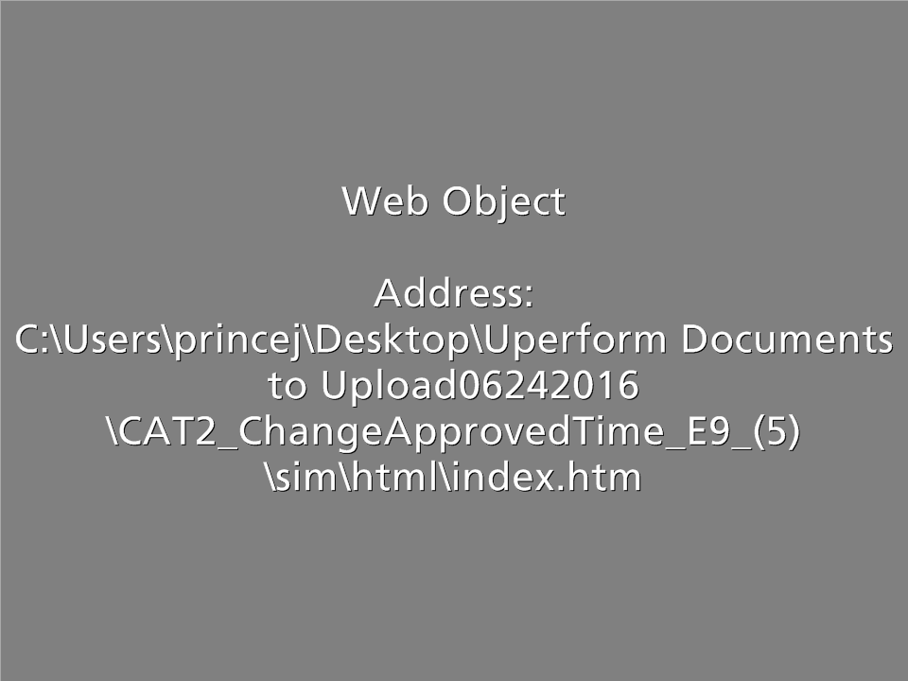
CAT2 - Change Approved Time
Scenario: Since you know your timesheet is missing hours for the week you are going into the timesheet to make changes and release the entries.
Notes:
Now that the process to change your time has been covered, let’s look at how to zero out time that has already been approved by your supervisor.
Click on the word Practice, when you do a new window will open. When you are done, click on the End Lesson button and you will be returned back to this course after the window closes.

Slide 115
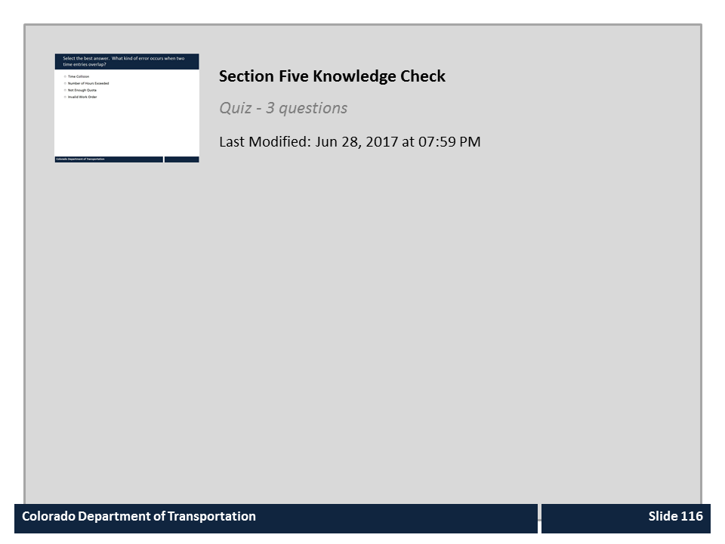
Section Five Knowledge Check

Slide 116
Learning Logistics
Section 1 – Time Entry Overview
Section 2 – Time Entry Process
Section 3 – Work Time Entry
Section 4 – Leave Time Entry
Section 5 – Timesheet Verification
Notes:
In the conclusion we'll summarize what you've learned, give you the chance to complete the course assessment and remind you of your resources for the time entry process.

Slide 117
Course Summary
You should now be able to:
Explain why time entry is important to the Employee and to CDOT
Describe the roles and responsibilities in the time entry process
Identify common errors on your timesheet
Enter and release attendance and absences in SAP
Use best practices to make sure your timesheet is correct
Identify who to contact if you have questions about time and leave
Notes:
Take a minute to review what you have learned from the course. If there is anything that is unclear, you can use the menu to navigate to the section or use the search feature. When you are done, click the Next button to review the resources available to help you with time and leave approval.

Slide 118

Where Can I Get Help - People?
For additional assistance contact:
  Human Resources at 7-9081
The following resources are also available to help you:
Click HERE for a list of Timekeepers
Click HERE to view Payroll Contacts
Notes:
Remember, you are not alone. If you run into technical problems or have policy questions, contact HR at extension 7-9081. Other resources available to help you include, your Timekeeper and the Payroll Office. If you have not already done so, it would be a good idea to bookmark these resources before you continue.

Slide 119
Resources After the Class
The resources link is located in the upper right-hand corner of the slides for this course. It contains:
Time Policies and Directives related to time and leave
Employee Time Entry Worksheet
Understanding Leave Types document
Regular Time Checklist
Annual Leave Accrual Chart
Notes:
In addition to people, this course is also a resource for you to use the resources link contains many documents that can help you with your questions about the time entry process. If you have not already done please review it now.

Slide 120

Course Complete
Congratulations, you have completed the Introduction to SAP Time Entry course!
To confirm you have completed the course, complete the following assessment.
For course credit, you must achieve a score of at least 70%. Please remember you can take the quiz as many times as you want until you achieve this score.
And remember, once you click the “Submit” button the question is locked and you can no longer change your selection.
Notes:
Congratulations on completing the Introduction to SAP Time Entry course! The final step is for you to take a short quiz to get credit for this course. You must get a score of at least 70% to pass and you can take it as many times as you like. Good Luck!

Slide 121
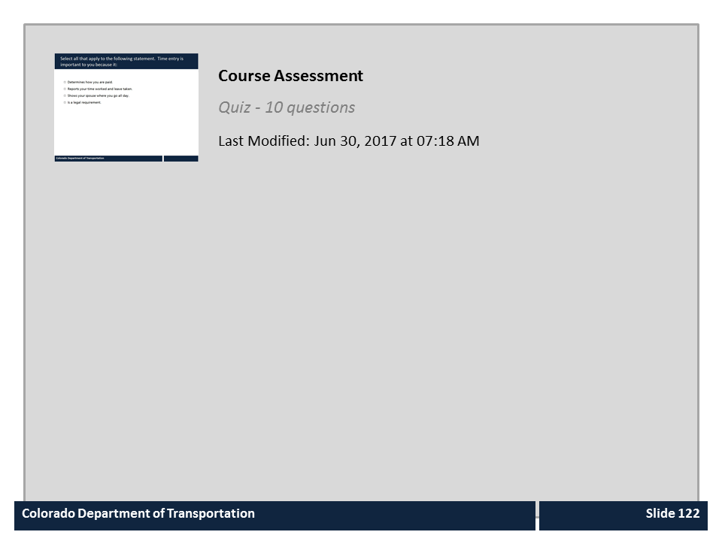
Course Assessment

