Slide 1
Creating A Course Using Training Templates
Notes:
Notes:
This course is designed to teach you how to develop training materials using templates that have been designed to guide you through the process. Upon completing this course you will be able to
Develop a curricula used as the framework for the development of a training course
Develop a training course used to train participants
Print and link all of the documentation you need into one guide used to deliver your training
All you need to bring is a topic and the knowledge of a process where training is required.

Slide 2
Click Continue

Slide 3
Course Agenda
Learning Logistics
Section 1 – Course Introduction
Section 2 – Curricula Design
Section 3 – PowerPoint Creation
Section 4 – Other Templates
Section 5 – Printing Training Materials
Conclusion
Notes:
Notes:
This course is designed to teach participants how to take the need for training and use templates to create a course. It takes four hours to complete and is composed of the following sections:
Learning Logistics – This section takes about 10 minutes to complete and introduces the content of the course, provides introductions, and what the learning expectations are of both the participants and the instructor.
Section 1: Introduction – The introduction takes about 20 minutes to complete and introduces the high-level concepts which are used to support learning in each of the sections.
Section 2: Curricula Design - This section takes about 60 minutes to complete and describes how to create and use the curricula template to create a curricula. It provides an opportunity to use the template to create a curricula.
Section 3: PowerPoint Creation - This section takes about 60 minutes to complete and describes how to use the curricula you created in the previous section and the PowerPoint template to create a course section.
Section 4: Other Templates – This section takes about 30 minutes to complete and introduces how to use the Terms and Concepts Template and the Resource Material Table of Contents Template.
Section 5: Printing Training Materials – This section takes about 30 minutes to complete and describes the process of preparing your training materials for printing and how to print the materials.
Conclusion – This section takes about 10 minutes to complete and summarizes the course. It also provides details about where you can get additional help if you need it.

Slide 4
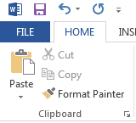
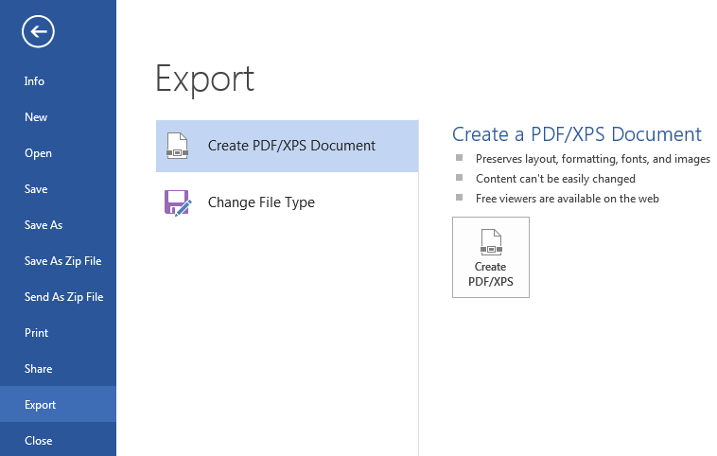
Convert Word Document to PDF
1
To convert a word document to PDF:
Select File
Select Export
Select Create PDF/XPS Document
Click Create PDF/XPS
Save to the file location
3
4
2
Notes:
Notes:
Prior to creating the PDF create a folder to place the PDF documents on either on your desktop or within your training folder.
Refer to the slide above for details of how to create the PDF document.
The PDF file inherits the name of the Word Document but will not overwrite the original file.
Prior to creating the PDF be sure you have used the naming convention from slide 20 Naming and Versioning Documents.

Slide 5
Convert Word Document to PDF
1
To convert a word document to PDF:
Select File
Select Export
Select Create PDF/XPS Document
Click Create PDF/XPS
Save to the file location
3
4
2
Notes:
Notes:
Prior to creating the PDF create a folder to place the PDF documents on either on your desktop or within your training folder.
Refer to the slide above for details of how to create the PDF document.
The PDF file inherits the name of the Word Document but will not overwrite the original file.
Prior to creating the PDF be sure you have used the naming convention from slide 20 Naming and Versioning Documents.

Slide 6
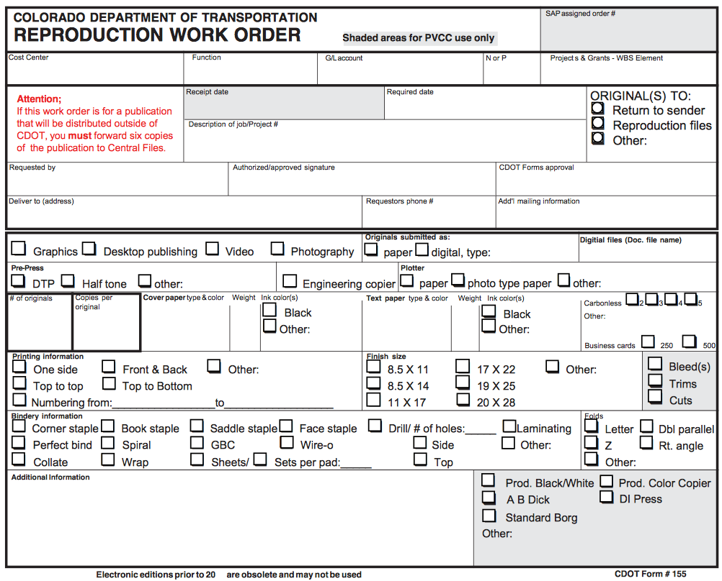
Completing the Reproduction Work Orders
There are two Reproduction Work Orders to complete:
Notes view of the PowerPoint
One for Reference Documents and Tabs
Prior to beginning you need
Your Cost Center
G/L Account
Notes:
Notes:
TAB 12 – Reproduction Work Order (PowerPoint)
TAB 13 – Reproduction Work Order (Resource Materials Table of Contents)
There are two Reproductive Work Orders you need to complete and send to the print shop. The notes on how to print the materials have already been completed. All you need to do is fill in the first section of the form with your contact details and payment details.
Prior to filling out the form, you need to contact your manager or supervisor to get the cost center and G/L account.

Slide 7
Email or Upload Files
Once the training material is complete
Email the files to cdphe_printshop@state.co.us
Or if the files are too big to send through email
Go to \\public\REPROJOBS
You will need to create a folder for your course and upload your materials
Notes:
Notes:
Most of the trainings you develop are able to be sent through email.
If you get a message when you send the file that it exceeds the allowed file size then you will need to save it to the public drive in the REROJOBS folder. The following are the actions you need to take to do so:
From the public drive and find the folder REPROJOBS
Double-click to open the folder
Right click in the blank space within the drive to display the quick options menu
Select New → Folder
Title the folder with the name of your course
Insert your training materials into the folder It is best to copy and paste the material
Confirm you have added all of the documents to the folder.
When you are done you will need to send the Print shop an email with the two completed Reproductive Work Orders (PowerPoint and Resource Materials Table of Contents with the name of the folder listed the location of the files in the notes section.
For assistance with performing this action, or if you need help with the form, contact the print shop at 7-9313.

Slide 9
Course Agenda
Learning Logistics
Section 1 – Course Introduction
Section 2 – Curricula Design
Section 3 – PowerPoint Creation
Section 4 – Other Templates
Section 5 – Printing Training Materials
Conclusion
Notes:
Notes:
This course is designed to teach participants how to take the need for training and use templates to create a course. It takes four hours to complete and is composed of the following sections:
Conclusion – This section takes about 10 minutes to complete and summarizes the course. It also provides details about where you can get additional help if you need it.

Slide 10
Conclusion
You should now be able to:
Identify training terms and concepts
Describe the training development processes at a high-level
Describe the connection points between the curricula and PowerPoint Template
Understand how to use the Curricula, PowerPoint, and other templates and its components
Describe how to create a Participant Manual from the PowerPoint
Describe how to prepare and send the completed course for printing
Notes:
Notes:
The slide above contains what you should now be able to do. If you have questions about the content after the course, refer to the next slides for the names and contact information of the people who can help.
If you have question now, please ask. You will have another chance at the end of the course, after we discuss where you are able to get help and the the resources available to you.

Slide 11
Where Can I Get Help – People?
For additional assistance contact:
Jason Prince
Email: jason.prince@state.co.us
Phone: 503-522-8448
Beverly Wyatt
Email: Beverly.wyatt@state.co.us
Phone: 7-9677
Notes:
Notes:
Contact the resources above if you need help with:
Location of the training templates
Help with the curricula or PowerPoint template
Use of the image, question or PowerPoint checklist
General questions about the development of the training using the materials provided

Slide 12
Additional CDOT Help Resources
The additional help resources are available:
The OED Team
For questions about printing you can contact the CDOT print shop at:
Phone: 7-9313
Email: cdphe_printshop@state.co.us
Notes:
Notes:
The following are the members of the OED Team who are able to answer any questions you may have about the development of training content.
The name and numbers of the team are:
Morgan Murphy 7-9684
Bryon Hays 7-9726
Jim Leuenberger 7-9621
Michael Muszynski 7-9667
Gayle Rafferty 7-9246

Slide 13
Questions?
?
?
?
Notes:
Notes:
Now let’s review the parking lot questions. If there are any questions that have not been answered I will have an answer to you within the next week. If you have any questions about training after the course please contact me at jason.prince@state.co.us or just drop by and ask.

Slide 14
Additional CDOT Help Resources
The additional help resources are available:
The OED Team
For questions about printing you can contact the CDOT print shop at:
Phone: 7-9313
Email: cdphe_printshop@state.co.us
Notes:
Notes:
The following are the members of the OED Team who are able to answer any questions you may have about the development of training content.
The name and numbers of the team are:
Morgan Murphy 7-9684
Bryon Hays 7-9726
Jim Leuenberger 7-9621
Michael Muszynski 7-9667
Gayle Rafferty 7-9246

Slide 16
Course Agenda
Learning Logistics
Section 1 – Course Introduction
Section 2 – Curricula Design
Section 3 – PowerPoint Creation
Section 4 – Other Templates
Section 5 – Printing Training Materials
Conclusion
Notes:
Notes:
This course is designed to teach participants how to take the need for training and use templates to create a course. It takes four hours to complete and is composed of the following sections:
Conclusion – This section takes about 10 minutes to complete and summarizes the course. It also provides details about where you can get additional help if you need it.

Slide 17
Conclusion
You should now be able to:
Identify training terms and concepts
Describe the training development processes at a high-level
Describe the connection points between the curricula and PowerPoint Template
Understand how to use the Curricula, PowerPoint, and other templates and its components
Describe how to create a Participant Manual from the PowerPoint
Describe how to prepare and send the completed course for printing
Notes:
Notes:
The slide above contains what you should now be able to do. If you have questions about the content after the course, refer to the next slides for the names and contact information of the people who can help.
If you have question now, please ask. You will have another chance at the end of the course, after we discuss where you are able to get help and the the resources available to you.

Slide 18
Where Can I Get Help – People?
For additional assistance contact:
Jason Prince
Email: jason.prince@state.co.us
Phone: 503-522-8448
Beverly Wyatt
Email: Beverly.wyatt@state.co.us
Phone: 7-9677
Notes:
Notes:
Contact the resources above if you need help with:
Location of the training templates
Help with the curricula or PowerPoint template
Use of the image, question or PowerPoint checklist
General questions about the development of the training using the materials provided

Slide 19
Additional CDOT Help Resources
The additional help resources are available:
The OED Team
For questions about printing you can contact the CDOT print shop at:
Phone: 7-9313
Email: cdphe_printshop@state.co.us
Notes:
Notes:
The following are the members of the OED Team who are able to answer any questions you may have about the development of training content.
The name and numbers of the team are:
Morgan Murphy 7-9684
Bryon Hays 7-9726
Jim Leuenberger 7-9621
Michael Muszynski 7-9667
Gayle Rafferty 7-9246

Slide 20
Course Learning Objectives
At the end of this course, you should be able to:
Identify training terms and concepts
Describe the training development processes at a high-level
Describe the connection points between the curricula and PowerPoint Template
Understand how to use the Curricula, PowerPoint, and other templates and its components
Describe how to create a Participant Manual from the PowerPoint
Describe how to prepare and send the completed course for printing
Notes:
Notes:
Upon completing this course you should be able to perform each of the learning objectives. We will confirm this at the end of the course.

Slide 21
Participant Introductions
Please take a moment to share:
Your name and role at CDOT
What would you like to get from the course?
What is your comfort level with training?
Notes:
Notes:
Your Name_______________________________________________________
Your Role at CDOT ________________________________________________
What would you like to get from the course?
____________________________________________________________
____________________________________________________________
____________________________________________________________
What is your comfort level with training?
________________________________________________________________________________________________________________________________________________________________________________________________

Slide 22
Additional CDOT Help Resources
The additional help resources are available:
The OED Team
For questions about printing you can contact the CDOT print shop at:
Phone: 7-9313
Email: cdphe_printshop@state.co.us
Notes:
Notes:
The following are the members of the OED Team who are able to answer any questions you may have about the development of training content.
The name and numbers of the team are:
Morgan Murphy 7-9684
Bryon Hays 7-9726
Jim Leuenberger 7-9621
Michael Muszynski 7-9667
Gayle Rafferty 7-9246

Slide 23
Learning Logistics
Regular breaks built into the class schedule
Classroom participation encouraged; ask, answer, and participate in the discussion
Exercise to practice development of training materials
Parking lot used to capture questions for in-class follow-up
Notes:
Notes:
This course is 4 hours long with a break scheduled between Section Two and Three.
Please feel free to ask any questions you may have during the course.
The section to the right of your manual contains an area for your notes and the answers for your questions.
During the course please keep side conversations to a minimum and share your experience with the whole class. These are what make for a great course!
During the course you can practice the development of a training course. This will be done by develop a training on how to complete the PDQ form. A copy of the form is provided for you.
The “Parking Lot” is used to capture questions that may require a longer answer than we have time for in this course. All of the questions will be answered within 2 days of the course.

Slide 24
Additional CDOT Help Resources
The additional help resources are available:
The OED Team
For questions about printing you can contact the CDOT print shop at:
Phone: 7-9313
Email: cdphe_printshop@state.co.us
Notes:
Notes:
The following are the members of the OED Team who are able to answer any questions you may have about the development of training content.
The name and numbers of the team are:
Morgan Murphy 7-9684
Bryon Hays 7-9726
Jim Leuenberger 7-9621
Michael Muszynski 7-9667
Gayle Rafferty 7-9246

Slide 25
Additional CDOT Help Resources
The additional help resources are available:
The OED Team
For questions about printing you can contact the CDOT print shop at:
Phone: 7-9313
Email: cdphe_printshop@state.co.us
Notes:
Notes:
The following are the members of the OED Team who are able to answer any questions you may have about the development of training content.
The name and numbers of the team are:
Morgan Murphy 7-9684
Bryon Hays 7-9726
Jim Leuenberger 7-9621
Michael Muszynski 7-9667
Gayle Rafferty 7-9246

Slide 26
Your Contributions to Learning
Please respect the other participants by silencing your cell phones
Focus on the course, please use the Internet and email over lunch and break times
Please delay your side conversations until break times
Notes:
Notes:
Please turn off or silence any electronic devices.
Please refrain from browsing the Internet, sending/reading text messages, or sending/reading e-mails during class.
If you have a question, or comment, please ask it of the whole group instead of the person next to you. Many times if there is something you do not understand everyone can benefit from an explanation.

Slide 27
Did you know…
The word “curriculum” is a Latin word that means “the course of the race” or the places you would see as you race.
PowerPoint was originally called “Presenter” and was designed to be used on Macintosh computers until is was bought by Microsoft for $14 million and renamed PowerPoint.
Notes:
Notes:
This slide is optional and is used to help you connect with the audience and to help them remember some of the key concepts.
When you complete this slide try to tie it into the main topics of the course. For example, Curricula design and PowerPoint creation are two of the major topics of the course. Do not exceed three bullets on this slide.

