Slide 1


Title of Course
Notes:
This course is designed to teach you how to (insert topic)
Upon completing this course you will be able to:
Insert objectives

Slide 2
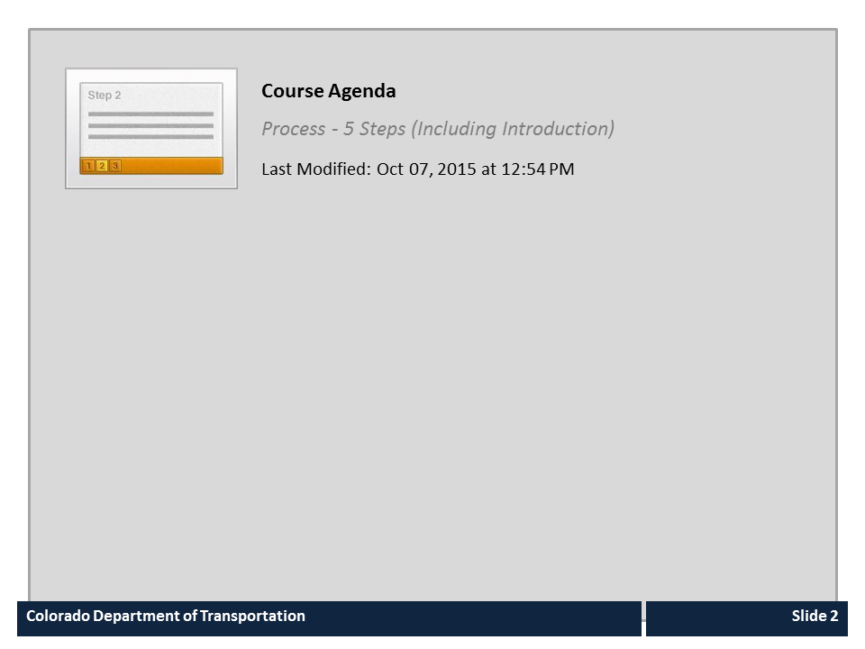
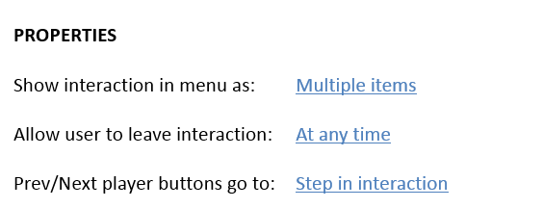


Course Agenda

Slide 3
Course Learning Objectives
At the end of this course, you should be able to:
Notes:
Notes:
Course learning objectives are the most important subject-matter that the students take away from the course.
In-class demonstrations and exercises (live-data and simulations) and self-check questions throughout the course help reinforce the course learning objectives

Slide 4
Course Agenda
Section 1 – Course Introduction
Section 2 –
Section 3 –
Conclusion
Notes:
Notes:
Provide a high-level overview of the course based on the summary of each of the sections below. The current section is bolded and for all proceeding sections you will only need to provide an overview of the section you are instructing.
Section 1: Course Introduction –
Section 2:
Section 3:
Conclusion –

Slide 5
Section 1 Learning Objectives
At the end of this section, you should be able to:
Notes:
Notes:

Slide 6
Terms and Concepts
Before we begin, take a moment to review the definitions of the
following terms in the Glossary tab to the right (next to Menu).
Terms
Notes:
Notes
Tab 01 - Terms and Concepts
The following terms are critical to your understanding of this section of the course and are found in both the Glossary and Terms and concept document found in the References tab.
Additional terms are located in the Terms and Concepts document located in the reference materials.
If you do not understand the term, please ask for additional clarification.
The Terms and Concepts document contains more terms than are listed in the course and should be reviewed to help with your learning.

Slide 7
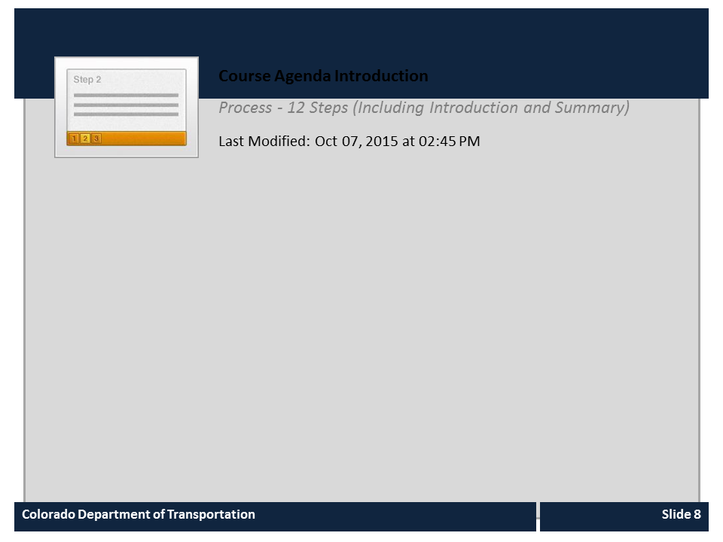
Course Agenda Introduction

Slide 8
Course Agenda
Section 1 – Course Introduction
Section 2 –
Section 3 –
Conclusion
Notes:
Notes:
Provide a high-level overview of the course based on the summary of each of the sections below. The current section is bolded and for all proceeding sections you will only need to provide an overview of the section you are instructing.
Section 1: Course Introduction –
Section 2:
Section 3:
Conclusion –

Slide 9
Section 2 Learning Objectives
At the end of this section, you should be able to:
Notes:
Notes:

Slide 10
Terms and Concepts
Before we begin, take a moment to review the definitions of the
following terms in the Glossary tab to the right (next to Menu).
Terms
Notes:
Notes
Tab 01 - Terms and Concepts
The following terms are critical to your understanding of this section of the course and are found in both the Glossary and Terms and concept document found in the References tab.
Additional terms are located in the Terms and Concepts document located in the reference materials.
If you do not understand the term, please ask for additional clarification.
The Terms and Concepts document contains more terms than are listed in the course and should be reviewed to help with your learning.

Slide 11
Process Flow Copy and Paste

Slide 12
Exercise XX
Roles:
Scenario:
Notes:
Notes:
Provide an overview of the scenario and roles. Spend particular attention to how this is similar to the demonstration if one was done.

Slide 13
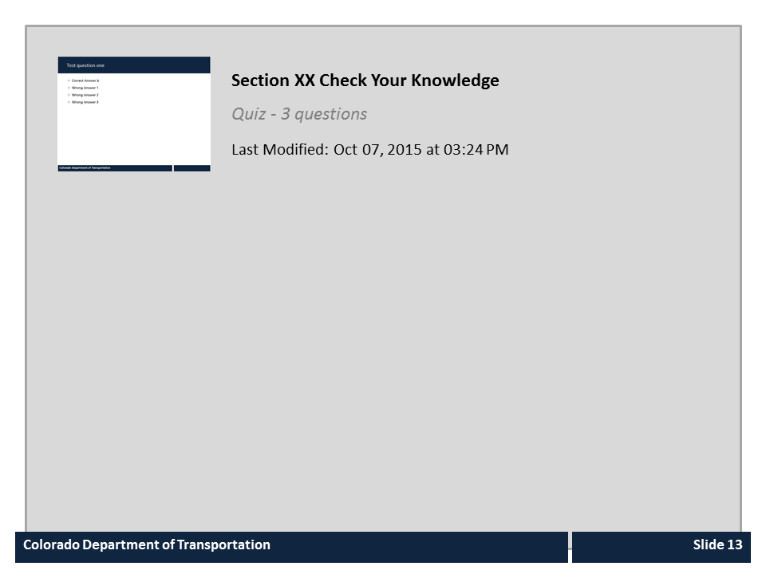
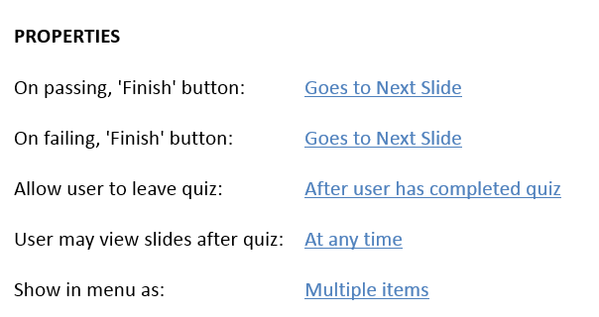

Section XX Check Your Knowledge

Slide 14
Course Agenda
Section 1 – Course Introduction
Section 2 –
Section 3 –
Conclusion
Notes:
Notes:
Provide a high-level overview of the course based on the summary of each of the sections below. The current section is bolded and for all proceeding sections you will only need to provide an overview of the section you are instructing.
Section 1: Course Introduction –
Section 2:
Section 3:
Conclusion –

Slide 15
Section 3 Learning Objectives
At the end of this section, you should be able to:
Notes:
Notes:

Slide 16
Terms and Concepts
Before we begin, take a moment to review the definitions of the
following terms in the Glossary tab to the right (next to Menu).
Terms
Notes:
Notes
Tab 01 - Terms and Concepts
The following terms are critical to your understanding of this section of the course and are found in both the Glossary and Terms and concept document found in the References tab.
Additional terms are located in the Terms and Concepts document located in the reference materials.
If you do not understand the term, please ask for additional clarification.
The Terms and Concepts document contains more terms than are listed in the course and should be reviewed to help with your learning.

Slide 17
Exercise XX
Roles:
Scenario:
Notes:
Notes:
Provide an overview of the scenario and roles. Spend particular attention to how this is similar to the demonstration if one was done.

Slide 18

Section XX Check Your Knowledge

Slide 19
Course Agenda
Section 1 – Course Introduction
Section 2 –
Section 3 –
Conclusion
Notes:
Notes:
Provide a high-level overview of the course based on the summary of each of the sections below. The current section is bolded and for all proceeding sections you will only need to provide an overview of the section you are instructing.
Section 1: Course Introduction –
Section 2:
Section 3:
Conclusion –

Slide 20
Conclusion
You should now be able to:
Notes:
Notes:
Review the course-level objectives stated earlier in the course. This slide reinforces the learning objectives and appears prior to the questions.

Slide 21

Where Can I Get Help?
For additional assistance contact:
  Name One:
    Email:
    Phone:
  Name Two:
    Email:
    Phone:
Notes:
Notes:
If you run into problems, you can contact:

Slide 22

Course Complete
Congratulations, you have completed the course!
To confirm you have completed the course, complete the following assessment.
For course credit, you must achieve a score of at least 70%. Please remember you can take the course as many times as you want until you achieve this score.
And remember, once you click the “Submit” button the question is locked and you can no longer change your selection.

Slide 23
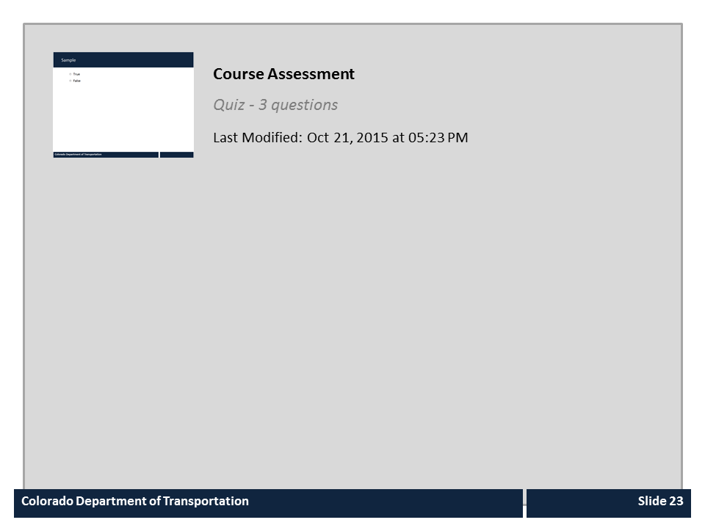
Course Assessment

Slide 24
Sample Engage Interactions
The following are samples of content they are:
Preformatted to match the standards of the course
Can be inserted or used in the course
Are independent of the rest of the content and may be deleted if they are not used
Select Preview drop-down → range of slides → From 24 to end of presentation

Slide 25
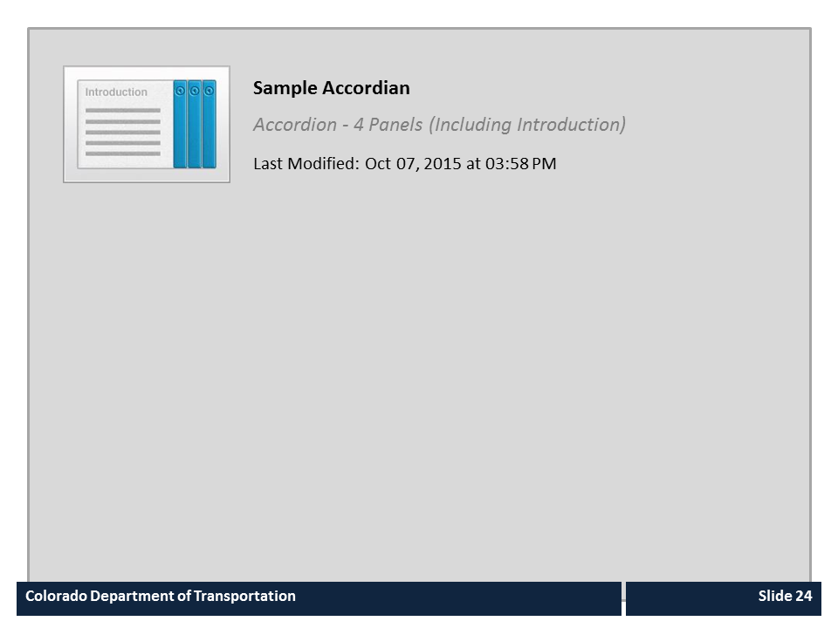
Sample Accordian

Slide 26
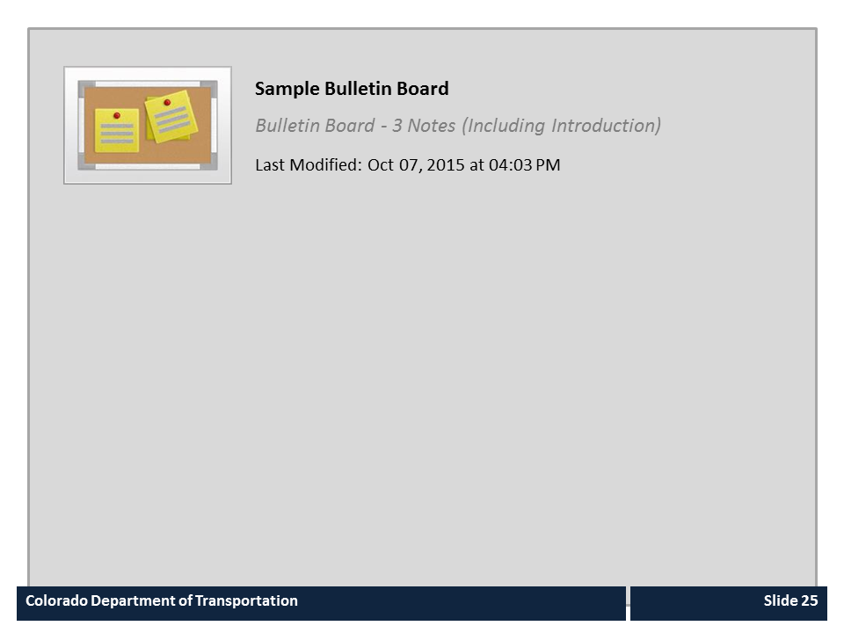
Sample Bulletin Board

Slide 27
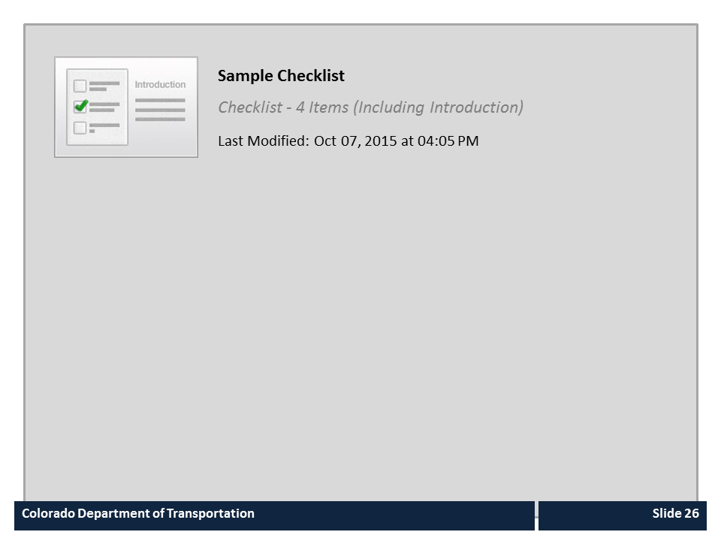
Sample Checklist

Slide 28
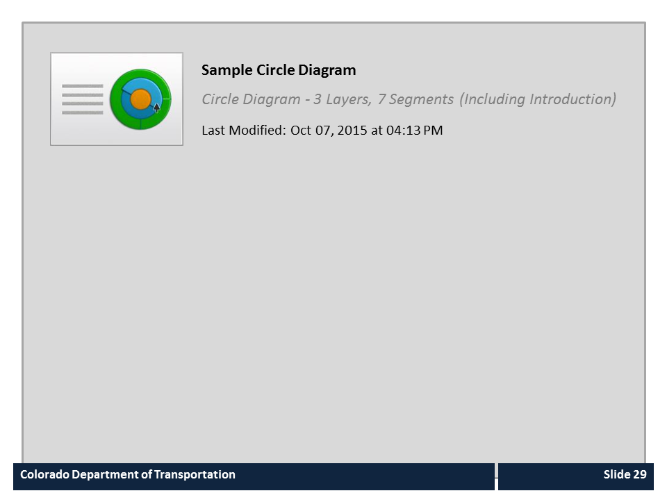
Sample Circle Diagram

Slide 29
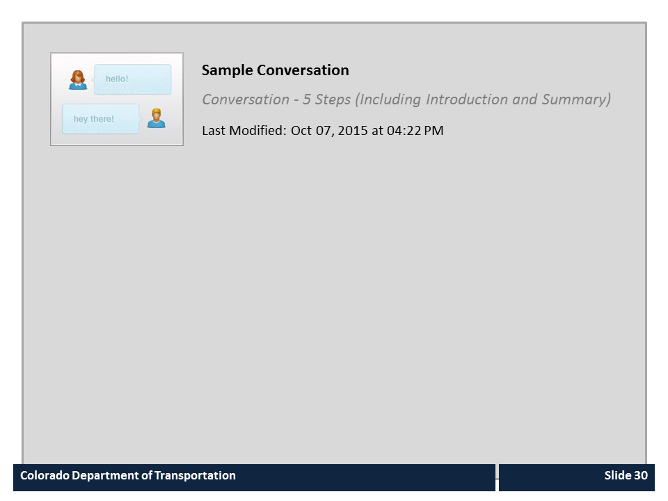
Sample Conversation

Slide 30
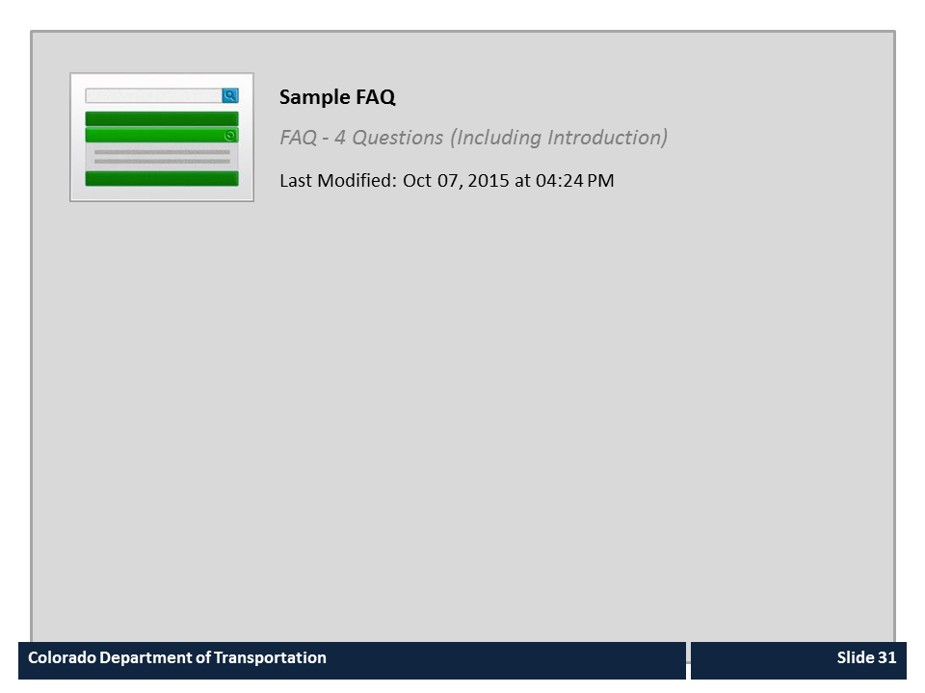
Sample FAQ

Slide 31
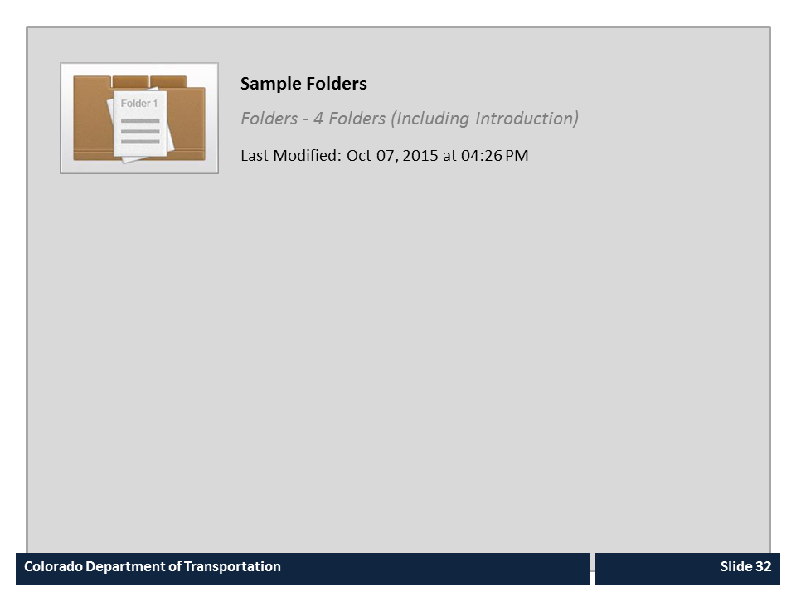
Sample Folders

Slide 32
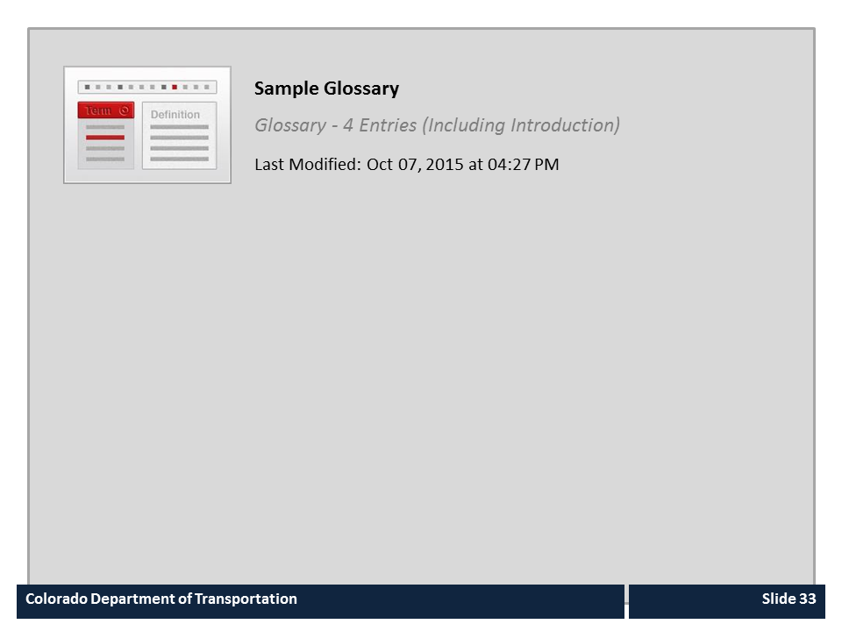
Sample Glossary

Slide 33
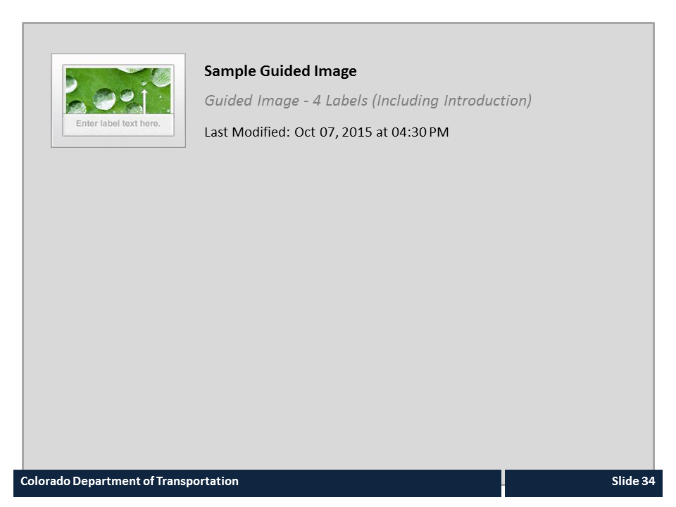
Sample Guided Image

Slide 34
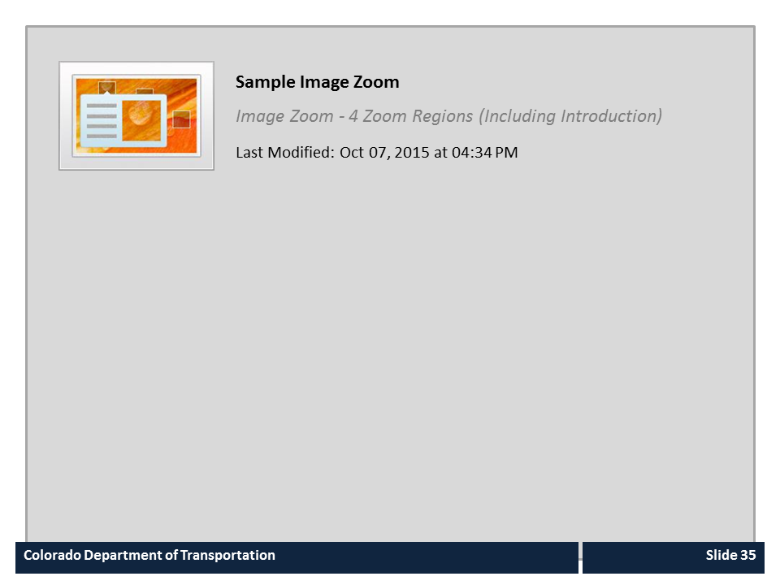
Sample Image Zoom

Slide 35

Sample Labeled Graphic

Slide 36
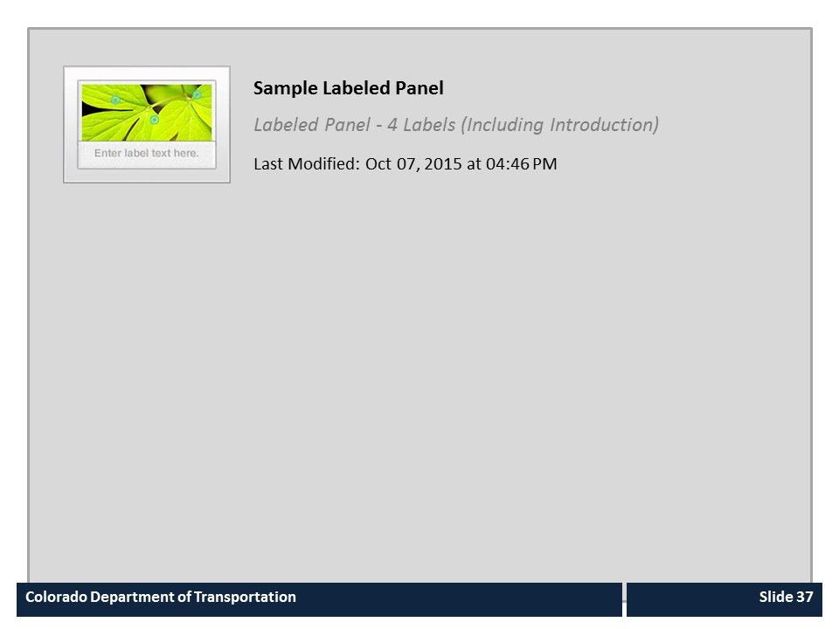
Sample Labeled Panel

Slide 37
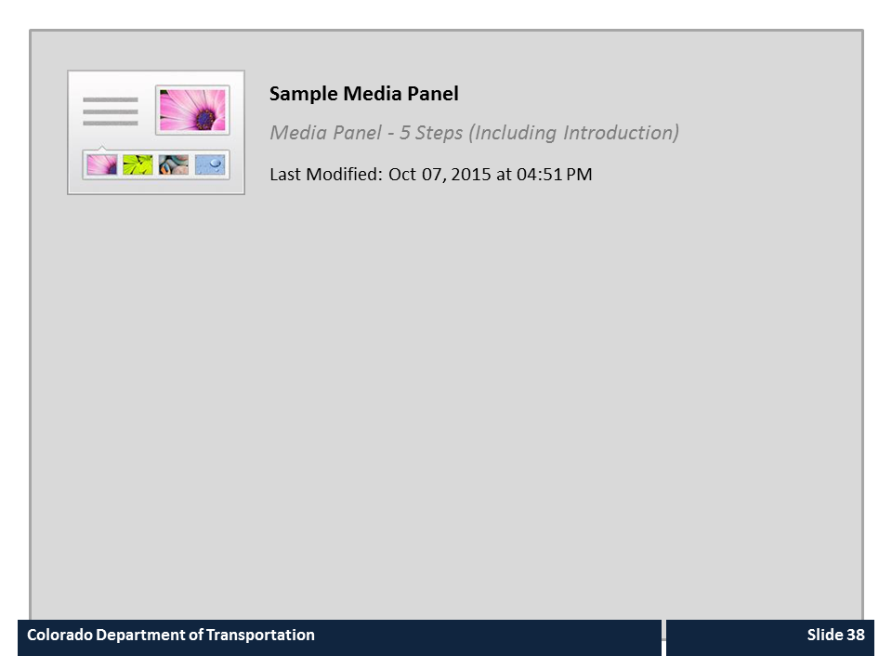
Sample Media Panel

Slide 38

Sample Process

Slide 39
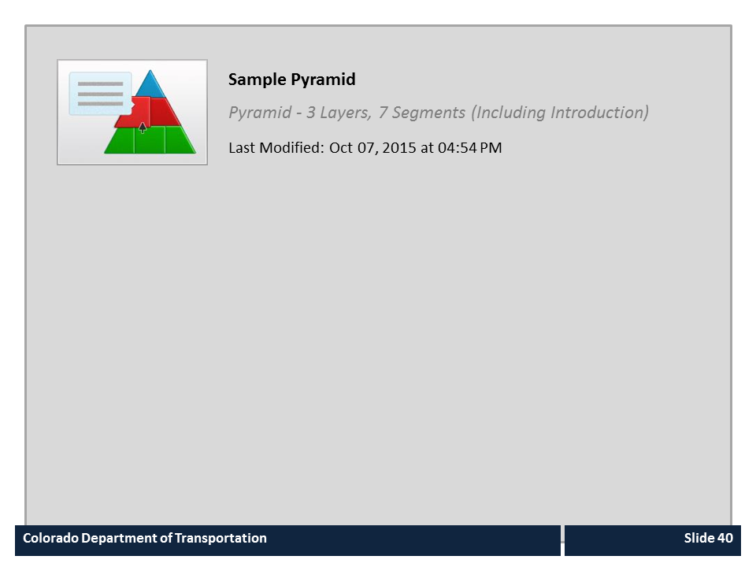
Sample Pyramid

Slide 40
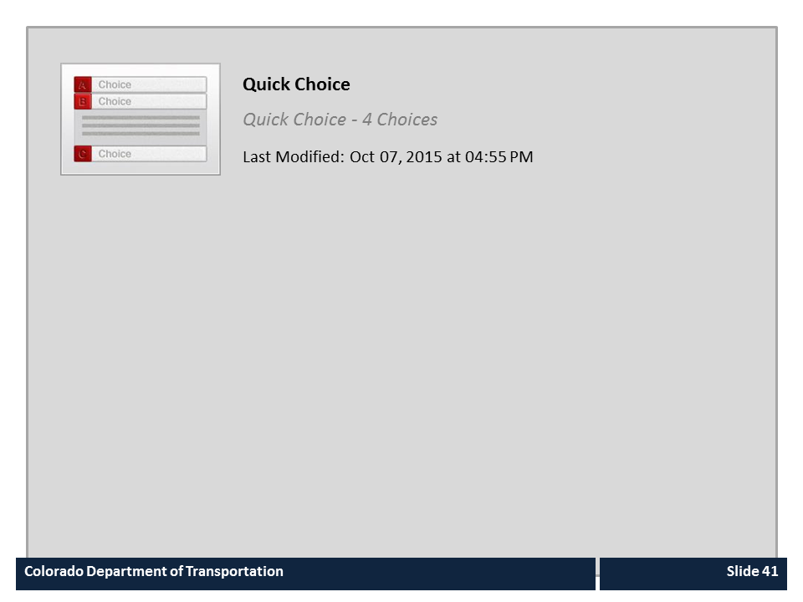
Quick Choice

Slide 41
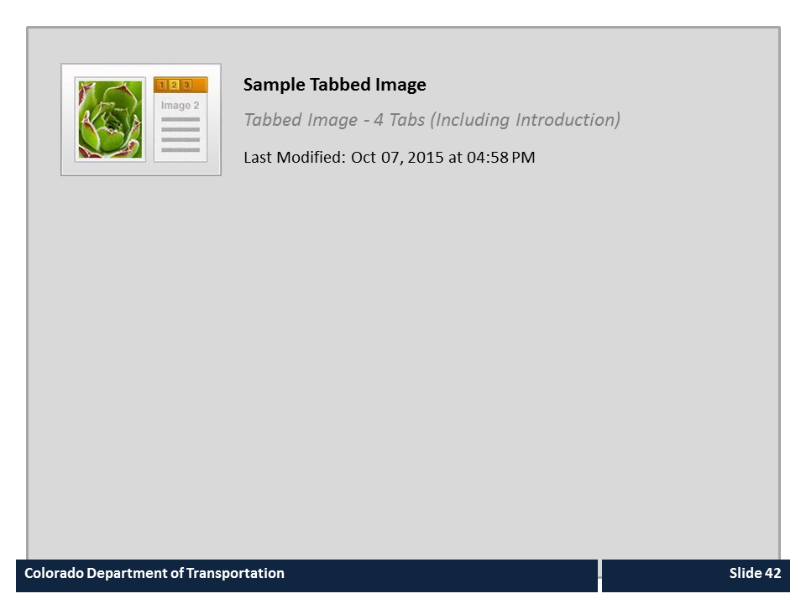
Sample Tabbed Image

Slide 42
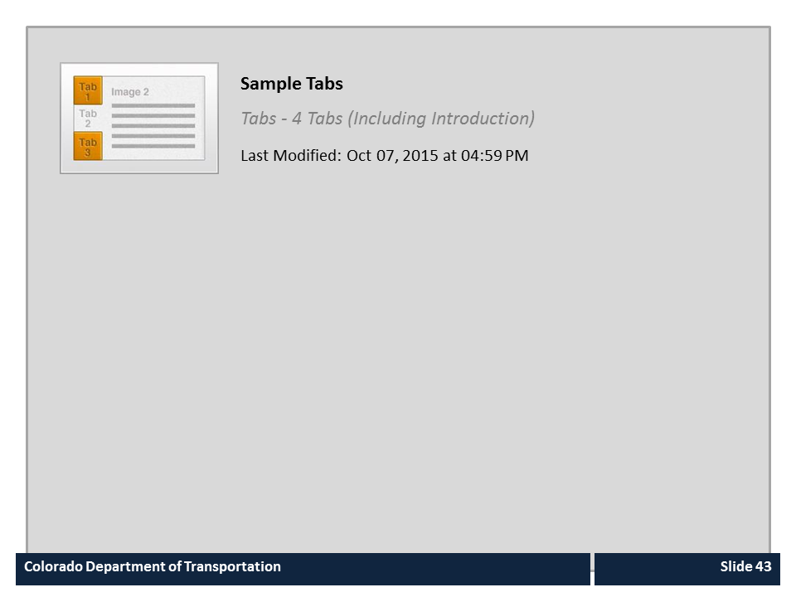
Sample Tabs

Slide 43
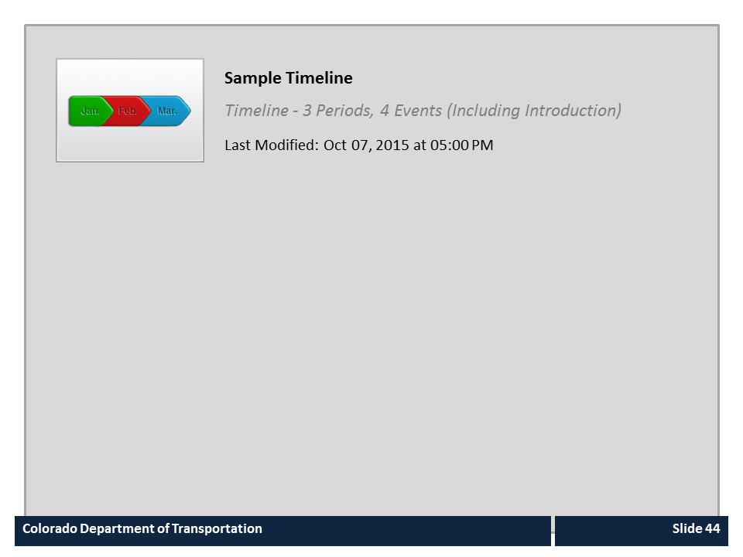
Sample Timeline

