Slide 1


Title of Course
Notes:
This course is designed to teach you how to (insert topic)
Upon completing this course you will be able to:
Insert objectives

Slide 2
Course Learning Objectives
Upon completing this course you will be able to:
Notes:
Notes:
Course learning objectives are the most important subject-matter that the students take away from the course.
In-class demonstrations and exercises (live-data and simulations) and self-check questions throughout the course help reinforce the course learning objectives

Slide 3
Terms and Concepts
Before we begin, take a moment to review the definitions of the
following terms in the Glossary tab to the right (next to Menu).
Terms
Notes:
Notes
Tab 01 - Terms and Concepts
The following terms are critical to your understanding of this section of the course and are found in both the Glossary and Terms and concept document found in the References tab.
Additional terms are located in the Terms and Concepts document located in the reference materials.
If you do not understand the term, please ask for additional clarification.
The Terms and Concepts document contains more terms than are listed in the course and should be reviewed to help with your learning.

Slide 4
Terms and Concepts
Before we begin, take a moment to review the following terms:
Term - definition
Notes:
Notes
Tab 01 - Terms and Concepts
The following terms are critical to your understanding of this section of the course and are found in both the Glossary and Terms and concept document found in the References tab.
Additional terms are located in the Terms and Concepts document located in the reference materials.
If you do not understand the term, please ask for additional clarification.
The Terms and Concepts document contains more terms than are listed in the course and should be reviewed to help with your learning.

Slide 5
Content
Add as many content slides as needed to cover the course topic

Slide 6
Sample Engage Interactions
The following are samples of content they are:
Preformatted to match the standards of the course
Can be inserted or used in the course
To use the sample Interactions:
Copy and rename the Engage Interaction to your project folder
Select Engage Interaction → Add existing → then navigate to the sample interaction → left click to select

Slide 7
Conclusion
You should now be able to:
Notes:
Notes:
Review the course-level objectives stated earlier in the course. This slide reinforces the learning objectives and appears prior to the questions.

Slide 8

Where Can I Get Help?
For additional assistance contact Human Resources
    Phone:
    Email:
Notes:
Notes:
If you run into problems, you can contact:

Slide 9

Course Complete
Congratulations, you have completed the course!
To verify you have completed the course, complete the following assessment.
For course credit, you must achieve a score of at least 70%. Please remember you can take the course as many times as you want until you achieve this score.
Just a note, once you pass the test you can no longer retake the assessment.

Slide 10
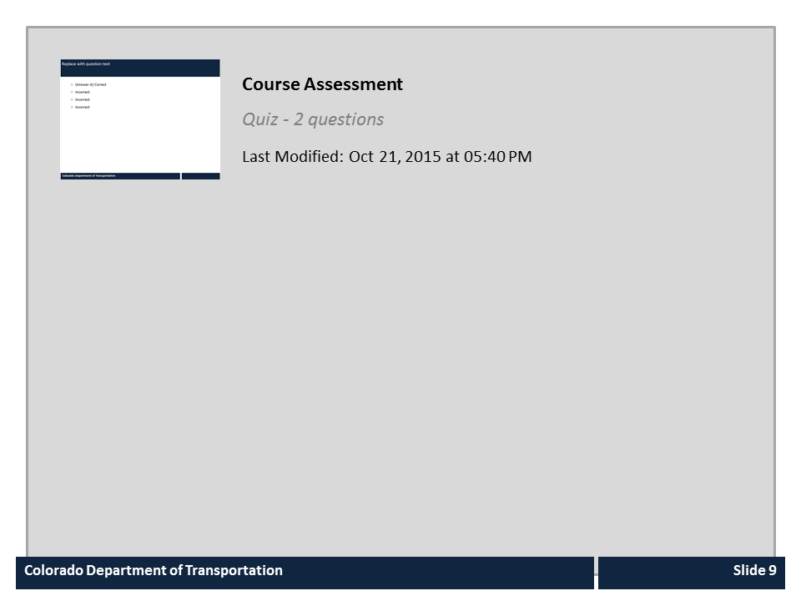
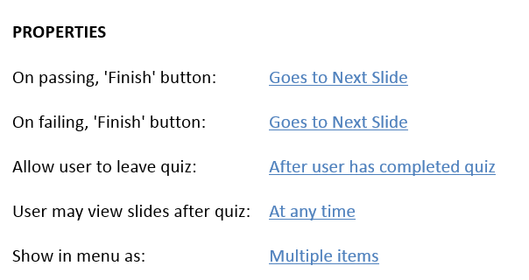


Course Assessment

