Slide 1

Compensation
Human Resources, CDOT
Notes:
Introduction or presentation title slide.

Slide 2
Compensation - Agenda
Why
  Compression
  Retention and salary growth
  Underpaid positions
  Hiring process
What
  State compensation in statute
How
  Pay grade creation
  Pay grade placement
    Philosophy vs practice
    Value of a promotion
Notes:
This slide could be the second slide.

Slide 3
Why
I. Compression
- Higher average salary amongst new employees relative to current employees
- Caused by pay grade movements through time, and lack of merit-pay
II. Retention and Salary Growth
- Career progressions vs. Hire-in positions
- Promotional opportunities and new-hire salary appointment
III. Underpaid positions
  - Underpaid positions vs underpaid employee
  - Underpaid positions defined by CDPA
IV. Hiring process
- Appropriately attribute the role of compensation in the hiring process
Notes:
This slide could be the second slide.

Slide 4
Compensation Philosophy
Notes:
State’s compensation philosophy

Slide 5
What:
Compensation Philosophy
Compensation (also known as Total Rewards) can be defined as all of the rewards earned by employees in return for their labor.
Direct financial compensation: wages, salaries, bonuses and commissions
Indirect financial compensation: benefits, leaves, retirement plans, education, and employee services
Non-financial compensation: career development and advancement opportunities, opportunities for recognition, as well as work environment and conditions
Notes:
What is compensation?

Slide 6
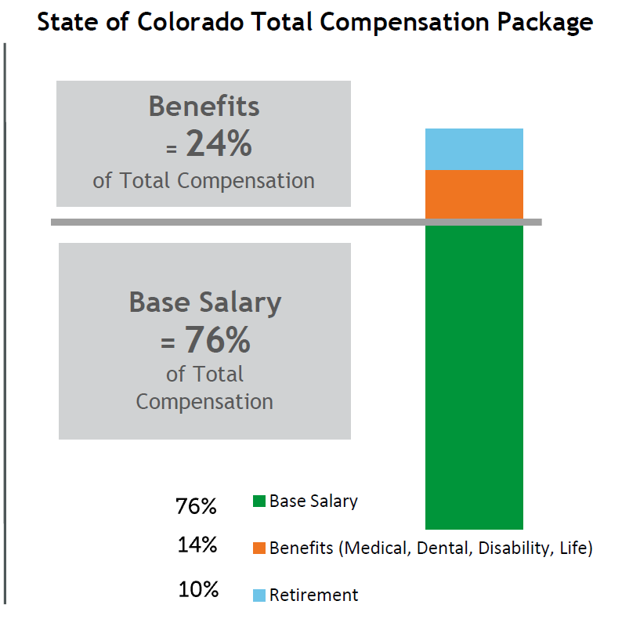
What:
State Compensation
The State’s policy by statute, is to provide employees total compensation that provides a competitive package designed to recruit, reward and retain a qualified workforce.
Notes:
CRS 24-50-104

Slide 7
How:
Pay Grade Creation
I. Prevailing Practices
  Market salary
    Establish “market” and prevailing practices for the class
    Match grade midpoints to market medians
II. Prevailing Practice and Adjustments
  A pay grade is in line with prevailing practices if the midpoint is within (+/-) 7.5% of market median
  Market trends, economic indicators, retention and recruitment problems considered in adjustment decisions
Notes:
Prevailing practices defined by legislature – CRS 24-50-104
“Market” is all of Colorado – may be non-profit, governmental, private sector, or some combination depending on class
Once the pay grade is created there are two reasons for adjustments. 1) annual compensation survey finds that midpoint is more than 7.5% from median 2) An agency requests

Slide 8
Pay Grade Adjustments
Market Min Salary
Market Max Salary
Pay Grade Min
(About 20% below Mid)
Pay Grade Max
(About 20% above Mid)
Midpoint < Market Median
By 7.5%

Slide 9
Pay Grade Adjustments
Adjustments by System Maintenance Study (18 month process)
2017 2018 2019
Agency makes request for class review
August letter
Meet & Confer
December letter
Junior Budget Committee reviews
Legislative approval is given
13 Months
4 Months
Adjustment goes into affect beginning of next fiscal year (July)
6-12 Months
Notes:
Prevailing practices defined by legislature – CRS 24-50-104
“Market” is all of Colorado – may be non-profit, governmental, private sector, or some combination depending on class
Once the pay grade is created there are two reasons for adjustments. 1) annual compensation survey finds that midpoint is more than 7.5% from median 2) An agency requests

Slide 10
Placement within the Pay Grade
It is industry standard for compensation to construct a functional relationship between experience and pay.
Min
Mid
Max
New employees expected to perform at entry-level, additional skills/qualifications
Notes:
This slide could be the second slide.

Slide 11
Placement within the Pay Grade
Where an employee’s pay sits relative to the minimum, should be related to the number of years of experience they have.
Min
Mid
Max
Employees who are approaching fully functional in their position
-New employees
-Current employees who promoted in or received raises
Notes:
This slide could be the second slide.

Slide 12
Placement within the Pay Grade
DPA standard is to move employees toward the midpoint by end of career
Min
Mid
Max
Fully-functional employees who have received merit (pay)
Notes:
This slide could be the second slide.

Slide 13
Placement within the Pay Grade
Min
Mid
Max
0-3 Job Years
3-5 Job Years
5+ Job Years
Notes:
This slide could be the second slide.

Slide 14
Compensation
In-Practice
Notes:
This slide could be the second slide.

Slide 15
Placement within the Pay Grade
What we observe at CDOT:
Min
Mid
Max
1.8 Job Years
3.6 Job Years
5.9 Job Years
6.6 Job Years
Notes:
How well are we meeting industry standards in terms of the expected placement of an employee within the range based on their qualifications. We don’t have a measure for how qualified an individual is, so we use “Job Years” as a proxy.

Slide 16
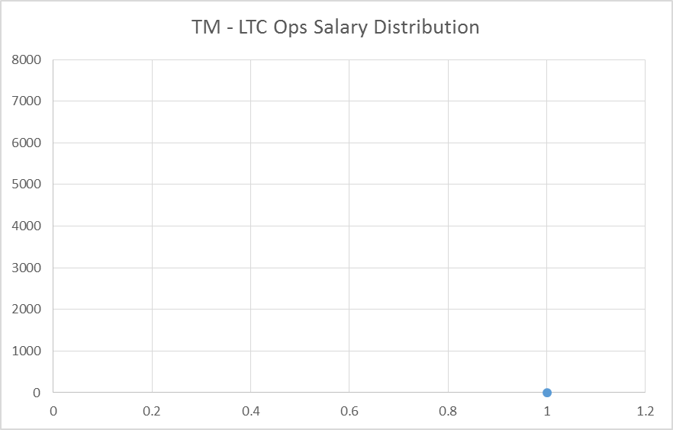
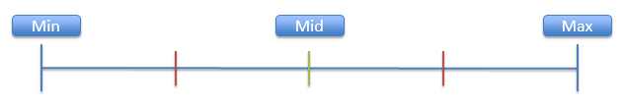
TM – LTC Ops Salary Distribution
At first glance, appears to be evenly distributed
Clear linear trend
No initial evidence of compression
Monthly Salary
TM I
TM II
TM III
LTC I
LTC II
Notes:
We can apply the same logic around placement within the range to understand group compensation or the aggregate.
The “Class Salary Range” bars are really just the previous image flipped on its side and grouped by position

Slide 17
TM – LTC Ops Salary Distribution
At first glance, appears to be evenly distributed
Clear linear trend
No initial evidence of compression
Monthly Salary
TM I
TM II
TM III
LTC I
LTC II
Notes:
We can apply the same logic around placement within the range to understand group compensation or the aggregate.
The “Class Salary Range” bars are really just the previous image flipped on its side and grouped by position

Slide 18
TM – LTC Ops Salary Distribution
Max
Monthly Salary
Min
TM I
TM II
TM III
LTC I
LTC II
Notes:
We can apply the same logic around placement within the range to understand group compensation or the aggregate.
The “Class Salary Range” bars are really just the previous image flipped on its side and grouped by position

Slide 19
TM – LTC Ops Salary Distribution
Monthly Salary
TM I
TM II
TM III
LTC I
LTC II
Notes:
We can apply the same logic around placement within the range to understand group compensation or the aggregate.
The “Class Salary Range” bars are really just the previous image flipped on its side and grouped by position

Slide 20
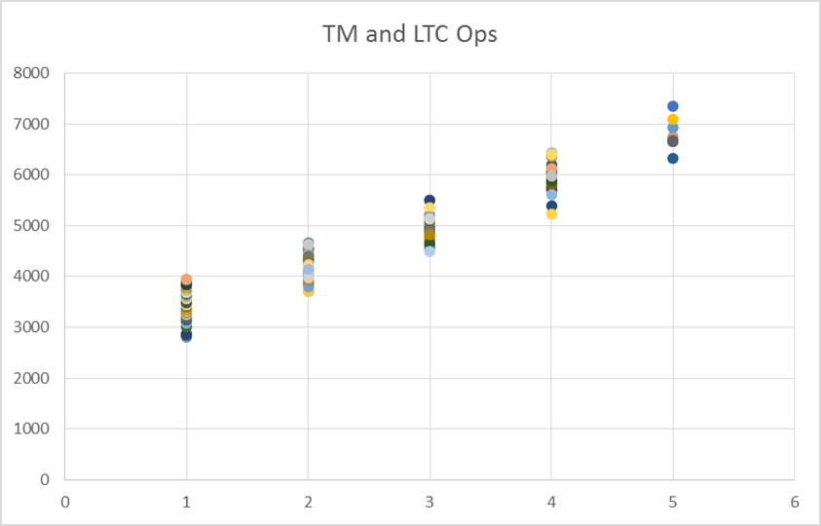
TM – LTC Ops Salary Distribution
TM I, II, III – LTC Ops I, II
At first glance, appears to be evenly distributed
Clear linear trend
No initial evidence of compression
Monthly Salary
TM I
TM II
TM III
LTC I
LTC II
Notes:
We can apply the same logic around placement within the range to understand group compensation or the aggregate.
The “Class Salary Range” bars are really just the previous image flipped on its side and grouped by position

Slide 21
TM – LTC Ops Salary Distribution
At first glance, appears to be evenly distributed
Clear linear trend
No initial evidence of compression
Monthly Salary
Legend:
Class Salary Range
Observed CDOT Pay
Salary Frequency
Distribution
TM I
TM II
TM III
LTC I
LTC II
Notes:
We can apply the same logic around placement within the range to understand group compensation or the aggregate.
The “Class Salary Range” bars are really just the previous image flipped on its side and grouped by position

Slide 22
TM – LTC Ops Salary Distribution
TM I, II, III – LTC Ops I, II
At first glance, appears to be evenly distributed
Clear linear trend
No initial evidence of compression
Monthly Salary
TM I
TM II
TM III
LTC I
LTC II
Notes:
We can then think about the frequency distribution of a position’s observed salaries.
NOTE: Most classes are not large enough to identify a mathematical distribution. Distributions above are intended for illustrative and educational purposes only and are not intended to reflect the actual distribution of salaries.

Slide 23
TM – LTC Ops Salary Distribution
TM I, II, III – LTC Ops I, II
At first glance, appears to be evenly distributed
Clear linear trend
No initial evidence of compression
Monthly Salary
What can the salary distribution of a class tell us about compensation?
TM I
TM II
TM III
LTC I
LTC II
Notes:
This method of presenting the data informs our understanding of compensation in three ways.

Slide 24
TM – LTC Ops Salary Distribution
TM I, II, III – LTC Ops I, II
At first glance, appears to be evenly distributed
Clear linear trend
No initial evidence of compression
Monthly Salary
Higher Average Job Years
Lower Average Job Years
TM I
TM II
TM III
LTC I
LTC II
Notes:
First: We already know that CDOT meets industry standards for placement within the range on average. We may believe that how well we adhere to industry standard expectations varies based on the position. This method of data visualization allows us to evaluate by position.

Slide 25
TM – LTC Ops Salary Distribution
TM I, II, III – LTC Ops I, II
At first glance, appears to be evenly distributed
Clear linear trend
No initial evidence of compression
Monthly Salary
Average Job Years = 9.3
Average Job Years = 4.7
TM I
TM II
TM III
LTC I
LTC II
Notes:
We can do the same analysis of job years shown on slide 16 on a position-by-position basis

Slide 26
TM – LTC Ops Salary Distribution
TM I, II, III – LTC Ops I, II
At first glance, appears to be evenly distributed
Clear linear trend
No initial evidence of compression
Monthly Salary
Why do we see crowding near the minimum in some positions, but not others?
TM I
TM II
TM III
LTC I
LTC II
Notes:
This exercise may help inform our understanding of compensation related issues that are highly variant depending on the position

Slide 27
TM – LTC Ops Salary Distribution
TM I, II, III – LTC Ops I, II
Compression occurs when those with higher pay are newer employees, but not different in any other skill set/qualification from the lower paid employees
At first glance, appears to be evenly distributed
Clear linear trend
No initial evidence of compression
TM I
TM II
TM III
LTC I
LTC II
Notes:
We can also build an empirical foundation for understanding how to identify compression

Slide 28
PEs have the highest number of duplicate salaries
  More formulaic salary analysis
Some evidence of compression in the movement from EIT III to PE I
Positions with a clear career progression
Notes:
We are able to use this same method to look at various career progressions because we have a sense that retention and recruitment difficulties look different for employees in the EIT series …

Slide 29
PEs have the highest number of duplicate salaries
  More formulaic salary analysis
Some evidence of compression in the movement from EIT III to PE I
Distributions are mostly gathered at the low end or midpoint of the range
Notes:
Where there is a very clear progression from EIT I – PE III. This forces distribution centers to the bottom of the range

Slide 30
PEs have the highest number of duplicate salaries
  More formulaic salary analysis
Some evidence of compression in the movement from EIT III to PE I
Why: A clear career progression incentivizes employees to promote out of their position quickly
Notes:
This is a secondary slide design. It is one of 4 that may be used.

Slide 31
Because GP positions are typically “in-hire,” we see more crowding around midpoint and top of range
GP I
GP II
GP III
GP IV
GP V
GP VI
GP VII
Notes:
Where GP series employees may face different recruitment and retention difficulties…

Slide 32
Key Takeaways
I. Educational effort around Colorado Revised Statutes and DPA rules and guidelines
  Communicating a clear definition and identification strategy of issues like compression, underpaid positions
II. Set expectations for how CDOT compensation procedure can address:
  New-hire pay and recruitment of qualified employees
    Experience-pay relationship
  Retention of skill when merit-pay is not funded
    Salary growth, promotional opportunities, rewards and recognition
  Filling vacancies effectively
  Compression
Notes:
This slide could be the second slide.

Slide 33

Questions and Assistance
For additional assistance or questions about this presentation contact:
  Margaret Vetterling
  Margaret.vetterling@state.co.us
  Beverly Wyatt
  Beverly.wyatt@state.co.us

