Slide 1


Affirmative Action in Employment
Notes:
This course is designed to teach you how to (insert topic)
Upon completing this course you will be able to:
Insert objectives

Slide 2
Message to CDOT Employees
Welcome to the training designed to assist you in understanding the concepts and requirements relating to Affirmative Action. CDOT is committed to Equal Employment Opportunity and Affirmative Action for all Colorado residents.
At CDOT, we want to foster a work culture that values diversity and one in which all employees feel welcomed and appreciated. We will not condone behavior that undermines our core values, which include a passion for dignity, respect, and integrity.
You are encouraged to review the content of this training module. Your participation ensures all CDOT employees have a common understanding of Affirmative Action to help make us the best transportation department in the country.
CDOT is a partner in a Stewardship and Oversight Agreement with the Federal Highway Administration (FHWA) and the foundation for CDOT’s Affirmative Action plan is contained in 23 CFR Part 230 and the Federal Transportation Administration (FTA) Circular 4701.1.
Please take a moment to review the following materials:
Affirmative Action Commitment Statement
Affirmative Action Report and Plan
600.0 PD Equal Employment Opportunity and Affirmative Action

Slide 3
Course Learning Objectives
Upon completing this course you will be able to:
Understand the origins and history of Affirmative Action
Identify what is and isn’t Affirmative Action and who benefits
Identify the components of an Affirmative Action Plan
Describe Affirmative Action strategies
Understand CDOT’s expectation of Managers and Supervisors working with Affirmative Action
Notes:
Notes:
Course learning objectives are the most important subject-matter that the students take away from the course.
In-class demonstrations and exercises (live-data and simulations) and self-check questions throughout the course help reinforce the course learning objectives

Slide 4
Terms and Concepts
Before we begin, take a moment to review the definitions of the
following terms in the Glossary tab to the right (next to Menu).
Affirmative Action
Affirmative Report and Plan
Diversity
Notes:
Notes
Tab 01 - Terms and Concepts
The following terms are critical to your understanding of this section of the course and are found in both the Glossary and Terms and concept document found in the References tab.
Additional terms are located in the Terms and Concepts document located in the reference materials.
If you do not understand the term, please ask for additional clarification.
The Terms and Concepts document contains more terms than are listed in the course and should be reviewed to help with your learning.

Slide 5

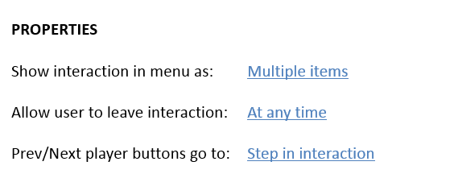


Sample Tabs

Slide 6


What is (and is not) Affirmative Action
Affirmative Action is to have CDOT’s workforce reflect our community. But, what is and isn’t Affirmative Action?
Affirmative Action Is:
Remedial action, such as implementing an AA program
Performing inclusive outreach to minority and female applicants during the hiring process
Bringing in diversity into the interview panels
Eliminate discrimination in hiring
Affirmative Action Is not:
A quota system
Reverse discrimination
Always court ordered or necessitated by law (it can be voluntary) hiring of minorities and women regardless of qualifications

Slide 7

Who Benefits from Affirmative Action?
Affirmative Action benefits everyone by:
Provide equal access to jobs, promotions, and training
Increasing the talent pool for jobs and creating a more diverse work environment
Increasing the representation of minorities across all levels of employment and within organizations
Eliminating discrimination against veterans, disabled veterans, persons with disabilities, Women, Blacks/African Americans, Hispanics/Latinos, Asians/Pacific Islanders, and American Indians/Alaskan Natives

Slide 8

Components of an Affirmative Action Plan
The components of an Affirmative Action Plan answer the following questions:
“What we do” – Contained in a narrative statement
"Who are we?” – Contained in a workforce analysis
"Who is out there?" – Contained in an availability analysis
"How do we compare to the local qualified workforce and what are the gaps?” – Contained in an analysis of the workforce vs. availability of the qualified minority and female population performing the same work
"What are we going to do to close the gaps?” – Contained in the goals and timetables of the plan

Slide 9
Affirmative Action Strategies
Now that we know about the plan, here are some strategies for obtaining the goals.
Outreach such as college job fairs and Construction Career Days
Review of internal processes to assess bias and barriers such as annual reviews of position descriptions or obtaining consultation to develop optimal interview questions
Mentoring and upward mobility programs such as the CDOT Intern and Tuition Reimbursement Programs
Training and engagement programs such as CDOTU and Employee Council
Diversity-related training, such as this training

Slide 10
Group Discussion
Roles:
Manager and Supervisor
Scenario:
In this exercise, we are going to discuss when Affirmative Action applies to the hiring process
Notes:
Notes:
TAB 04 - PDQ Form
TAB 03 – Curricula Template
Break into groups of three to four. Discuss the details of what a Manager needs to know when the fill in the PDQ form. The title of the section is PDQ form. Populate the remaining cells with the details of the your groups conversation.

Slide 11
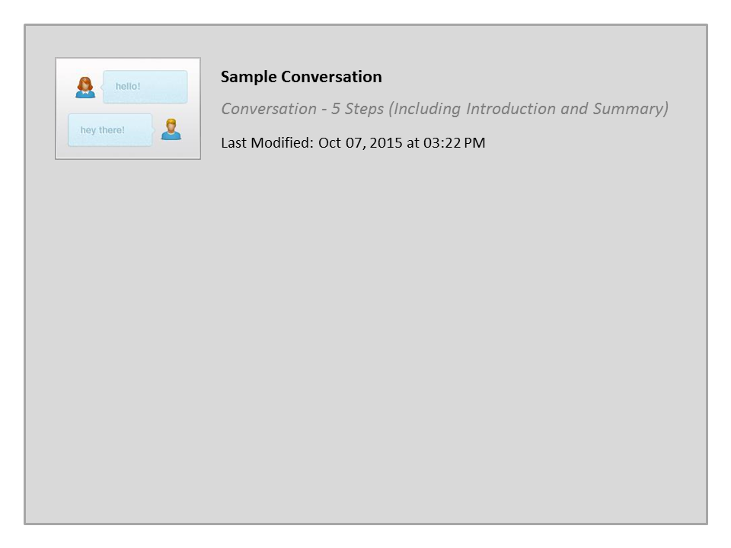
Sample Conversation

Slide 12

The Challenges Ahead
Affirmative Action programs still face many challenges, such as:
Eliminating myths and misinformation
Involving all employees, regardless of rank
Providing management with skills and tools to motivate, supervise, and reward a diverse workforce
Overcoming resistance, uncertainty, controversy and perceived lack of relevance

Slide 13

Sample Accordion

Slide 14
Conclusion
You should now be able to:
Understand the origins and history of Affirmative Action
Identify what is and isn’t Affirmative Action and who benefits
Identify the components of an Affirmative Action Plan
Describe Affirmative Action strategies
Understand CDOT’s expectation of Managers and Supervisors working with Affirmative Action
Notes:
Notes:
Review the course-level objectives stated earlier in the course. This slide reinforces the learning objectives and appears prior to the questions.

Slide 15

Where Can I Get Help?
For additional assistance contact Human Resources
    Phone: (303) 757-9216
    Email: dot_workforce_staffing@state.co.us
Notes:
Notes:
If you run into problems, you can contact:

Slide 16

Course Complete
Congratulations, you have completed the course!
To verify you have completed the course, complete the following assessment.
For course credit, you must achieve a score of at least 70%. Please remember you can take the course as many times as you want until you achieve this score.
Just a note, once you pass the test you can no longer retake the assessment.

Slide 17
Check Your Knowledge
(True or false) CDOT's Affirmative Action plan establishes goals for hiring, and promoting women and minorities with the intent to eliminate the present effects of past discrimination.
  Answer: True
Which of the following is not a component of an organization's Affirmative Action Plan? The Workforce Analysis, Availability Analysis, or Salary Analysis
  Answer: Salary Analysis
(True or false) Affirmative Action specifically prohibits hiring or promotion quotas.
  Answer: True
Notes:
Notes:
Question One
What are three views in PowerPoint we will be using?
Answer One
They are, Normal, Note Page and Presentation.
Question Two
Which view is used to create the manual?
Answer Two
The Notes Page view.

Slide 18
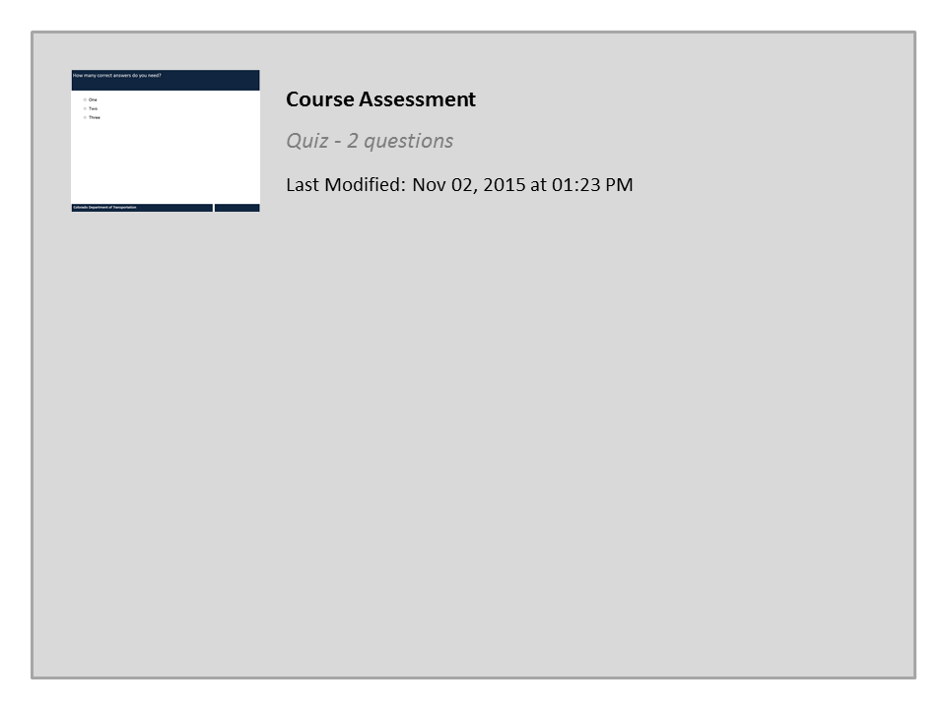
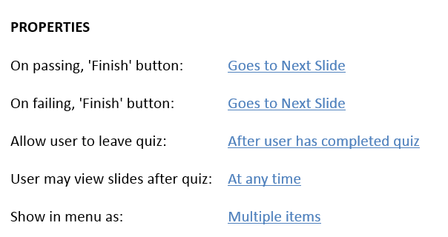

Course Assessment

