Slide 1
How to Request and Coordinate New Training at CDOT
Notes:
Notes:
Welcome! This 10 minute course guides you through the process of requesting a new training for either purchase or develop in-house for CDOT employees or contractors.
This process will help you, the training purchaser, developer, or administrator to save time and possibly a lot of money. We’ll explain how in just a few minutes.
Important note: If you intend to purchase a training course from the National Highway Institute, there is a separate and shorter process. Please contact the NHI Coordinator at the Office of Employee Development at extension 7-9167.
Before we get into the content, let’s learn how to navigate the course.

Slide 2
Let’s Get Started
The topics covered in this learning include:
Identifying how the process helps you
Locating the form
Identifying the Roles (who does what)
Describe how to complete the form
Answering Frequently Asked Questions FAQs
Notes:
Take a moment to review the topics of the learning. When you are done reviewing them, click the Next button to go to the next slide.

Slide 3
How this Process Helps You
Help avoid duplication of courses that CDOT or the state has already bought or developed
Identify training that requires a DPA approval (waiver) for purchase
Gather data to get the training supported in the Learning Management System
Notes:
As was mentioned on the first slide, this process helps you in several important ways.
First, by avoiding the purchase or development of a course that either CDOT or another state agency may already have available to you for free or at a highly discounted price.
Second, it will help you obtain any required waivers to purchase training, as may be required by state and CDOT purchasing policies.
Third, it will help you get your training course supported in the Learning Management System, which assists you in advertising your course, registering your participants and recording credit for the course in the employee’s official learning history at CDOT.

Slide 4
Locating the Form
The Form for Requesting Development of New Training can be found by going to the CDOTU Intranet page, and clicking on the link for “CDOTU Manual and Forms”.
A copy of the form can also downloaded from the resources link.
Notes:
The Form for Requesting Development of New Training can be found by going to the CDOTU Intranet page, and clicking on the link for “CDOTU Manual and Forms”.
A copy of the form can also be downloaded by clicking on the resources link at the top right of this window.

Slide 5
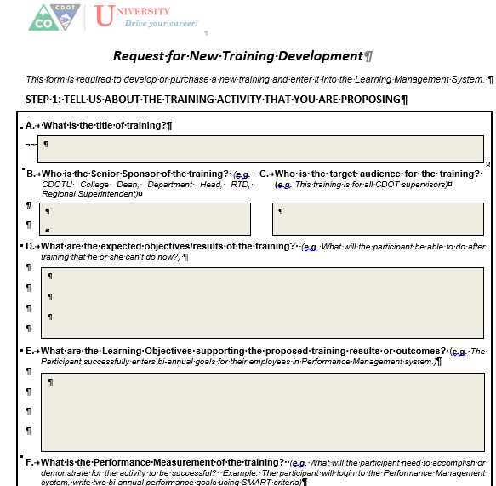
Step 1: Initiator
Initiator
Completes Step One of the form
Forwards form to Sponsor for approval
Notes:
There are three roles that are part of the request process.
The request begins the you, the initiator, who completes Step One of the form. The initiator is typically a training coordinator, subject matter expert or manager who has identified a training need for CDOT employees, consultants or contractors.
This Section collects all of the required data to both get the training into the Learning Management System, and help the Office of Employee Development to identify if there is already a comparable training option that has already been developed or purchased by CDOT. If so, OED will provide the initiator with the details of that training and help the initiator to decide if the existing training is a suitable substitute.
If no currently available training fits the need, OED will use the information in Section One to coordinate a DPA waiver to purchase that training, if required.

Slide 6
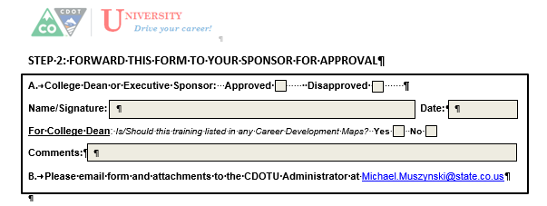
Step 2: Sponsor
Sponsor
Completes Step Two of the form
Notes:
Every initiative to develop or purchase new training needs a Sponsor. This is typically a CDOTU Dean, senior manager or member of the Executive Management Team. The level of sponsor depends on the scope of the intended audience.
For example, if the target audience is a single business unit, then the senior manager of that unit is an appropriate sponsor. (The request will be coordinated with the appropriate CDOTU Dean so that he/she will have awareness of it, as the training may be of interest to other groups or may be included on a career development map. ) If the target audience is across multiple business units, then an Executive-level sponsor is required. When in doubt contact either the Dean for the CDOTU College that represents your business unit or contact the CDOTU Administrator in OED.

Slide 7
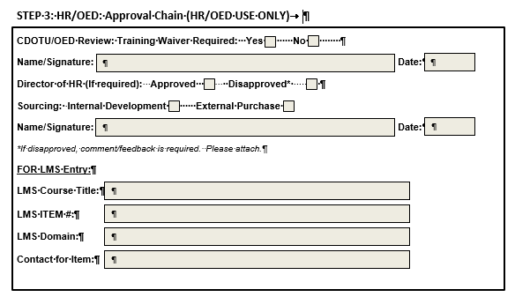
Step 3: OED
OED
Completes Section Three of form
Coordinates any needed waivers
Loads the Course into the LMS
Notes:
The Office of Employee Development and the Director of HR provide a CDOT-wide visibility on both training that is currently available as well was what is in planning or development and also what is available from DPA and other sources. This awareness of state-wide training is important in avoiding unnecessary duplication of effort or expenditure for training. Also, HR/OED is your liaison for DPA waivers required for purchase of training.
Lastly, you may need the approval of the HR Director if your proposed training is intended as mandatory for CDOT employees.

Slide 8
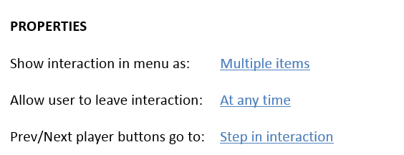
Sample Image Zoom

Slide 9
Timeframes

Slide 10
Sample FAQ

Slide 11
Navigation, Resources and Glossary
Before we begin, let’s look at the resources available to you
Notes:
As you go through the course there are a couple of items you can use to help you learn. The first is the Resources link as indicated by the red arrow. This link contains copies of all of the documents referenced in this course.
The Glossary tab displays an alphabetical list of terms that are used throughout the course. Anytime you are uncertain about a term, this is the best place to look. Unlike the resources link clicking on the glossary does not pause the course.
If you want to navigate, use the previous or next buttons or click on the slide you want to navigate to under the menu tab. There is also a search field located at the bottom of the Menu tab that brings up all of the slides related to your search. The progress bar displays your progress within a slide.
If for any reason, you need to close the course before you have completed it, you will be returned to the page you were on once you log back in. Now let’s move on to what you will learn in this course.

Slide 12
Outline
Click on the button of the topic you want to learn about or the green button to learn what is covered in the Section.
?
Getting Started
?
Completing the Form
?
Timeframes and Help
Notes:
This brief learning is divided into three sections. You can view the sections in any order, based on what you want to learn, or you can take go through the sections in order to complete the tutorial.

Slide 13
Completing the Form
The topics covered in this section include:
Identifying the sections of the form
Complete the sections of the form
Send the form to the next role
Notes:
Take a moment to review the topics for this section of the course. When you are done reviewing them, click the Next button to view the section, or if you are only reviewing the objectives, select the Return to Course Outline button to select a different topic.

Slide 14
Timeframes and Help
The topics covered in this section include:
Identify the turn around time on the form
Answer frequently asked questions
Notes:
Take a moment to review the topics for this section of the course. When you are done reviewing them, click the Next button to view the section, or if you are only reviewing the objectives, select the Return to Course Outline button to select a different topic.

