Slide 1


Affirmative Action in Employment
Notes:
This course is designed to teach you how to (insert topic)
Upon completing this course you will be able to:
Insert objectives

Slide 2
Message to CDOT Employees
Welcome to the online training designed to assist you in understanding the concepts and requirements relating to Affirmative Action. CDOT is committed to Equal Employment Opportunity and Affirmative Action for all Colorado residents.
At CDOT, we want to foster a work culture that values diversity and one in which all employees feel welcomed and appreciated. We will not condone behavior that undermines our core values, which include a passion for dignity, respect, and integrity. As a step toward this goal, we are providing this important professional development opportunity designed to help you understand Affirmative Action.
You are encouraged to review the content of this training module. Your participation ensures all CDOT employees have a common understanding of Affirmative Action to help make us the best transportation department in the country.
CDOT is a partner in a Stewardship and Oversight Agreement with the Federal Highway Administration (FHWA) and the foundation for CDOT’s Affirmative Action plan is contained in 23 CFR Part 230 and the Federal Transportation Administration (FTA) Circular 4701.1.
Click the Resources link in the upper right corner of this page to review CDOT’s:
Affirmative Action Commitment Statement
Affirmative Action Report and Plan
600.0 PD Equal Employment Opportunity and Affirmative Action

Slide 3
Course Learning Objectives
Upon completing this course you will be able to:
Understand the origins and history of Affirmative Action
Identify what is and isn’t Affirmative Action and who benefits
Identify the components of an Affirmative Action Plan
Describe Affirmative Action strategies
Understand CDOT’s expectation of Managers and Supervisors working with Affirmative Action
Notes:
Notes:
Course learning objectives are the most important subject-matter that the students take away from the course.
In-class demonstrations and exercises (live-data and simulations) and self-check questions throughout the course help reinforce the course learning objectives

Slide 4
Terms and Concepts
Before we begin, take a moment to review the following terms:
Affirmative Action Program - Specific actions taken by an organization to have its workforce reflect the race, ethnicity and gender of the qualified local population and other protected classes such individuals or veterans with disabilities.
Affirmative Action Report and Plan – An annual publication that outlines the organizational actions taken when a workforce does not naturally reflect the qualified local population. The publication includes an analyses of the workforce and qualified local population. The Plan identifies gaps, sets goals and timetables to close those gaps and the results of the previous year.
Diversity - The unique qualities, experiences and work styles of individuals contributing to increased staff engagement, retention and productivity as well as enhancing an organization's relationship with its customers and community.
Notes:
Notes
Tab 01 - Terms and Concepts
The following terms are critical to your understanding of this section of the course and are found in both the Glossary and Terms and concept document found in the References tab.
Additional terms are located in the Terms and Concepts document located in the reference materials.
If you do not understand the term, please ask for additional clarification.
The Terms and Concepts document contains more terms than are listed in the course and should be reviewed to help with your learning.

Slide 5
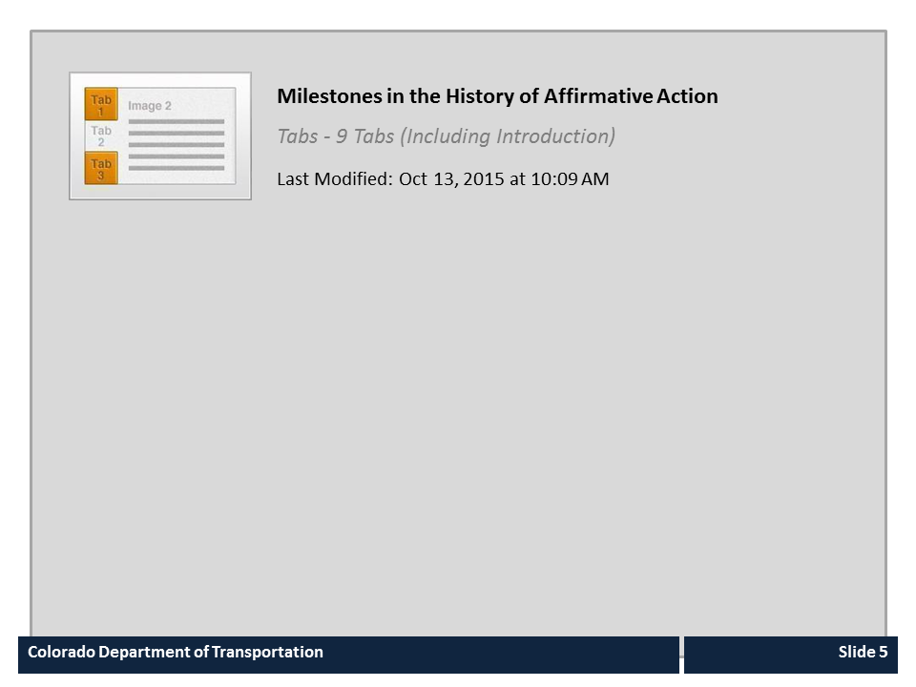
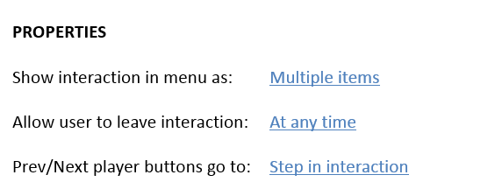


Milestones in the History of Affirmative Action

Slide 6


What is (and is not) Affirmative Action
Affirmative Action is to have CDOT’s workforce reflect our community. But, what is and isn’t Affirmative Action?
Affirmative Action Is:
Remedial action, such as implementing an AA program
Performing inclusive outreach to minority and female applicants during the hiring process
Bringing in diversity into the interview panels
Eliminate discrimination in hiring
Affirmative Action Is not:
A quota system
Reverse discrimination
Always court ordered or necessitated by law (it can be voluntary) hiring of minorities and women regardless of qualifications

Slide 7

Who Benefits from Affirmative Action?
Affirmative Action benefits everyone by:
Providing equal access to jobs, promotions, and training
Increasing the talent pool for jobs and creating a more diverse work environment
Increasing the representation of minorities across all levels of employment and within organizations
Eliminating discrimination against veterans, disabled veterans, persons with disabilities, Women, Blacks/African Americans, Hispanics/Latinos, Asians/Pacific Islanders, and American Indians/Alaskan Natives

Slide 8

Components of an Affirmative Action Plan
The components of an Affirmative Action Plan answer the following questions:
“What we do” – Contained in a narrative statement
"Who are we?” – Contained in a workforce analysis
"Who is out there?" – Contained in an availability analysis
"How do we compare to the local qualified workforce and what are the gaps?” – Contained in an analysis of the workforce vs. availability of the qualified minority and female population performing the same work
"What are we going to do to close the gaps?” – Contained in the goals and timetables of the plan

Slide 9
Affirmative Action Strategies
Now that we know about the plan, here are some strategies for obtaining the goals.
Outreach such as college job fairs and Construction Career Days
Review of internal processes to assess bias and barriers such as annual reviews of position descriptions or obtaining consultation to develop optimal interview questions
Mentoring and upward mobility programs such as the CDOT Intern and Tuition Reimbursement Programs
Training and engagement programs such as CDOTU and Employee Council
Diversity-related training, such as this training

Slide 10
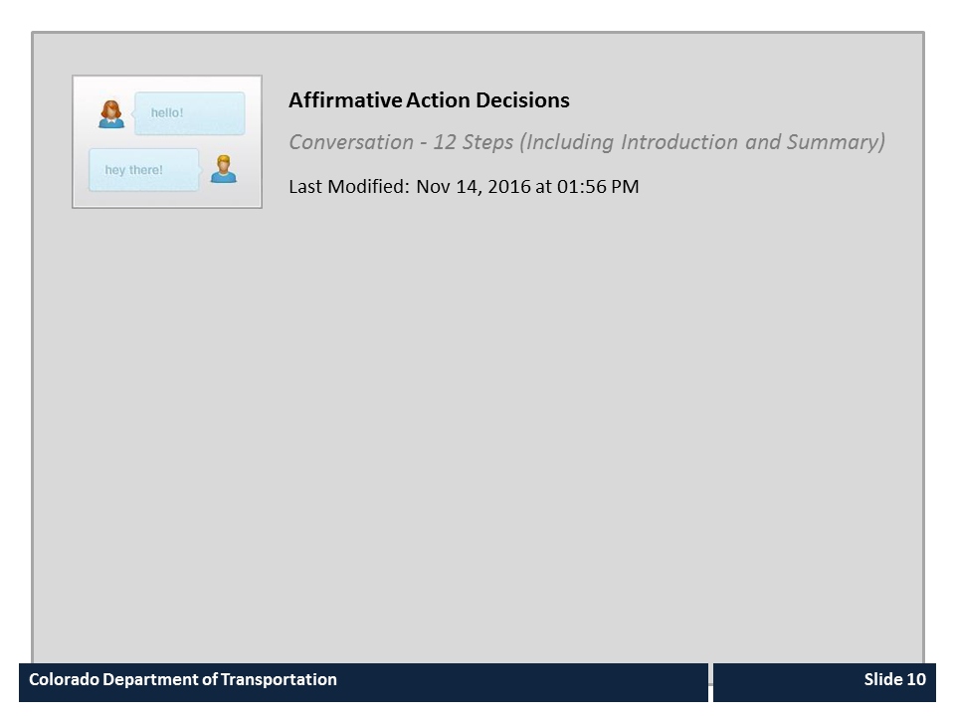
Affirmative Action Decisions

Slide 11

The Challenges Ahead
Affirmative Action programs still face many challenges, such as:
Eliminating myths and misinformation
Involving all employees, regardless of rank
Providing management with skills and tools to motivate, supervise, and reward a diverse workforce
Overcoming resistance, uncertainty, controversy and perceived lack of relevance

Slide 12
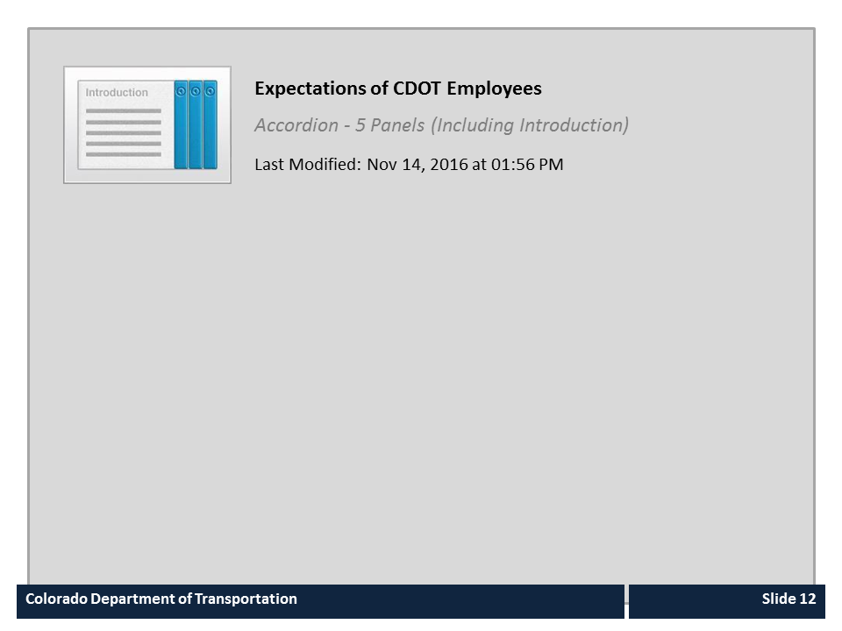
Expectations of CDOT Employees

Slide 13
Conclusion
You should now be able to:
Understand the origins and history of Affirmative Action
Identify what is and isn’t Affirmative Action and who benefits
Identify the components of an Affirmative Action Plan
Describe Affirmative Action strategies
Understand CDOT’s expectation of Managers and Supervisors working with Affirmative Action
Notes:
Notes:
Review the course-level objectives stated earlier in the course. This slide reinforces the learning objectives and appears prior to the questions.

Slide 14

Where Can I Get Help?
For additional assistance contact Human Resources
    Phone: (303) 757-9216
    Email: dot_workforce_staffing@state.co.us
Notes:
Notes:
If you run into problems, you can contact:

Slide 15

Course Complete
Congratulations, you have completed CDOT’s Affirmative Action in Employment Training!
To confirm you have completed the course, complete the following assessment.
For course credit, you must achieve a score of at least 70%. Please remember you can take the course as many times as you want until you achieve this score.
And remember, once you click the “Submit” button the question is locked and you can no longer change your selection.

Slide 16
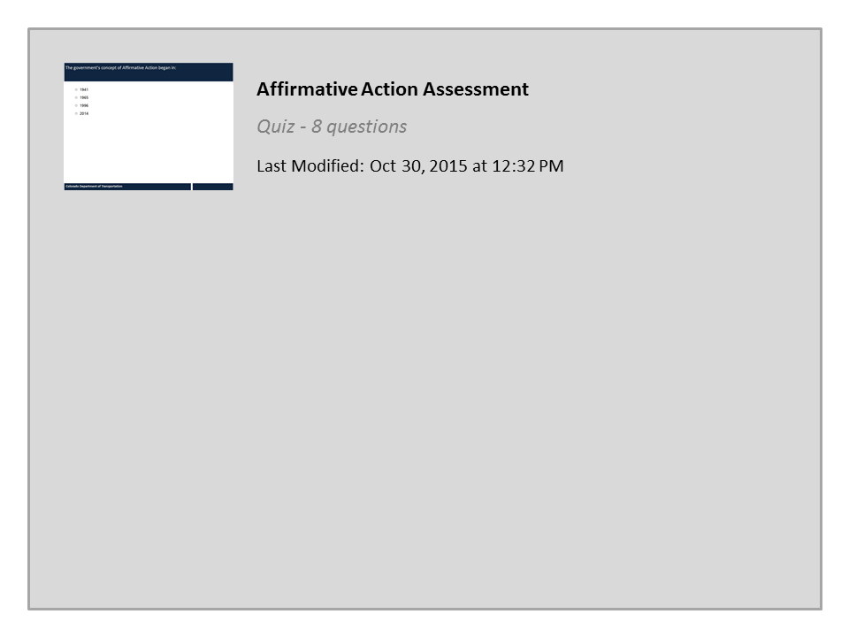
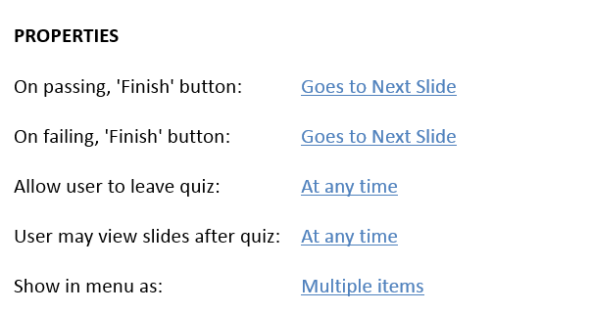

Affirmative Action Assessment

