Slide 1
Records on the Move
Notes:
Welcome! As crews begin the process of breaking ground on the new headquarters and R-2 buildings, it is time to begin thinking about steps we need to take to be prepared for the move. One of the things you can do to prepare, is to begin the process of reducing your files to only what is needed and required. In this brief training, we will cover what is a record, who the records management team is and how to find their website. We will also discuss how to complete the Records Destruction Form and how to box up your documents for storage scanning or destruction. Now let’s take a look at what you can expect for storage so you know how much you can take with you.

Slide 2
Expect the following for Storage:
Records Storage Room
Work Station Space:
Three 36” wide lateral file drawers
Two 18” wide drawers
One 36” wide and 24” high bookcase
One 18” to 24” wardrobe
Notes:
While we don’t know the square footage for the storage rooms, we have been told to reduce our current records needs by 50%. This means we will need to box, scan and shred records which we are no longer required to store. In terms of the storage of the work stations, it is still being determined, but there are a couple of things we can tell you. There will be three lateral files drawers you can use for storing hanging files, two 18 inch drawers mostly good for pens and office supplies, a small bookcase that you can use to store books and binders and an 18 to 24 inch wardrobe used to store your coats, umbrella or hard hat. The wardrobe will also contain two drawers for additional storage. Now let’s look at what is and is not a record so you know if you need to keep it or properly dispose of it.

Slide 3
What is and is not a Record
In general, records are NOT:
Books, manuals, or pamphlets, not written by CDOT
Personal papers
Documents of immediate or transitory value only (ex.: Post-it Notes, to-do lists)
Documents that do not have historical, legal or financial importance
Documents created by another entity that do not have historical, legal or financial importance
Notes:
The first step in reducing the amount of documents you are going to take to the new building is by determining what you must keep and what you can recycle. There is a legally correct way to dispose of documents. In general, if a document is created by CDOT, it must be retained for a specific time period, and when destroyed, you must follow a specific process. The documents that may be destroyed without following the required destruction process include: Books, manuals or pamphlets not written by CDOT, or copies of the same written by CDOT, personal copies, notes, and training materials that are no longer needed.

Slide 4
What is and is not a Record
A record is a document (physical or electronic) created or (in some cases) received by CDOT that is retained for legal, administrative or historical reasons as part of CDOT’s business.
All CDOT employees are responsible for retaining CDOT records for the time frames required by law.
Notes:
So what is a record? Records document the legal, administrative or historical business and history of CDOT, regardless of their physical or electronic format. This includes any papers, maps, photographs, audio recordings, or electronic documents that are created by CDOT or retained for business purposes. The record retention schedule will provide you guidance on how long a record must be retained. Remember, as a State employee, you are required to keep all records until it is legally permissible to have them destroyed. At this point, you may have some questions about the documents so let’s look at where you can go for help.

Slide 5
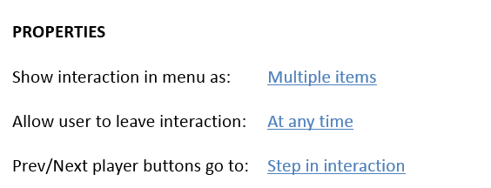
The Records Management Web Page

Slide 6
Deciding Together on the “3-S” Options
The three options on what to do with your records are:
Option 1 - Storing
Best for records that have short retention periods (three years or less) or where there is a business need to retain them
Option 2 - Scanning
Best for documents with a permanent or long (four years or more) retention period
Option 3 - Shredding
Best for records that have met their legal retention period
Notes:
The first step on deciding on what to do with your records is to work with the Records Management team to determine what needs to be done with them. It is important not to make these decisions without our team. There are three options: scan, store or shred. Scanning and storing are options for records that need to be retained and shredding is the proper method for destroying documents that have met their legal retention period. Shredding protects confidentiality and all shredded materials are recycled. The Records Management Program budget can assist with shredding costs.

Slide 7
Option 1: Storing
There is a right and a wrong way to store records.
Wrong: mix up the records and place them out of sight
The Right Way:
Inventory records using the Inventory Spreadsheet
Use correct size box
Place records in box in logical order (year/category)
Properly fill out ORANGE records retention box label and affix to short side of box
Notify records management that box is ready
Notes:
For records that you and the Records Team decide should be stored in paper form, a process needs to be followed to store records properly. This means that the records need to be scanned but are not high priority, and they are of legal, administrative or historical value, or there is a business need to keep them. Once they are properly boxed up and marked, the Records team will work with you to log your boxes in a staging area to be moved to the new R-2 or HQ/R-1 location.

Slide 8
Records Inventory for HQ , R-1 and R-2
An inventory of records has occurred for locations moving in 2018. The:
HQ inventory was completed in June 2016
Region 1 inventory of storage rooms was completed in Sept. 2016
Region 2, inventory is currently underway
To help the Records Management Team:
Always contact Records Management prior to moving any boxes located in storage rooms
Notes:
And while we are talking about help, there is something you can do to help the Records Management Team. Contact the Records Management team prior to moving any of the boxes located in storage rooms at HQ, R-1 South Holly or R-2. This is because the inventory of records is specific to the location of the boxes. Now let’s discuss the steps you go through when determining what to do with your records.

Slide 9
Inventory of your Stored Records
The Inventory Spreadsheet is:
Downloaded from the Records Management webpage
Filled out when a record needs to be retained in paper form
Approved by a Supervisor with authority over the record
Approved by the Records Management team
Retained by the records coordinator for the division/office or program manager
Notes:
When you and your supervisor have determined that your records must be stored in paper form, the first step is to use the Inventory Form to document which records you are storing. This will help the Records Coordinator and Records Management team assign a retention period to the records. Don’t worry about filling out the proper retention period – the Records Management team will fill out that part of the form. Now let’s look at labeling the boxes.

Slide 10
The Records Retention Box Label
The Records Retention Box Label is:
Downloaded from the Records Management webpage
Filled out when a record needs to be stored in paper form
Approved by a Supervisor with authority over the record
Approved by the Records Management team
Affixed to the box of the records being stored using an ORANGE label
Notes:
The Records Retention Box Label is your way of marking a box when the records need to be stored. Printing the label in Orange paper means the box is going with us to the new R-2 or HQ/R-1 location. The box label is also used to show approval of the need to store the records. The approval process includes the Supervisor with authority over the record, and approval by the Records Management team and finally it must be affixed to the box of the records being stored. You should then contact the Records Management team to discuss where your records will be stored. Now let’s look at the Records Retention box label in more detail.

Slide 11
Records Retention Box Label

Slide 12
Option 2: Scanning
To scan your documents you must:
Fill out a Scanning Spreadsheet downloaded from the records management webpage
Prepare your records for scanning (free of all paper clips, staples, and unfolded)
Obtain approval from the supervisor and Records Management team
Place documents in box and mark with BLUE records retention box label
Notify records management that box is ready to scanned
Notes:
This step concerns large quantities of records the Records Management Team will send out to be professionally scanned, not the scanning you do for small quantities of documents in-house. The first step is to complete the Scanning Spreadsheet. We need this spreadsheet in order to tell the scanning company what we are sending them to scan, and to tell them what to name your electronic file. The first thing you should know about scanning is that only certain documents are going to be scanned. The Records Management Team is prioritizing CDOT’s most critical documents from HQ and all Regions. These documents either have a permanent retention period (such as construction, engineering, right of way, survey, specialty groups and Transportation Commission records) a retention period of 4 years or longer, or are valuable to CDOT for legal, administrative or historical reasons. The proper retention period is determined by the Records Management team. Scanning will be handled through the Records Management Program, which has partnered with a qualified vendor. Please contact us prior to preparing the manifest or preparing the records for scanning. Now let’s look at the Scanning Spreadsheet which must be prepared prior to boxing up the records, and must be included in the shipment with the records.

Slide 13
Scanning Spreadsheet

Slide 14
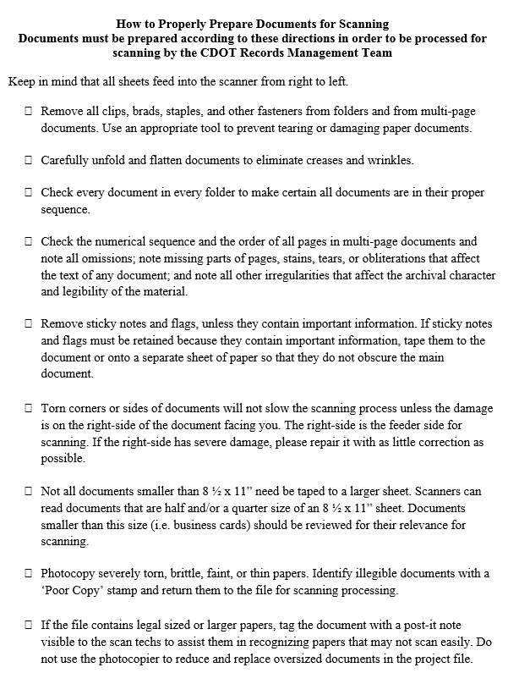
Preparing your Documents for Scanning
Follow these requirements to properly prepare a box of records for scanning
Click on the image to the left to download the checklist or
Download the checklist for the Resources tab
Notes:
Now that you have completed the Scanning Spreadsheet you are ready to prepare your documents to be scanning. Properly preparing your documents will ensure your records are scanned correctly and at the lowest possible cost. Click on the image to open a copy of the How to Prepare Document for Scanning checklist and then click save. If you don’t want to do that now you can always return to the course and download it from the resources link. Now let’s look at the third option shredding your documents.

Slide 15
Option 3: Shredding
To determine if your records may be shredded:
Contact the Records Management to determine if the record has met its retention period
Fill out a Destruction Form
Supervisor and Records Management team sign
Place your records in a box marked with a PINK Destruction Box Label
Notify the Records Management team that your records are ready to be sent to the shredding company
Notes:
CDOT employees may only destroy public records after they have met their legal retention period. If you believe your records may be shredded, please contact the Records Management Team prior to placing them in boxes to confirm that they are eligible for shredding.

Slide 16
The Record Destruction Label
The Record Destruction Label is:
Downloaded from the Records Management webpage
Filled out when a record has met its retention period
Approved by a Supervisor with authority over the record
Approved by the Records Management Program
Affixed to the box of the records being stored using a PINK label
No record may be destroyed Until the label is approved by the Supervisor and the Records Management Team
Notes:
The Record Destruction Label is your way of marking a box when the records have met the end of their retention period. The label must be approved by a Supervisor with authority over the record, and the Records Management team. It must be affixed to the box of the records being stored and printed on PINK paper to indicate the records are being destroyed. Once approved, the records will be sent to the Records Management team’s qualified shredding company by the Records Management Program. Now let’s look at the Record Destruction Box label in more detail.

Slide 17
Slide 8

Slide 18
Overview: Labeling and Boxing Records
When labeling and boxing records:
If you are:
Storing and Scanning use the Record Retention Box Label
Shredding use the Record Destruction Box Label
When labeling the records for:
Storage print the Records Retention Box Label on Orange paper
Scanning print the Records Retention Box Label on Blue paper
Shredding print the Records Destruction Box Label on Pink paper
Attach the label and box the records and notify Records Management
Notes:
Now let’s look at the three times when you need to box and label records. They are when you send them to storage, when they are going to be destroyed and when they are going to be scanned. Because you may be storing, scanning and/or shredding records, color coding the label is critical. Now let’s go through how to box your records.

Slide 19
Boxing Records for Storage (Orange Box Label)
When boxing records for storage:
Don’t mix different types of files together (i.e. timesheets and invoices)
Box files according to the needs of your office (ex. Financial records by fiscal year, construction projects by project closure date (Form 950)
Box all the records in a 1.2 cubic ft. size box
Print the Record Retention Box Label on Orange paper
Notes:
When files are boxed for storage the records contained in them need to be sorted. The first thing to do is to group the records by similar file types by the time frame your division or office uses, for example fiscal year for financial records and closure date for projects. The Records Management Team can provide you with boxes, labels and transparent envelopes for the labels that will be affixed to the boxes. If you are printing the label yourself, be sure that that the label is printed on orange paper to indicate it should be moved to the new location. Now let’s take a look at how to prepare a box for scanning.

Slide 20
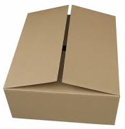
Boxing Records for Scanning (Blue Label)
When boxing records for Scanning:
Compile a Scanning Spreadsheet listing your records and specifying your file name
Box files according to the needs of your office (ex. Financial records by fiscal year, construction projects by close date)
Remove all staples, hanging files, paper clips and binders
There must be no objects holding paper together – it must be ready to be placed in an industrial scanner
Box all the records in an appropriate size box
Print the Record Retention Box Label on Blue paper
Notes:
The process for boxing your records for scanning is similar to boxing your records for storage. You need to box the records based on the needs of your office, but you also need to remove all staples, hanging files, paper clips and binders for storage, and take extra care to have only the paper in the boxes to be scanned. This is because there is a $150 dollar charge if these items are found. The Records Retention Box Label is used for labeling the box, but in this case the label should be printed on blue paper. Now let’s look as how to complete the Record Destruction Box Label.

Slide 21
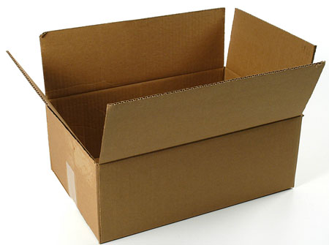
Boxing Records for Destruction (Pink Label)
To box documents for destruction:
Complete a Records Destruction Inventory Form
Confirm the records have met the retention period
Box records by type and fiscal year
Box all records in a 1.2 cubic size box (remove all staples, paper clips, etc. from all documents, binders and hanging folders)
Print and attach the Record Destruction Box Label on Pink paper
Notify Records Management to coordinate the destruction
Notes:
For all of the records which can be destroyed, there are a couple of actions you want to follow. The first is to check with the Records Management team and confirm the records have met their retention period. This approval process is formalized through the completion of the Records Destruction Inventory Form. As part of the process of completing the form, sort all records by record type and year. It is also a good idea, to remove the materials from binders and hanging files; these will need to be removed prior to shredding the documents. Once the materials are ready, contact Records Management which will schedule time for pickup with the shredding company. Now that we have covered the boxing of materials let’s look at how to complete the Records Destruction Box Label.

Slide 22
Records Destruction Box Label
Best for records that have met their legal retention period

Slide 23
Coming Soon!
To assist you with the move we will be:
Identifying and training Records Coordinators
Developing record file plans for all divisions/ offices
Conducting training on how to scan documents
Conducting outreach on electronic document management systems at CDOT (including SharePoint and ProjectWise)
Notes:
As the date of the move comes closer, we will be helping you with the move by providing a variety of services. Take a moment to review the slide and click next to continue.

Slide 24
Record Management Team
Records Management Team Contacts:
Herman Stockinger, Director of OPGR
Mary Frances Nevans, Program Manager
James Mabry, Central Files Office
Lizzy Savino, Records Management
Tammi Haddad, Records Management
Kelley Tatman, Records Management
Group email: Dot_Records_Mgmt@state.co.us
Notes:
In addition to our website, we are here to help you. We have created an email box to respond to questions. This is checked often by our team and is the best way to get help. The team is also starting to identify and train Records Coordinators who will be responsible for records in each office and divisions. If you have questions that are not answered by the Frequently Asked Questions section of our webpage, please reach out to us.

Slide 25
Congratulations!
You have completed the course!
If you have questions contact us at:
Dot_Records_Mgmt@state.co.us
Notes:
Congratulations! You have completed the “Records on the Move Course”. Please reach out to us if you have any questions.

